Slide 1
902106 Niobicon AUV docking
What’s the fundamental problem, question, or issue you are addressing?
MBARI relies heavily on AUVs, but their endurance is severely limited by their battery capacity.
Remote AUV charging is a very challenging problem that MBARI and other groups have attempted to solve with limited success.

Slide 2
902106 Niobicon AUV docking
Why is it important/why should anyone care?
Remote AUV charging could allow months-long deployments of the AUVs, to perform time series and event-response missions.
Not having to recover the AUV on a regular basis to recharge its batteries will save time and money

Slide 3
902106 Niobicon AUV docking
What are we doing about it/what’s MBARI’s unique contribution?
We have been developing and testing a docking station for the LRAUV to allow remote battery charging and data transfer.
The AUV dock relies on Niobicon, a technology patented by Northrop Grumman that allows electrical connections in water, without insulation.
MBARI is uniquely positioned to tackle this problem, thanks to our fleet of AUVs and experience with AUV docking.

Slide 4
902106 Niobicon AUV docking
What are your project plans for next year (2023)?
In 2023, we will finish building the new mooring and AUV docking system, improving upon the prototype built and tested in 2022.
We will first deploy it in Monterey Bay for a 3-month engineering test.
We will deploy it again in the fall to support the Blue Whale Observatory experiment.
We will start designing a new version of the AUV dock to be deployed at MARS in 2024.

Slide 5
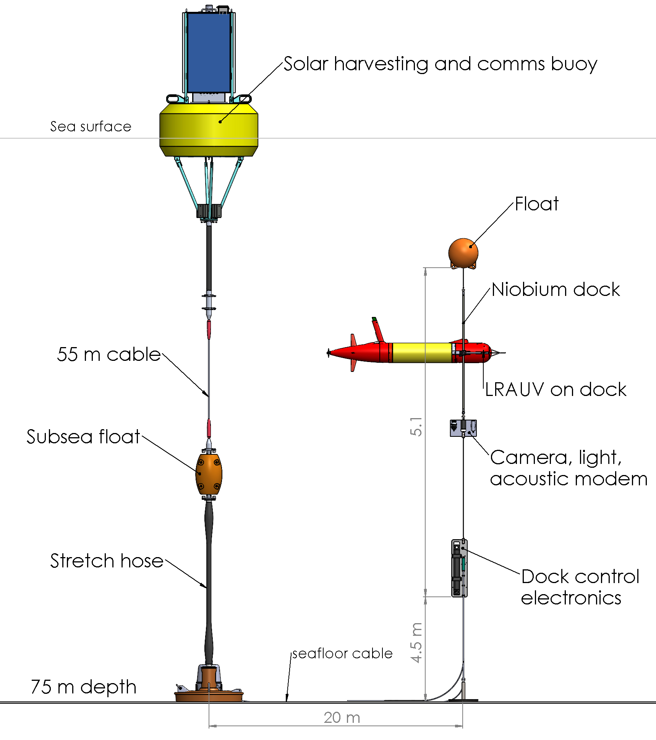
902106 Niobicon AUV docking
A solar harvesting buoy will bring power and data to the seafloor-mounted AUV dock.

