Slide 1
902106 Niobicon AUV docking
What’s the fundamental problem, question, or issue you are addressing?
MBARI relies heavily on AUVs, but their endurance is severely limited by their battery capacity.
Remote AUV charging is a very challenging problem that MBARI and other groups have attempted to solve with limited success.

Slide 2
902106 Niobicon AUV docking
Why is it important/why should anyone care?
Remote AUV charging could allow months-long deployments of the AUVs, to perform time series and event-response missions.
Not having to recover the AUV on a regular basis to recharge its batteries will save time and money.

Slide 3
902106 Niobicon AUV docking
What are we doing about it/what’s MBARI’s unique contribution?
We have been developing and testing a docking station for the LRAUV to allow remote battery charging and data transfer.
The AUV dock relies on Niobicon, a technology patented by Northrop Grumman that allows electrical connections in water without waterproofing.
MBARI is uniquely positioned to tackle this problem, thanks to our fleet of AUVs and experience with AUV docking.
A completely new AUV docking system has been designed and build and we will be deployed in October 2023 to support engineering tests and science missions.

Slide 4
902106 Niobicon AUV docking
What are your project plans for next year (2024)?
In 2024, we will continue to support and develop the AUV docking system.
We will relocate the system to North Monterey Bay to support a months-long study of upwelling in the spring and time-series observations in the summer.
We will design a new version of the AUV dock to be deployed at the MARS cable observatory.
We will adapt the system to the new deep-rated LRAUV so that it can be operated at MARS.
We will study the possibility of powering the dock with the wave-energy buoy.

Slide 5
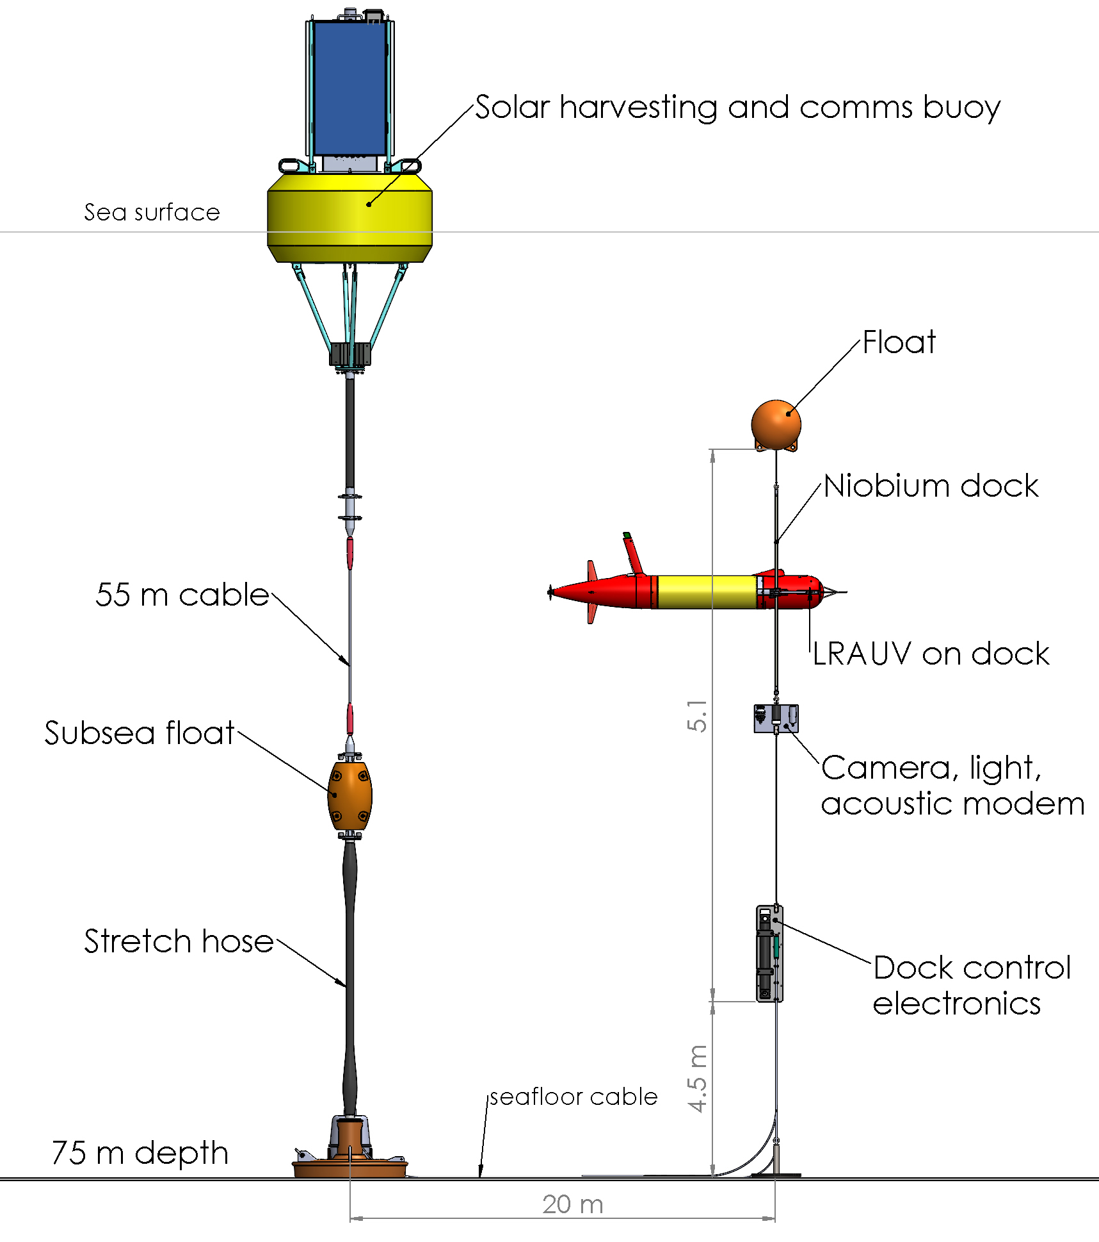
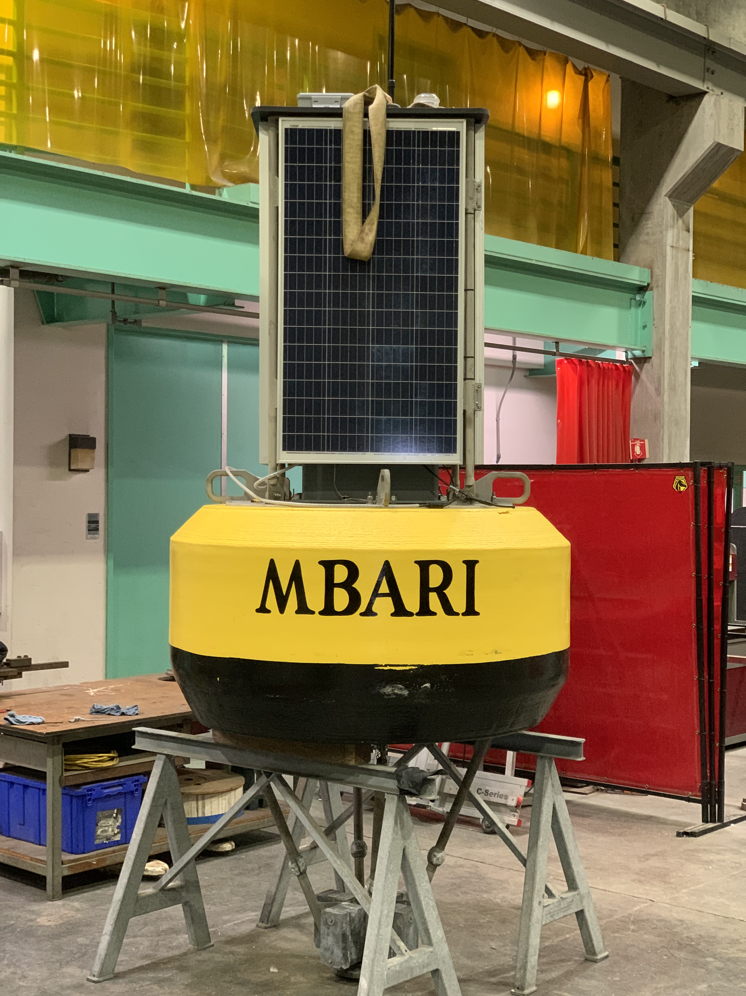
902106 Niobicon AUV docking
A solar harvesting buoy will bring power and data to the seafloor-mounted AUV dock.

