Slide 1
AUV Docking 2021
PDR for the Test Mooring
March 2021

Slide 2
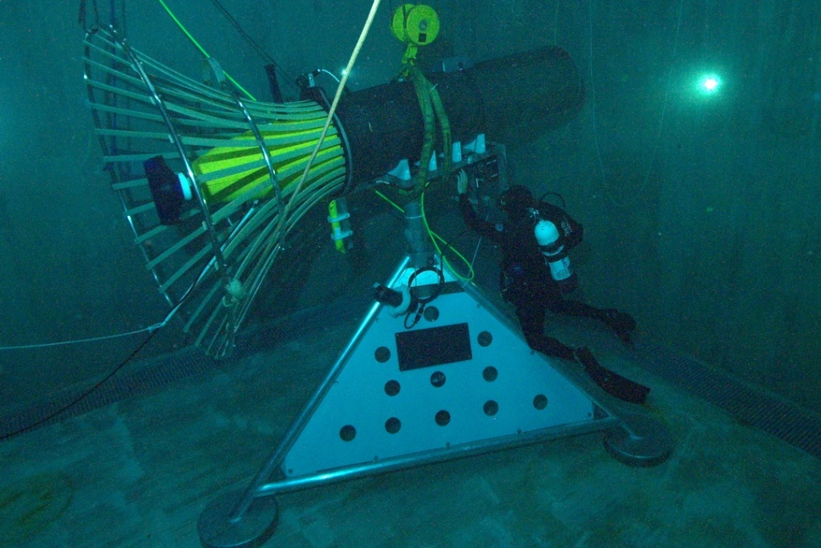
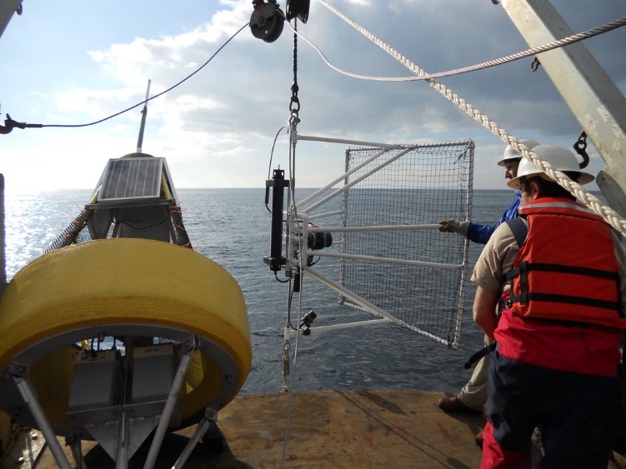
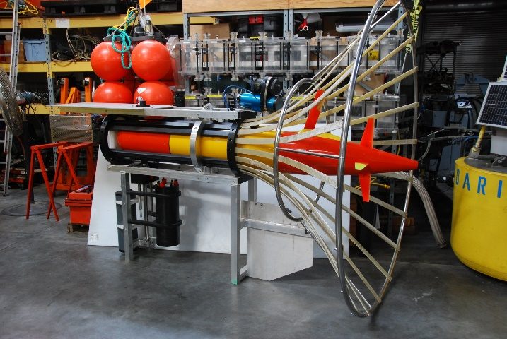
AUV Docking Backstory:
2007 -Designed, built, deployed and tested a docking station for Dorado
  Inductive power transfer of 500 watts,
  Thru-water WiFi 802.11g 100b Ethernet data transfer
  Sonardyne USBL-based acoustic homing system
2012 – started the design of a cone dock for the LRAUV under DARPA funding
  AUV Docking component was canceled to focus on WEP
  Planned to use ODI connector for power and data transfer
  Benthos DAT-based homing; proved unreliable at that time, though it works well now

Slide 3
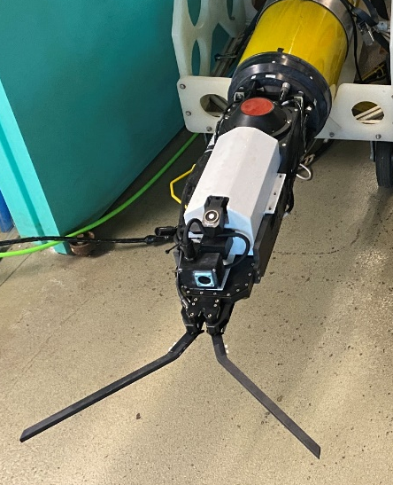
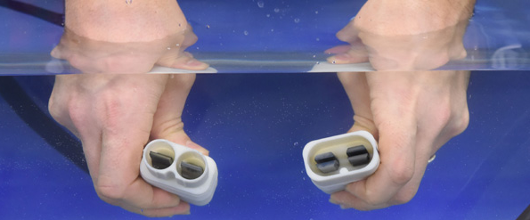
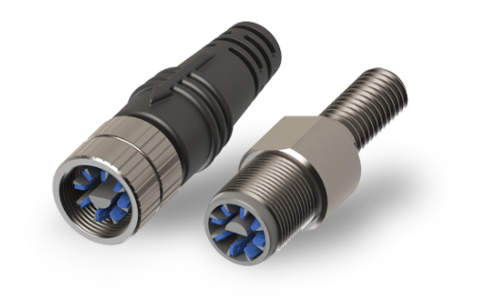
Recent Developments
DHS/US Coast Guard funded, under-ice oil spill mapping project
  LRAUV can now home to a cable and capture that cable using a WHOI Whisker Box docking device with a WHOI Micromodem + linear USBL array
Northrop Grumman developed their Neobium, naturally self sealing conductive metal contact connector
  MBARI has (almost) secured a license from NG to use this material for an AUV dock power transfer system
iCONN’s Wet-Mate Connector

Slide 4
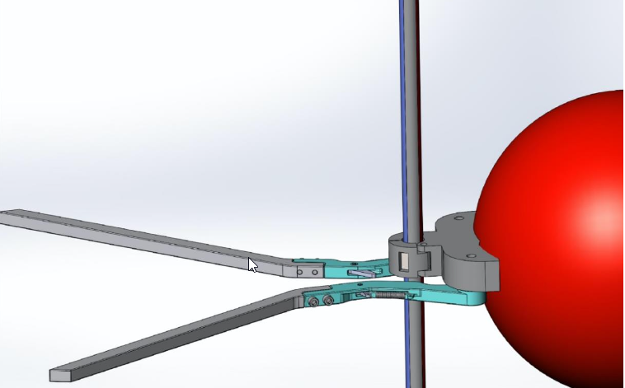
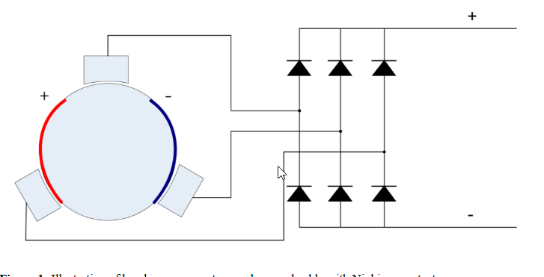
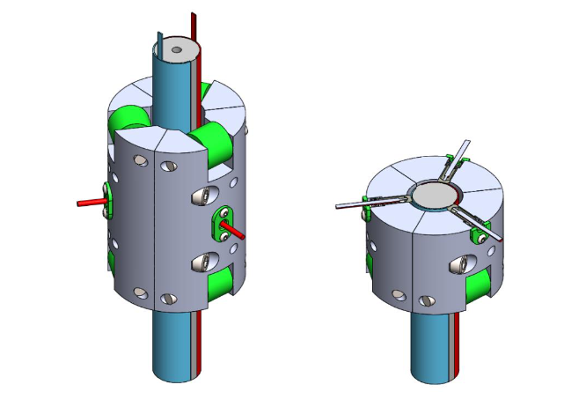
MBARI project #902106
Niobicon Based AUV Docking Development
We’ve proposed to build and test a few prototypes 2021

Slide 5
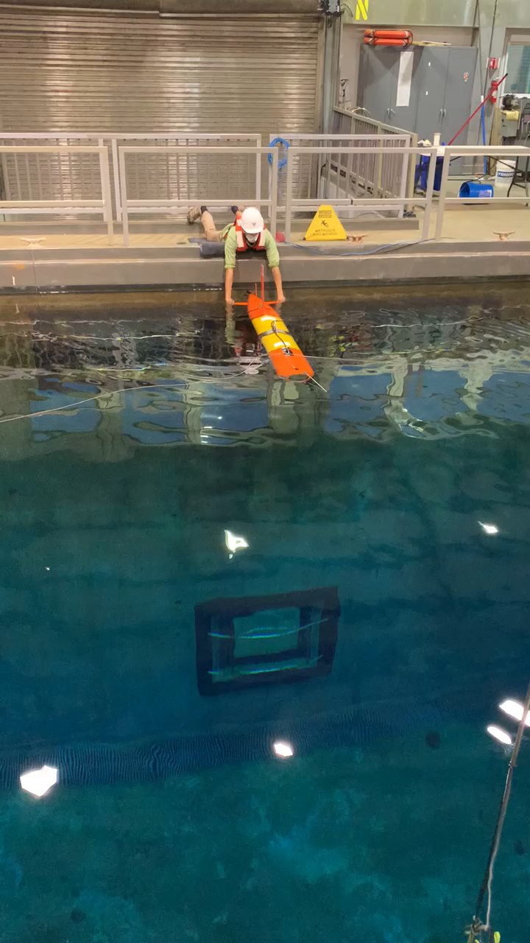
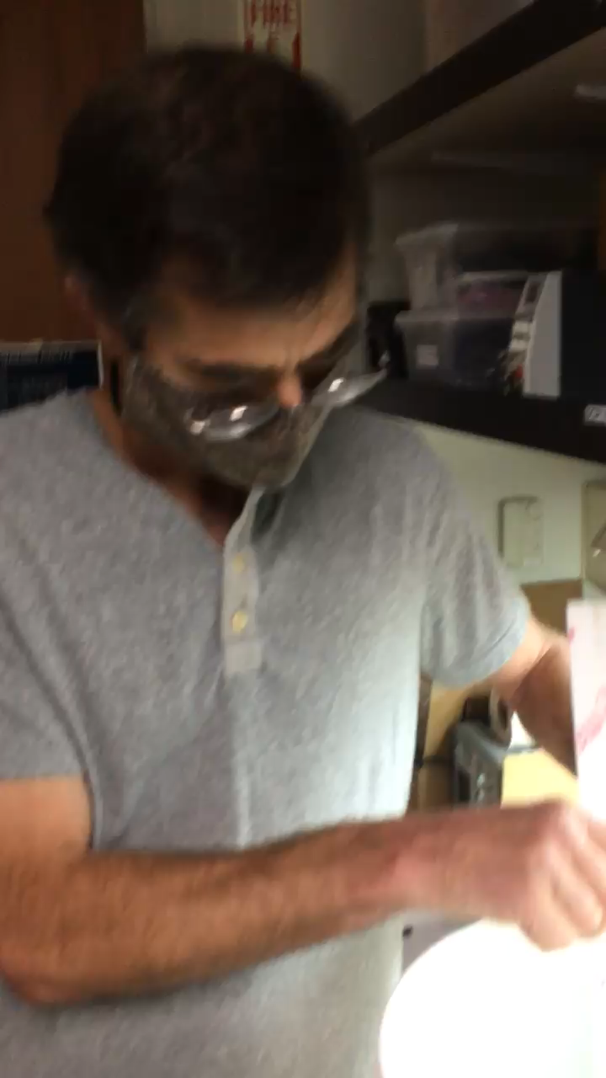
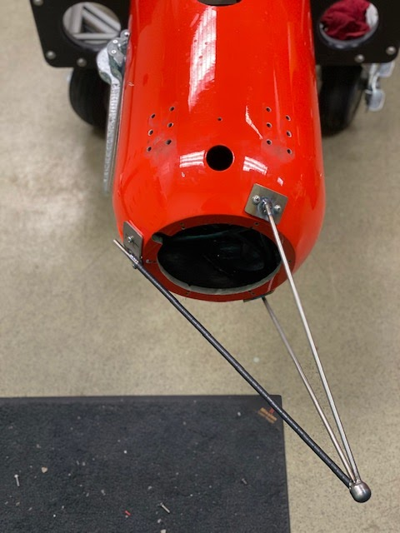
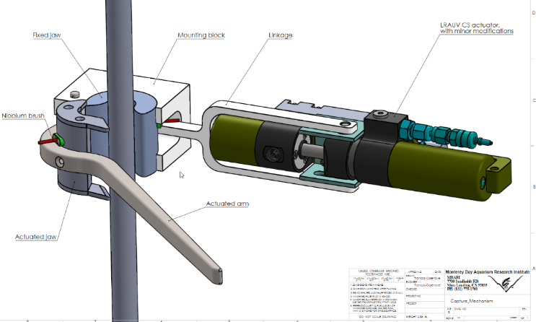
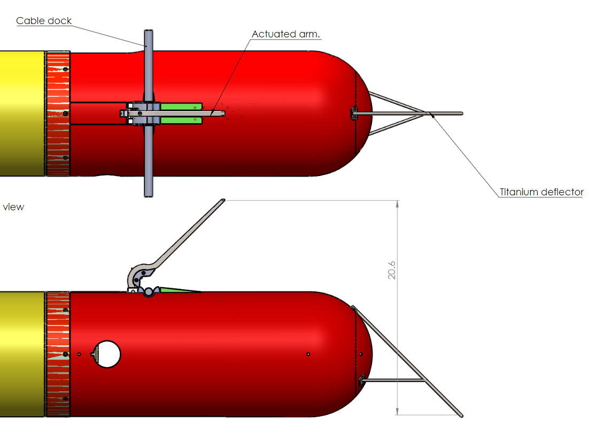
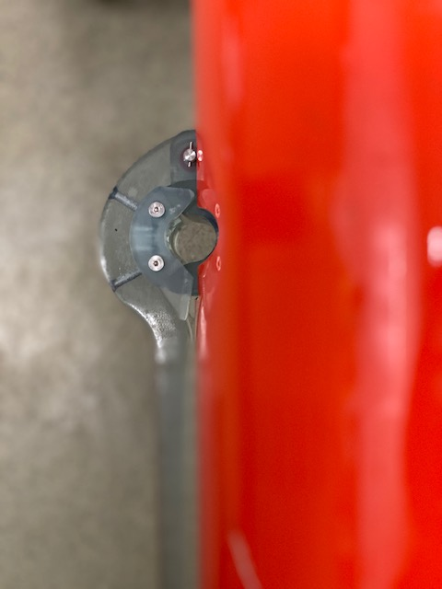
Early Progress

Slide 6
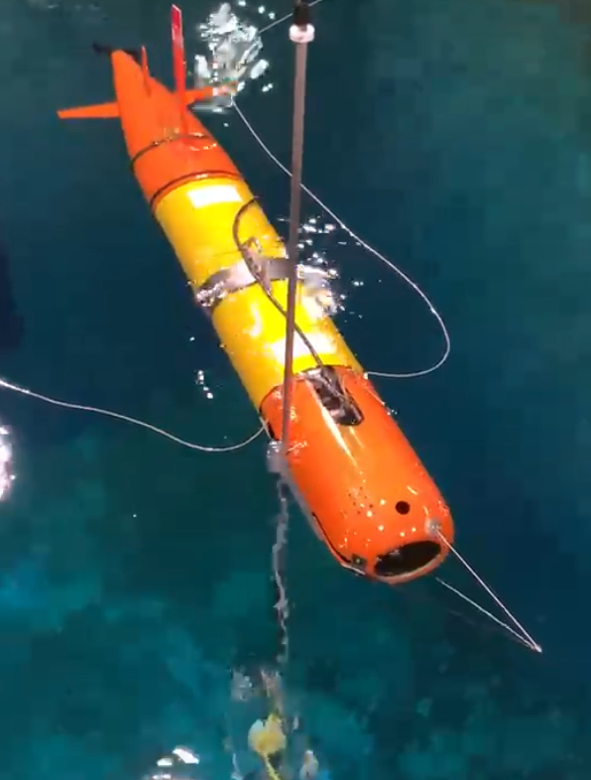
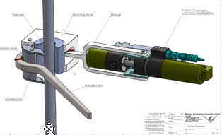
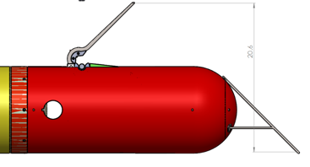

Slide 7
Questions for Sea Tests:
Can we reliably home to a cable with a Benthos DAT?
  Offshore USBL homing and guidance testing underway now at WHOI
Can we reliably detect and capture a cable?
  Test tank tests with prototype capture device at the surface (2D)
  Repeat test tank tests at depth (3D motion)
Can we transfer power to the AUV through a niobium system?
  Lab tests with prototype NB power transfer system
  Test tank tests with AUV deployable NB power transfer system
  Add simulated ocean motion to tests
Does it work in the real environment?
  Offshore homing, latching and power transfer tests
Time to upgrade from our dumb modem on a rope

Slide 8
Requirements for a new test mooring (1/2):
Need a mooring system to support the AUV Docking development at a relatively calm location
  70m of water, docking at 8m above seafloor
The system shall have a docking section and acoustic homing beacon
  Some lateral compliance is required to lessen the impact of capture
  ¾” diameter, 6’ long NB power transfer section
  Benthos MF acoustic modem
Must be able to quantify homing and docking performance
  Shall be equipped with a video camera and light(s)
  Would be nice to see these data on shore in real-time, but transfer to shore of recent data is required
Must be able to transfer power
  24 volts/16 amps (400 watts) to the AUV battery system for at least 5 minutes
  Control and Monitor voltage and current at 20 kHz, would be nice to get data in real-time, but near-real-time file transfer of recent data is required
  Would be nice if power transfer could continue for 10 hours, once per week
Must be able to communicate with the AUV while underwater and at the dock
  Benthos MF Acoustic comms is OK at the dock, but there shall be an Ethernet port for communications to the AUV while it is docked using some kind of data transfer system in the future.

Slide 9
Requirements (2/2)
The power and control system shall have web access
The system shall be deployable from the Paragon
The system shall use as many existing parts as possible
  Buoy, anchor, subsea housing, cable
The system shall be reliable for a six-month deployment, possibly through winter storms
We expect to perform a system upgrade/redesign during 2022 for longer deployments. That system could be larger, and should be more robust with greater long-term reliability.

Slide 10
Subsystems – Top Down
Radio telemetry to shore
Power generation and energy storage
Buoy and misc. electronics
Riser to buoy – Electro/Mechanical
Anchor
Seafloor Cable to 2nd anchor
Subsurface Dock with electronics
Niobium power transfer section
Subsurface float

Slide 11
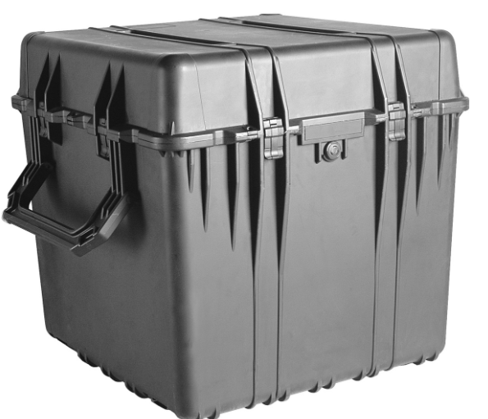
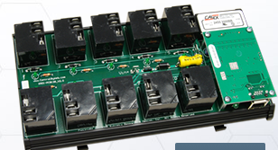

Buoy
Use the MBARI Vertical Profiler (MVP) surface float
  Old tower is being used on the WEC project
  Build a new frame to hold solar panels, radio antennas, lifting eyes
  Paint below waterline with antifouling paint
Electronics installed in a Pelican 0370 plastic box
  Heat sink and U/W connectors added
Sierra MP55 cellular router and WiFi
CBW 10 power relay with temp/humidity
  SPST 270VAC/30VDC, 15 amp
  accessible via the web
DSL modem between buoy and subsea Moxa IEX-408x
Could add security camera and hub (Arlo is watching)
Radar reflector, light, Spot tracker, Cell antenna

Slide 12
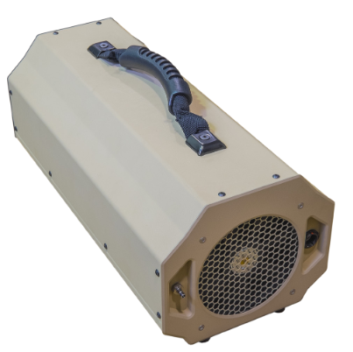
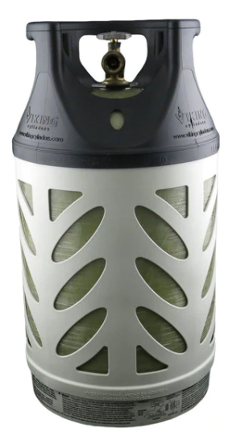
Other Options
Other COTS solar/battery/inverter options
Fuel Cell to reduce solar panel area
  Adaptive Energy unit runs on propane
  350 watts – runs during battery charge
  Burns ~1 lb of propane per kWh: ~4 lbs/week for LRAUV
  5.1 kg (11.2lbs) plus fuel
  600 hours runtime
  Exchange fuel tank every month
    22 lbs of propane in a 13.5 lb tank provides 5.5 kWh/week
  Start up fuel cell (~15 min) for docking and charging
  Solar panels support continuous load (~6W)
LRAUV Battery pack

Slide 13
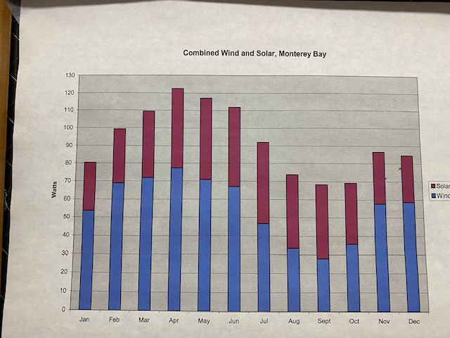
Buoy Electronics Overview
Power from the sun 30-45 watts continuous to charge (2) 80 A/hr SLA Batts
Cellular router/modem, Ethernet switch and WebRelay on continuously
  ~6 watts
  If energy is available, webcam and electric fence can be used
Access WebRelay and manually turn on a 230 VAC Inverter and DSL modem to power up and talk to subsea electronics
Shoreside operator (or AUV) can turn on a dock light and camera with another WebRelay. Video is loged and streamed to shore. 90 watts
Operator uses WebRelay to enable 24 v (or 48v) to power NB power transfer section
Power transfer voltage and current is logged and can be monitored from shore
AUV triggers dock camera/light power up when 30 seconds out, to save energy
Copper shutter keeps dock camera lens free of biofouling
\\atlas\projectLibrary\707976_EPBuoyPrototypeAndTesting\Docking\Drawings\EE\Docking 2021\2021AUV DOCK.opj

Slide 14
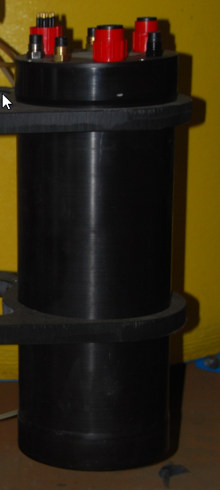

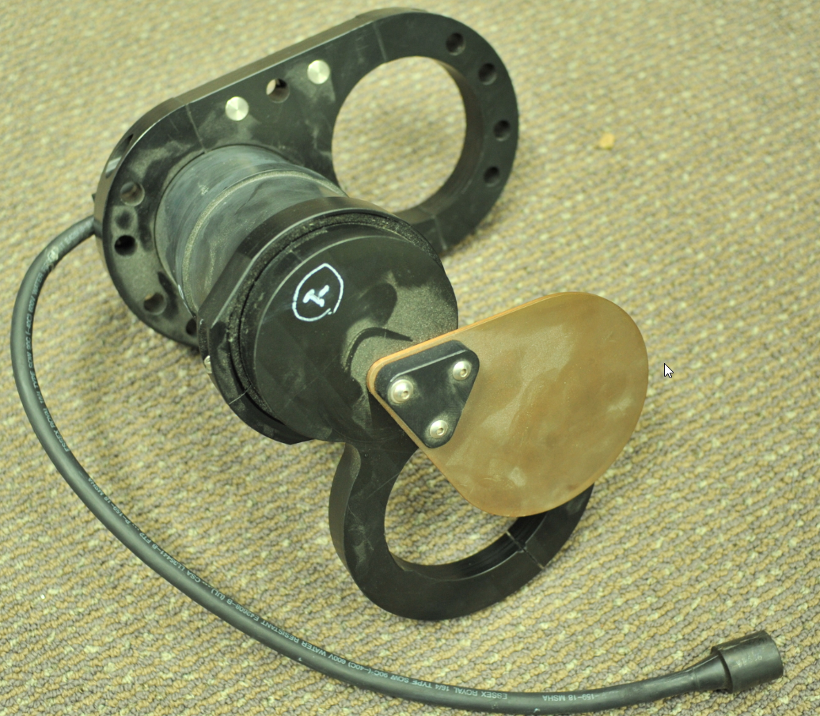
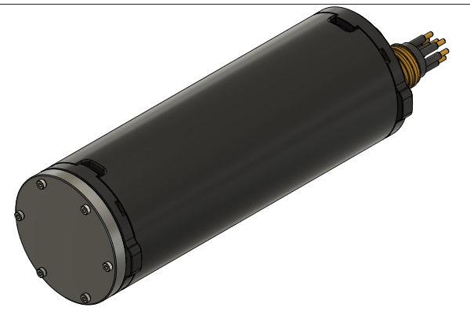
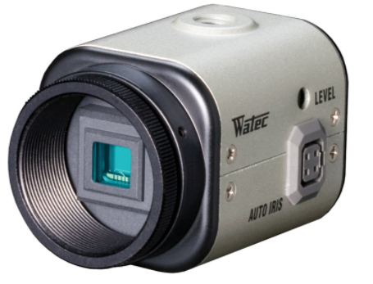
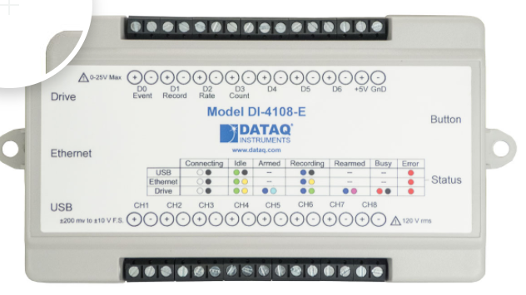
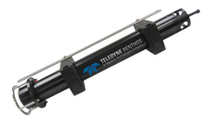
Subsurface Housing
Use existing Deep Flight Housing
230 VAC – 24 VDC with a 400W Vicor PFM+AIM
  Initial power transfer tests will be to a resistive load dump on AUV
  Change out to 48 VDC when updated LRAUV batteries are available
WebRelay-10 for power control and temp/hum sensing
DSL modem + 6 port Switch
Benthos modem, Serial through Moxa terminal server
IP camera with internal storage and network streaming with ~80W light
  Copper shutter device to ensure a clean viewport for up to 6 month deployment
DAQ, auto starts and logs charging voltage and current at 25 kHz to on-board memory that is accessible from shore.

Slide 15
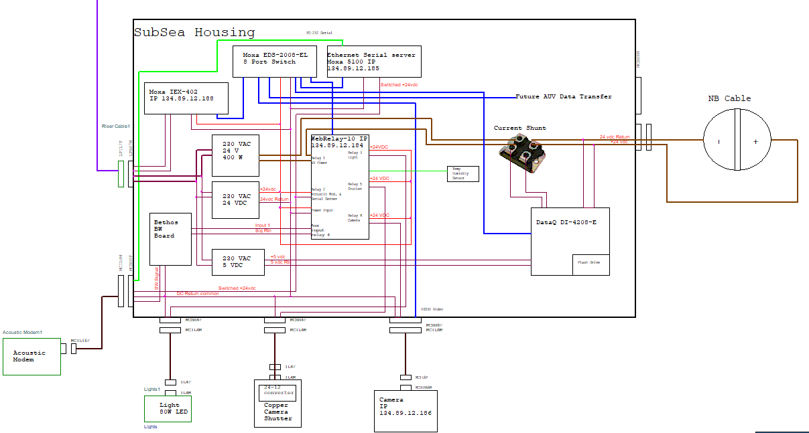
Subsea Can Electronics Overview
\\atlas\projectLibrary\707976_EPBuoyPrototypeAndTesting\Docking\Drawings\EE\Docking 2021\2021AUV DOCK.opj

Slide 16
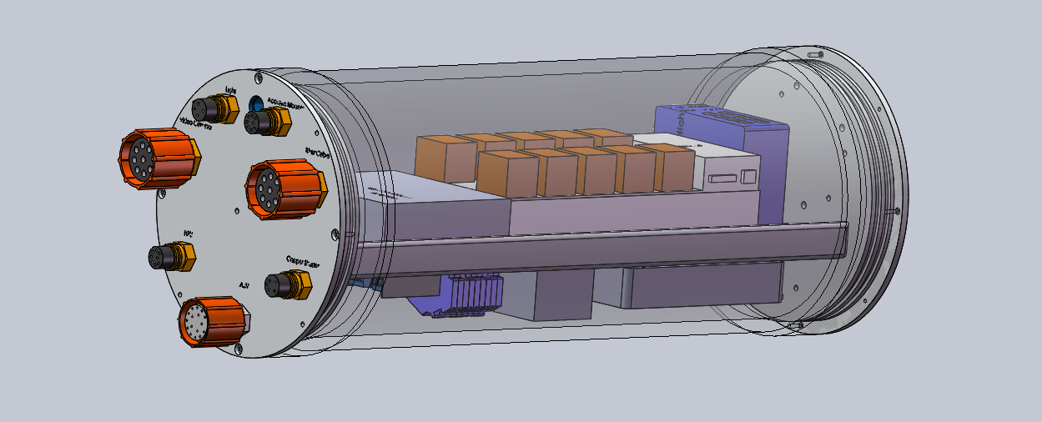
Sub-surface Housing

Slide 17
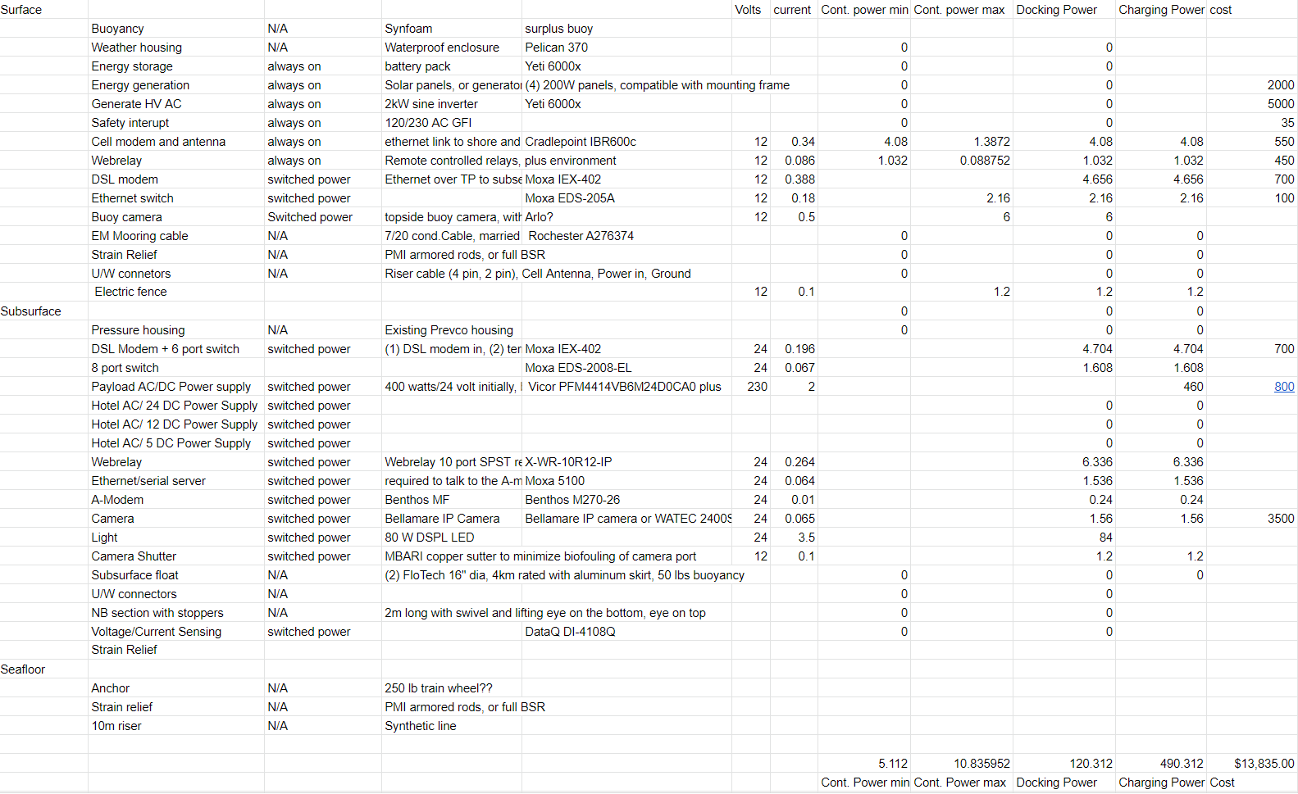
Components with power draw
\\atlas\projectLibrary\707976_EPBuoyPrototypeAndTesting\Docking\Documents\Datasheets

Slide 18
Ocean Surface
Surface float with solar panels, flag, flasher and satellite tracker and Cellular Modem
~100m mooring EM cable with S near surface
(2) 12” football floats
~75 meters (250’) Water Depth
AUV Docking Section
Seafloor
Subsurface Flotation Sphere
Benthos MF Acoustic
Modem/Transponder
Electronics Housing
~100 lb anchor
250 lb steel anchor
~20m seafloor section

Slide 19
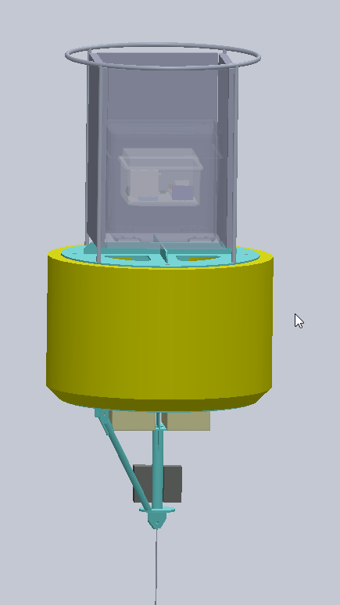
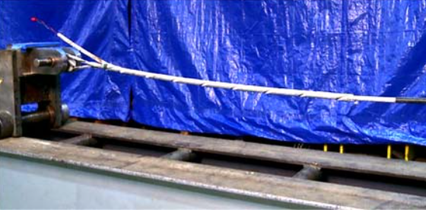

Slide 20
Mooring Launch and Recovery
Launch:
  Lift buoy into the water, stream riser, subsurface float, dock and lower riser out on the surface, then release anchor – stand back.
Recovery:
  Grab recovery loop from top of buoy and begin lift with the capstan, separating the EM cable from line.
  Remove football floats and stop at subsurface float.
  With a boat hook, reach down below dock and attach davit lift to loop below AUV Dock and take up the strain.
  Remove the rest of the mooring and tie in a new lift line back to the capstan and transfer the load.
  Recover lower 7m riser until anchor is at the surface.
  Recover anchor with davit

