Slide 1
AUV Docking 2021
PDR for the Test Mooring
26 January 2021

Slide 2
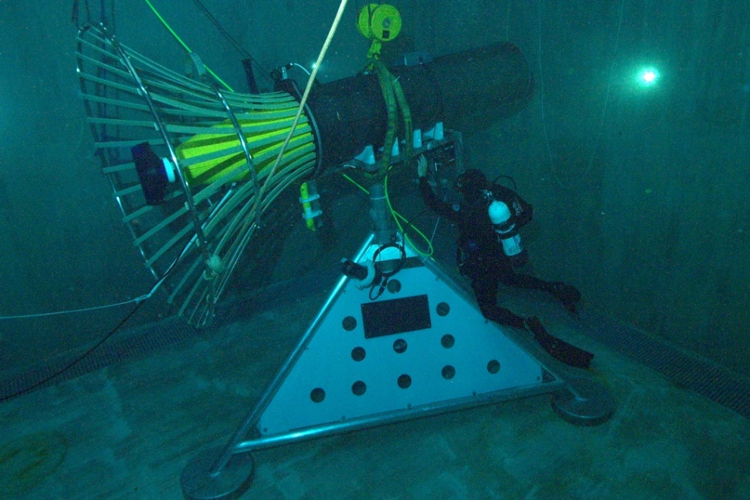
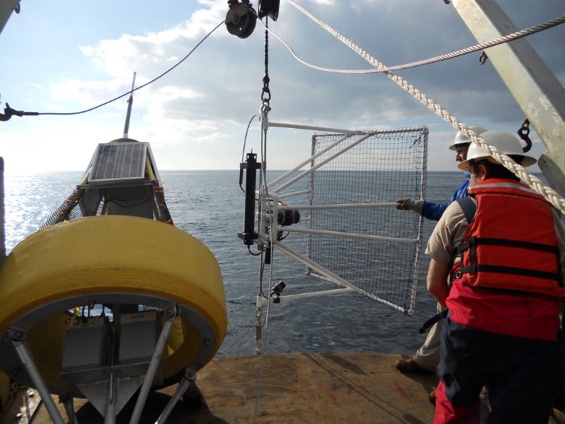
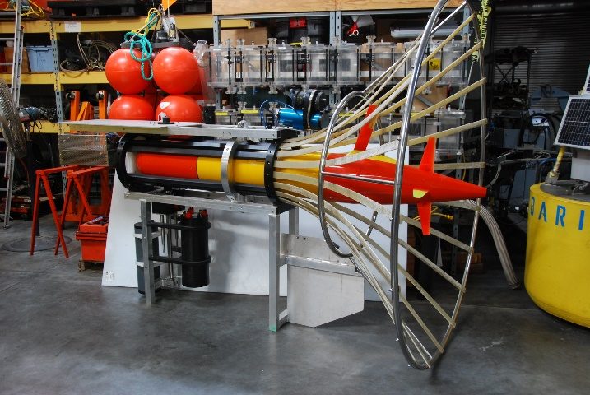
AUV Docking Backstory:
2007 -Designed, built, deployed and tested a docking station for Dorado
  Inductive power transfer of 500 watts,
  Thru-water WiFi 802.11g 100b Ethernet data transfer
  Sonardyne USBL-based acoustic homing system
2012 – started the design of a cone dock for the LRAUV under DARPA funding
  AUV Docking component was canceled to focus on WEP
  Planned to use ODI connector for power and data transfer
  Benthos DAT-based homing; proved unreliable at that time, though it works well now

Slide 3
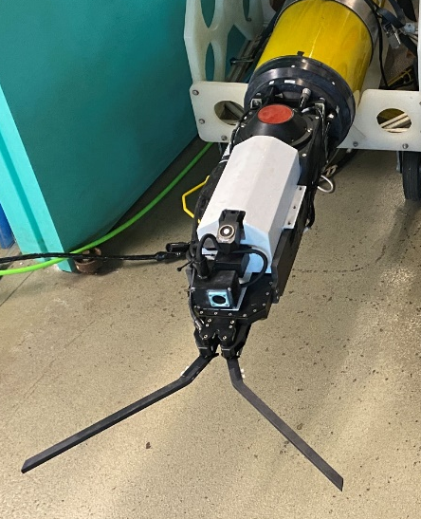
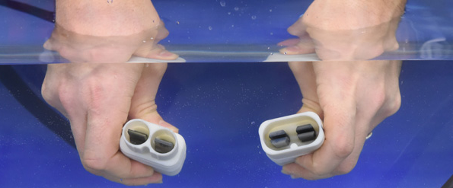
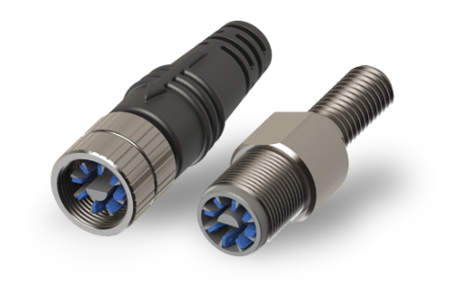
Recent Developments
DHS/US Coast Guard funded, under-ice oil spill mapping project
  LRAUV can now home to a cable and capture that cable using a WHOI Whisker Box docking device with a WHOI Micromodem + linear USBL array
Northrop Grumman developed their Neobium, naturally self sealing conductive metal contact connector
  MBARI has (almost) secured a license from NG to use this material for an AUV dock power transfer system
iCONN’s Wet-Mate Connector

Slide 4
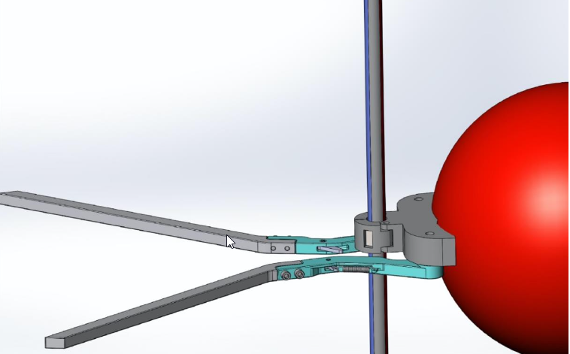
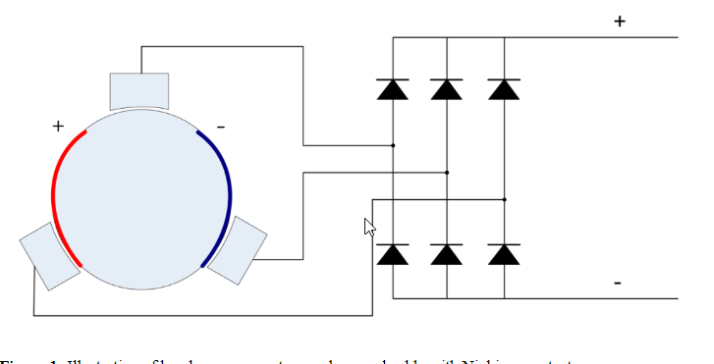
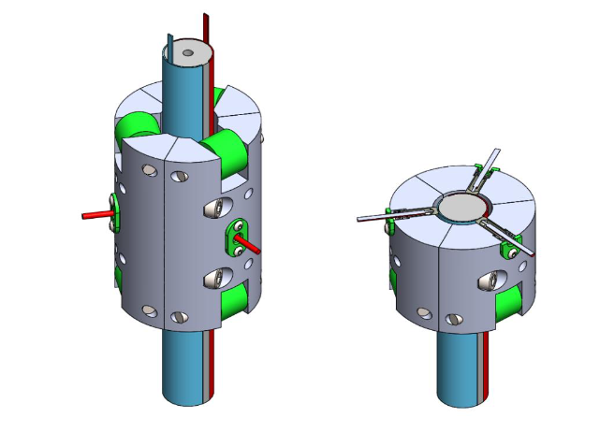
MBARI project #902106
Niobicon Based AUV Docking Development
We’ve proposed to build and test a few prototypes 2021

Slide 5
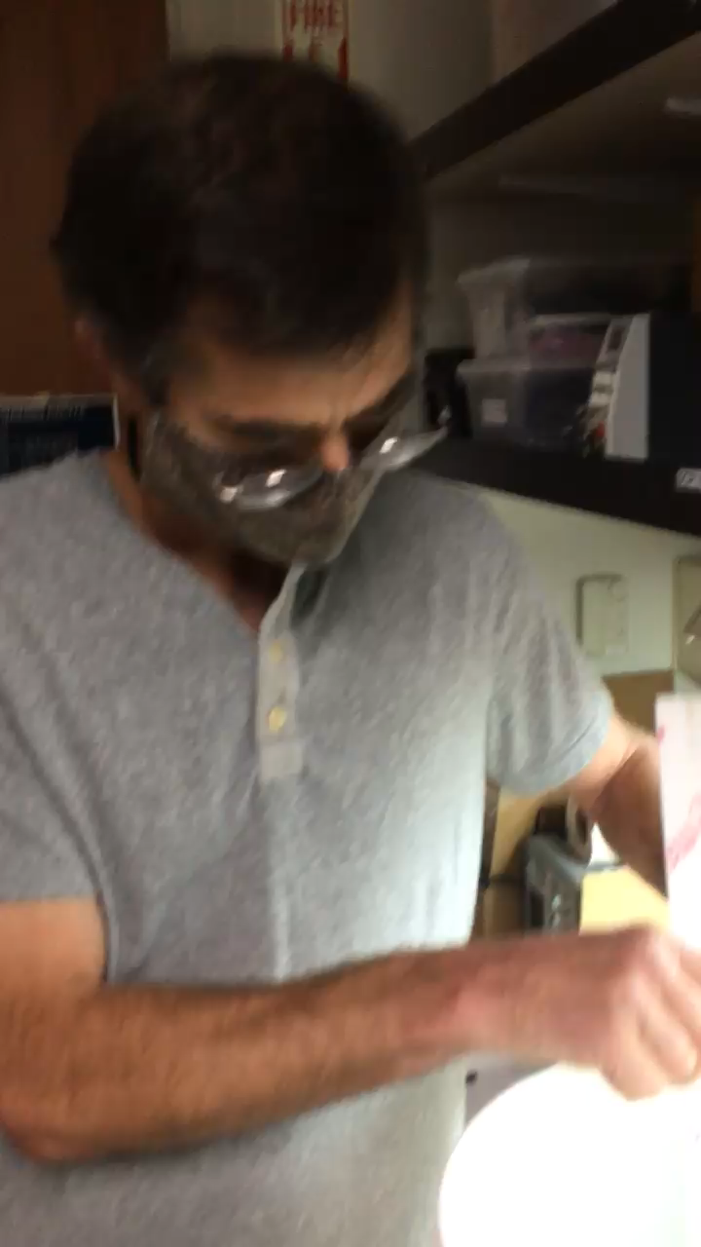
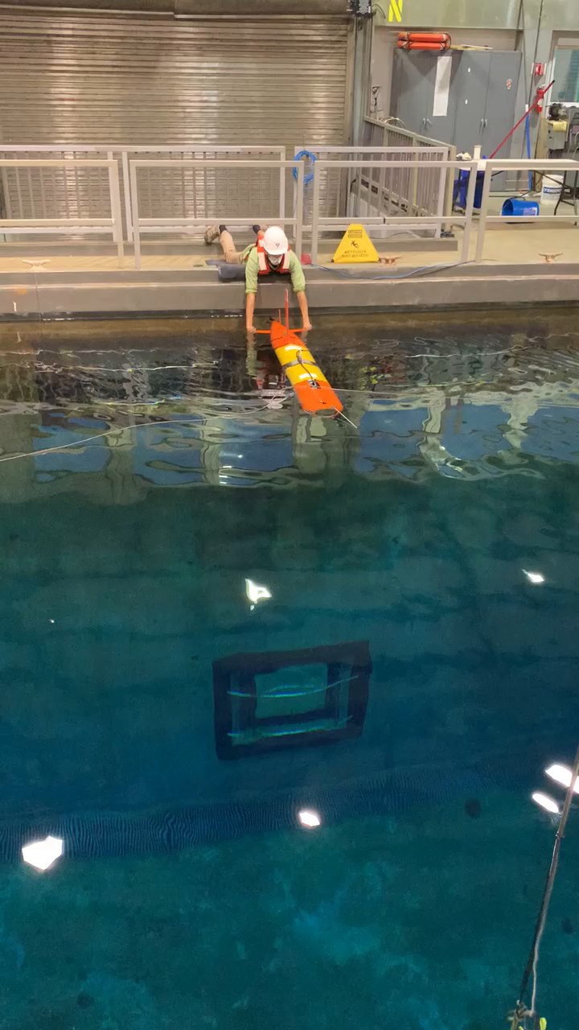
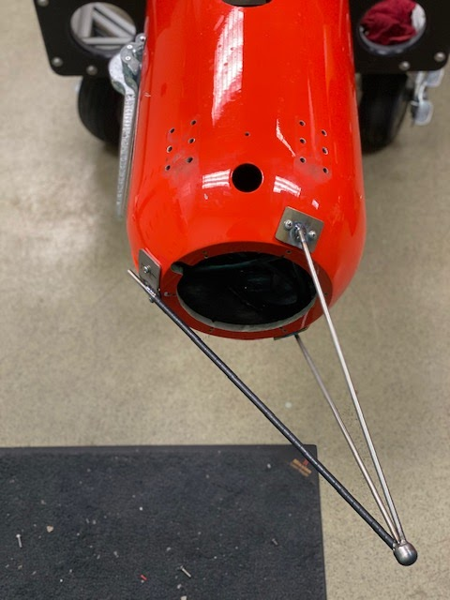
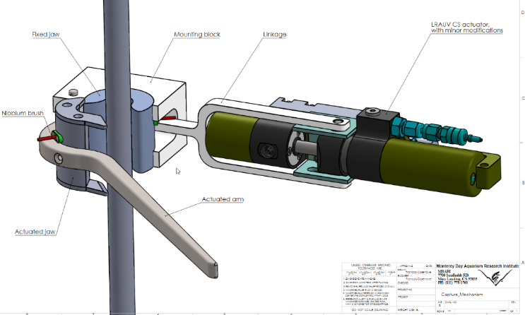
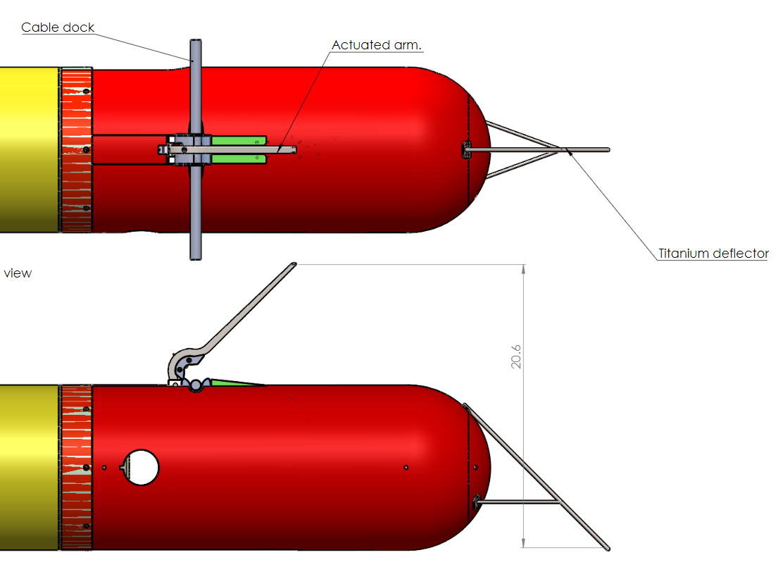
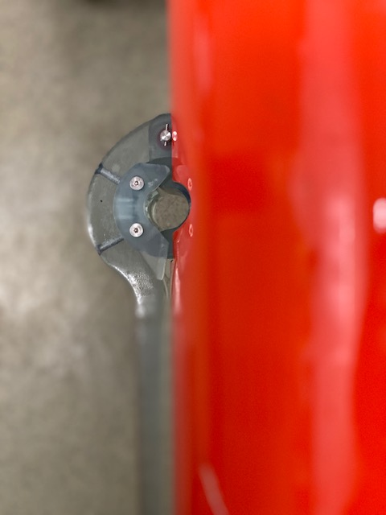
Early Progress

Slide 6
Questions for Sea Tests:
Can we reliably home to a cable with a Benthos DAT?
  Offshore USBL homing and guidance testing underway now at WHOI
Can we reliably detect and capture a cable?
  Test tank tests with prototype capture device at the surface (2D)
  Repeat test tank tests at depth (3D motion)
Can we transfer power to the AUV through a niobium system?
  Lab tests with prototype NB power transfer system
  Test tank tests with AUV deployable NB power transfer system
  Add simulated ocean motion to tests
Does it work in the real environment?
  Offshore homing, latching and power transfer tests
Time to upgrade from our dumb modem on a rope

Slide 7
Requirements for a new test mooring (1/2):
Need a mooring system to support the AUV Docking development at a relatively calm location
  70m of water, docking at 8m above seafloor
The system shall have a docking section and acoustic homing beacon
  Some lateral compliance is required to lessen the impact of capture
  ¾” diameter, 6’ long NB power transfer section
  Benthos MF acoustic modem
Must be able to quantify homing and docking performance
  Shall be equipped with a video camera and light(s)
  Would be nice to see these data on shore in real-time, but transfer to shore of recent data is required
Must be able to transfer power
  24 volts/16 amps (400 watts) to the AUV battery system for at least 5 minutes
  Control and Monitor voltage and current at 20 kHz, would be nice to get data in real-time, but near-real-time file transfer of recent data is required
  Would be nice if power transfer could continue for 10 hours, once per week
Must be able to communicate with the AUV while underwater and at the dock
  Benthos MF Acoustic comms is OK at the dock, but there shall be an Ethernet port for communications to the AUV while it is docked using some kind of data transfer system in the future.

Slide 8
Requirements (2/2)
The power and control system shall have web access
The system shall be deployable from the Paragon
The system shall use as many existing parts as possible
  Buoy, anchor, subsea housing, cable
The system shall be reliable for a six-month deployment, possibly through winter storms
We expect to perform a system upgrade/redesign during 2022 for longer deployments. That system could be larger, and should be more robust with greater long-term reliability.

Slide 9
Subsystems – Top Down
Radio telemetry to shore
Power generation and energy storage
Buoy and misc. electronics
Riser to buoy – Electro/Mechanical
Subsurface float with electronics
Niobium power transfer section
Anchor and 7m riser

Slide 10
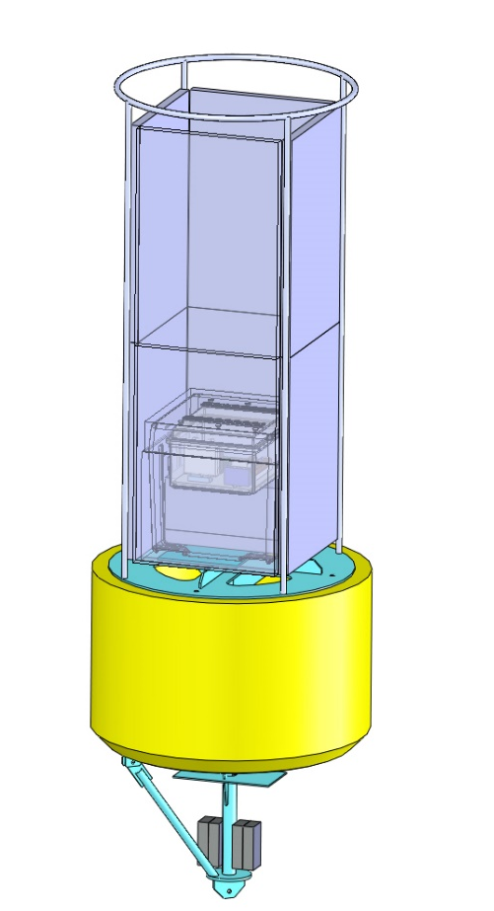
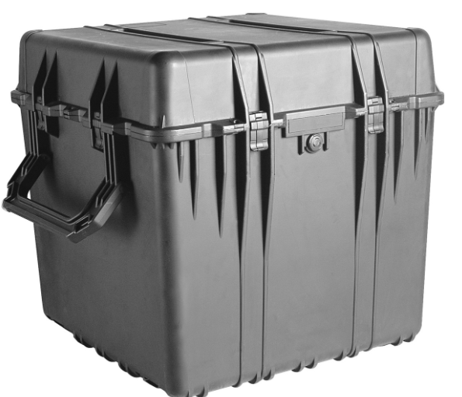
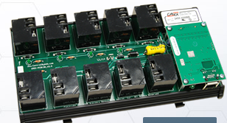

Buoy
Use the MBARI Vertical Profiler (MVP) surface float
  Old tower is being used on the WEC project
  Build a new frame to hold solar panels, radio antennas, lifting eyes
  Paint below waterline with antifouling paint
Electronics installed in a Pelican 0370 plastic box
  Heat sink and U/W connectors added
Cradlepoint IBR 600C for cellular and WiFi
CBW 10 power relay with temp/humidity
  SPST 270VAC/30VDC, 15 amp
  accessible via the web
DSL modem between buoy and subsea Moxa IEX-408x
Could add security camera and hub (Arlo is watching)
Radar reflector, light, Spot tracker, Cell antenna

Slide 11
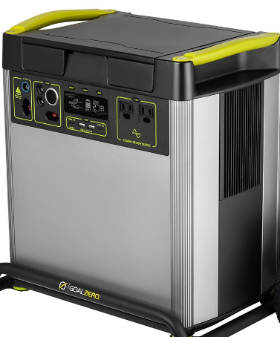
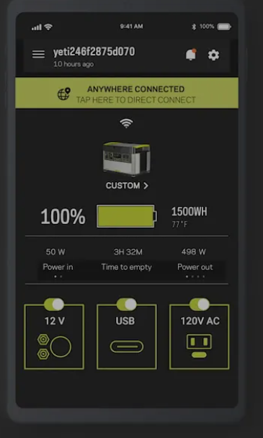
Power Generation and Energy Storage
Even for short tests, significant storage is required
COTS solution: GoalZero 6000
  6 kW-hr of Li-ion NMC, at 10.9v
  230 VAC/50hz, 2 kW cont. (possibly 120 VAC
  12 VDC @ 30 amps
  MPPT solar charging at 600 W
(4) 100 W solar panels
Remote monitoring with app
Fits inside a Pelican 1610 with heat sink added
GFI circuit breaker on AC output

Slide 12
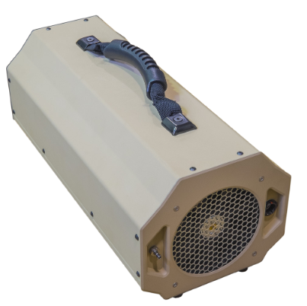
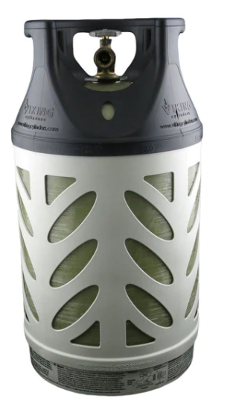
Other Options
Other COTS solar/battery/inverter options
Fuel Cell to reduce solar panel area
  Adaptive Energy unit runs on propane
  350 watts – runs during battery charge
  Burns ~1 lb of propane per kWh: ~4 lbs/week for LRAUV
  5.1 kg (11.2lbs) plus fuel
  600 hours runtime
  Exchange fuel tank every month
    22 lbs of propane in a 13.5 lb tank provides 5.5 kWh/week
  Start up fuel cell (~15 min) for docking and charging
  Solar panels support continuous load (~6W)
LRAUV Battery pack

Slide 13
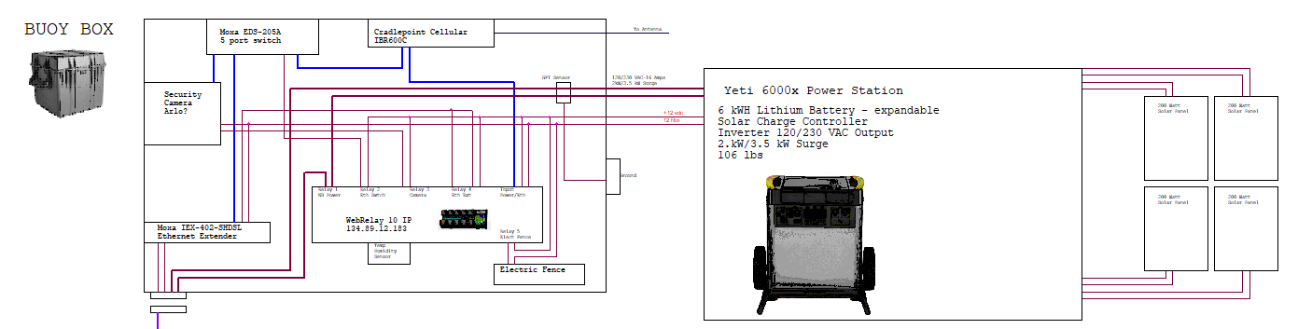
Buoy Electronics Overview
\\atlas\projectLibrary\707976_EPBuoyPrototypeAndTesting\Docking\Drawings\EE\Docking 2021\2021AUV DOCK.opj

Slide 14
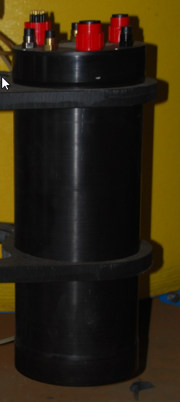

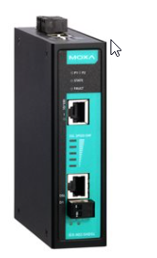
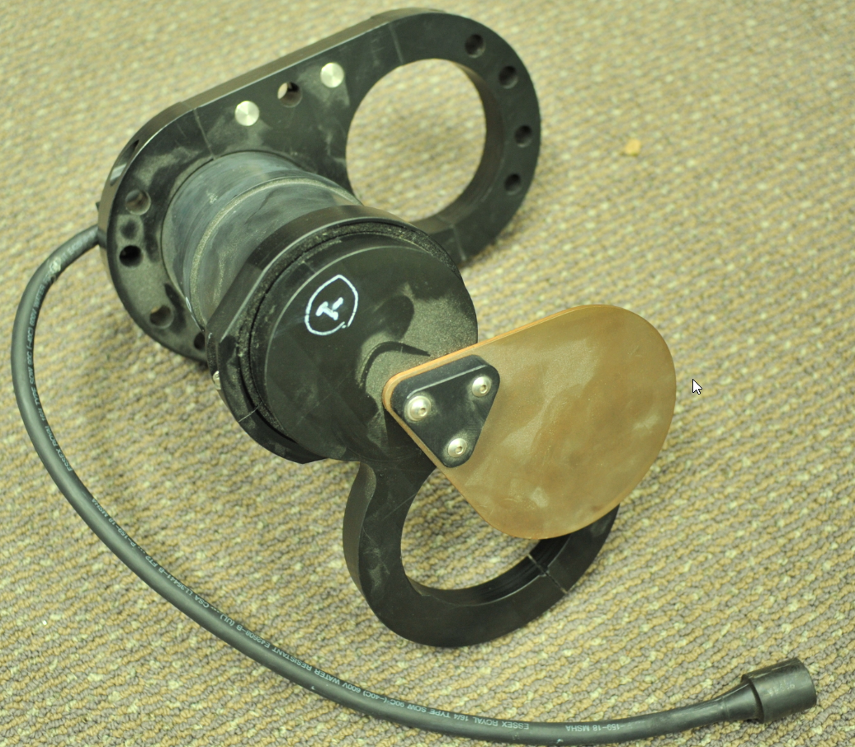
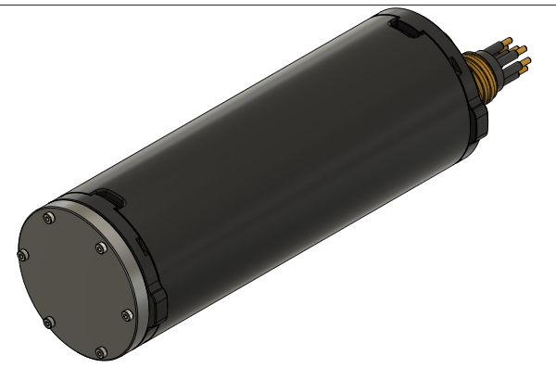
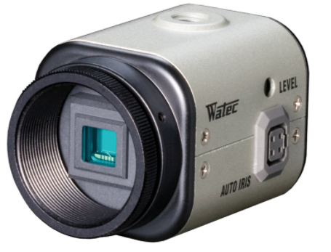
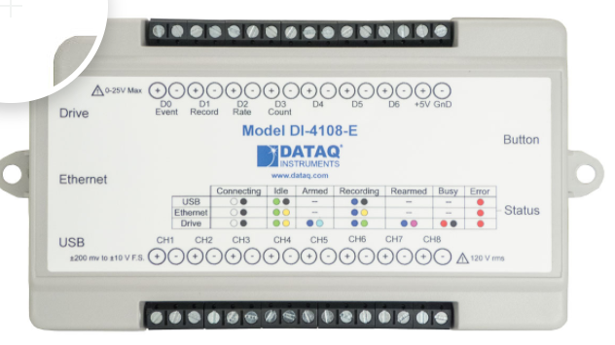
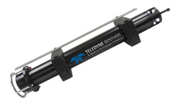
Subsurface Housing
Use existing Housing
230 VAC – 24 VDC with a 300 W AC-DC Power Supply
  Initial power transfer tests will be to a resistive load dump on AUV
  Change out to 48 VDC when updated LRAUV batteries are available
WebRelay-4 for power control and temp/hum sensing
DSL modem + 6 port Switch
Benthos modem, Serial through Moxa terminal server
IP camera with internal storage and network streaming with ~80W light
DAQ, auto starts and logs charging voltage and current at 25 kHz to on-board memory that is accessible from shore.

Slide 15
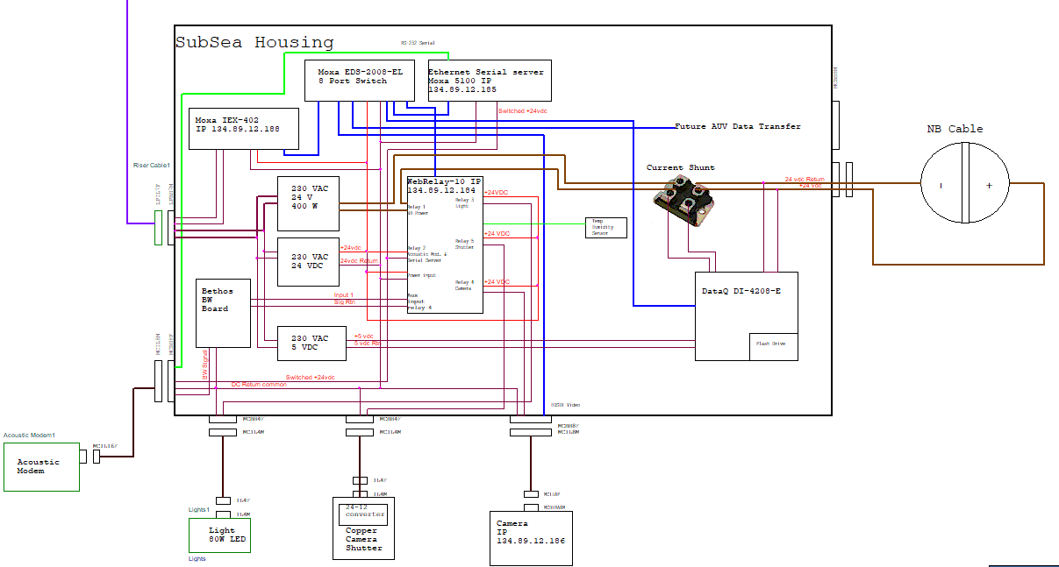
Subsea Can Electronics Overview
\\atlas\projectLibrary\707976_EPBuoyPrototypeAndTesting\Docking\Drawings\EE\Docking 2021\2021AUV DOCK.opj

Slide 16
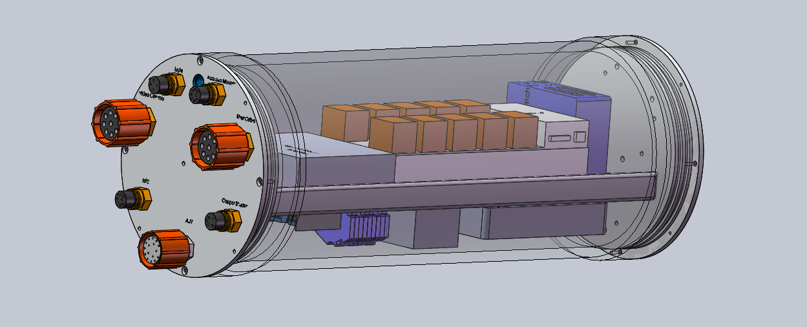
Sub-surface Housing

Slide 17
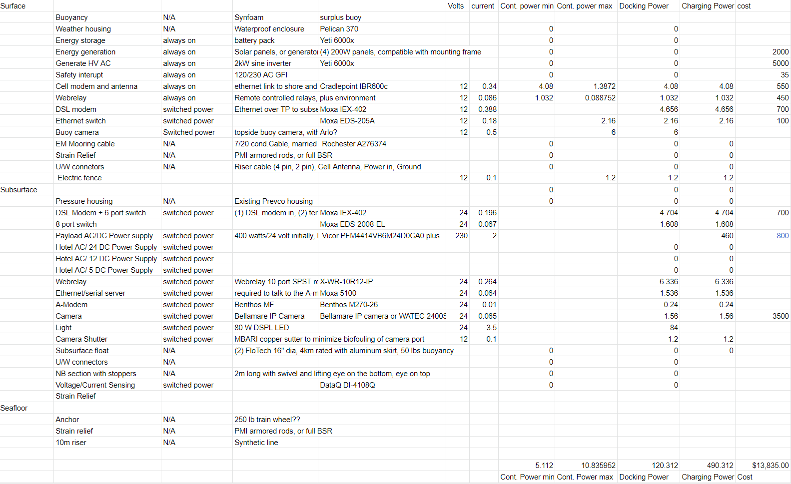
Components with power draw
\\atlas\projectLibrary\707976_EPBuoyPrototypeAndTesting\Docking\Documents\Datasheets

Slide 18
Mooring recovery loop
Ocean Surface
Surface float with solar panels, flag, flasher and satellite tracker and Cellular Modem
80m mooring riser rope + EM cable married together
(2) 12” football floats
Existing 24/7/360 observatories:
~75 meters (250’) Water Depth
Seafloor
Syntactic Foam Subsurface Flotation Sphere
Stopper and Swivel
Benthos MF Acoustic Modem/Transponder
Electronics Housing
Recovery Loops
AUV Docking Section
250 lb steel anchor

Slide 19
Ocean Surface
~75 meters (250’) Water Depth
250 lb steel anchor
Seafloor

Slide 20
Ocean Surface
~900 meters
Water Depth
MARS Node
Seafloor

Slide 21
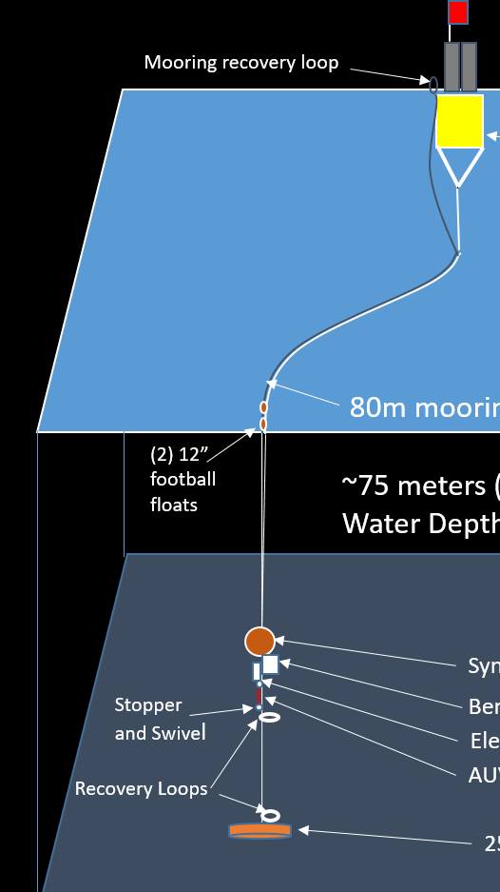
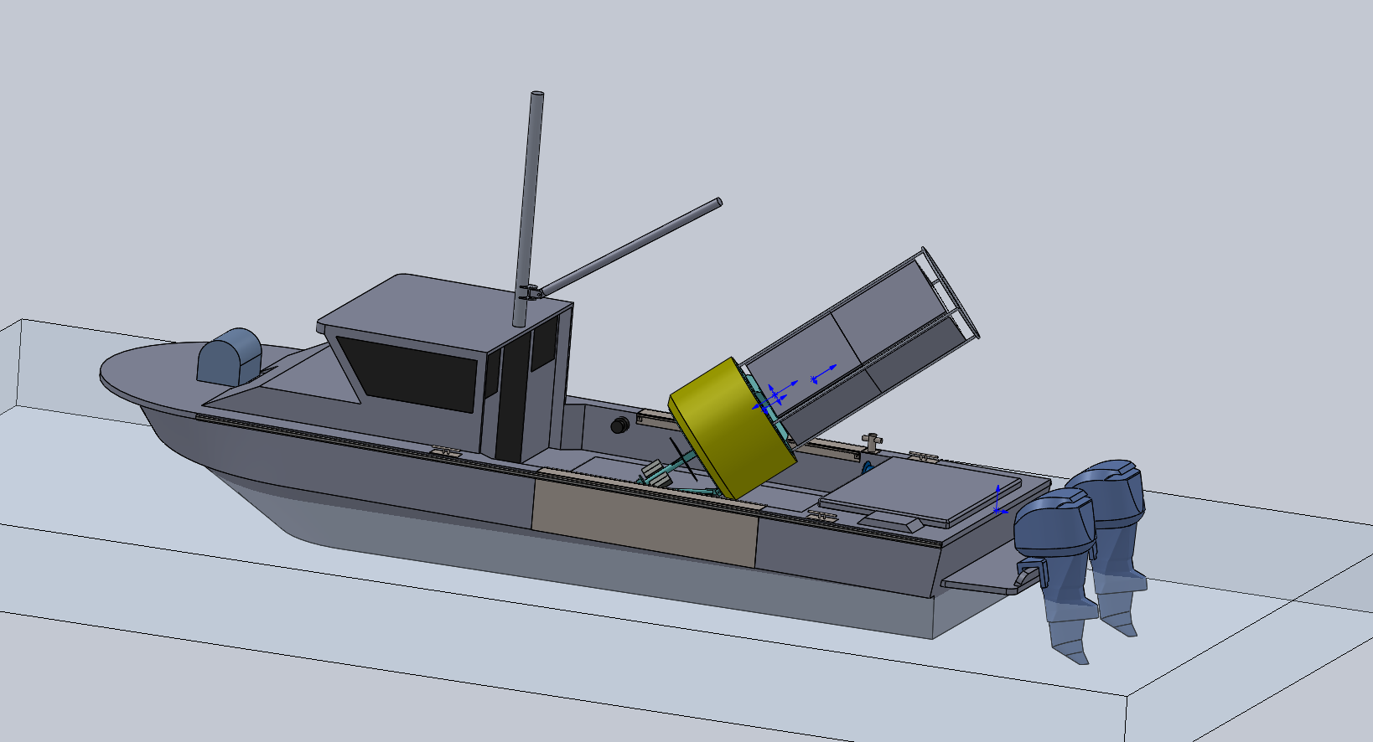
Mooring Launch and Recovery
Launch:
  Lift buoy into the water, stream riser, subsurface float, dock and lower riser out on the surface, then release anchor – stand back.
Recovery:
  Grab recovery loop from top of buoy and begin lift with the capstan, separating the EM cable from line.
  Remove football floats and stop at subsurface float.
  With a boat hook, reach down below dock and attach davit lift to loop below AUV Dock and take up the strain.
  Remove the rest of the mooring and tie in a new lift line back to the capstan and transfer the load.
  Recover lower 7m riser until anchor is at the surface.
  Recover anchor with davit

