Slide 1
Underwater Vehicle Docking
Northrop Grumman Collaboration
Brett Hobson
François Cazenave
Rob McEwen
Brian Kieft
Ben Ranaan
Scott Jensen
Andrew Hamilton

Slide 2
Why should MBARI be developing AUV Docking, now?
LRAUVs are ready:
  Reliable: over 25,000 hours
  Payloads: ESP, BioAcoustic, Biolum, Water Sampler, Imaging (soon)
  On-Board Processing: Plankton Proxies, eDNA (soon)
  Expanding Operator Pool for Routine Operations (Time-Series):
    25 Now
    New User Interface to Allow Novice Operators: 100? (soon)
Time-Series operations are great, but Event Response is the “Killer App” for Long-Endurance, Mobile Robots Like our LRAUV
Existing 24/7/360 observatories:

Slide 3
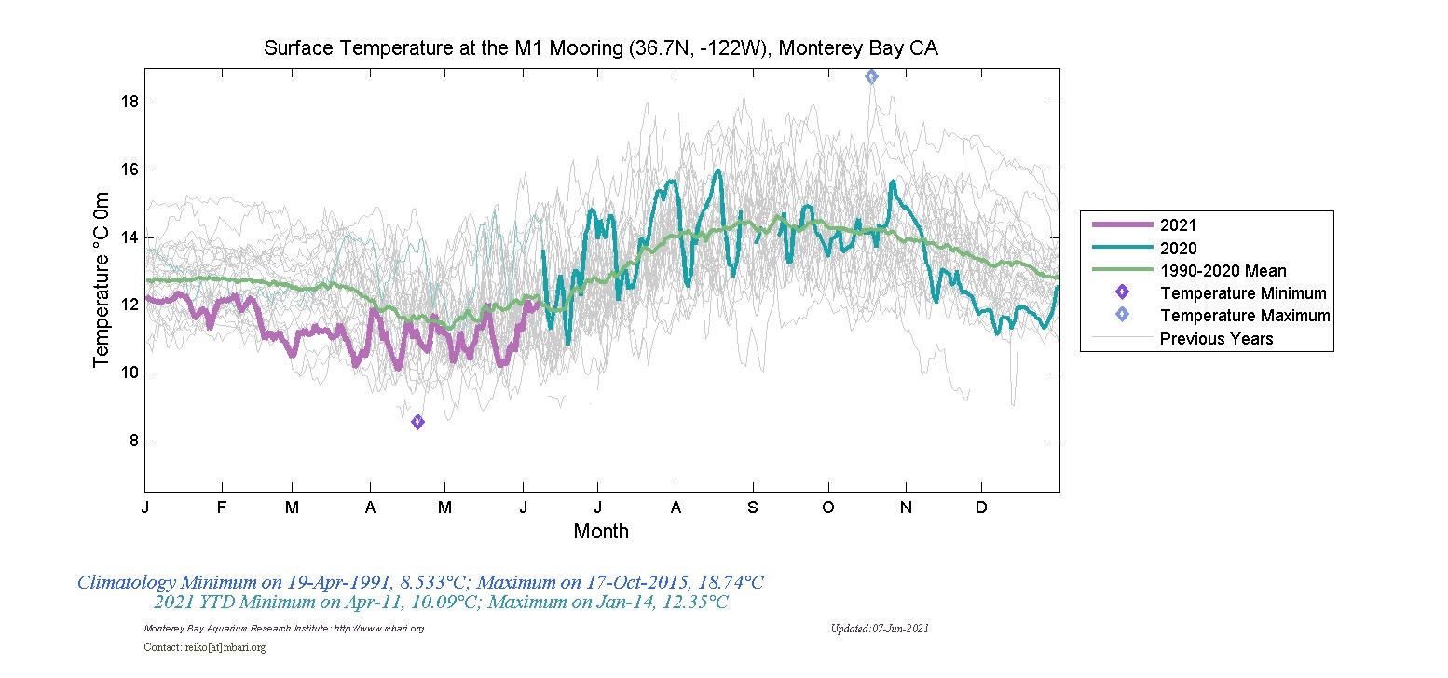
    M1 Mooring:
    Temp anomaly at red line
    What are the spatial extents and biogeochemical characteristics of this anomaly?

Slide 4
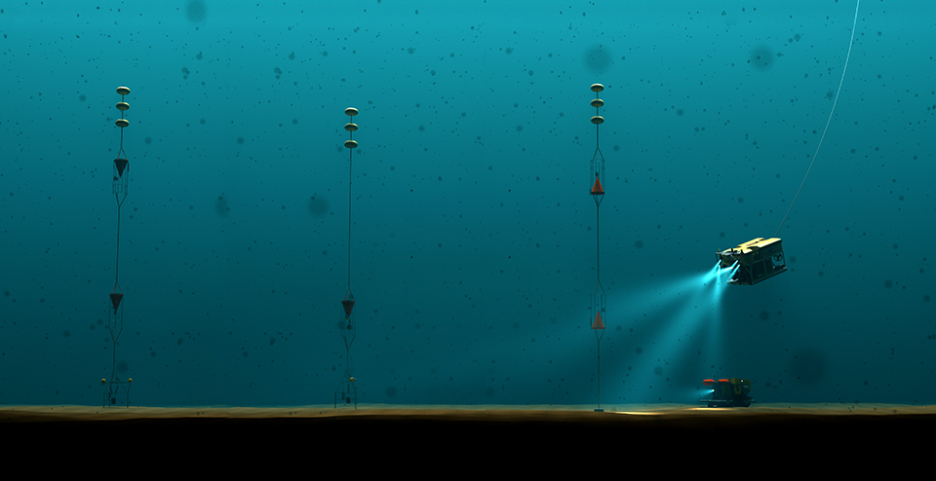
    Station M: What was happening in the upper water column before the detrital pulse arrived at the seafloor?

Slide 5
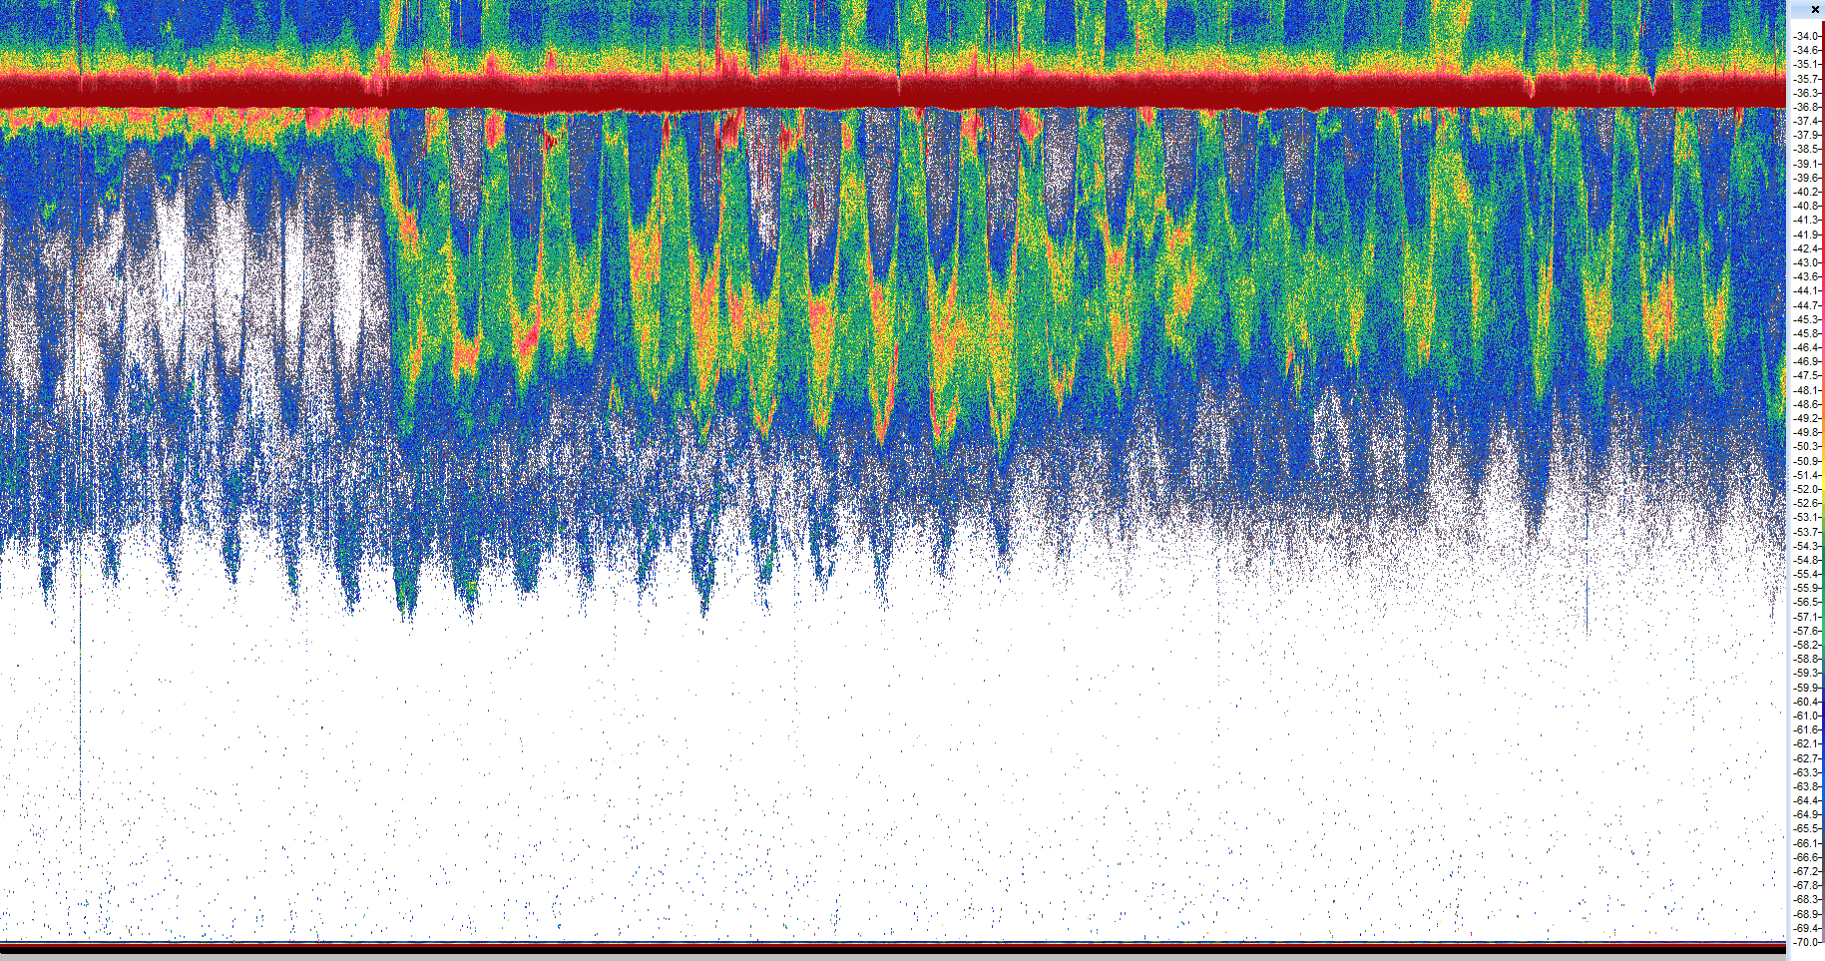

surface
MARS + DEIMOS:
Major shift in biology at red line. What Changed?
Did the environment cause the change?
Change in predator/prey?
450 m
Time-series
Event response
900 m
-35
One month of migrations in Monterey Bay
April 2019
Urmy, Benoit-Bird et al
-45
-60
S_{v} (dB re 1 m⁻¹)
-55
-65
-75

Slide 6
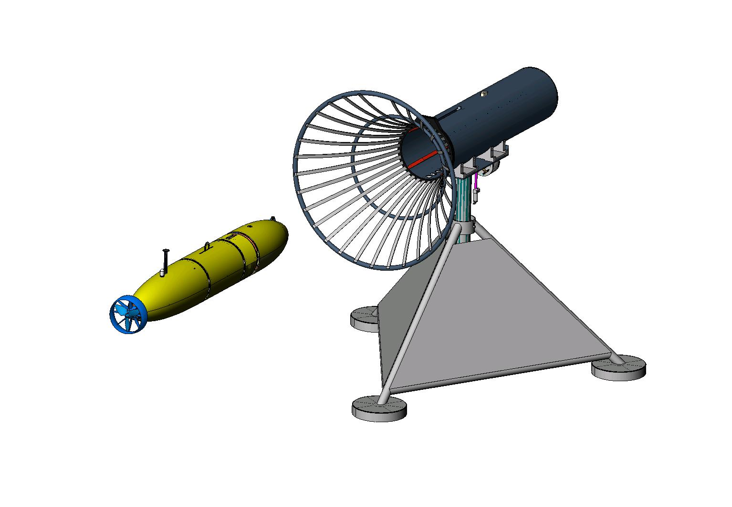
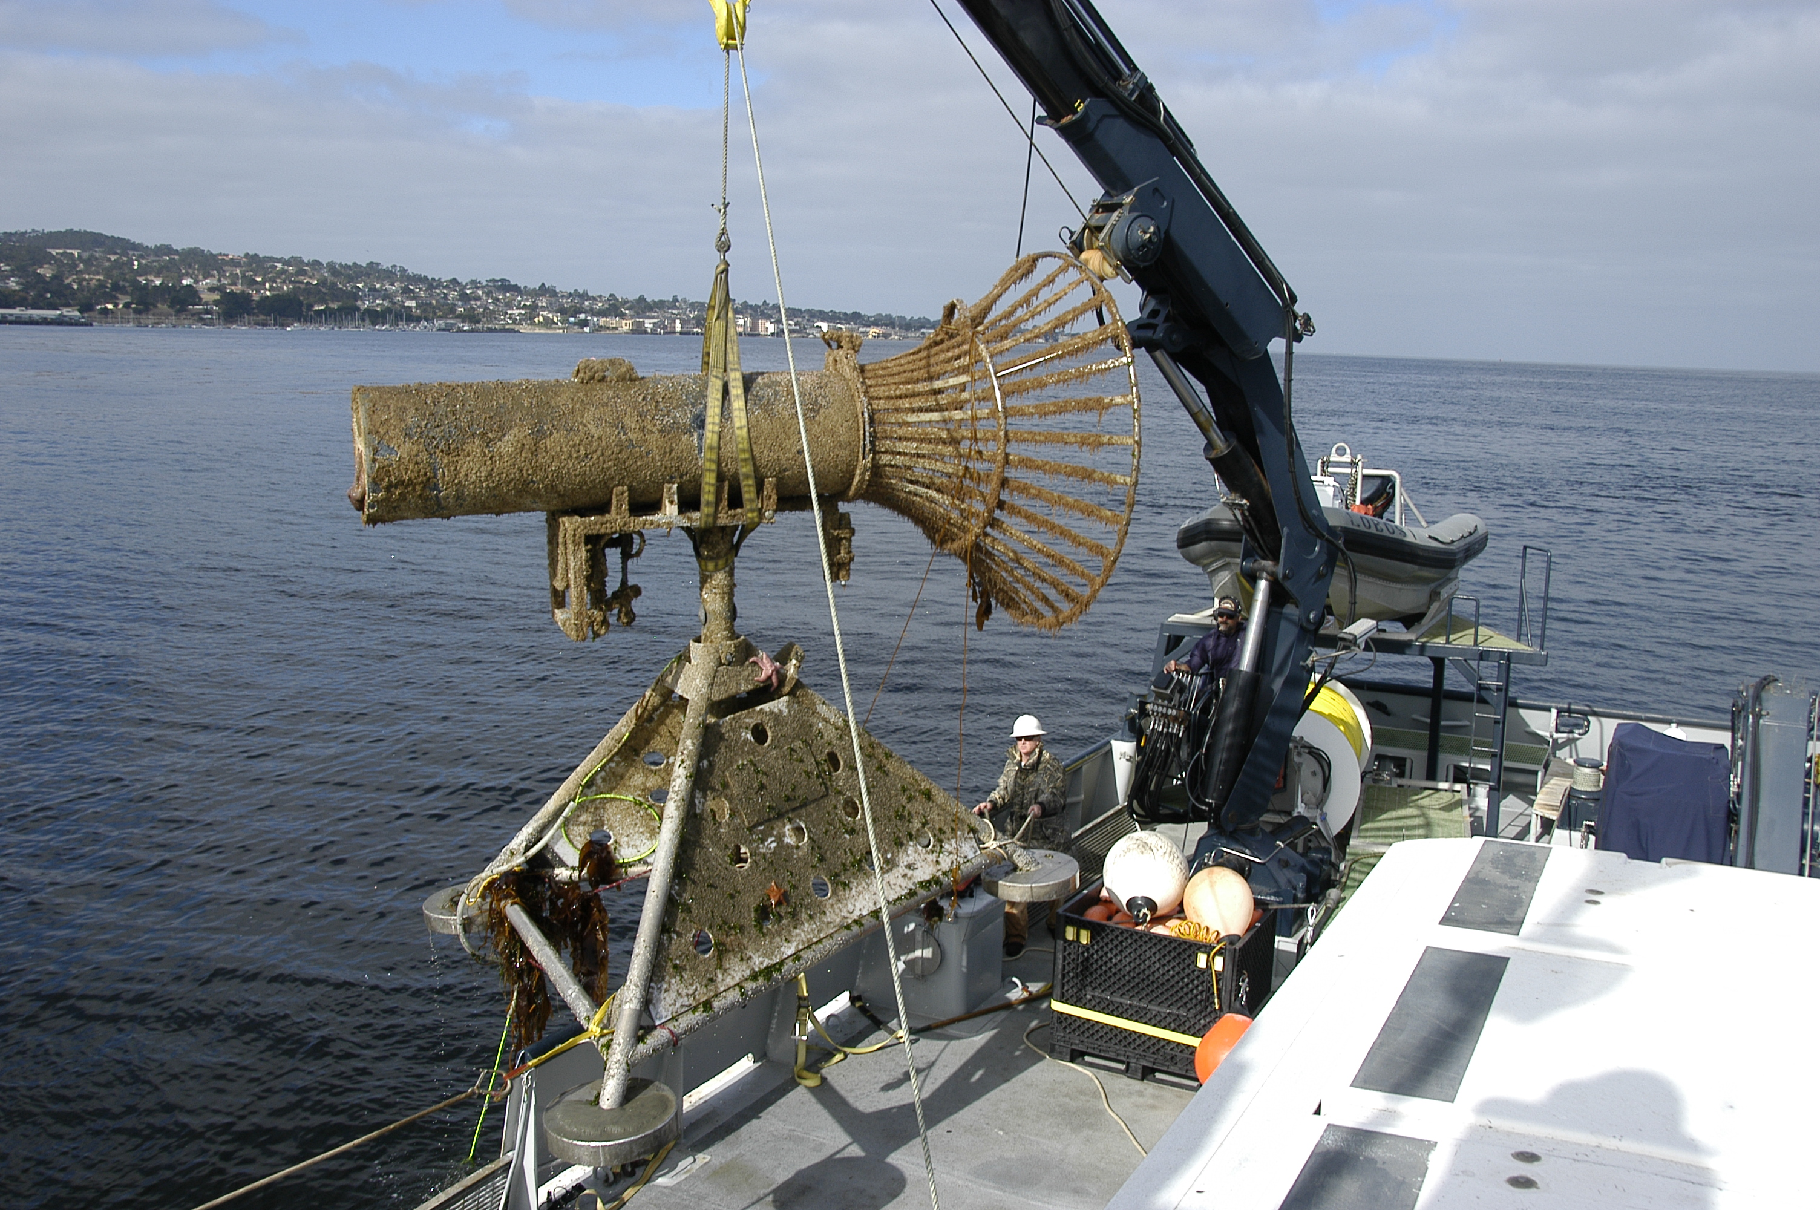
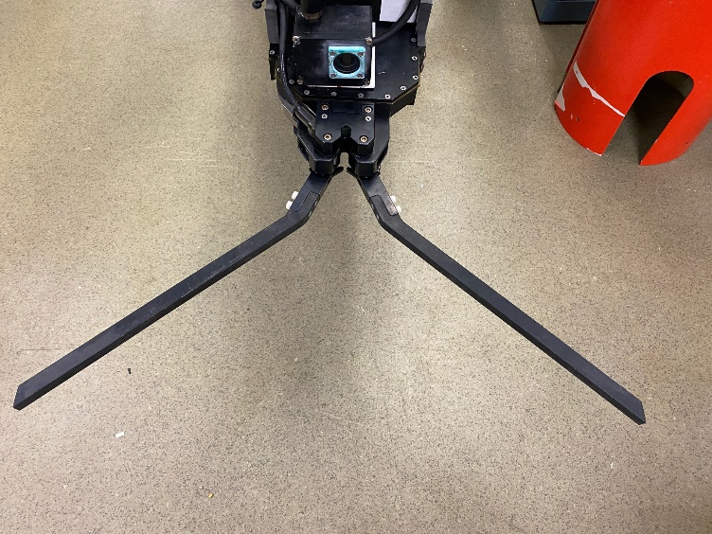
Cone-type AUV Dock for Dorado

Slide 7
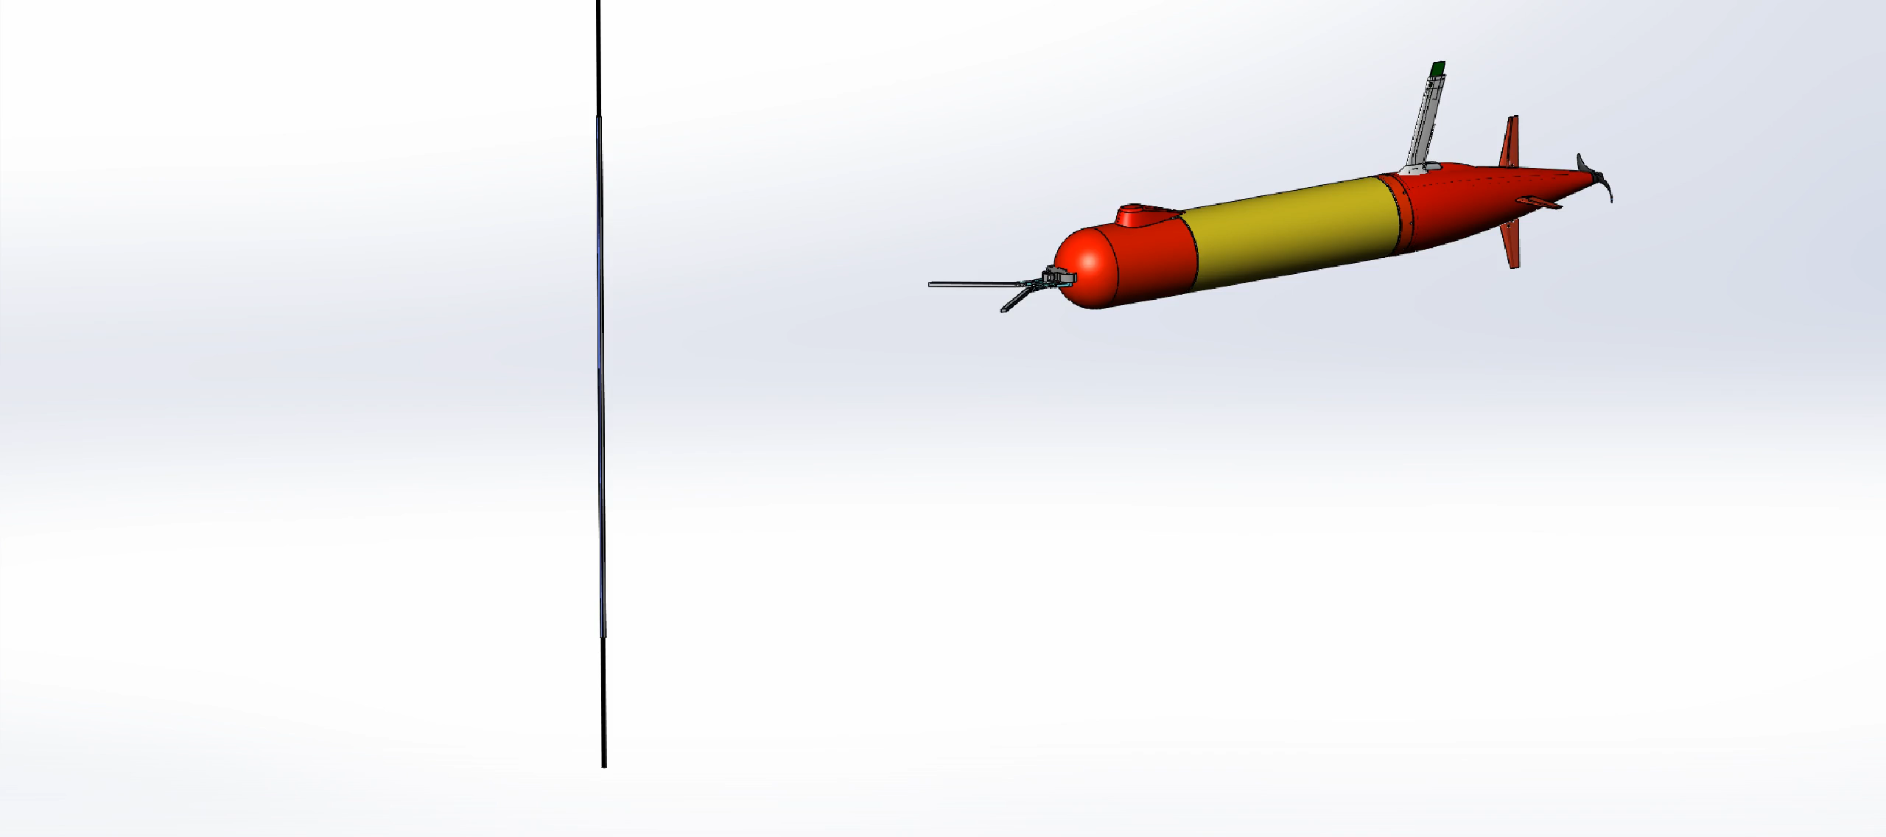
Vertical Line Docking
Approach From Any Direction e.g. into current
Vertical Precision Not Important
Compliant, Soft-Stop
Power and Data Transfer Challenges
Mooring line or dedicated docking line

Slide 8
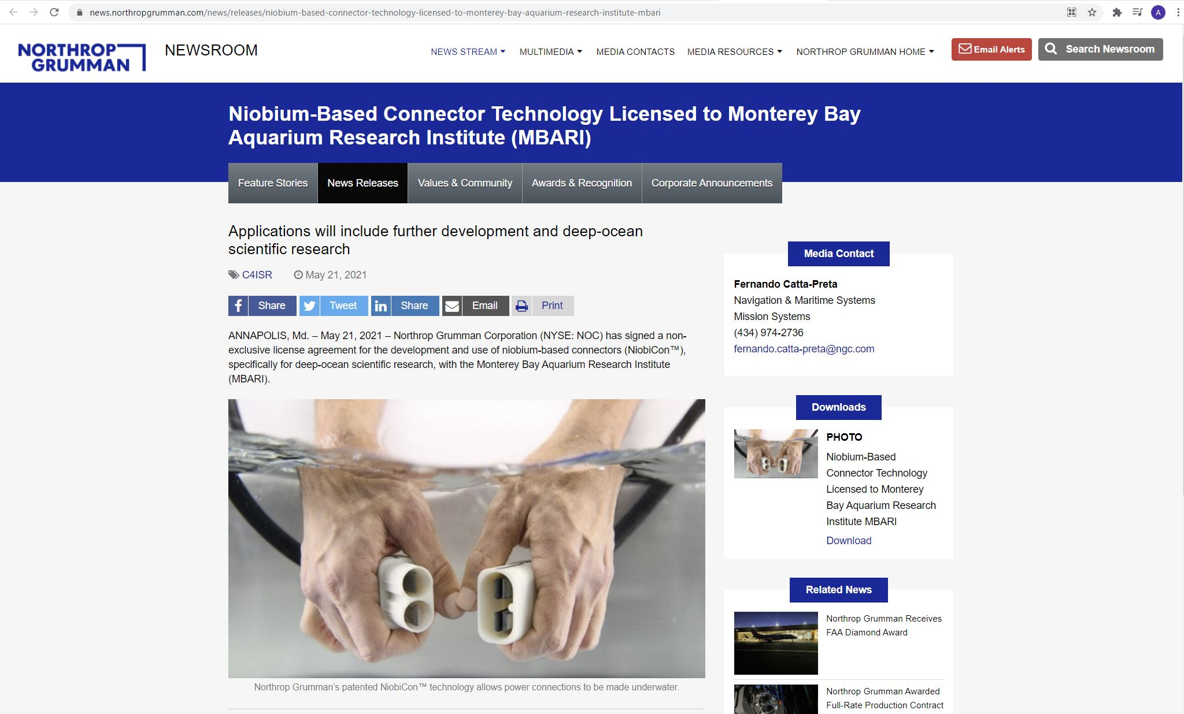

Slide 9
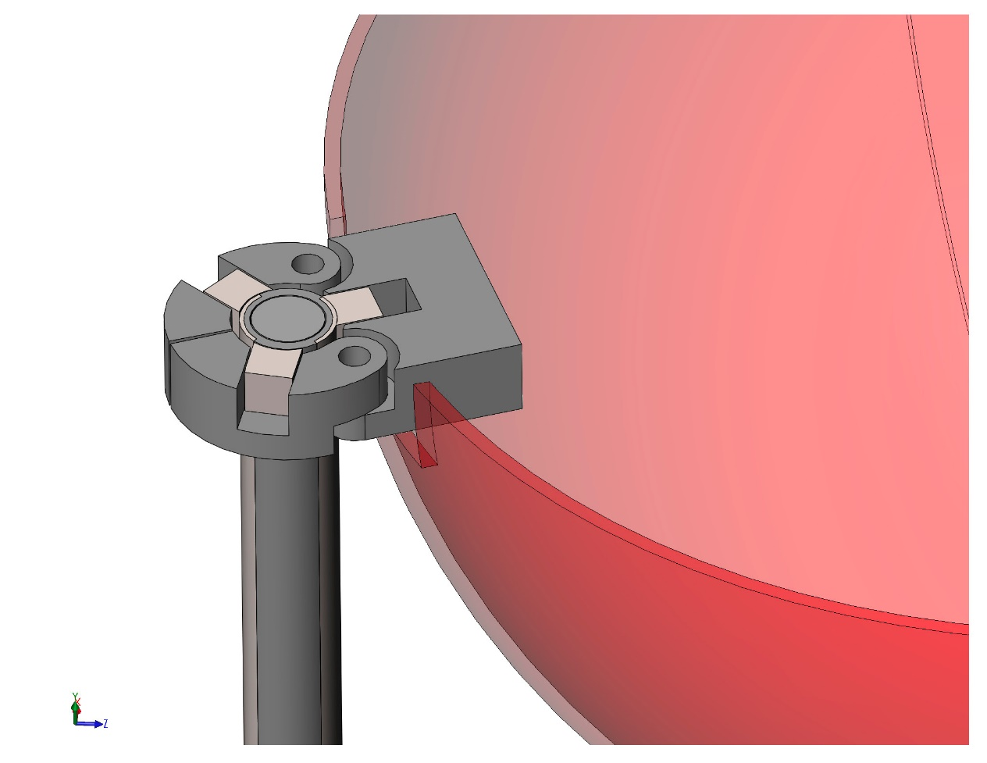
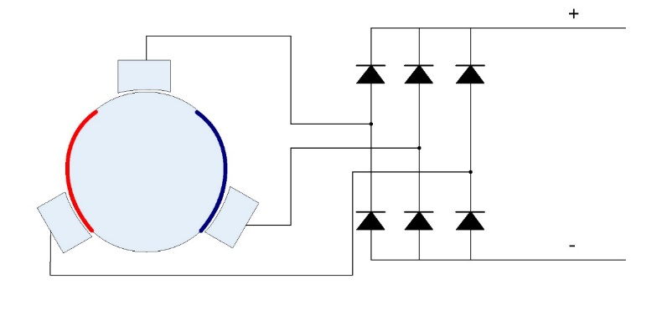

Slide 10
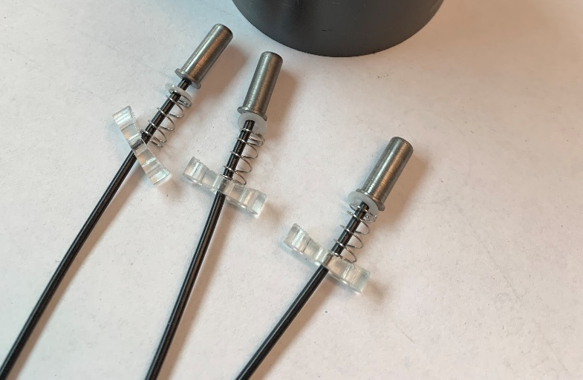
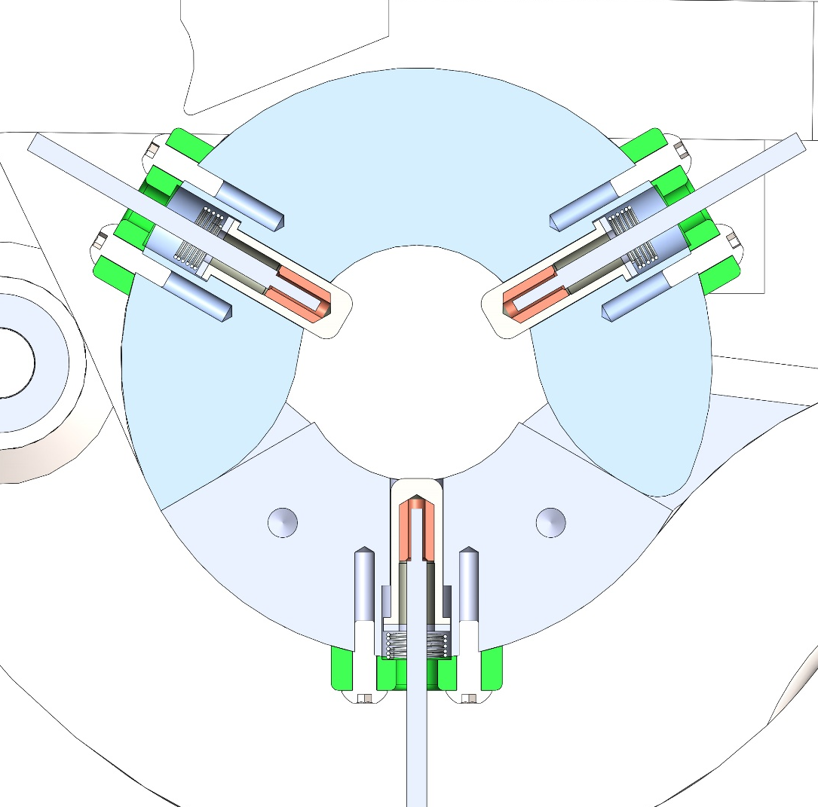

Slide 11
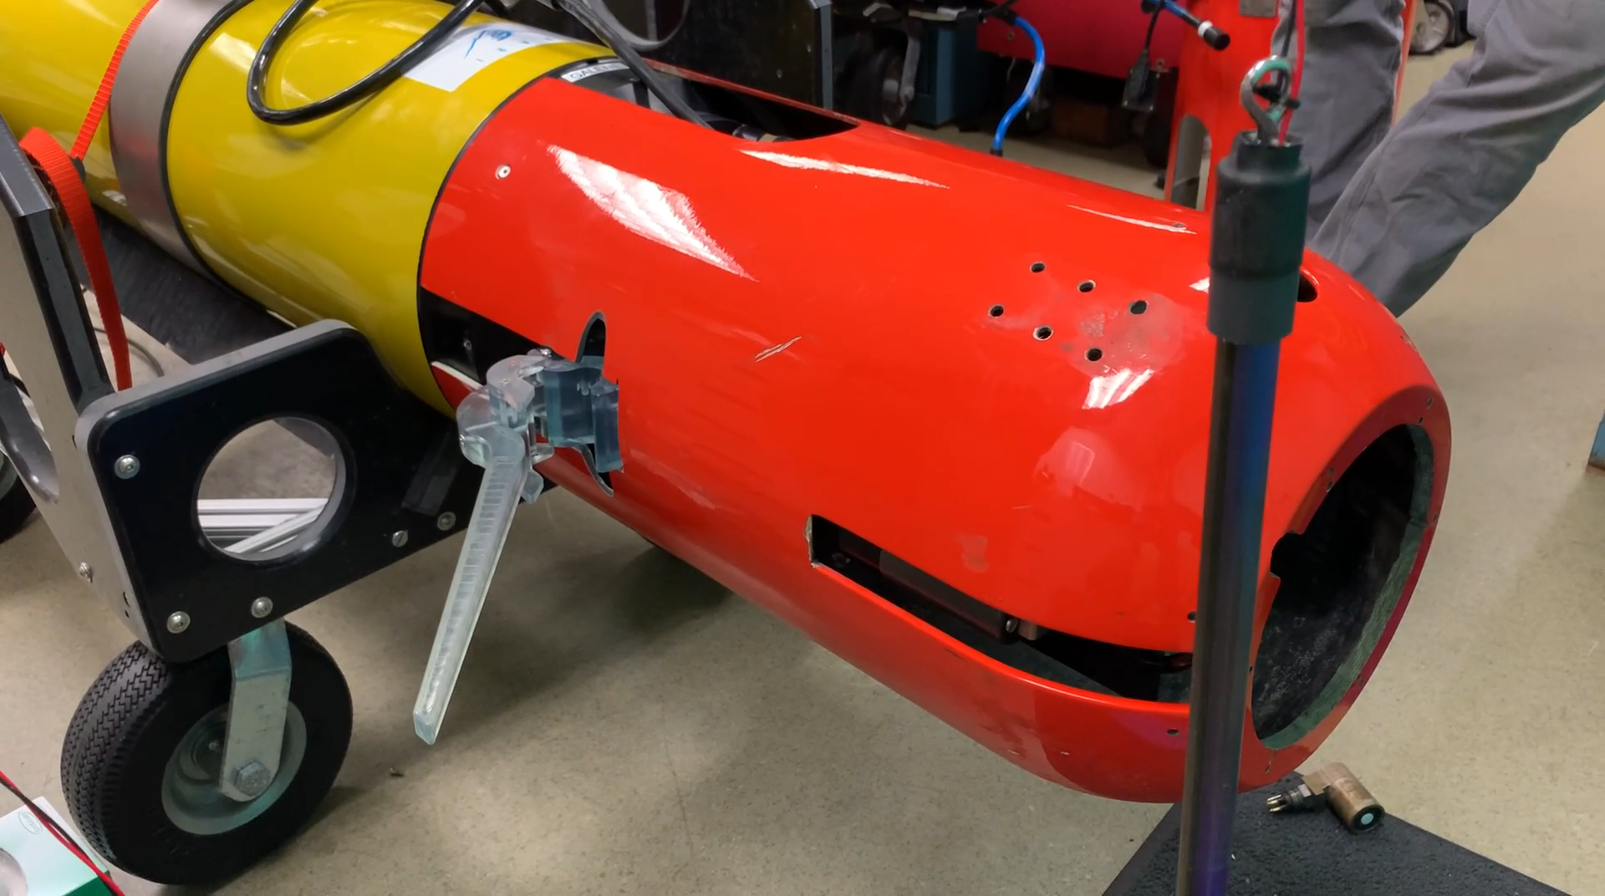

Slide 12
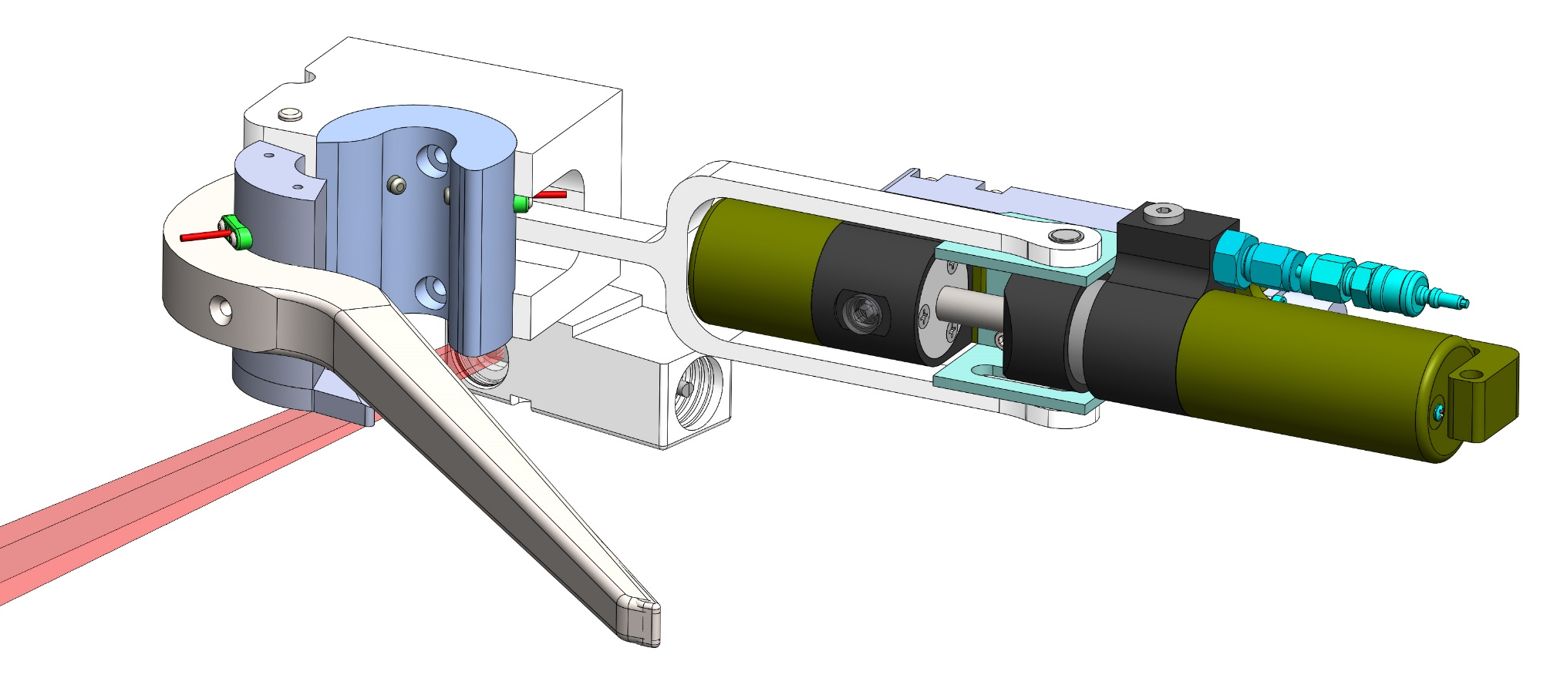

Slide 13
Northrop Grumman License Agreement
Royalty free license. Signed May 15th
New technology developed is Jointly owned IP
Existing MBARI IP remains owned by MBARI (and vice versa)
Patent procurement is Northrop Grummans responsibility
Future commercial license revenue is split
MBARI has a right to use all Joint IP for our own use

Slide 14
Next Steps
At sea testing of homing and latching (next week)
Brush design refinement for wear and longevity
Explore data transfer possibilities
Deploy on stand-alone buoy system or MARS

Slide 15
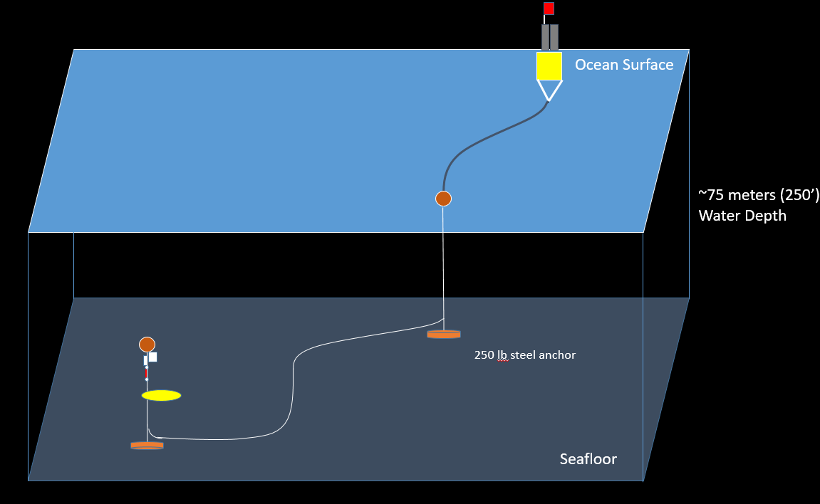
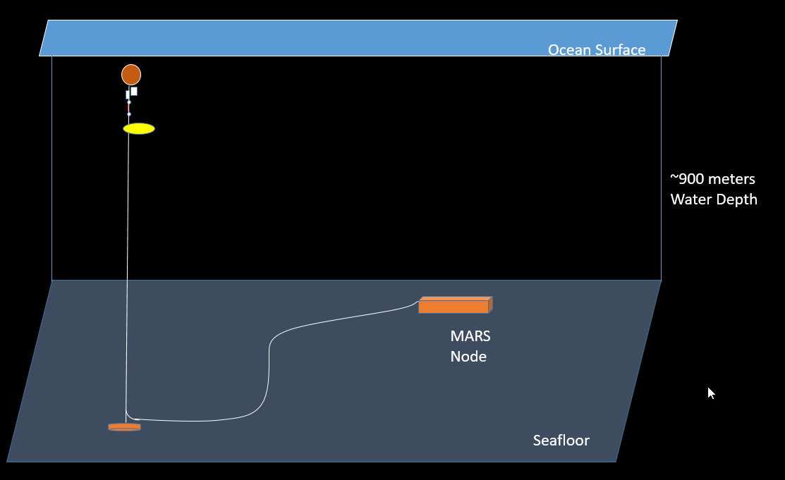
Shelf Deployment with Buoy
MARS Deployment

Slide 16
