Slide 1
AUV Docking with Niobicon technology
Presentation for May 21, 2021 meeting with NG enginer

Slide 2
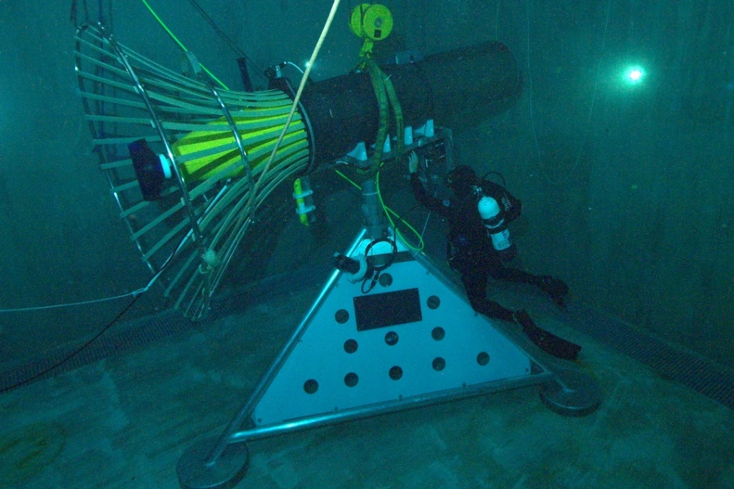
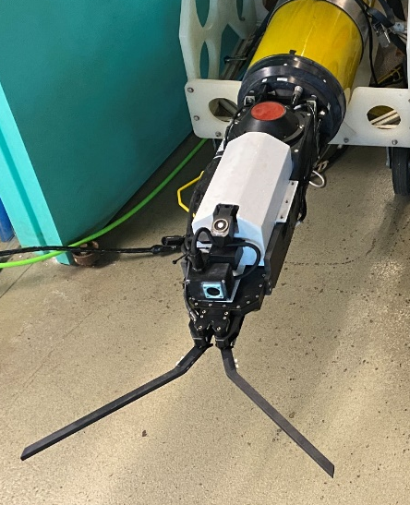
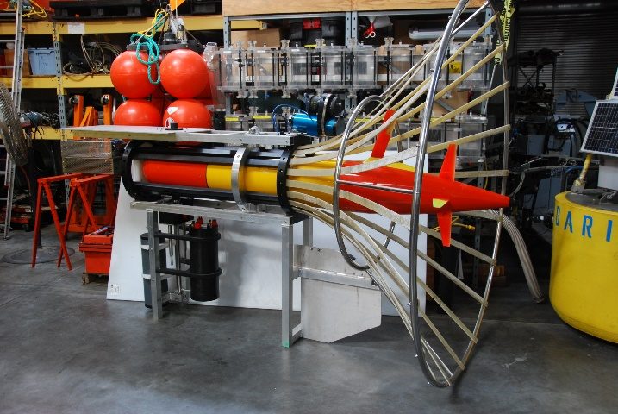
AUV Docking at MBARI:
2007 - Designed, built, deployed and tested a docking station for 21” AUV
  Inductive power transfer of 500 watts,
  Thru-water WiFi 802.11g 100b Ethernet data transfer
2012 - started the design of a cone dock for the 12” LRAUV under DARPA funding
  Planned to use ODI connector for power and data transfer
2020 – WHOI line capture device.
  LRAUV can now home to a cable and capture that cable using a WHOI Whisker Box docking device with a WHOI Micromodem + linear USBL array

Slide 3
Docking goal
Designed MBARI Long range AUV. (12” diameter, approx. 8’ long)
Power transfer: 500 W
Data transfer not required for now
Longevity: 1 year (?)
Approachable from any direction (depending on current)
Connected to a surface buoy or a cable from shore

Slide 4
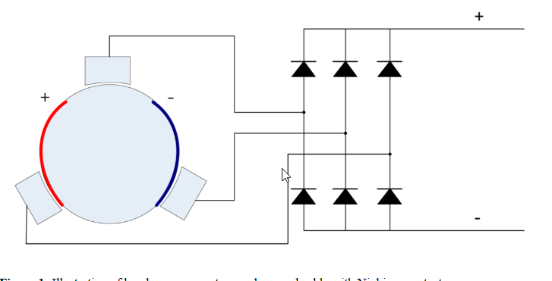
Niobium dock concept
Polarity is rectified using diode bridge
Dock is ¾” diameter niobium tube withr fiberglass core. Two isolated halves.
Dock can be attached to a buoy or to the seafloor.
Capture device is mounted on the side of the AUV
Contact is made using 3 niobium ‘brushes’.
Dock allows axial and rotary motion

Slide 5
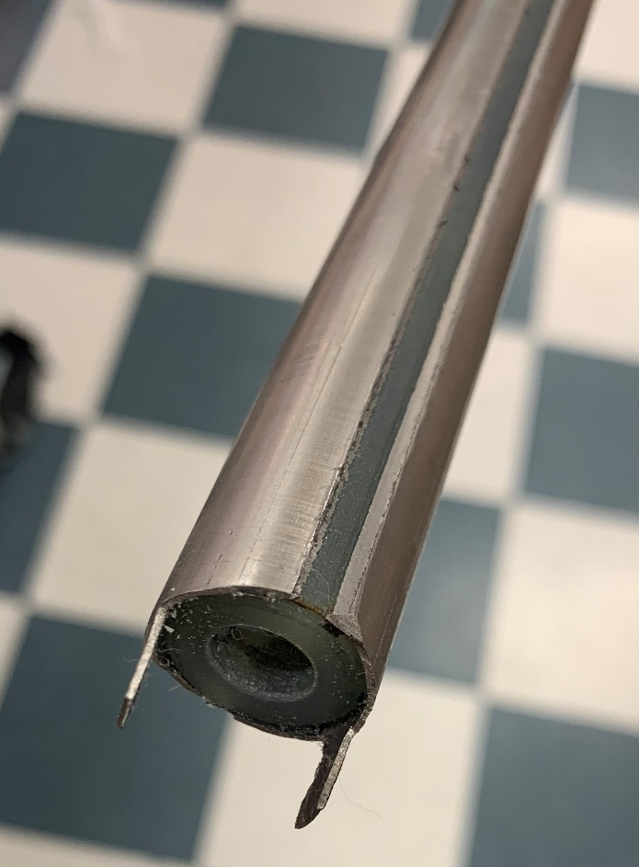
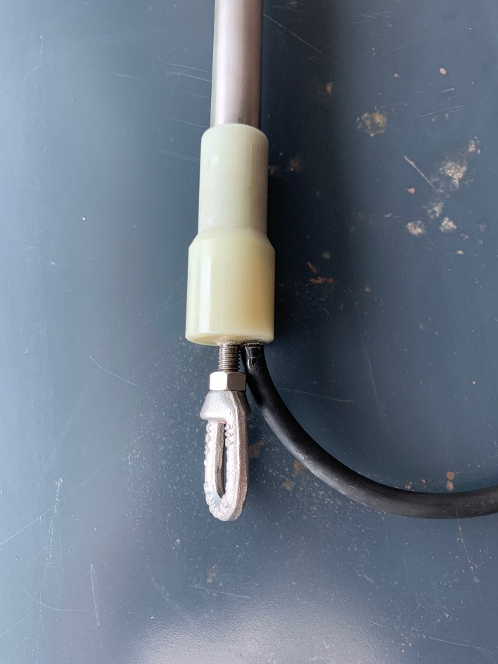
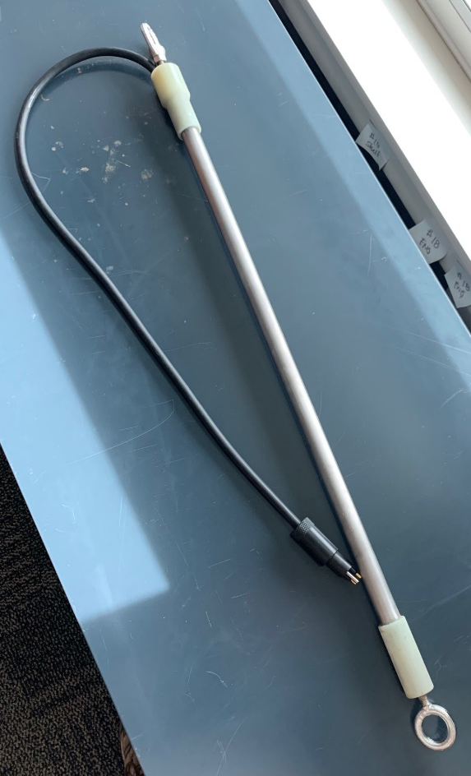
Niobium dock details
¾” OD, 0.020” wall, 6’ long tubing
G10 fiberglass core
Glued with epoxy
Contacts potted with resin

Slide 6
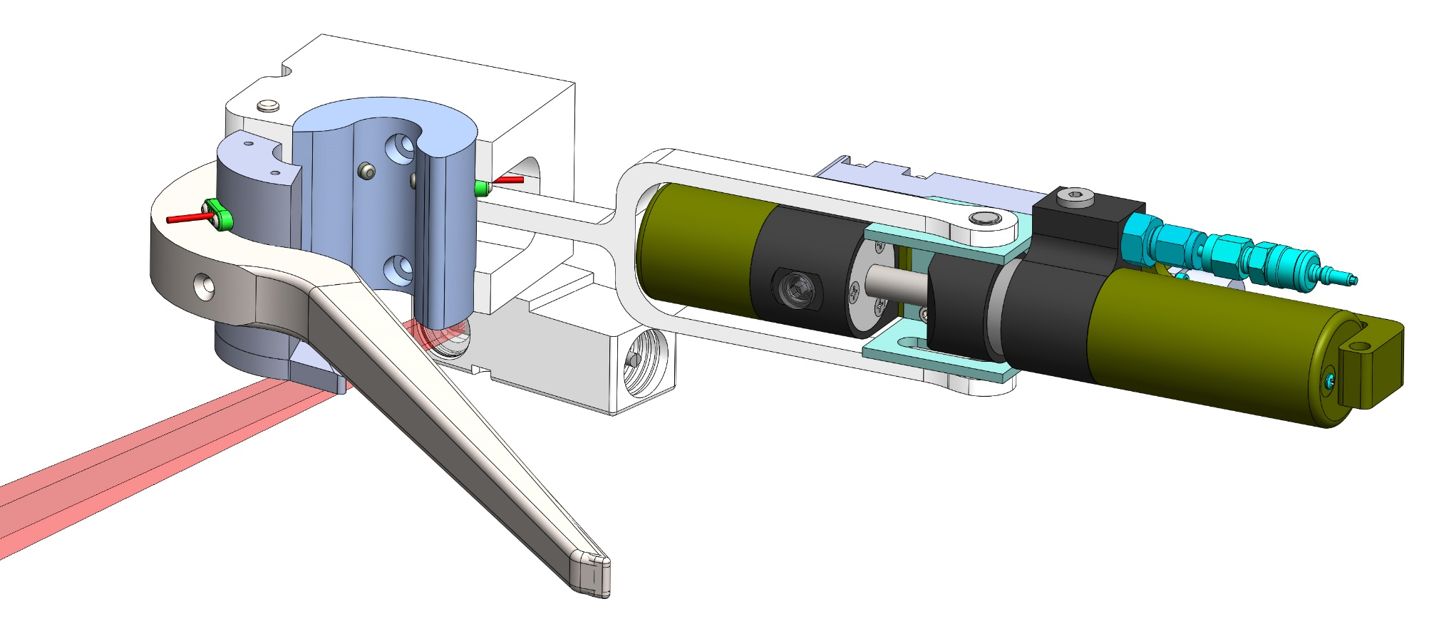
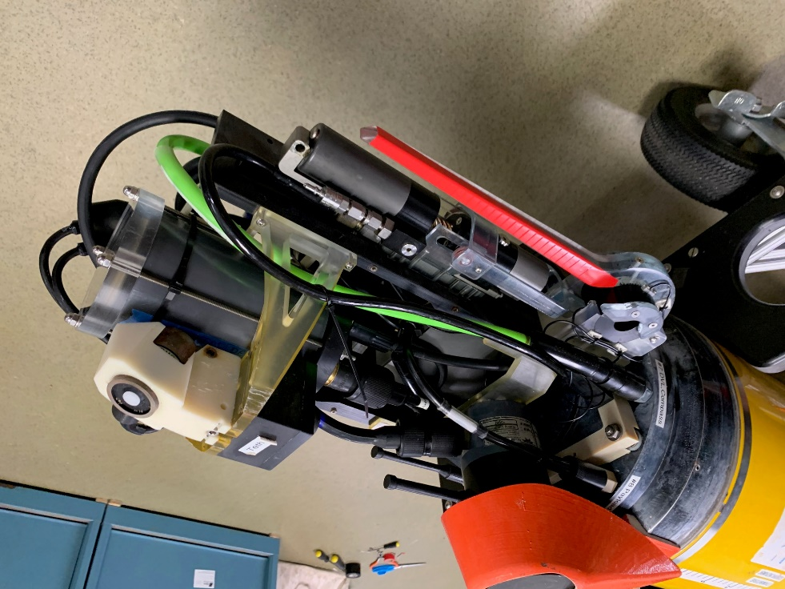
Capture device details
Actuator driven arm and jaws
Photosensor dock detection
3 spring load niobium ‘brushes’ in capture jaws

Slide 7
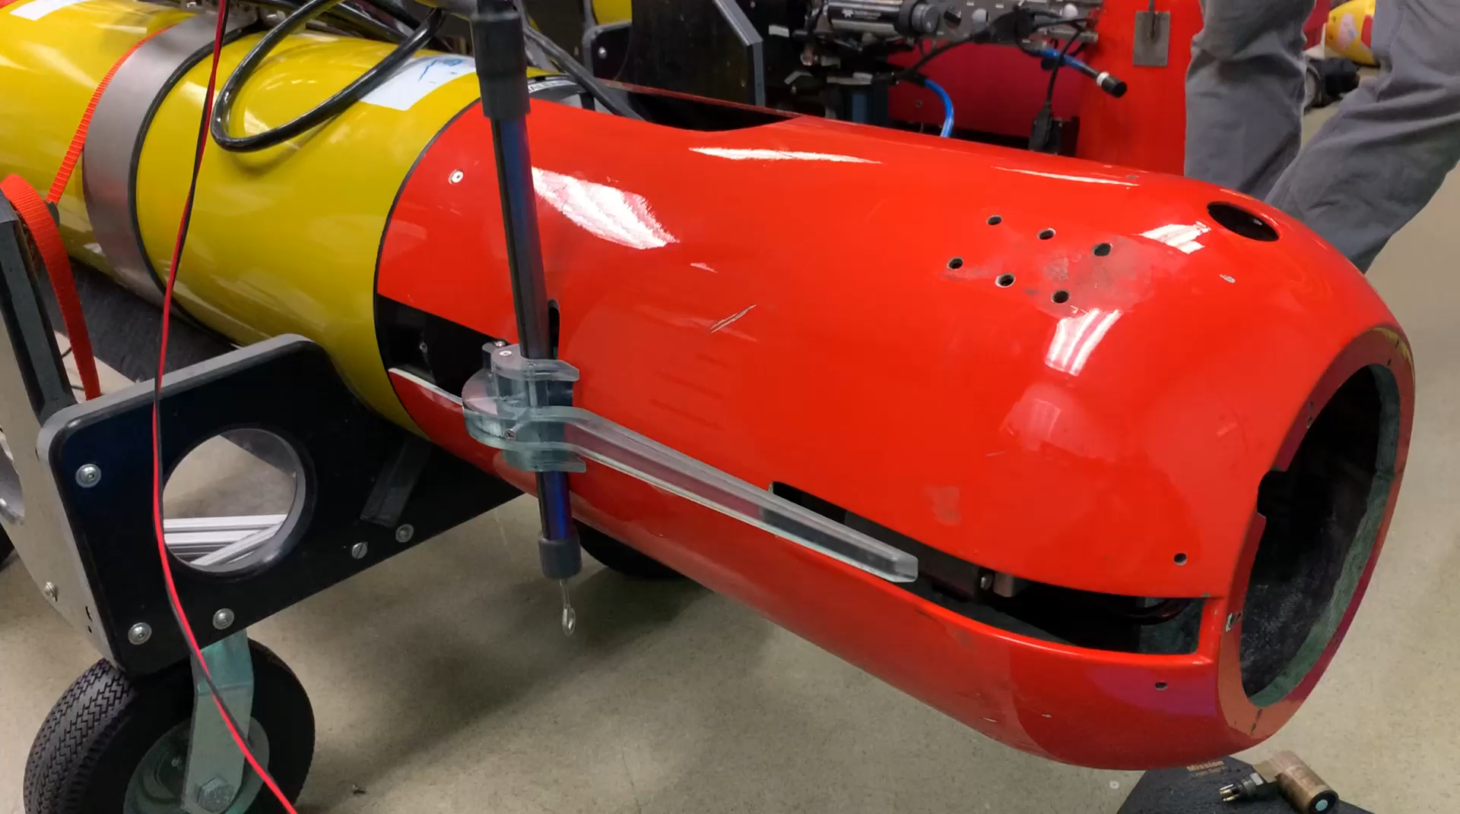
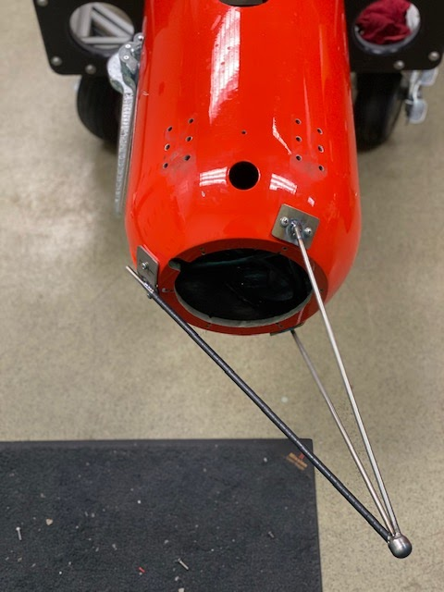
Capture device details

Slide 8
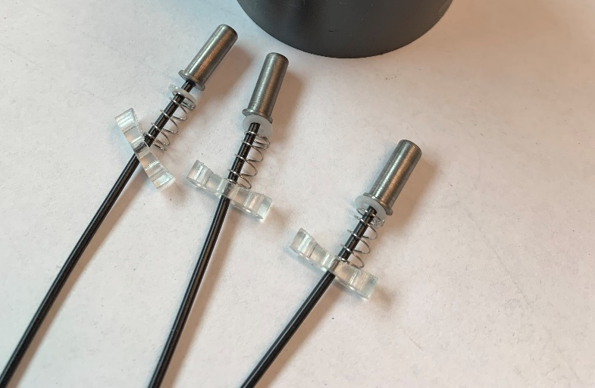
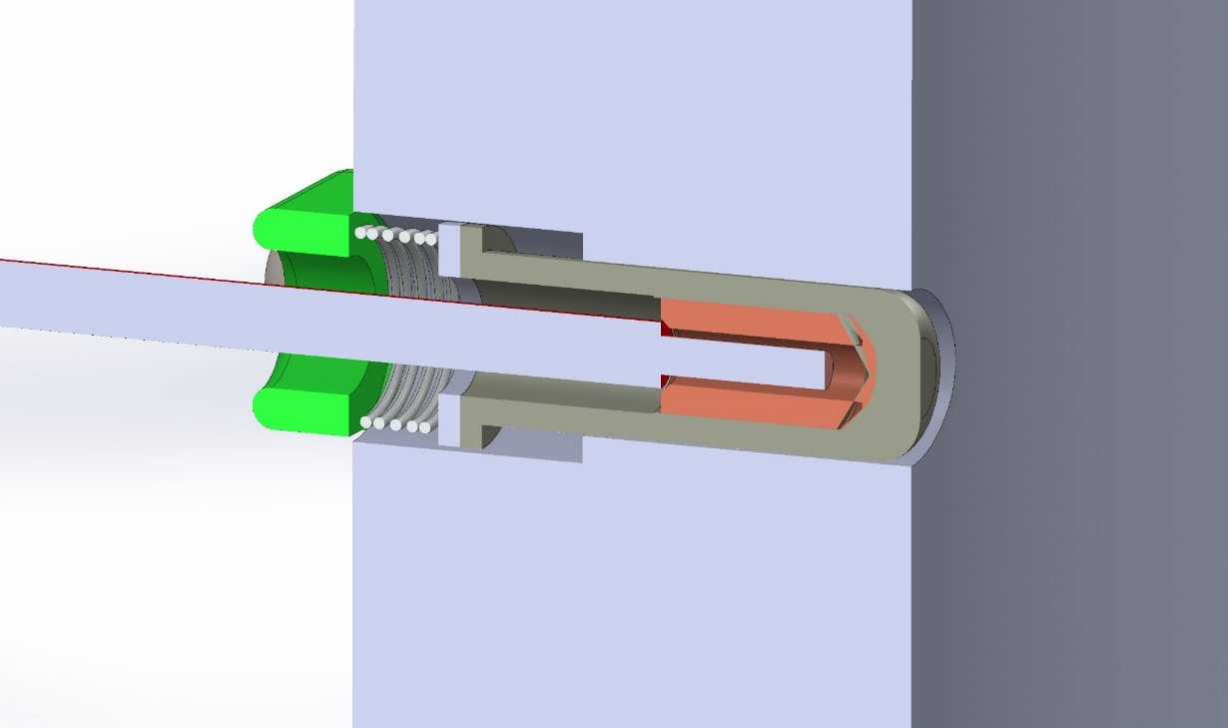
Power-transfer device details
Nb brush cross section view
Nb brushes

Slide 9
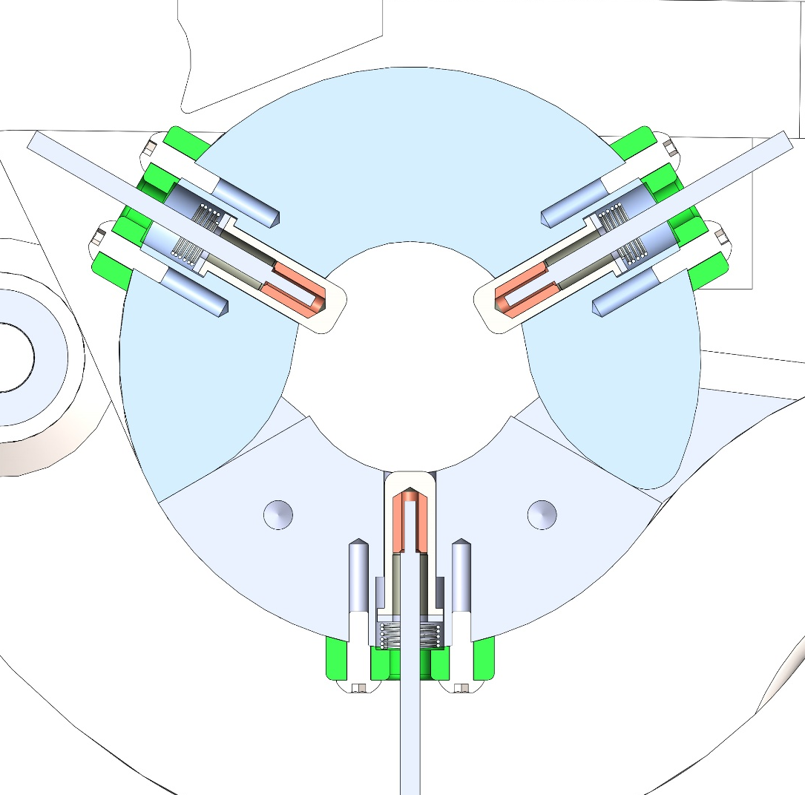
Power-transfer device details
Cross section of 3 brushes

Slide 10
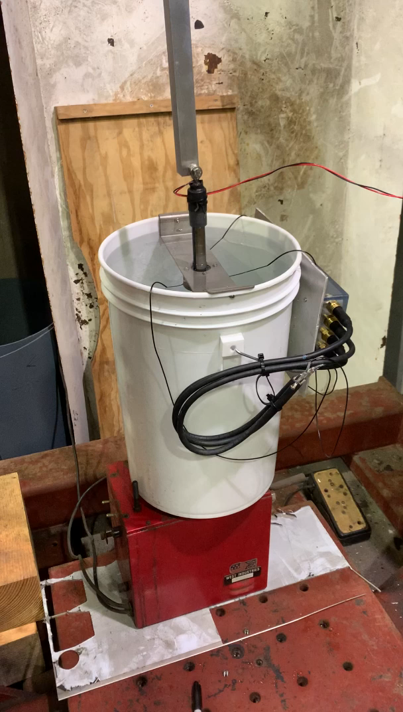
Testing the Nb brushes and dock
Tests power transfer capability, and longevity.
Simulates at-sea conditions
  Rotary motion
  Axial motion
  Submerged in seater
Power is transferred and dissipated in a resistor
Current and voltage are recorded

Slide 11
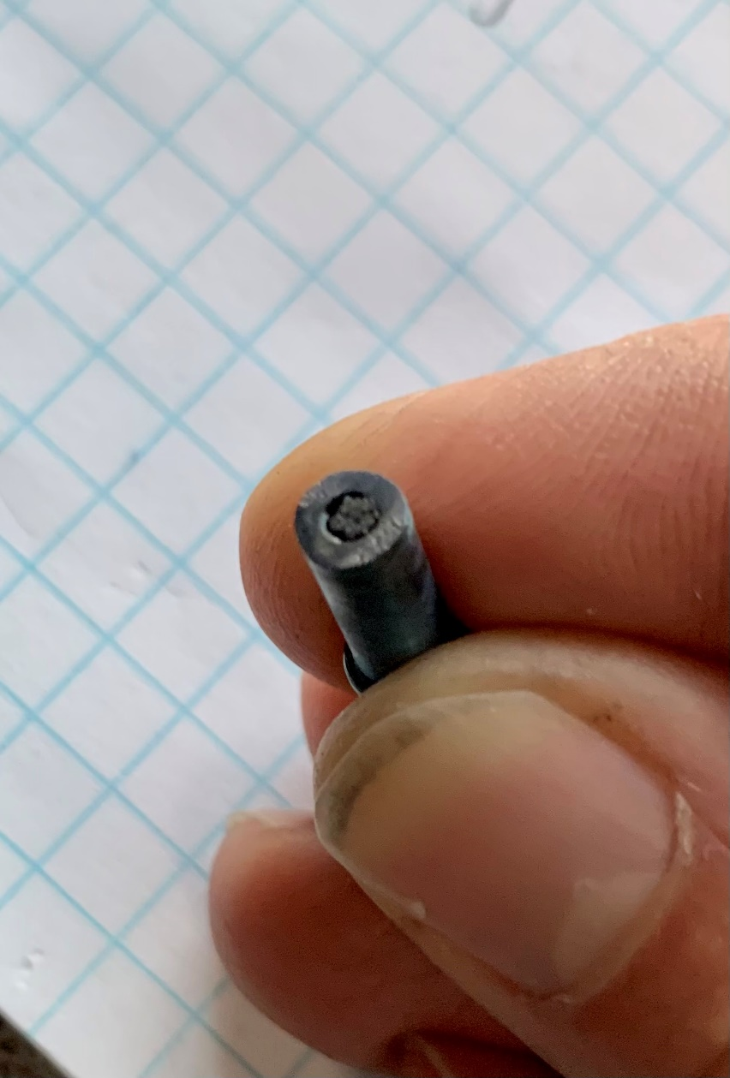
Test procedure and findings, First test.
Simulating buoy mounted dock with a lot of motion
- Vertical amplitude: 7”
- Period: 6 s
- Bucket rotation: 80 s per rev.
- 22 VDC, 3.8 A (83.6 W)
Failed after 2 days due to wear of the brushes.

Slide 12
Second test
Simulating a bottom mounted dock with very little motion:
Vertical amplitude: 7”
Period: 6.8 minutes
Bucket rotation: 80 s per rev.
40 VDC, 14 A (560 W)
Failed after 20 minutes. Lots of arcing. Current too high. Brushes overheated. Required brush redesign.

Slide 13
Third test
Very little motion, lower power:
Vertical amplitude : 7”
3” every 12 hours
Bucket rotation: ¼” turn every 6 hours
42 VDC, 5.5 A (231 W)
Some arcing and current dropouts after one day. Brush springs too weak.

Slide 14
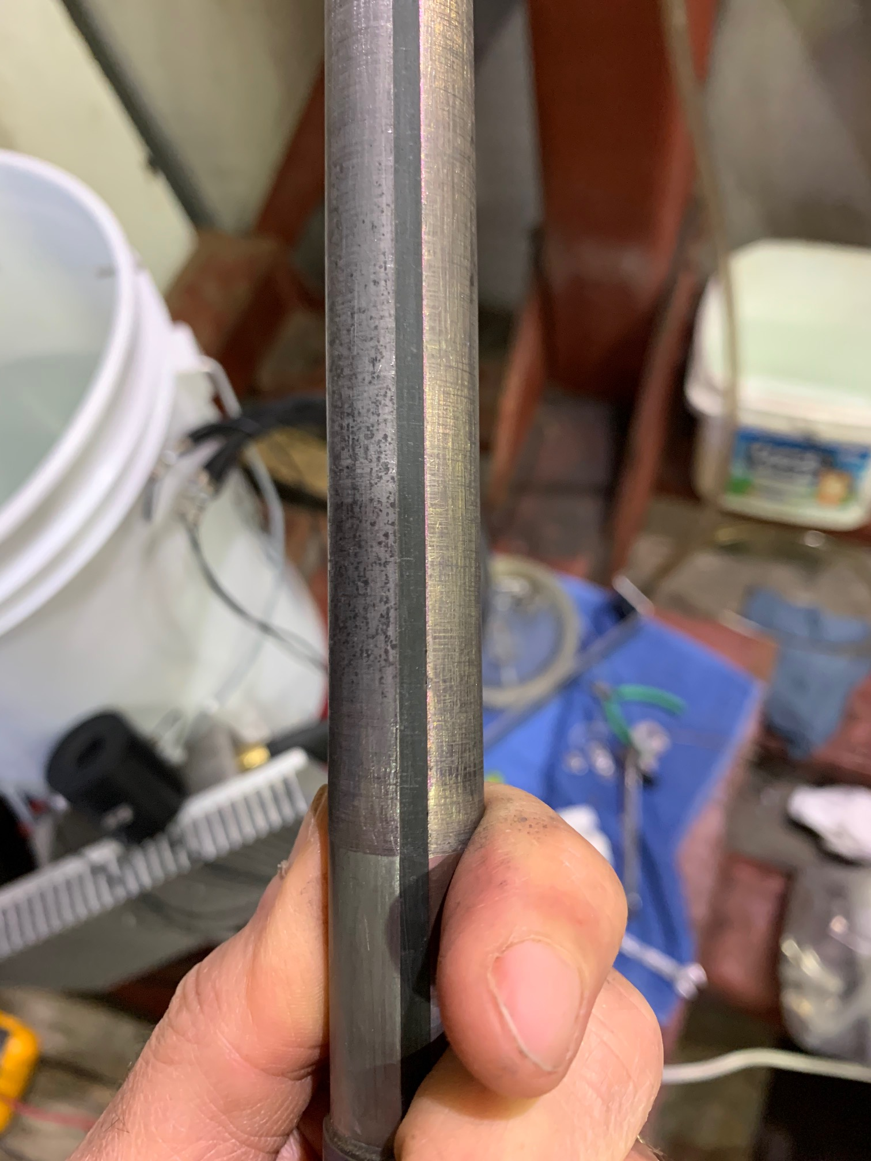
Fourth test
Using 8 x stiffer springs
Vertical amplitude : 7”, then 6”
Travels approximately 0.5” every 10 min Rotation: 2 turns every 3 hours
42.3 VDC, 5.5 A (231 W)
Nearly continuous power transfer for 13 days. Surface degradation due to arcing caused very short dropout.

Slide 15
Fifth test
Similar to fourth test, but higher current
Vertical amplitude : 6”
Travels approximately 0.5” every 10 min Rotation: 2 turns every 3 hours
42.3 VDC, 7.6 A (330 W)
Nearly continuous power transfer for 8 days. Surface degradation due to arcing caused very short dropout. Significant wear of the brushes

Slide 16
Main findings of test
Arcing occurs when there is motion and degrades the surface.
Good surface conditions help prevent arcing.
High spring force helps prevent arcing.
Brushes wear relatively quickly
Low power (about 300 W) can be transferred reliably for a long time.
Noisy connection makes data transfer unlikely when there is motion.

Slide 17
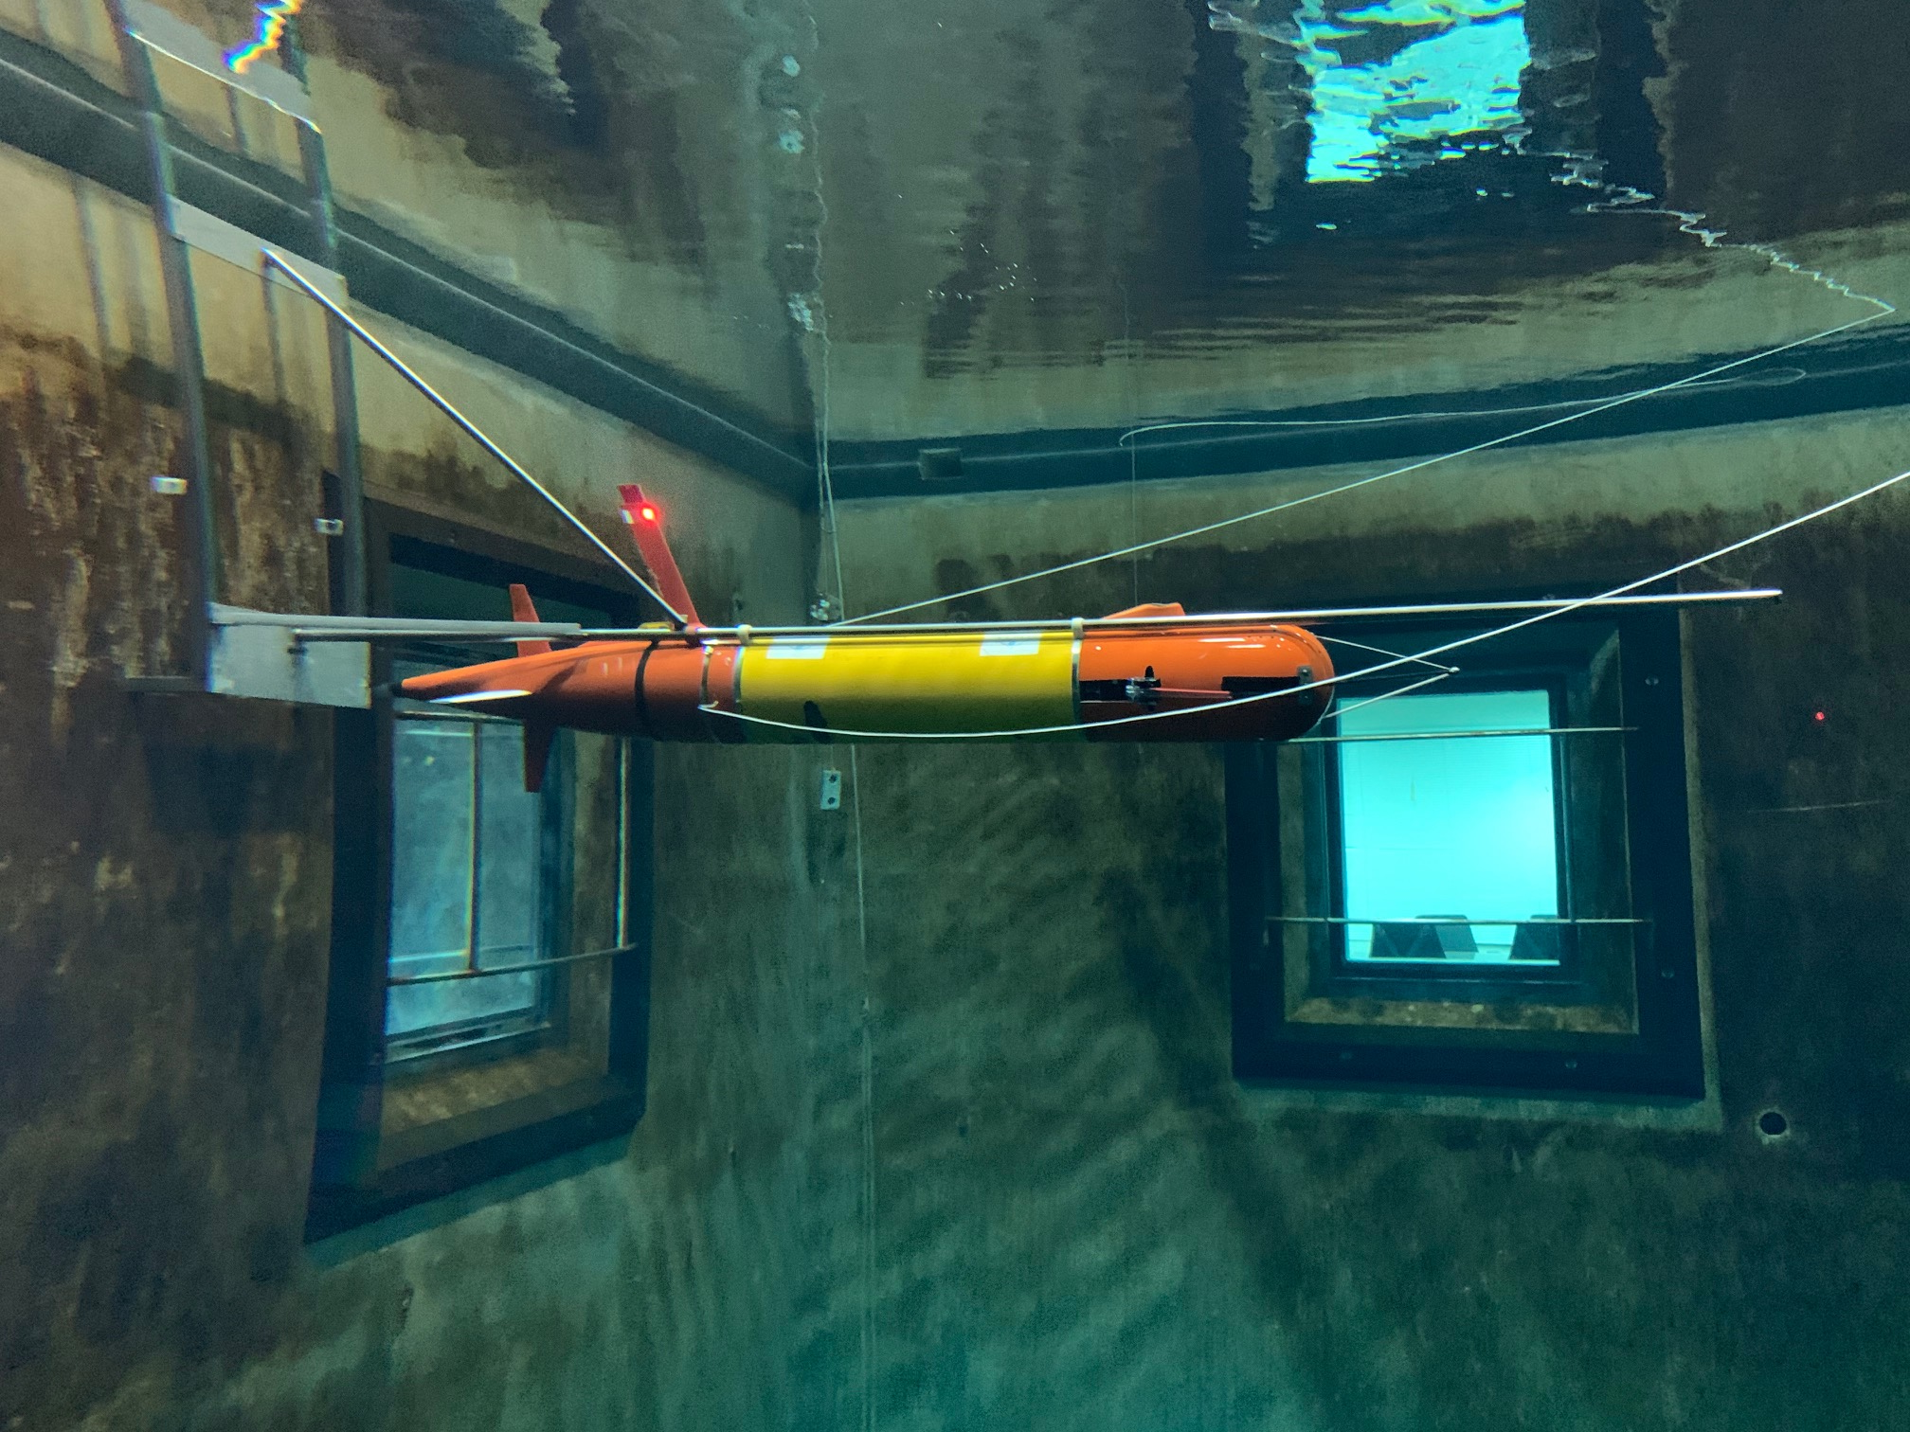
Docking test in MBARI test tank
We tested the dock capture device on the AUV, in the test tank.

Slide 18
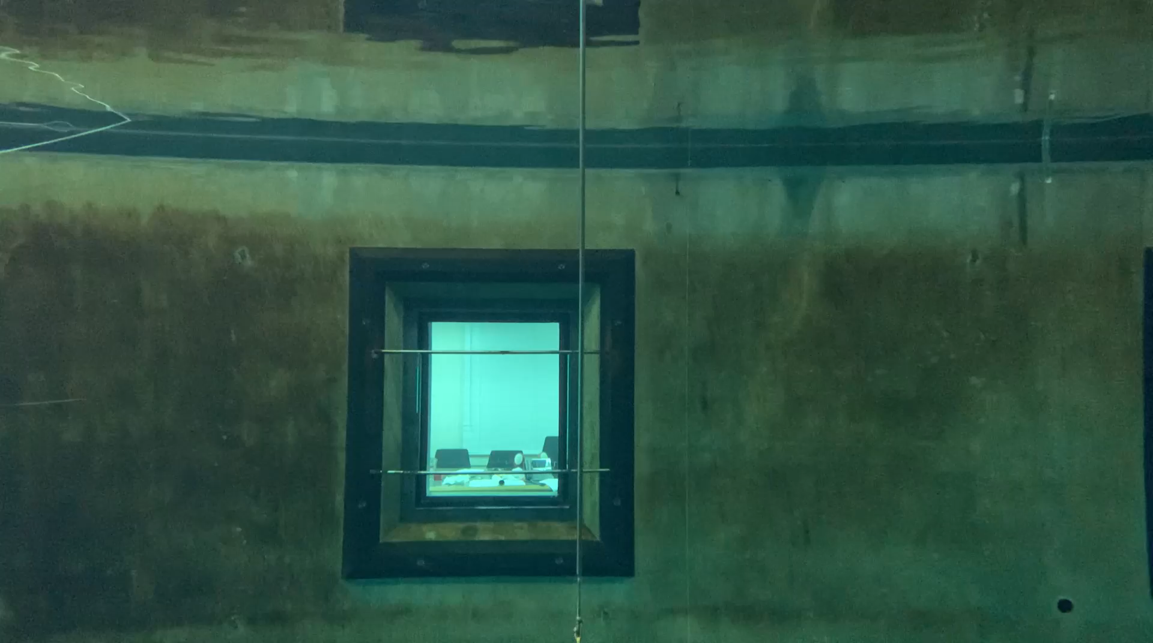

Slide 19
Questions for Jim and Harvey
How to reduce arcing
Are there grades of nb that may have better wear resistance
Suppliers
How to make and seal nb to copper contact
Etc…

