Slide 1
Northrop Grumman License Agreement
Royalty free license. Signed May 15th, 2021
New technology developed is jointly owned IP
Existing MBARI IP remains owned by MBARI (and vice versa)
Patent procurement is Northrop Grumman's responsibility
Future commercial license revenue is split
MBARI has a right to use all Joint IP for our own use

Slide 2
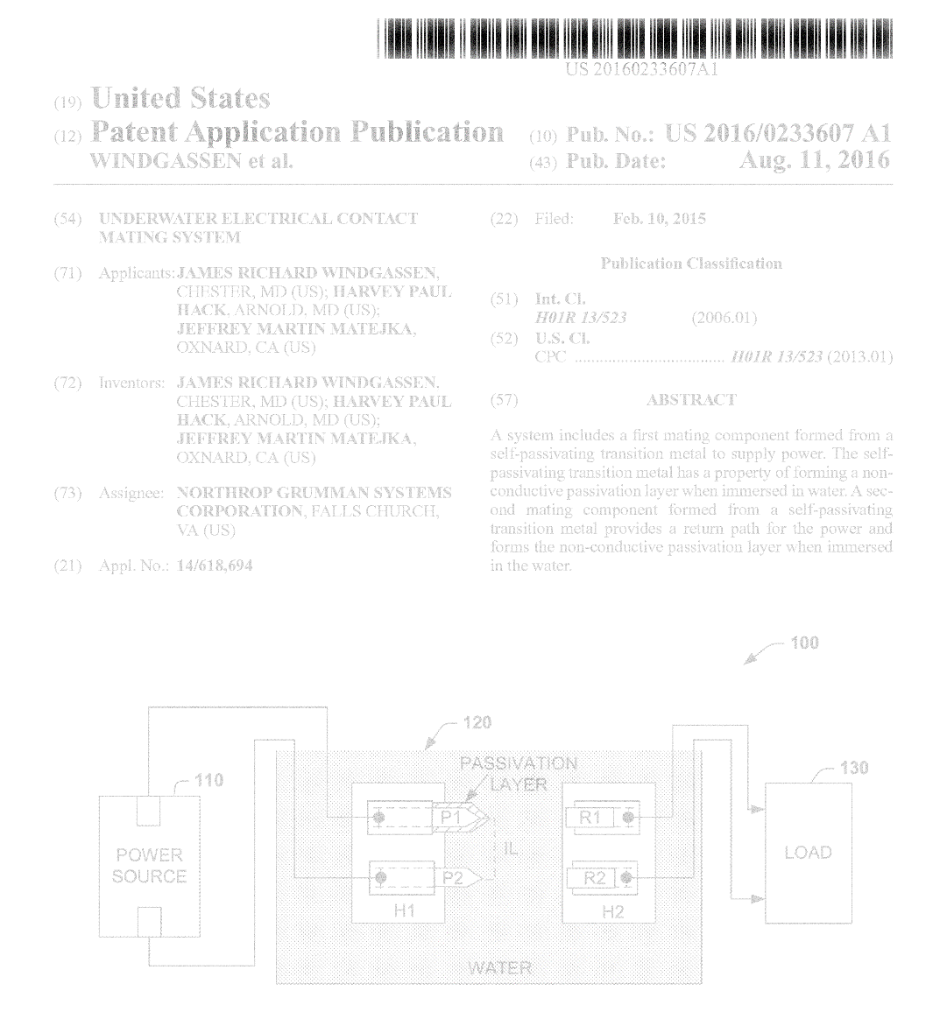
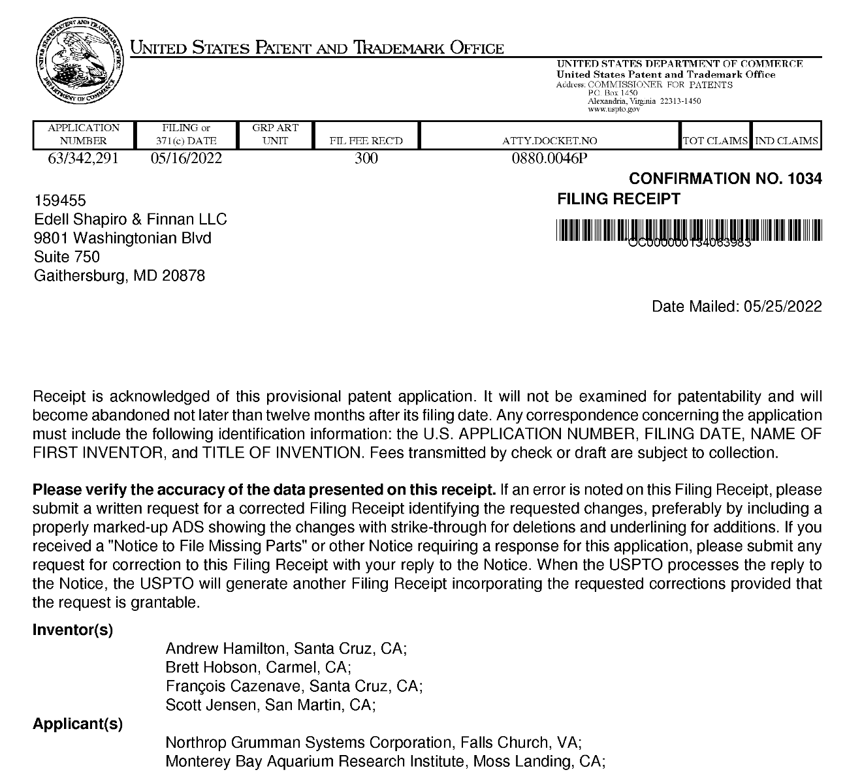
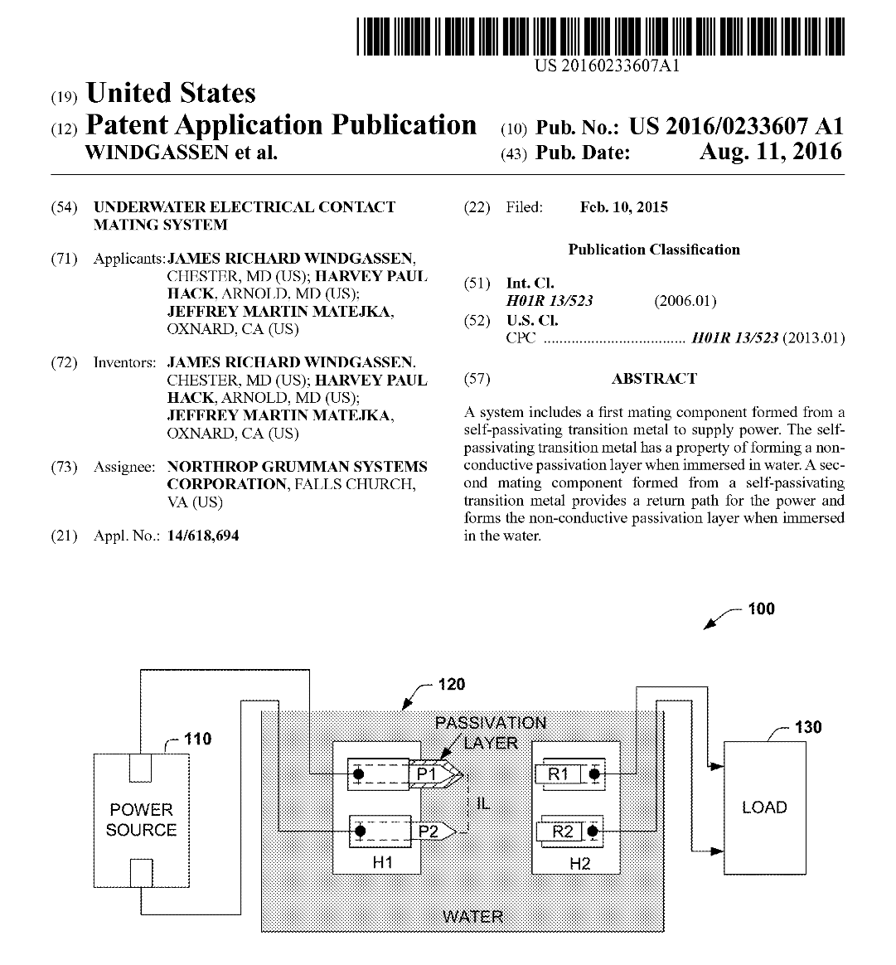

Slide 3
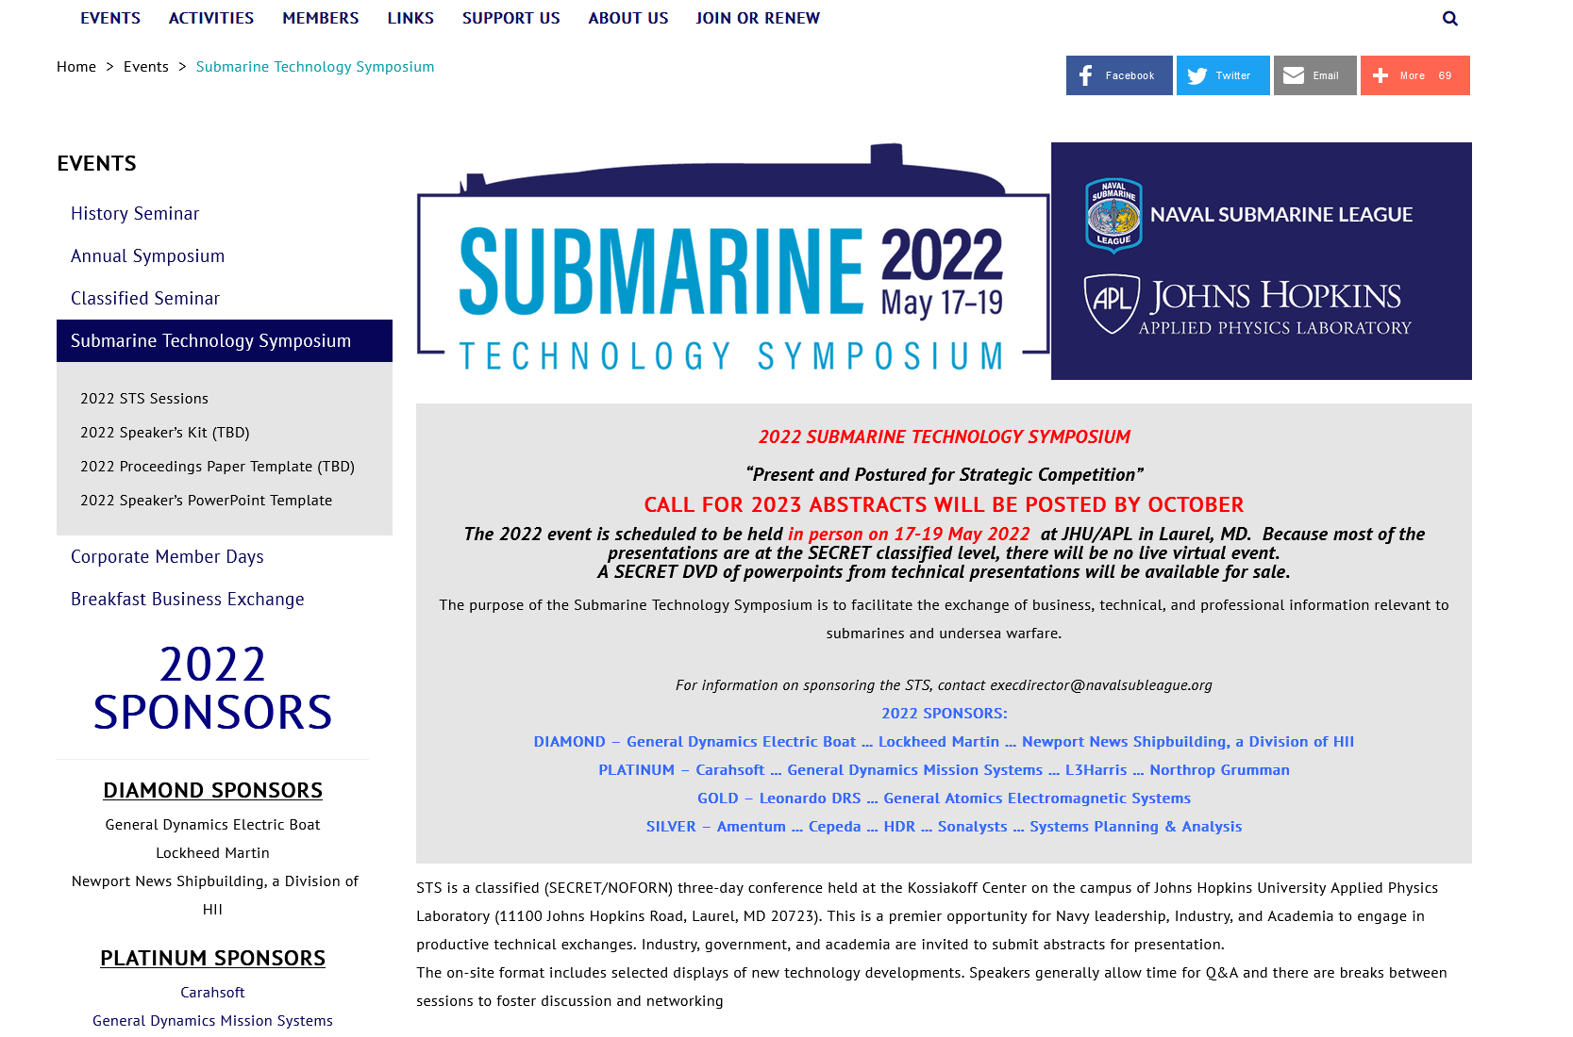

Slide 4
Organization | Name | Title
Naval Research Warfare Center (NUWC Newport) | CDR Jason Patton | CDR
VTG Defense | Jim Shannon (RADM USN, Retired) | Executive Vice President Gov't Relations
Leidos | Steve Boraz | Business Development Director - Maritime
Teledyne Energy Systems | Gard Clark | Senior Vice President Energy and Environment
Teledyne Technologies | Thomas Altshuler | Senior Vice President, Global Maritime Defense Strategy and Business Development
Landing Craft Support Museum | Christopher Lehman | Chairman
RCT Systems | Stephen M. Cobb | President
Massa Products Corporation | Dawn Massa Stancavish | President/CEO & Chief Innovation Officer
Artimus Robotics | Timothy G Morrissey | Chief Executive Officer
SAAB Autonomous & Undersea Systems | Daniel Lawrence | Director, Marine Operations and Training
General Dynamics Electric Boat | Chris Tate
General Dynamics Electric Boat | Keith Sacco | Principal Engineer
Proteq | Robert Grieve | President & CEO (former WHOI rep)
Advanced Technology International | Chance Xavier Roman | Sr Project Manager
L3 Harris | Michael Rose | Principal Mission Solution Architect
L3 Harris | Noland Smith | Principal Business Development Manager
L3 Harris | Matt Gusto | Business Development Director - Maritime

