Slide 1
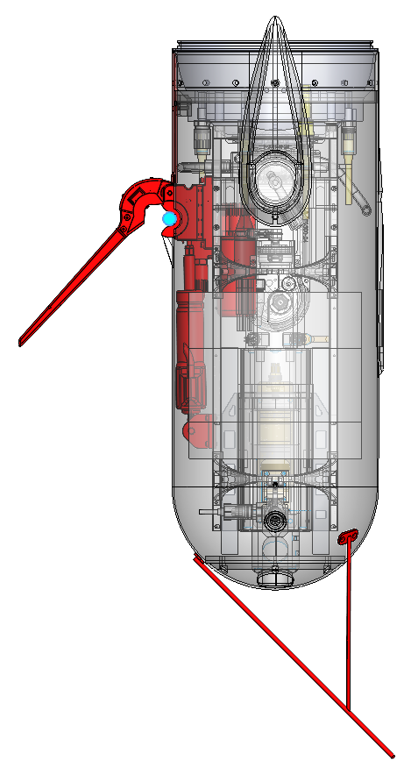
Motor Controller & Charge Rectifier
Arm & Brush Mechanism
Docking Rod
Linear Actuator
Rod Deflector

