Slide 1
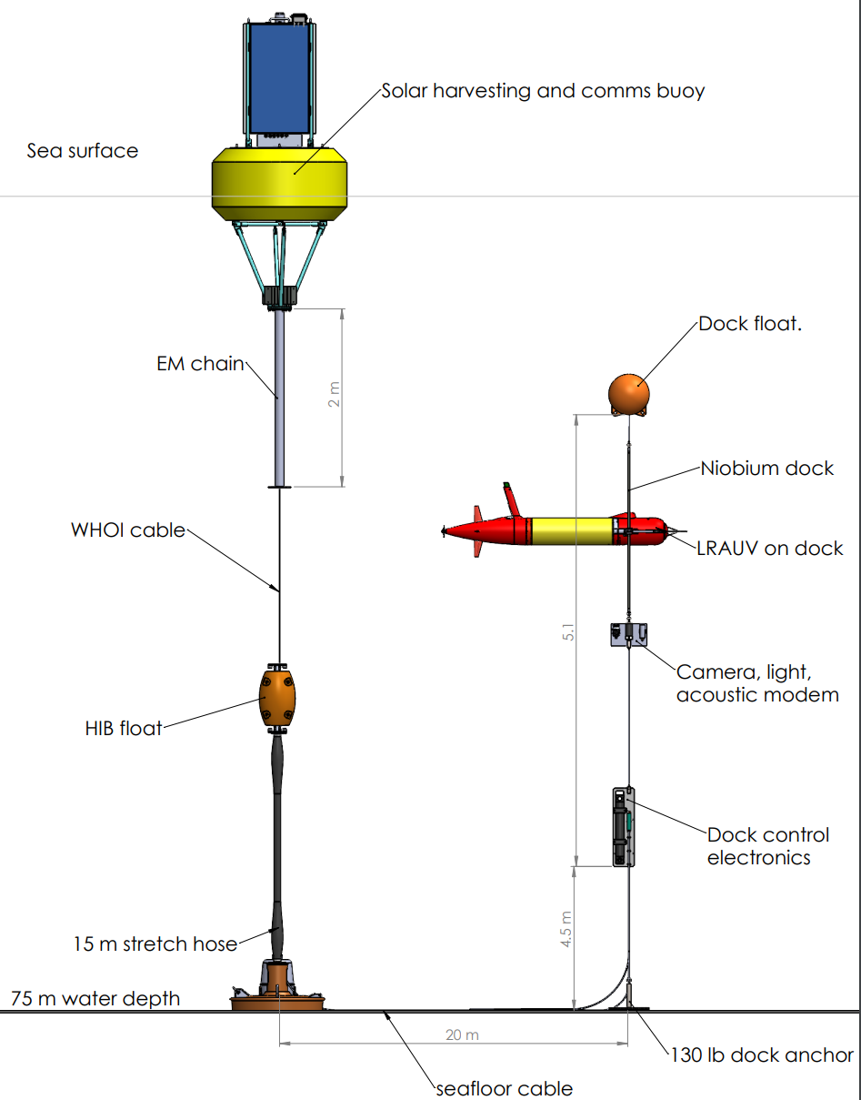
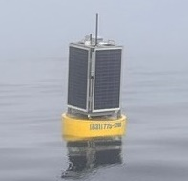
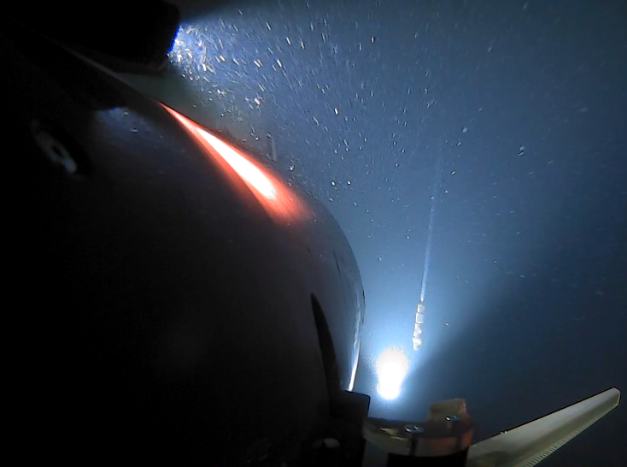
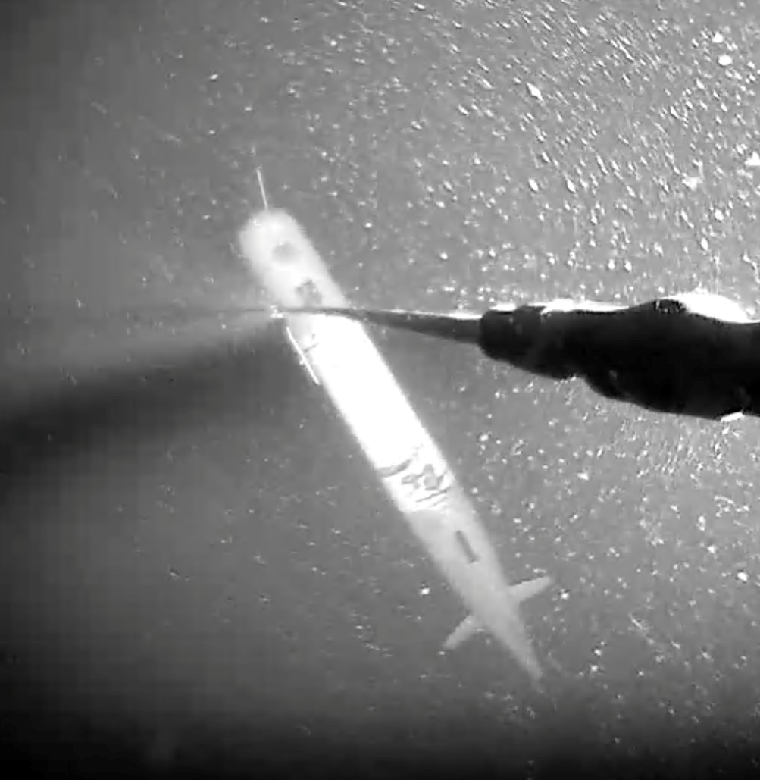
Docking
For Persistent Operations
Omni-directional, compliant vertical line dock
Niobicon sliding contact power transfer: Patent pending with Northrop Grumman; 500 Watts (48v @ 11 amps)
1+ Mbps data transfer, plus acoustic modem backup
Web-based dock control interface with live video
Input power: Solar, wind, wave, cable, battery
Solar for 1 LRAUV
Homing to Dock
AUV Parked on Dock

Slide 2
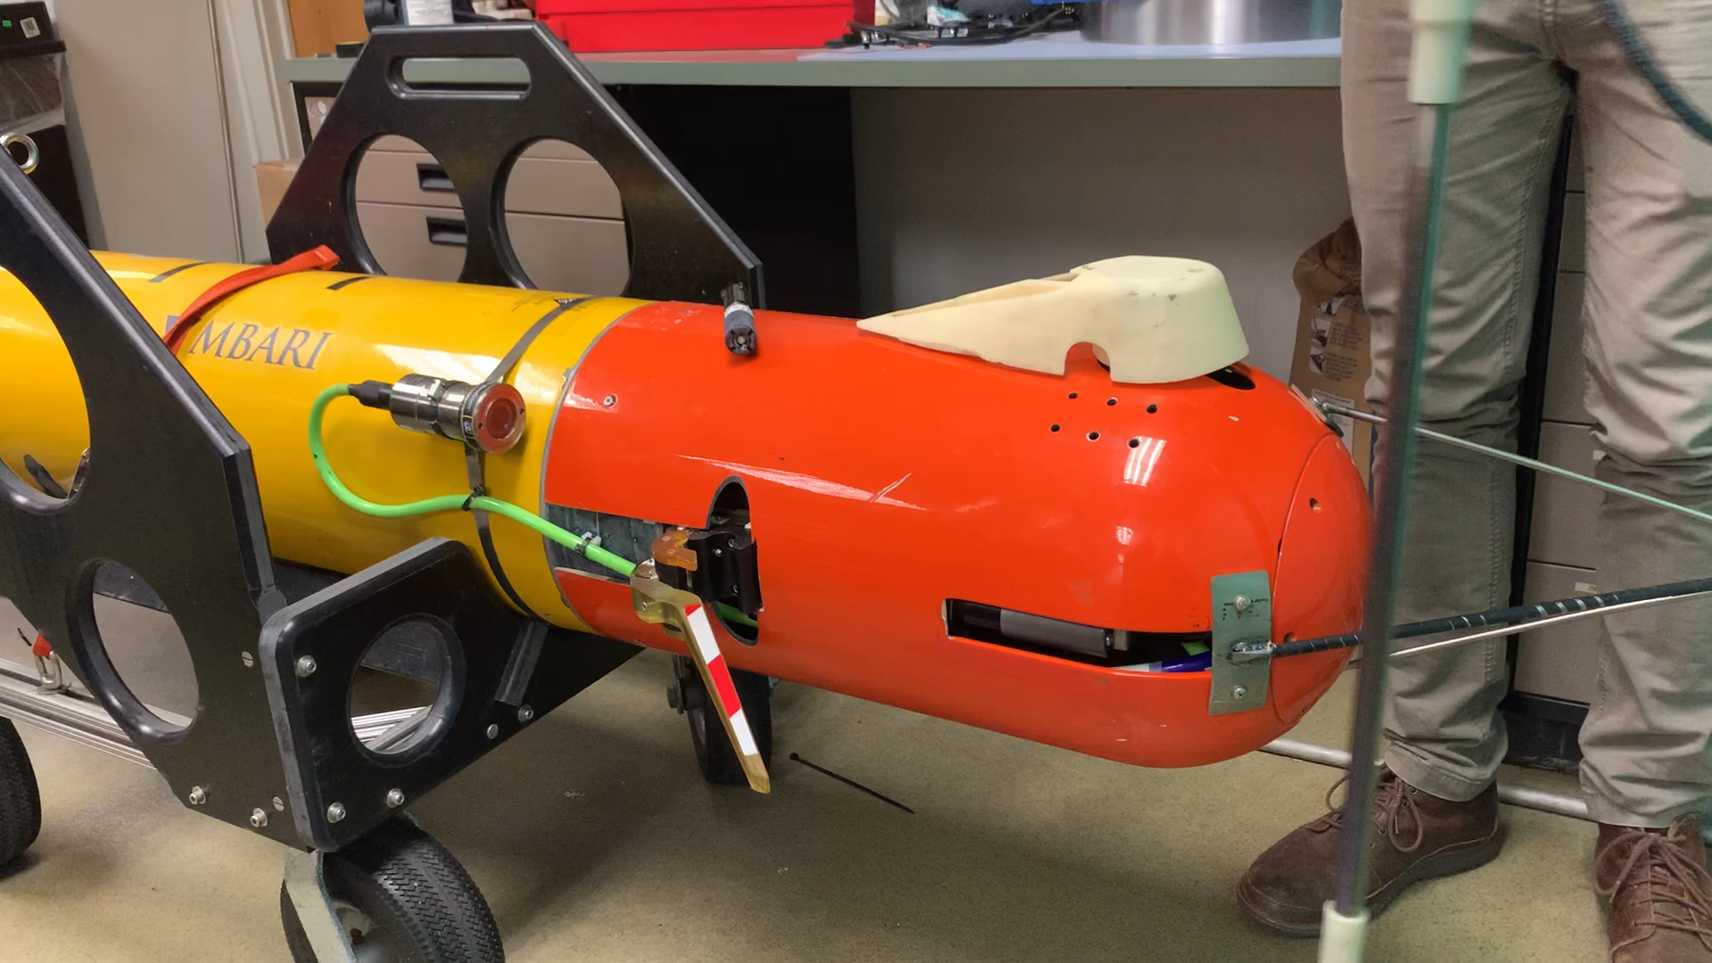
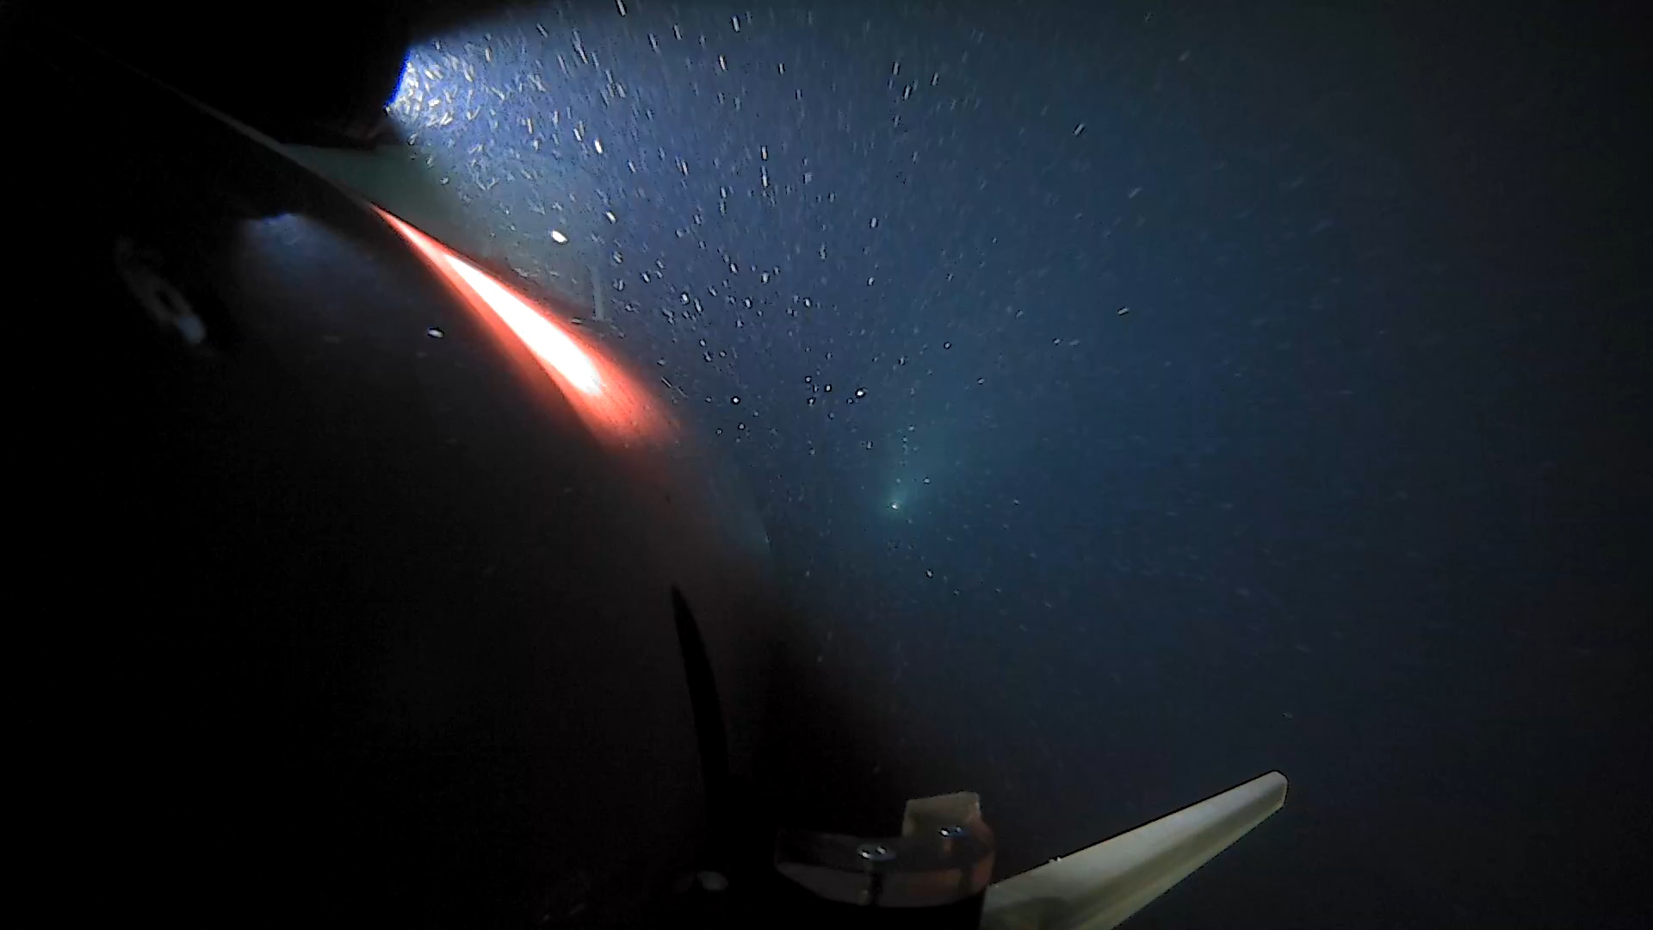
LRAUV Docking Video
Video showing side mount capture arm
Video showing docking rod capture
Position of camera (optional)
Dock deflector
Power transfer components
Capture arm

