Slide 1
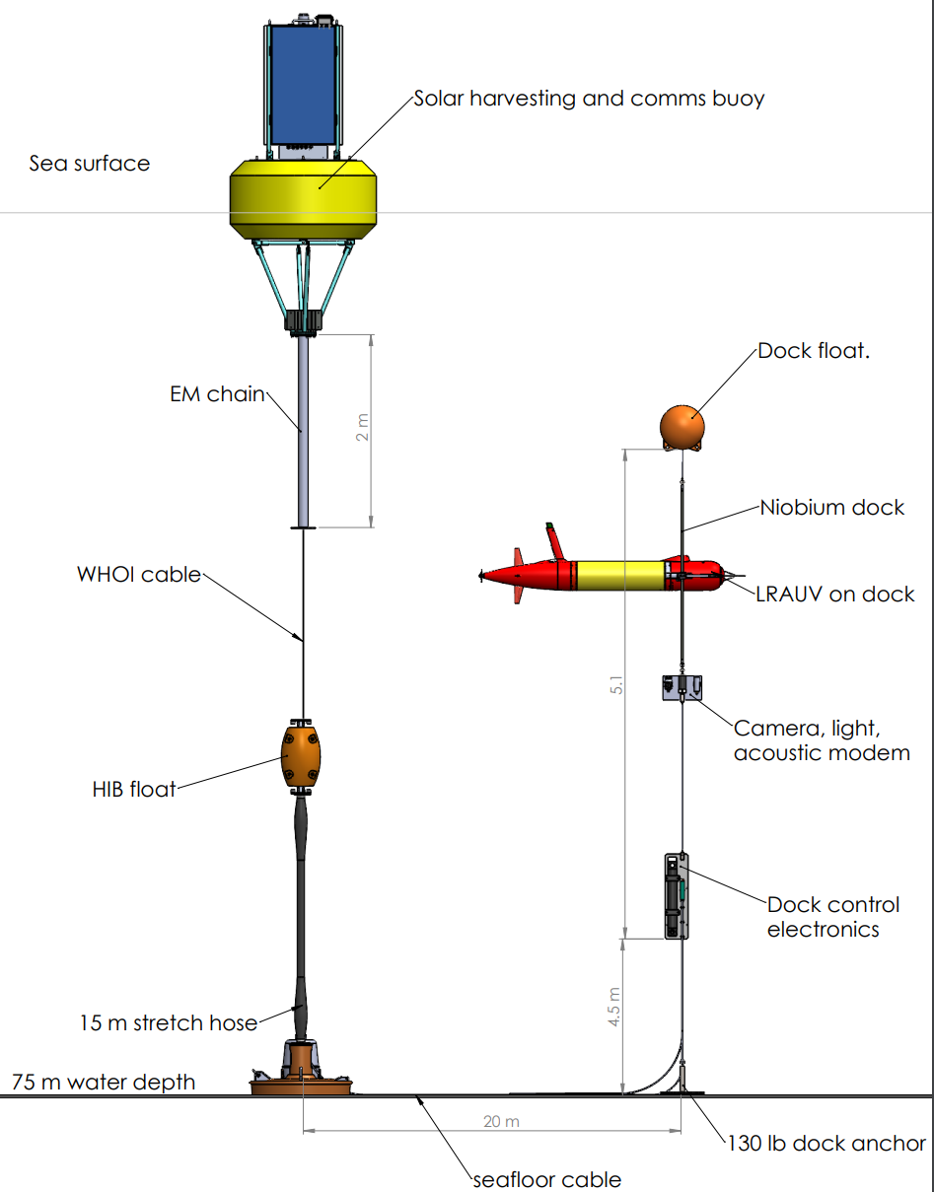
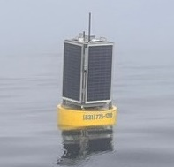
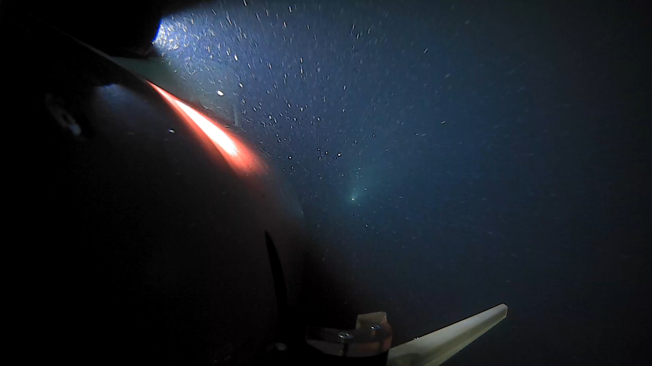
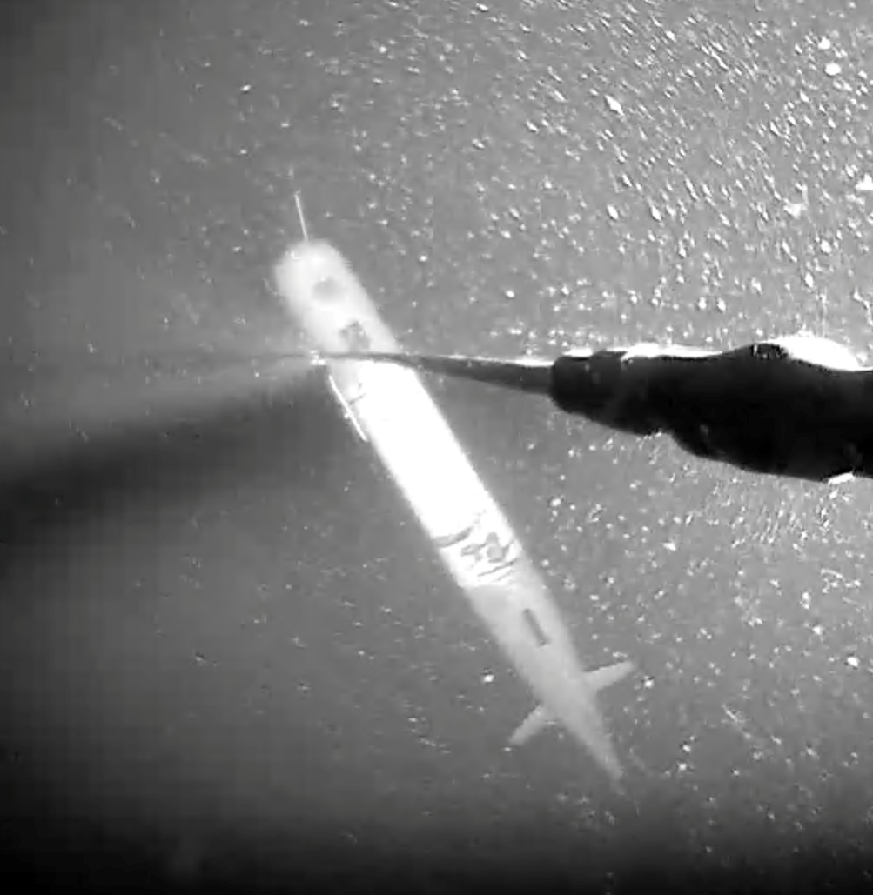
AUV Docking
Persistent Operations
Proven design with thousands of offshore docks
All acoustic homing for operation in low visibility ocean water
Omni-Directional design works with ocean currents – AUV swims into current
Niobicon sliding contact power transfer: 500 Watts
Collaboration and patented with Northrop Grumman
1+ Mbps data transfer, plus acoustic modem backup
Web-based dock control interface with live video, lights, DAQ,
Optional surface expression for solar/wave energy harvesting and RF comms
Or use stand-alone seafloor battery/fuel cell, or seafloor cable
Surface buoy with Solar Energy Harvesting
Video – Homing to dock
AUV Parked on Dock

Slide 2
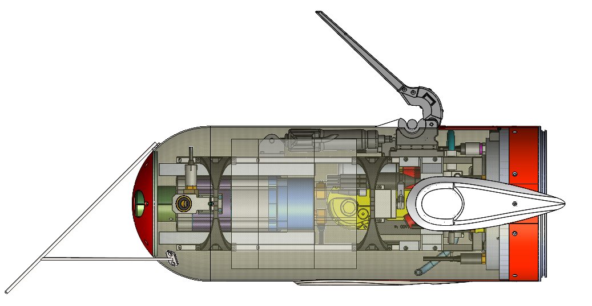
AUV Docking
Components
Capture Arm (open)
Linear Actuator
Power Transfer Brushes (3)
Dock Detector Sensor
(Not shown)
Payload Protector
Deflector
Power Transfer/comms Electronics Can

Slide 3
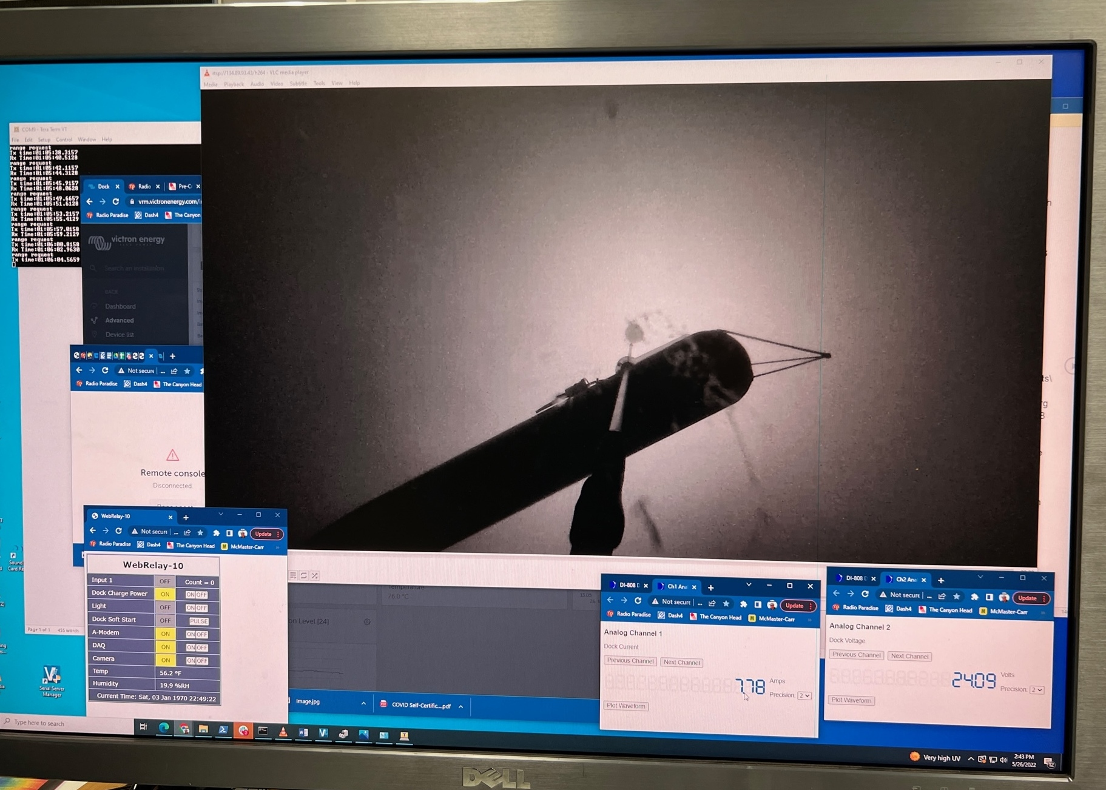
AUV Docking
Dock - Subsea Interface
Live Video, with Light
Acoustic Modem
Console
Power Transfer
Voltage and Current
Dock Relay Control

Slide 4
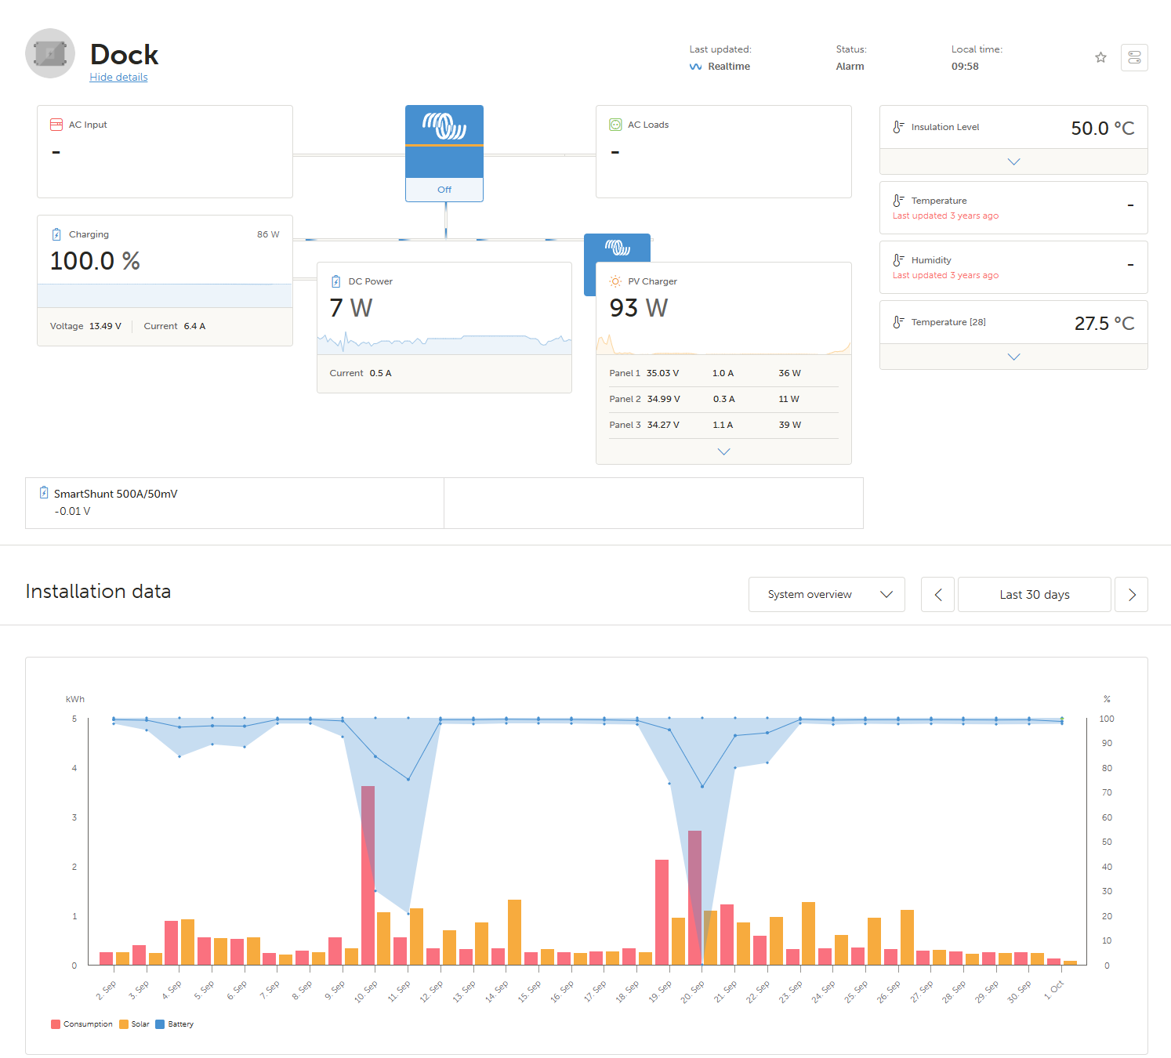
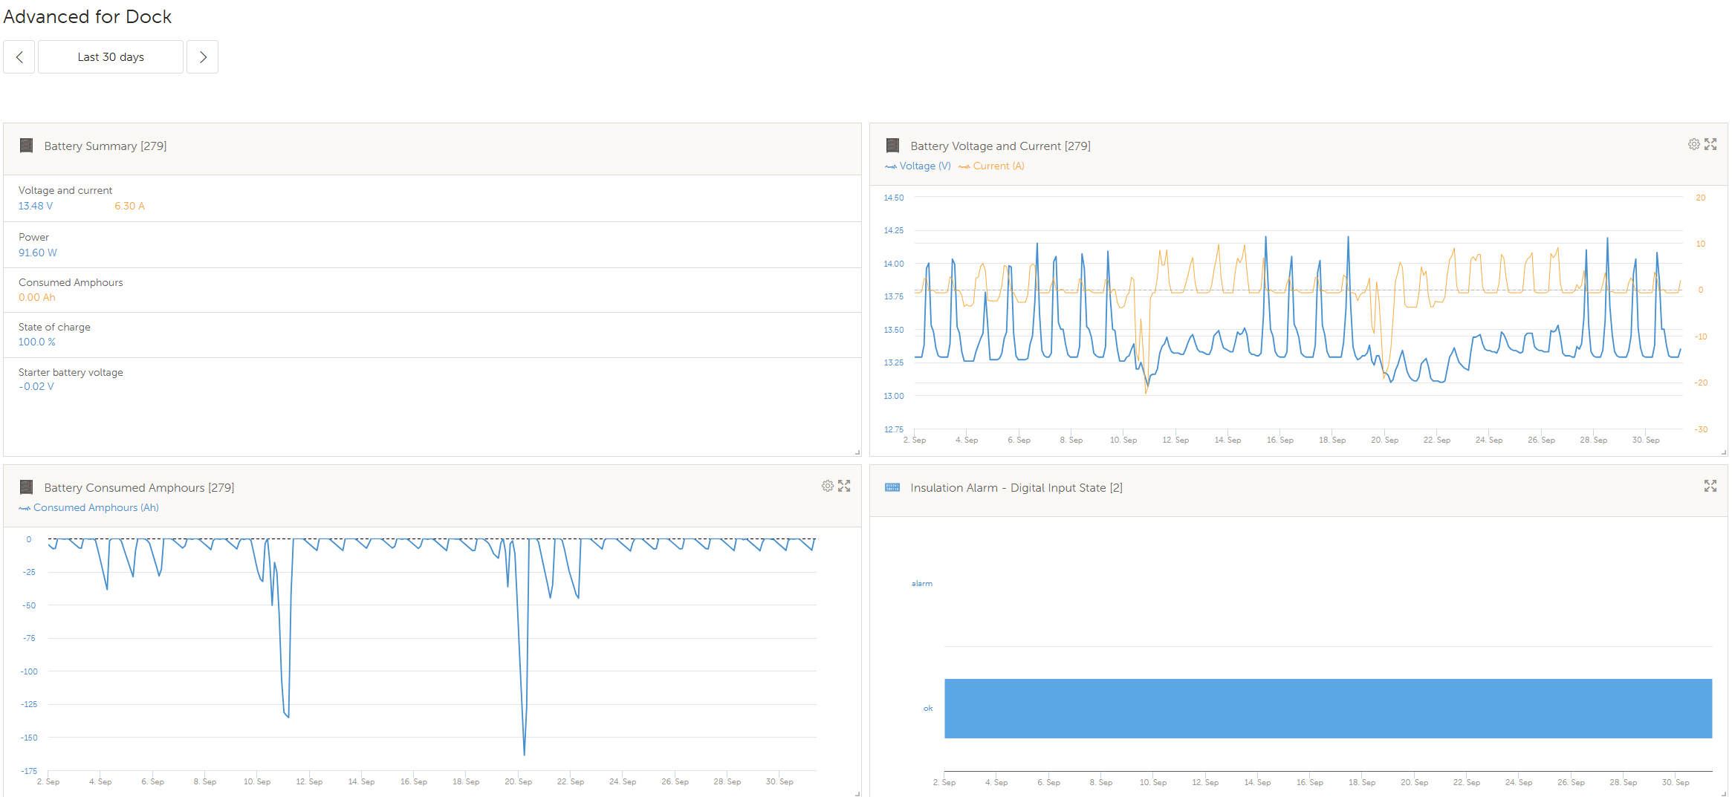
AUV Docking
Dock – Topside by Victron
Dashboard
Dock Energy Storage History
Power Harvesting and Consumption History
Dock Ground Fault Monitor

