Slide 1
AUV Docking and Wave-Energy Conversion for Extended Deployments
Andrew Hamilton

Slide 2
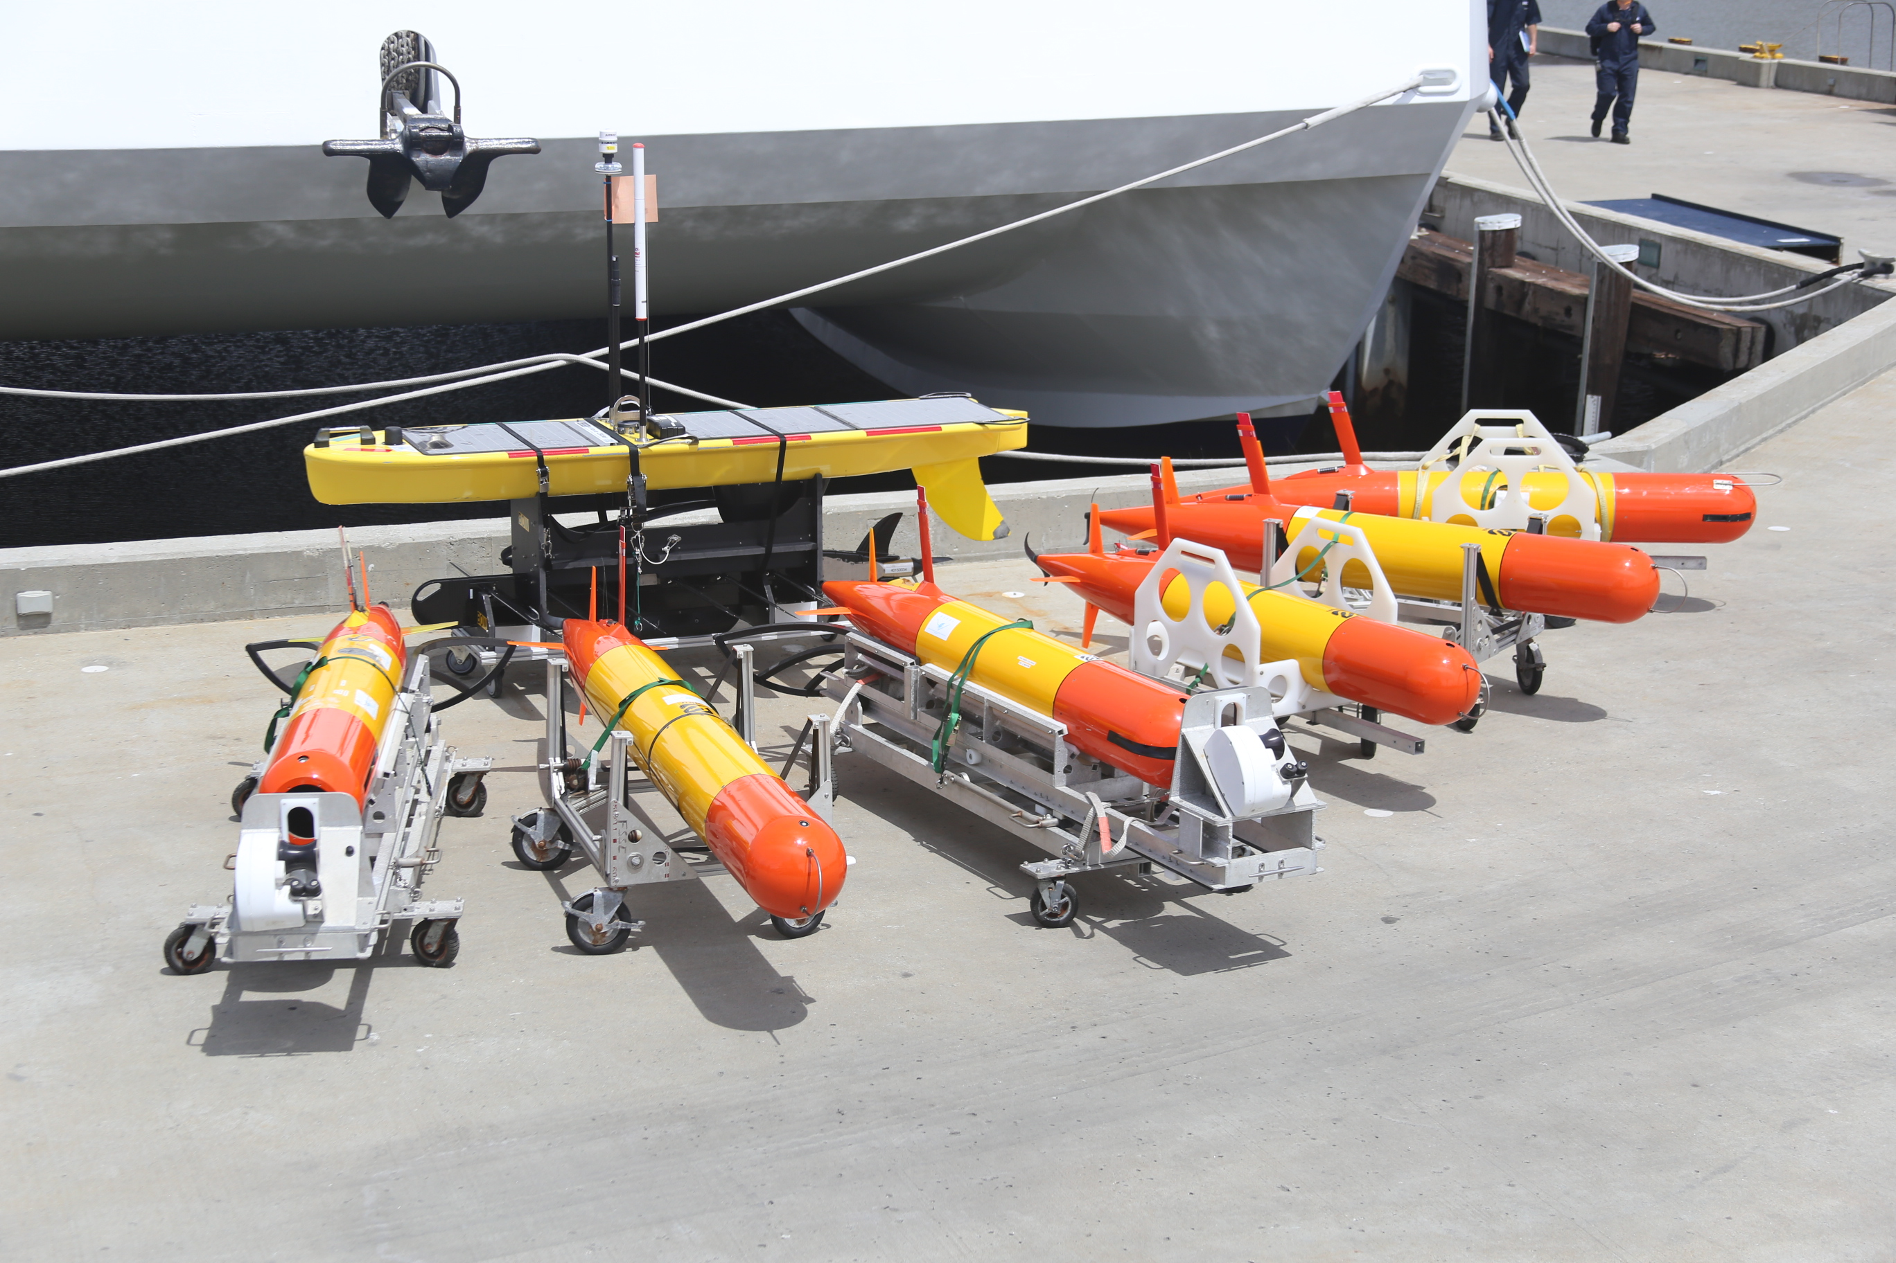
Persistent Presence – Near and Far
Technology needed:
Vehicles (Capability, Reliability)
Autonomy
Instrumentation
Energy
Communications
Docking Capability

Slide 3
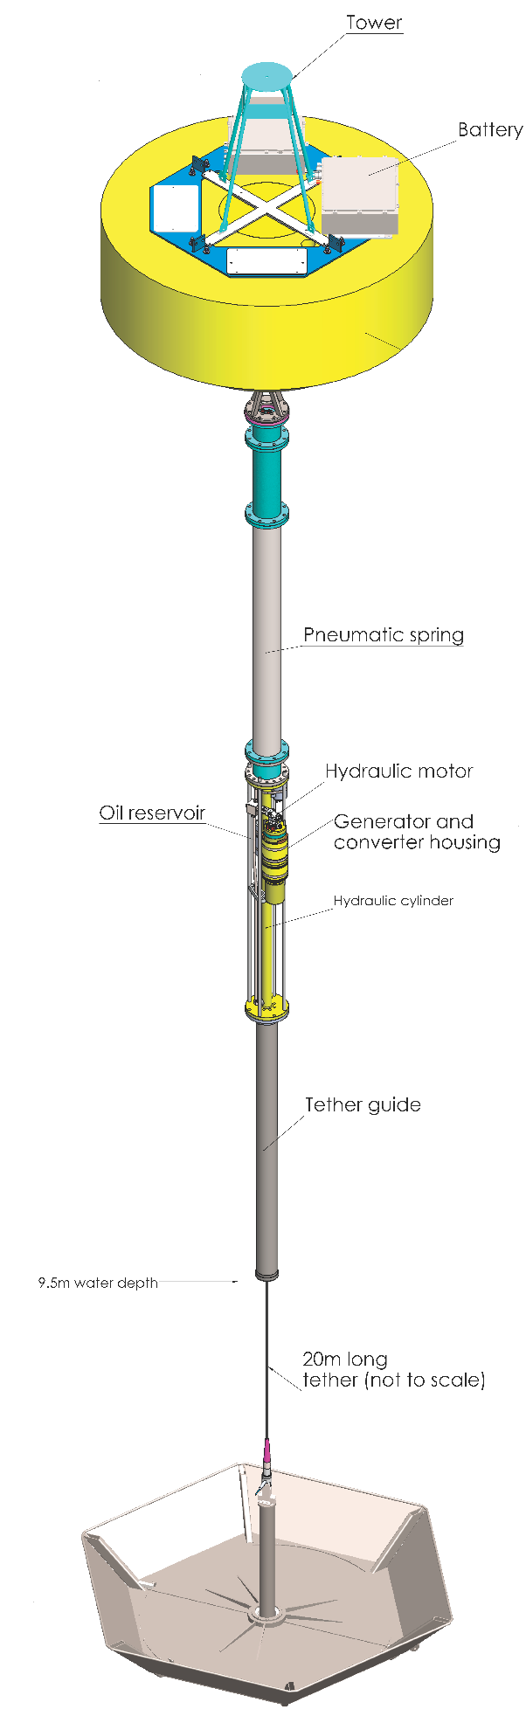

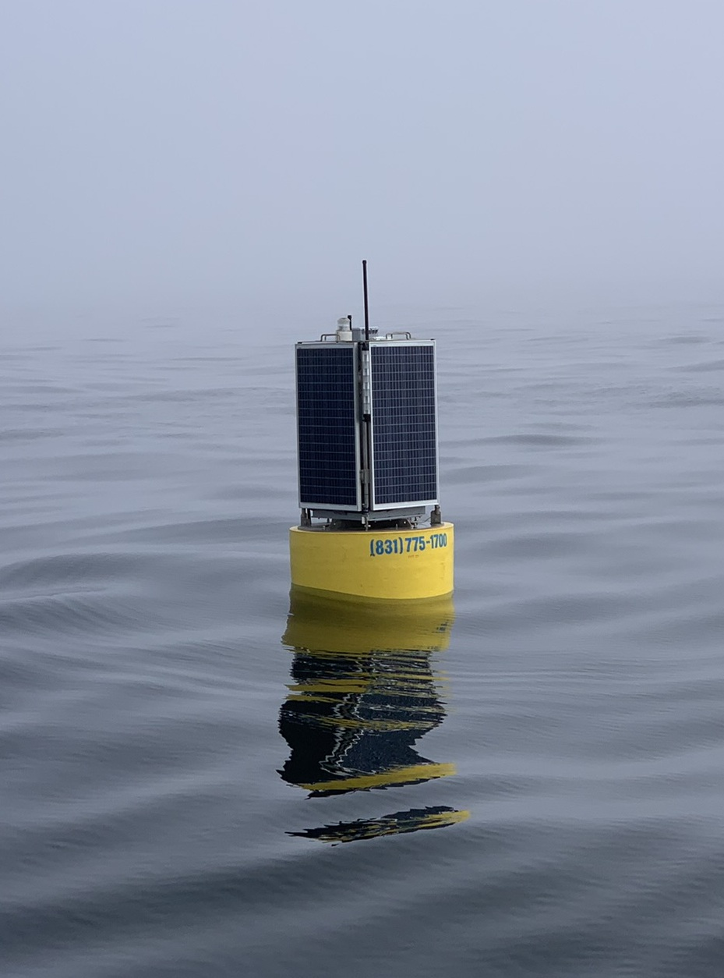
Persistent Presence – Near and Far
Technology needed:
Vehicles (Capability, Reliability)
Autonomy
Instrumentation
Energy
Communications
Docking Capability

Slide 4
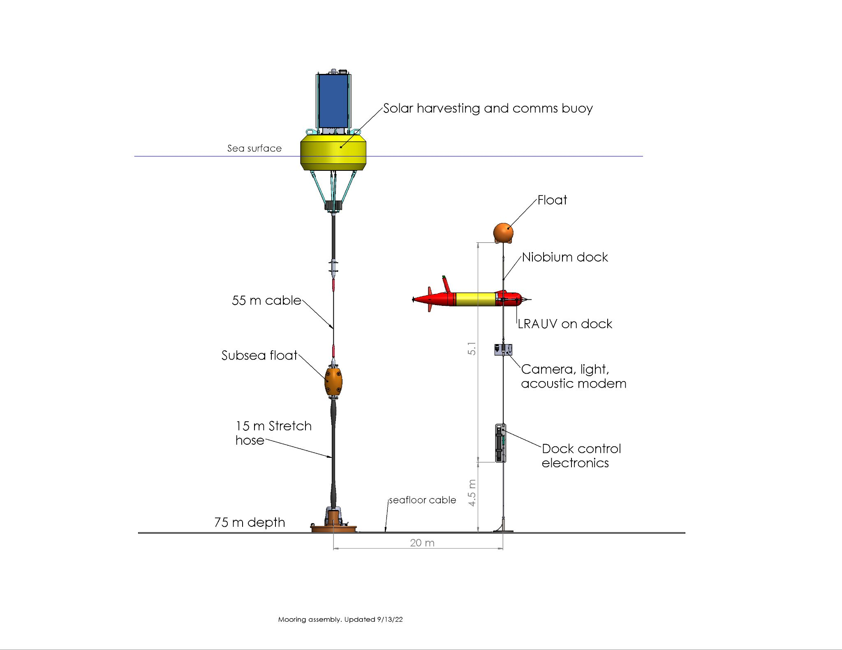
Persistent Presence – Near and Far
Technology needed:
Vehicles (Capability, Reliability)
Autonomy
Instrumentation
Energy
Communications
Docking Capability

Slide 5
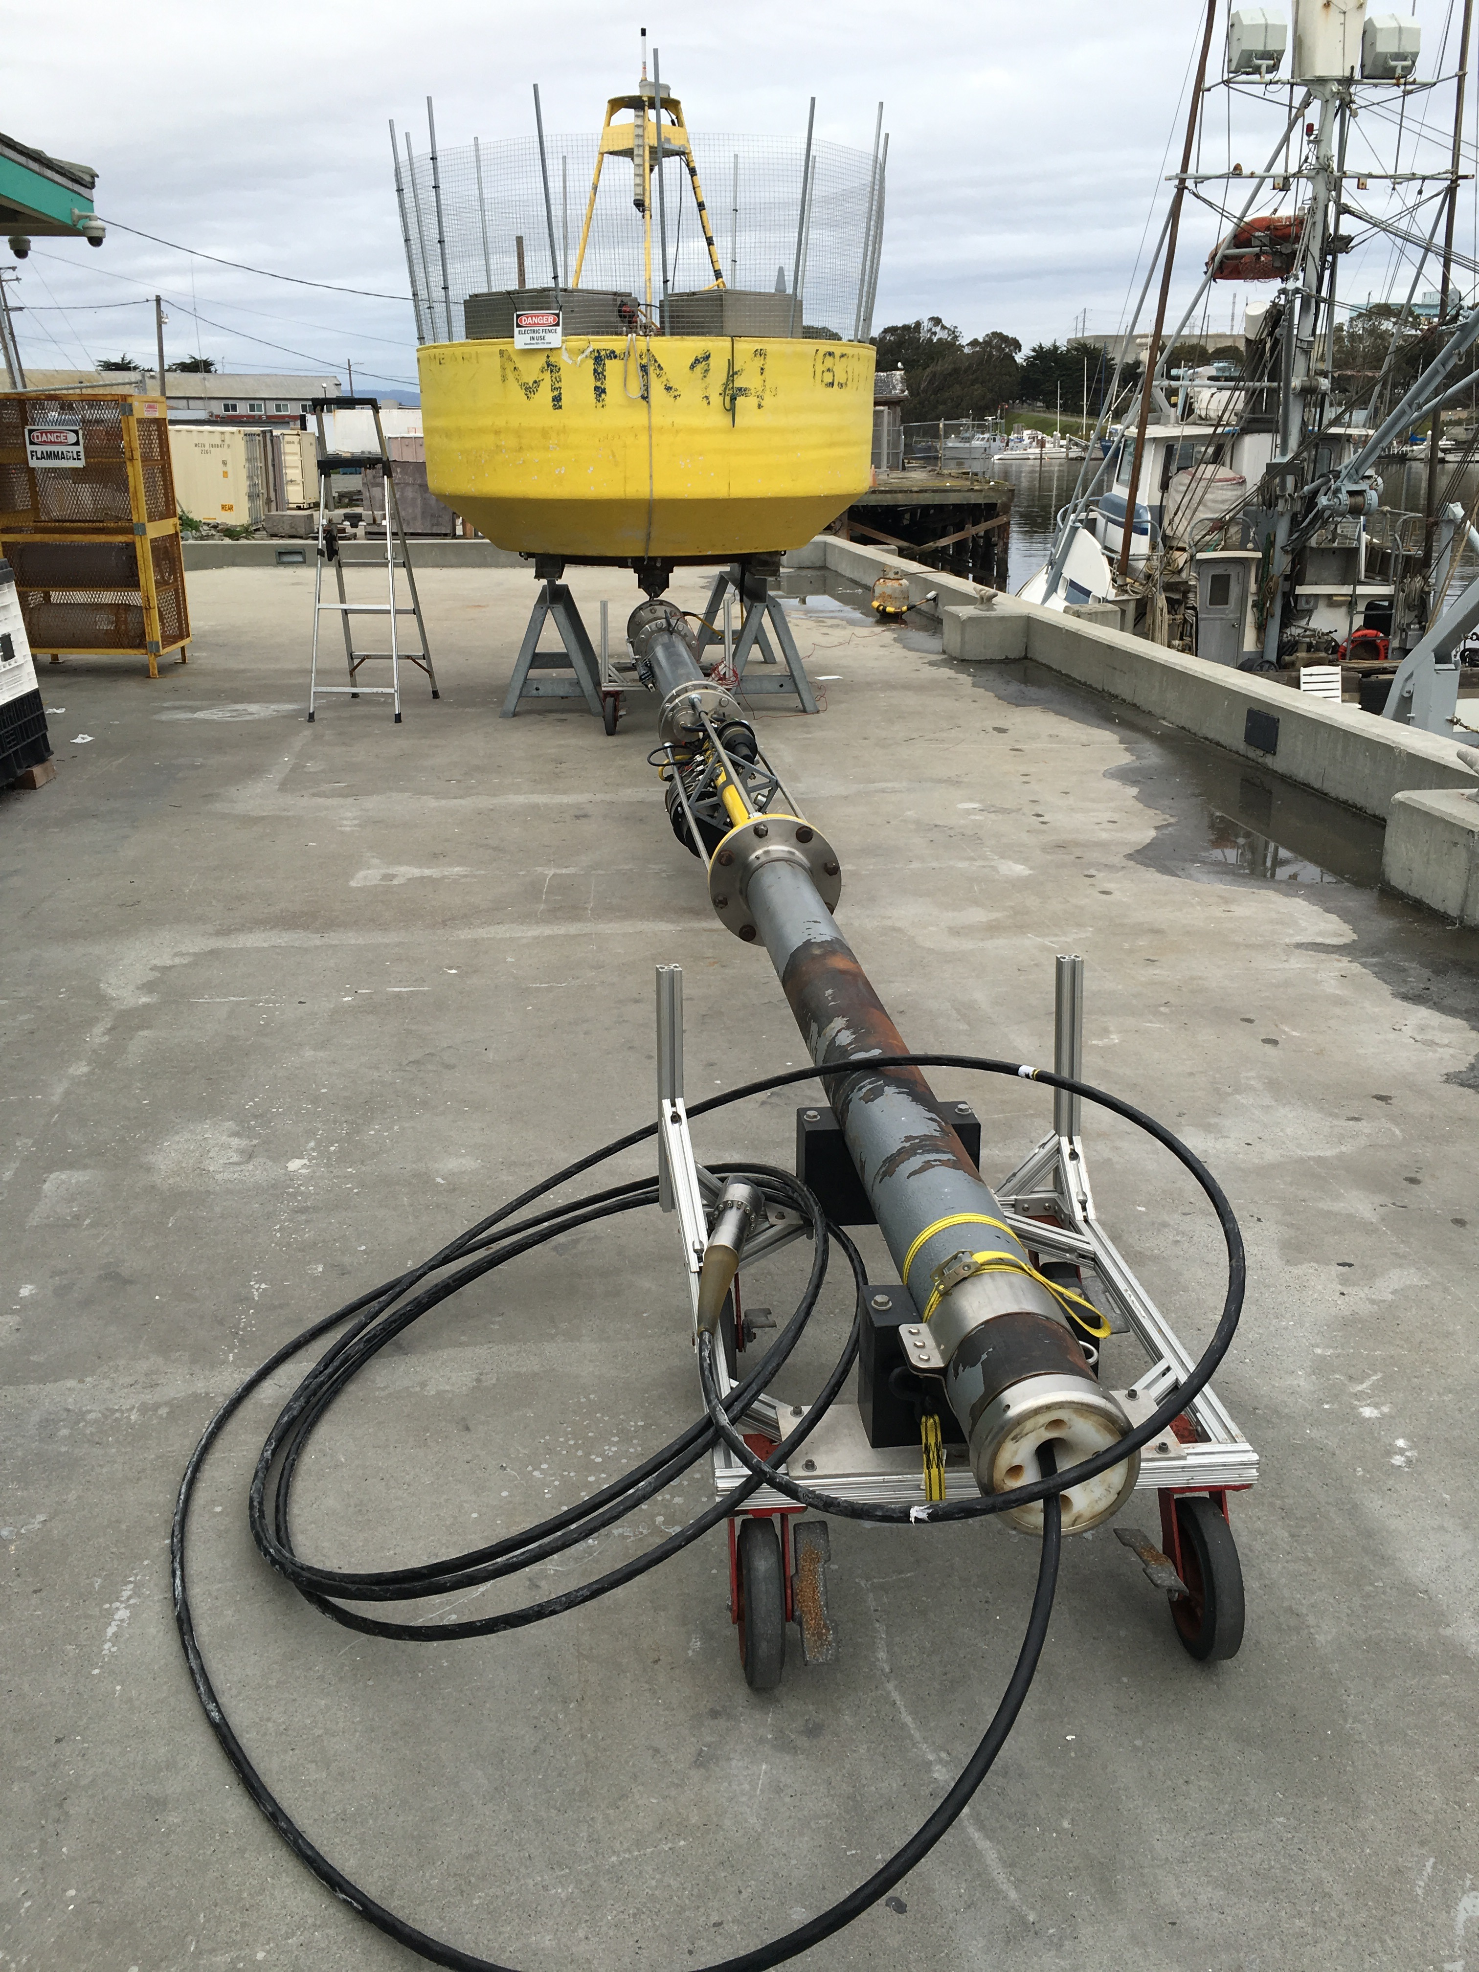
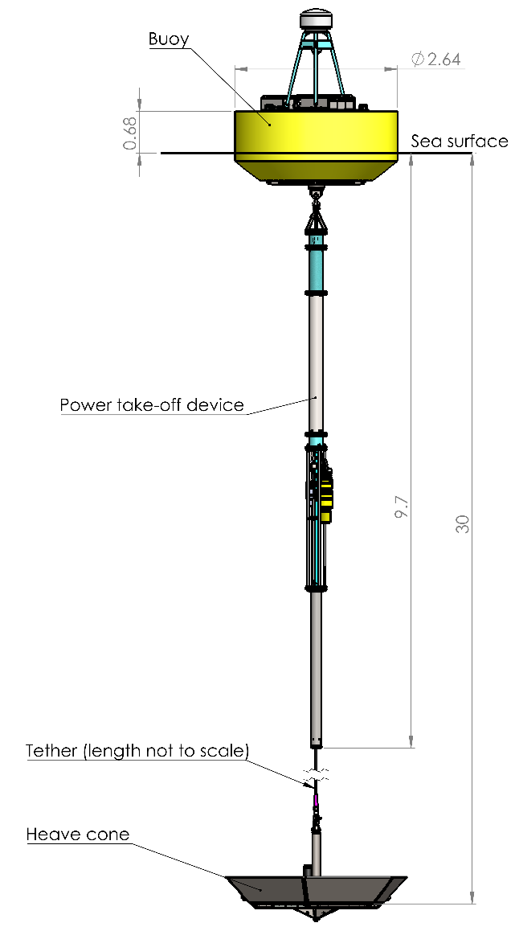
MBARI Wave-Energy Converter

Slide 6
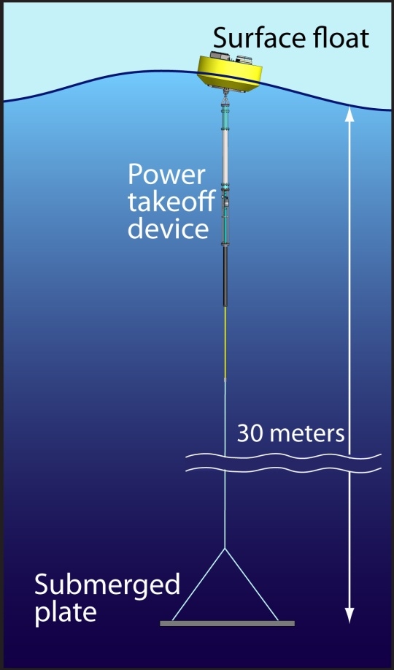
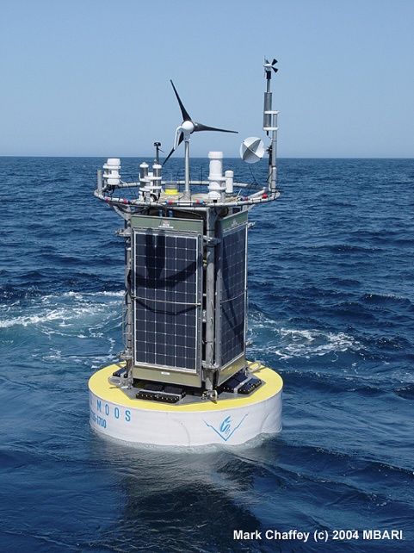
MBARI Mooring with
Wind and Solar Collection:
Weight Avg. Power
5000lbs 50W
Wave Power Buoy Prototype
Weight Avg. Power
5000lbs 200W-300W

Slide 7
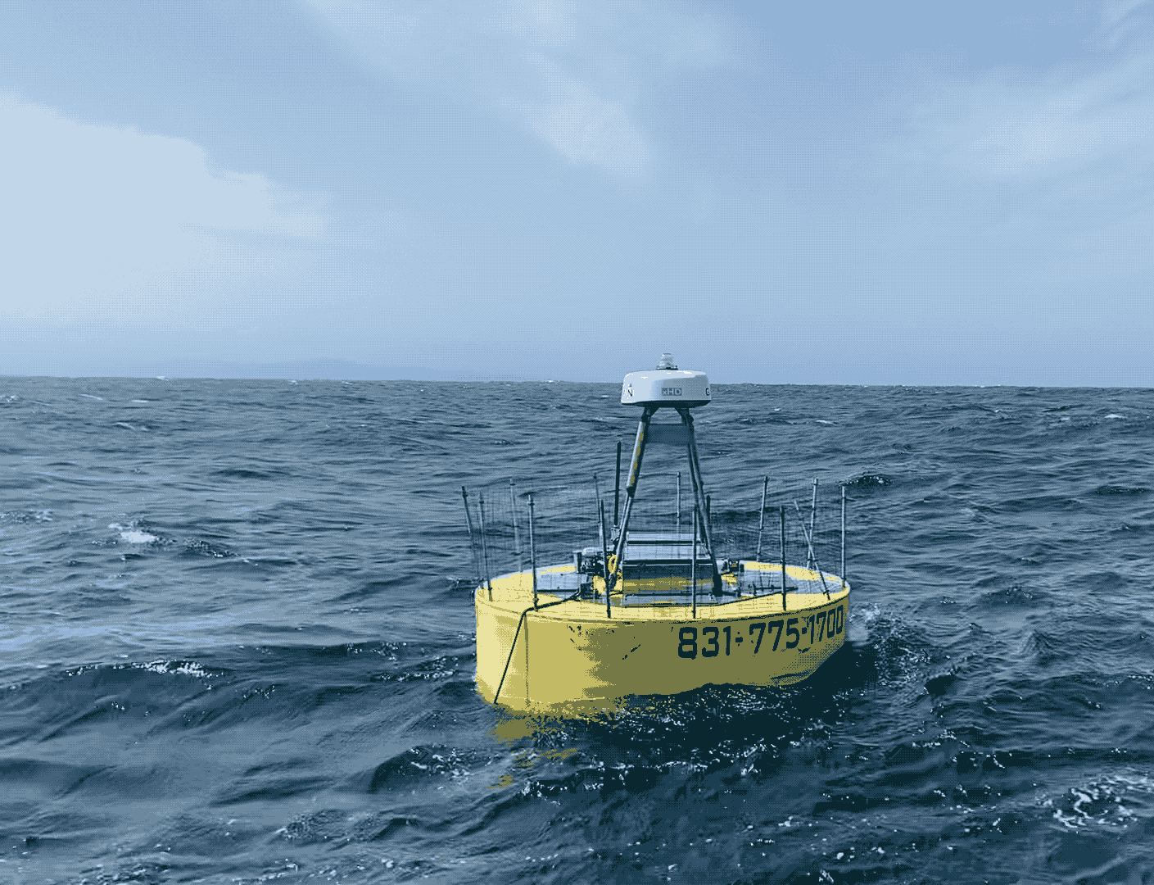
Wave-Energy Conversion Technical Challenges
Reliability and Storm Survivability
  3-5 Million wave cycles per year
  1-2 Million meters of linear travel
  Designed to maximize forces - extreme events

Slide 8
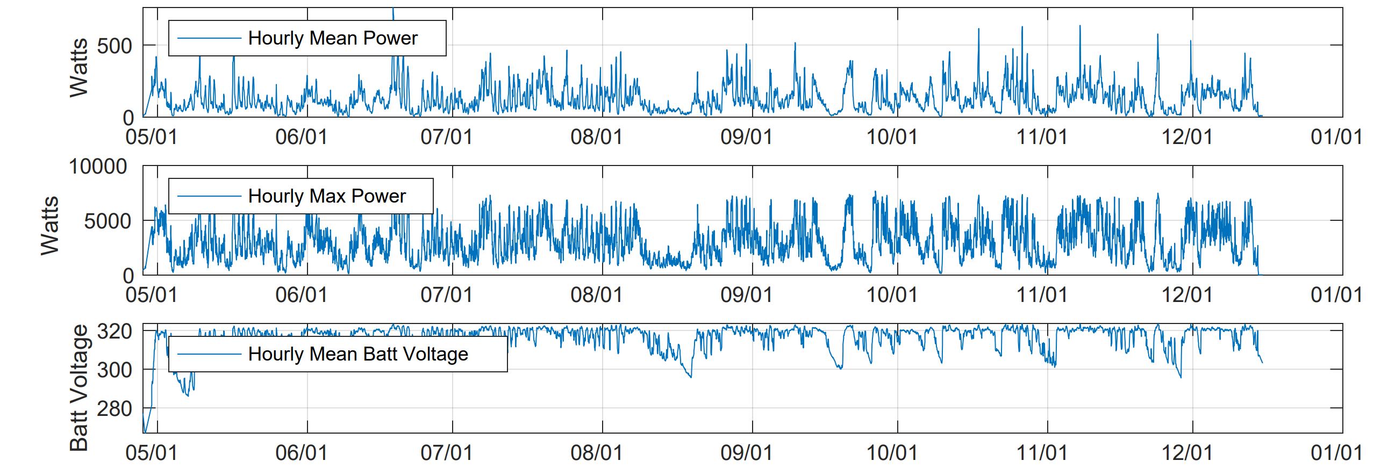
2023 Deployment - 232 Days

Slide 9
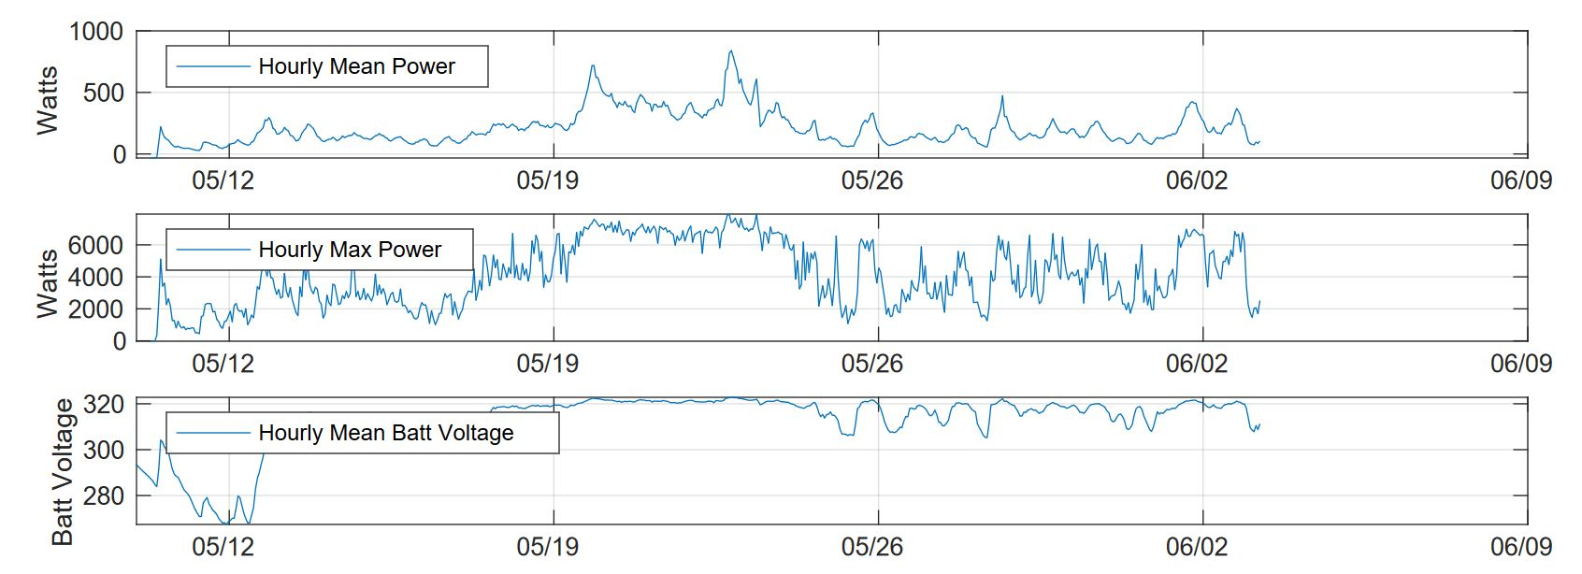
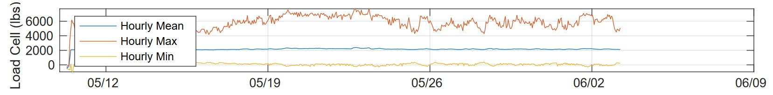
2024 Deployment - Ongoing

Slide 10
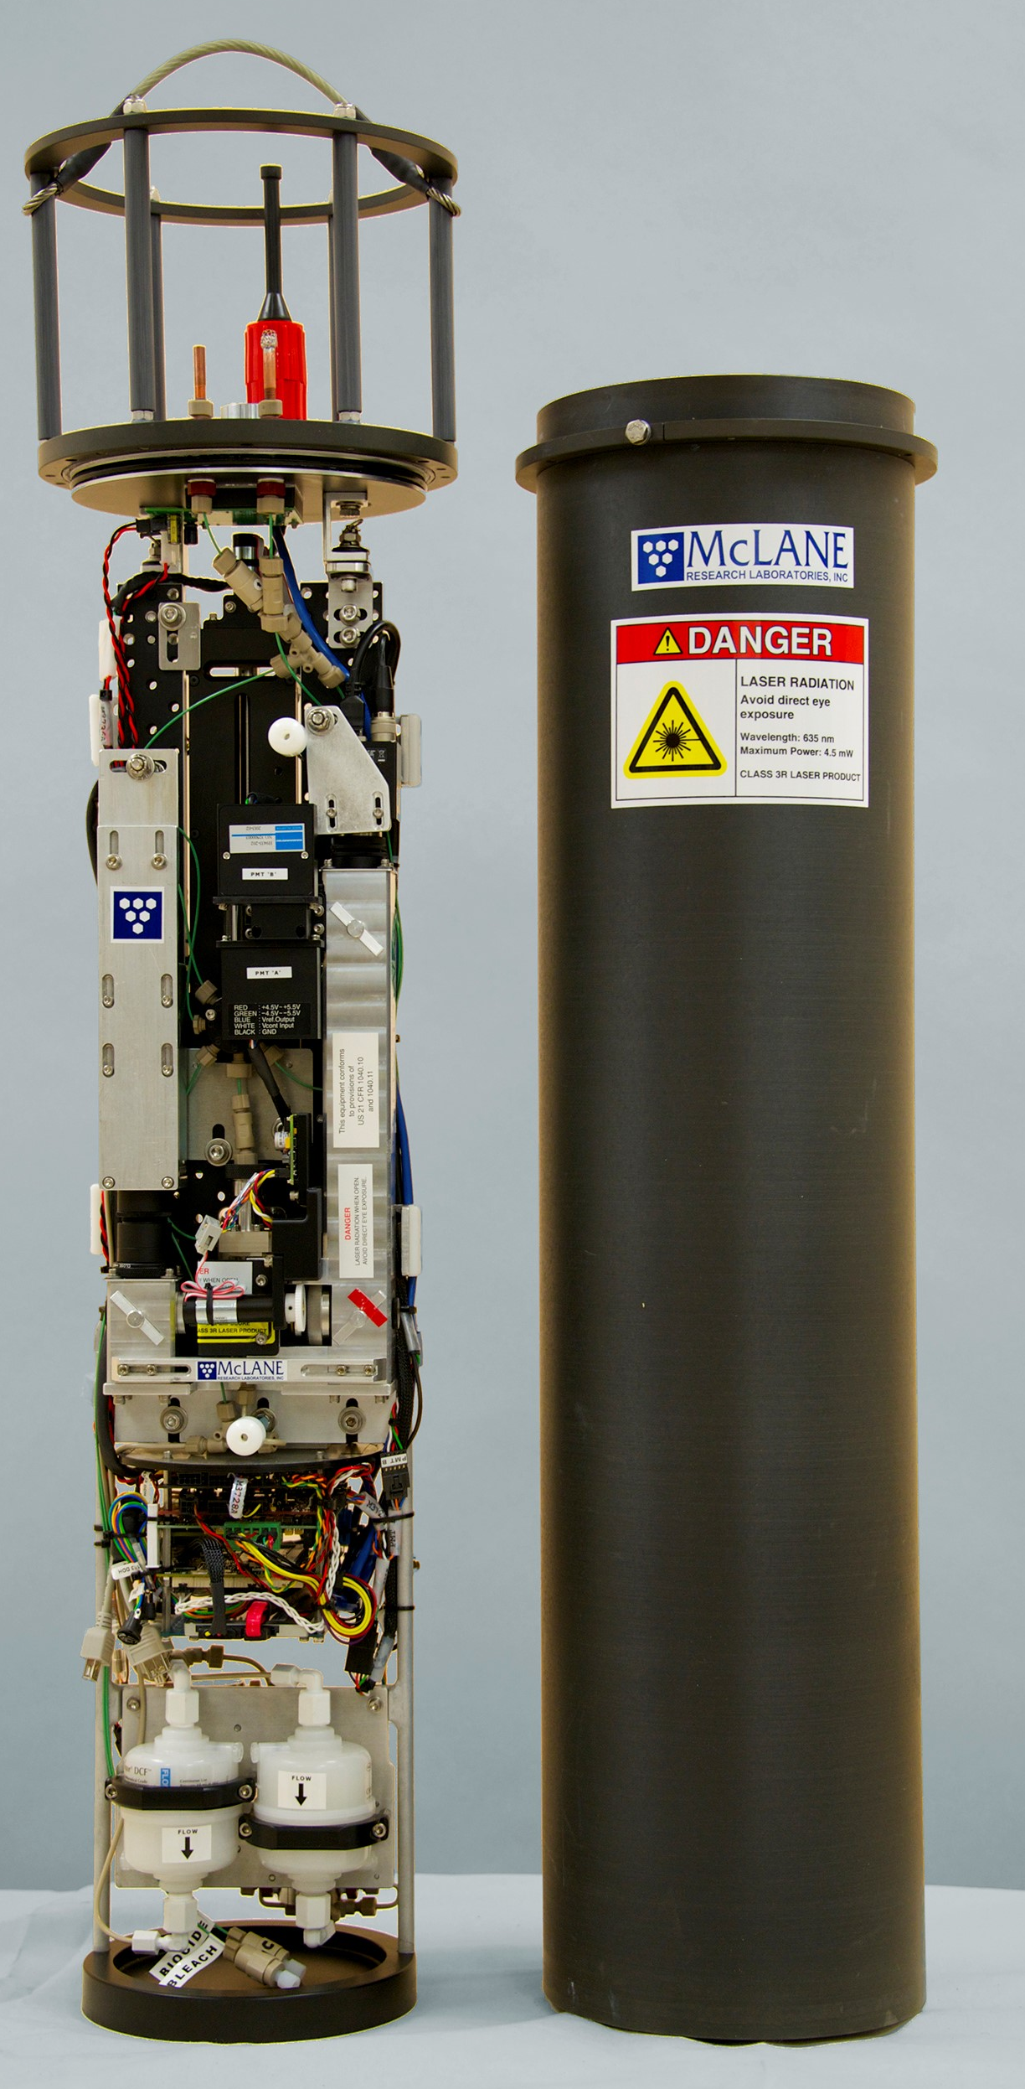
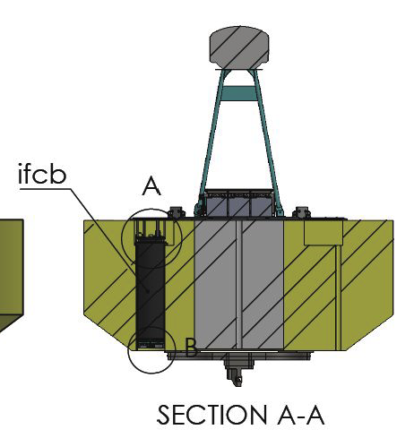
Imaging Flow Cytobot On Wave-Energy Buoy (2022, 2023, 2024)
Sampling freq: 20-30 mins
Sampling Vol: ~5 ml
Size Range: <10 μm to 150 μm
Image Resolution: ∼ 3.4 pixels/micron
1000s of images generated every hour
~ 1GB per Day
Intake
~ 45 Watts
Patrick Daniel (Kudela Lab / UCSC)
Photo: McLane

Slide 11
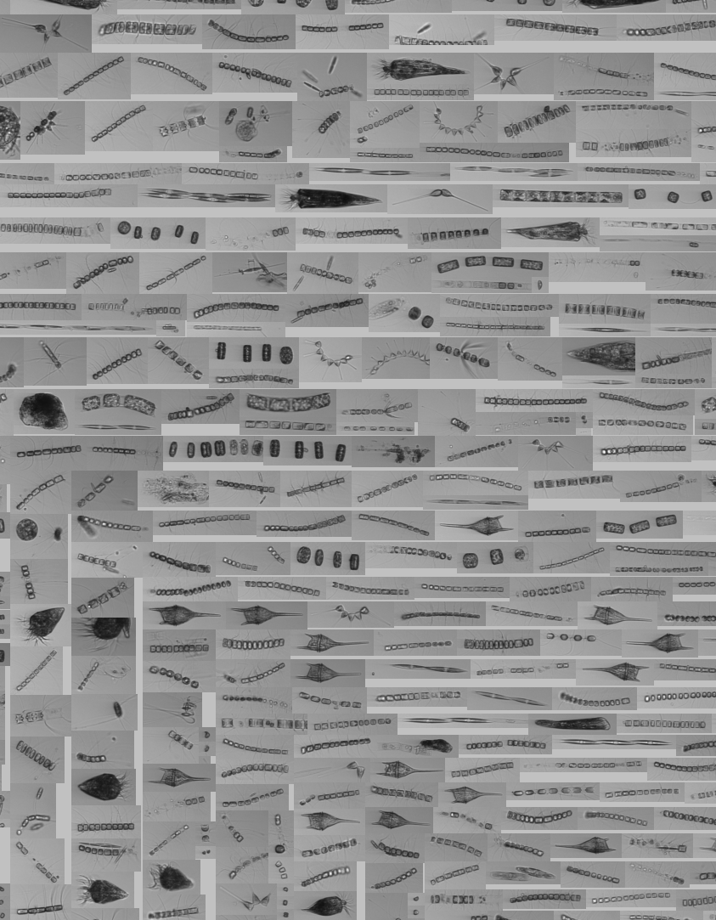
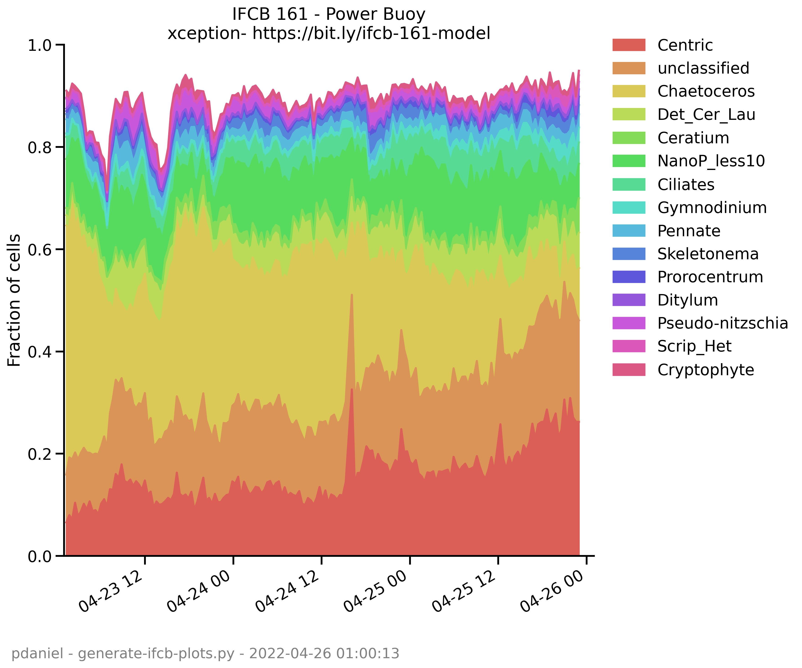
Chaetoceros Bloom
Chaetoceros

Slide 12
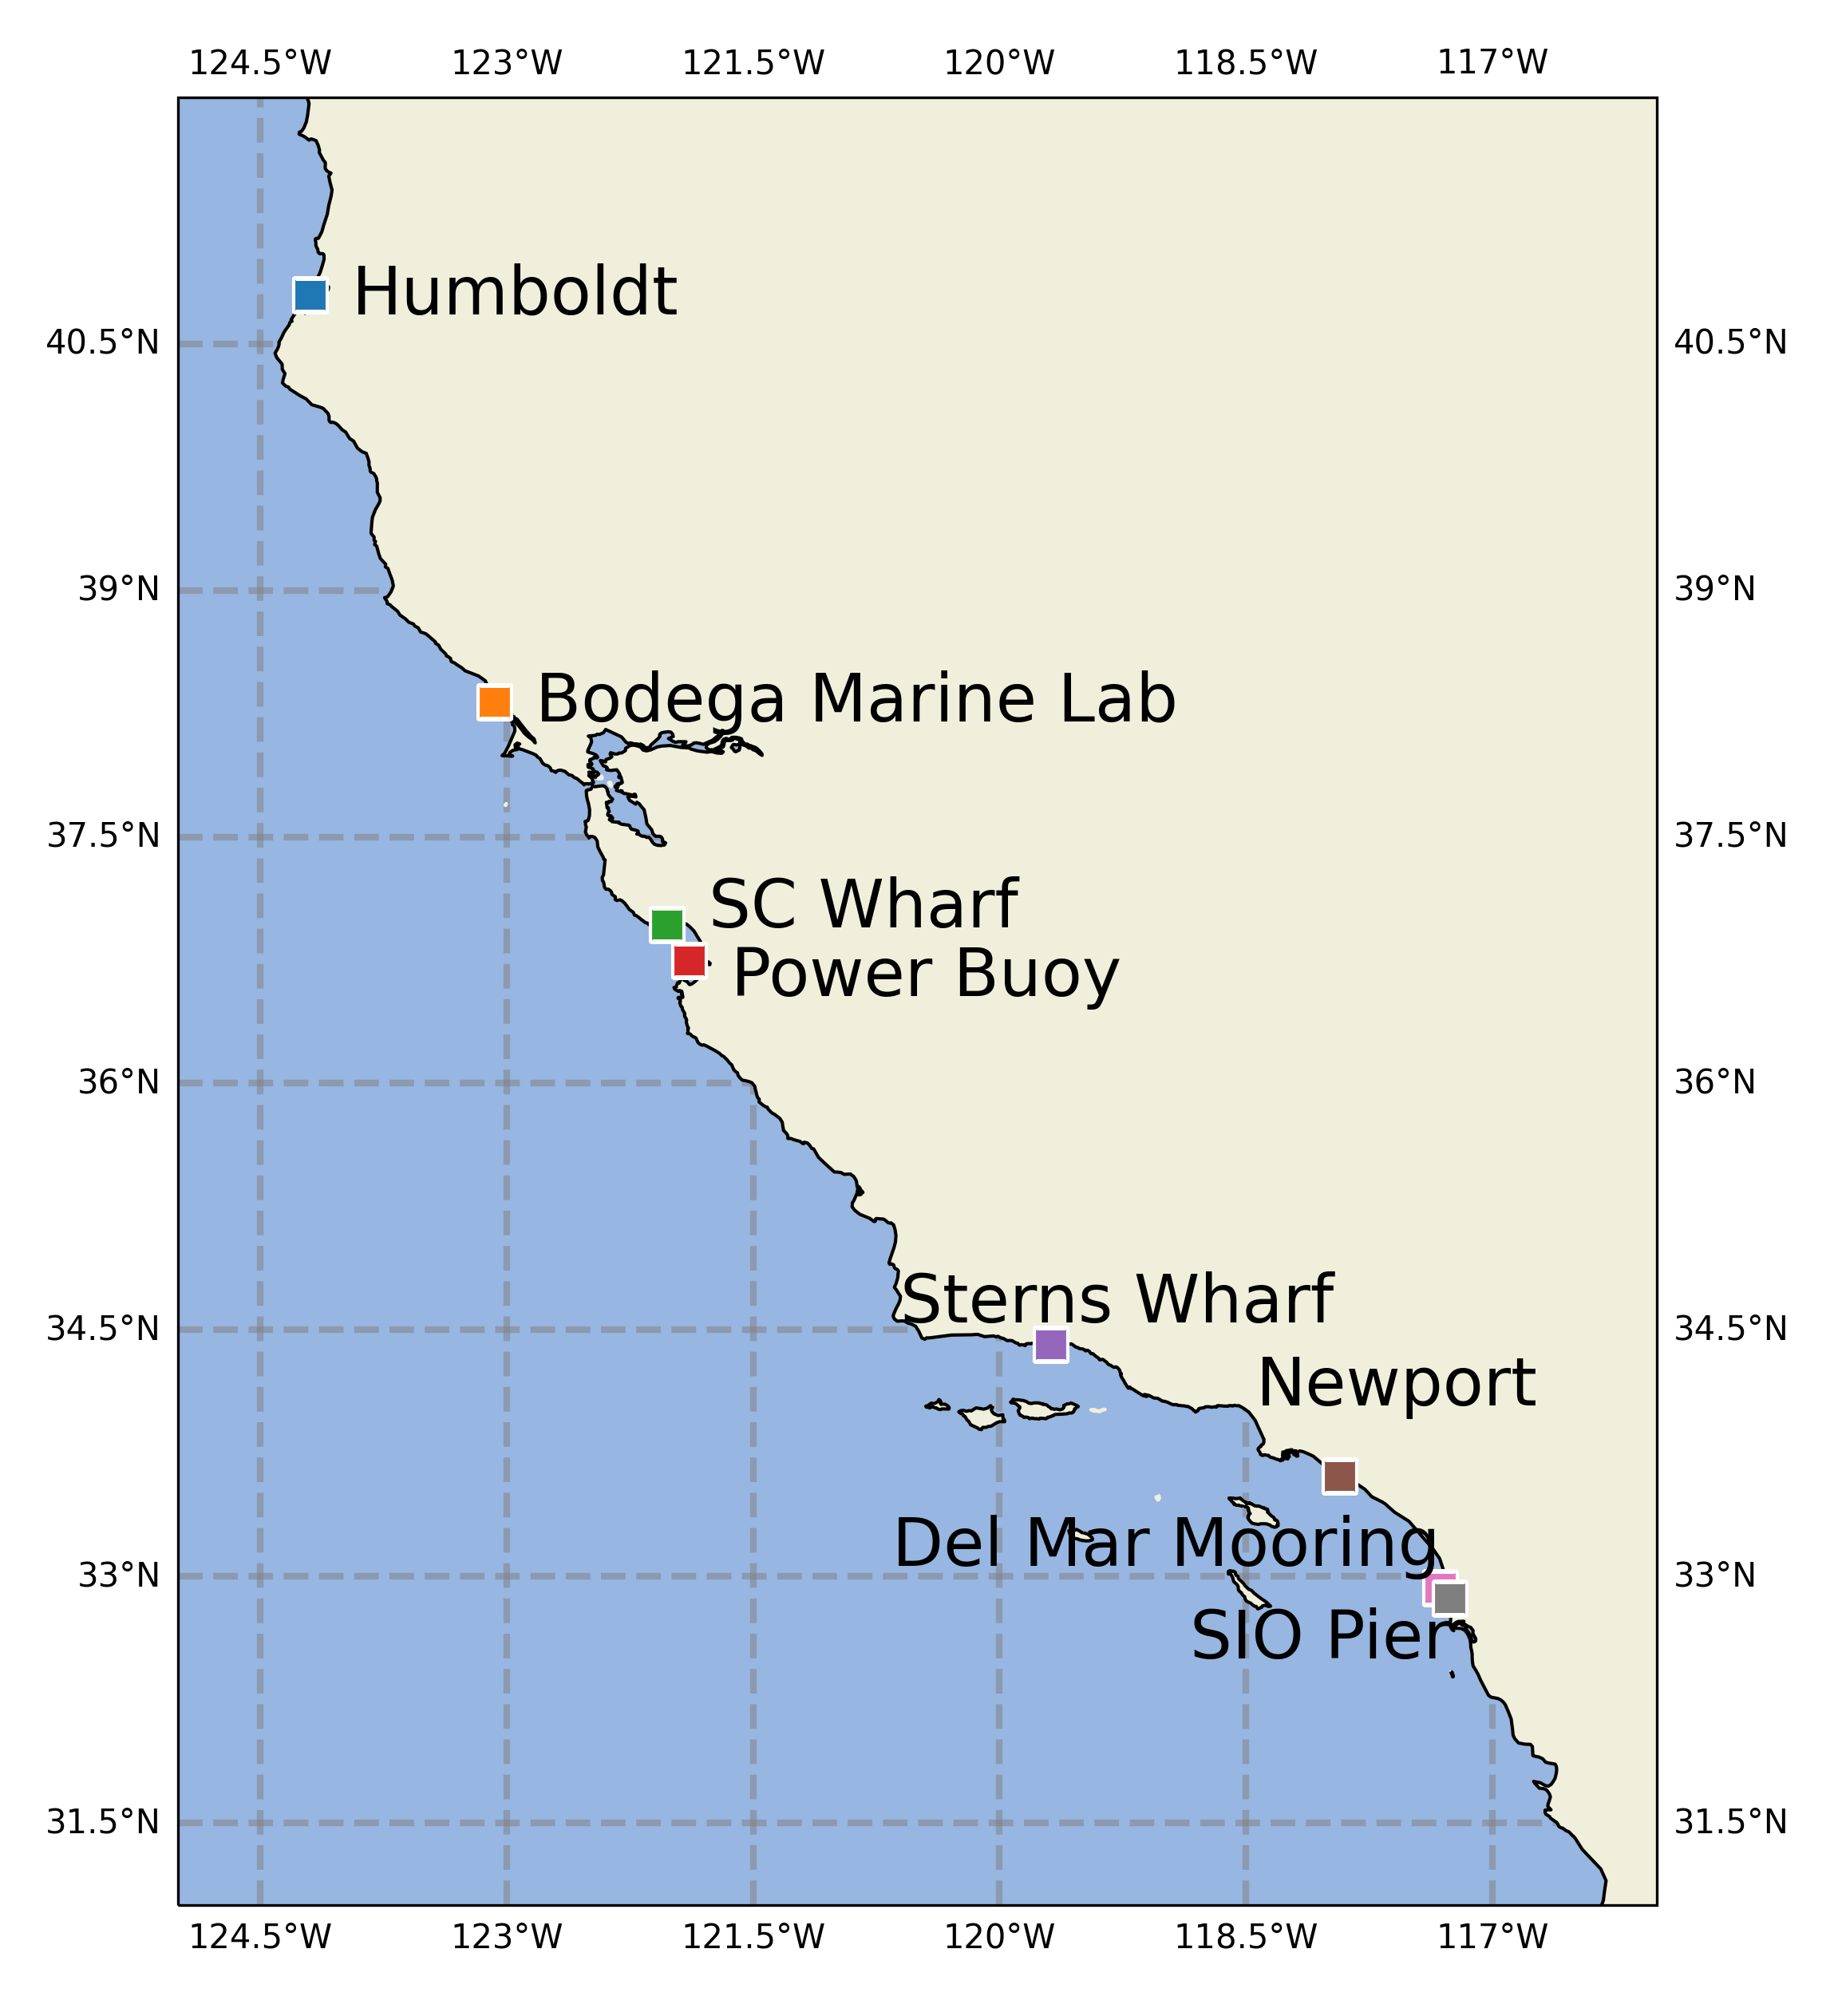

Slide 13
Underwater Vehicle Docking

Slide 14
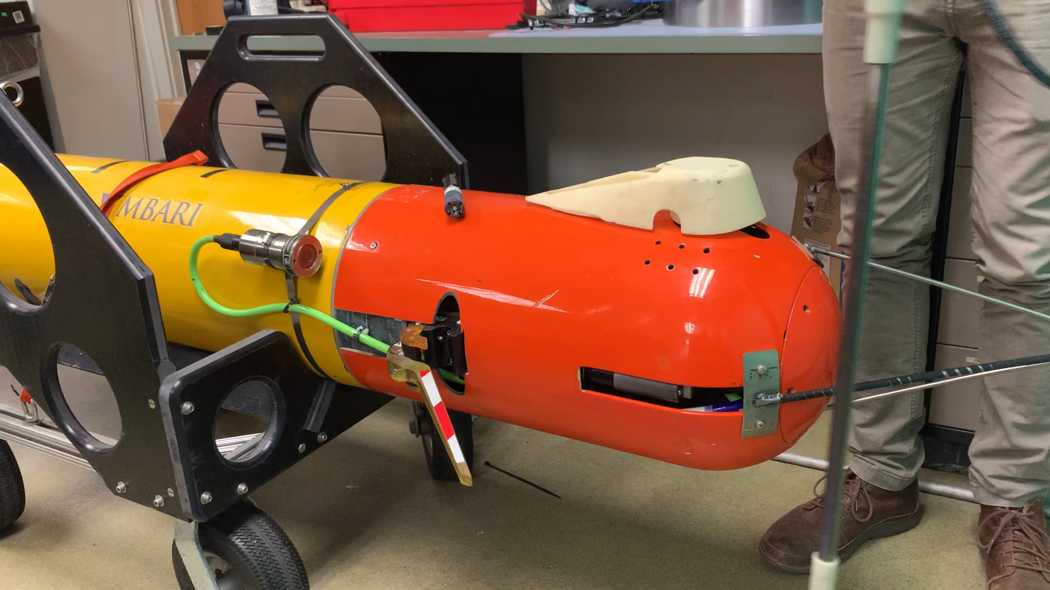
Notes:
Replace with more recent video

Slide 15
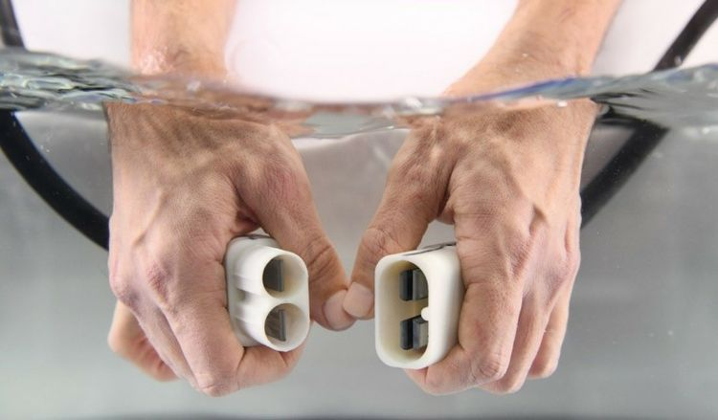
Niobicon technology
Patented and developed by Northrop-Grumman
Uses pure niobium
Thin film isolates niobium in water
Can allow axial and rotary motion
Limited to 60 V and moderate power

Slide 16
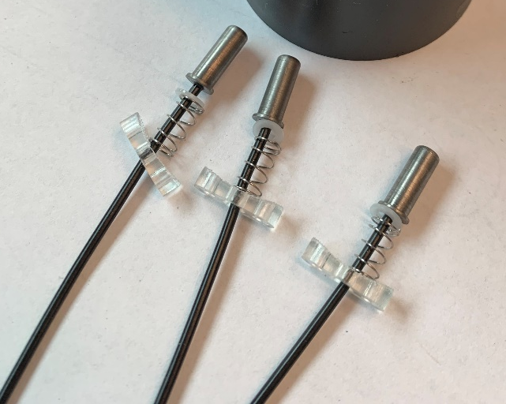
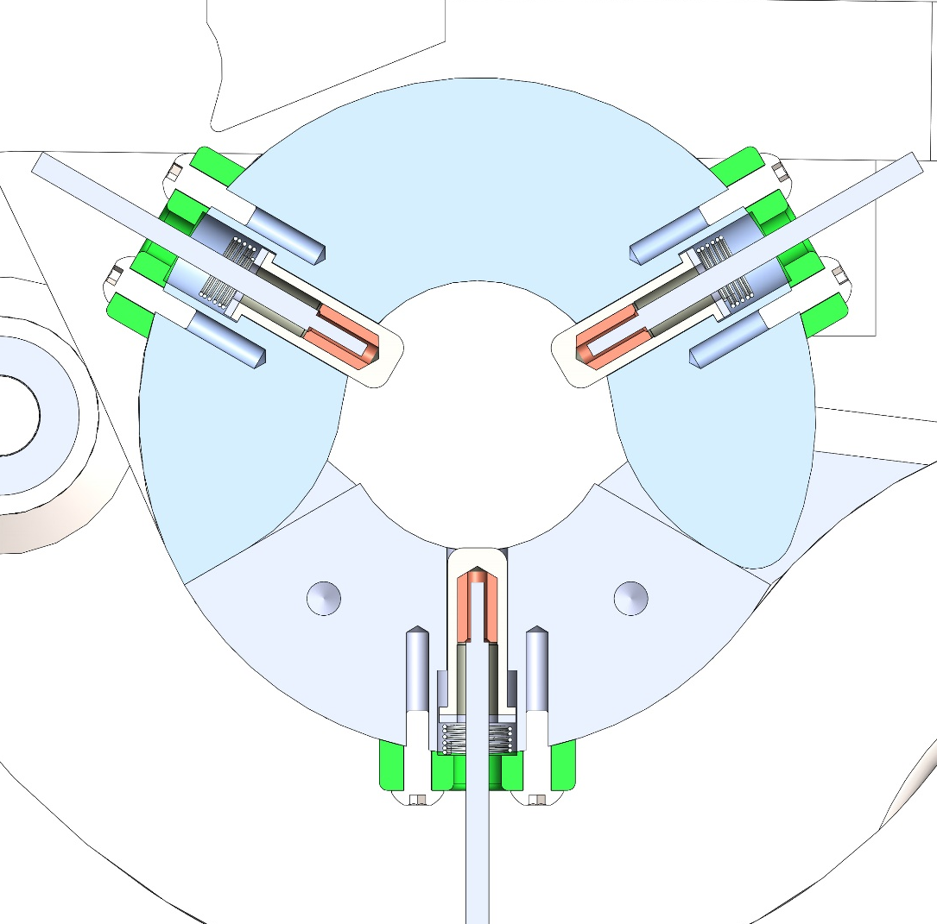
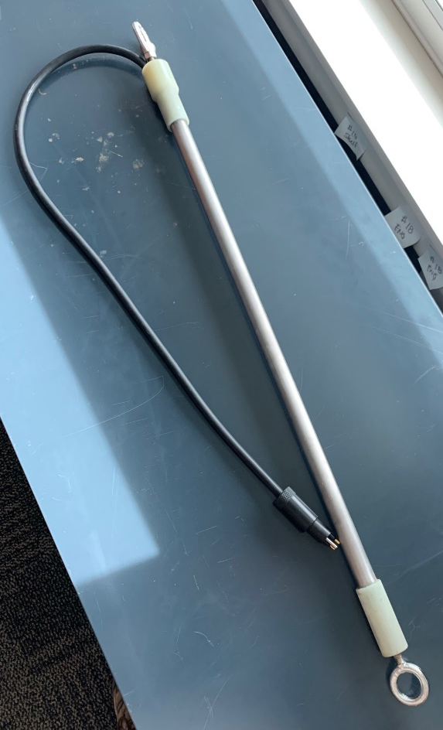
Power Transfer Device
Niobium “brushes”
Spring loaded niobium brushes inside clamp
Charge rod

Slide 17
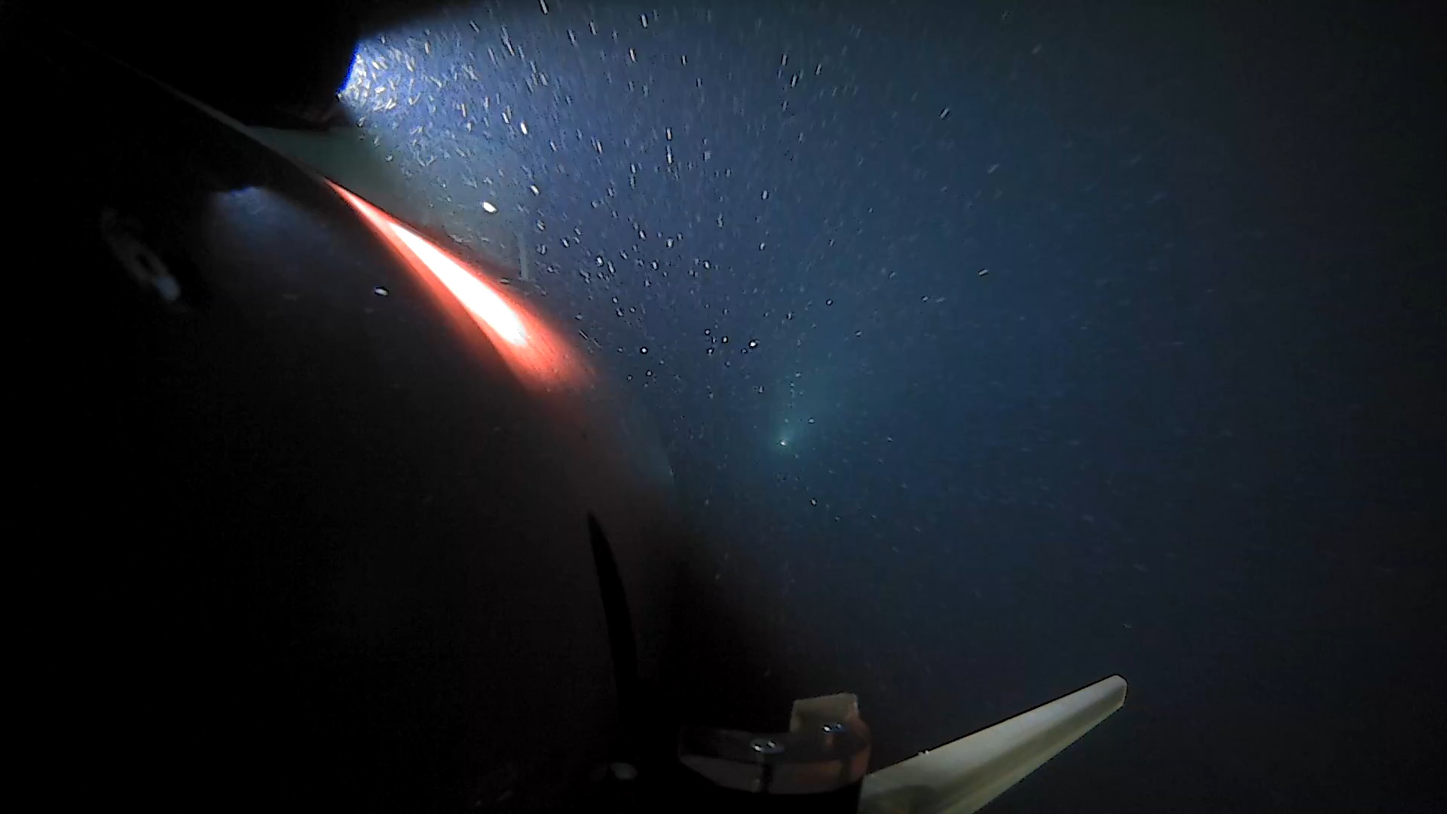

Slide 18
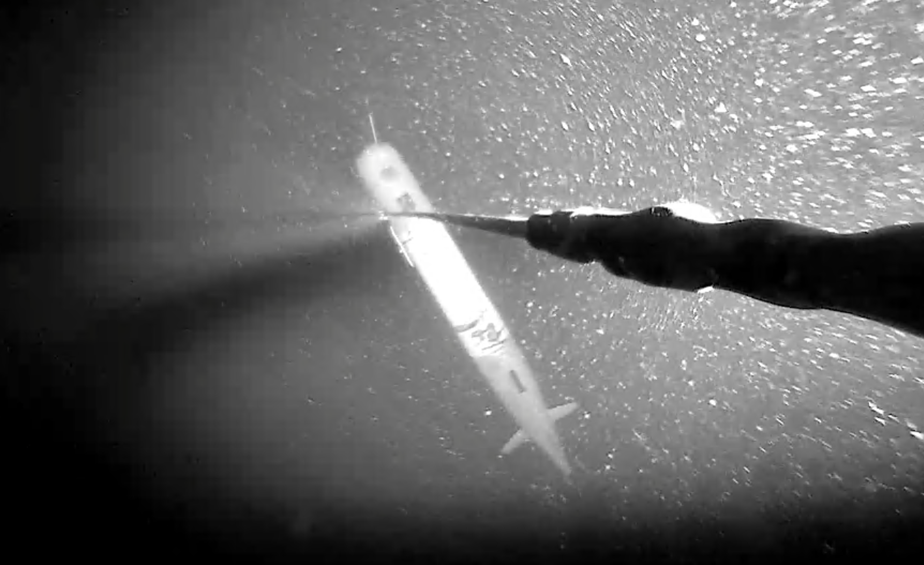
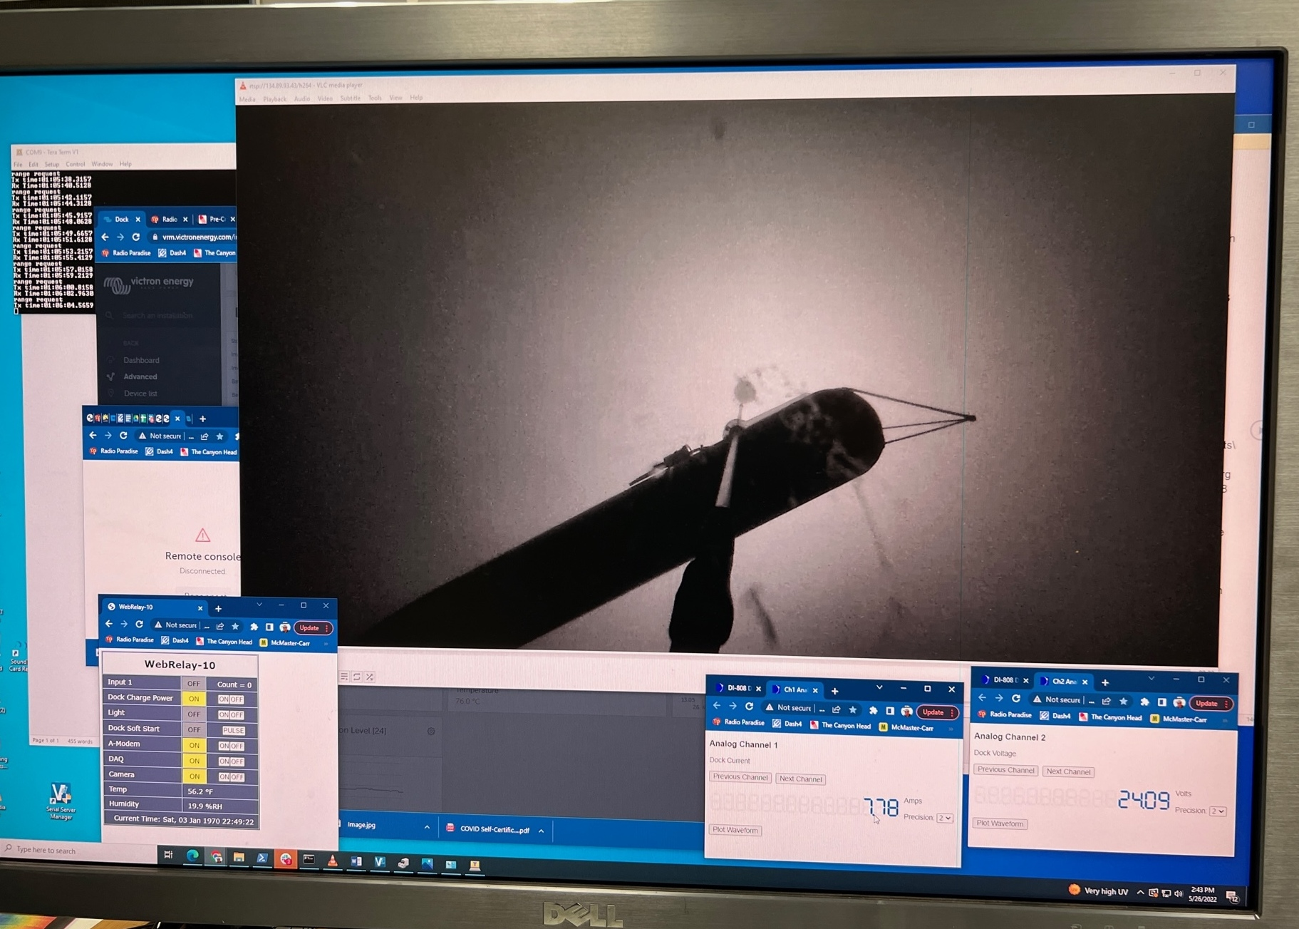

Slide 19
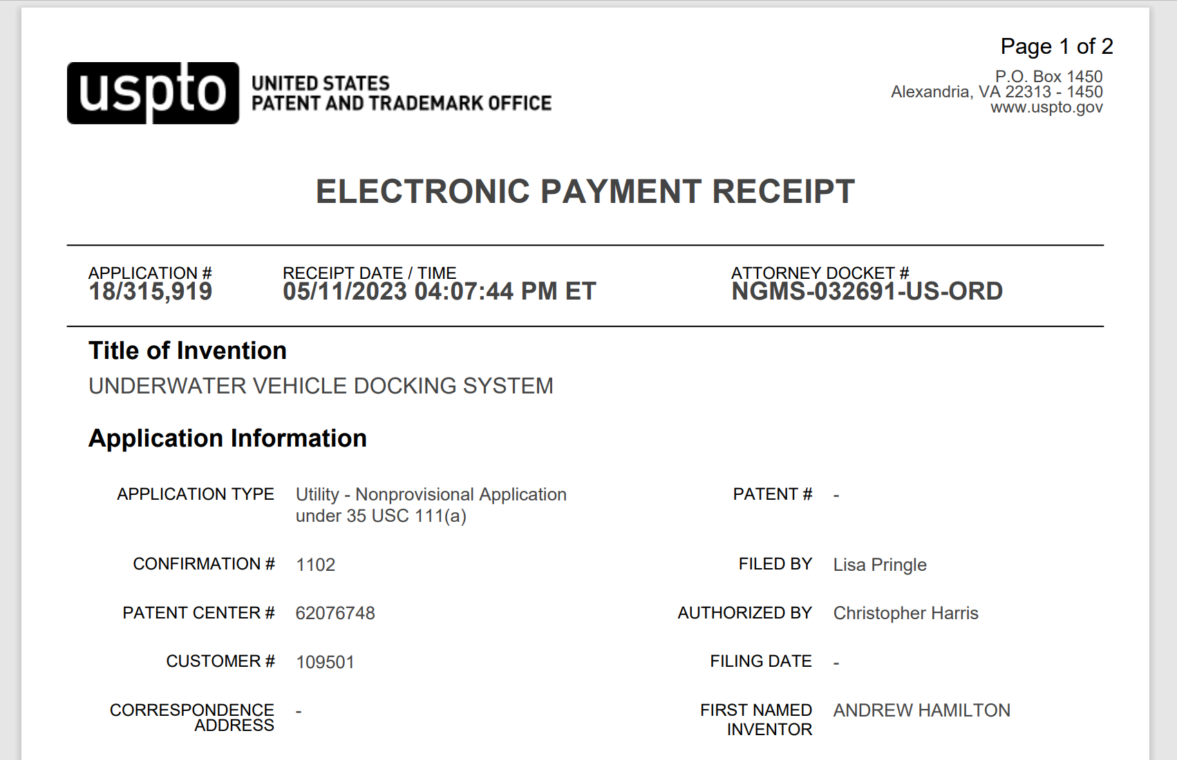

Slide 20
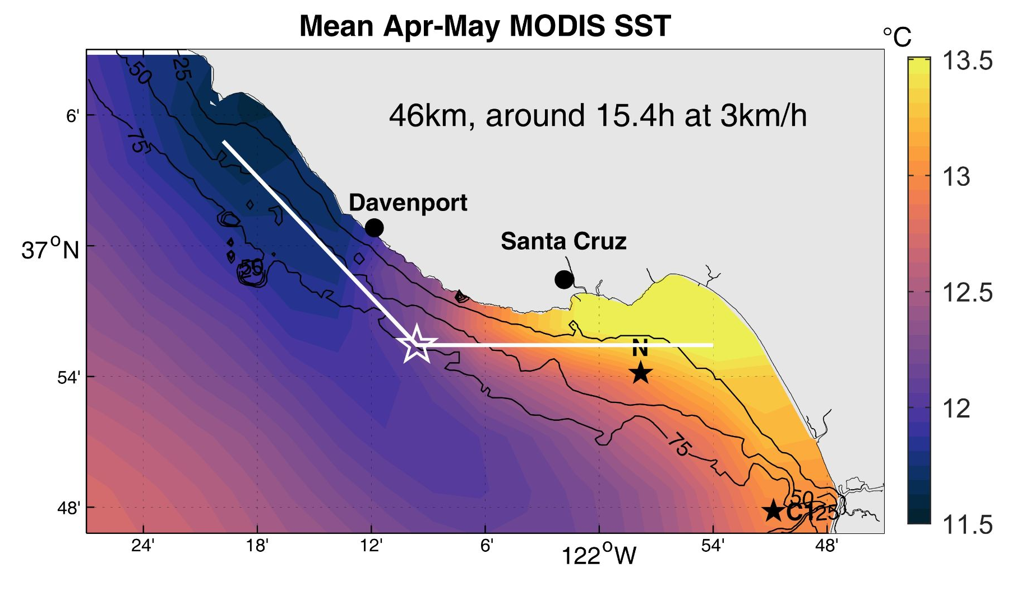

Slide 21
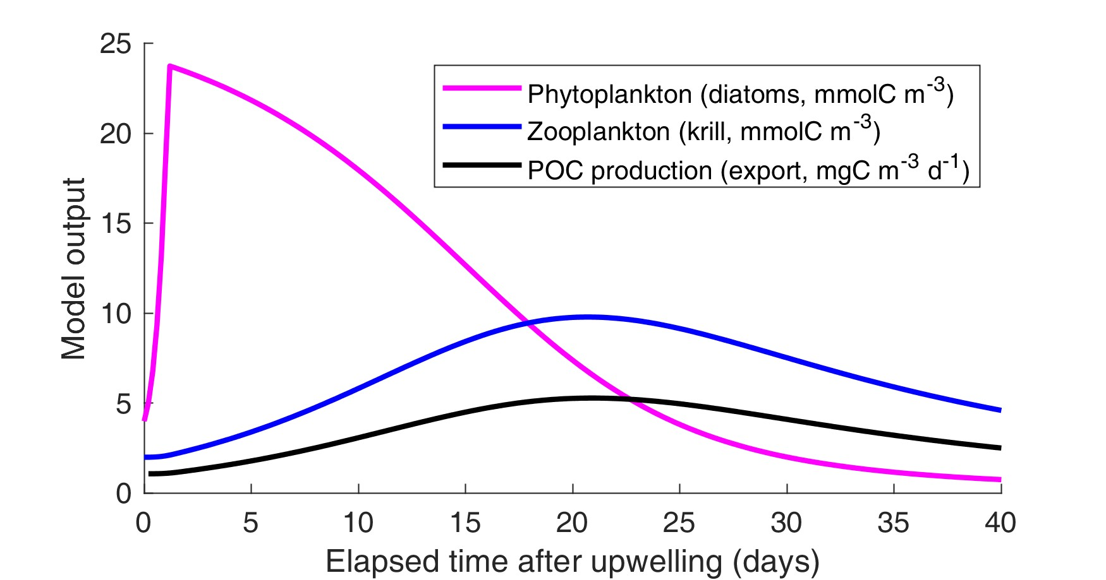
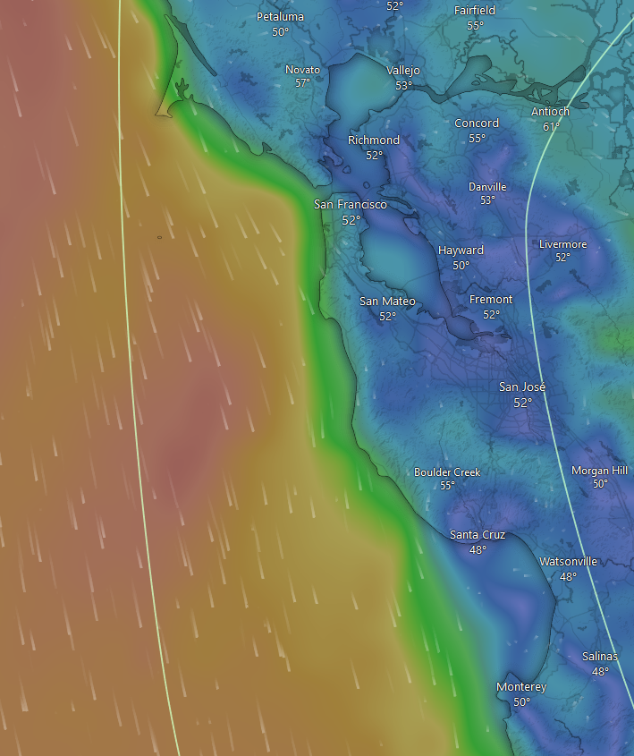
Repeat Transects – Monique Messie & Steve Haddock

Slide 22
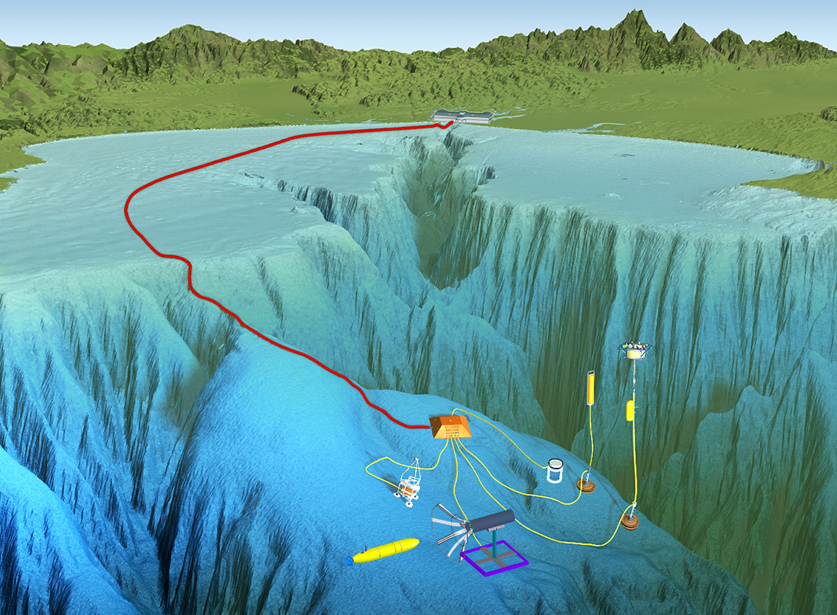
Docking - Mars Deployment

Slide 23
Docking/Wave-Energy Combination

Slide 24
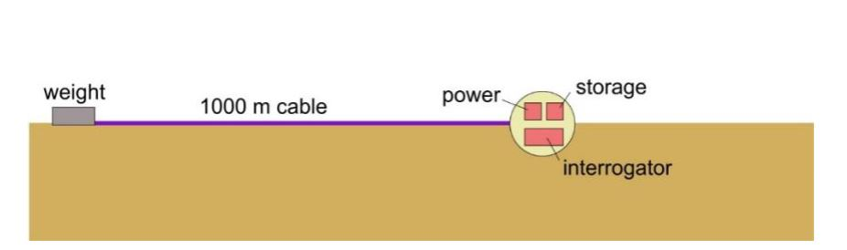
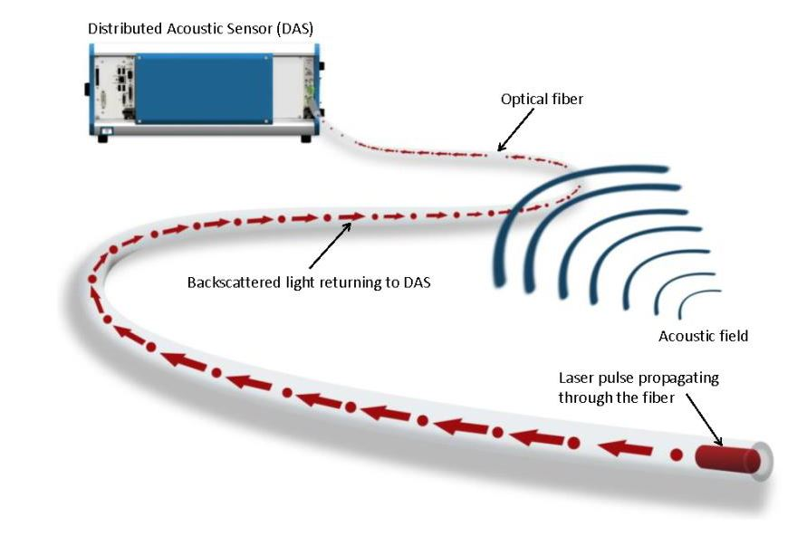
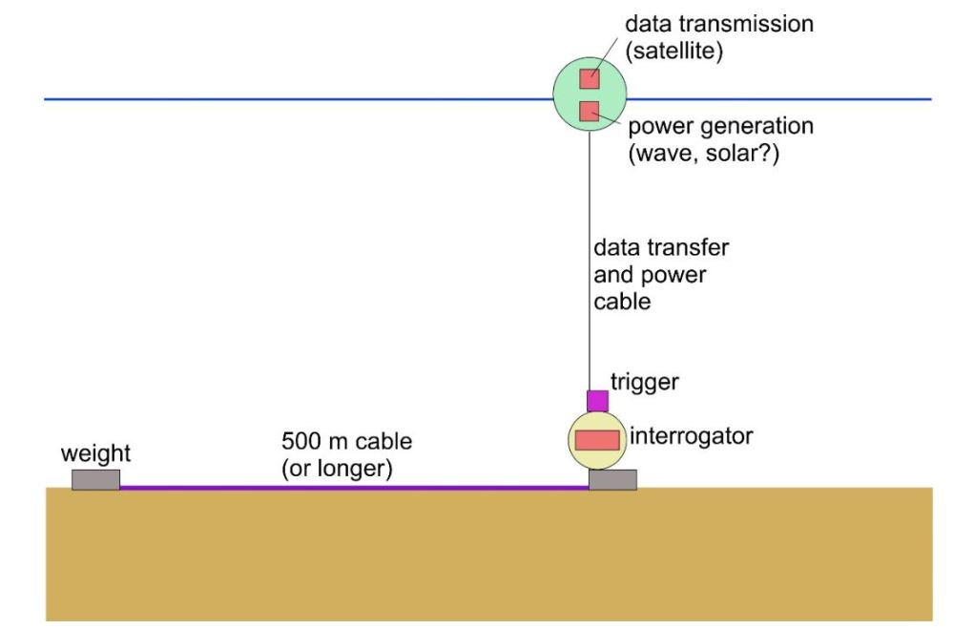
Distributed Acoustic Sensing – Power and Comms

Slide 25
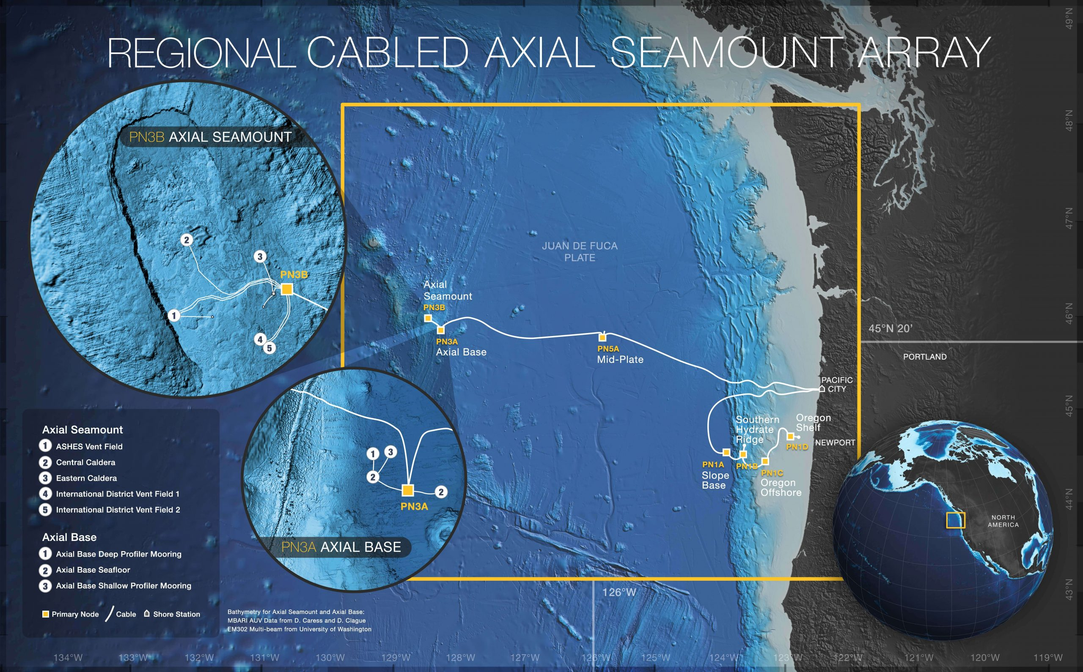

Slide 26
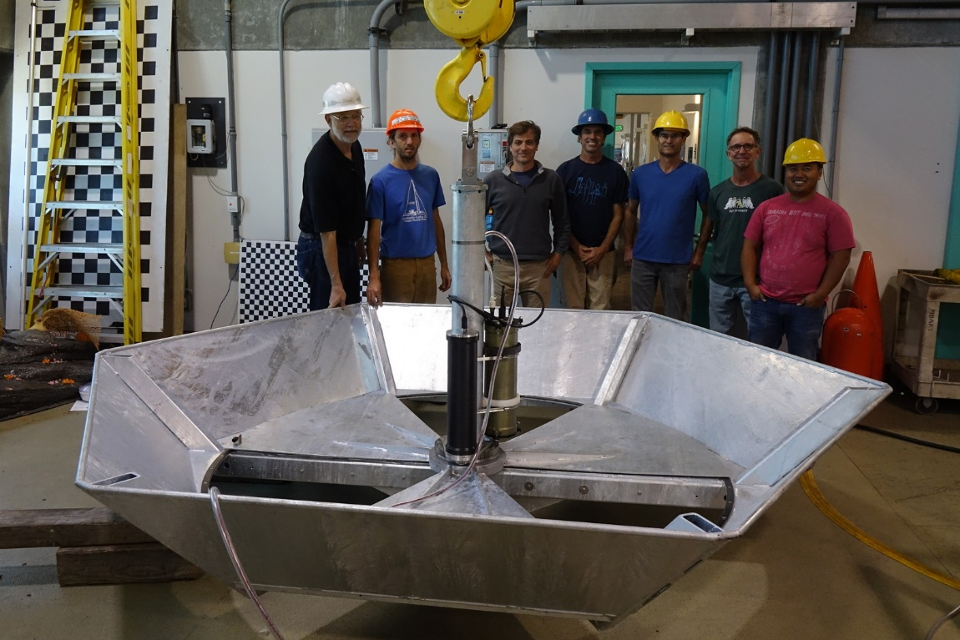
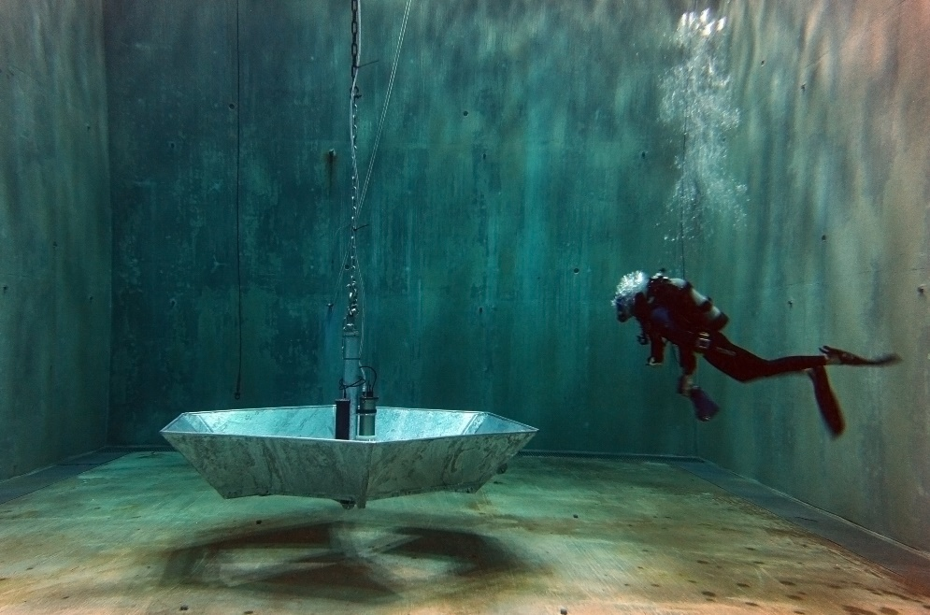
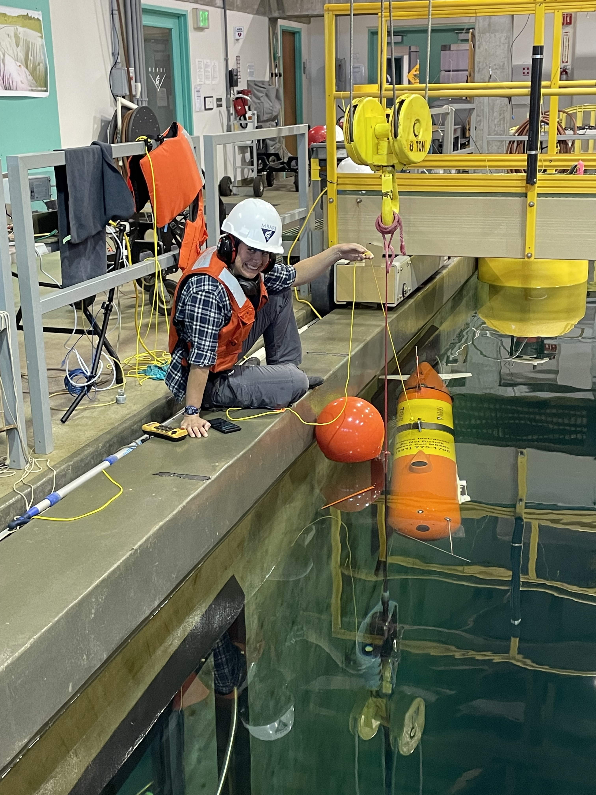
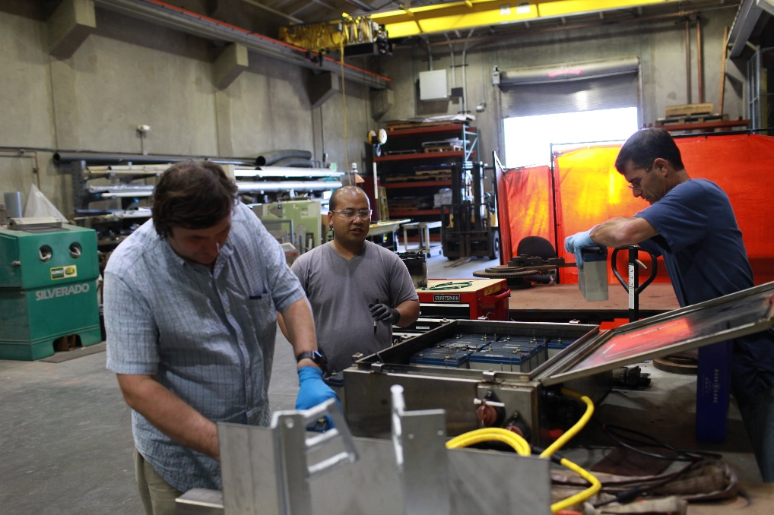
- François Cazenave
- Scott Jensen
- Michael Anderson
- Jon Erickson
- Rich Henthorn
- Eric Martin
- Denis Klimov
- Rob McEwen
- Jose Rosal
- James McClure
- Brian Kieft
- Quinn Shemet
- Brett Hobson
- Monique Messie
- Steve Haddock

