Slide 1
Underwater Vehicle Docking for Extended Deployments
Andrew Hamilton

Slide 2
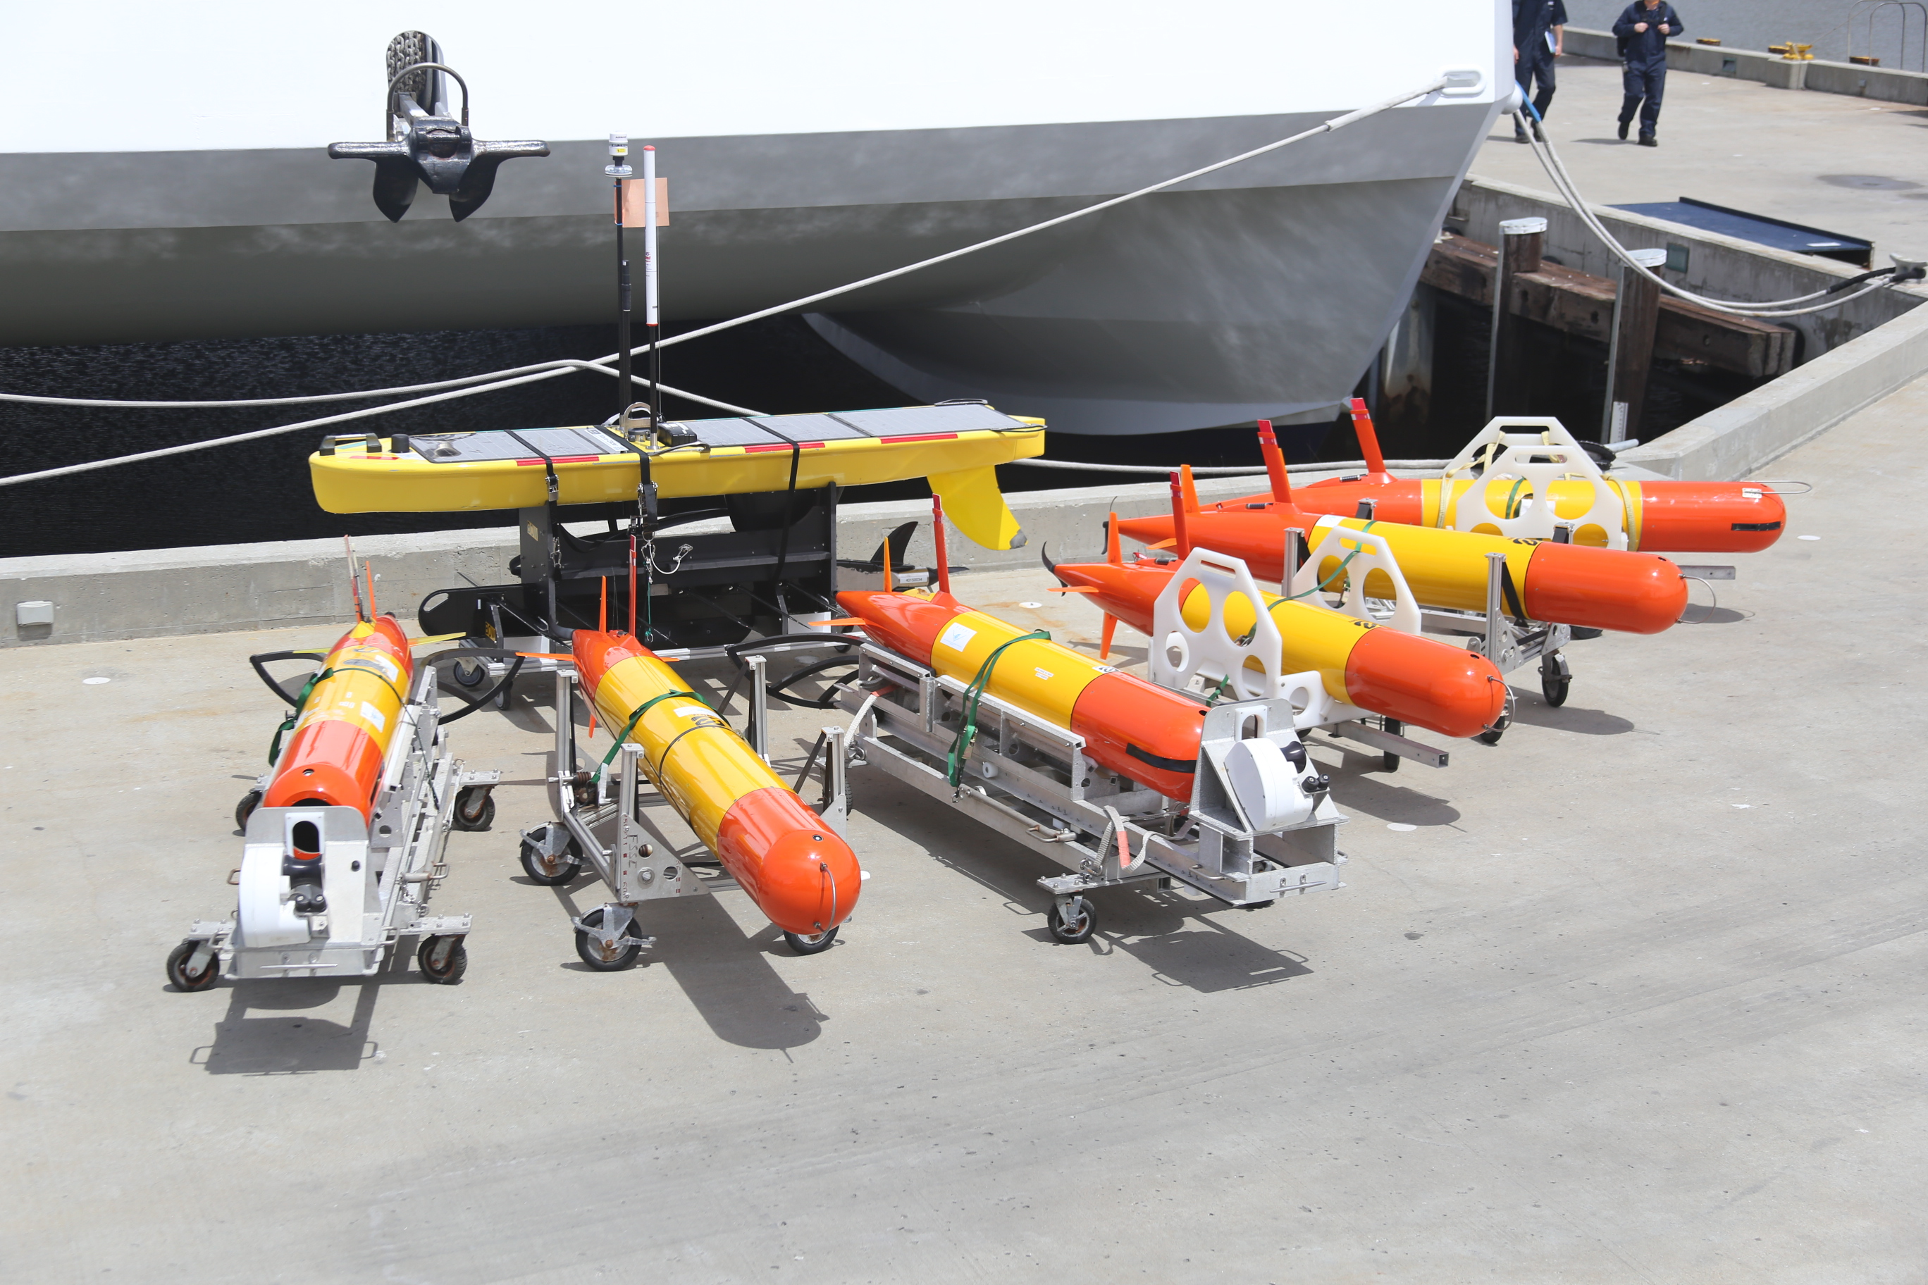
Persistent Presence for Autonomous Long Term Monitoring
Technology needed:
Vehicles (Capability, Reliability)
Autonomy
Instrumentation
Energy
Communications
Docking Capability

Slide 3
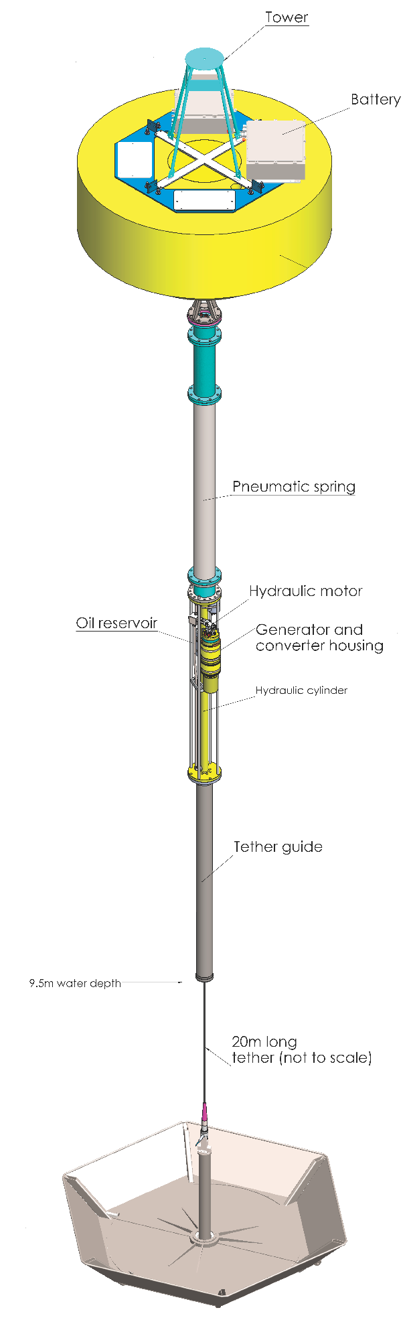

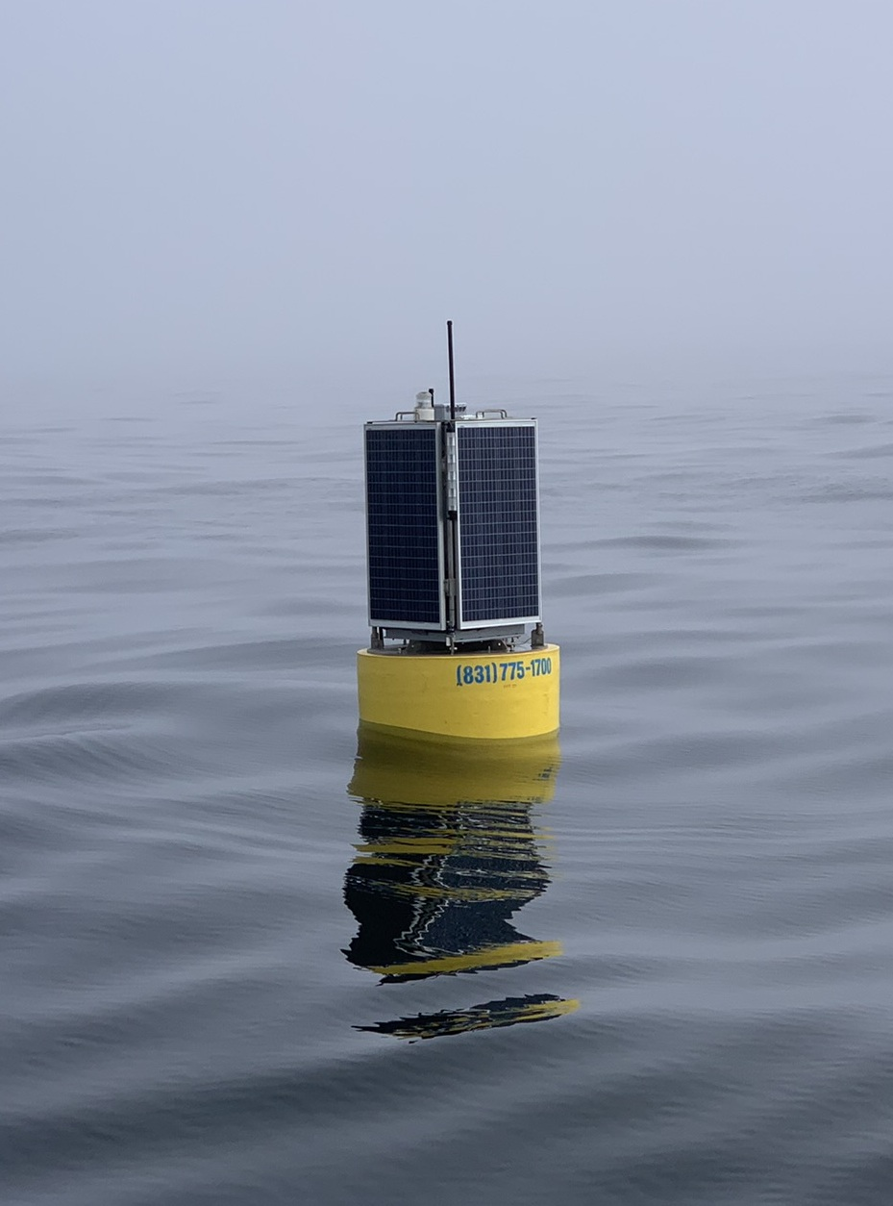
Persistent Presence for Autonomous Long Term Monitoring
Technology needed:
Vehicles (Capability, Reliability)
Autonomy
Instrumentation
Energy
Communications
Docking Capability

Slide 4
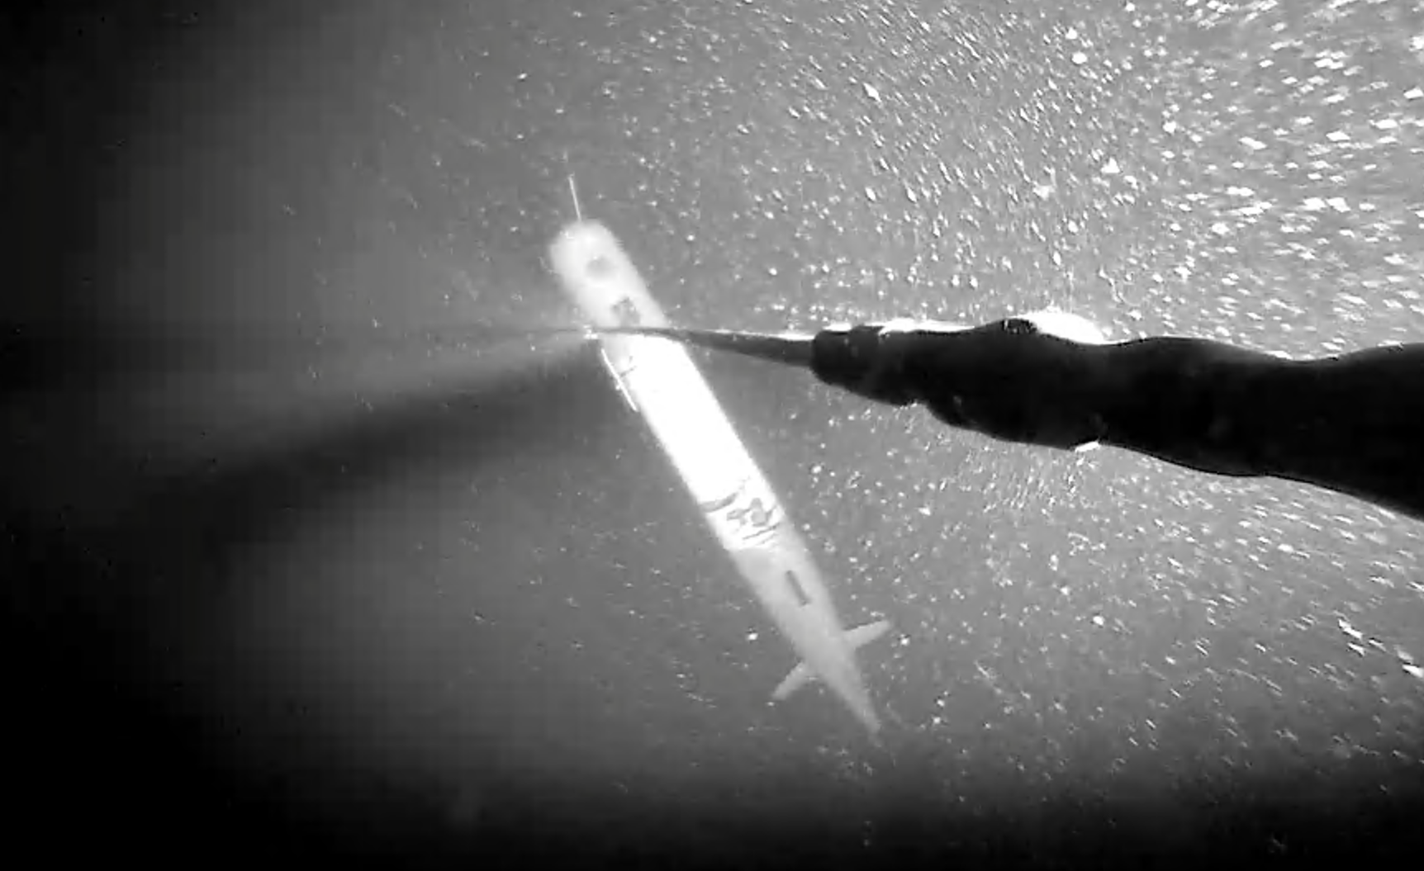
Persistent Presence for Autonomous Long Term Monitoring
Technology needed:
Vehicles (Capability, Reliability)
Autonomy
Instrumentation
Energy
Communications
Docking Capability

Slide 5
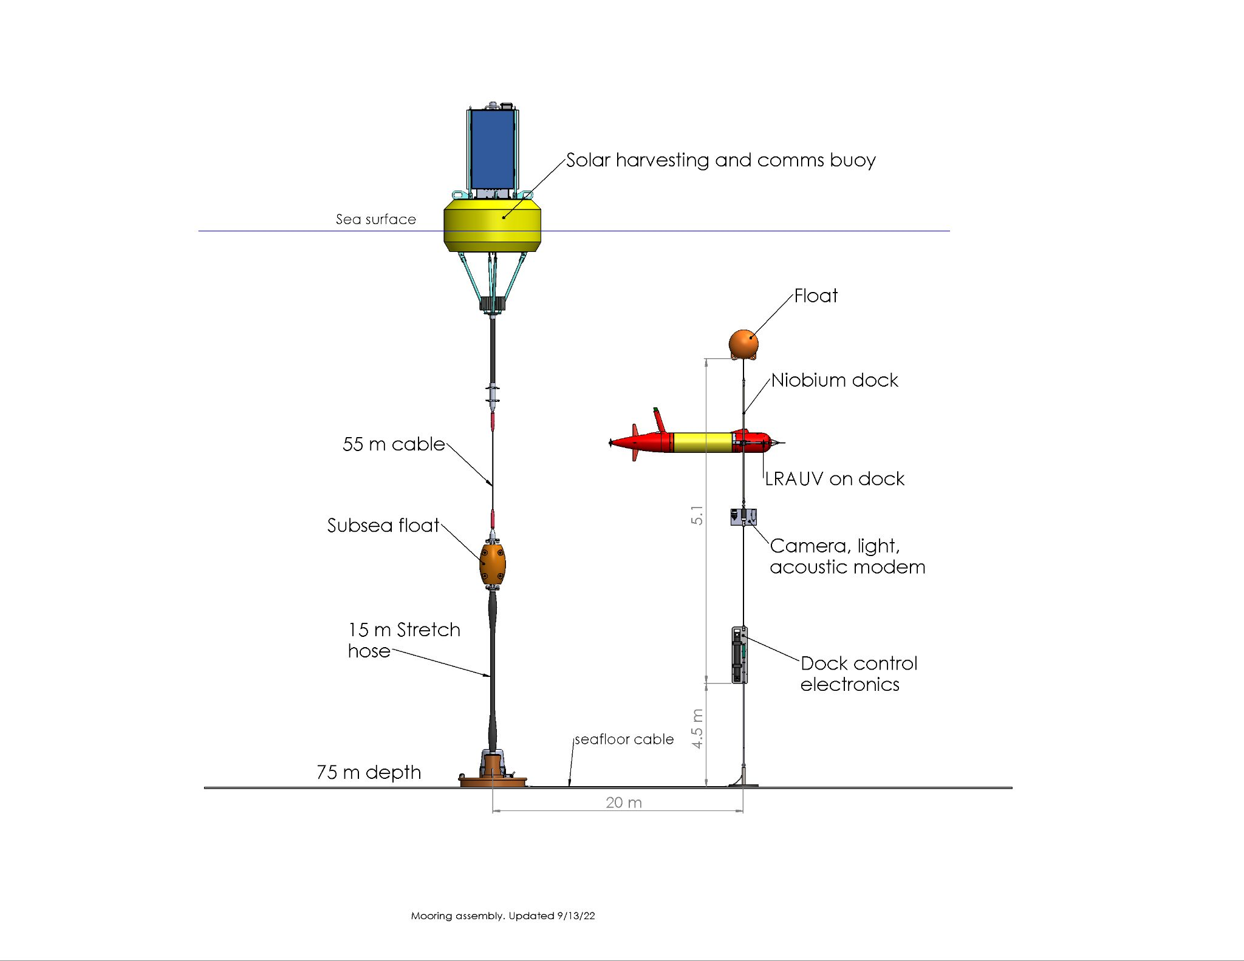
Current Solar Powered Dock

Slide 6
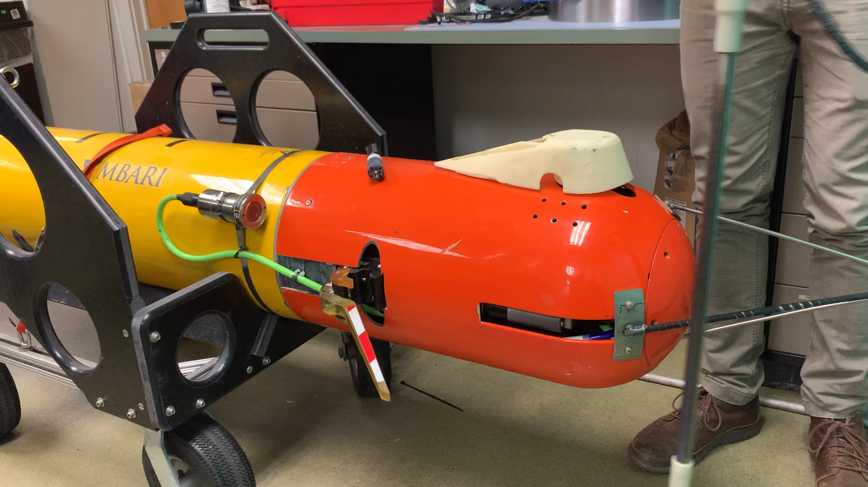
Notes:
Replace with more recent video

Slide 7
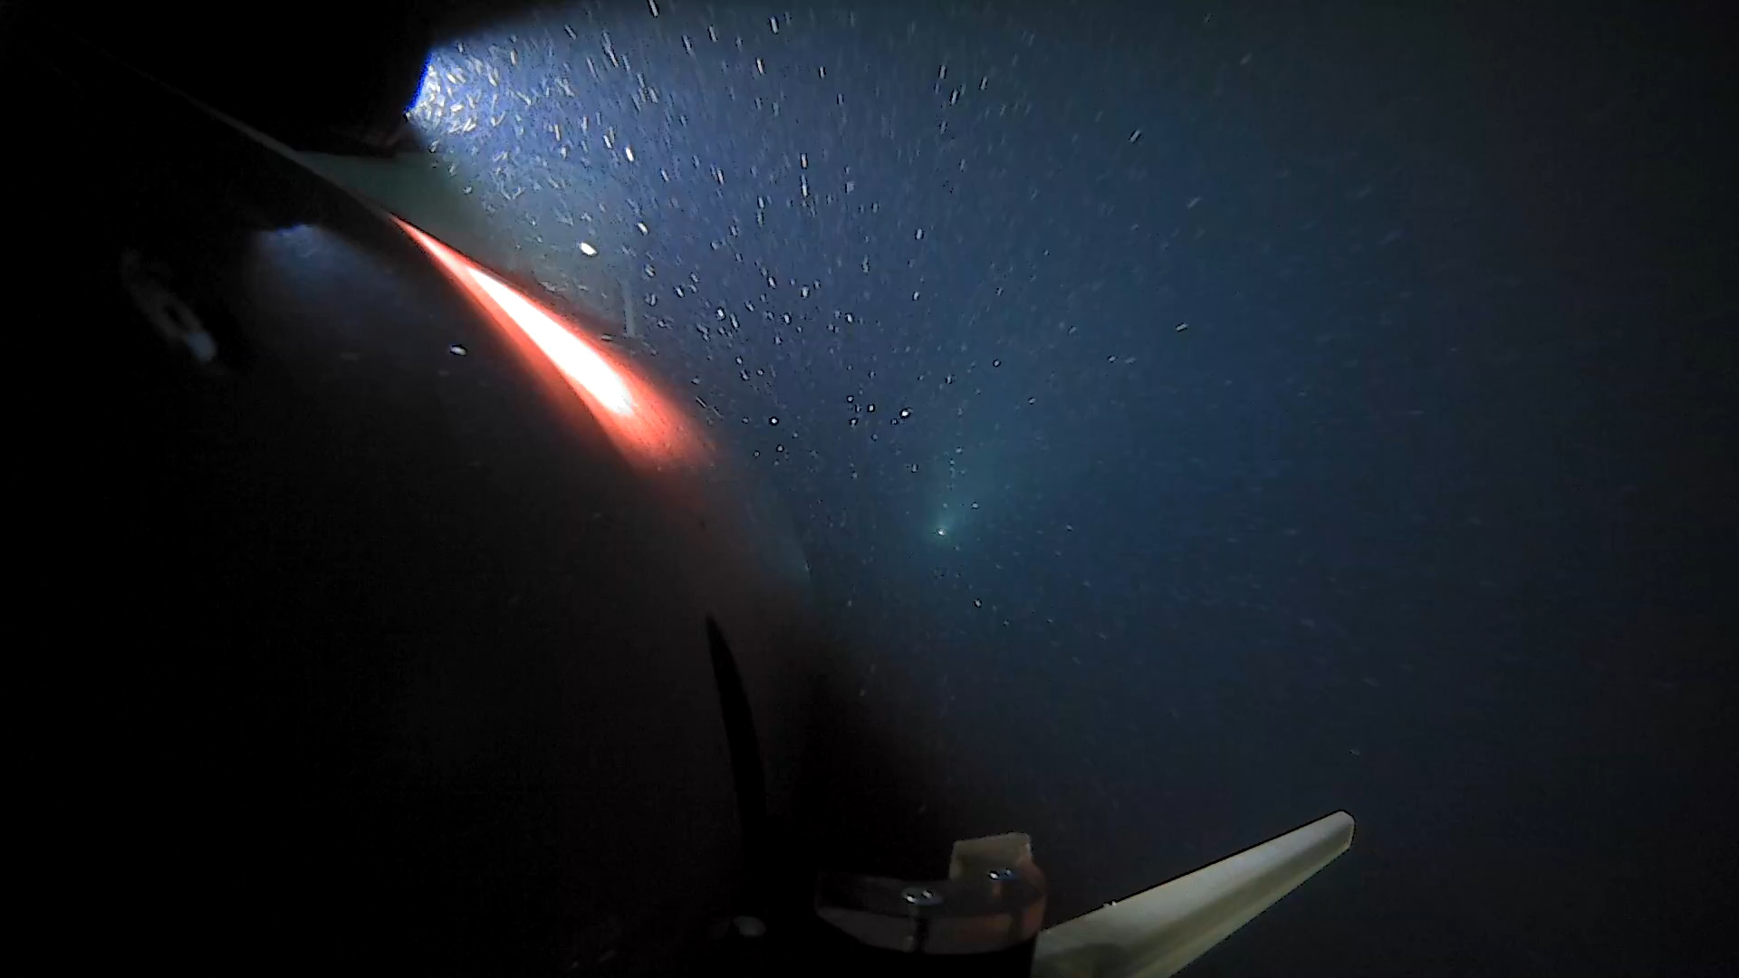

Slide 8
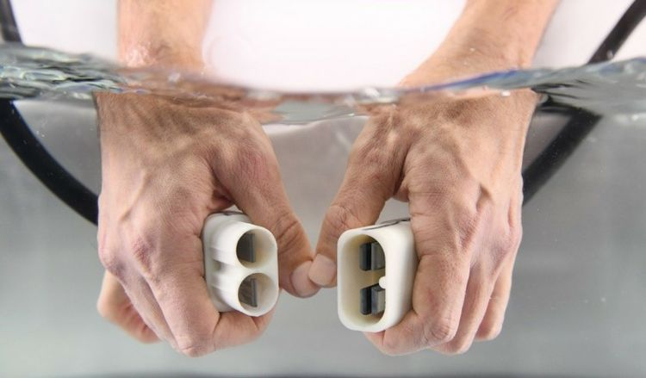
Niobicon Technology for Power Transfer
Patented and developed by Northrop-Grumman
Uses pure niobium
Thin film isolates niobium in water
Can allow axial and rotary motion
Limited to 60 V and moderate power

Slide 9
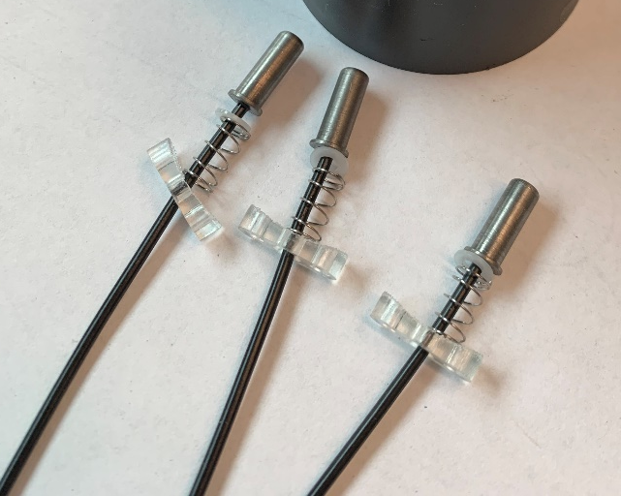
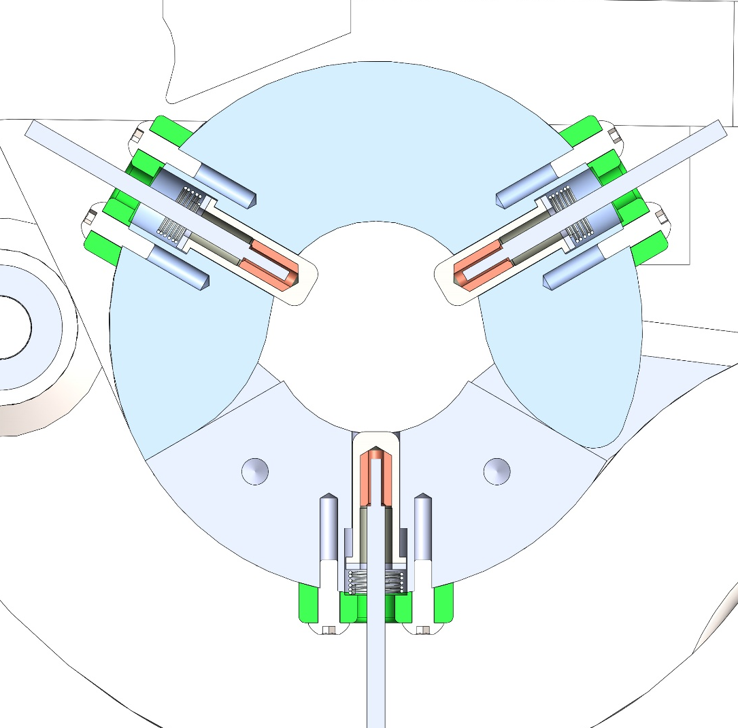
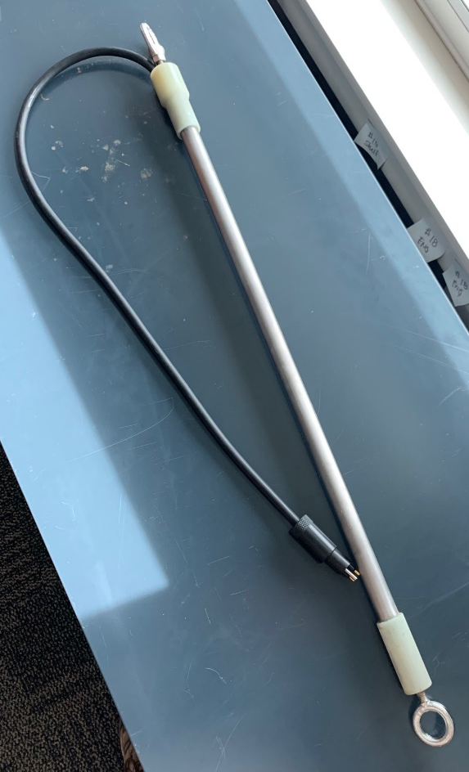
Power Transfer Device
Niobium “brushes”
Spring loaded niobium brushes inside clamp
Charge rod

Slide 11
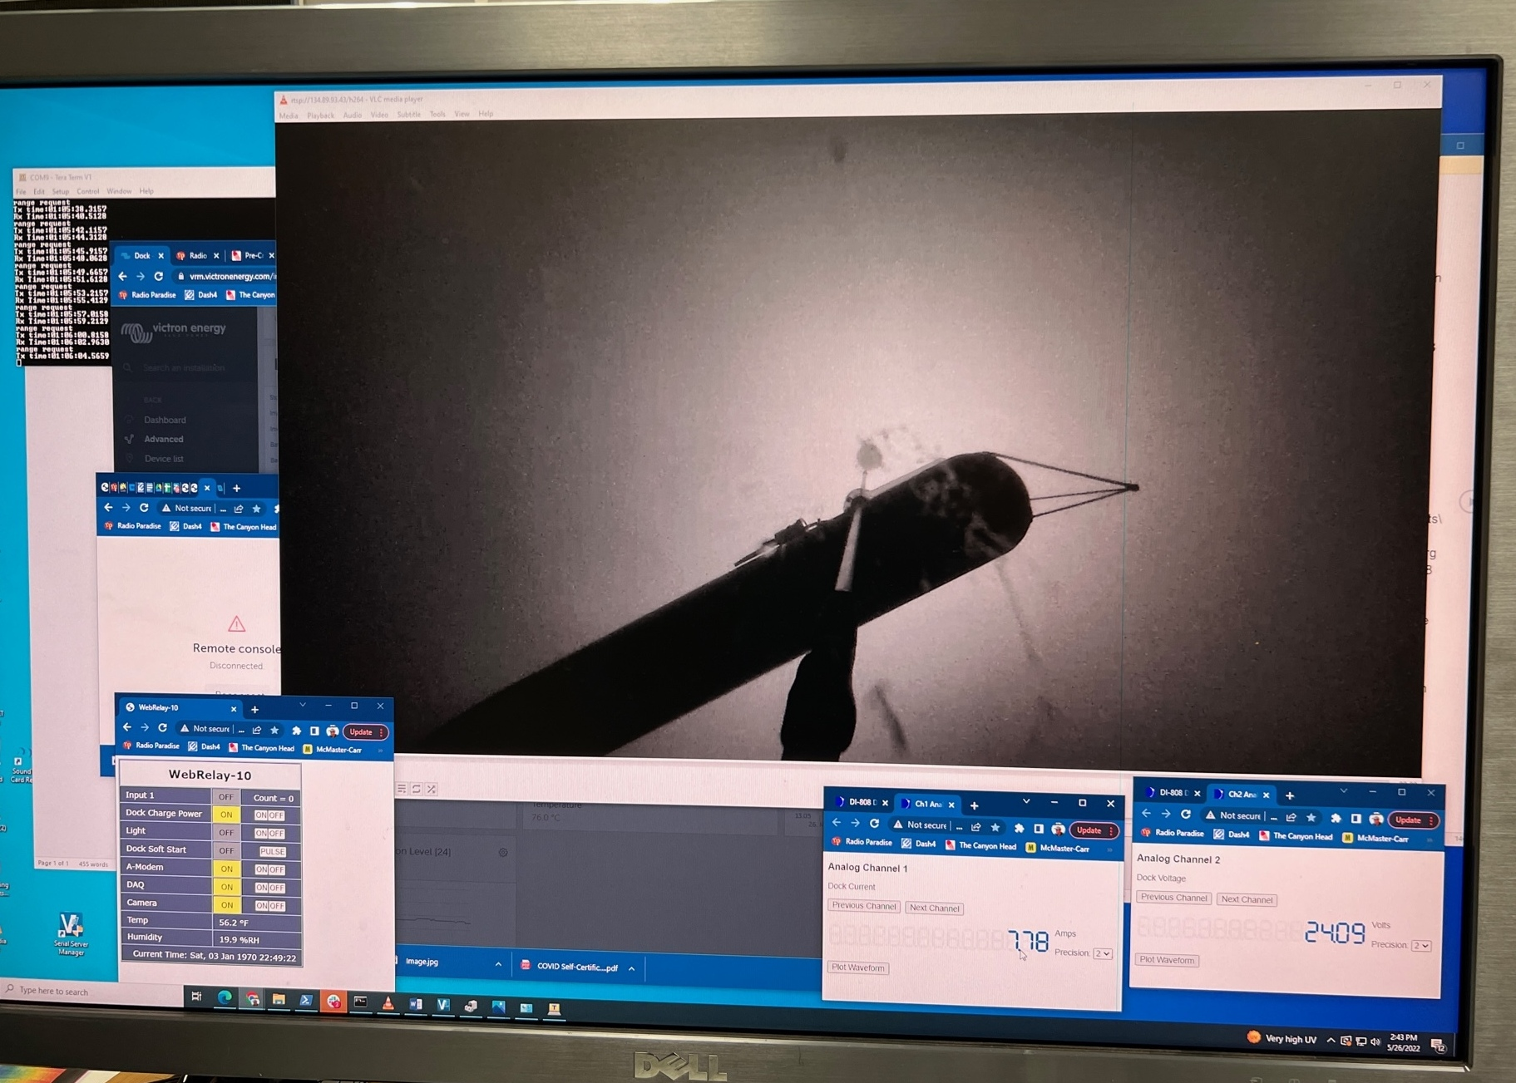

Slide 12
Underwater Vehicle Docking

Slide 13
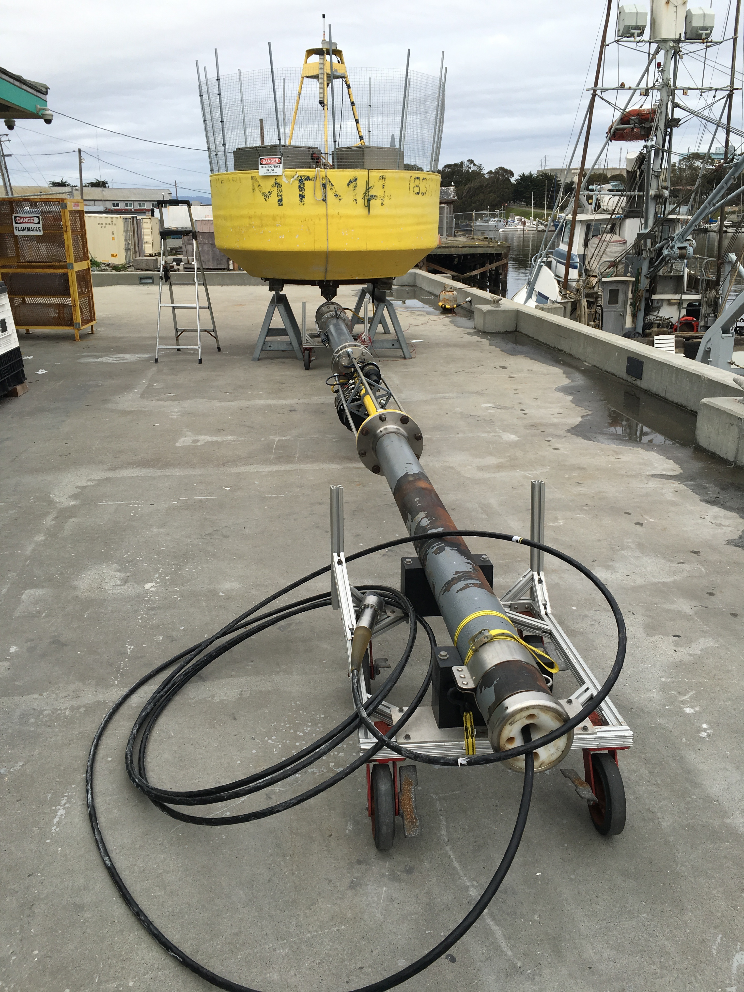
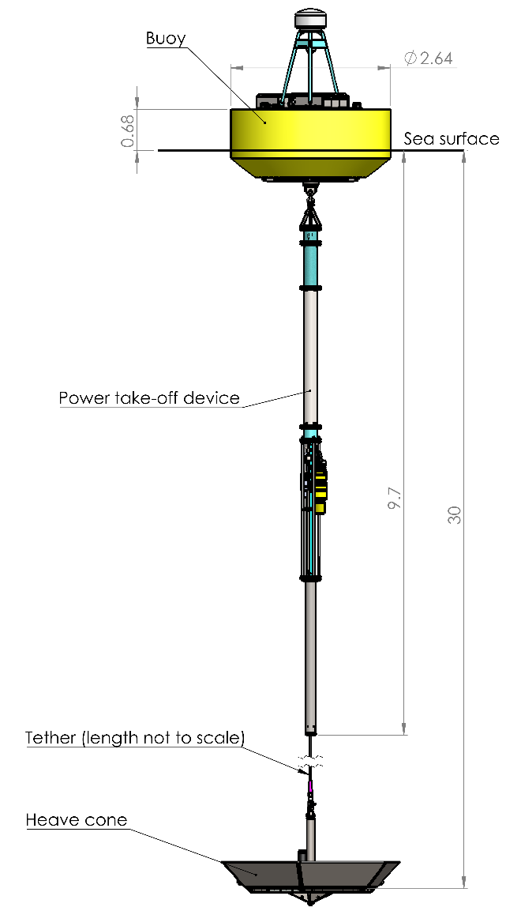
MBARI Wave-Energy Converter

Slide 14
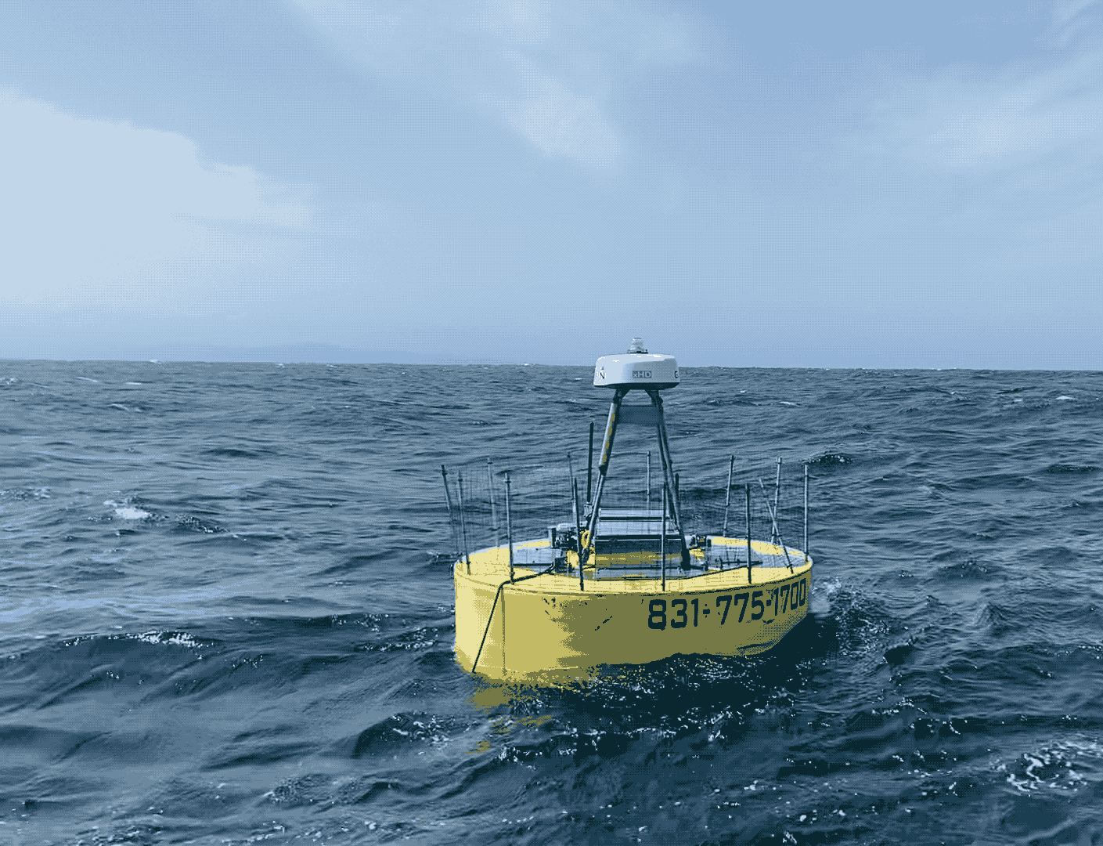
Wave-Energy Conversion Technical Challenges
Reliability and Storm Survivability
  3-5 Million wave cycles per year
  1-2 Million meters of linear travel
  Designed to maximize forces - extreme events

Slide 15
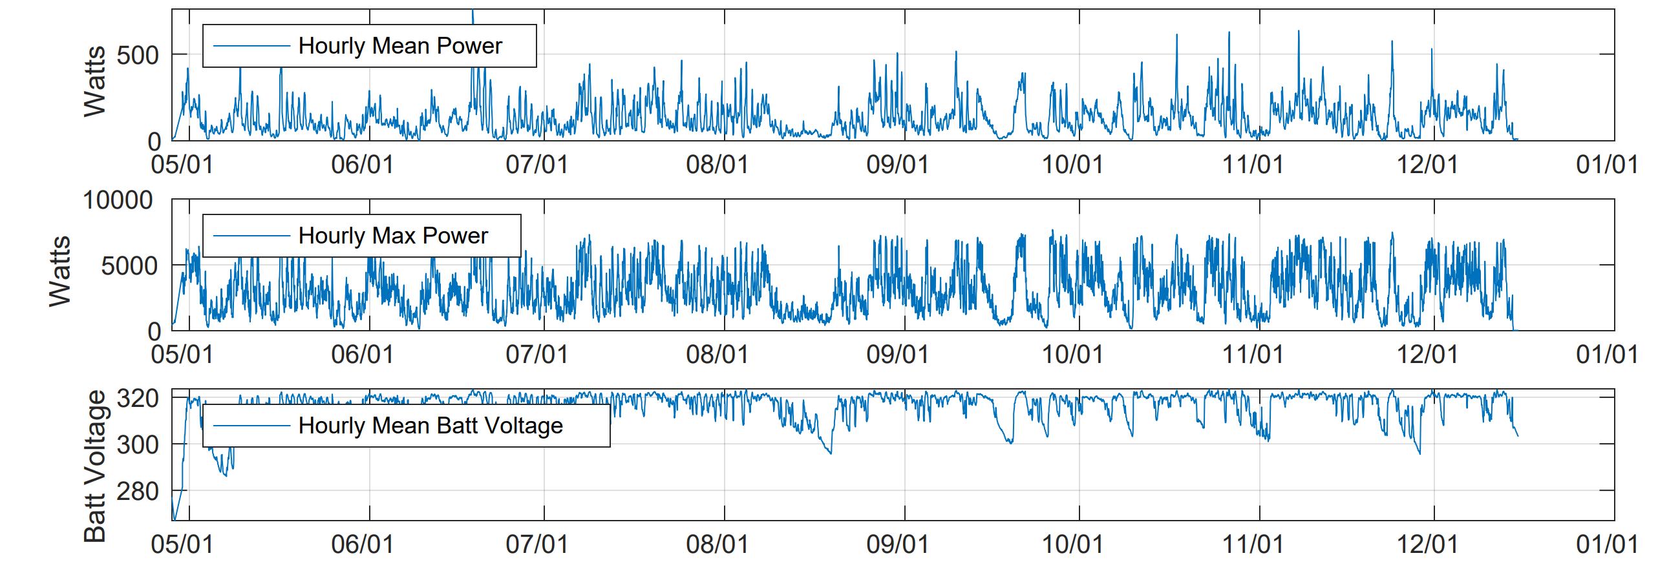
2023 Deployment - 232 Days - 225 W Avg Power

Slide 16
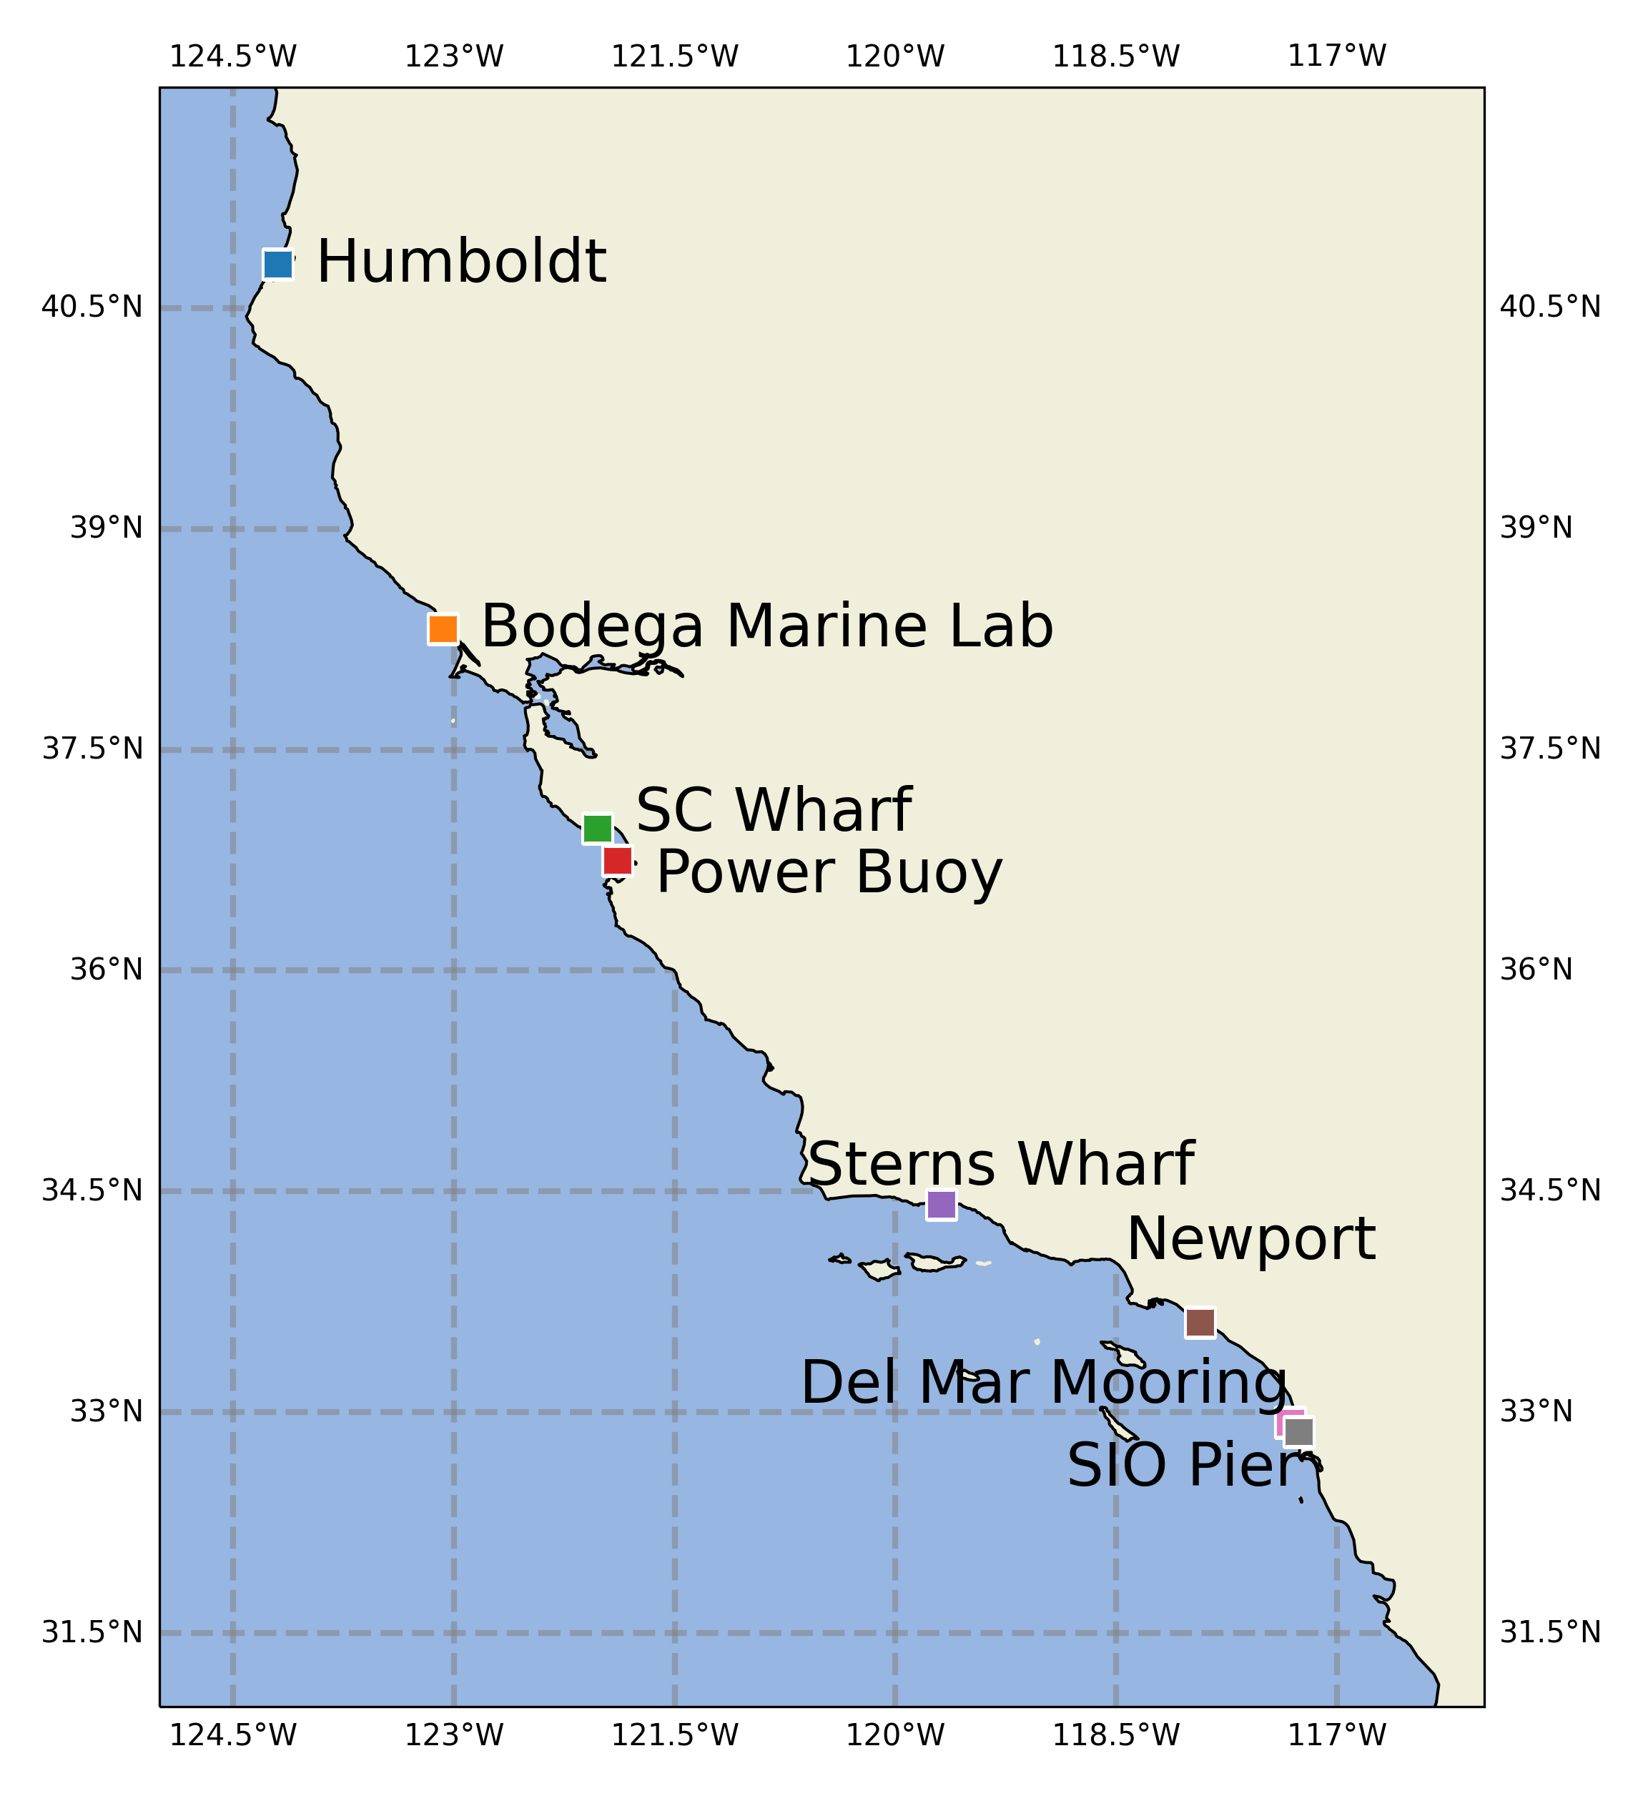
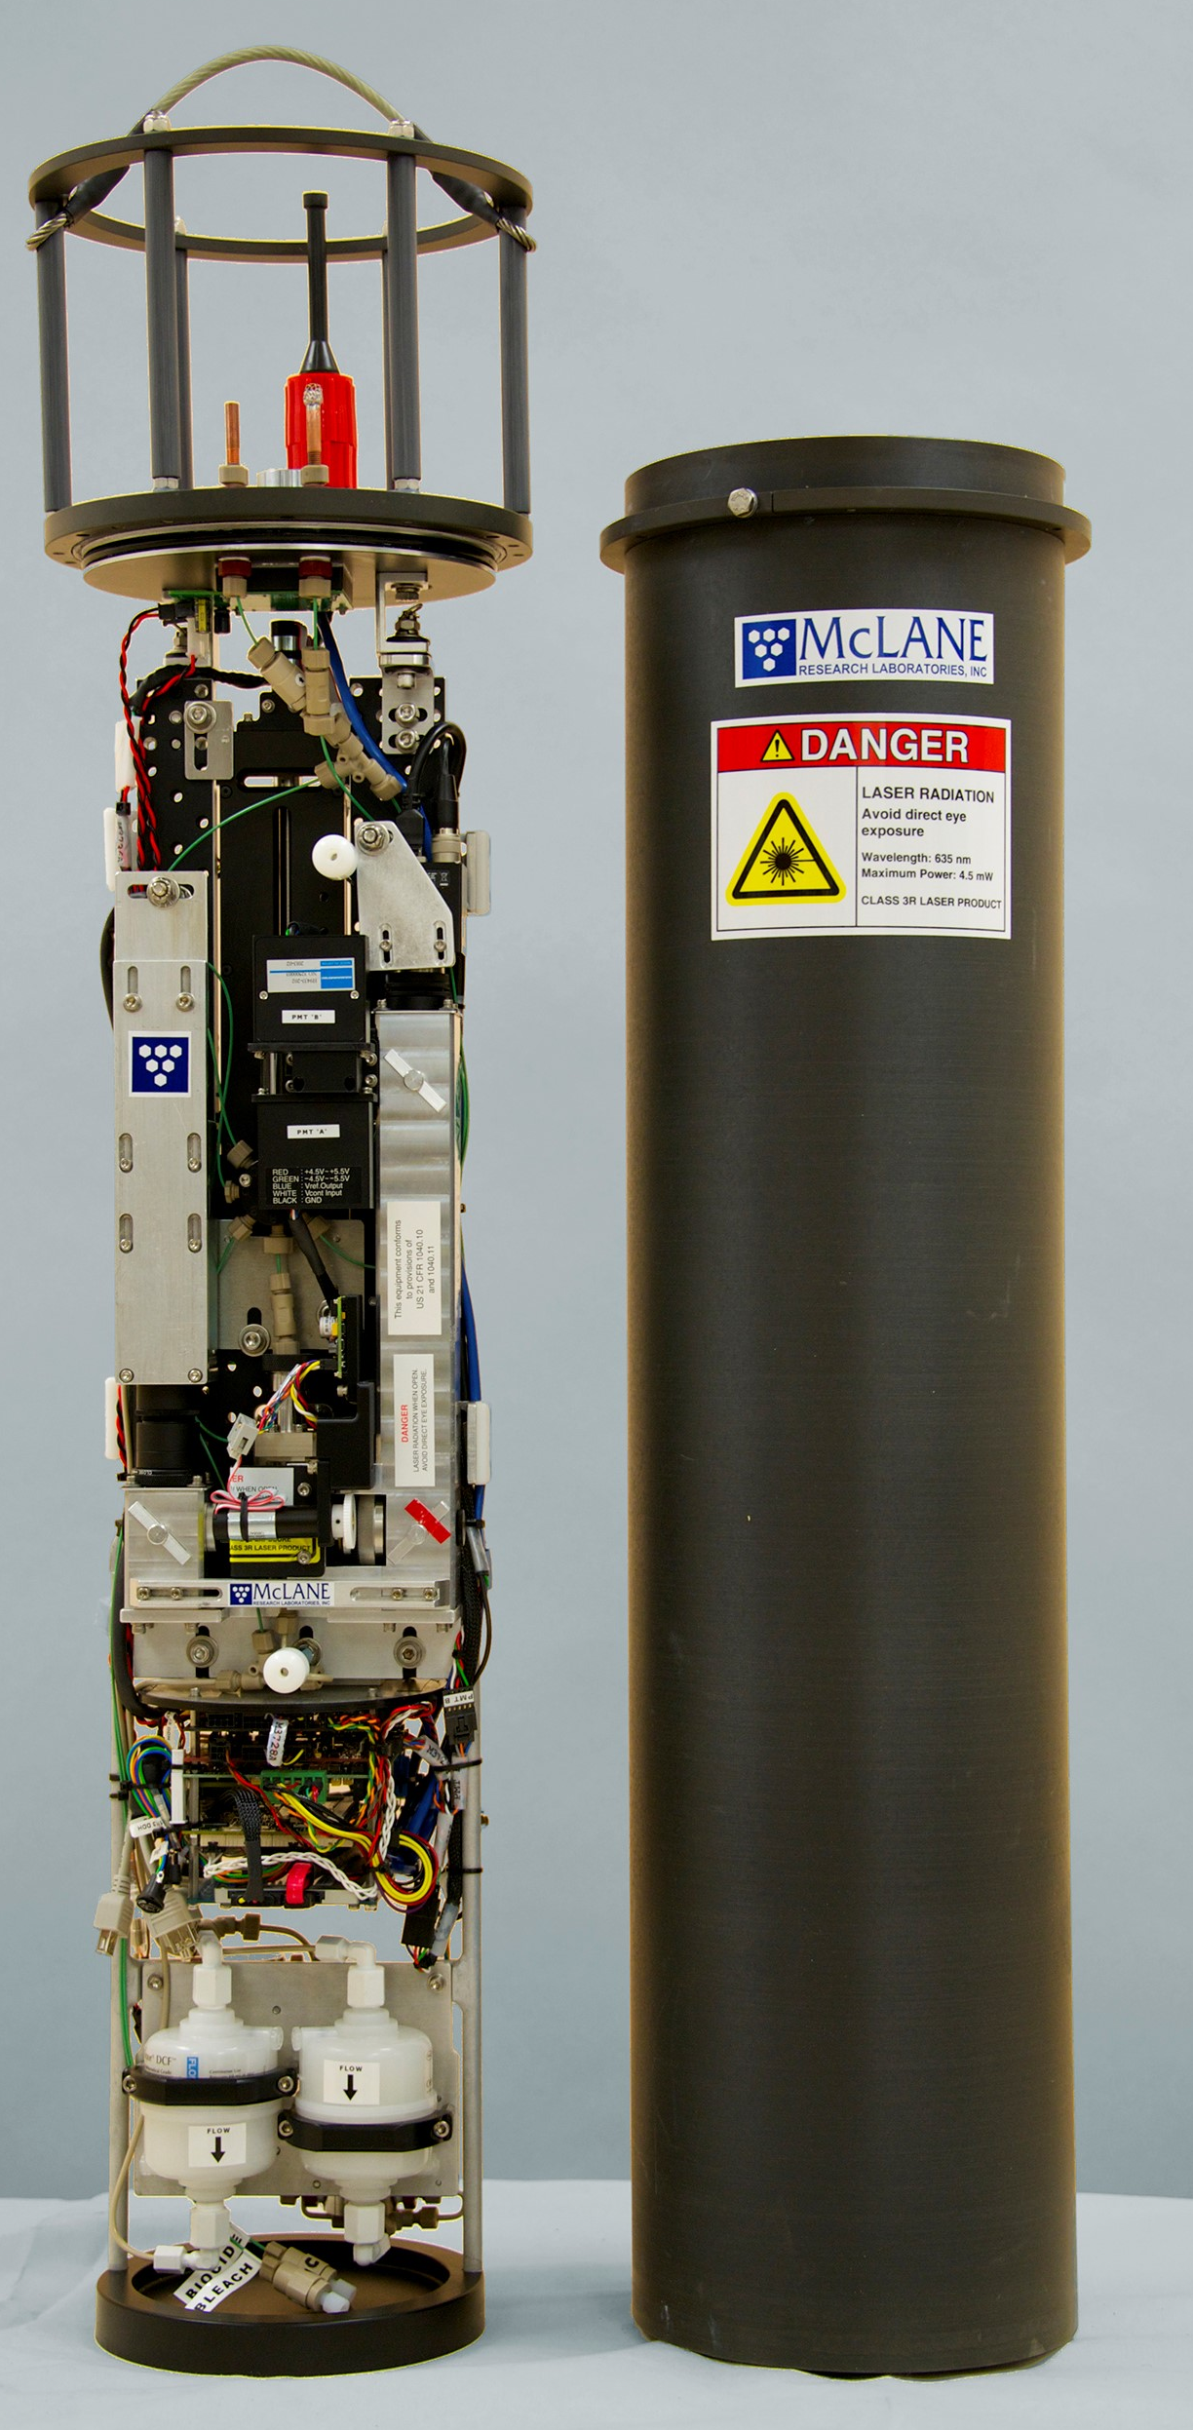
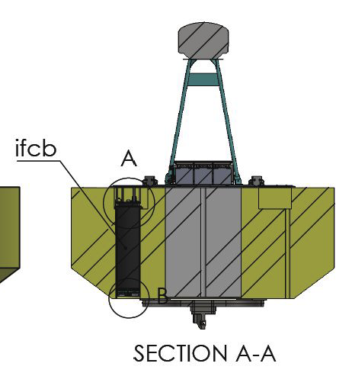
Imaging Flow Cytobot On Wave-Energy Buoy (2022 - 2025)
Sampling freq: 20-30 mins
Sampling Vol: ~5 ml
Size Range: <10 μm to 150 μm
Image Resolution: ∼ 3.4 pixels/micron
1000s of images generated every hour
~ 1GB per Day
Intake
~ 45 Watts
Patrick Daniel (Kudela Lab / UCSC)
Photo: McLane

Slide 17
Docking/Wave-Energy Combination

Slide 18
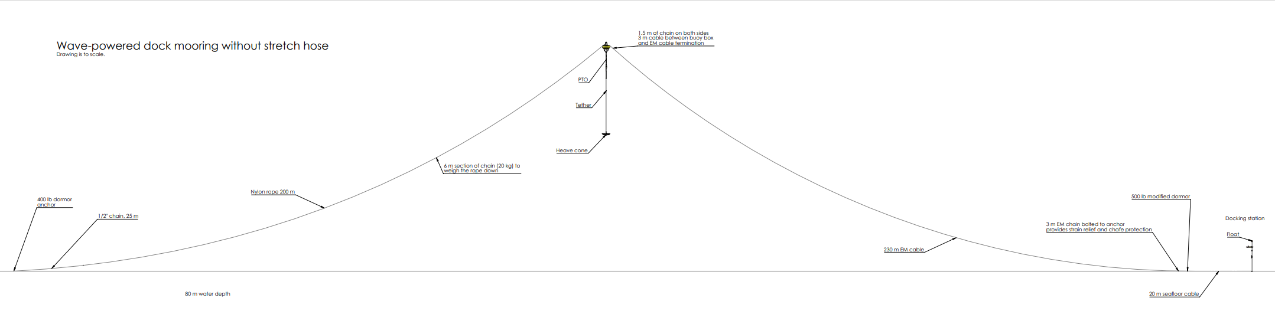
Wave-Energy Converter
Water Surface
Seafloor - 80m water depth
AUV Dock
350 m
Add Map of deployment location in the Bay

Slide 19
Facts and Figures

