Slide 1
Underwater Vehicle Docking for Extended Deployments
Andrew Hamilton

Slide 2
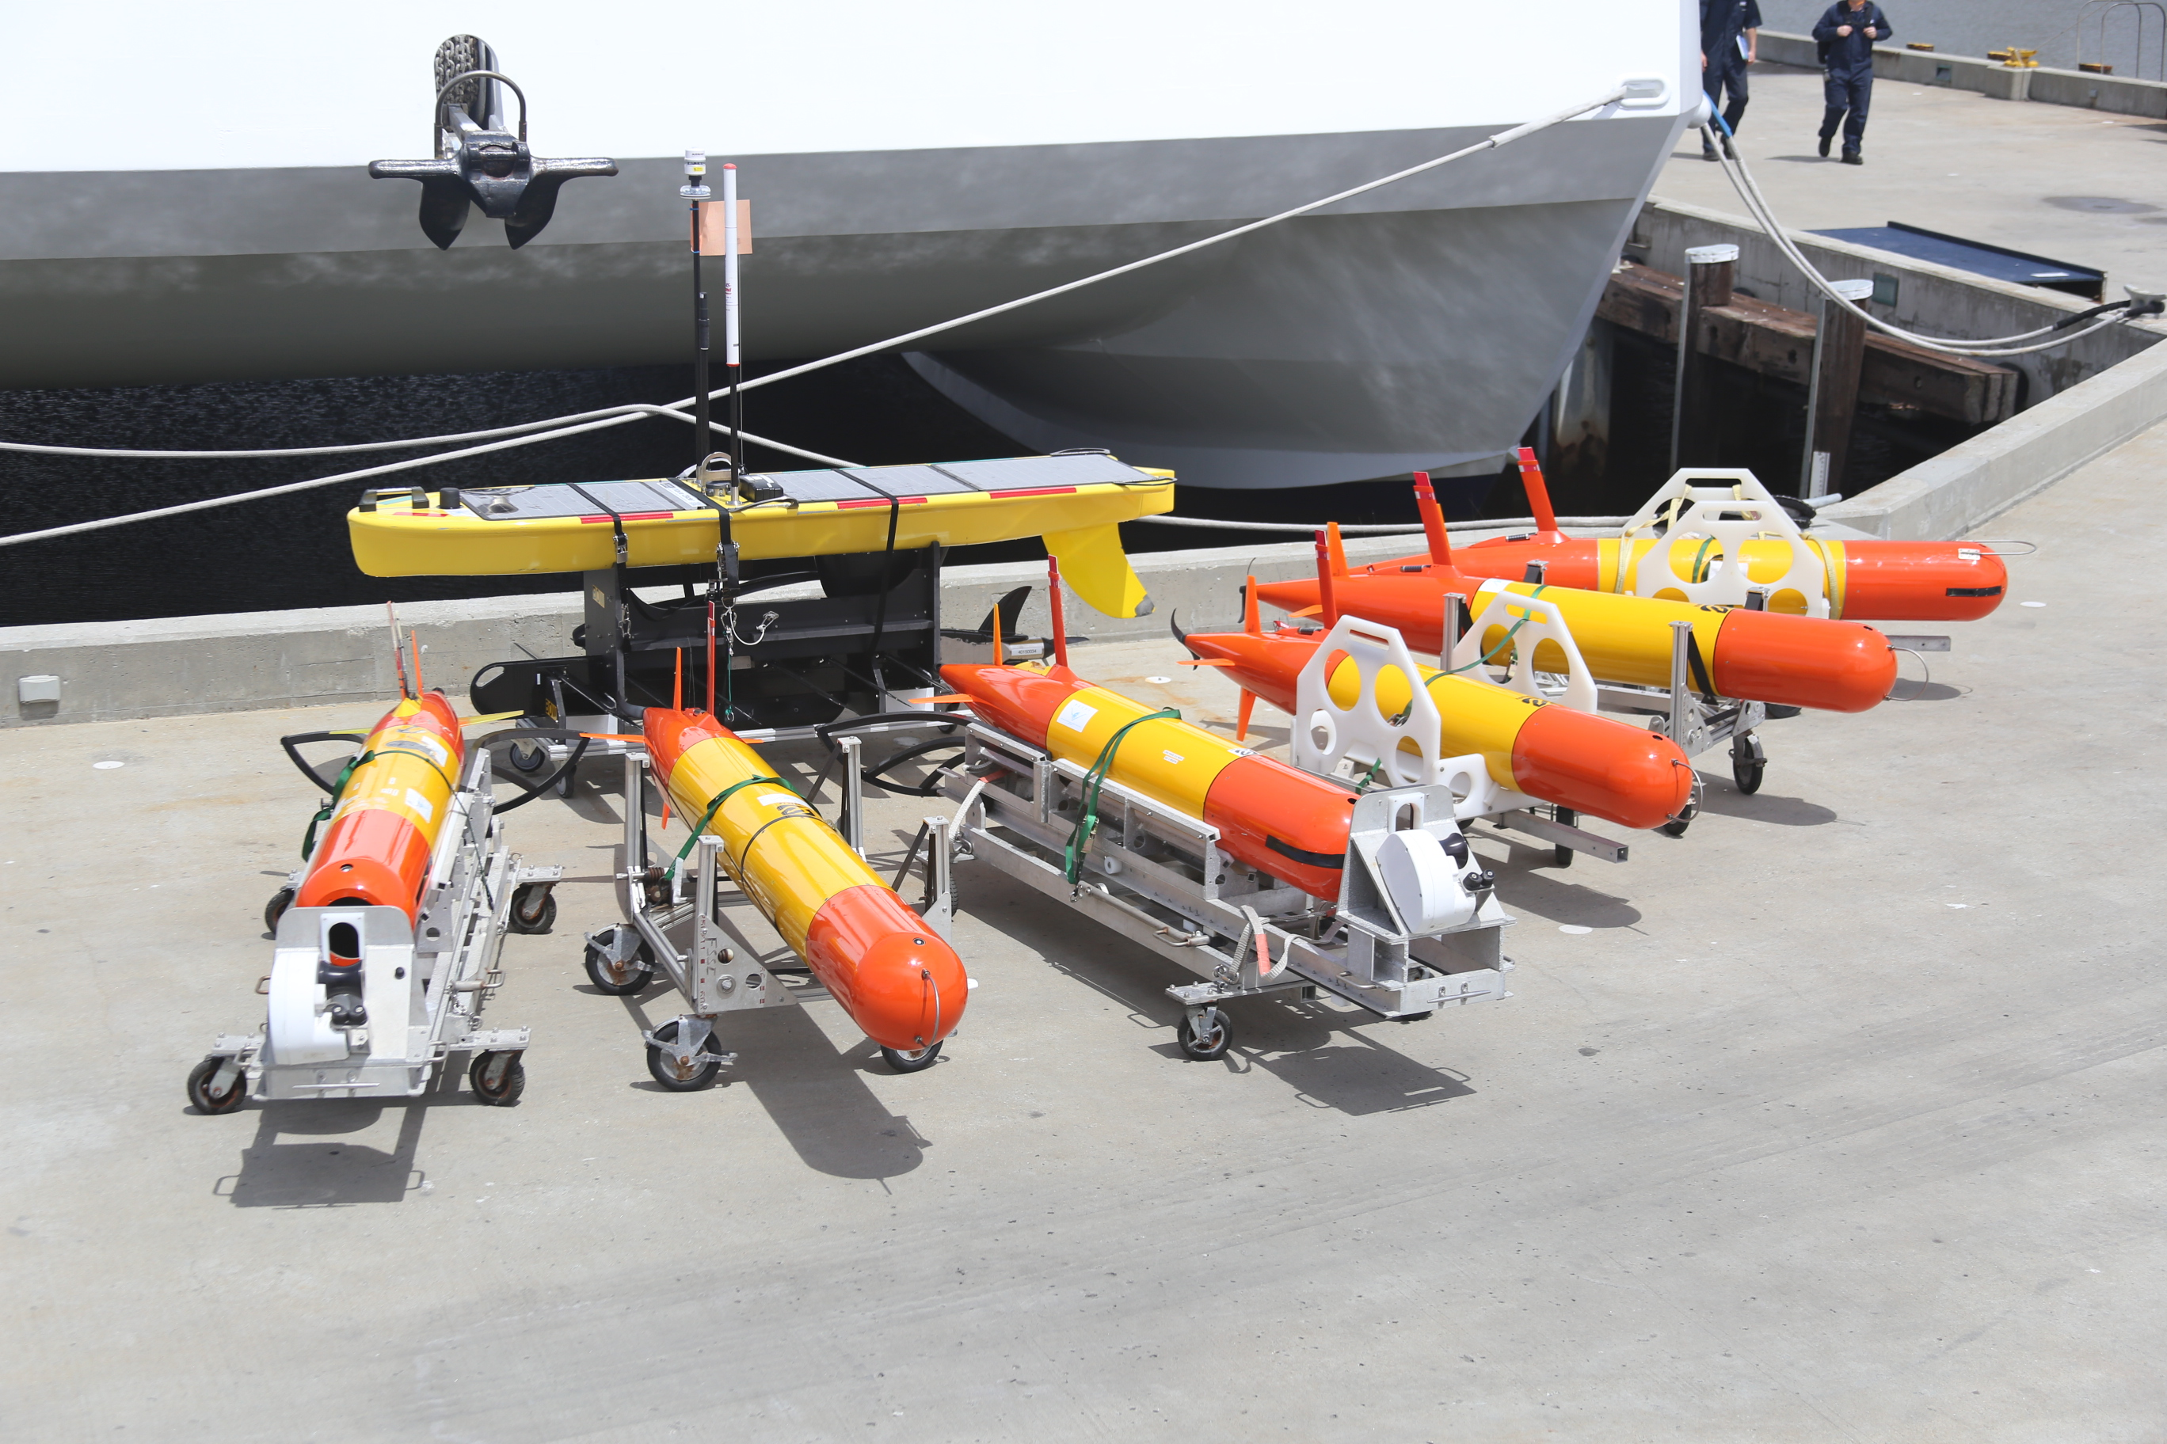
Persistent Presence for Autonomous Long Term Monitoring
Three technology areas needed:
Vehicles
  Reliability
  Autonomy
  Instrumentation
Energy & Communication
Docking Capability

Slide 3
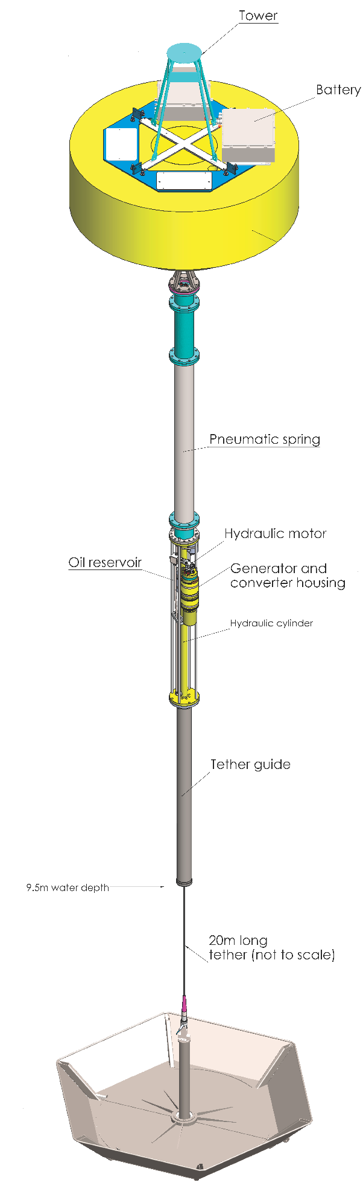
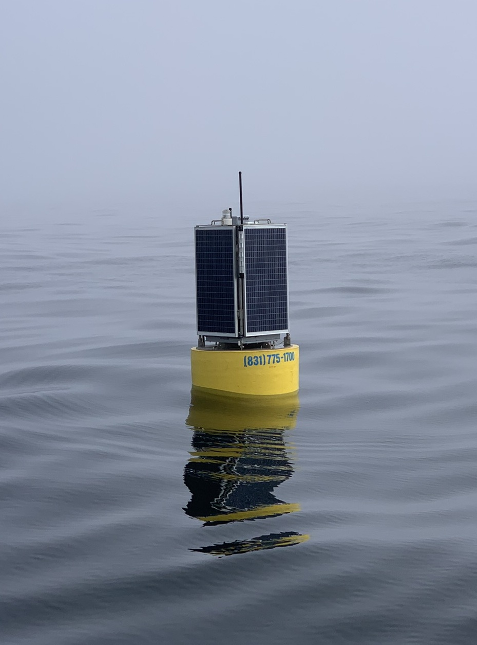

Persistent Presence for Autonomous Long Term Monitoring
Three technology areas needed:
Vehicles
  Reliability
  Autonomy
  Instrumentation
Energy & Communication
Docking Capability

Slide 4
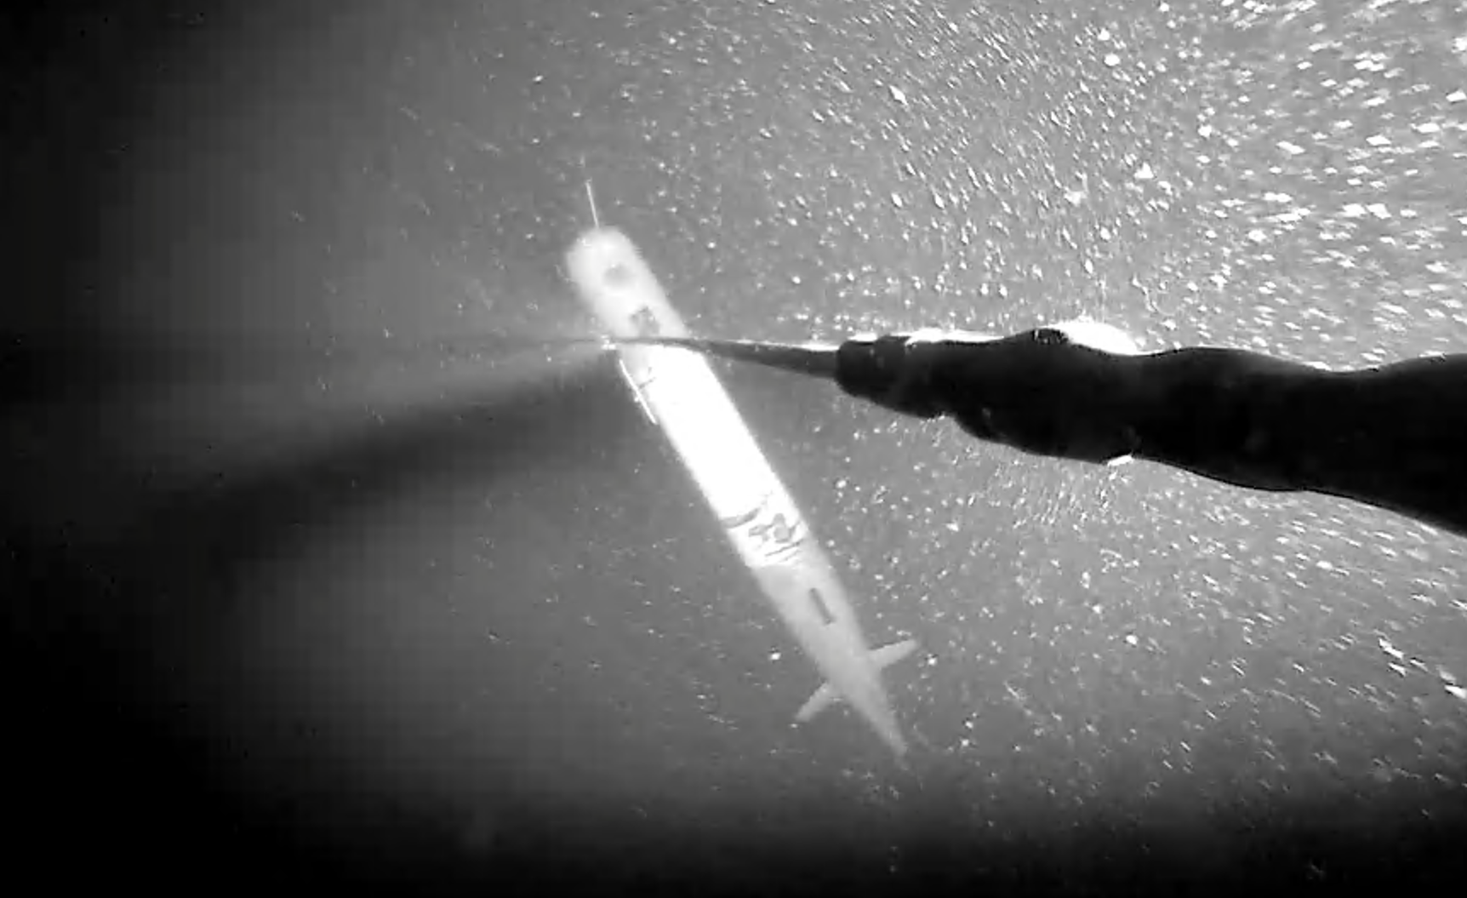
Persistent Presence for Autonomous Long Term Monitoring
Three technology areas needed:
Vehicles
  Reliability
  Autonomy
  Instrumentation
Energy & Communication
Docking Capability

Slide 5
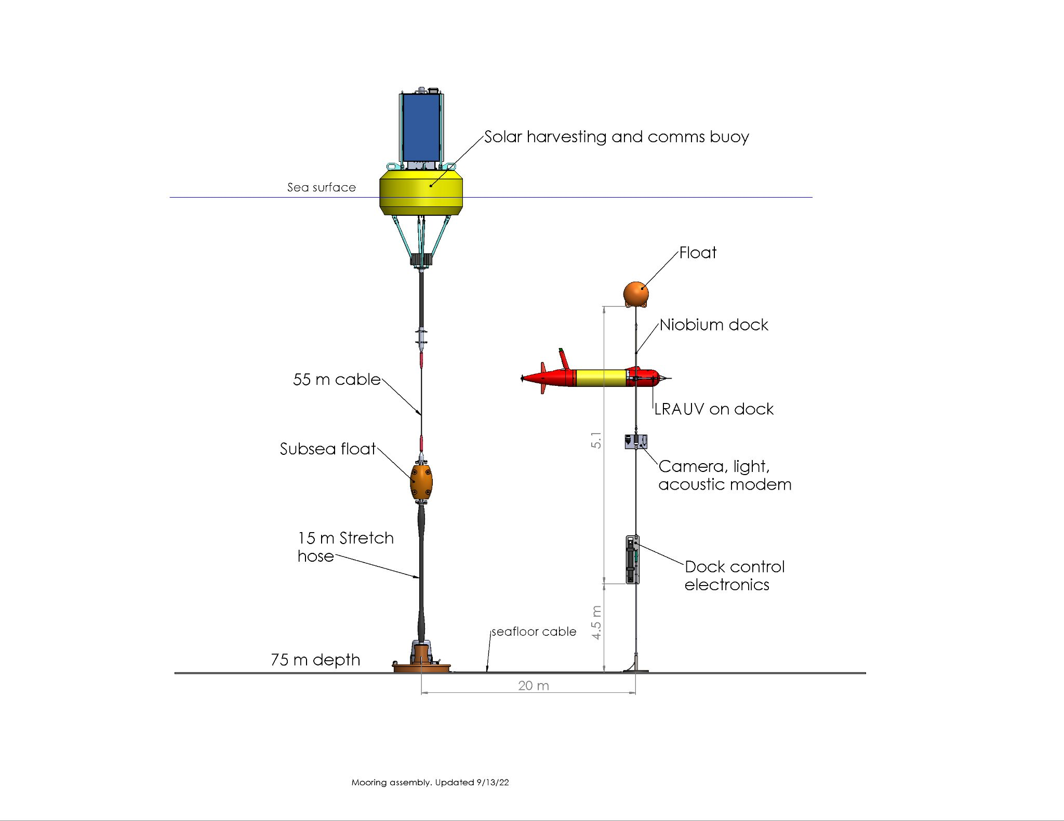

Slide 6
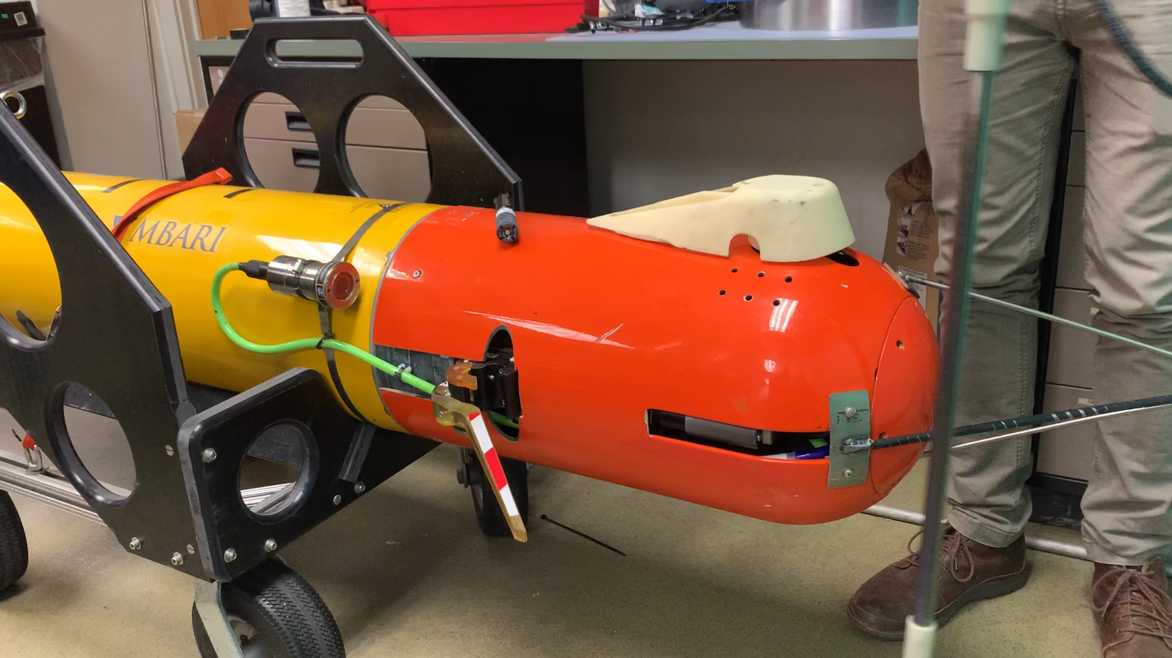
Notes:
Replace with more recent video

Slide 7
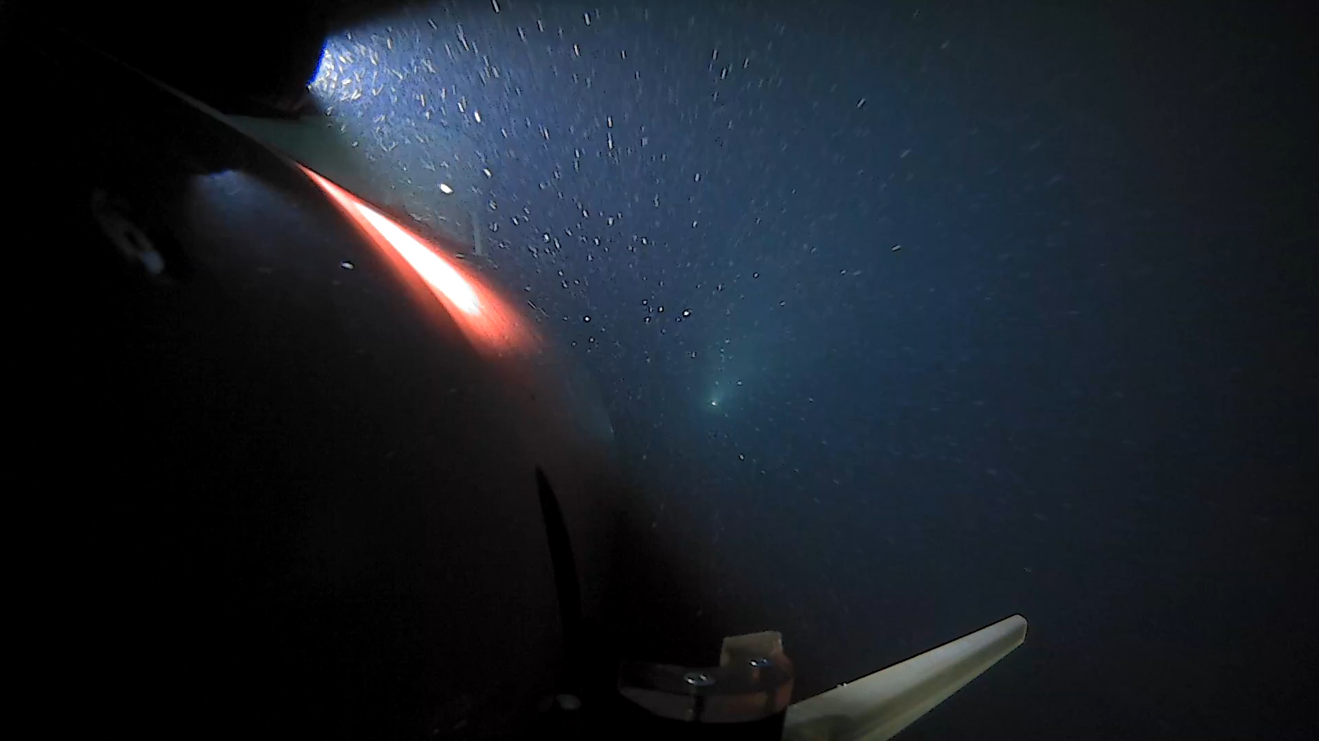

Slide 8
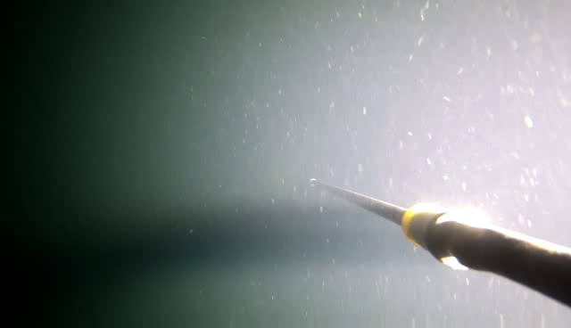

Slide 9
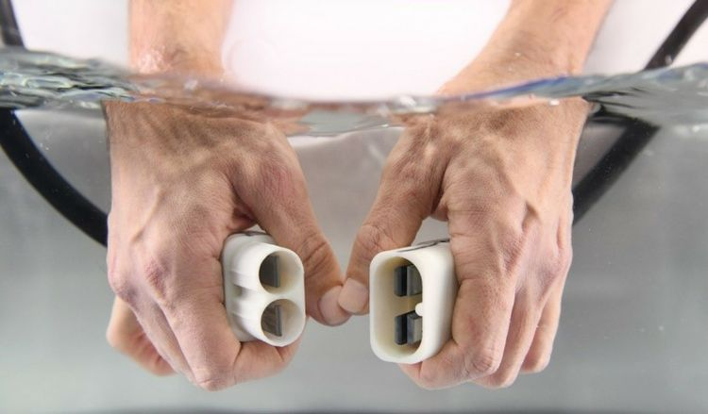
Niobicon Technology for Power Transfer
Patented and developed by Northrop-Grumman
Uses pure niobium
Thin film isolates niobium in water
Can allow axial and rotary motion
Limited to 60 V and moderate power

Slide 10
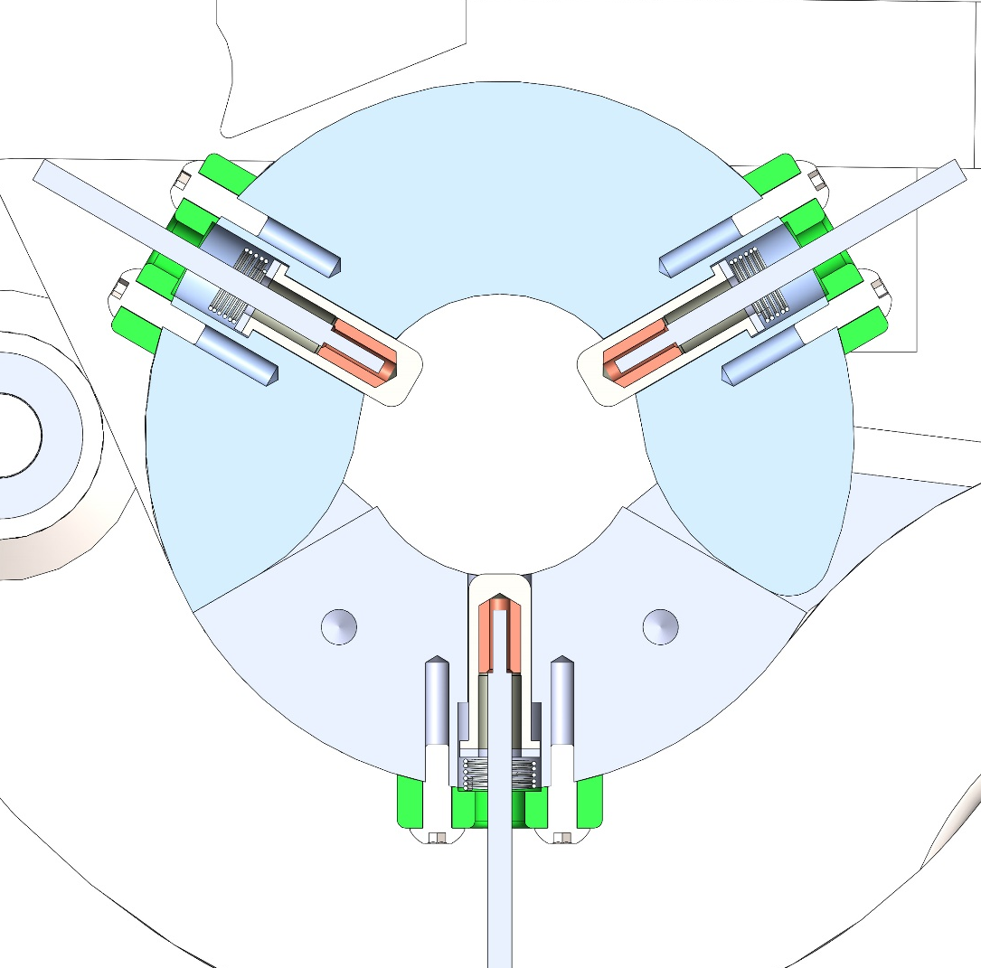
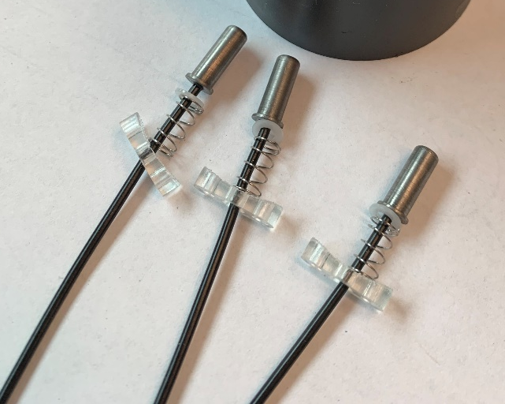
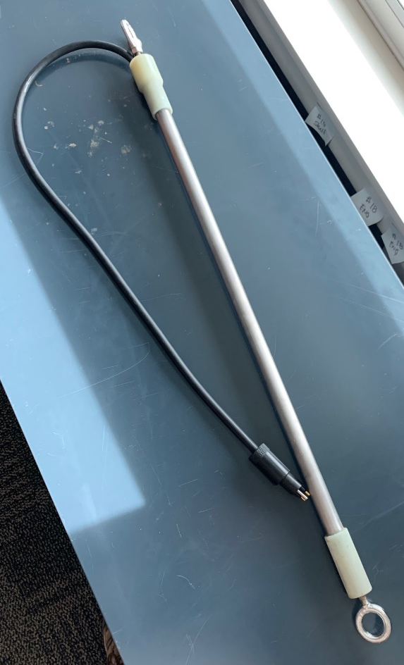
Power and Data Transfer
Niobium “brushes”
Spring loaded niobium brushes inside clamp
Charge rod

Slide 11
Solar Powered Dock
~15 Watts: Recharge one LRAUV each week or two

Slide 12
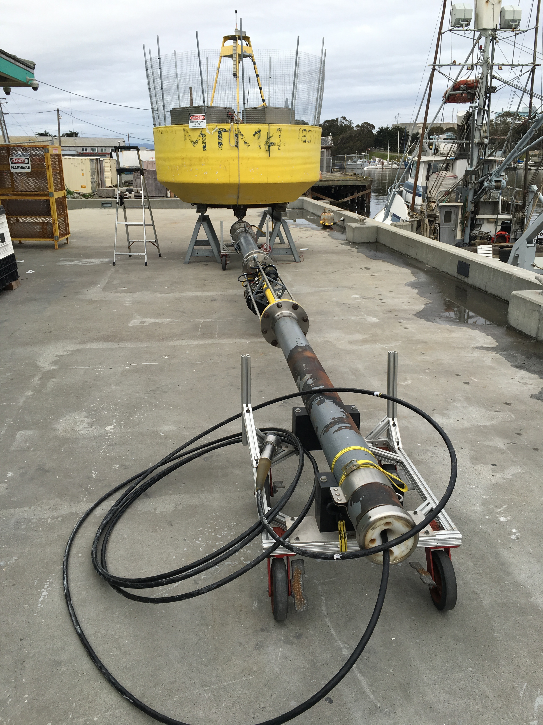
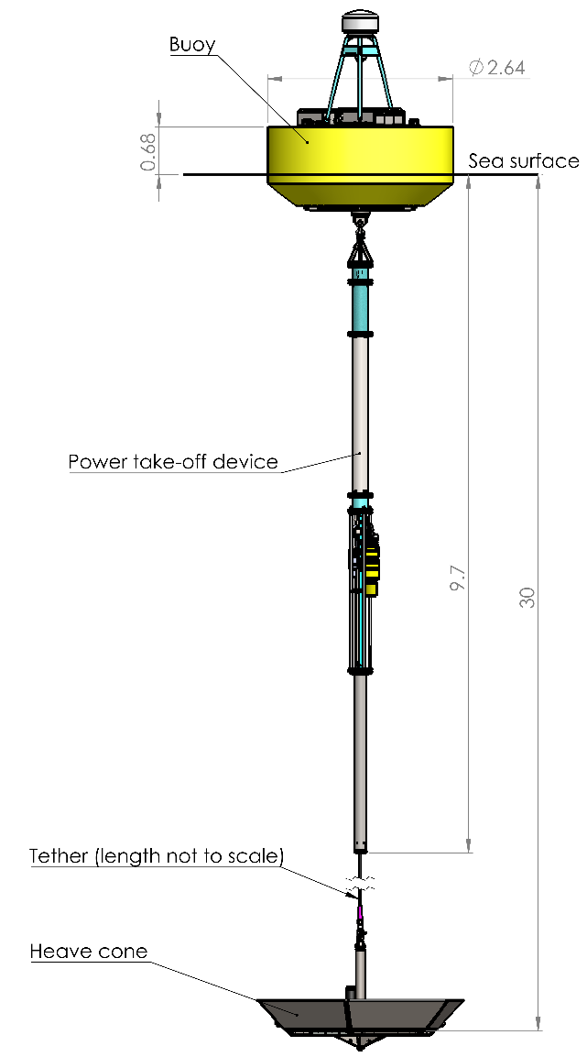
MBARI Wave-Energy Converter

Slide 13
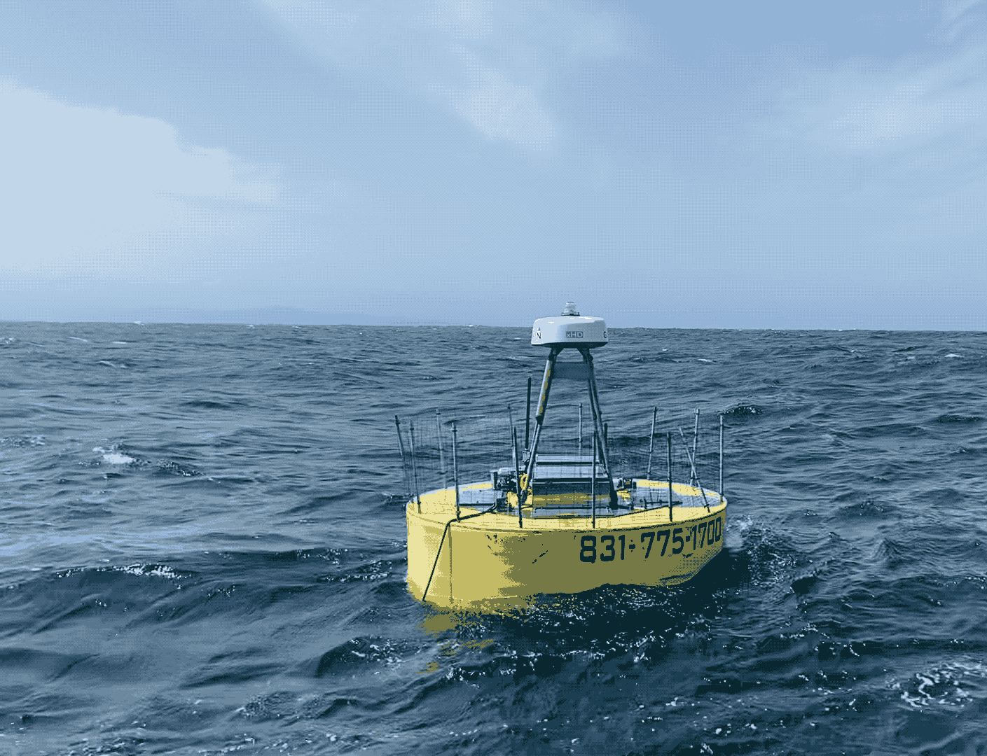
Wave-Energy Conversion Technical Challenges
Reliability and Storm Survivability
  3-5 Million wave cycles per year
  1-2 Million meters of linear travel
  Designed to maximize forces - extreme events

Slide 14
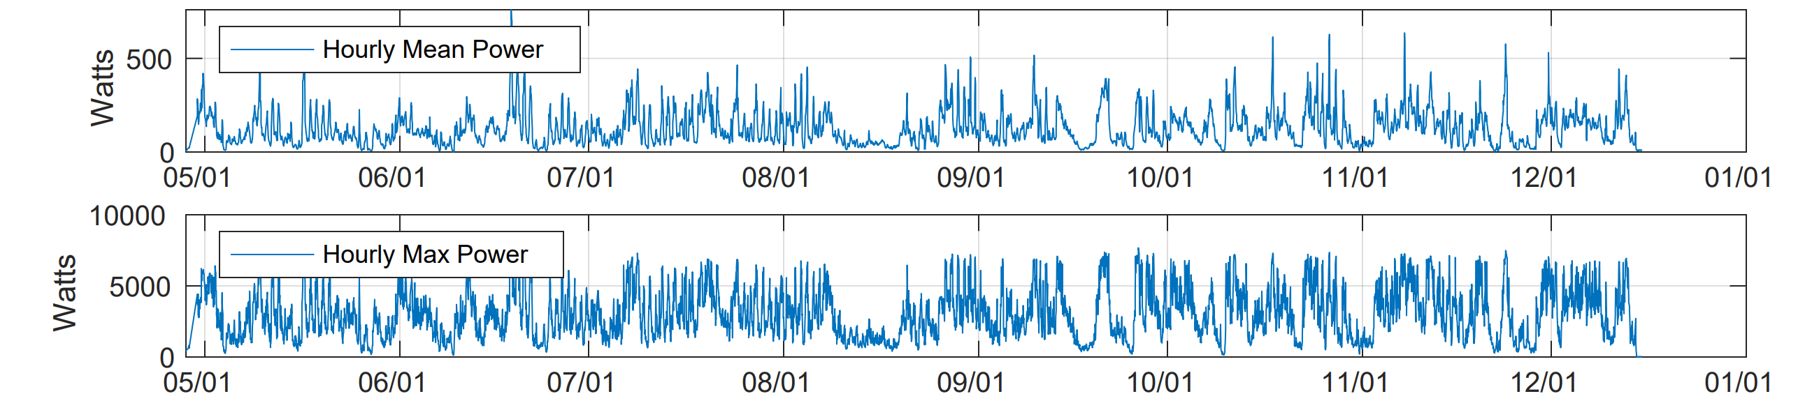
2023 Deployment - 232 Days - 225 W Avg Power

Slide 15
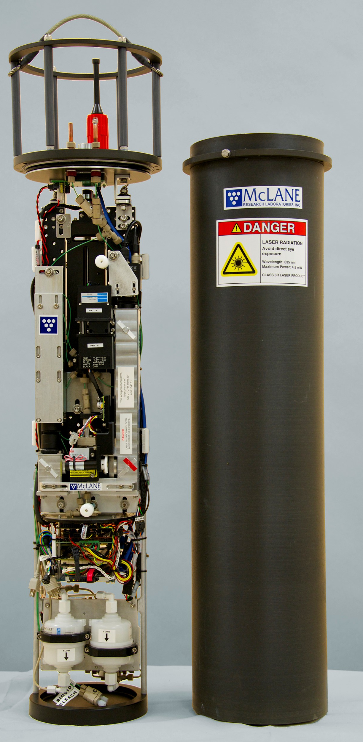
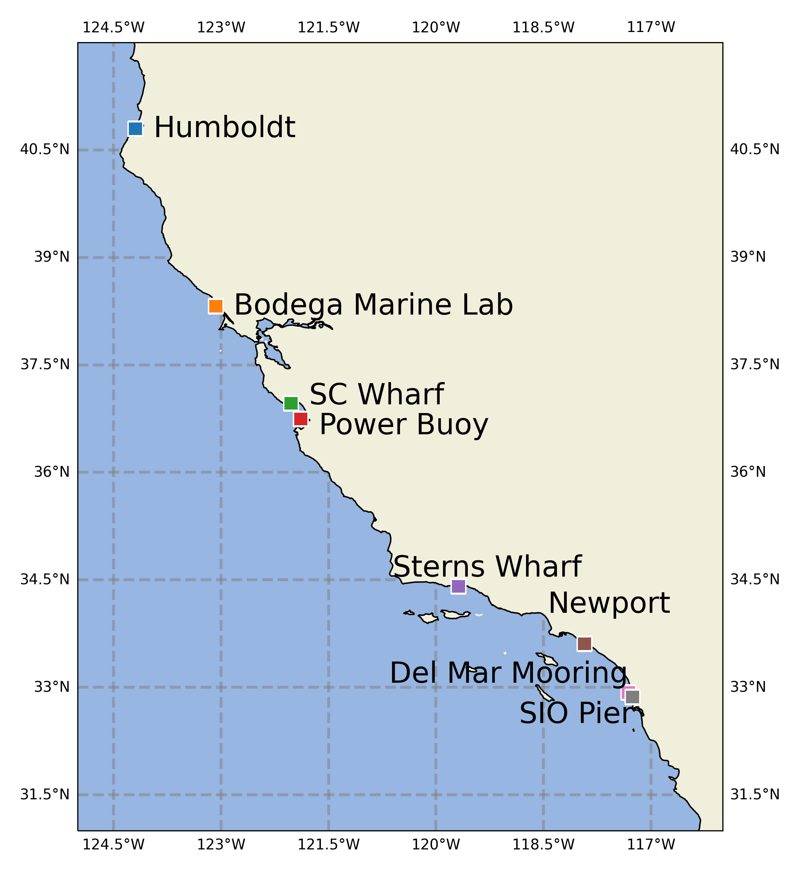
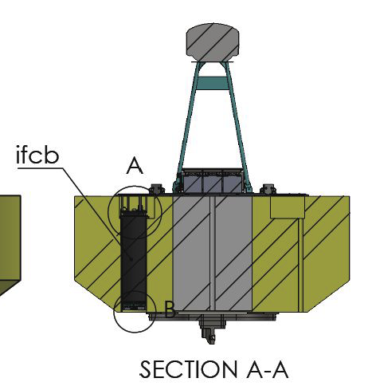
Imaging Flow Cytobot On Wave-Energy Buoy (2022 - 2025)
Sampling freq: 20-30 mins
Sampling Vol: ~5 ml
Size Range: <10 μm to 150 μm
Image Resolution: ∼ 3.4 pixels/micron
1000s of images generated every hour
~ 1GB per Day
Intake
~ 45 Watts
Patrick Daniel (Kudela Lab / UCSC)
Photo: McLane

Slide 16
Docking/Wave-Energy Combination
~225 Watts: Recharge one LRAUV each day

