Slide 1
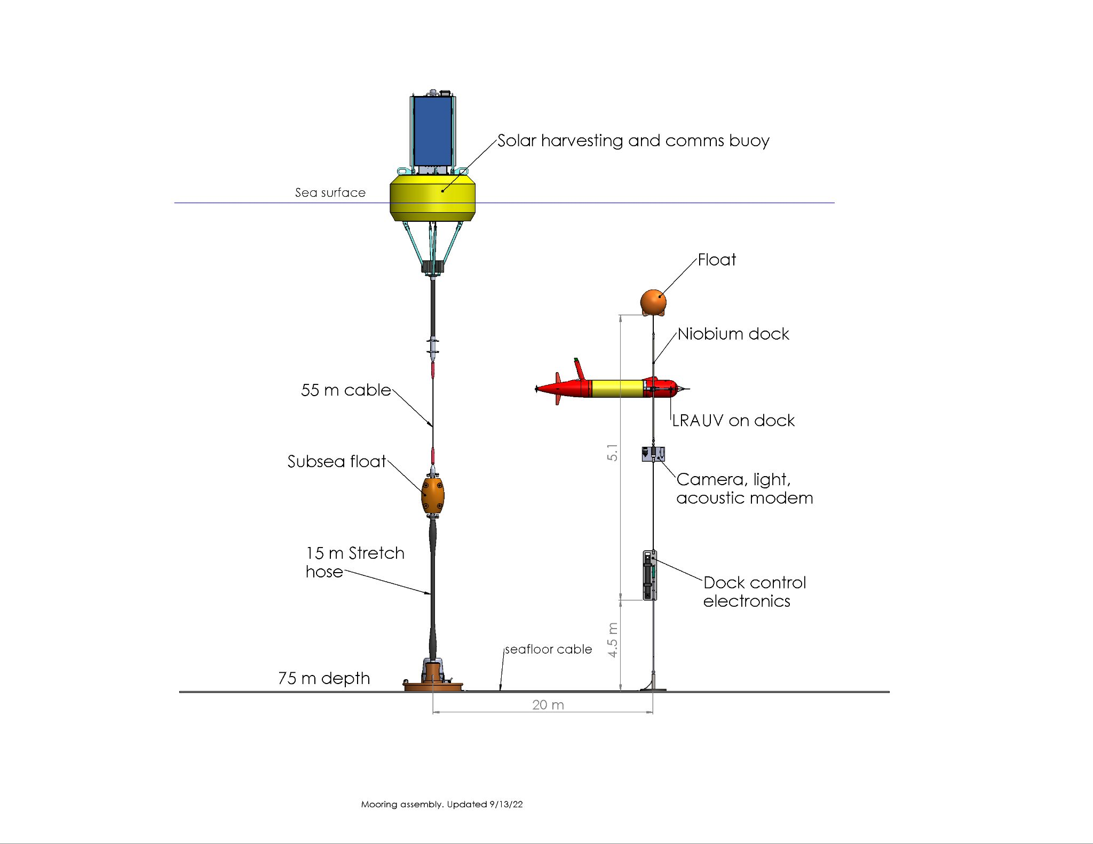

Slide 2
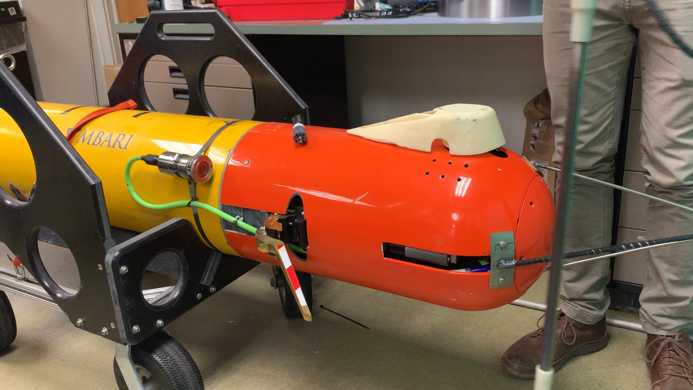
Notes:
Replace with more recent video

Slide 3
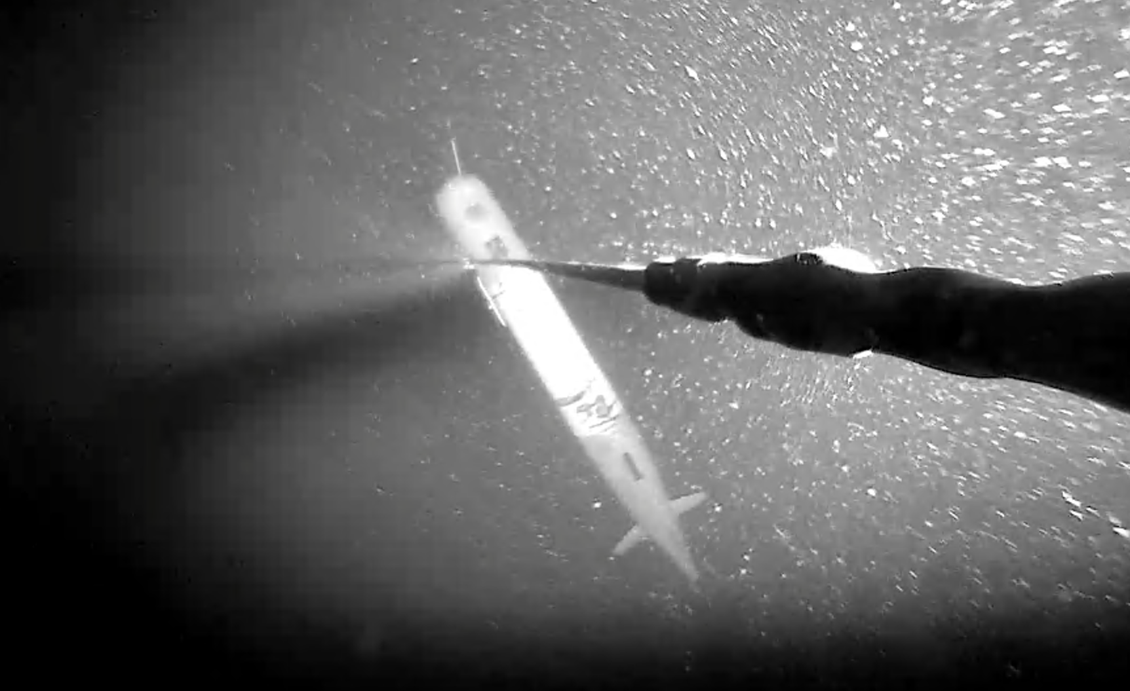

Slide 4
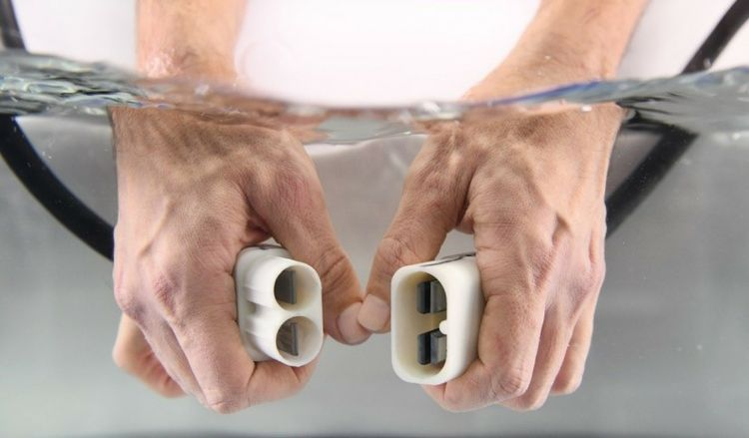
Niobicon Technology for Power Transfer
Patented and developed by Northrop-Grumman
Uses pure niobium
Thin film isolates niobium in water
Can allow axial and rotary motion
Limited to 60 V and moderate power

Slide 5
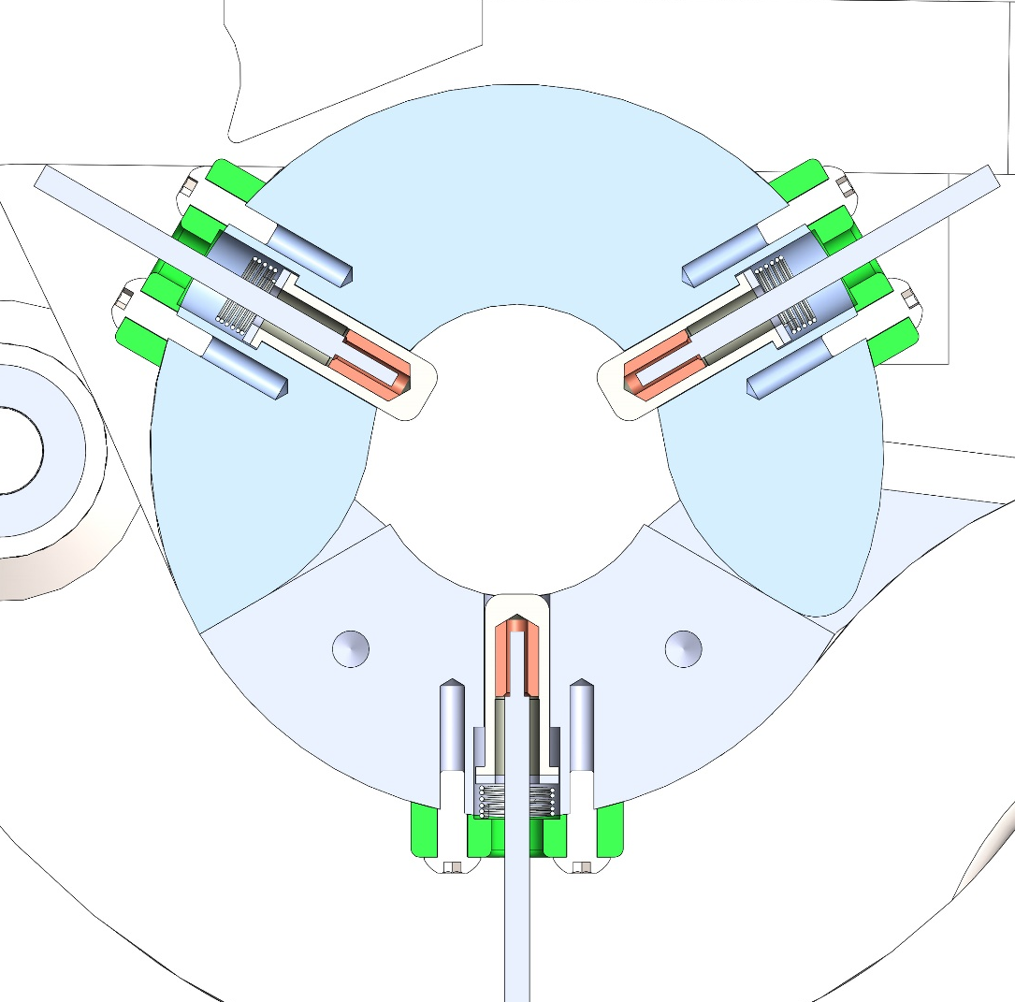
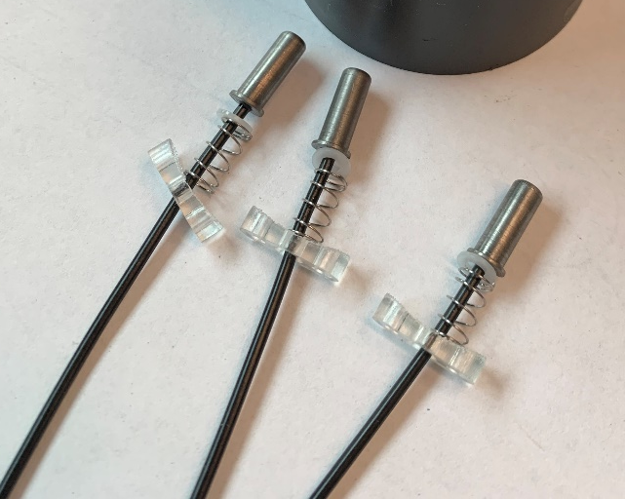
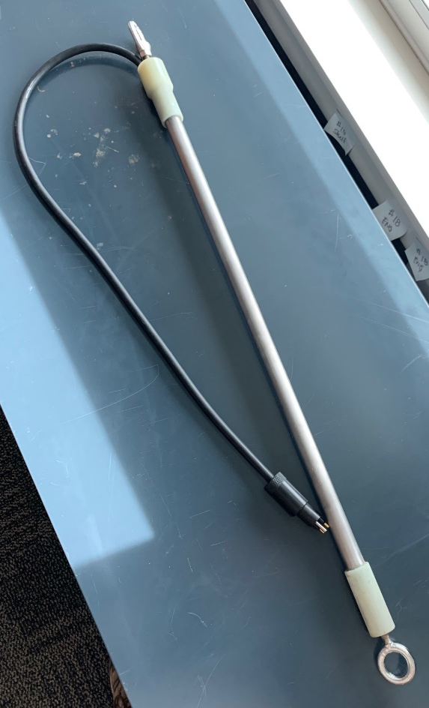
Power and Data Transfer
Niobium “brushes”
Spring loaded niobium brushes inside clamp
Charge rod

Slide 6
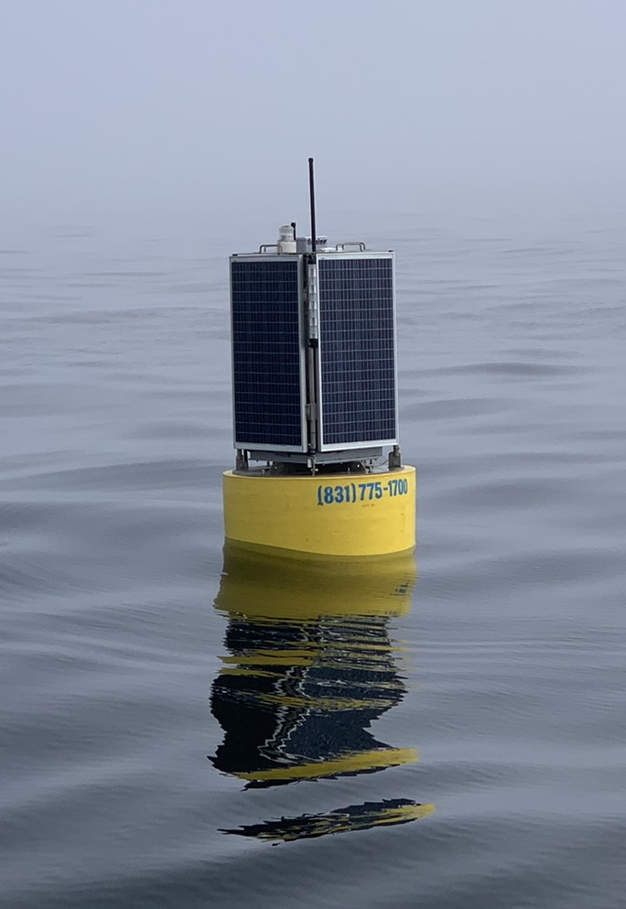
Solar Powered Dock
~15 Watts: Recharge one LRAUV each week or two

Slide 7
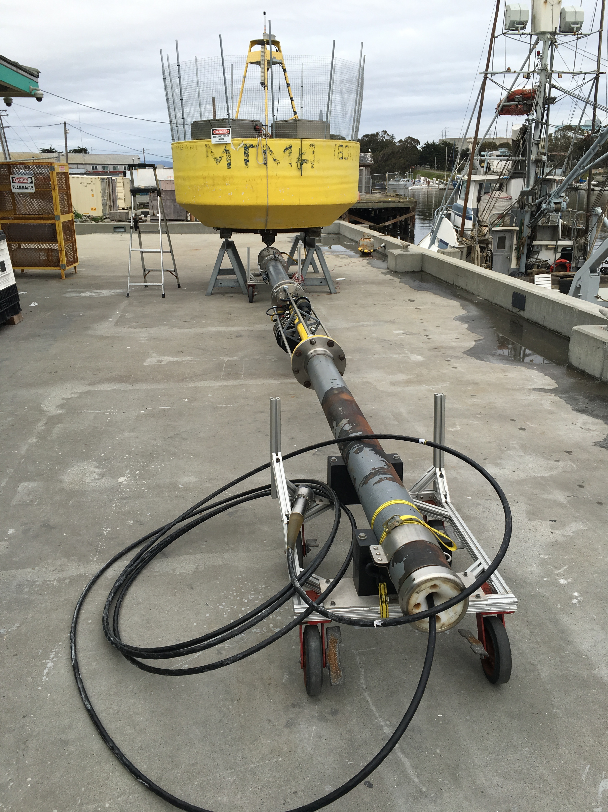
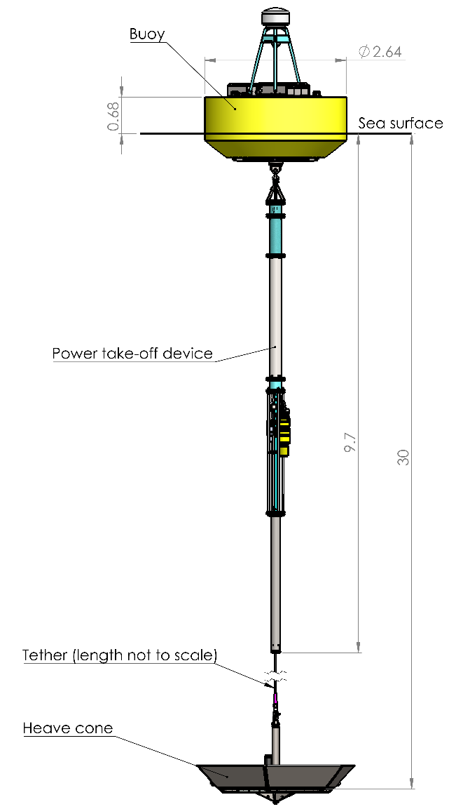

MBARI Wave-Energy Converter

Slide 8
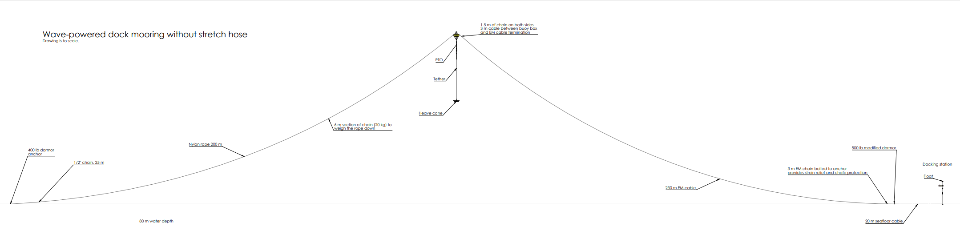
~200 Watts: Recharge one LRAUV each day or two

Slide 9
Status and Plans
Solar-powered Dock to be deployed – September 1st
  - minor updates to previous deployments.
Wave-powered Dock to be deployed September 15th
  New hardware and mooring.

