Slide 1
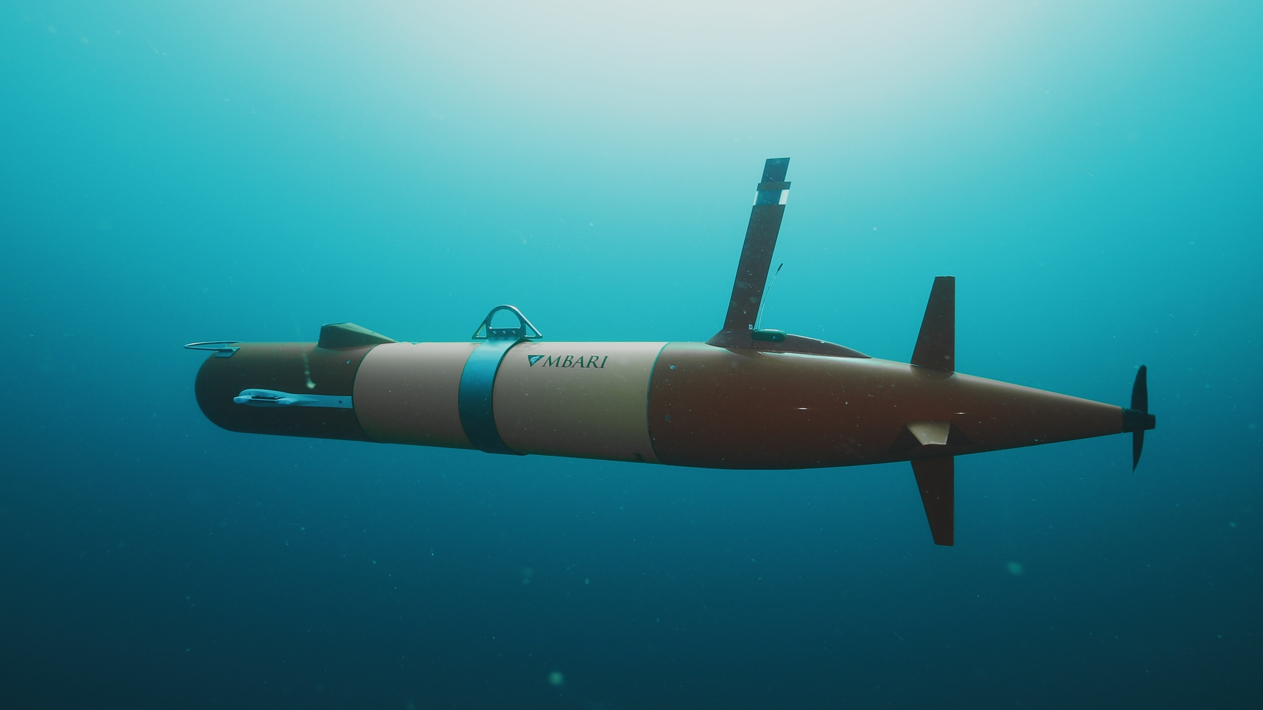

Slide 2
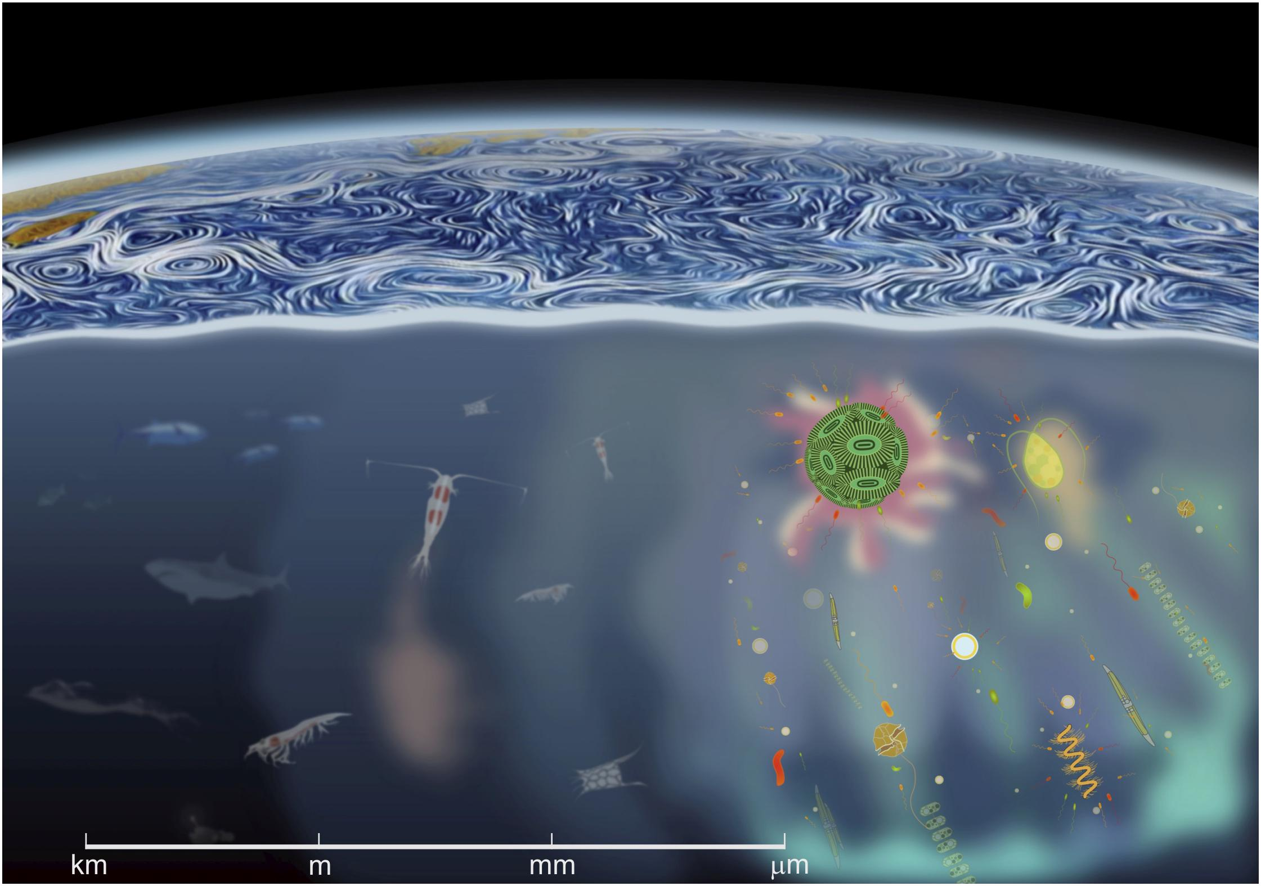
LRAUV Imaging Systems: Micro to Mega
Piscivore (Mega)
Triton (Macro)
Planktivore (Micro)
Basterratxea et al. Front. Mar. Sci., 25 March 2020
Notes:
Why are they so difficult to answer?
The ocean is a complex volume of fluid with a vast assortment of organisms that span nearly 9 orders of magnitude in size.
On the bottom right, we have the micron sized phytoplankton, protists, and bacteria
Moving to the left we have the zooplankton grazers like krill and copepods that feed on phytoplankton and other zooplankton
And on the left we have the large fish and mammals that feed on the zooplankton and other top predators
Despite this vast range is sizes, many of these organisms directly depend on and interact with each other. This makes it necessary to broaden our questions and samples to cover this immense range of space and time scales

Slide 4
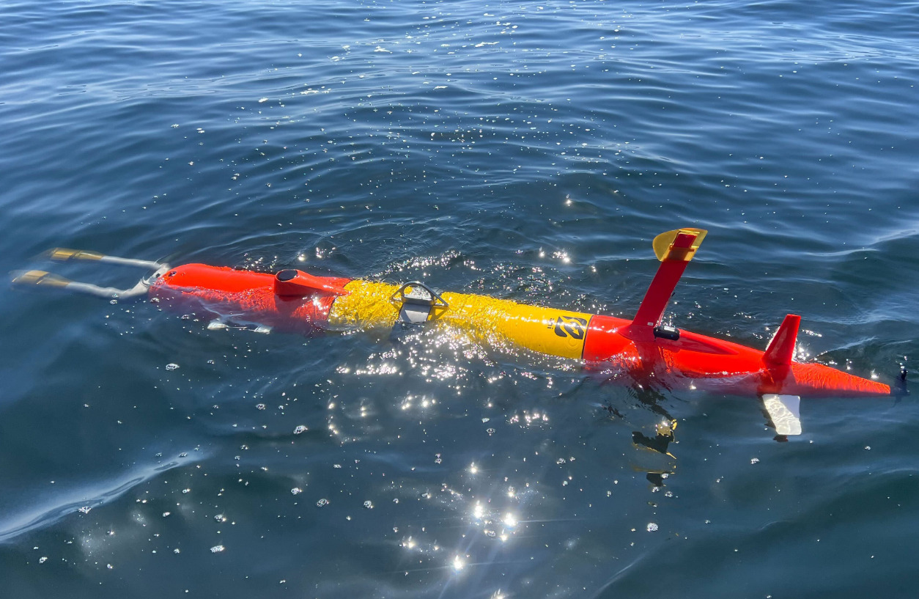
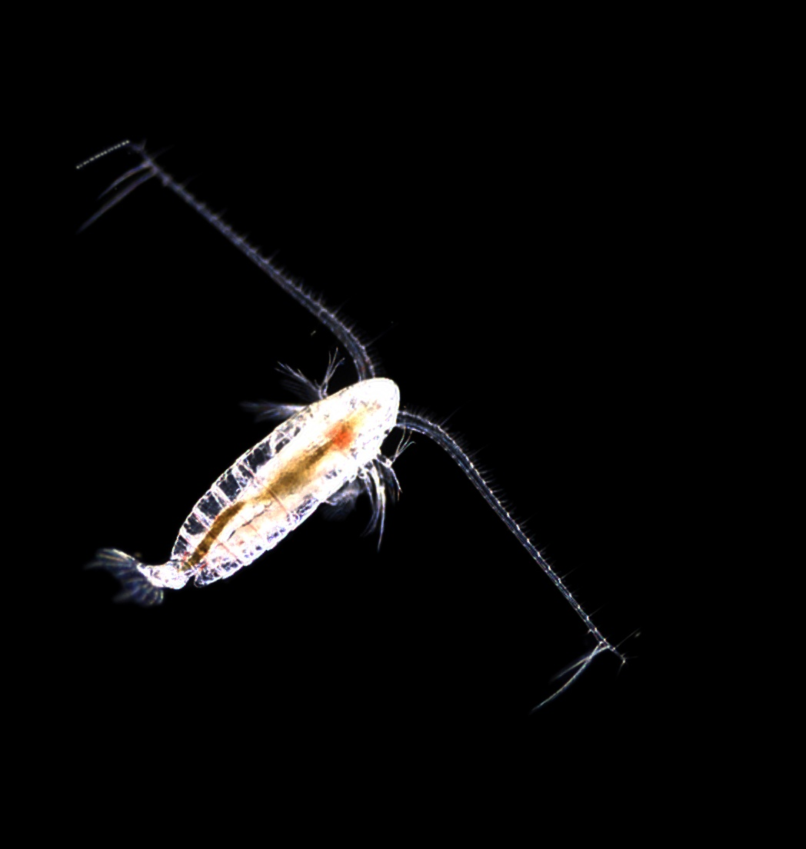
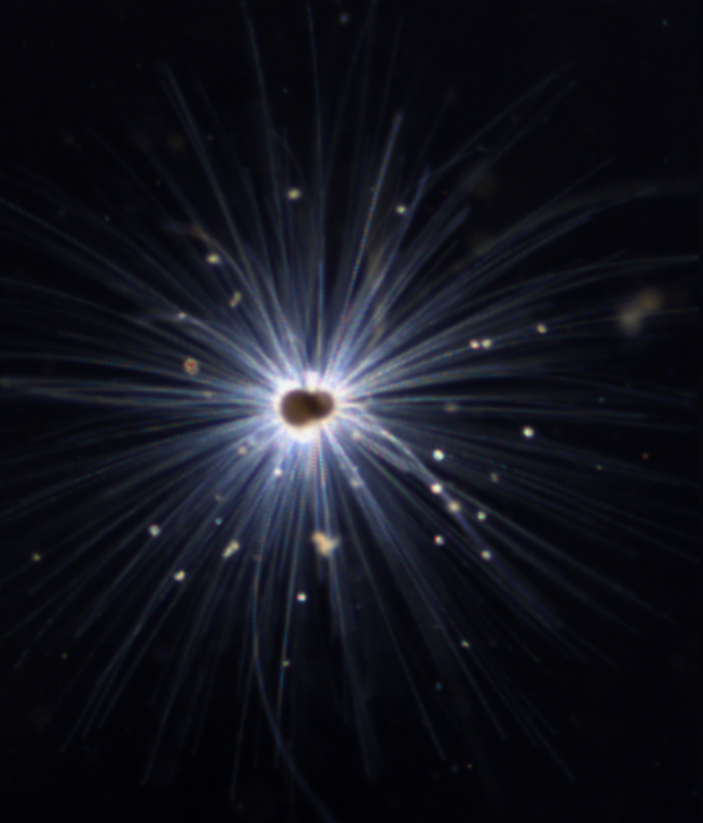
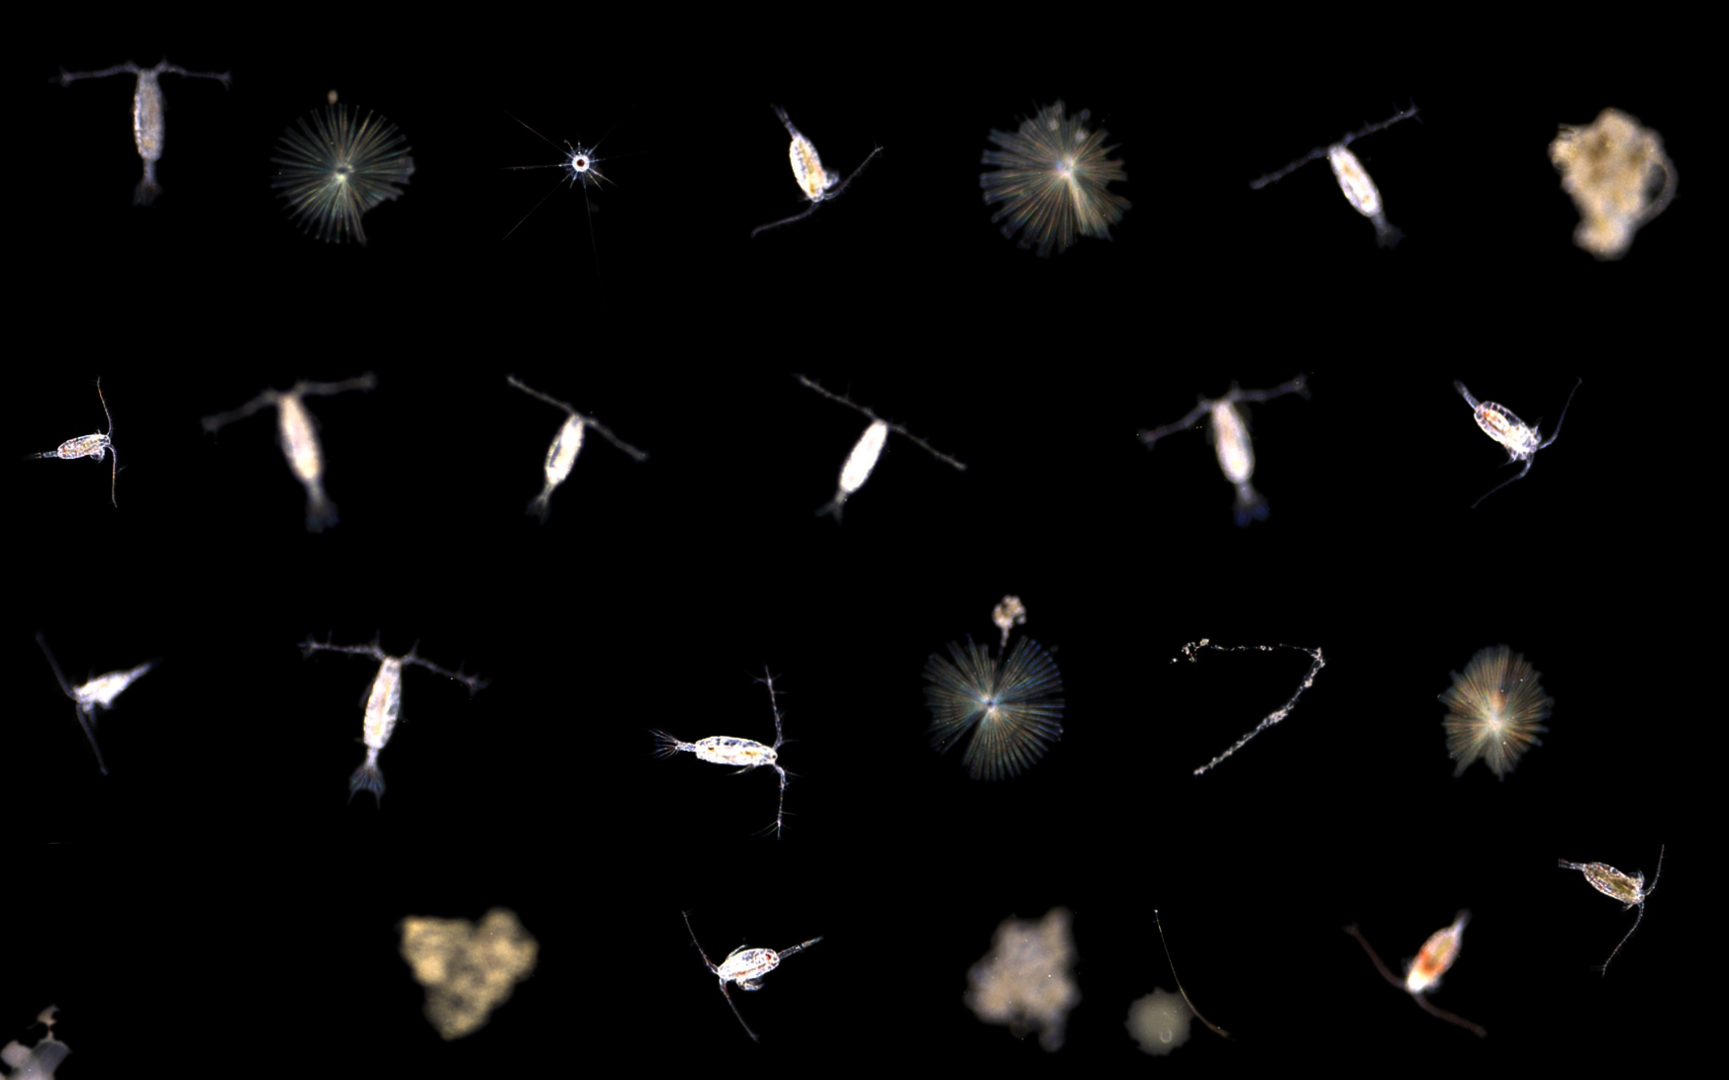
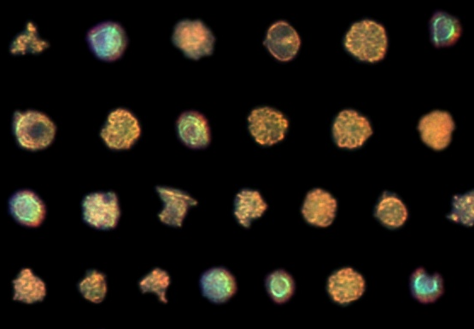
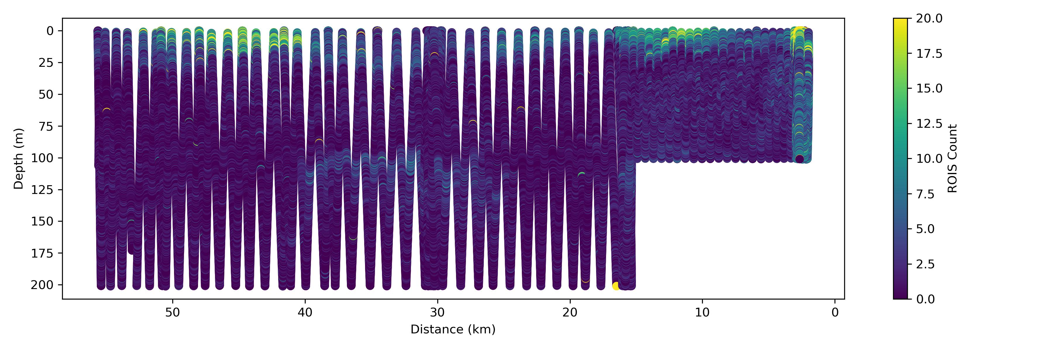
LRAUV Payload: Planktivore
Plankton Imaging
Dual Simultaneous Imaging
  High Magnification
    Microliters, 20 um size and up
  Low Magnification
    Milliliters, up to 2 cm size
Embedded Compute module
  1000:1 data reduction with ROIs
  Real-time particle size spectra
  ML Identification – getting better
Region of Interest (ROI) Counts vs Depth/Position
- Available in real-time for Adaptive Sampling
Low Mag - 2 mm
High Mag – 80 um

Slide 5
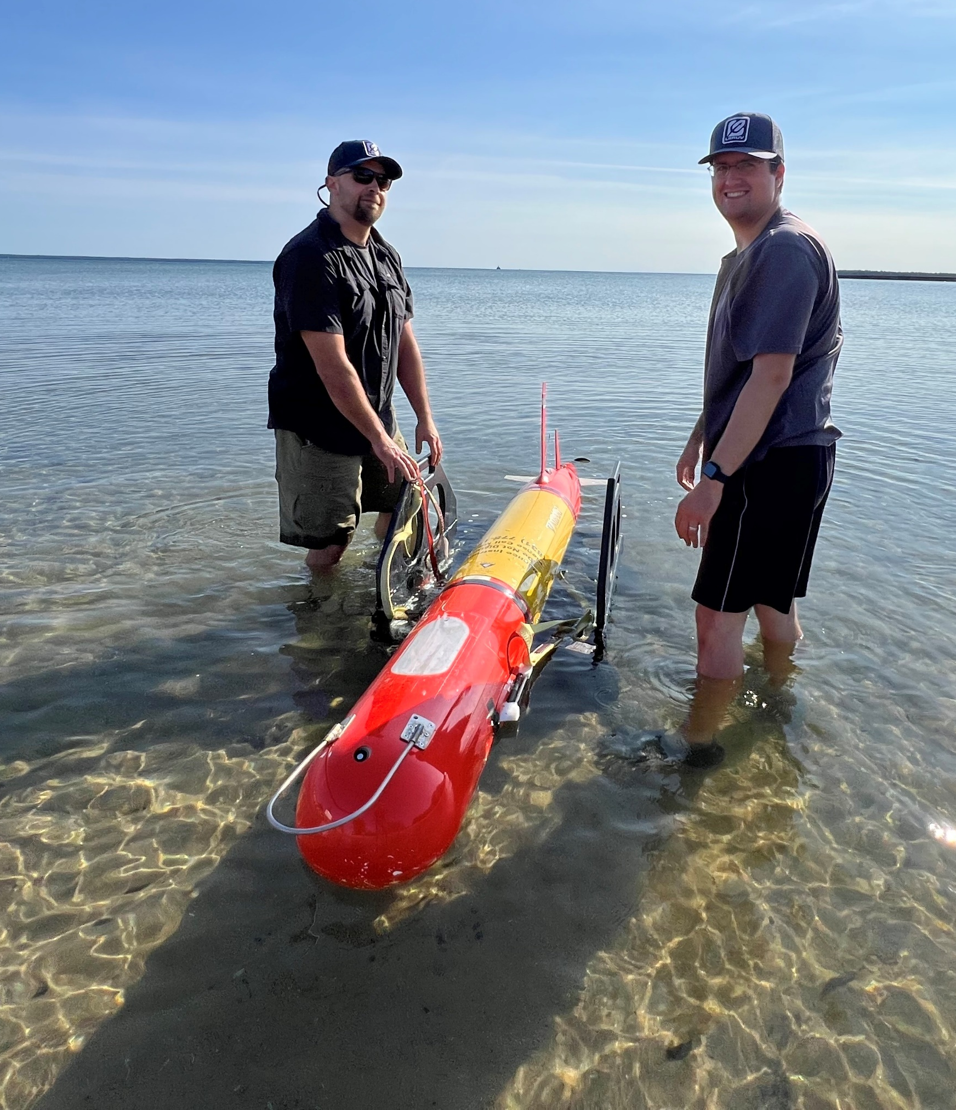
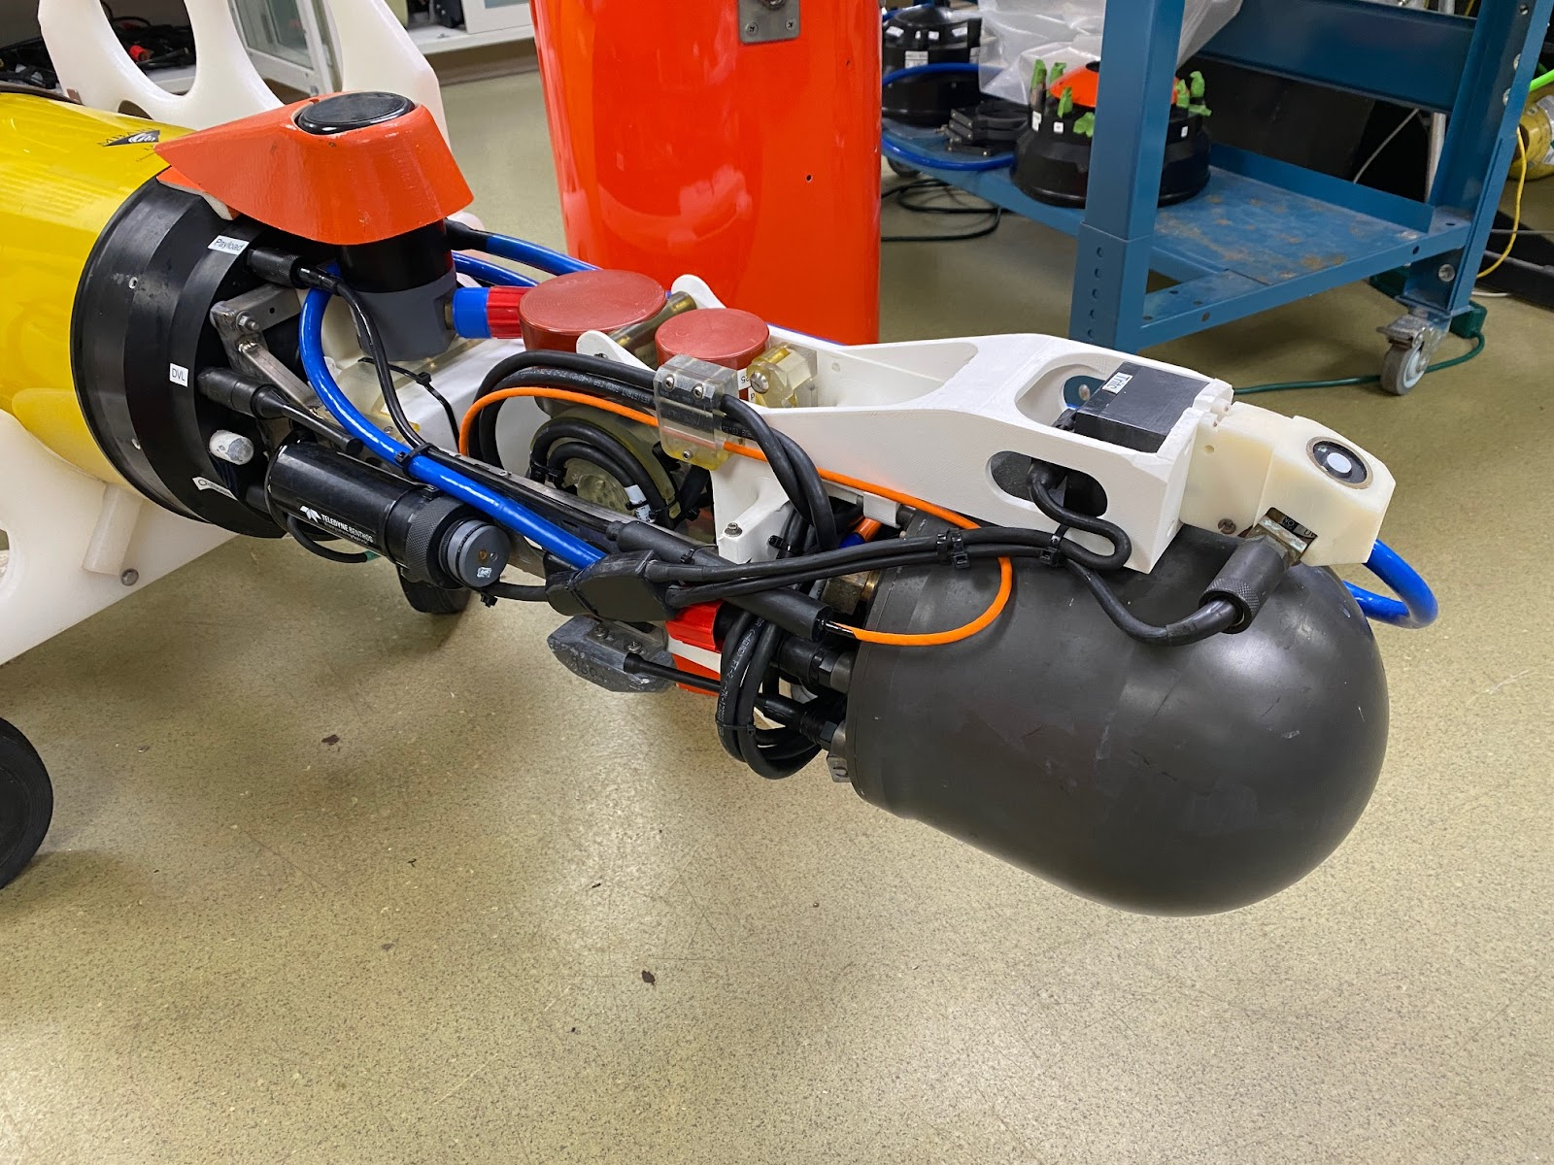
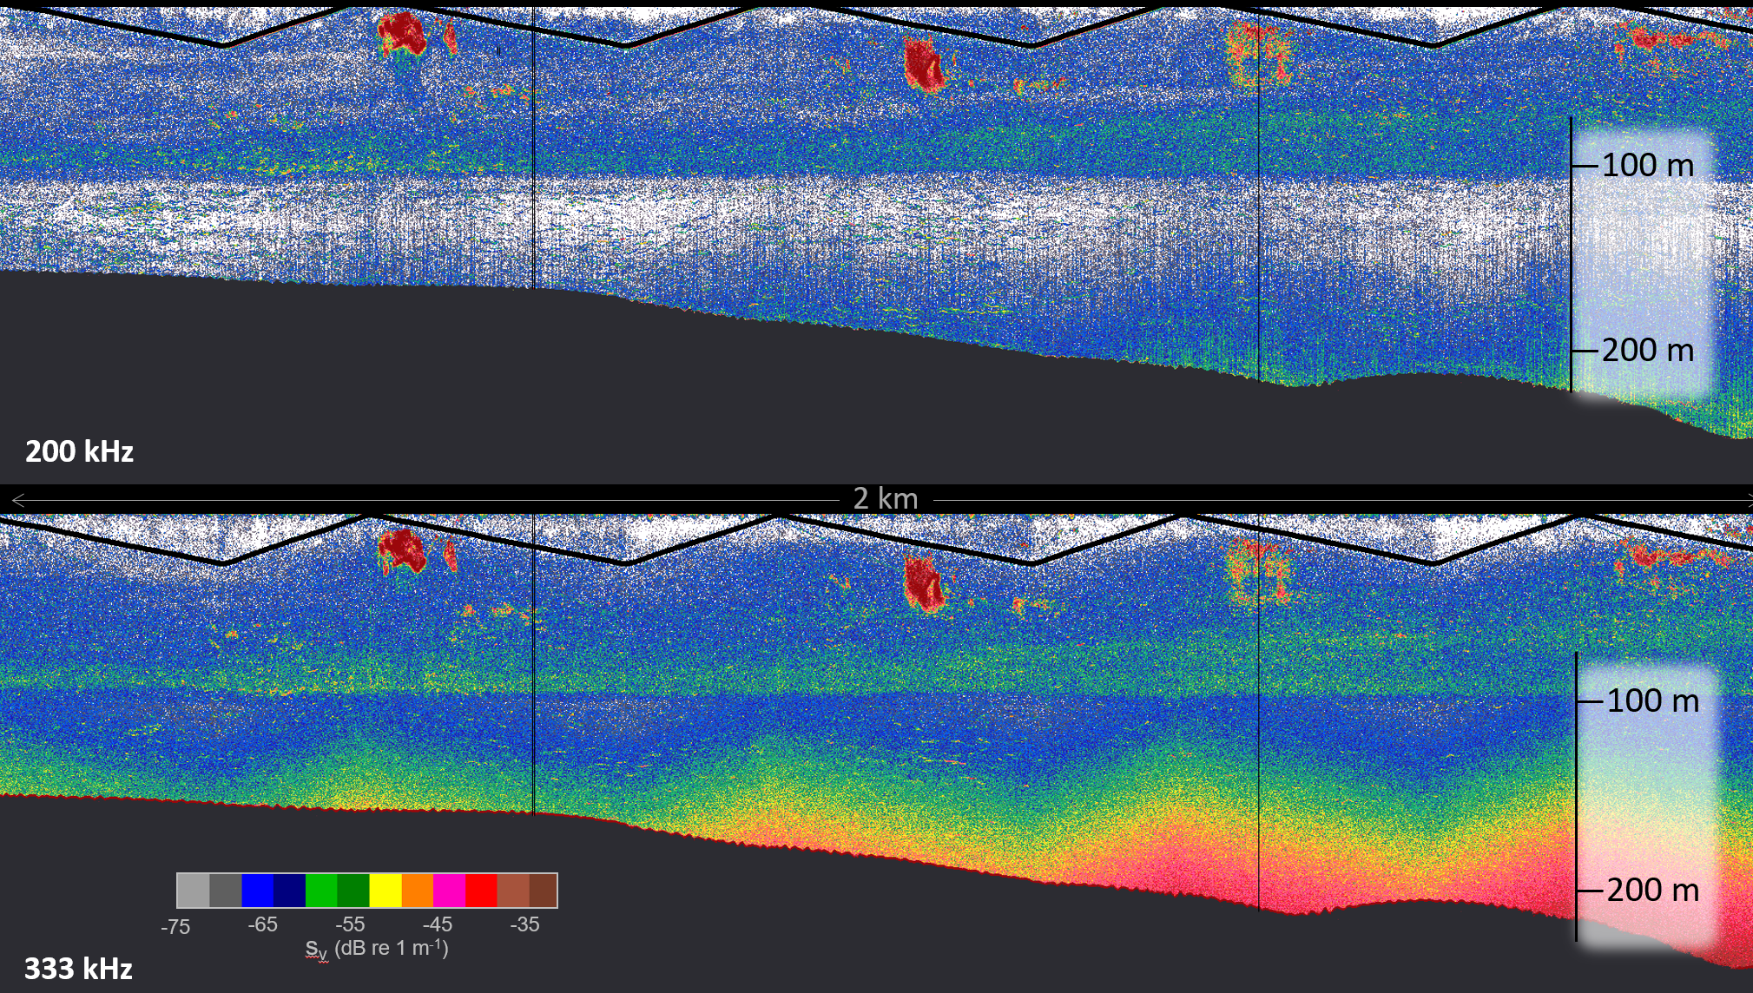
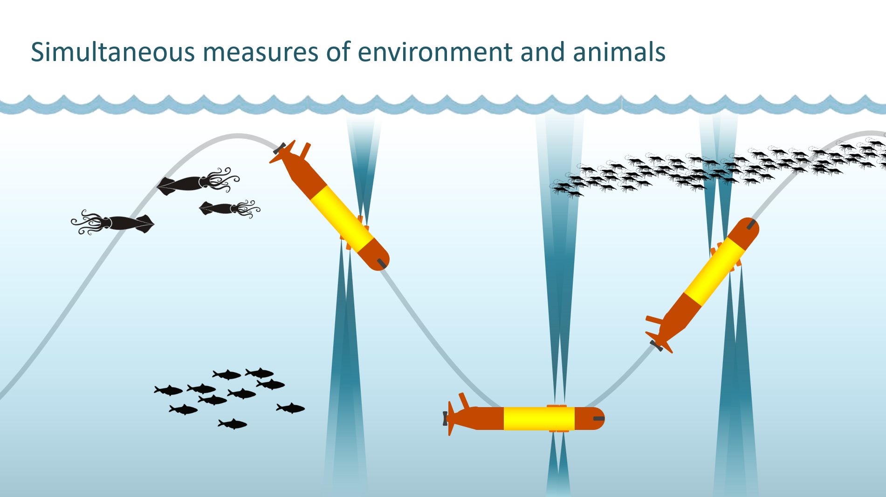
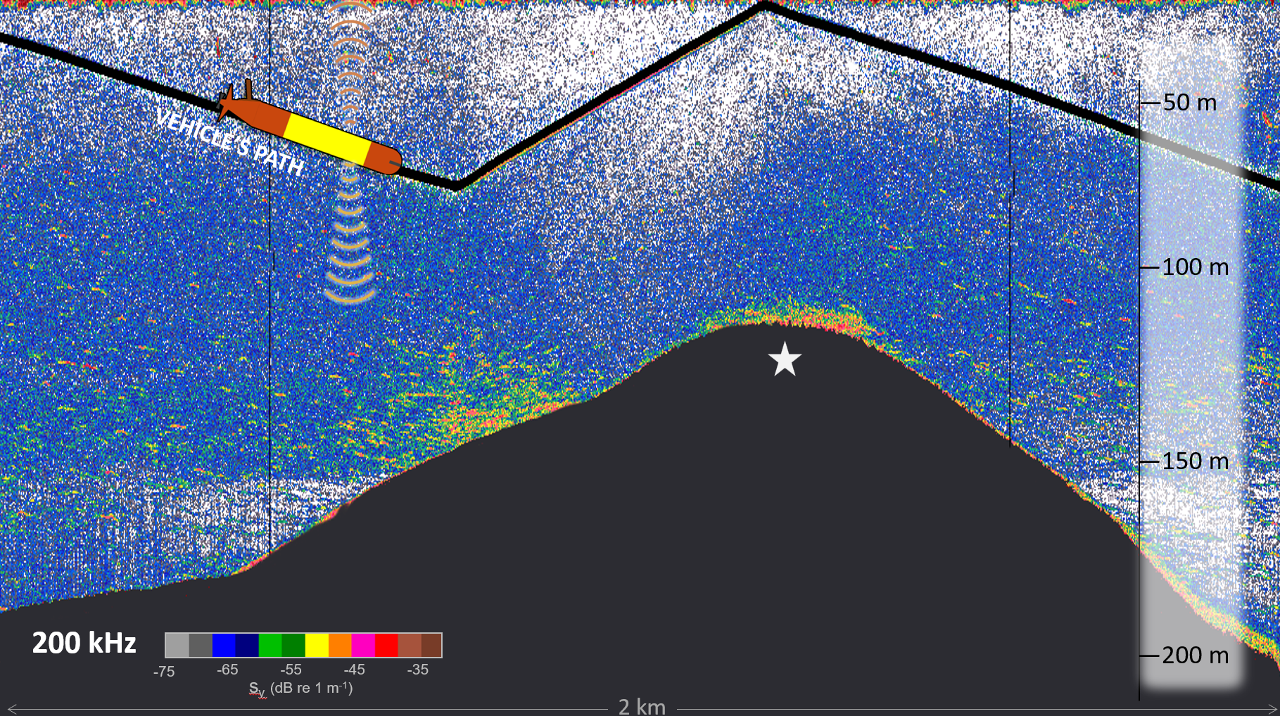
LRAUV Payloads: Active BioAcoustics
Simrad EK-80 Mini 200 Hz and 333 kHz
  Upward and Downward-looking
Gimbled transducers to allow simultaneous
measurement of environment and animals
Upward-looking
transducers
200 kHz
333 kHz
Downward-looking
transducers
(not visible)
Electronics
housing

Slide 6
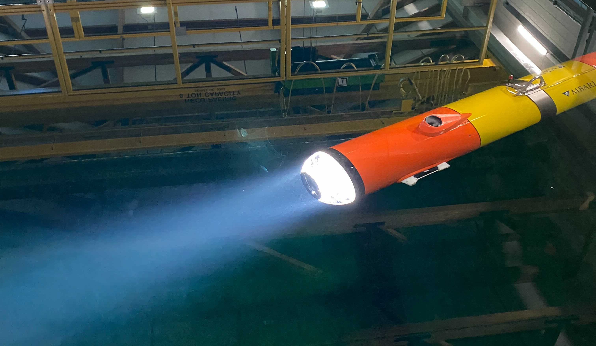
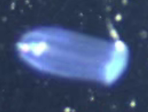
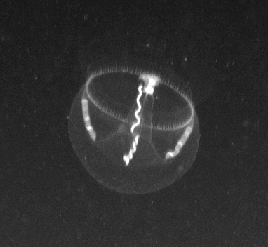
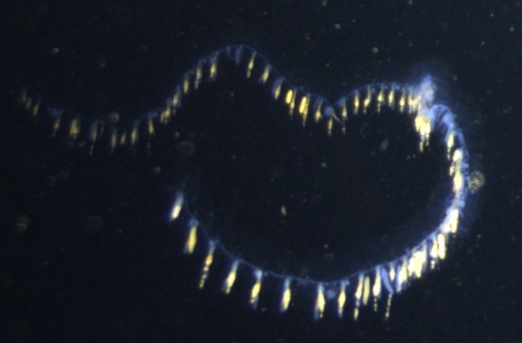
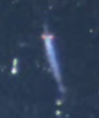
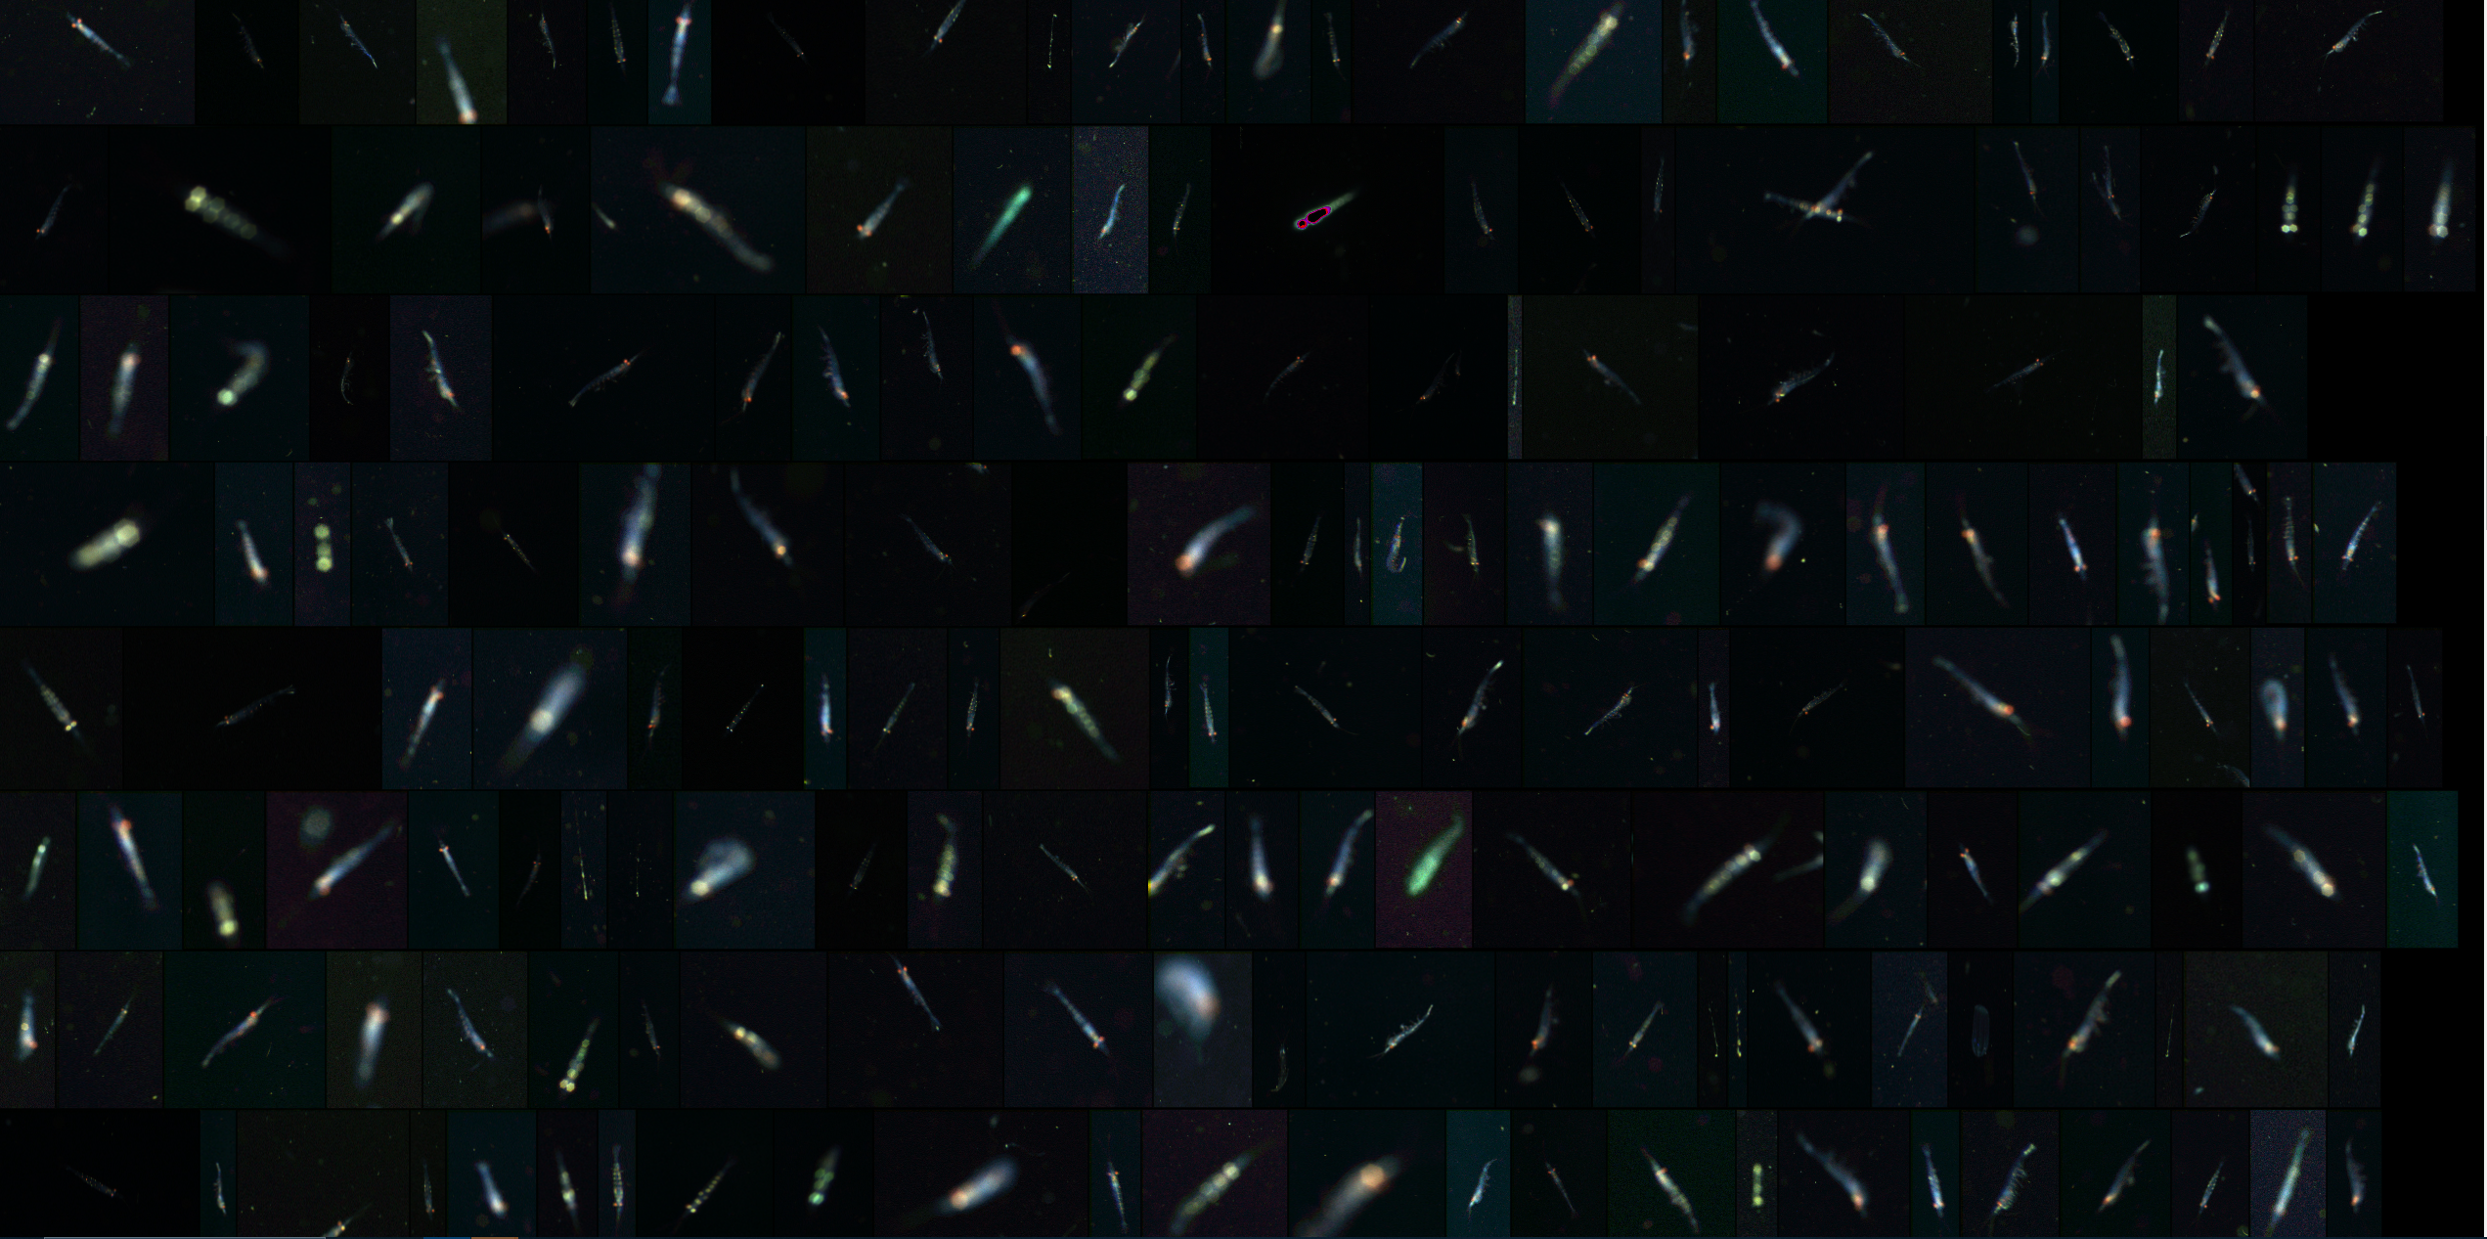
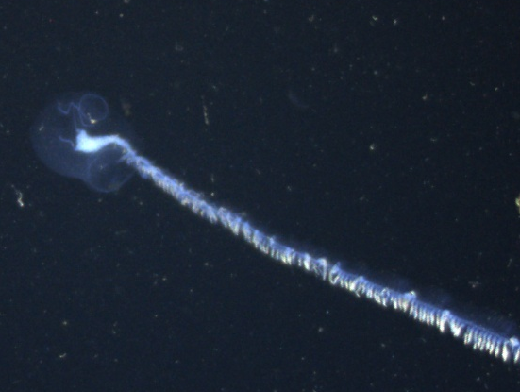
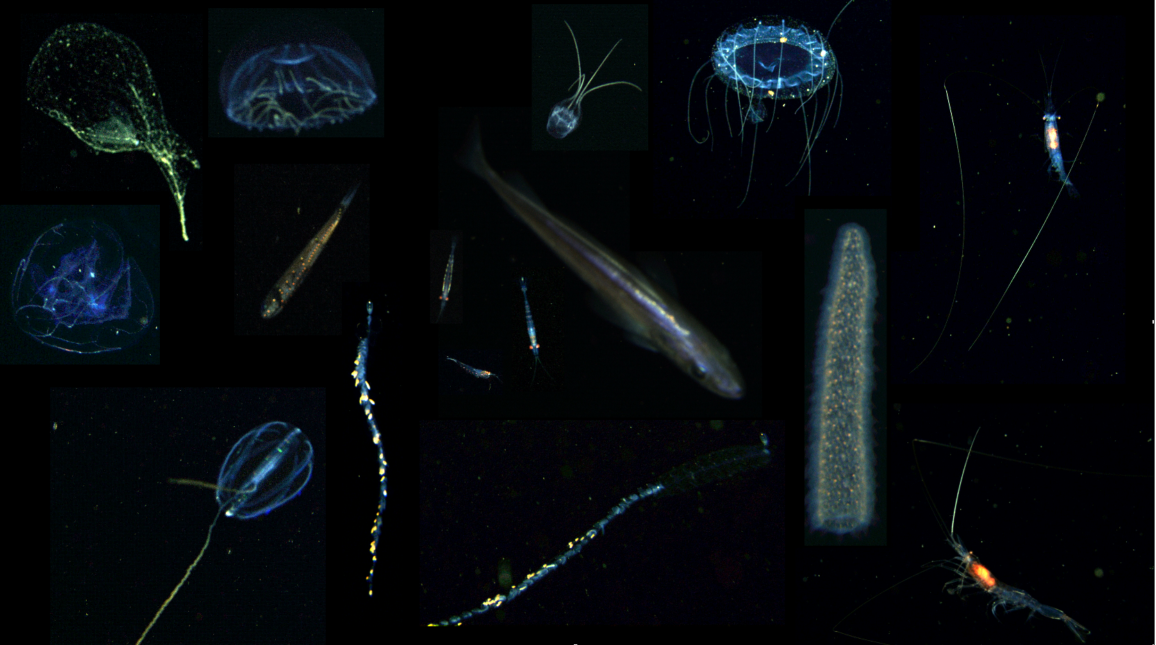
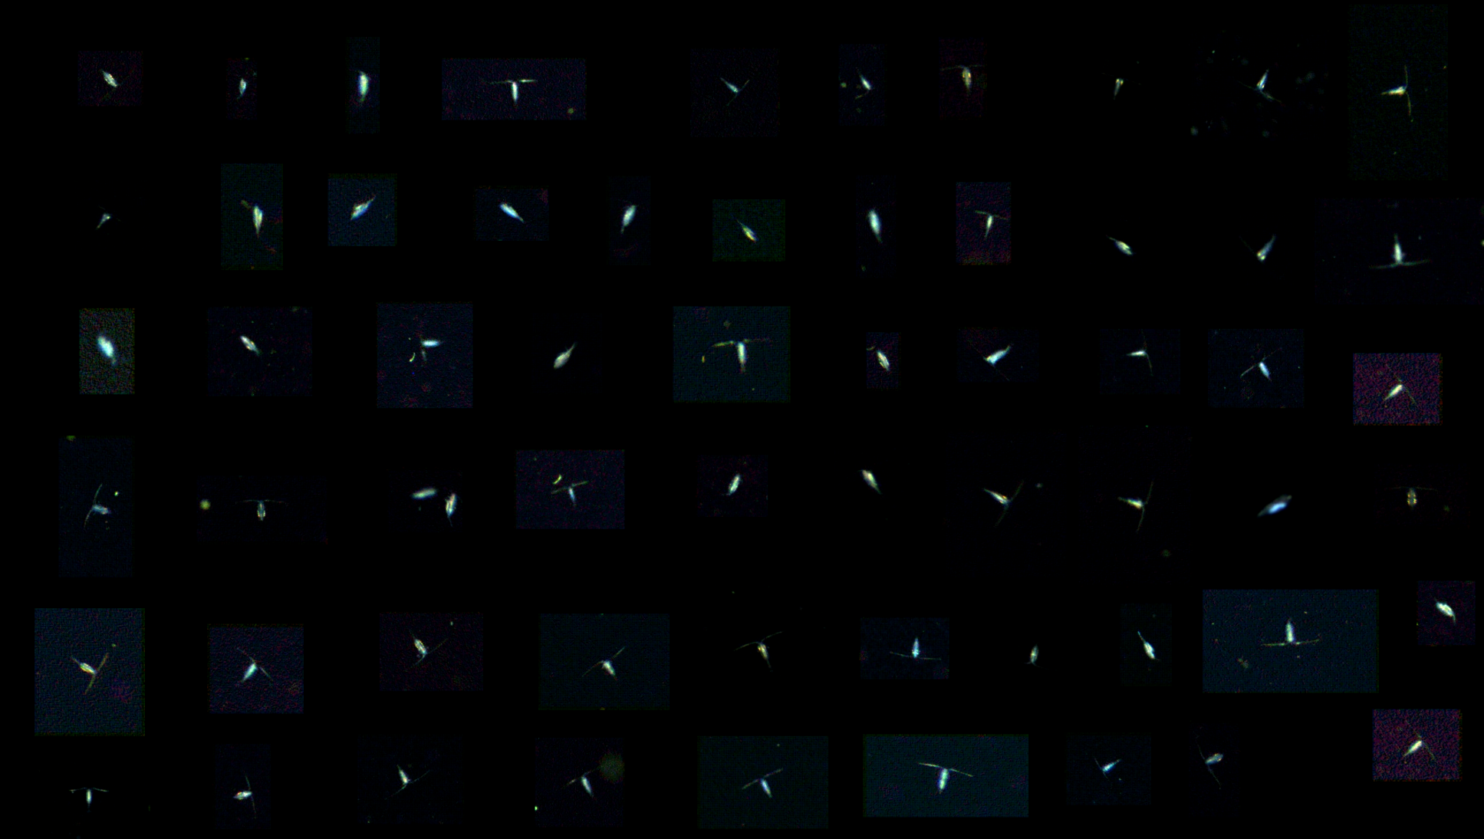
Payloads – Triton
3-D Plankton Imaging
LRAUV Payload: Triton Zooplankton Imaging
300k Lumen Strobe
24 MP 3 Camera Array
2 L Imaged Volume
@ 50 um Resolution
20 mm
10 mm
5 mm
Quantitative macroscopic imaging of 3D particle distributions, plankton/nekton, and marine snow
Detection of objects: 2 mm to 20 cm
Detection of particles: 0.4 mm to 20 cm
Realtime Region of Interest (ROI) extraction
Realtime particle size analysis
Animals, Marine Snow, Oil droplets, and Dispersant
Mining Sediment in the Water Column

Slide 7
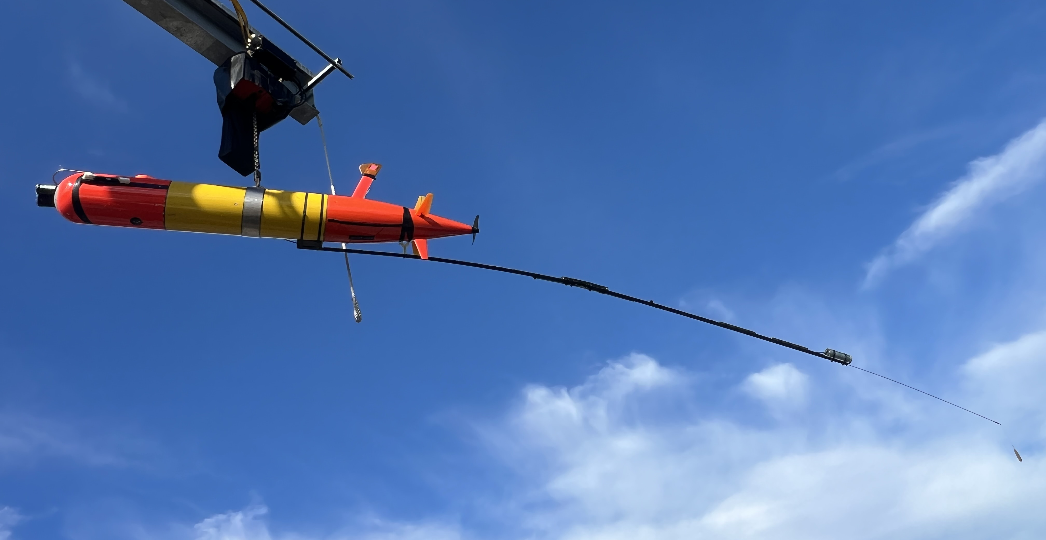
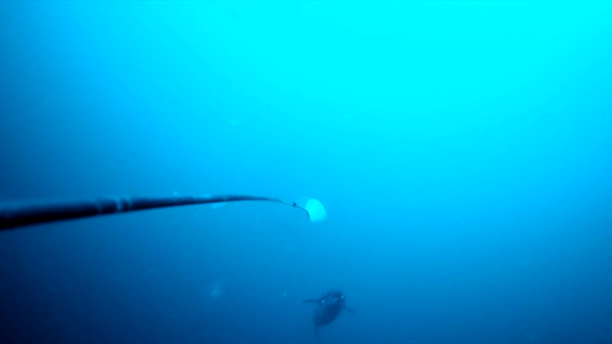
Piscivore system
LRAUV Payload: Piscivore
Images of Predators and Prey
Contextual Environmental Sensors
Passive eDNA collectors
Typically deployed for 10-14 days
Samples over 250 km/deployment
LRAUV
Rear Camera
Flashing
Fish Attractor
4 meters
Contextual Sensor Payload
Forward Camera
Passive eDNA Samplers
Notes:
Here’s what the whole system looks like. We start with a LRAUV
From there, we add a forward facing camera in the nose of the AUV to image what’s ahead of us – primarily prey fields like schools of anchovy
At the back, a long pole extends, on which sits the rear facing camera and the attractor, which is basically a fishing lure without a hook
Once the vehicle is moving underwater, the attractor spins [click] to draw in curious (and hungry) predators, just like the lure on a fishing hook
[sensors, eDNA[
Together, this allows us to autonomously study predators

Slide 8
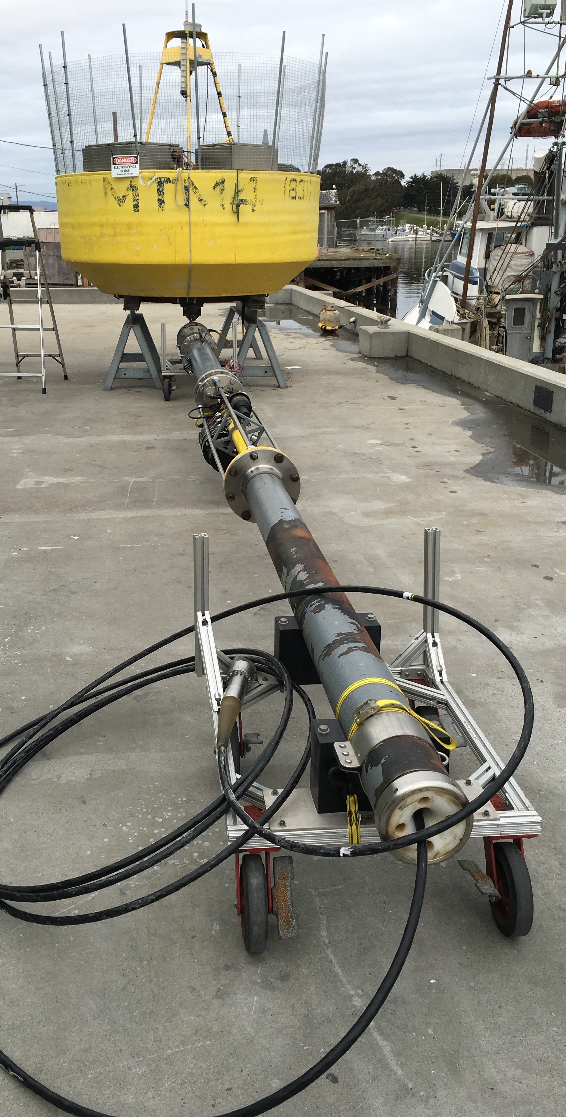
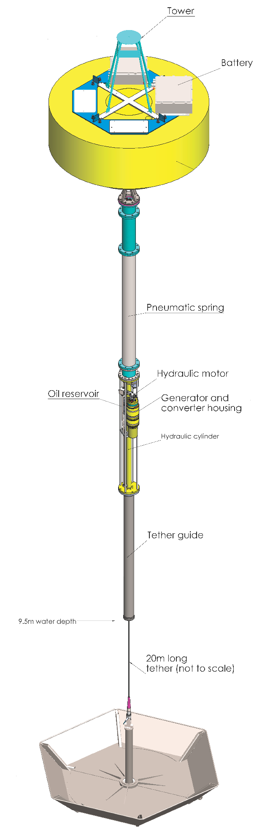
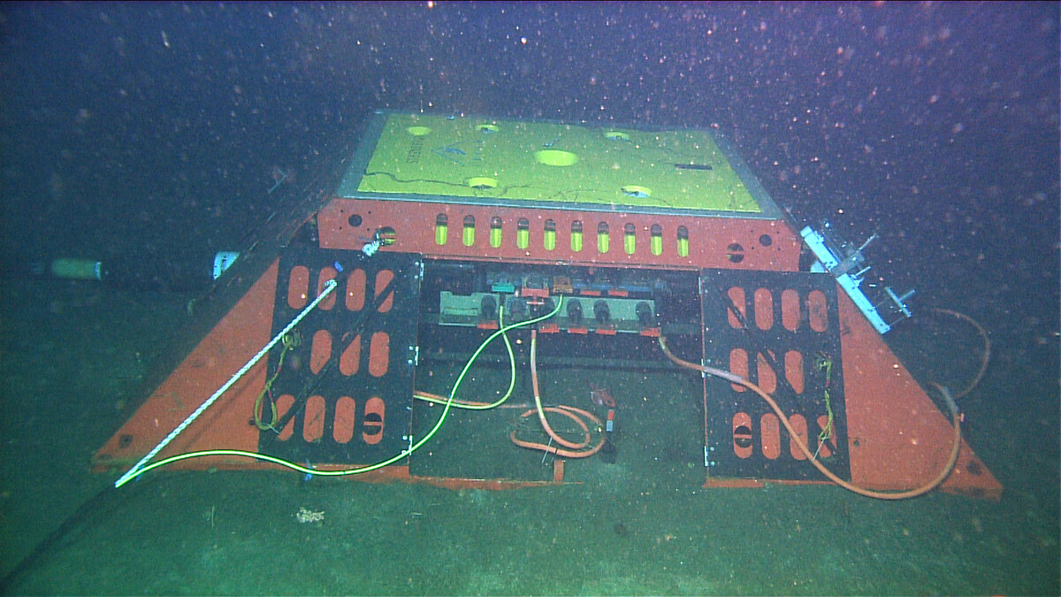
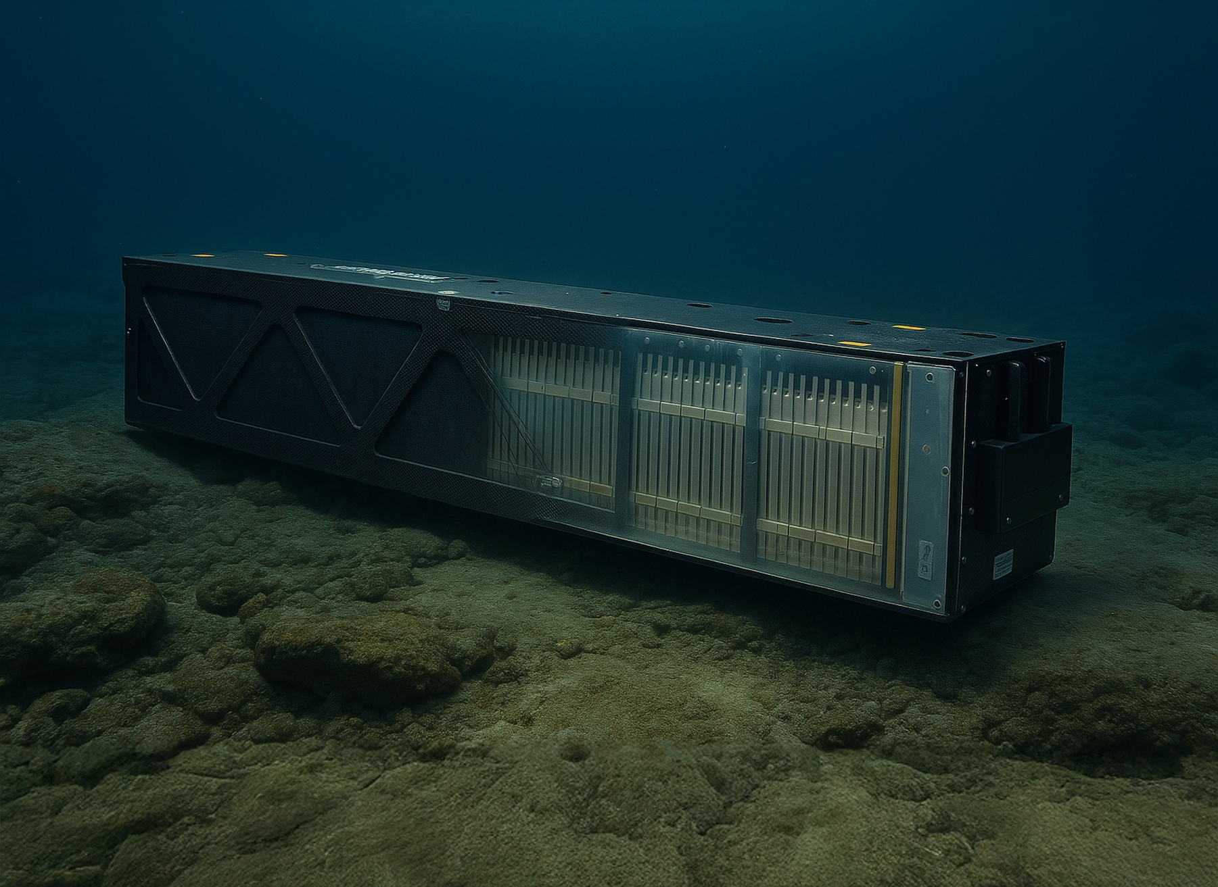
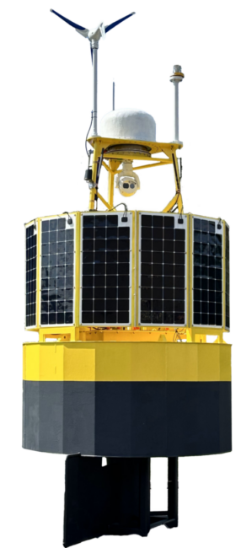
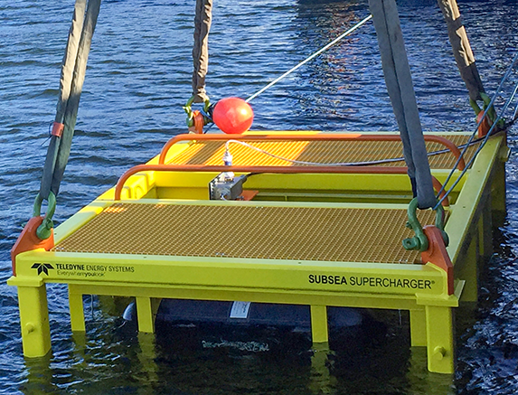
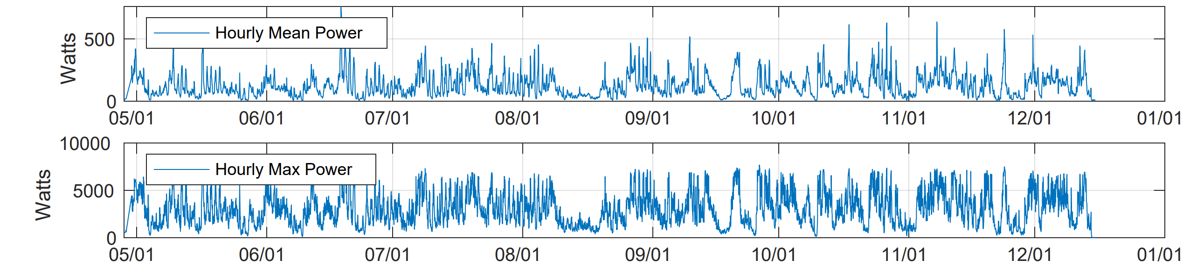
Higher Energy Docking Station Supply Options
Cabled Observatories
  MBARI MARS, Neptune, H20,ESONET
MBARI Wave Energy Converter (WEC)
  ~225 Watts: Recharge one LRAUV each day
  Carbon Neutral, Long Lasting
OPT’s Power Buoy
Subsea Batteries and Fuel Cells
  No surface expression – possibly easier deployment/recovery
  Limited power
Seafloor Cabled Observatory
Subsea Batteries like Kraken’s
MBARI’s WEC: 6 month average power output
Power Buoys like MBARI’s or OPT’s
Fuel Cell like Teledyne’s

Slide 9
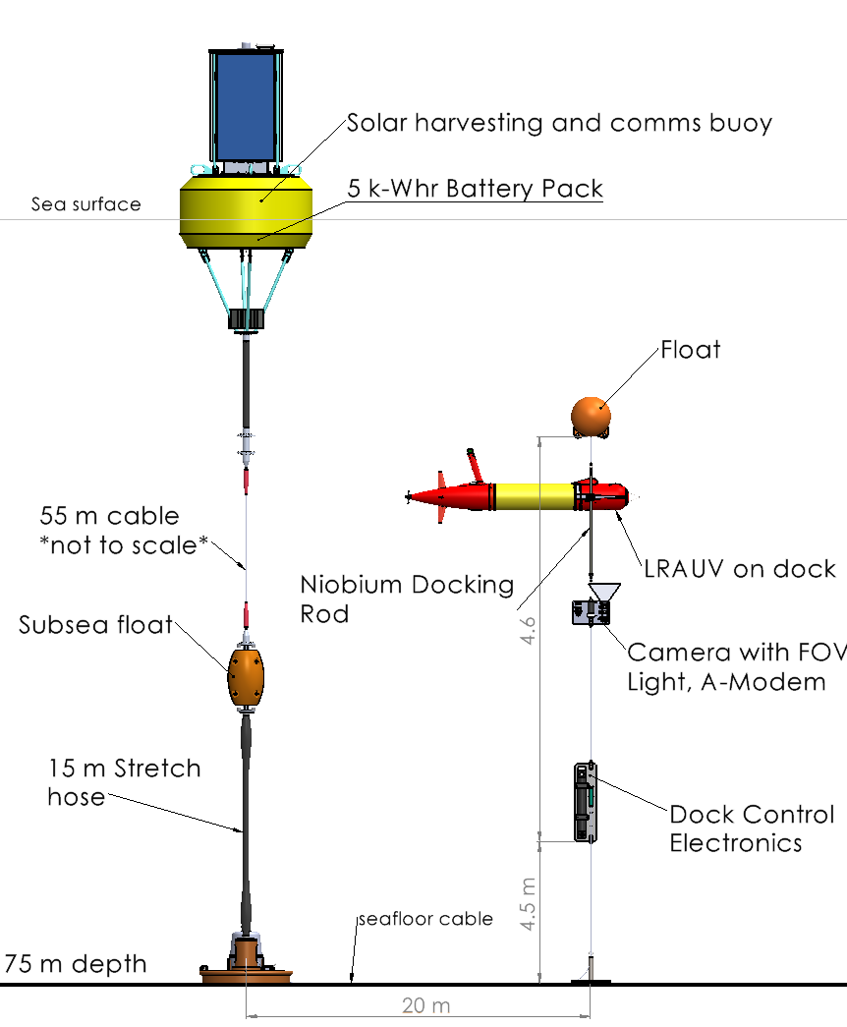
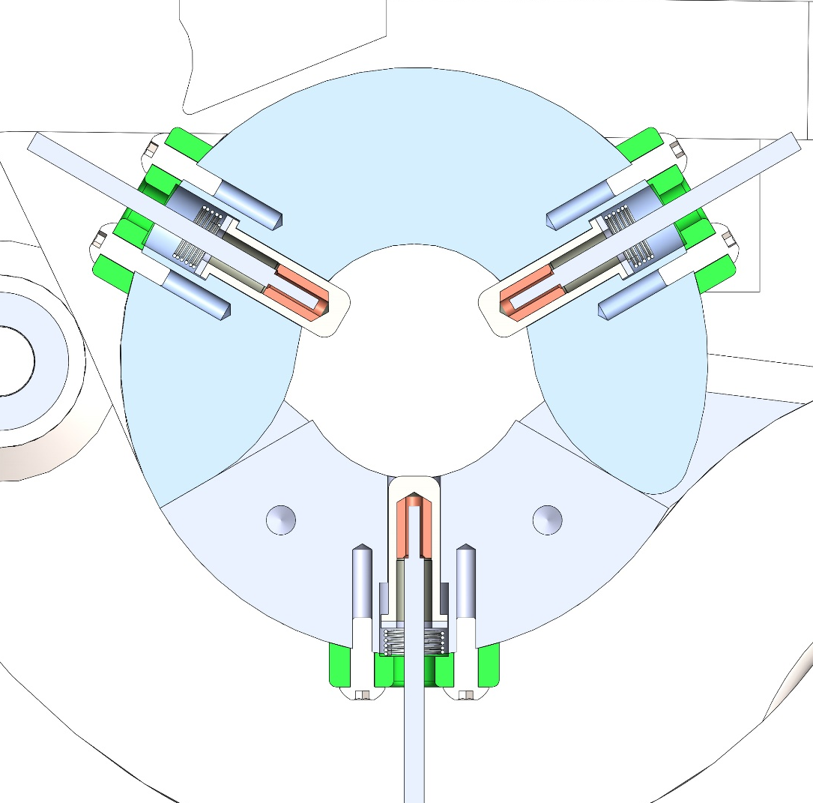
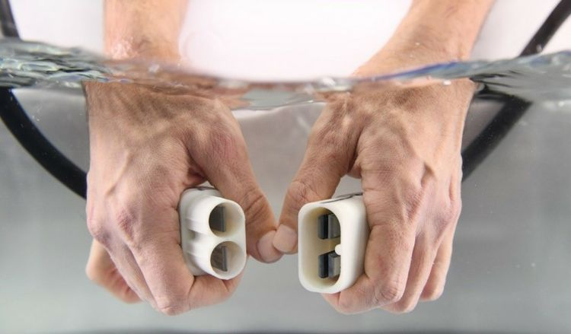
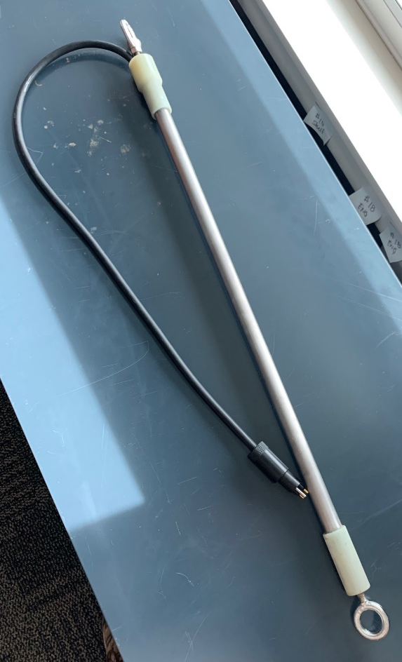
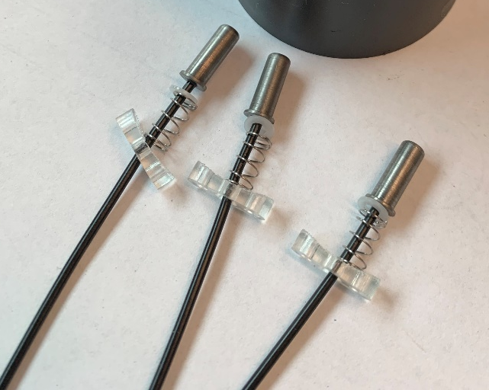
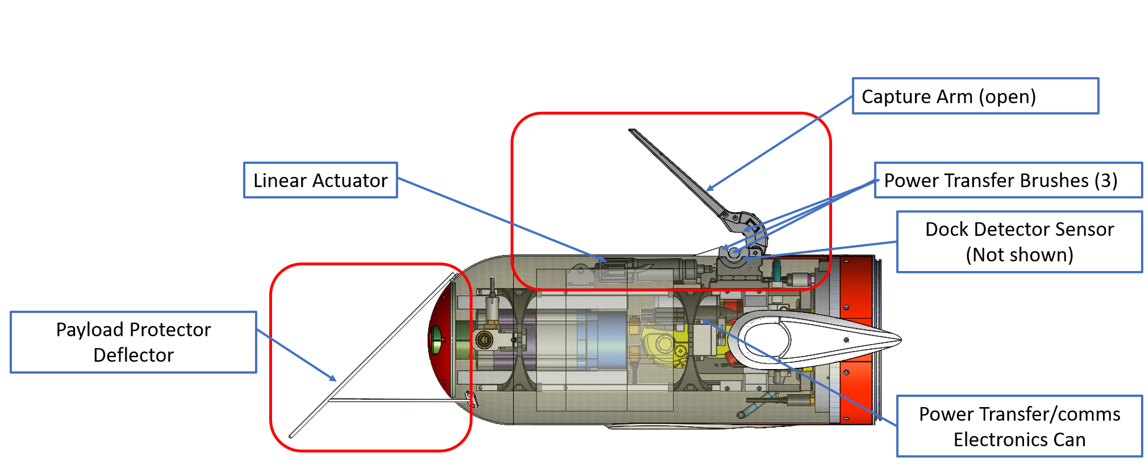
LRAUV Docking – For Cruising-type AUVs
Enabling Niobicon
Patented and developed by Northrop-Grumman
Uses pure niobium
Thin film isolates niobium in water
Can allow axial and rotary motion
Limited to 60 V and moderate power
Niobium Power and Data Transfer Rod
Niobium Brushes
LRAUV Docking Payload Module – Doesn’t interfere with existing science payloads. Bathyphotometer shown

Slide 10
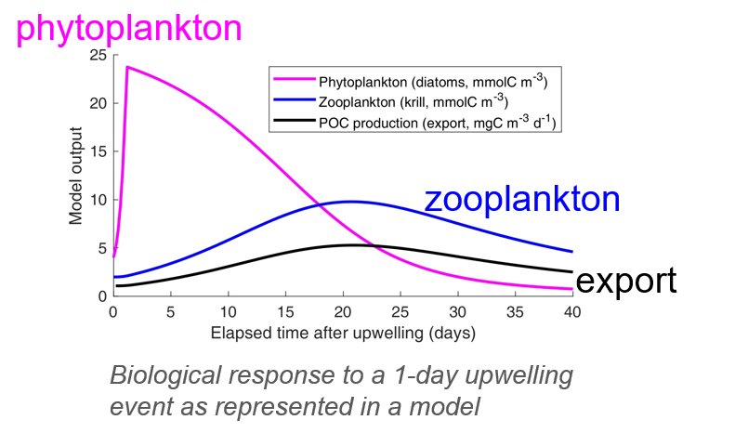
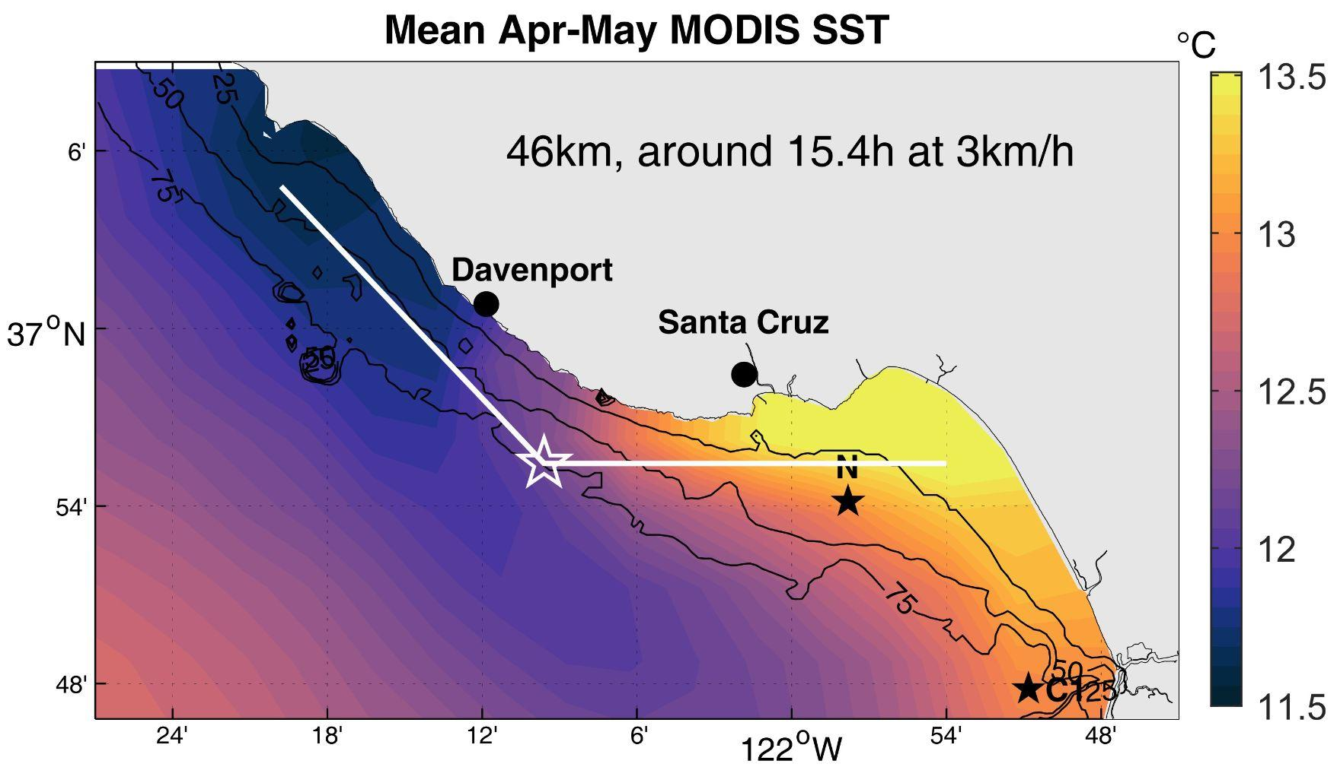
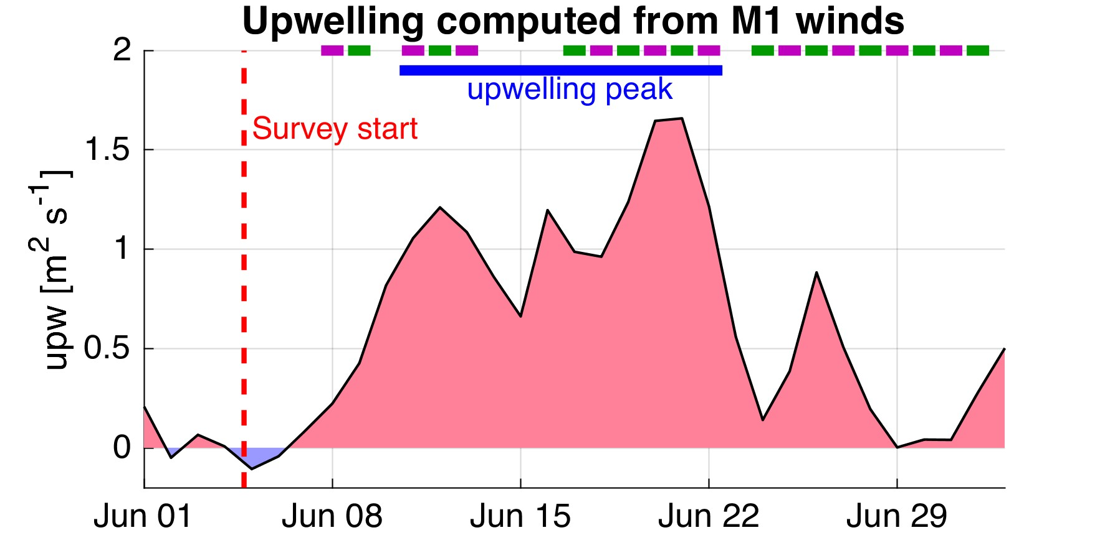
Challenge: Analyze plankton response to upwelling: diatoms, auto- and heterotrophic dinoflagellates, zooplankton
Sample over a complete upwelling cycle: 1 month, 1000 km of survey lines
Carry instruments capable of assessing the ecosystem composition: Chl, OBS, Bioluminescence
upwelling center
upwelling shadow
frontal area
LRAUV track overlaid on mean satellite springtime sea surface temperature

Slide 11
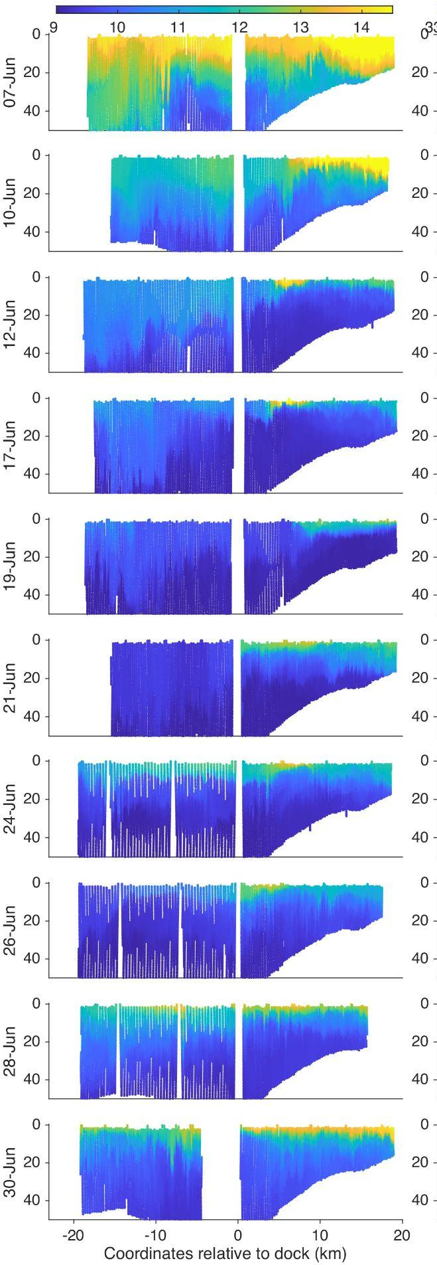
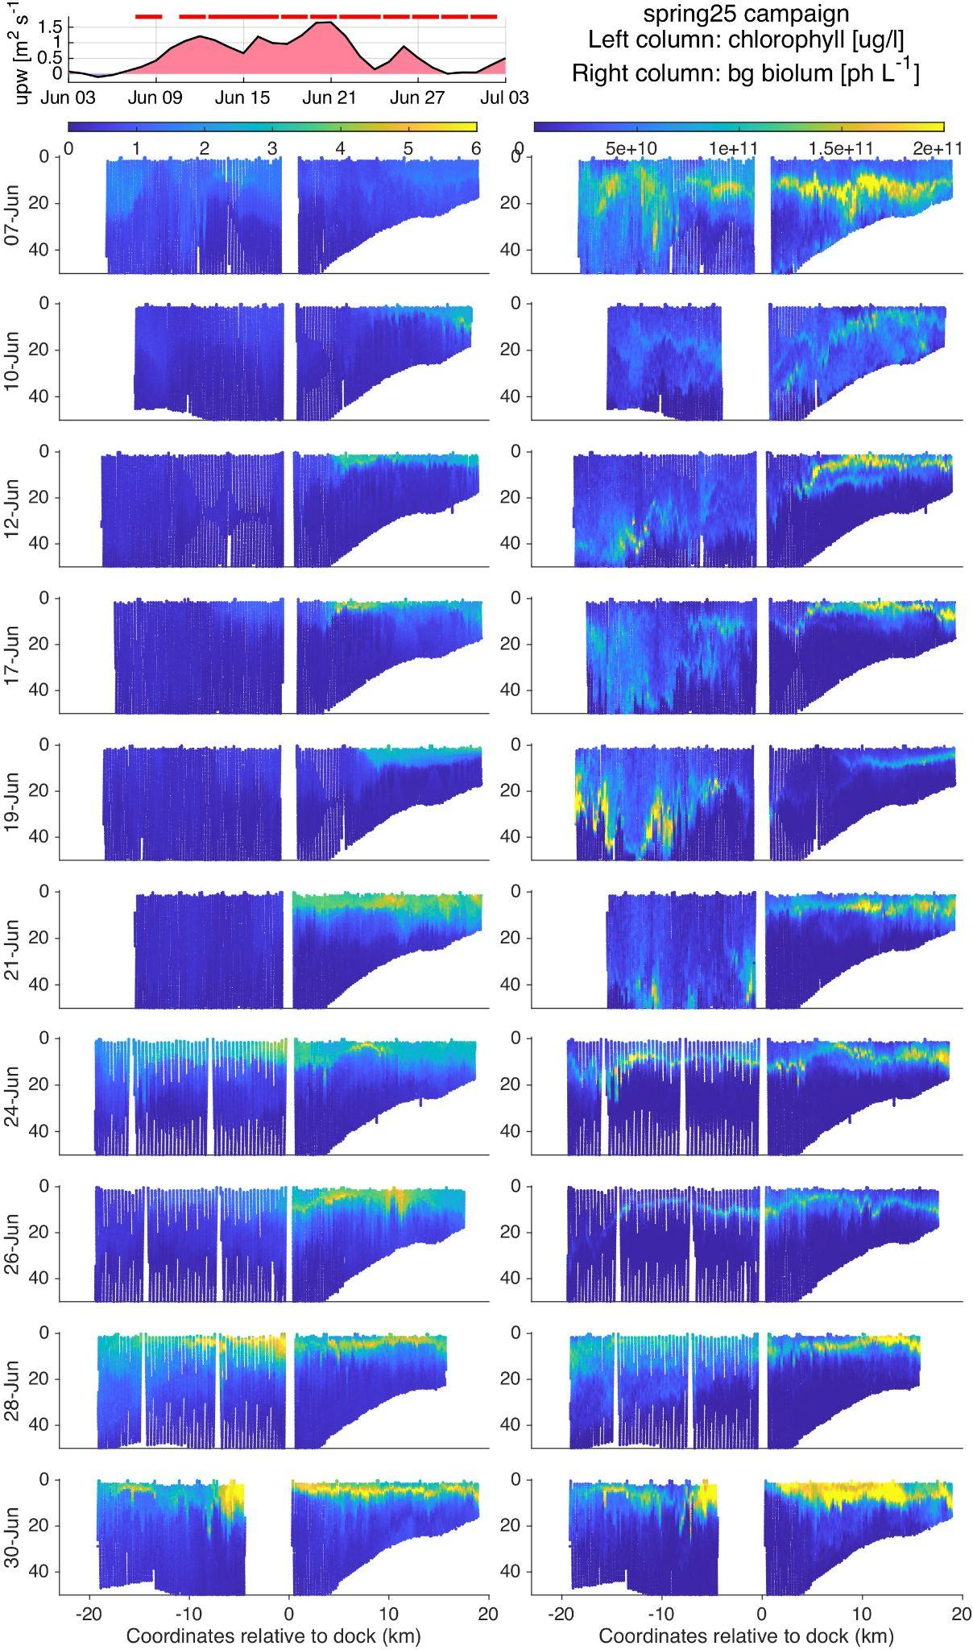
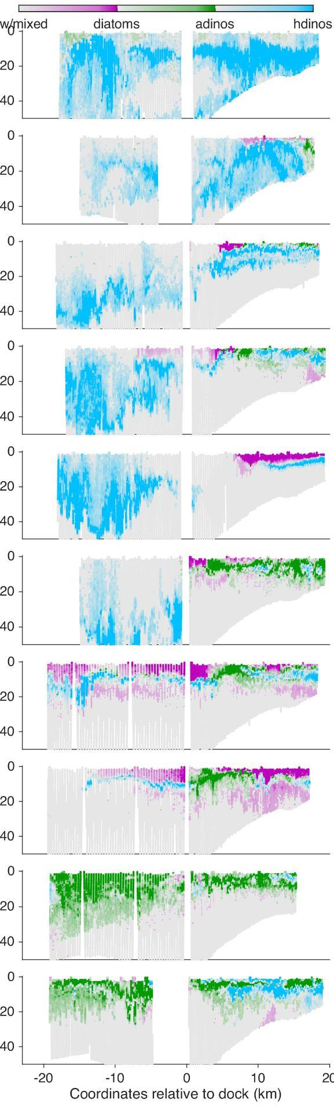
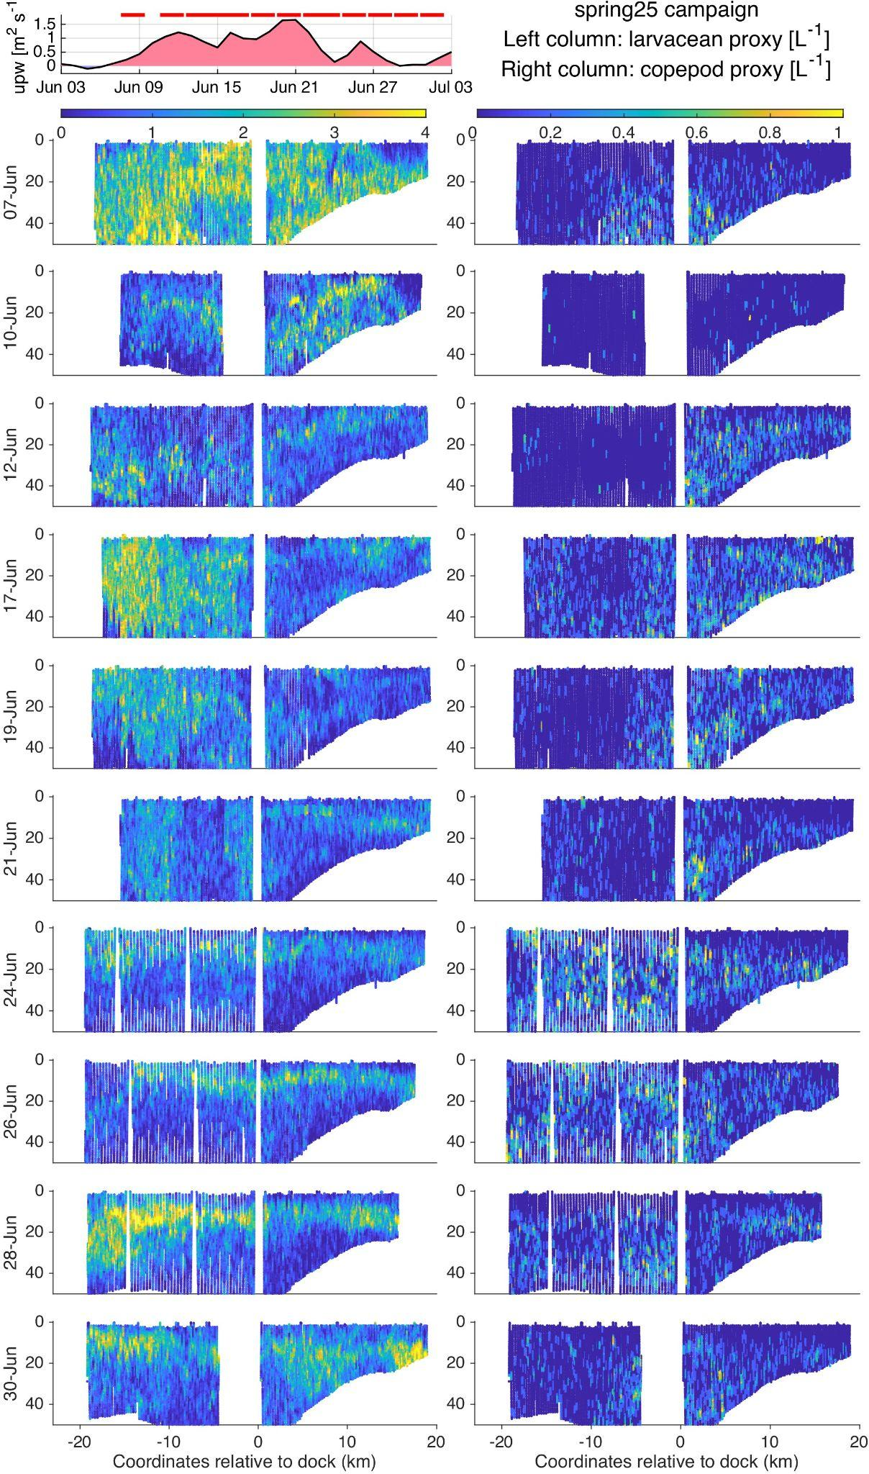
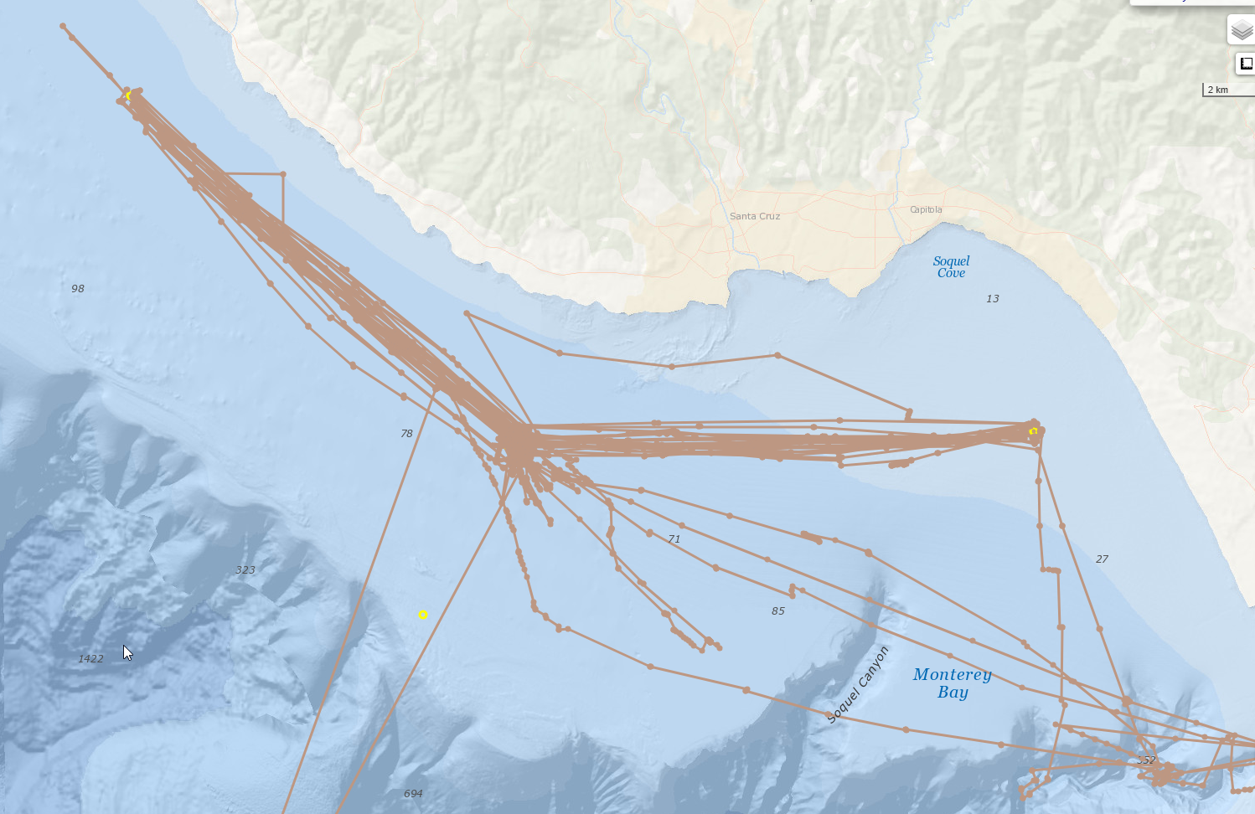
Plankton dominance proxy
Temperature
Chlorophyll
Bioluminescence
Larvacean proxy
Copepod proxy
°C
mg/m3
ph/L
flash/L
flash/L
Upwelling Peak

Slide 12
Plankton dominance proxy
Temperature
Chlorophyll
Bioluminescence
Larvacean proxy
Copepod proxy
°C
mg/m3
ph/L
flash/L
flash/L
Upwelling Peak

Slide 13
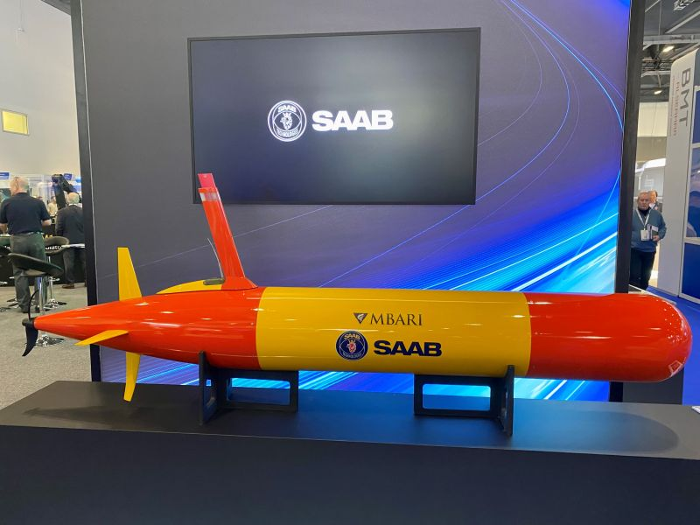
LRAUV Export - Technology
News release from October 10, 2025:
Exciting news from Saab, Inc.! We have recently been selected to deliver a Long Range Autonomous Undersea Vehicle (LRAUV) to @NOAA’s Northeast Fisheries Science Center. This vehicle will become the next generation platform for offshore scallop bed surveys, boosting efficiency, helping advance sustainable fisheries and driving marine science forward. #SaabintheSea

