Slide 1
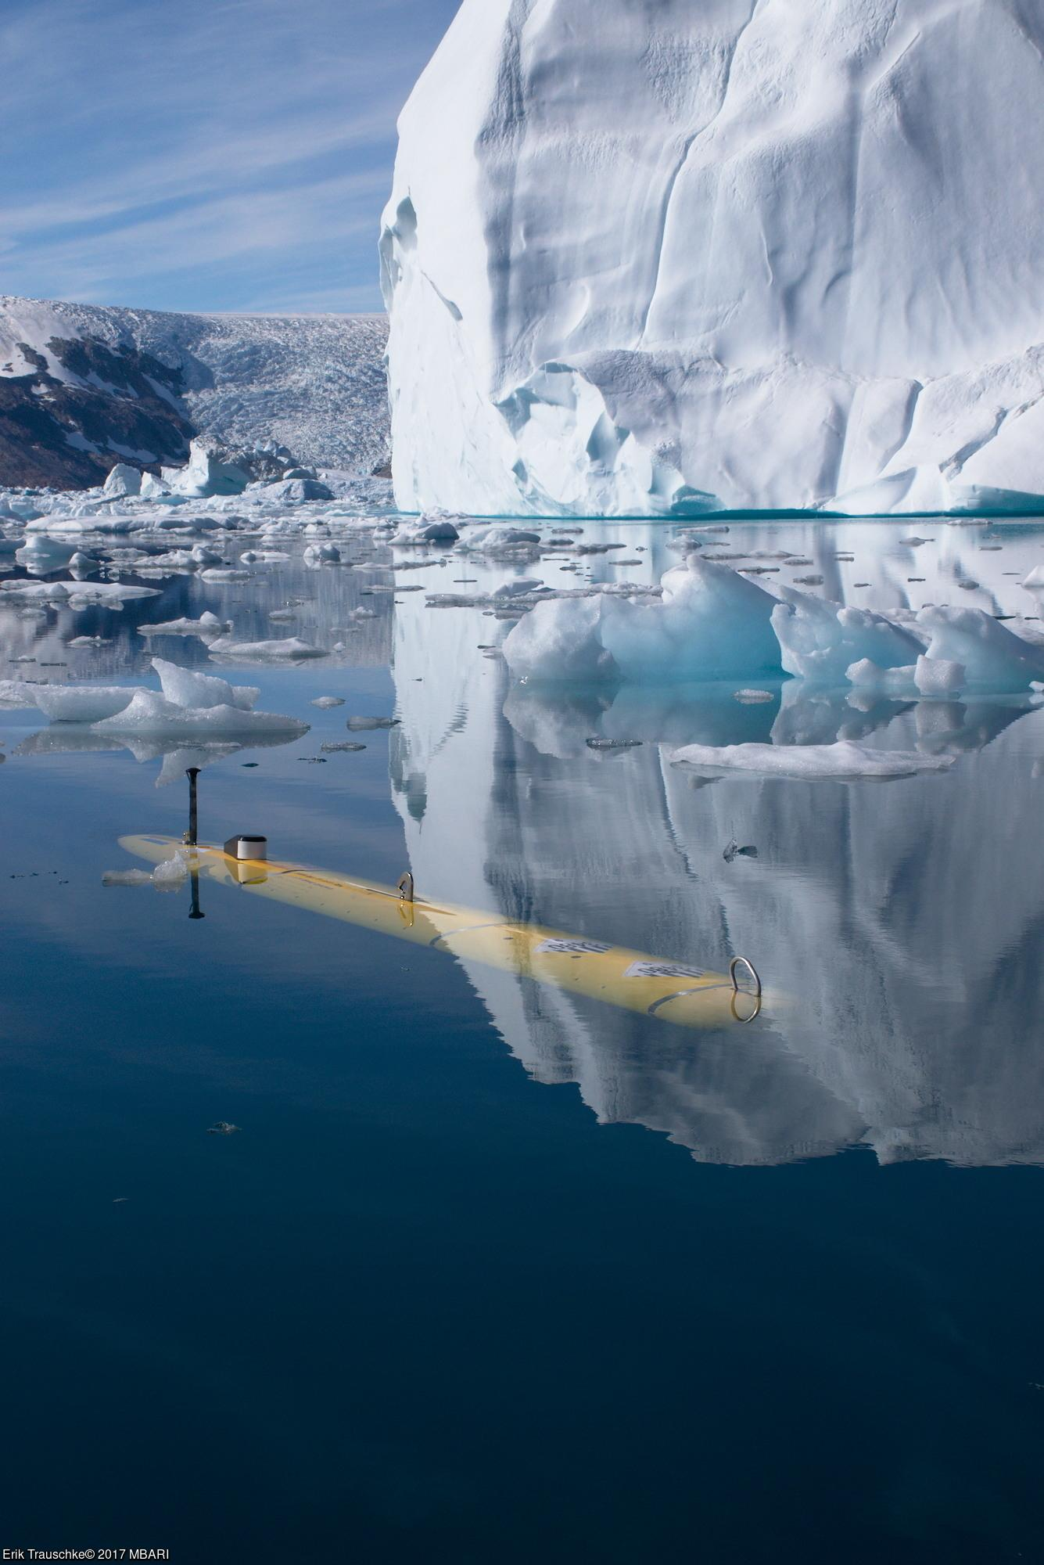
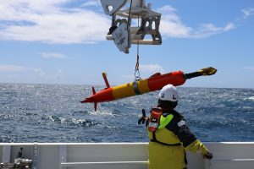
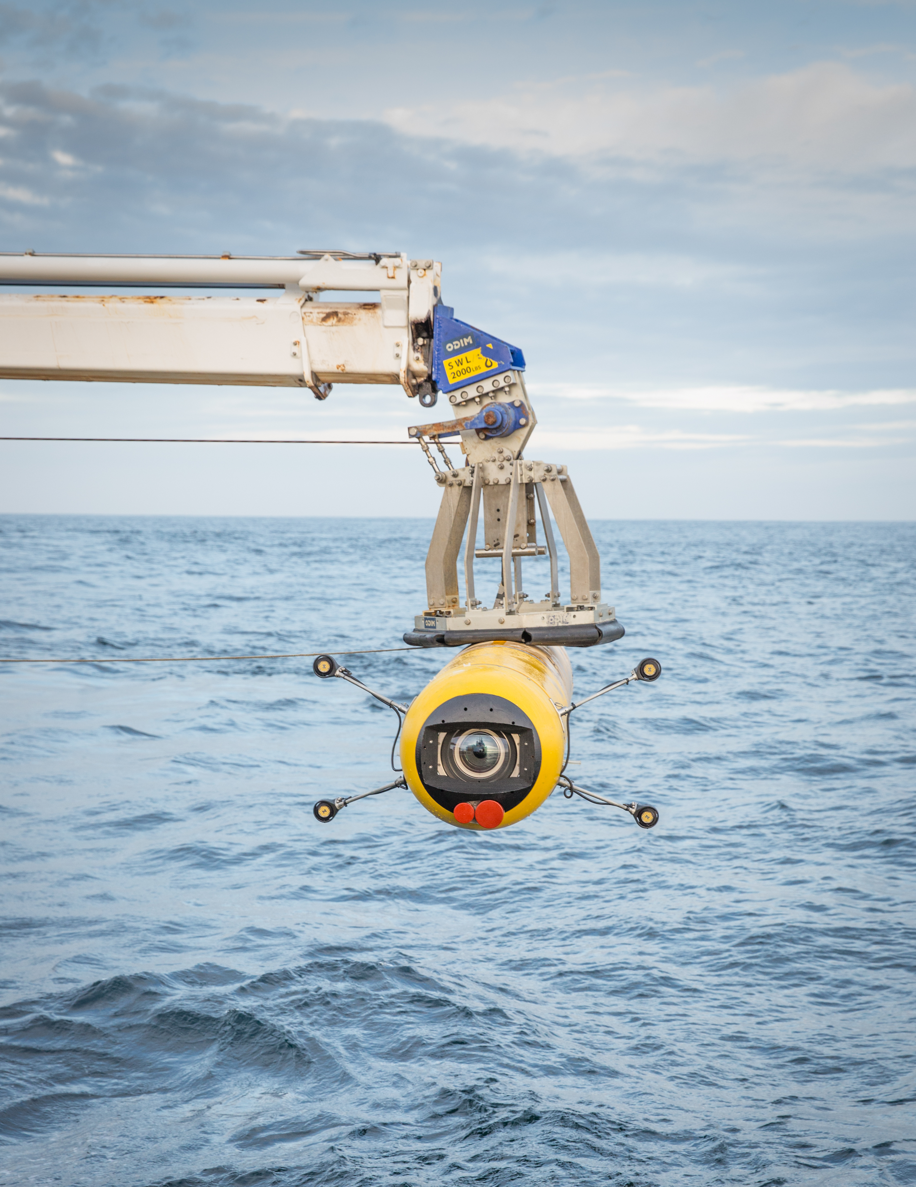
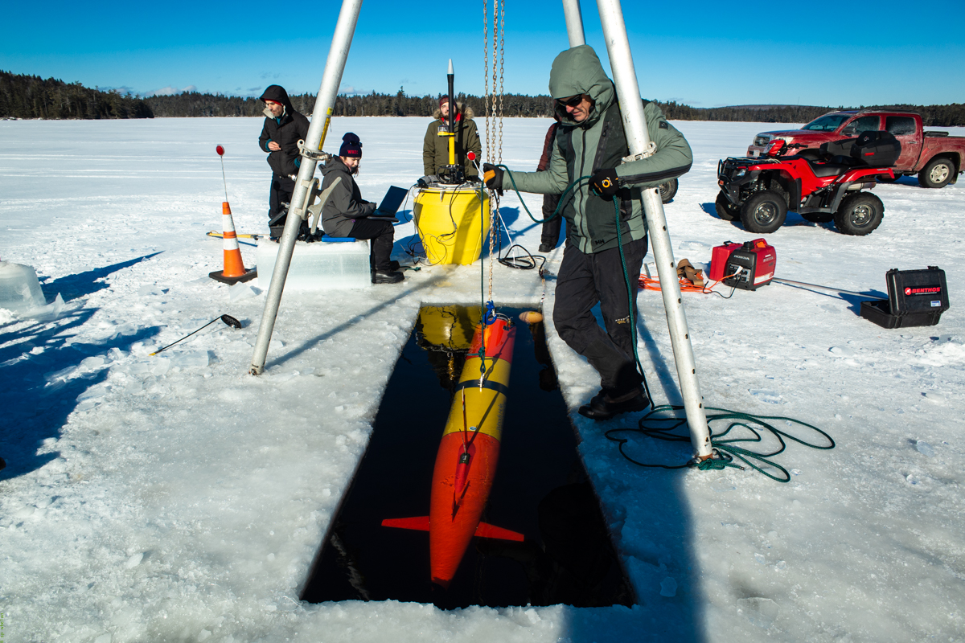
Intelligent interactive AUV missions to understand life’s interactions;
(Side story: future challenge: AUVs following swarms and large animals)
(Side story: listening in: soundscapes with John)
Brett Hobson

Slide 2
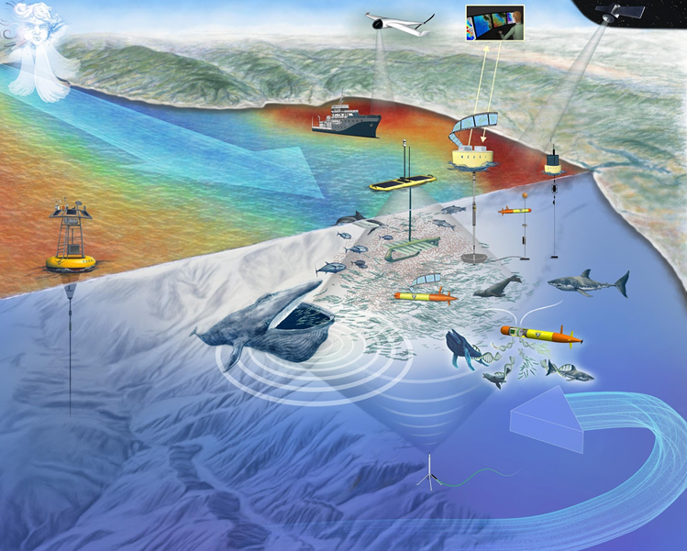
Persistence
  Long Range, 1000 km, Autonomous Underwater Vehicles (LRAUVs)
  Position able Recharge Docking Stations
Full Ecosystem Sensing
  eDNA, Microbial sampler, Passive and Active Acoustics, Imaging for phytoplankton, Zooplankton, Fish and Whales
Collaboration through Inter-vehicle Acoustic Positioning and Communication
Distributed Computing include 1/3 Watt Main Computer to a High Power Edge Computer
Now COTs through Saab
Notes:
We strive to understand how entire 3D ocean echo systems function through the use of fleets of collaborating mobile robots, or Long Range Autonomous Underwater Vehicles (LRAUVs). We instill autonomy to a heterogenous fleet of LRAUVs to allow them to find, follow and sample features of interest throughout the oceans interior. When zones of interest are detected, typically along frontal boundaries, vertical layers, around upwelling zones or eddies, these robots change their behaviour based on how they are equipped. Also, through the use of acoustic position and communication they can request nearby vehicles with complimentary instruements tooin the hunt. Vehicles are equipped with various cameras, microscopes, active or passive acoustics, or samplers that cover the entire animal spectrum from microbes to whales.

Slide 3
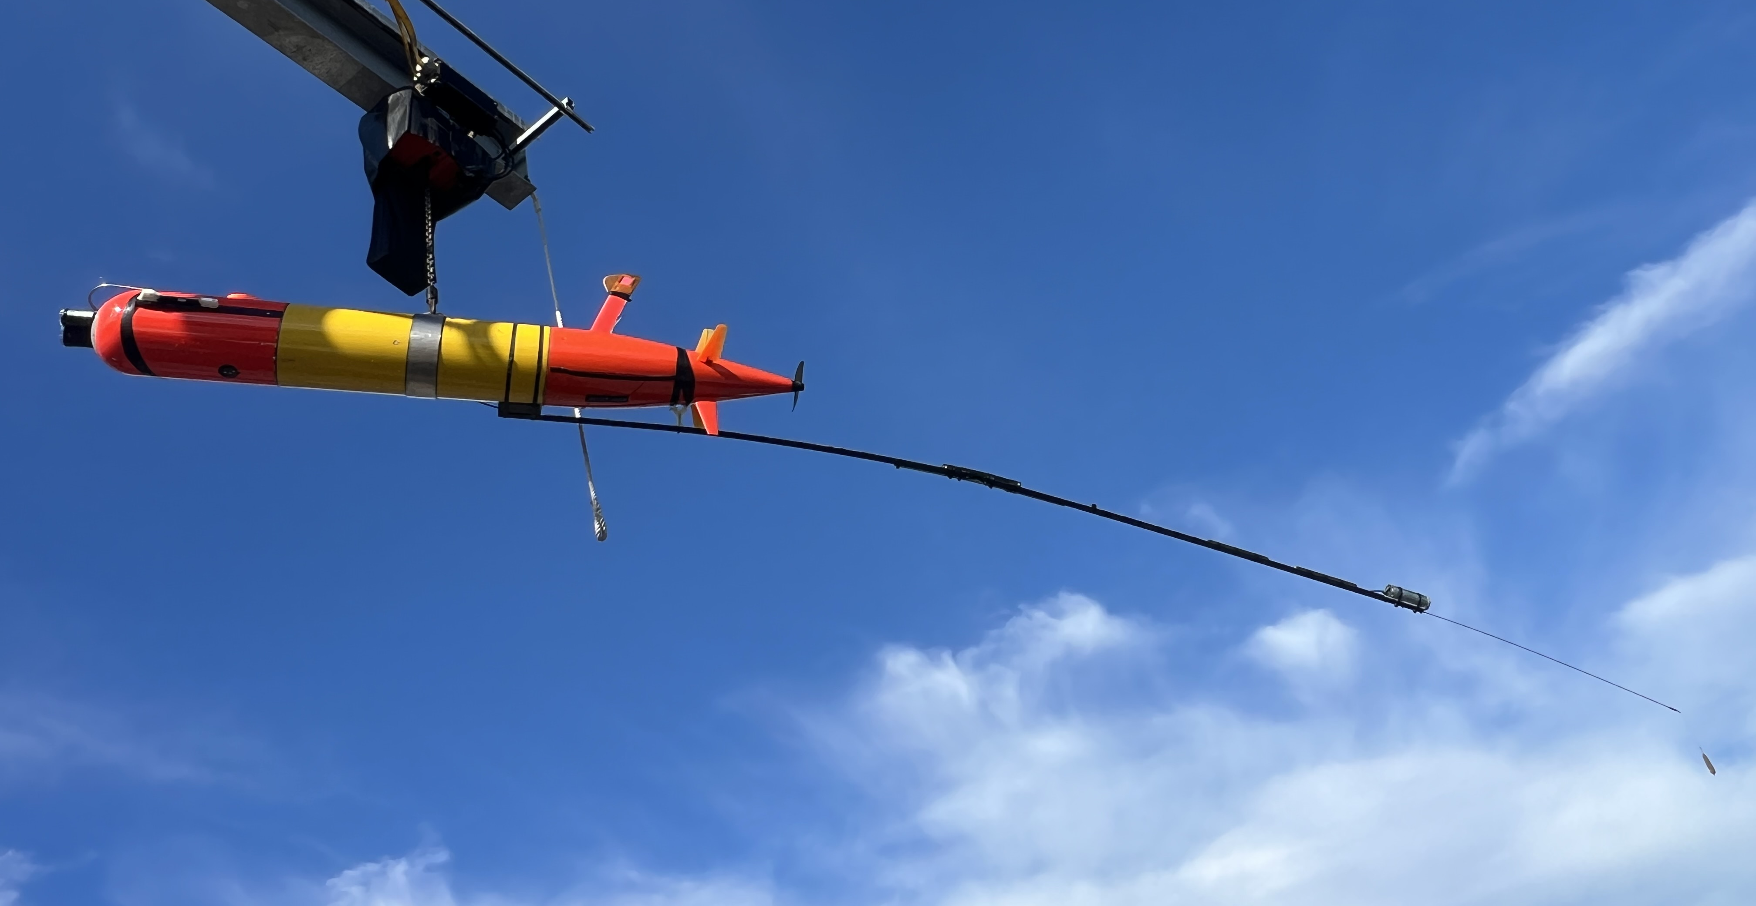
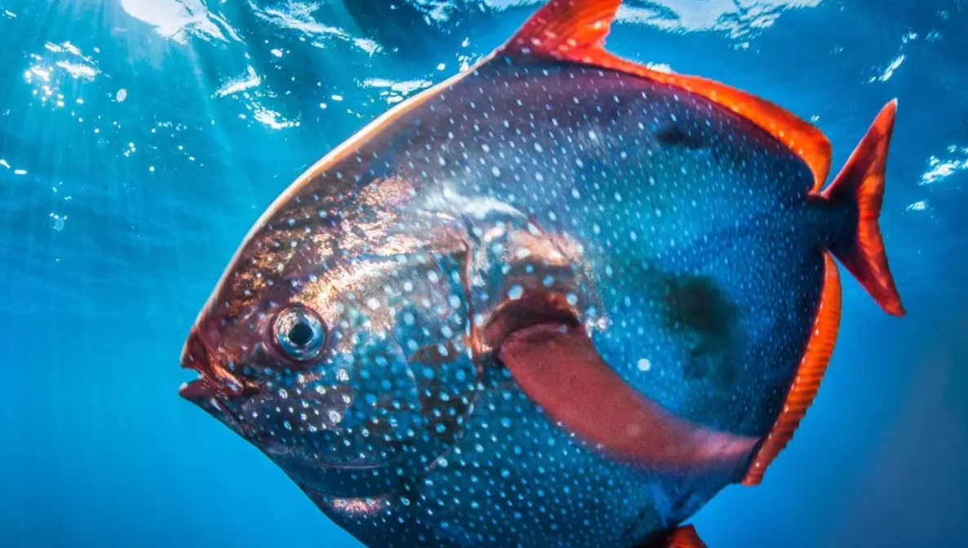
Fish is attracted to the flashing lure
Camera films the fish
On-board computer detects and identifies the fish and checks for uniqueness
Contextual sensors quantify the water mass properties
Optionally, the AUV modifies its mission to stay in the water mass
Optionally, a second, hover-capable camera equipped LRAUV is requested
Notes:
We strive to understand how entire 3D ocean echo systems function through the use of fleets of collaborating mobile robots, or Long Range Autonomous Underwater Vehicles (LRAUVs). We instill autonomy to a heterogenous fleet of LRAUVs to allow them to find, follow and sample features of interest throughout the oceans interior. When zones of interest are detected, typically along frontal boundaries, vertical layers, around upwelling zones or eddies, these robots change their behaviour based on how they are equipped. Also, through the use of acoustic position and communication they can request nearby vehicles with complimentary instruements tooin the hunt. Vehicles are equipped with various cameras, microscopes, active or passive acoustics, or samplers that cover the entire animal spectrum from microbes to whales.

