Slide 1
RASP AUV Docking
Why pair AUV Docking with RASP?
  Either use the power aboard the buoy or transfer it off
  Easier to transfer power well below the surge zone
    Surface vehicles would have to dock to the buoy
  Collect and store power and then batch transfer
  AUVs can collect or “mule” data back to the RASP for transfer ashore via VSAT or other

Slide 2
AUV Docking
Components
  Docking station
  Homing system
  Power and data transfer system

Slide 3
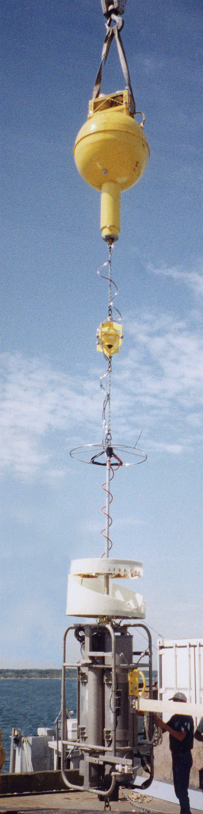
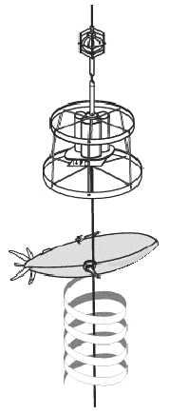
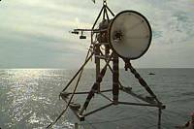
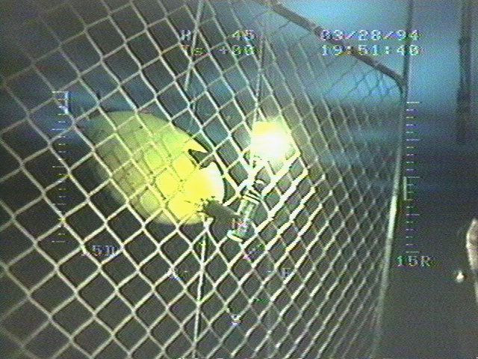
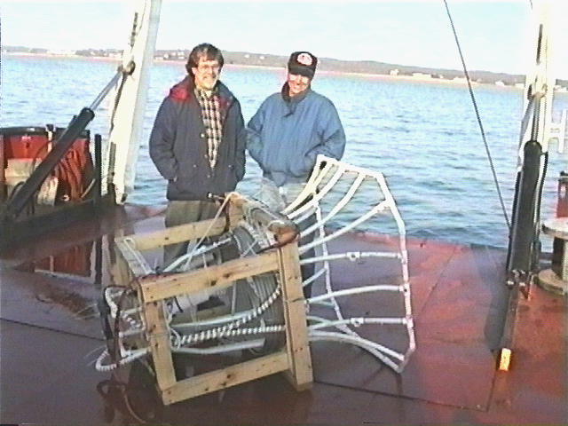
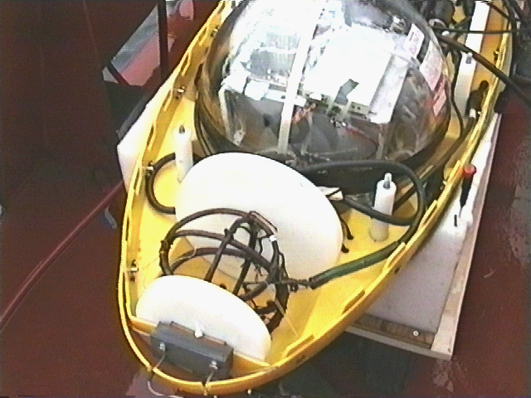
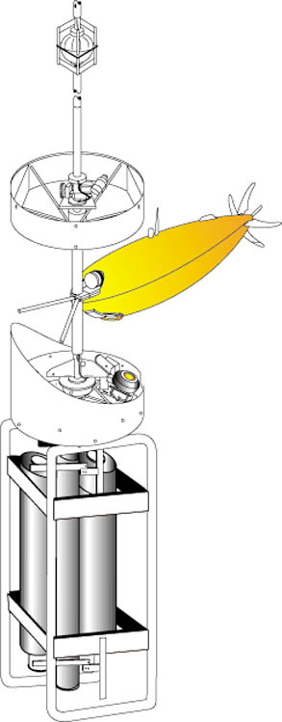
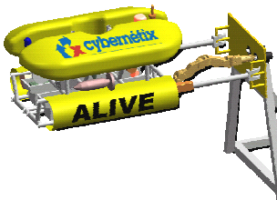
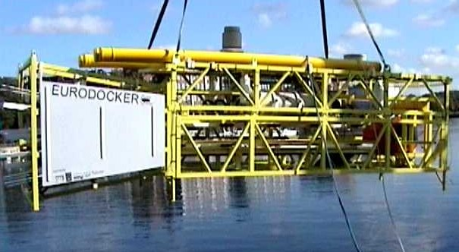
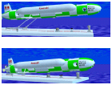
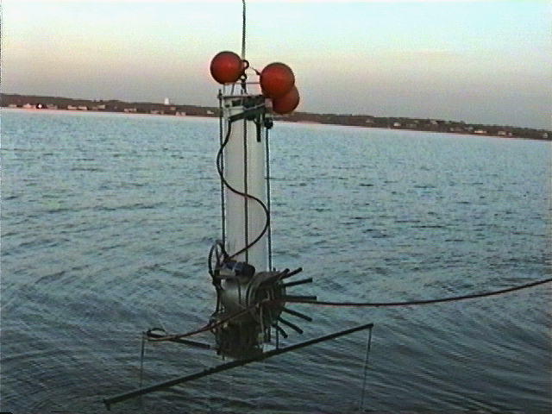
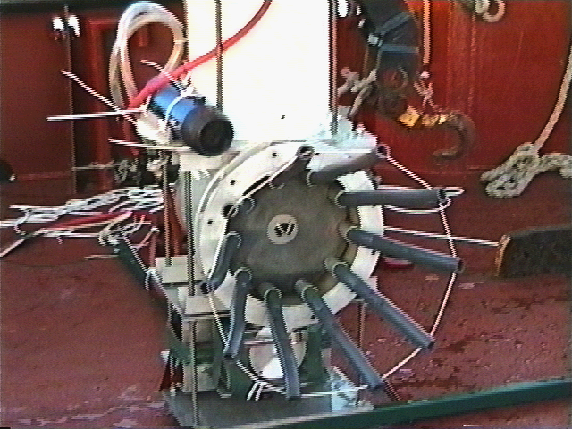
Previous Docking Stations
MIT Sea Grant
REMUS
FAU
WHOI
EDC
EDC
WHOI
ALIVE
KRISO-KORDI
Eurodocker
Kawasaki
WHOI
NRaD
NRaD

Slide 4
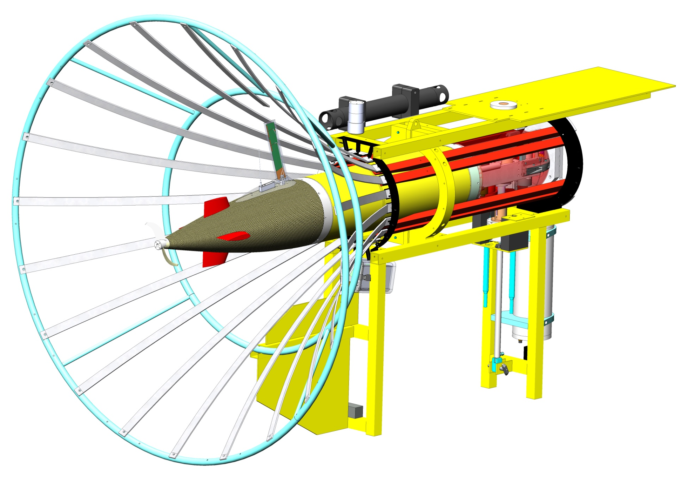
CONE DOCK w/ LRAUV

Slide 5
Homing Systems locate and guide the AUV precisely to the dock
Acoustic
  Long range (+1km) ~2 deg accy., COTS avail.
    USBL: LinkQuest, Sonardyne, Sonatech
    2 Beacon SBL, USBL on dock with modem, local LBL
Electro-Magnetic: Heavy, short range ~30m
Optical: short range, high update, water clarity/bio-fouling issues

Slide 6
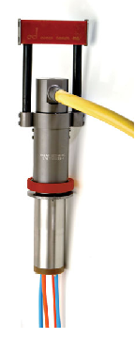
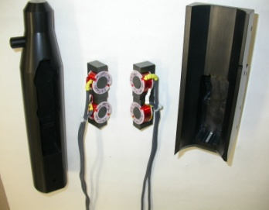
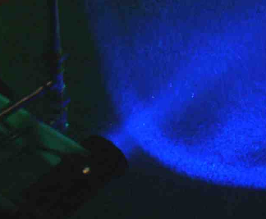
Power Transfer
  Direct Connect - no efficiency losses; Uses AC or DC, very high power
    Could be combined with Data Transfer
    COTS available
    Long-term reliability issue on Dock side (1000 cycles, 2 years)
    Mechanically complex
  Inductive - Contact-less, high reliability
    Conversion to AC incurs efficiency losses between 10 and 30%
    Electrically complex
  Other
    Optical: Light to solar cells
    Mechanical: motor to generator
Data Transfer
  Direct Connect
    Combined with power
  RF
    Functional systems at 100kHz, 14 MHz, 433MHz
      custom devices, too slow
    2.4 GHz – 802.11 (WiFi)
      Short range (<5cm)
      Custom antenna or antenna packaging
  Inductive
    COTS available, though slow
  Optical
    IrDa – up to 10 Mbps +
      Susceptible to bio-fouling
    Laser

Slide 8
Docking Behavior Sequence
Pure Pursuit Homing & Navigation Fix
Current
Dock
2. Waypoint
Heading
3. Docking Control
N
Bearing
−ΔΨ
Cross-Track Error: y, v
Outer Marker
Waypoint
Rotated Inertial
Coordinates
Vehicle
E
4 states; ΔΨ, r, y, v
Inertially Fixed
Coordinates

Slide 9
