Slide 1
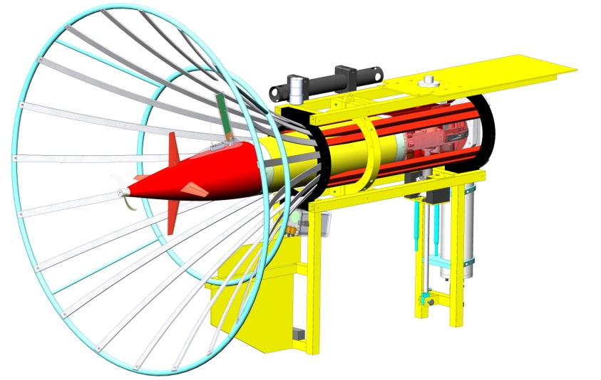
Power Buoy AUV Docking
Electrical Review

Slide 2
Overall Project Objectives
Phase 1 – under existing funding
  Demonstrate AUV Docking with the AUV Tethys
  On a stand-alone mooring
  Demo reliable docking, power transfer, and comms to shore
Phase 2
  Integrate with Power buoy in a stand-alone moored configuration
  This will require a project extension with add-on funding
Phase 3
  Integrate AUV dock on the power buoy riser cable
  This will require a project extension with add-on funding

Slide 3
Requirements
1.0 An AUV Docking Station (ADS) is needed that can use power from the RASP
1.2 The AUV Docking Station shall be compatible with the AUV Tethys and can be adapted for other AUVs.
1.3 The design shall strive to minimize the ADS payload required on the AUV
1.4 The ADS design shall support autonomous docking, though supervisory control is preferred for this effort
Electrical Derived Requirements
2.0 The ADS shall interface with the PB electrical system: 24 volts at 15 amps max and ethernet communications
2.1 The ADS can be developed as a stand-alone moored system before integration with the PB
2.2 The ADS shall be capable of charging the AUV at 10 amps and 17.5 volts
2.3 The ADS shall support data transfer between the dock and the buoy at 1 Mbps
2.4 The ADS shall provide shore operators with the following:
2.4.1 Heading of the dock
2.3.2 Ability to open and close an AUV latch – and verify the vehicle is latched and plugged in and that the latch/connector is fully open or fully closed
2.4.1 Ability to start and stop battery charging
2.5The ADS shall provide a isolation relay to ensure plug in connectors are never energized unless the AUV is docked
2.6 The ADS shall have a GFI if lethal voltages are used

Slide 4
PB AUV Docking CONOPS
Shore-side operators initiate Docking
  Query dock heading, select an appropriate homing start point and send vehicle there
  Open the dock by sending a message to the dock HPU to lower the pin. Confirm it is open by monitoring the status of the open reed switch
  Initiate the AUV docking mission
AUV dives and flies to the dock’s position and acoustically interrogates the dock-mounted A-modem, which responds with the dock’s compass heading. The AUV determines the range and bearing to the dock based on the acoustic time of flight and the angle with which the acoustic response hits a USBL array on the vehicle. The AUV controls its altitude off the seafloor to match the known dock altitude.
AUV determines whether it is in the dock
  Range isn’t changing, “Docked” reed switch on AUV is activated by a fixed magnet in the dock
AUV sends a message to shore via the acoustic modem that it is in the Docked position
Shore-side operators send a message to the dock HPU to raise the latch pin. The “dock open” reed switch opens and the HPU overloads when the docking connector is plugged into the AUV which happens before the “dock closed” reed switch is activated.
If the connector is properly inserted the “mate good” input on the dock relay board will be detected and there should be ethernet connectivity to the AUV
Battery charging could commence by enabling the AUV Charge power supply in the dock
Battery charging status is monitored over the ethernet telemetry link between shore and the AUV
After charging, the AUV is commanded to begin the Un-docking mission and the docking connector is opened and the AUV drives in reverse for 20 (?) seconds and ballasts positive to drift up and free of the dock before thrusting forward

Slide 5
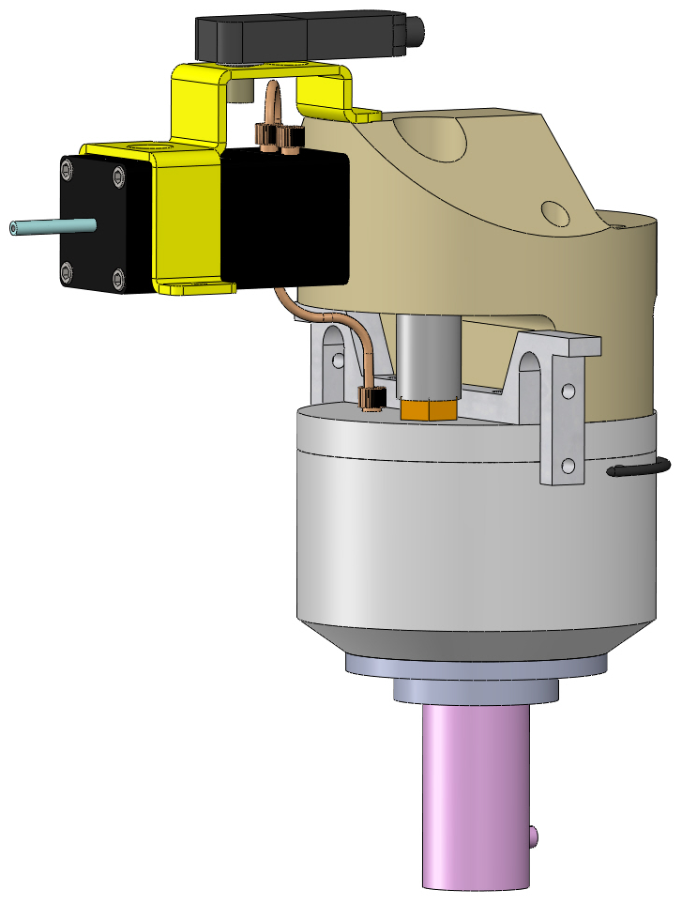
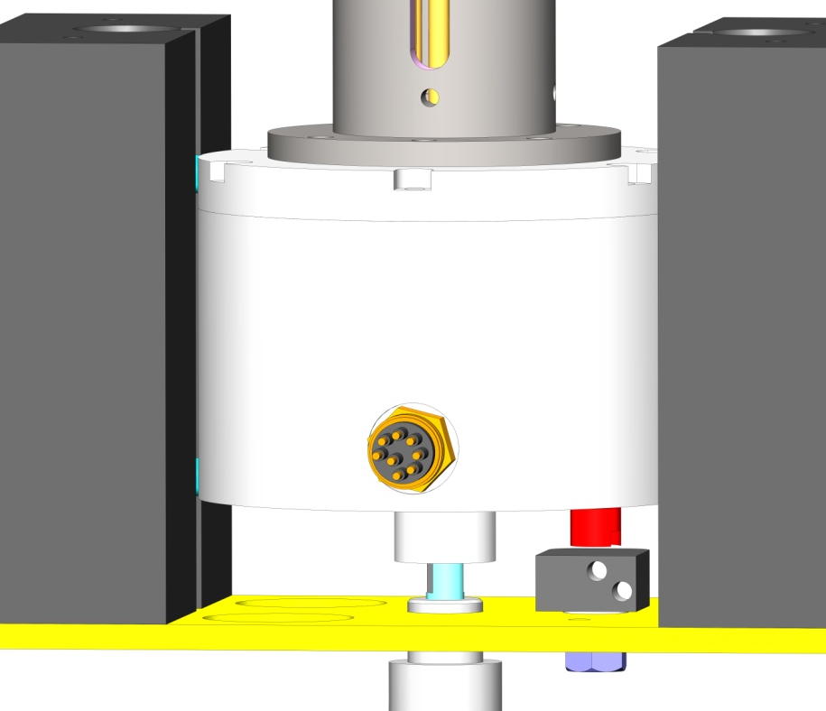
In-Dock Reed Switch
Acoustic Modem
Latch Actuator HPU Housing
Combined Latch, Power and Electrical Connector
Camera + Light
Subsea Electronics Housing (not shown)

Slide 6
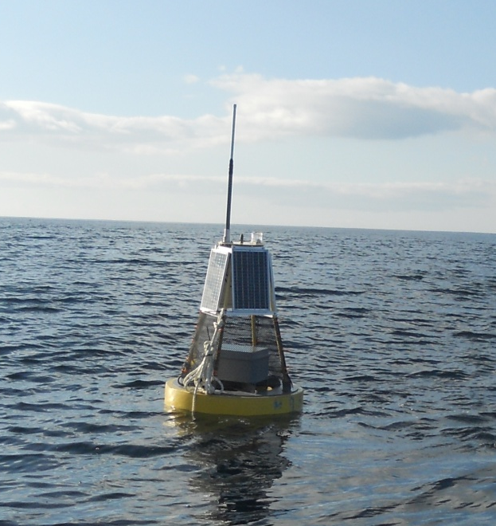
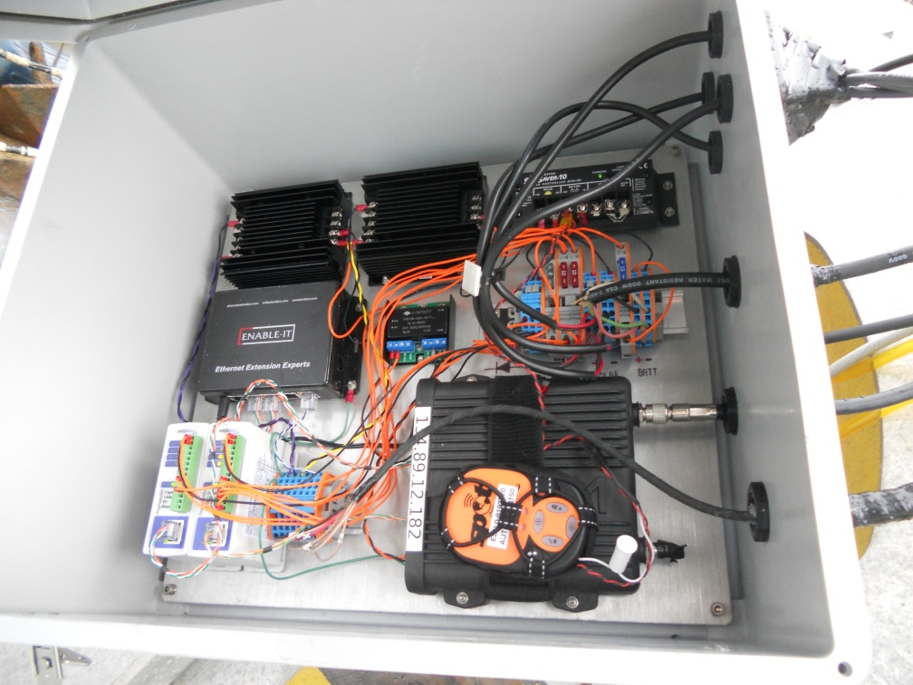
AUV Dock Surface Buoy

Slide 7
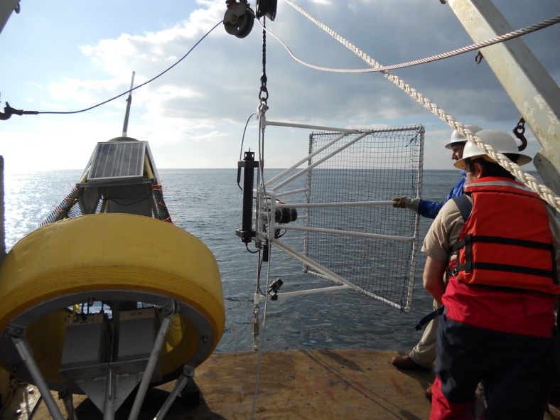
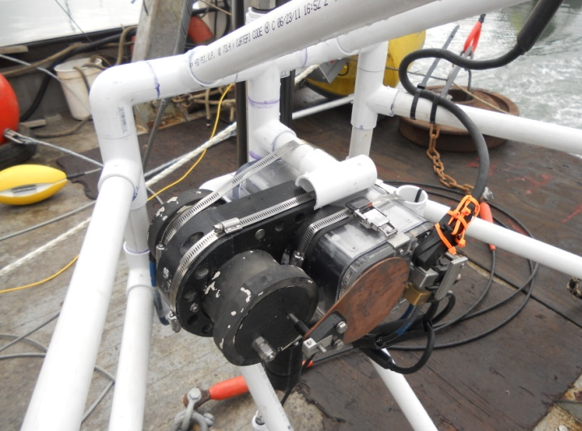
AUV Mock Dock
Homing sensor was problematic
  Bad calibration, a few bugs, and multi-path issues
  New calibration should resolve critical issues
Algorithms to locate and home to the dock are working
Test Deployment “Mock Dock” is complete
  Vehicle passed within 1m of 1.2m target 8/10 times last deployment – real dock is 2m diameter
  900 MHz Radio link was a problem; 2.4 GHz works well
  Cable telemetry is intermittent
  Camera worked OK when telemetry worked
    60m acrylic housing needs to be changed
    Using old still camera housing
  Batteries were marginal
    105 A-hr were ~70 A-hr, then submerged in cold water;
    Oil leak in one
  Solar charged OK; need to change panels to 24 volt
  Mooring survived 3 months – knock on wood

Slide 8
AUV Electrical Overview

Slide 9
AUV Dock Buoy Box

Slide 10
AUV Dock Subsea Electronics

Slide 11
AUV Connector (ODI) Interlock Relay

Slide 12
Power Budget and Power Supply Sizing
Normal Operation - No Subsea Electronics, just radio cycling on/off
Instrument | Min/event | Events/day | days/week | Current (A) | Voltage (v) | Watts | Total Op. Time (hr) | Total Power (A-h) | Total Energy (W-h) | % of total energy
Buoy
Esteem Radio | 10 | 8 | 5 | 0.5 | 24 | 12.00 | 7 | -3.33 | -80.00 | 21.66%
Web Relay comms | 60 | 24 | 7 | 0.07 | 24 | 1.68 | 168 | -11.76 | -282.24 | 76.43%
Relay Esteem radio | 10 | 8 | 5 | 0.044 | 24 | 1.06 | 7 | -0.29 | -7.04 | 1.91%
Solar
four 20watt panels derated 90% | 60 | 24 | 7 | 0.33 | 24 | 7.92 | 168 | 55.44
Total |  |  |  |  |  |  | 349 | 40.05 | -369.28 | 100.00%
With Subsea Electronics on
Instrument | Min/event | Events/day | days/week | Current (A) | Voltage (v) | Watts | Total Op. Time (hr) | Total Power (A-h) | Total Energy (W-h) | % of total energy
Buoy
Esteem Radio | 60 | 4 | 5 | 0.5 | 24 | 12.00 | 20 | -10.00 | -240.00 | 12.19%
Ethernet Switch | 60 | 4 | 5 | 0.09 | 24 | 2.16 | 20 | -1.80 | -43.20 | 2.19%
Web Relay Comms | 60 | 4 | 5 | 0.07 | 24 | 1.68 | 20 | -1.40 | -33.60 | 1.71%
Relay Esteem radio | 60 | 4 | 5 | 0.044 | 24 | 1.06 | 20 | -0.88 | -21.12 | 1.07%
Relay PS 1 | 60 | 4 | 5 | 0.044 | 24 | 1.06 | 20 | -0.88 | -21.12 | 1.07%
Relay PS 2 | 60 | 4 | 5 | 0.044 | 24 | 1.06 | 20 | -0.88 | -21.12 | 1.07%
Relay Ethernet and DSL | 60 | 4 | 5 | 0.044 | 24 | 1.06 | 20 | -0.88 | -21.12 | 1.07%
5 v P/S | 60 | 4 | 5 | 0.044 | 24 | 1.06 | 20 | -0.88 | -21.12 | 1.07%
GFI | 60 | 4 | 5 | 0.083 | 24.00 | 1.99 | 20 | -1.66 | -39.84 | 2.02%
300 vdc P/S (2) | 60 | 4 | 5 | 0.44 | 24.00 | 10.56 | 20 | -8.80 | -211.20 | 10.73%
GFI sensor | 60 | 4 | 5 | 0.0125 | 300.00 | 3.75 | 20 | -0.25 | -75.00 | 3.81%
Patton DSL Modem | 60 | 4 | 5 | 1 | 5.00 | 5.00 | 20 | -20.00 | -100.00 | 5.08%
Web Relay Comms | 60 | 4 | 5 | 0.07 | 24 | 1.68 | 20 | -1.40 | -33.60 | 1.71%
Relay Acoustic Modem | 60 | 3 | 5 | 0.044 | 24 | 1.06 | 15 | -0.66 | -15.84 | 0.80%
Relay Serial Server | 60 | 3 | 5 | 0.044 | 24 | 1.06 | 15 | -0.66 | -15.84 | 0.80%
Relay 18.5V PS enable | 60 | 3 | 5 | 0.044 | 24 | 1.06 | 15 | -0.66 | -15.84 | 0.80%
Relay Light | 60 | 3 | 5 | 0.044 | 24 | 1.06 | 15 | -0.66 | -15.84 | 0.80%
Relay copper shutter | 60 | 3 | 5 | 0.044 | 24 | 1.06 | 15 | -0.66 | -15.84 | 0.80%
Relay camera | 60 | 3 | 5 | 0.044 | 24 | 1.06 | 15 | -0.66 | -15.84 | 0.80%
Relay HPU | 60 | 3 | 5 | 0.044 | 24 | 1.06 | 15 | -0.66 | -15.84 | 0.80%
Relay ODI interlock | 60 | 3 | 5 | 0.044 | 24 | 1.06 | 15 | -0.66 | -15.84 | 0.80%
300/24 vdc P/S | 60 | 3 | 5 | 0.63 | 24 | 15.12 | 15 | -9.45 | -226.80 | 11.52%
300/18.5 vdc P/S | 1 | 1 | 5 | 0.09 | 300 | 27.00 | 0 | -0.01 | -2.25 | 0.11%
24/5 vdc P/S | 60 | 3 | 5 | 0.044 | 24 | 1.06 | 15 | -0.66 | -15.84 | 0.80%
24/12 vdc P/S | 60 | 3 | 5 | 0.13 | 24 | 3.12 | 15 | -1.95 | -46.80 | 2.38%
Filter module | 60 | 3 | 5 | 0.015 | 300 | 4.50 | 15 | -0.23 | -67.50 | 3.43%
Patton DSL Modem | 60 | 3 | 5 | 1 | 5 | 5.00 | 15 | -15.00 | -75.00 | 3.81%
Camera | 60 | 3 | 5 | 0.56 | 12 | 6.72 | 15 | -8.40 | -100.80 | 5.12%
Serial Server | 60 | 3 | 5 | 0.166 | 24 | 3.98 | 15 | -2.49 | -59.76 | 3.03%
Ethernet Switch | 60 | 3 | 5 | 0.09 | 24 | 2.16 | 15 | -1.35 | -32.40 | 1.65%
shutter | 8 |  |  |  |  | 0.00 | 0 | 0.00 | 0.00 | 0.00%
ODI interlock board | 60 | 3 | 5 | 0.08 | 24 | 1.92 | 15 | -1.20 | -28.80 | 1.46%
AUV Charge | 60 | 1 | 2 | 0.09 | 24 | 2.16 | 2 | -0.18 | -4.32 | 0.22%
Light | 40 | 1 | 5 | 3.5 | 24 | 84.00 | 3 | -11.67 | -280.00 | 14.22%
HPU | 1 | 5 | 5 | 2 | 24 | 48.00 | 0 | -0.83 | -20.00 | 1.02%
Solar |  |  |  |  |  | 0.00 | 0 | 0.00 | 0.00 | 0.00%
four 40watt panels derated 90% | 60 | 24 | 7 | 0.65 | 24 | 15.60 | 168 | 109.20
Total |  |  |  |  |  |  | 689 | 0.80 | -1969.03 | 100.00%

Slide 13
High Risk Elements - Electrical
Submerged batteries in Phase 1 mooring
High voltage power transmission – shorts and safety
High speed telemetry over un-twisted/un-shielded wires in a shared bundle with power transmission
  Trouble with Mock Dock, new Patton modems work on MARs and have been tested in the lab
Radio telemetry interference (RF and environmental)
    Existing radio works, Cellular link is untested
ODI connector
    complicated design with some history of issues but mature design
Power budget
  May want to use light/video and charging more than is supported

Slide 14
High Risk Elements - Overall
AUV
  Low thrust: may have trouble pushing into the dock
    dock motion should loosen stuck vehicle
  Low maneuverability: low-power, small fins and slow control cycle
    could build larger fins but seems to work OK so far
  Damage: exposed fins and antenna
    could pad dock hoop; so far so good
Dock
  Wave motion may cause the dock to rotate and heave
    may only work in calm weather
  Bio-fouling
    copper shutter on camera
  Ship collision with buoy
    So far so good (3 months)

Slide 15
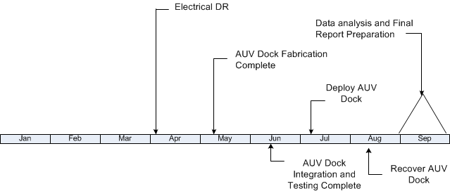
Schedule

Slide 16
Costs
Expense - $6k + contingency
  ~ $6k of hardware to order
  ~ $1k of additional costs for PB integration (longer cable,+)
  ~$3k of additional spare parts we’d prefer to have on hand, but have held off on
Labor ~ 120 days of Engineering
  25 days for Hobson
  10 days for Cazenave
  30 days for McEwen
  25 days for Kieft
  20 days for Erikson
  10 days for Hoover

Slide 17
List of electrical components
Component name | vendor | quantity | spare | cost | total cost | Lead time
Webrelay 10-Industrial Plus | control by web | 2 |  | $500 | $1,000 | stock
Temperature/Humidity sensor (wall mount) X-DTHS-WM | control by web | 2 |  | $94 | $188 | stock
Temperature sensor X-DTS-U | control by web | 0 |  | $10 | $0 | stock
Ground Fault interuptor GR-2601 | Littelfuse | 1 |  | $708 | $708 | 4w
Ground Fault sensor PGG-0400 | Littelfuse | 1 |  | $792 | $792 | 4w
H150-300 power supply | American power design | 2 |  | $360 | $720 | stock
Wireless ethernet modem 195E series | Esteem | 1 |  | $0 | $0 | mbari
BH8F Connector | Subconn | 1 | 0 | $107 | $107
IL8M Connector | Subconn | 1 | 1 | $69 | $138
MCBH8F Connector | Subconn | 3 | 0 | $105 | $315
MCIL8M Connector | Subconn | 3 | 0 | $76 | $228
MCBH4F Connector | Subconn | 2 | 1 | $71 | $213
MCIL4M Connector | Subconn | 2 | 1 | $40 | $120
MCBH16F Connector | Subconn | 1 |  | $0 | $0
Sunsaver-10L-24V | Morningstar | 1 |  | $81 | $81 | stock
CUI-VYB10W-Q24-S5-T power supply | CUI | 1 |  | $37 | $37 | stock
CUI-VYB20W-Q24-S12-T power supply | CUI | 2 |  | $37 | $74 | stock
Ethernet Serial Server | B&B electronics | 1 |  | $0 | $0 | mbari
Ethernet switch ESW105 | B&B electronics | 2 | 1 | $0 | $0 | mbari
VI-26N-EU-B1 power supply | Vicor | 2 |  | $172 | $344 | 2-3w
VI-263-EU-B1 power supply | Vicor | 2 |  | $172 | $344 | 2-3w
VI-A66-EQ filter module | Vicor | 1 |  | $60 | $60 | 2-3w
Bus Mod ternimal block 18952 | Vicor | 1 |  | $32 | $32 | 2-3w
Bus Mod ternimal block 06322 | Vicor | 2 |  | $32 | $64 | 2-3w
Patton GSHDSL-3241 modem | Patton | 0 |  | $417 | $0 | stock
Power Supply PCB | Francois/Jose MBARI | 1 |  |  | $0
Solar Panels
Ezservo EZSV23 | all motion | 1 |  | $325
ODI interlock PCB | Brett/Jose MBARI | 1 |  |  | $0
 |  |  |  |  | $5,565

Slide 19
PB/AUV Dock Deployment

Slide 20
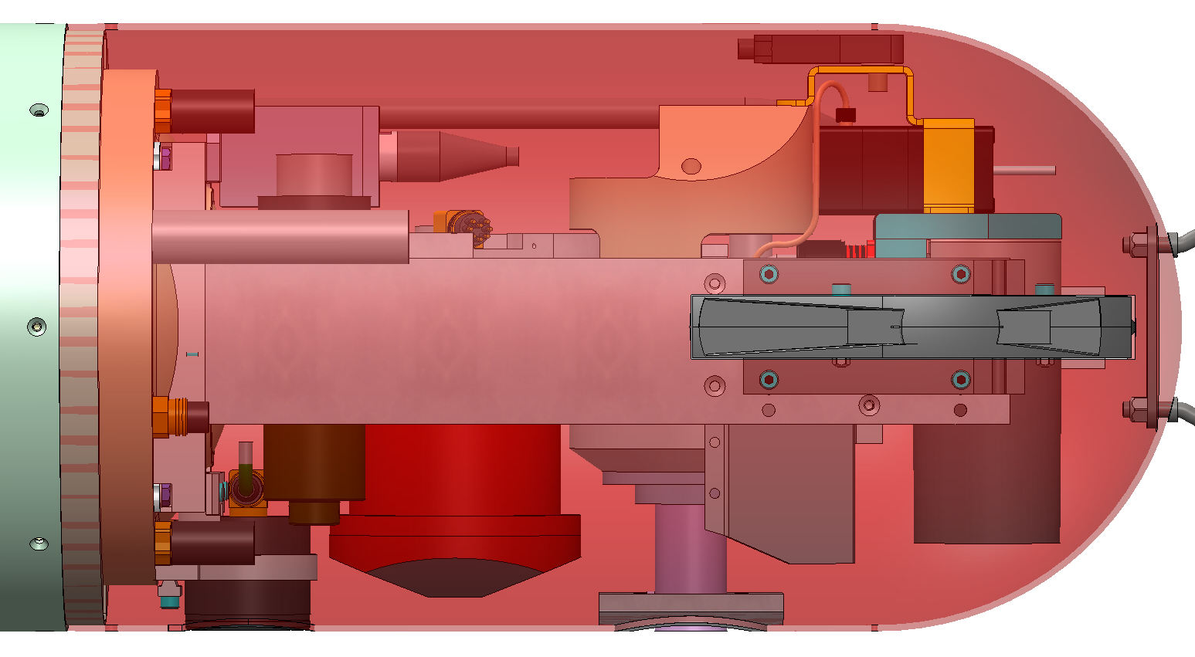
LRAUV Nose

Slide 21
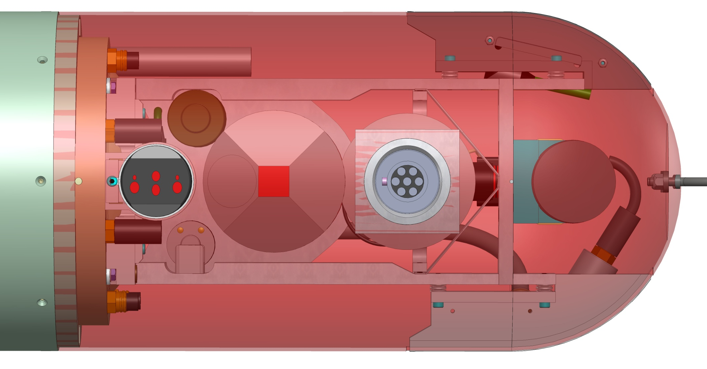
LRAUV Nose_Bottom View

Slide 22
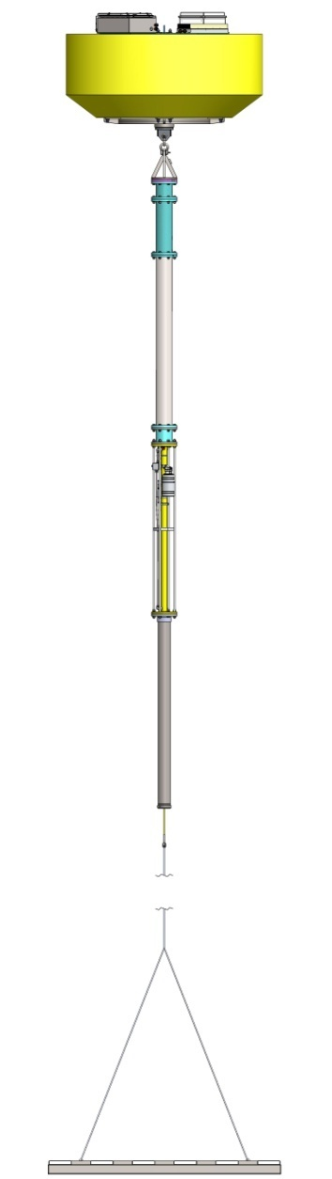
Wave-Buoy Components

