Slide 1
State of Homing

Slide 2
Where Are We Now?
Nov 2023: Dock/miss ratio was 1 in 6.
Objective: Do better.
Jan 2024: Hit miss ratio was 1 in 3.
Progress due to several incremental fixes.

Slide 3
Fixes So Far:
Fixed rangeClosing()
PP was latching the last dock location 2 m out, needed 10.
Corrected median filter initialization to eliminate delay.
Integrator windup now correctly handled.
Bandwidth/gains increased (not finished).
Vehicle consistently approaching up-current (not tested at sea yet)

Slide 4
Remaining Problems and Questions:
Dock “walks” as vehicle approaches (why)?
Why does the vehicle hook and the end?
What is the size of the point spread?
  Masked by the median filter

Slide 5
1. Dock Walk: Data
12 Jan run:
  Dock usually walks in the direction of the turn.
  20240112T171341. 7-10% DT
  20240112T042707. 3-9% DT
Show data:

Slide 6
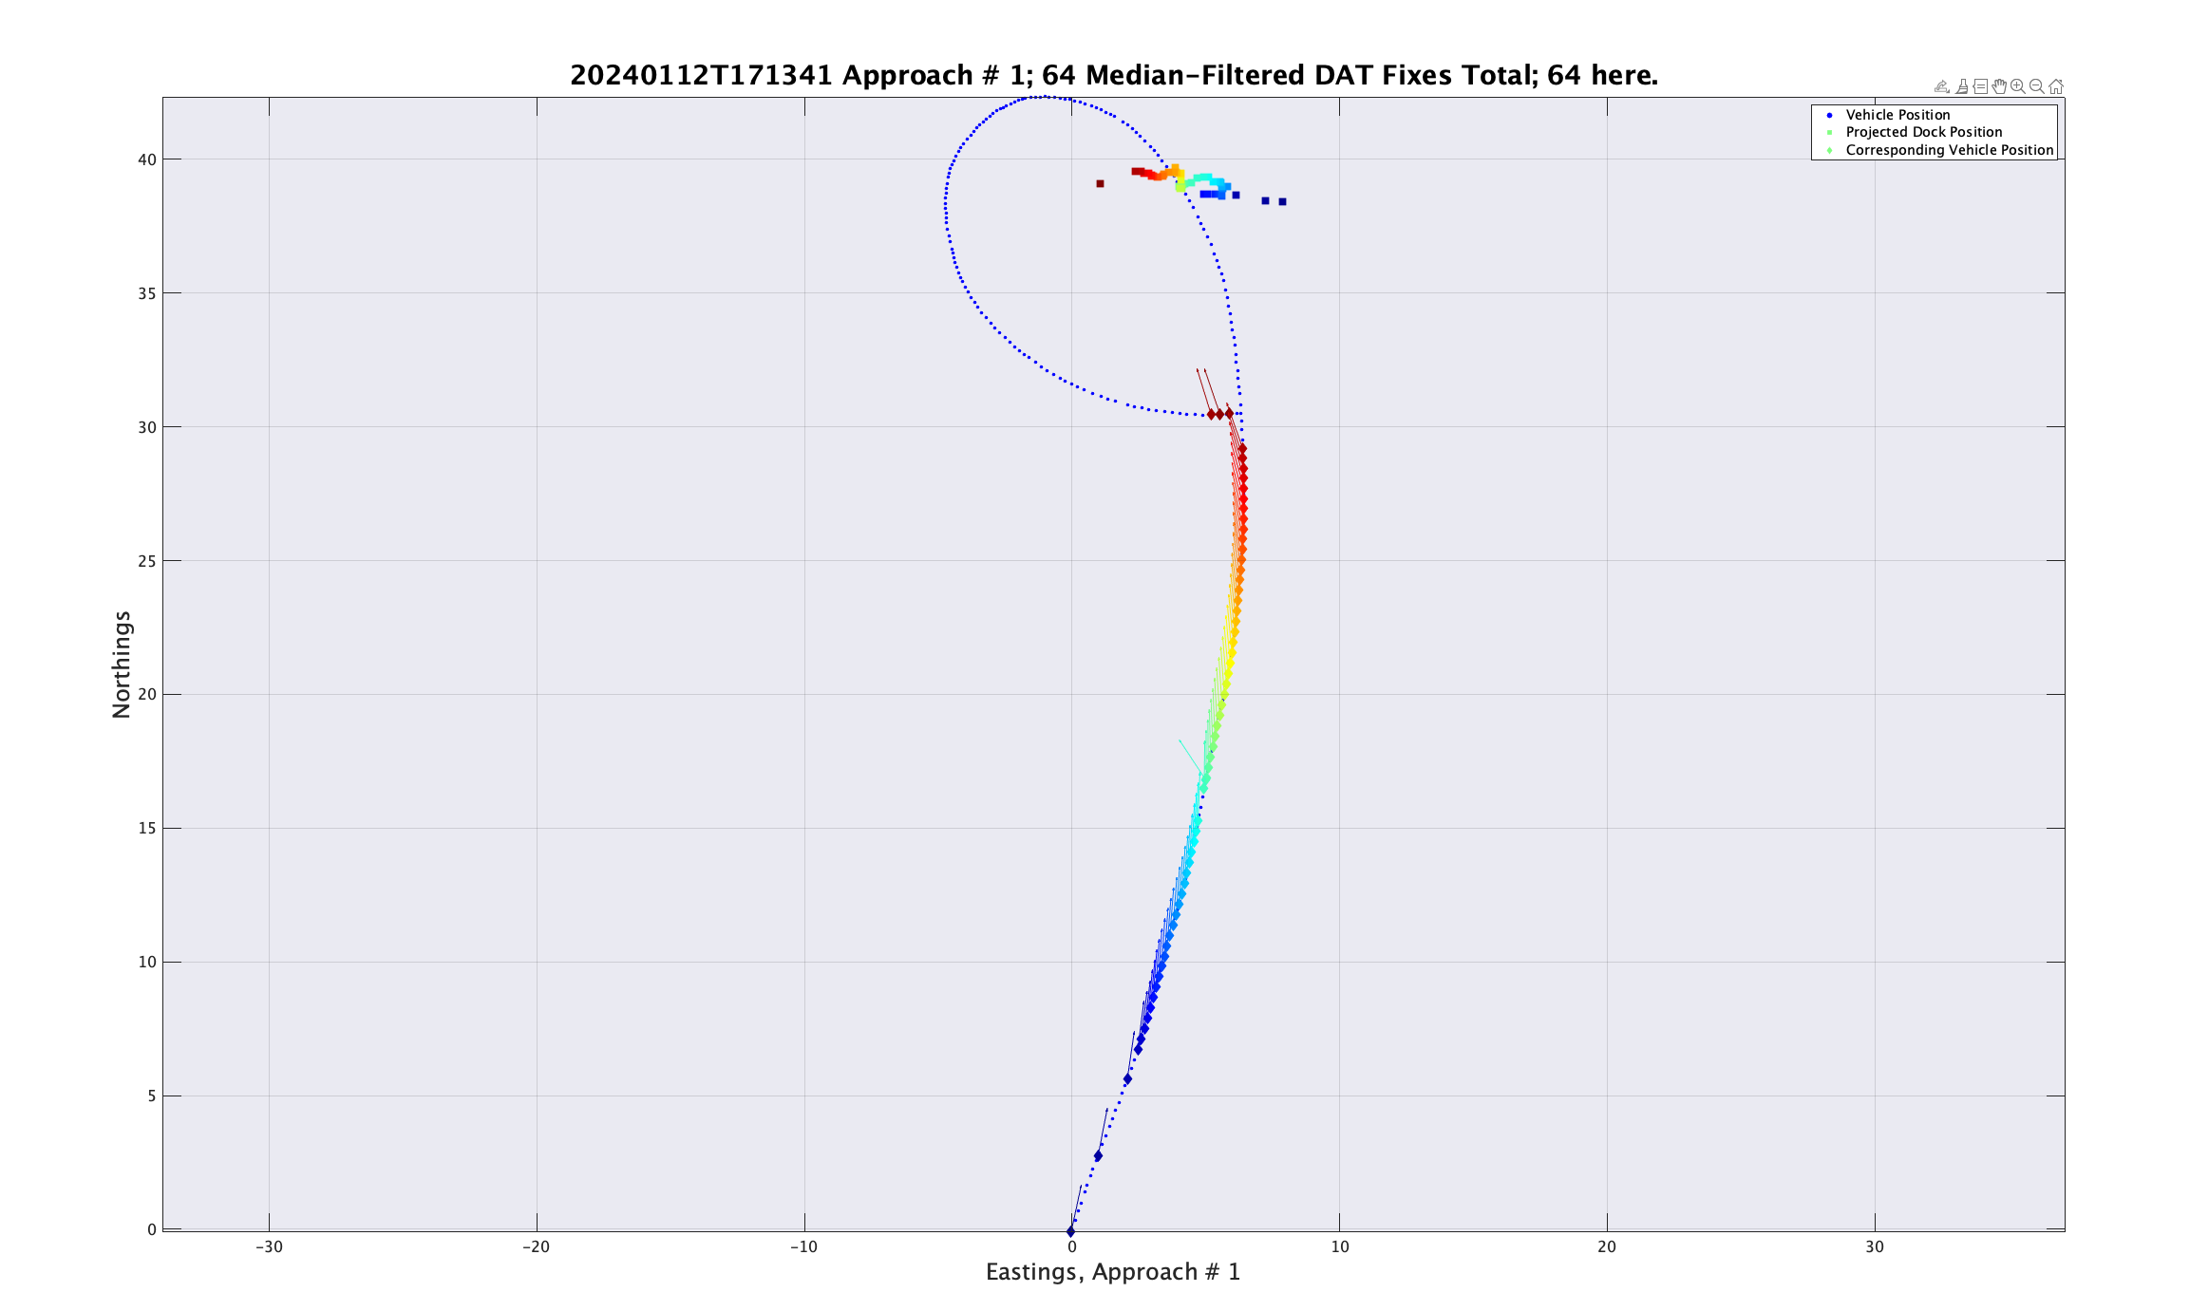
Tethys Log: Down/Cross Current

Slide 7
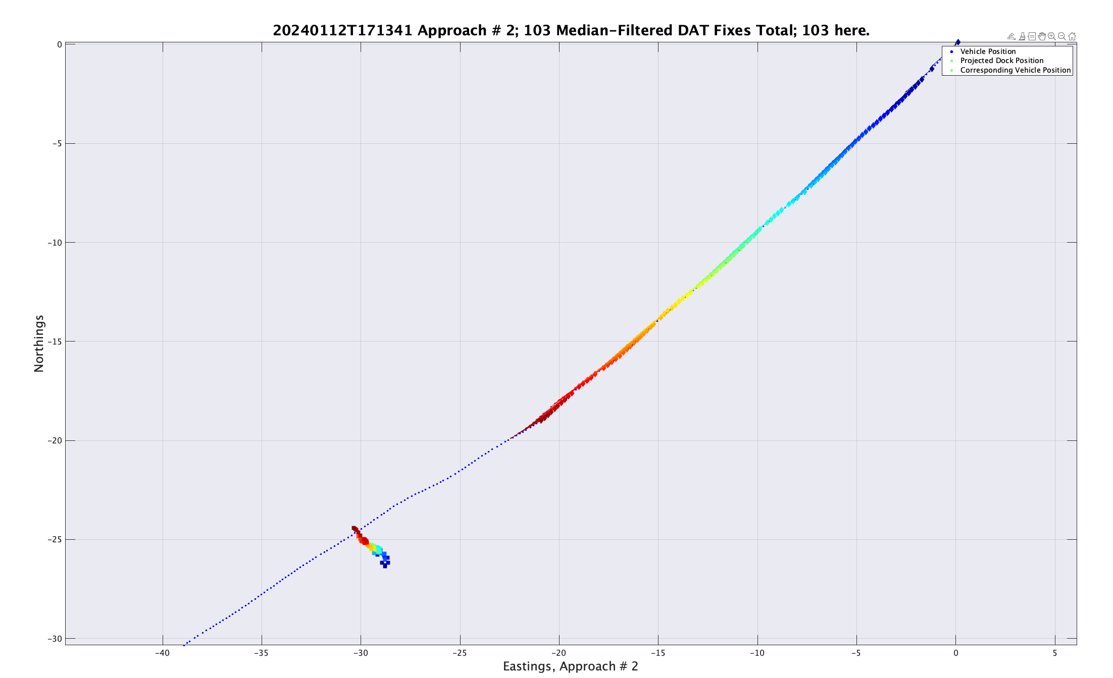
Tethys Log: Up current

Slide 8
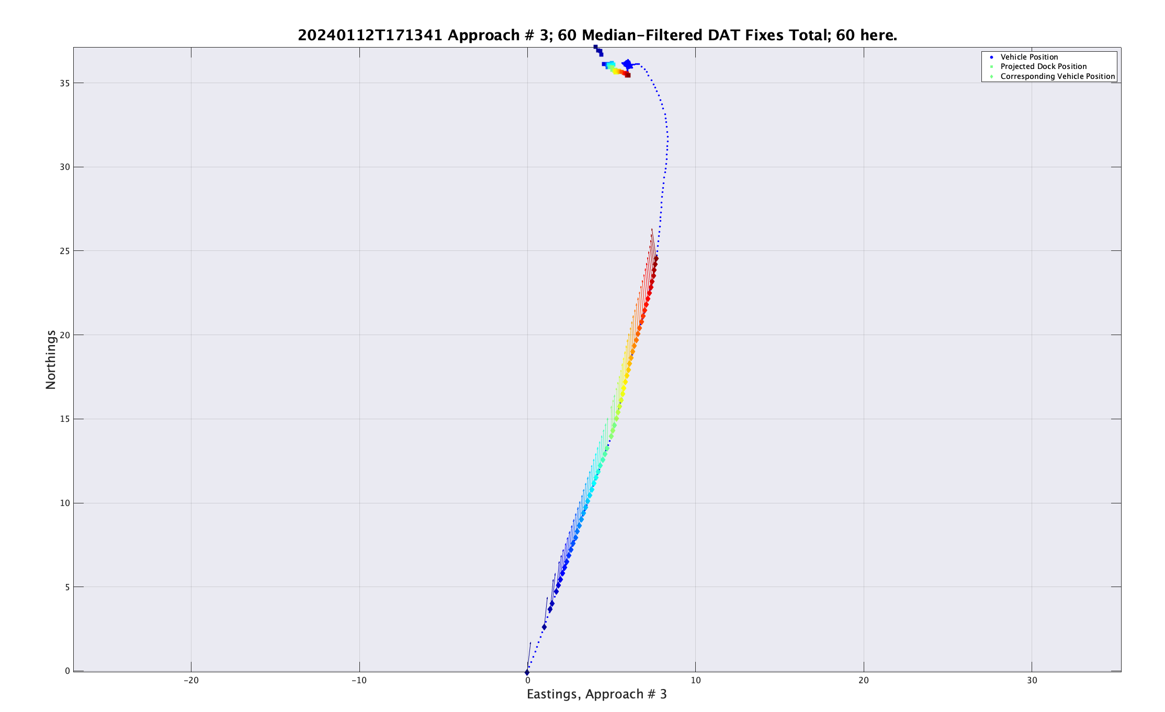
Tethys Log: Down/Cross Current with Dock

Slide 9
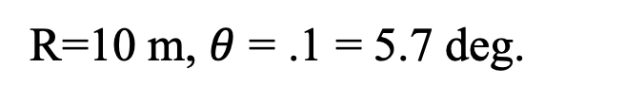
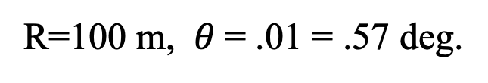


2. Hook at the End:
d =1 m
$$rθ=d$$
R=10 m, $θ$ = .1 = 5.7 deg.
r
$$θ=d/r$$
R=100 m, $θ$= .01 = .57 deg.

Slide 10
What is Causing Dock Walk?
Simulate Sensor and Navigation Error:
DAT: range & misalignment.
DAT: delay.
Nav: yaw delay.
Nav: Dvl velocity scale factor.

Slide 11
Dock Walk: Simulation Results
50% lateral Dvl:
  Dvl possibly has nonlinearity around zero.
  Northerly Start: 20240312T213652.
  Southerly Start: 20240312T182612.
Show data:

Slide 12
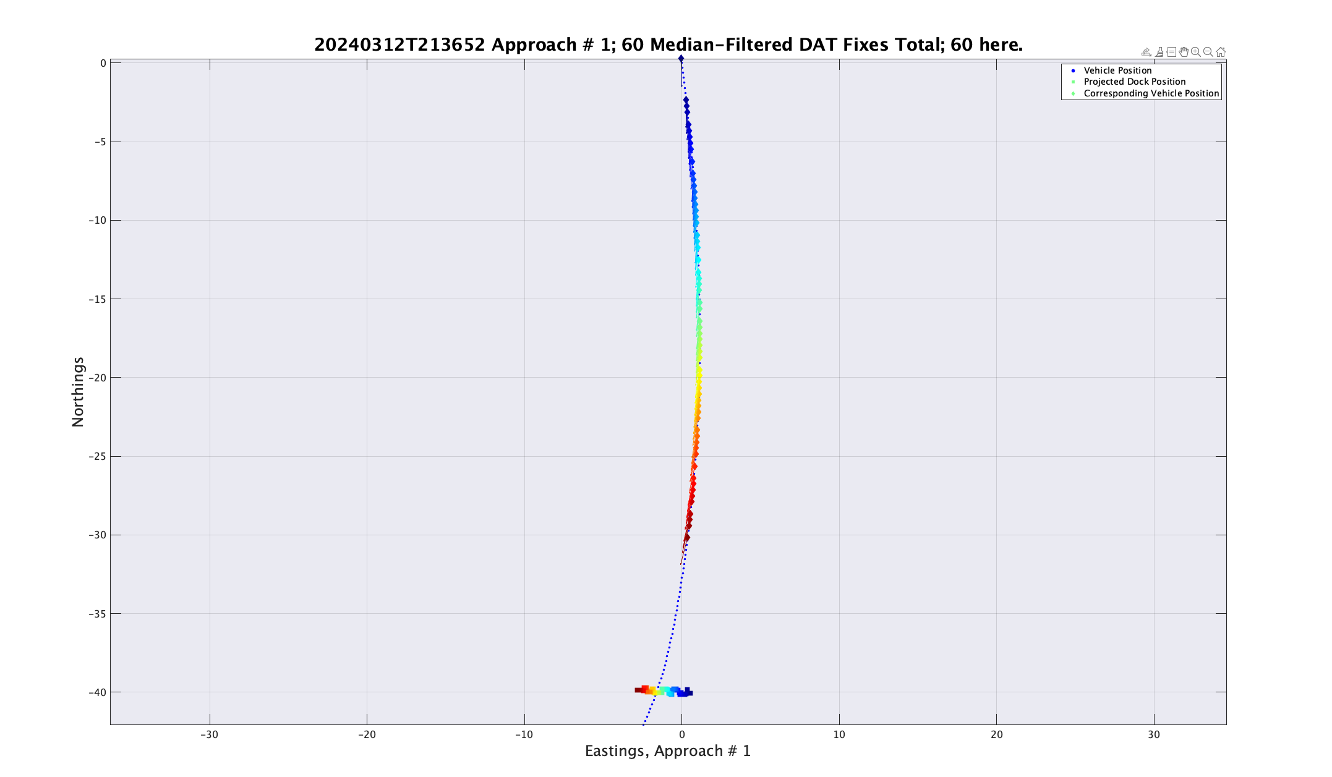
Docking Simulation - Cross Current

Slide 13
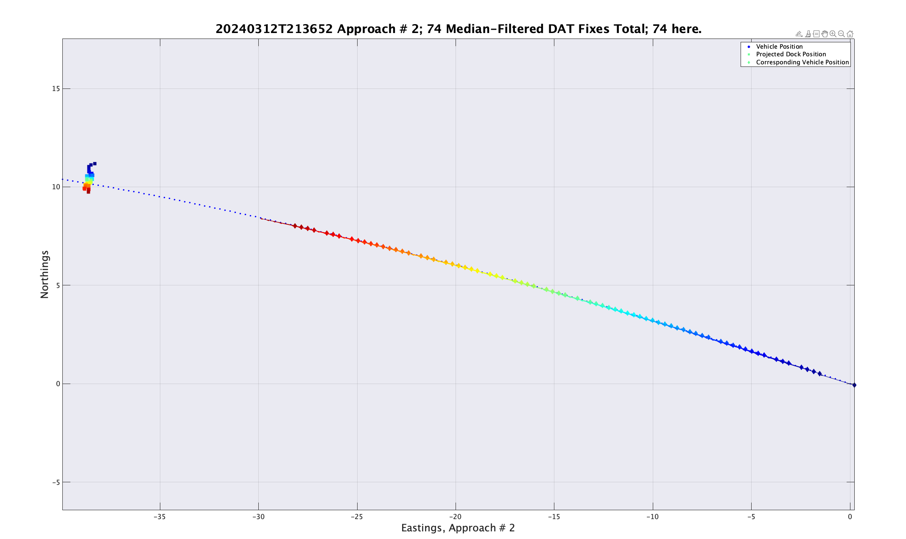
Docking Simulation – Up Current

Slide 14
1. Proposed Solutions:
Feed DAT bearing directly into PN/PP:
  Eliminates Nav error source.
  Expect better performance in one-way mode.
  May need filtering.
  How to latch bearing 10 meters out?
Use Buoy Location to Reset Nav:
  May need additional filter/estimator.
  Suited to simulation.

Slide 15
3. Point Spread: Two Ways
Use Radii
Use Lateral Distance

Slide 16
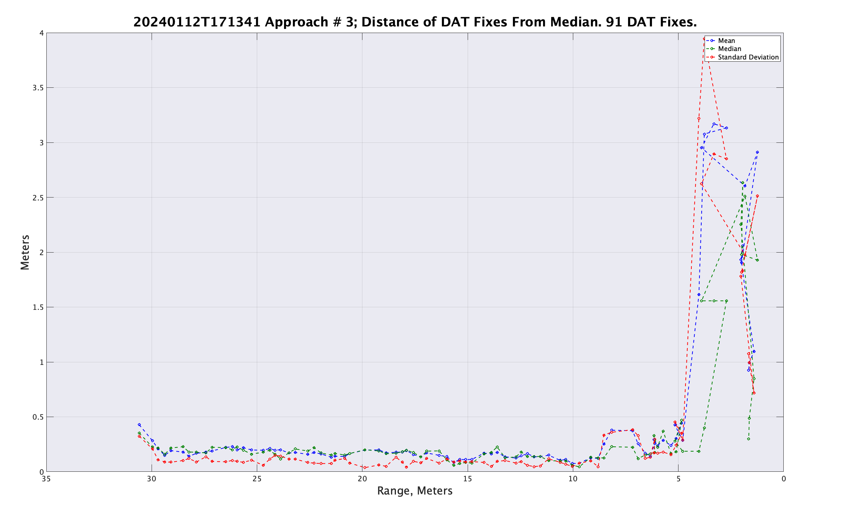
Tethys Log: Down/Cross Current with Dock

Slide 17
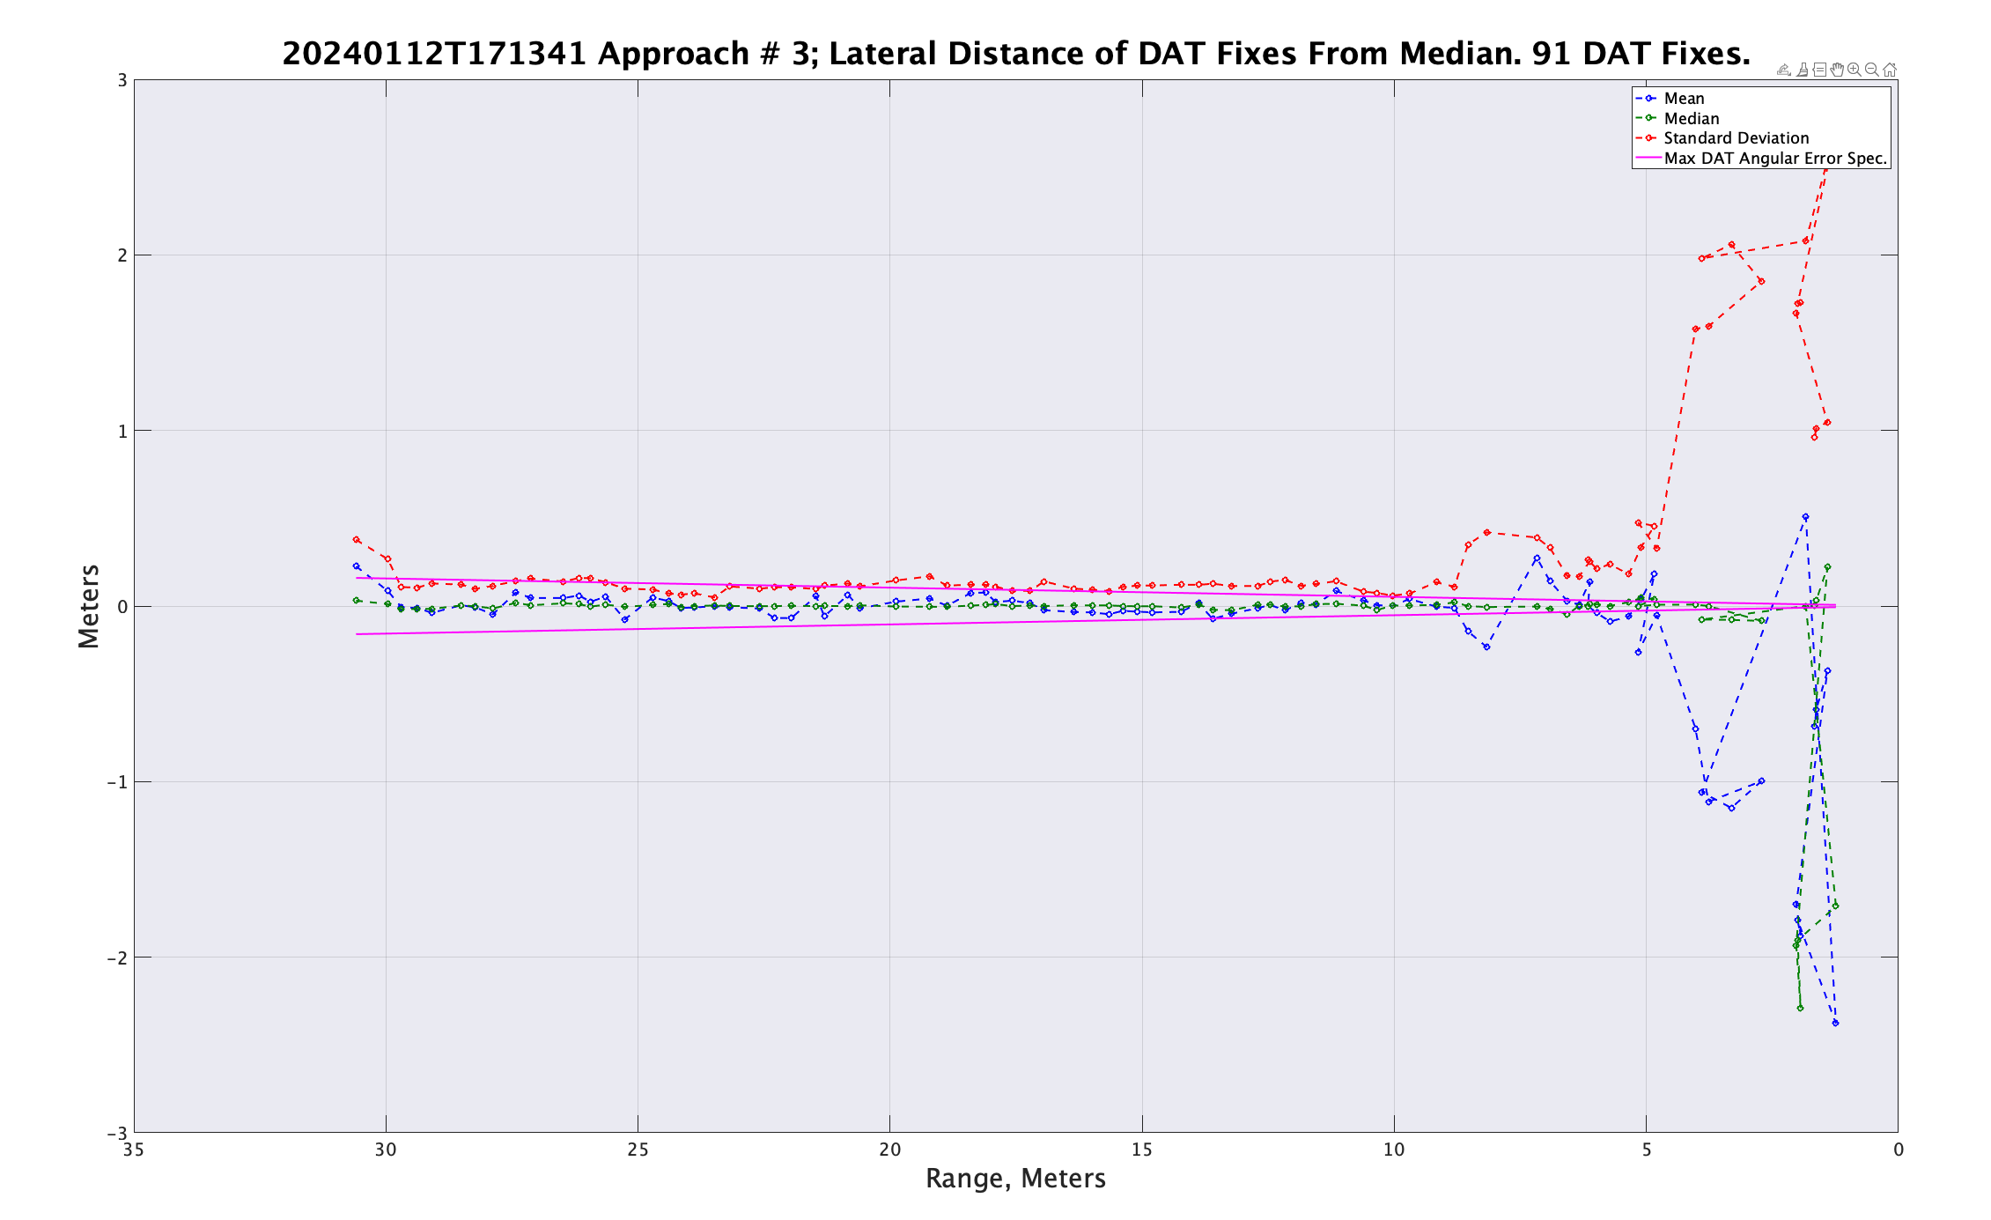
Tethys Log: Down/Cross Current with Dock

Slide 18
To Do:
Implement bearing-only control with switch.
  Latch filtered bearing at 10 meters out.
Implement dock-referenced nav updates with switch.
Simulate docks with higher bandwidth control.
  Larger fins.
Fix gain scheduling to resume original gains after rollout.
Note: All of the above well suited to simulation!

Slide 19
End

Slide 20
Navigation Error
Consider last 10 meters:
  Assume nav error = 2% DT.
  10 * .02 = 20 cm.
  Aperture center is offset to the arm side ~15 cm.
  Vehicle aperture = (+ 39, -9 ) cm, 48 cm edge-to-edge.
  9/20 = 45% or about 1 in 2 on the left side.

Slide 21
Causes: Homing Error Sources in H Plane
Sensor error – DAT
  How is SOS set?
  Roll angle
Navigation error
Latency in homing loop
PN algorithm
Bugs in code
  Median reset bug
  One-way bug(?)
Dock motion – watch circle
  How fast can it move?
More?

Slide 22
Nav and Sensor Error
Simple kinematic simulation.
All error sources removed except nav and sensor.
Pure pursuit control assumed perfect.

Slide 23
Supplementary Information
Reynolds:
  1 m/s => Re = 1.42e6
  .35 m/s => Re = 4.98e5

