Slide 1
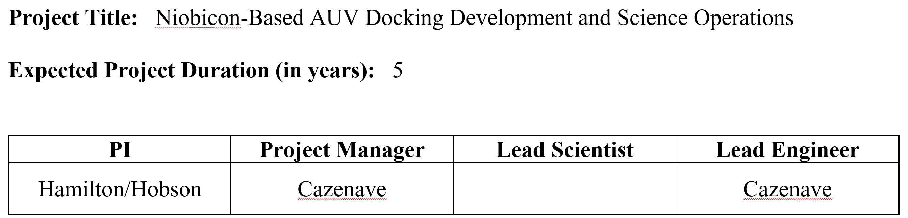

Slide 2
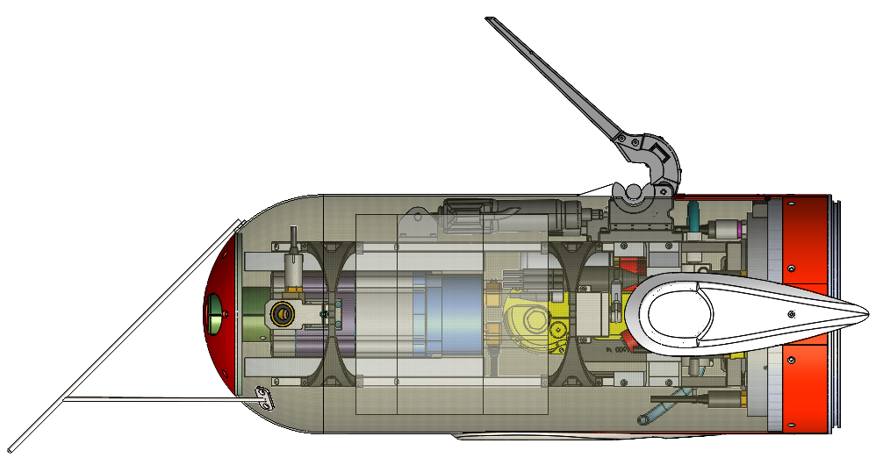
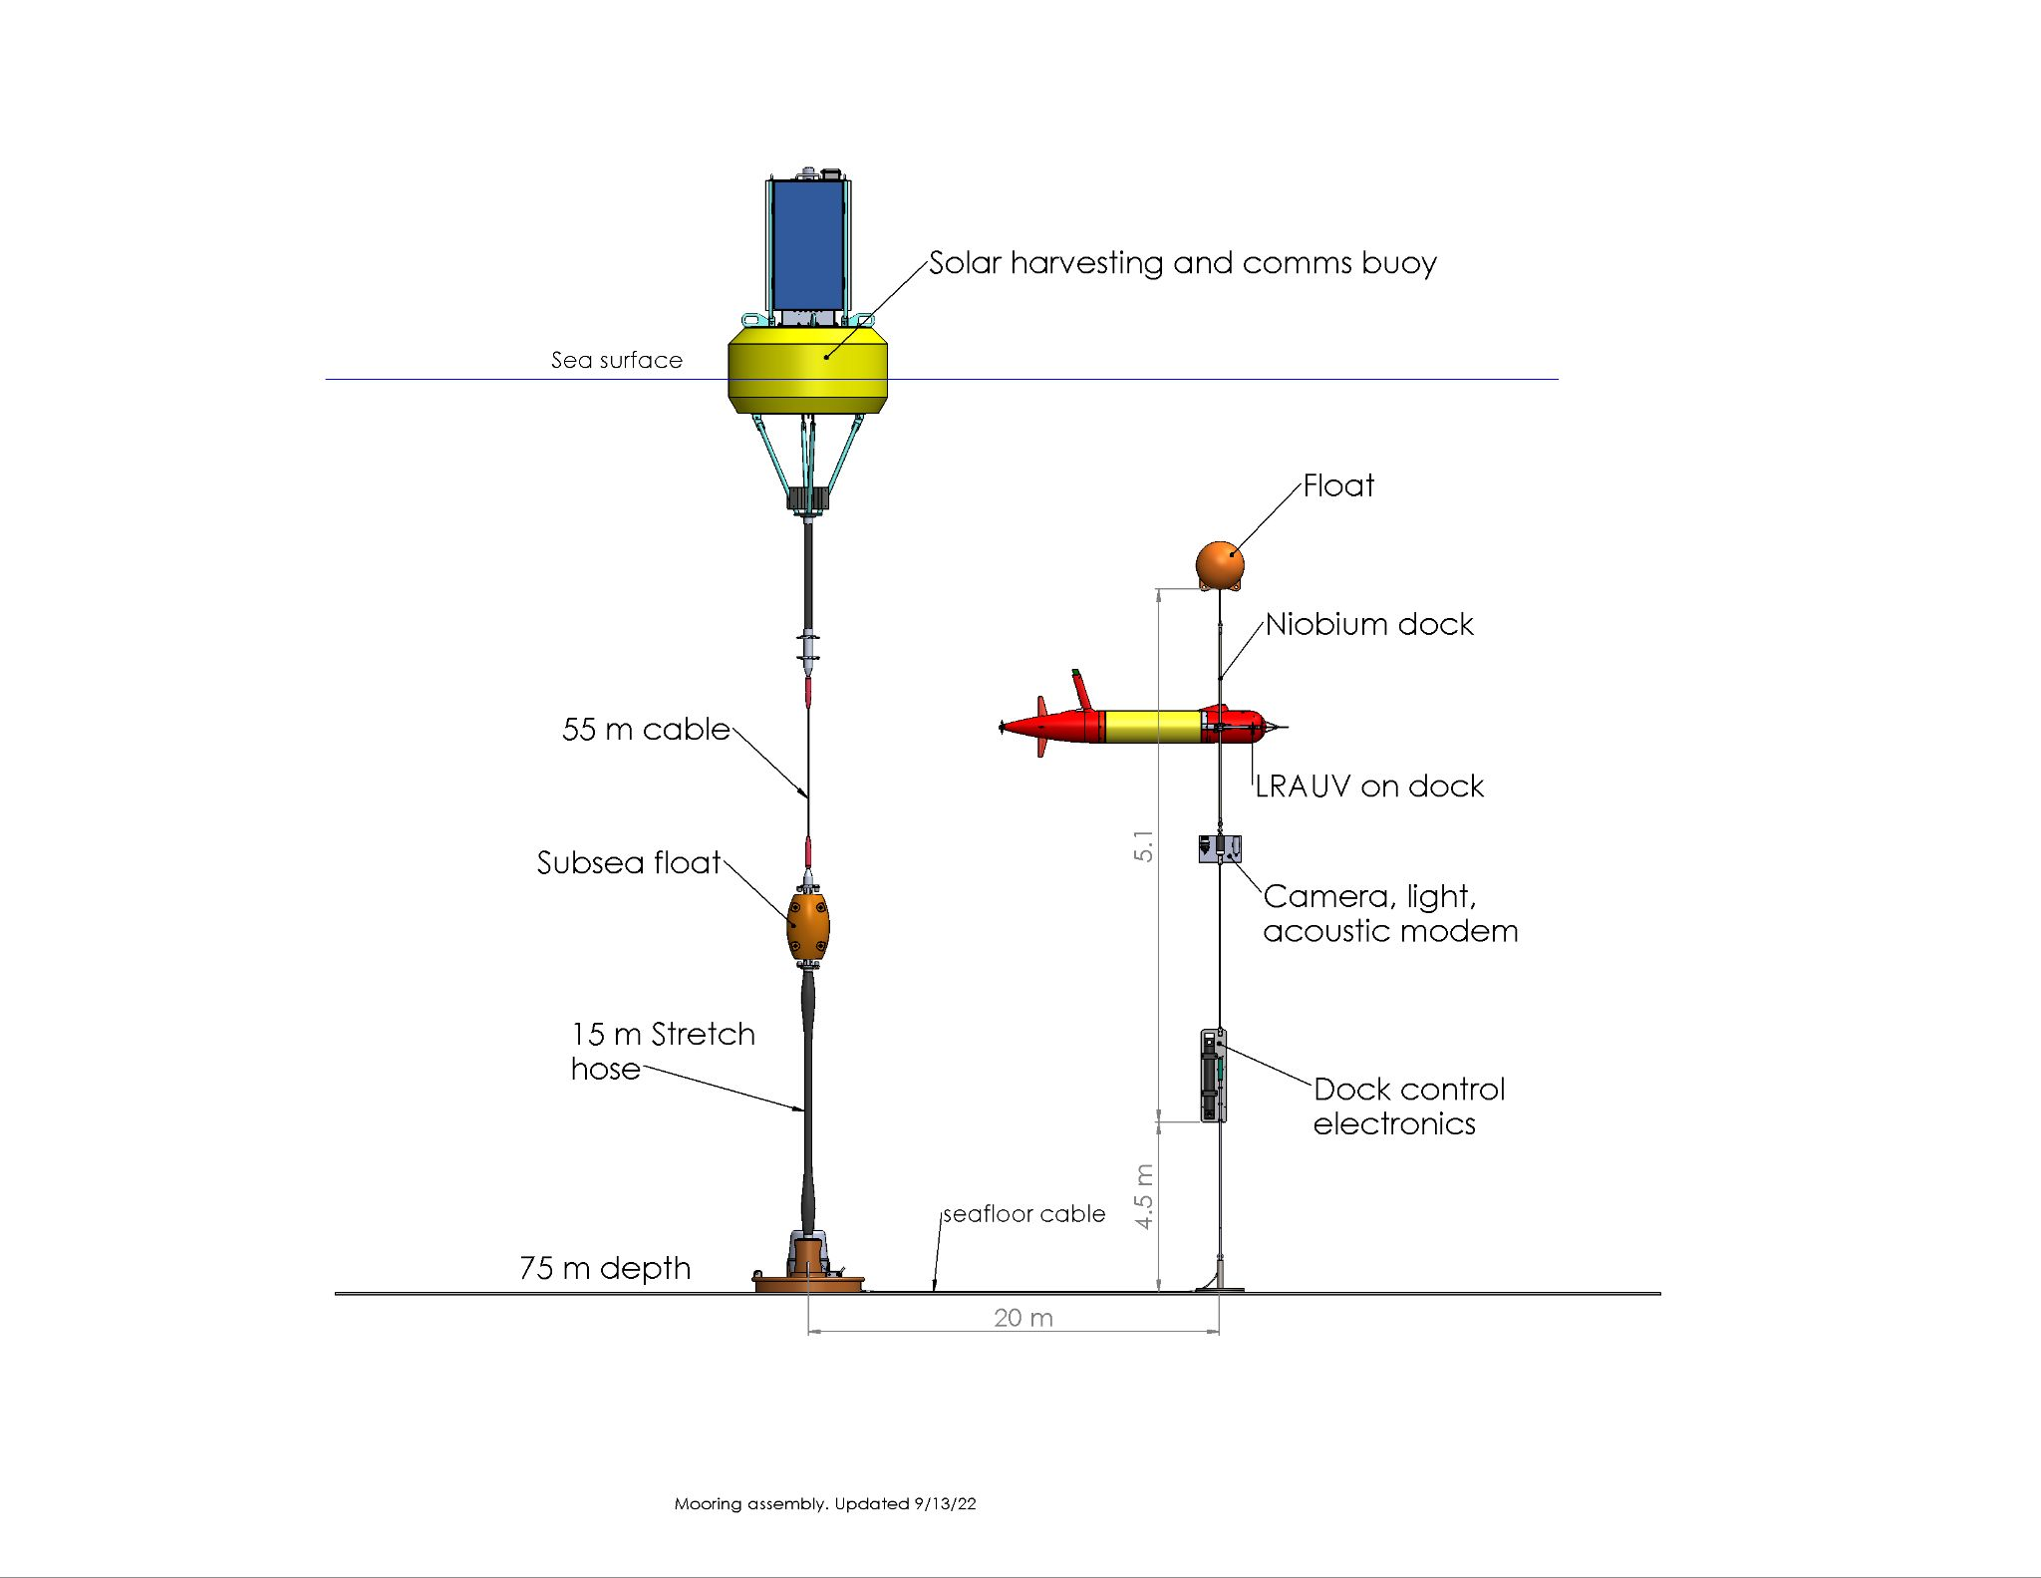
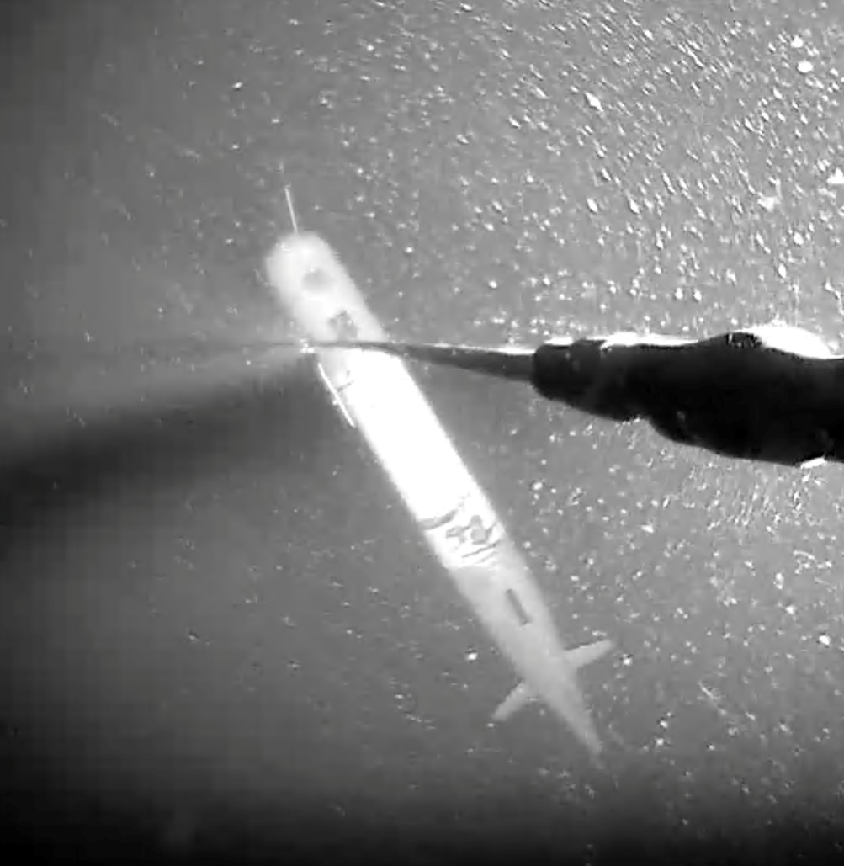
Niobium Based Docking

Slide 3
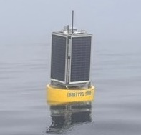
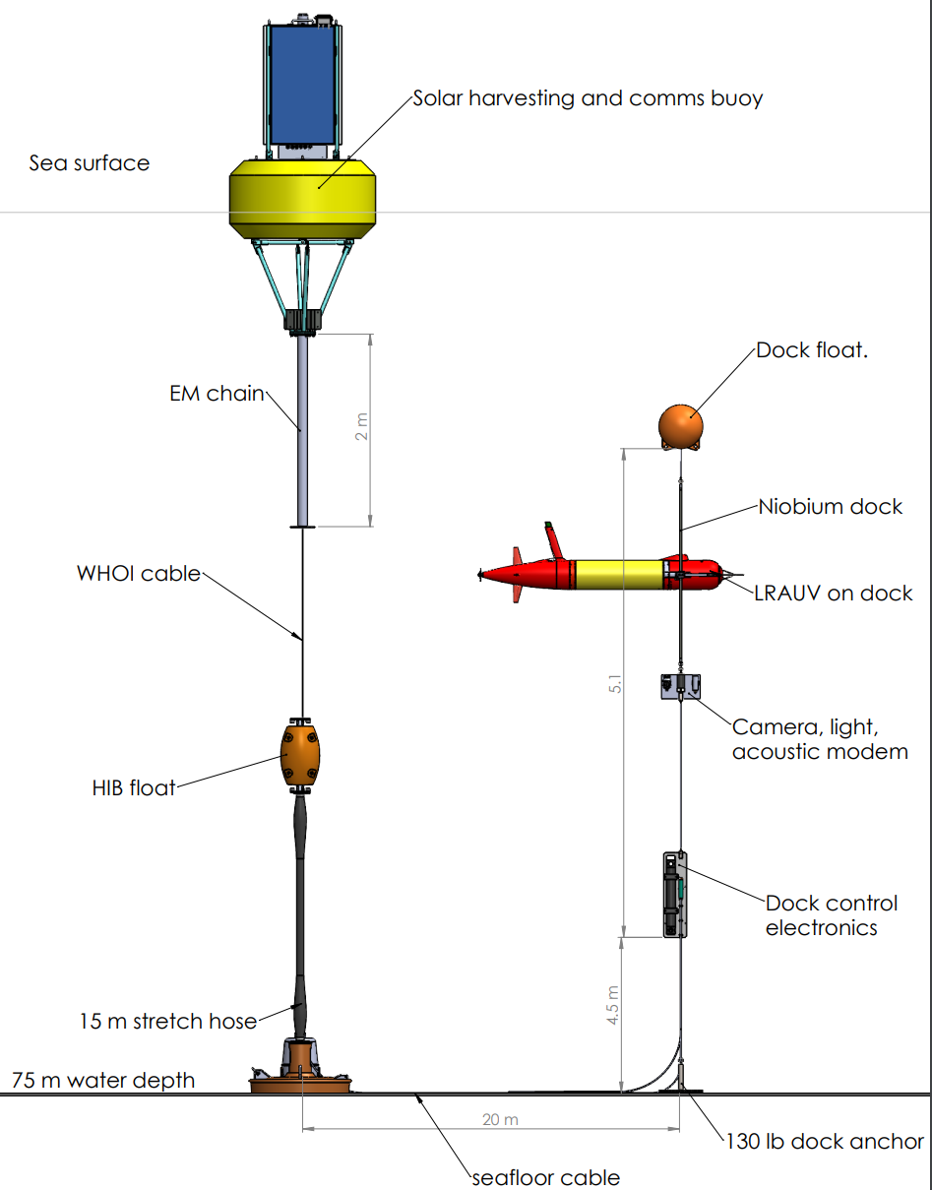
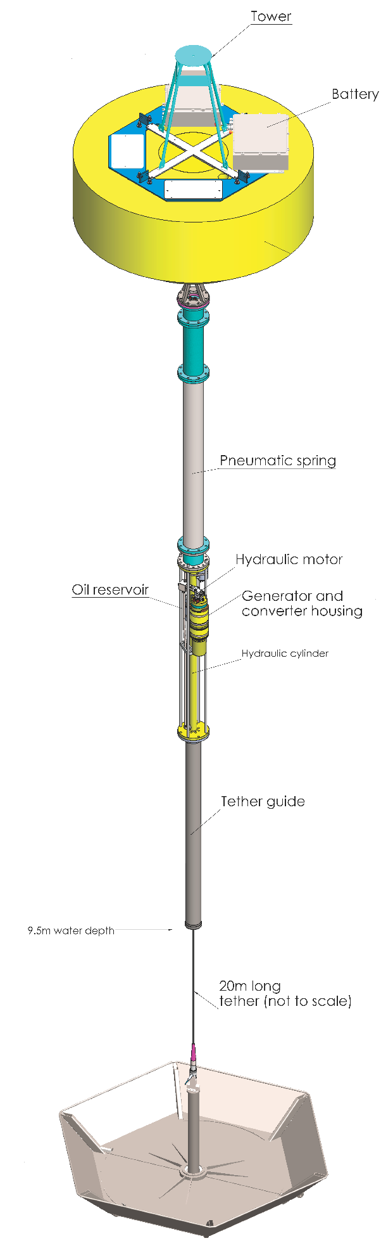
2022-2026
Solar Support: ~15 Watts
Recharge one LRAUV every 2 weeks
2026
Wave-Energy Support:
~225 Watts
Recharge one LRAUV per day

Slide 4
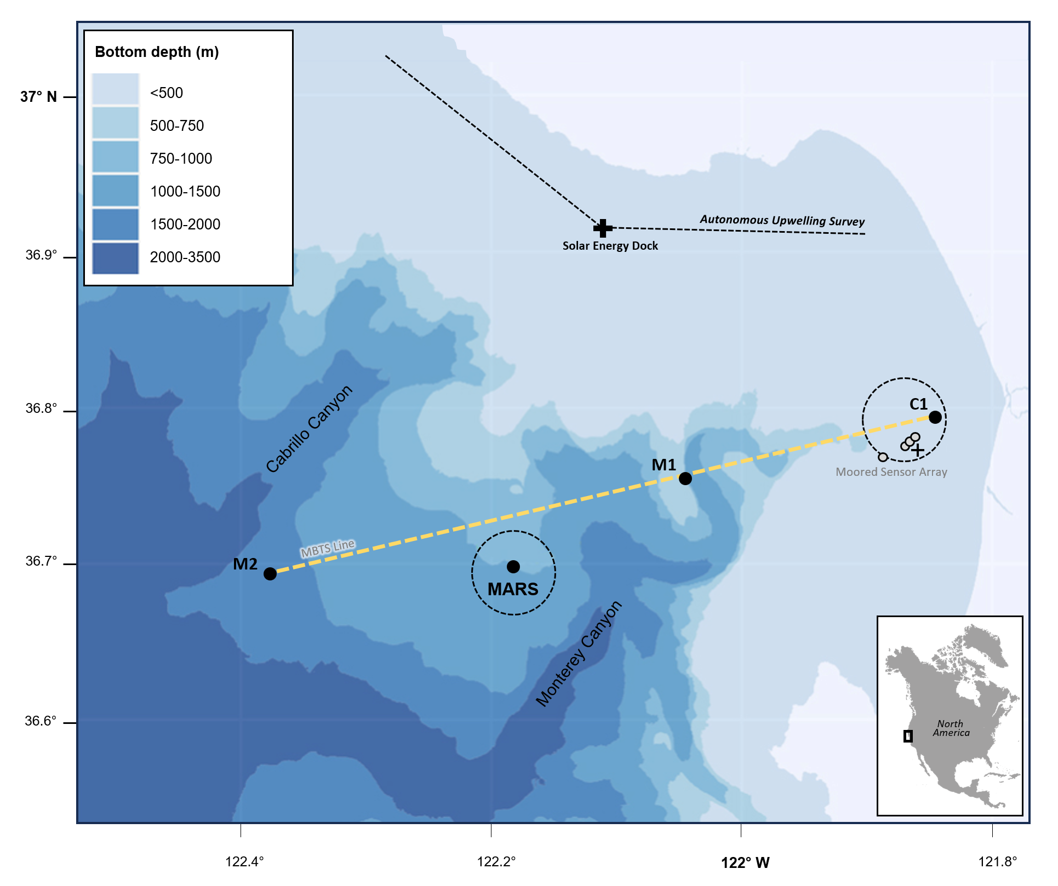
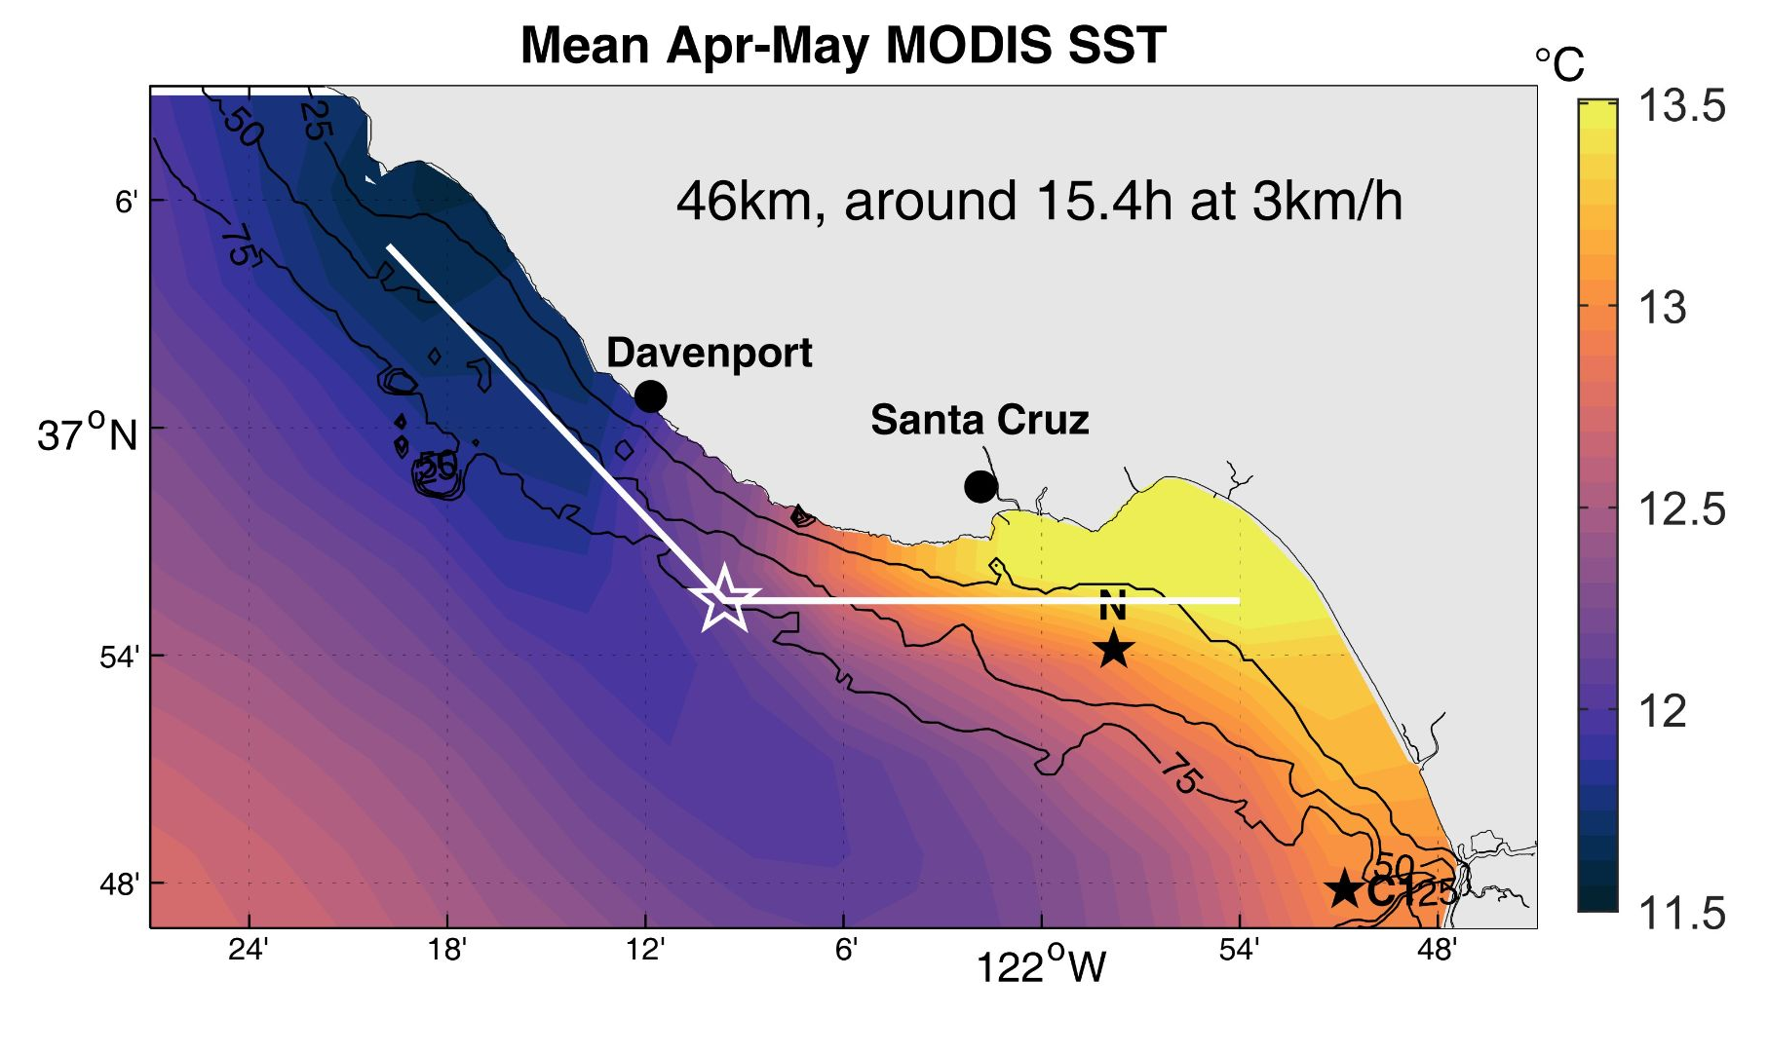
Current Docking Activities in Monterey Bay
NOWRDC - 2026
Plankton Response to Upwelling 2024, 2025 - Monique and Steve Haddock

Slide 5
Planned New Technology Developments
Seafloor Battery-Supported Docks
Power Delivery AUVs
Cabled Seafloor Connected Docks
The intent is to perform these developments in conjunction with target Science Applications

Slide 6
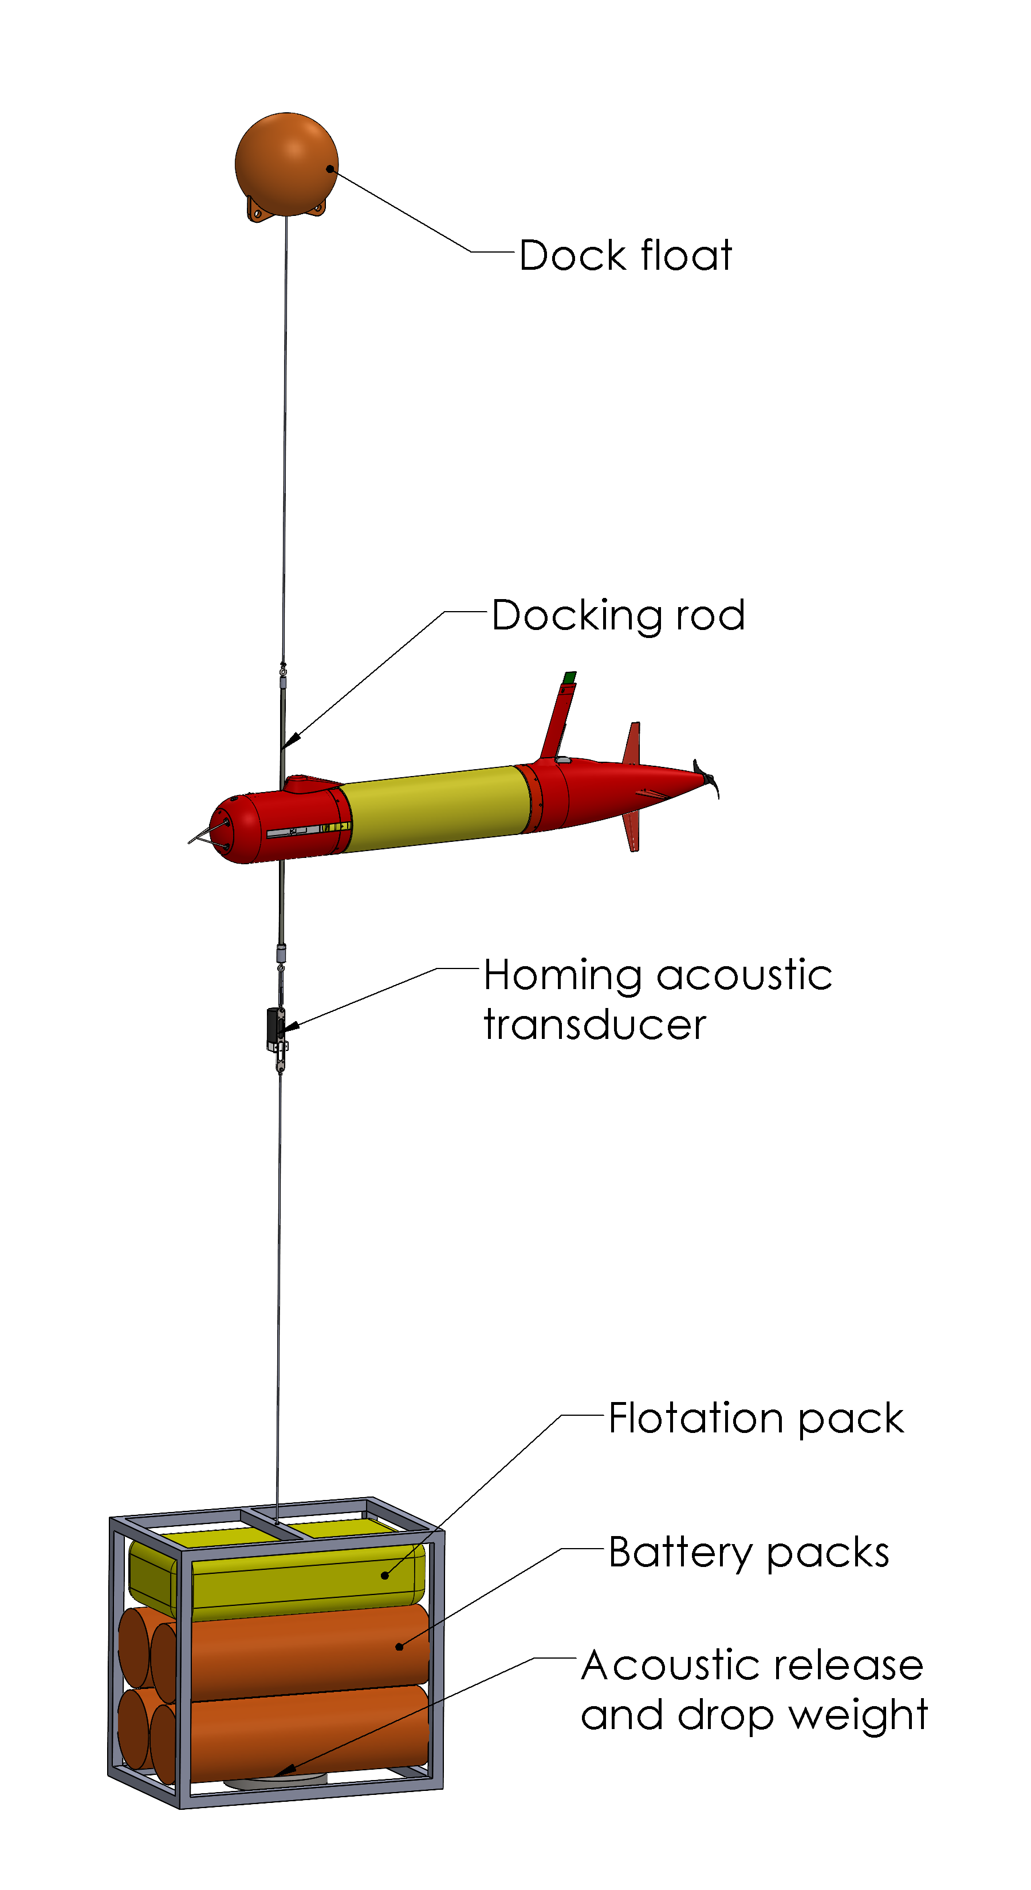
Seafloor Battery-Supported AUV Docks
Stored Energy: 5-10 LRAUV Re-charges
Free-fall deployments
Local Data Storage
Application-specific designs
Autonomy and Reliably Tested Locally
Uniquely suited to under-ice applications

Slide 7
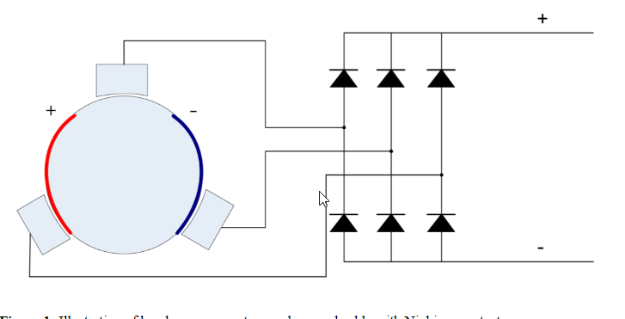
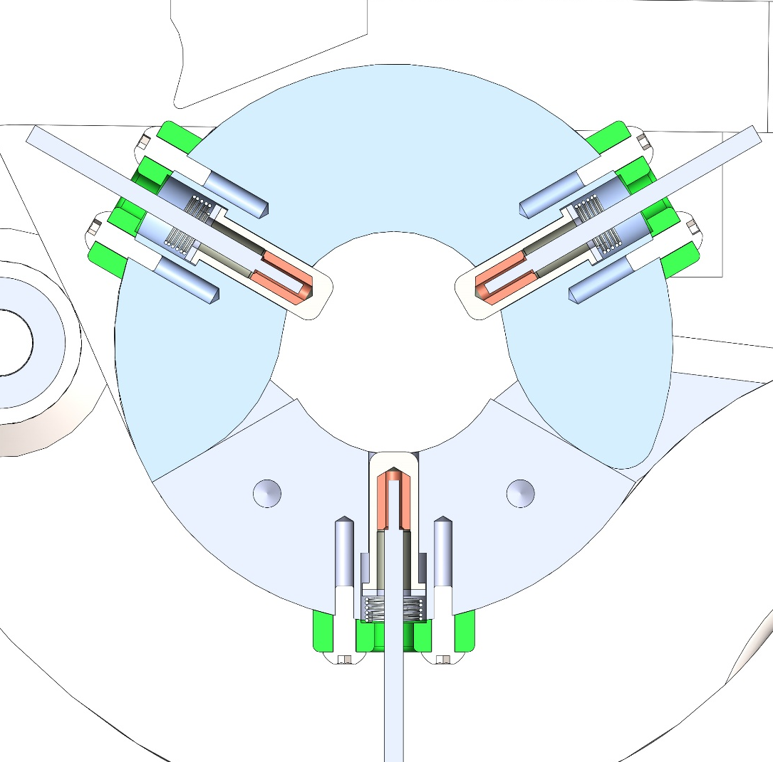
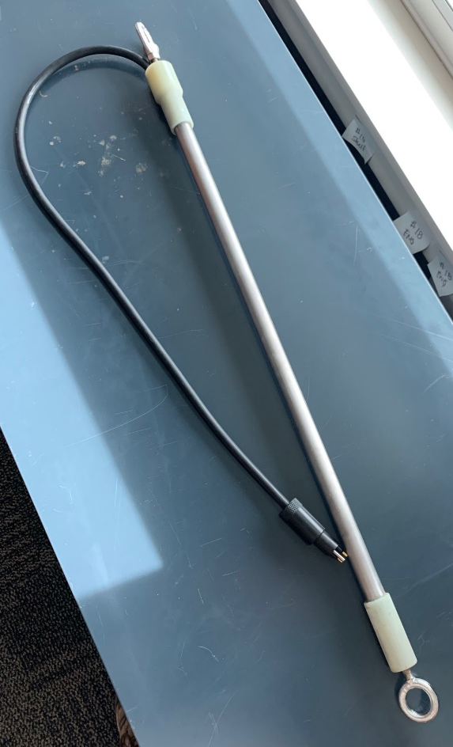
Power Delivery AUV
Dock
Vehicle
System is currently charge-only (communications is bi-directional though)
A change in configuration and some added electronics can enable bi-directional power.
Enables instrument nodes serviced by AUV.
DAS system is an example of an energy-intensive system that may be difficult to couple directly to an energy source.

Slide 8
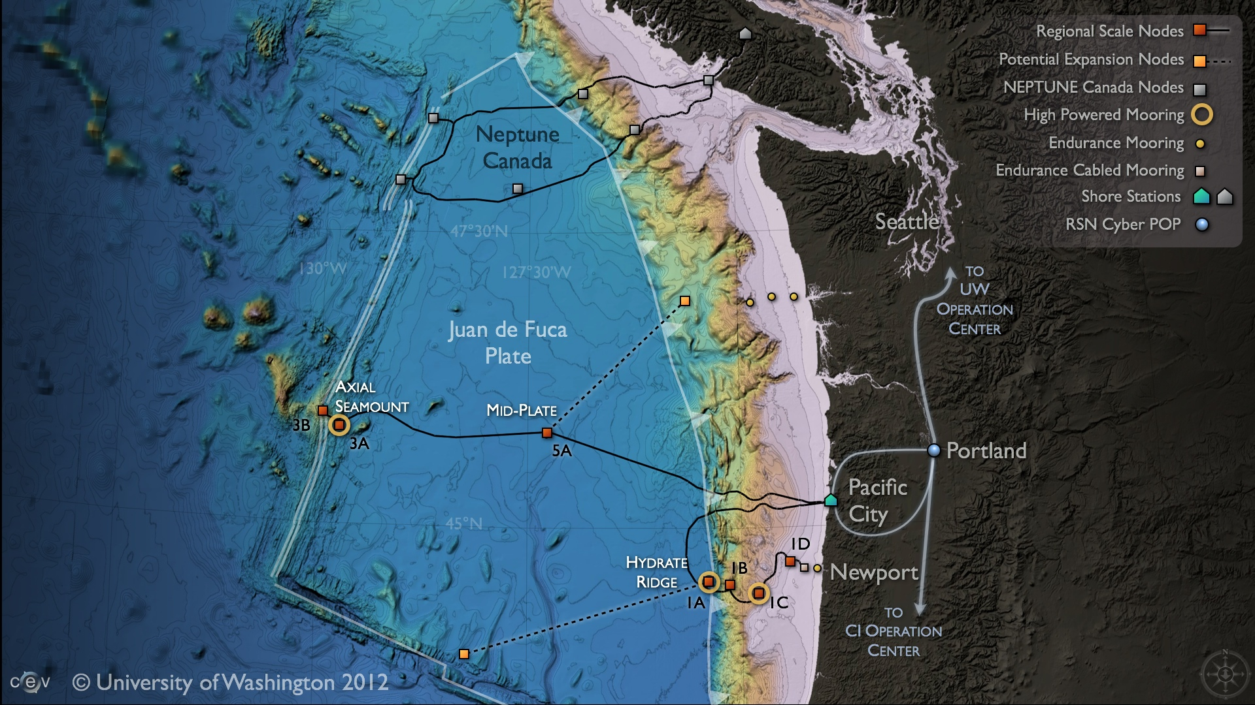
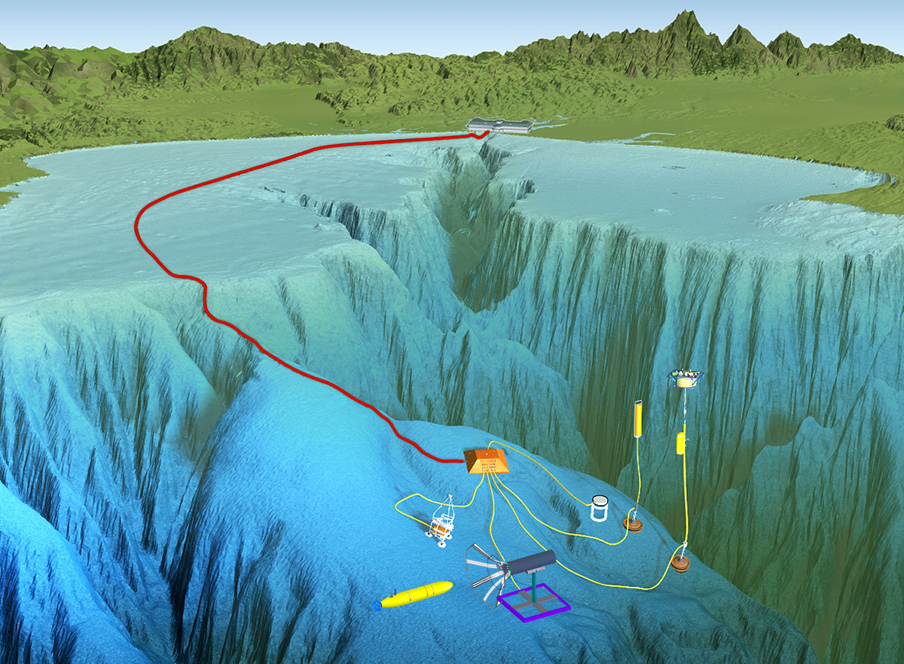
Cabled Seafloor Observatories
Resident AUV at Axial Seamount
Deploy at MARS for engineering development/test and Sur-Ridge repeat surveys, Jim Barry

Slide 9
Technology Export
Saab and Northrop-Grumman in discussions regarding a license of this technology to complement their LRAUV offering.
MBARI and Northrop-Grumman in discussions regarding providing Northrop access to MBARI’s electro-mechanical designs.

Slide 10
Expected Schedule
2027 – Continue Wave/Solar supported deployments in Monterey Bay. Maintain these through the Project Period and demonstrate utility of higher power from Wave-Energy
2027 – Develop target applications concepts for the new technology developments outlined here. Specific deployments and activities.
2028-2031 – Execute developments and deployments.

Slide 11
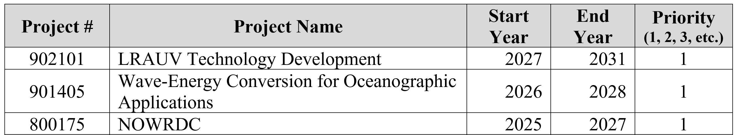
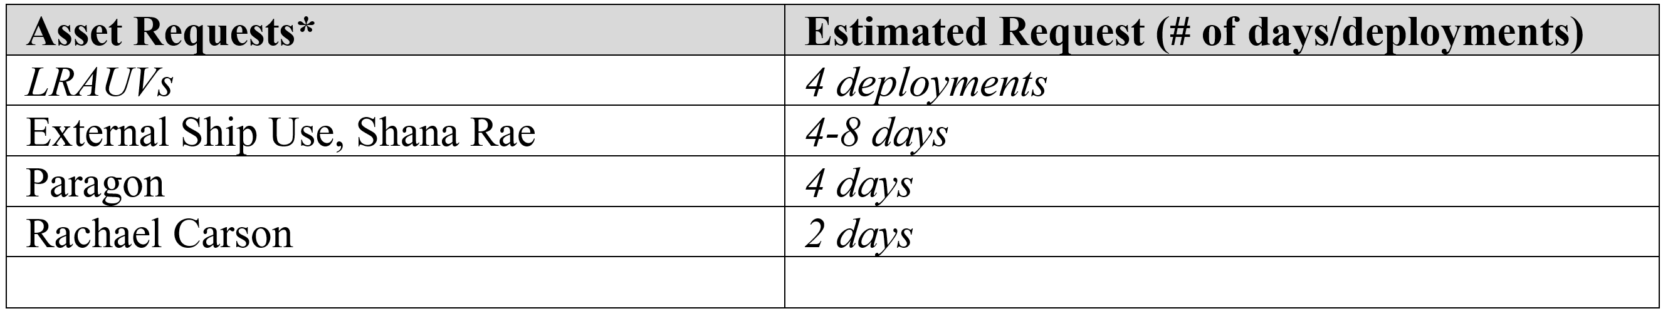
Related Projects and Required Resources

