Slide 1
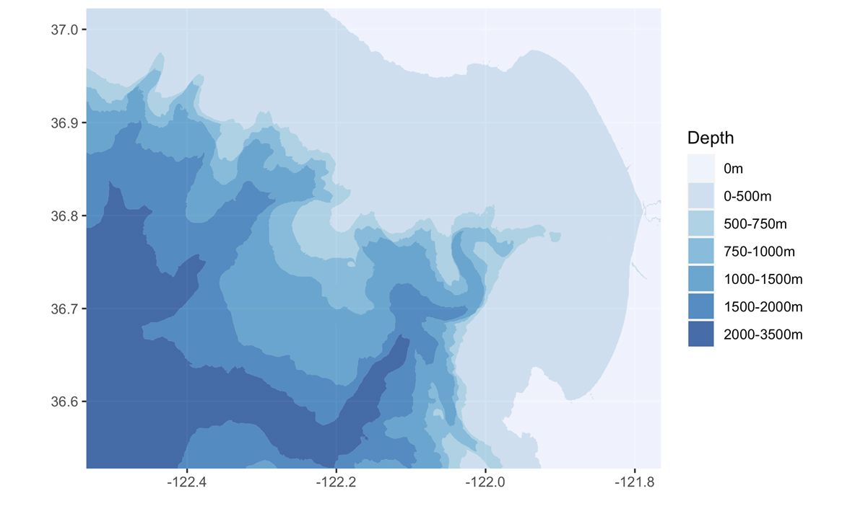
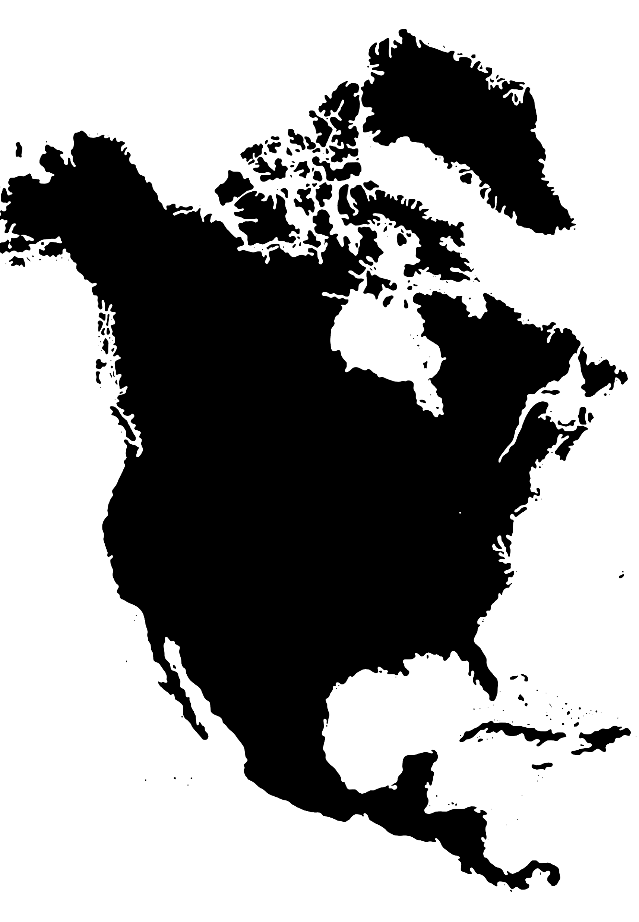
Bottom depth (m)
37° N
<500
500-750
750-1000
1000-1500
1500-2000
2000-3500
Autonomous Upwelling Survey
36.9°
Solar Energy Dock
36.8°
C1
Cabrillo Canyon
M1
Moored Sensor Array
Wave Energy Dock
36.7°
M2
MBTS Line
MARS
Monterey Canyon
36.6°
North
America
122.4°
122.2°
122° W
121.8°
Notes:
A

