Slide 1
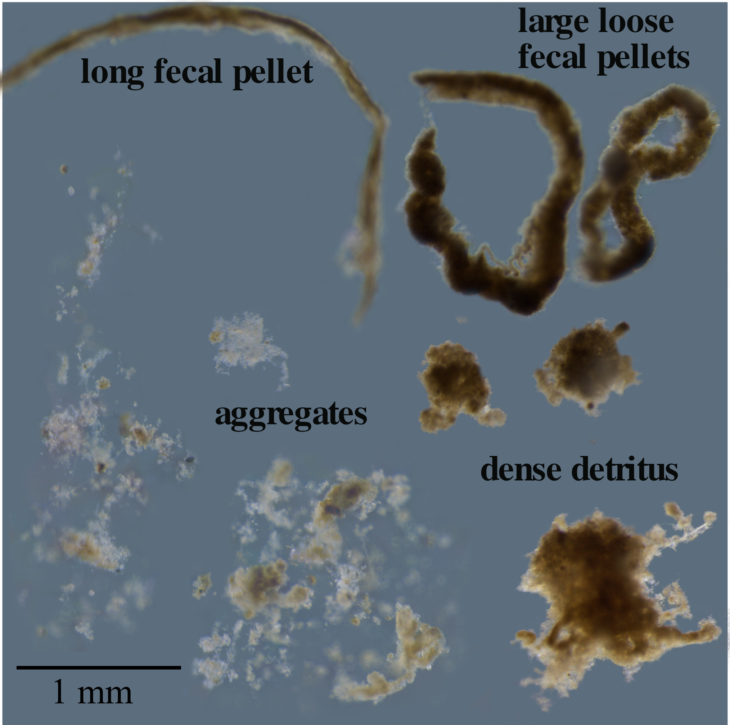
Why do we need to fix particles?
Traps deployed in 2017
Two, successive 1-day deployments
Geltraps at 150 m deep
Particles with no fixative
Isolated immediately after recovery
Isolated after 1 or 2 days in the fridge
Particles are rapidly degrading and diversity decreases as they degrade
Durkin et al. 2022

Slide 2
But, not all taxonomic groups are equally effected by degradation
Chlorophytes
are only unaffected
group
Dinoflagellates
are dramatically
affected
Durkin et al. 2022

Slide 3
Particles are rapidly degrading and diversity decreases as they degrade
Taxonomic groups are not equally effected by degradation
Need to use fixative but worry about:
Interference with successful DNA extraction and PCR
Effects on the detected community composition that bias interpretation

Slide 4
Shiozaki et al 2021: Lysis buffer that enables DNA extraction from 10% formalin preserved sediment trap samples
But we don’t know whether there is a bias in detected community composition.
Wietz et al. 2022
  Qiagen kit does not work on formalin preserved samples (did not use Shiozaki buffer)
  Nucleospin kit works on 1.8% formalin preserved seawater samples
  minor difference in community composition
  compared to unpreserved t=0
T=0
1.8% formalin
richness
28 50
weeks

Slide 5
Fixation Experiment 1: Fresh Anchovy fecal pellets from trawl of opportunity
(Exp 2 – CPF sediment trap. No data.)
No fixative, no incubation control
Zymo DNAshield
RNAlater
5% formalin
Modified Longmire’s solution
Five replicates each
Incubate at 4C
5days
3months
DNA extraction
- Durkin
- Durkin + repair
61 samples total
- Shiozaki lysis + Durkin
18Sv4v5 PCR + sequencing
Shiozaki lysis solution:
50mM borate-NaOH pH11
1% SDS
50ul/rxn Qiagen Proteinase K
- Shiozaki lysis + Durkin + repair

Slide 6
All fixatives cause a bias that detects a different community composition from unfixed
All fixatives change the apparent community composition compared
to t=0 community.
Formalin (5%) differed
from the established DNA fixatives RNAlater and Zymo

Slide 7
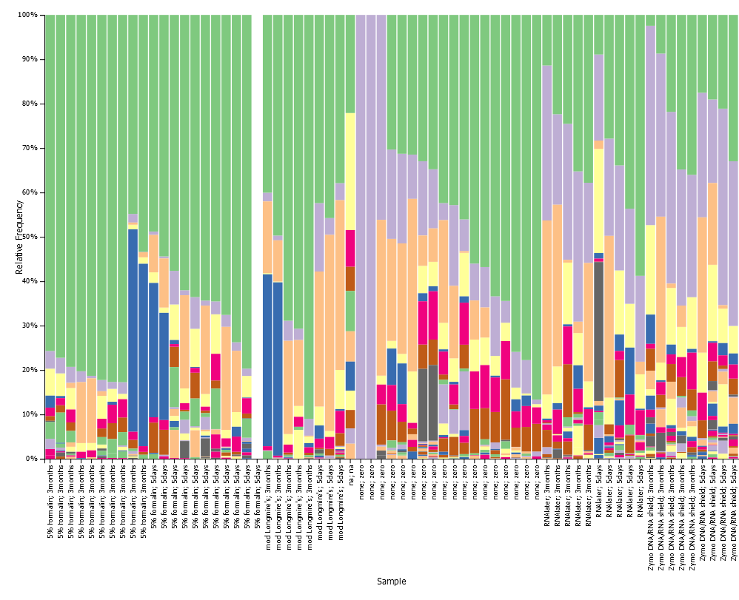
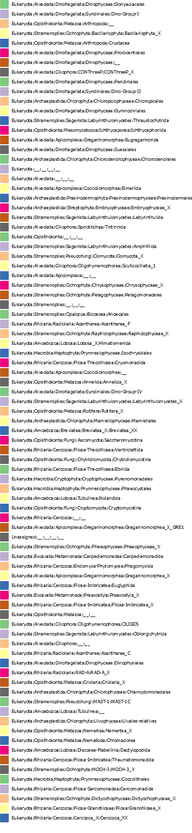
What are the diversity numbers and versus time?
Which taxa are different?
Did DNA repair treatment affect community composition?
Formalin
(3 month)
Formalin
(5 days)
No fixative
(no incubation)

Slide 8
Controlled experiment #2: Short term, bulk traps.
Bulk trap particles extracted with Nucleospin kit:
T=0
T=3 in RNAlater
T=3 in 0.3% formalin
T=3 in 5% formalin and use Shiozaki buffer
T=3 in 0.3% formalin and use Shiozaki buffer

Slide 9
Final test:
Compare with our real field data to see if the same as controlled experiments
Formalin vs. unpoisoned geltrap particles (n=5 traps, North Atlantic)
Formalin vs. RNAlater bulk particles (n=5 traps N. Pacific and n=? N. Atlantic)

Slide 10
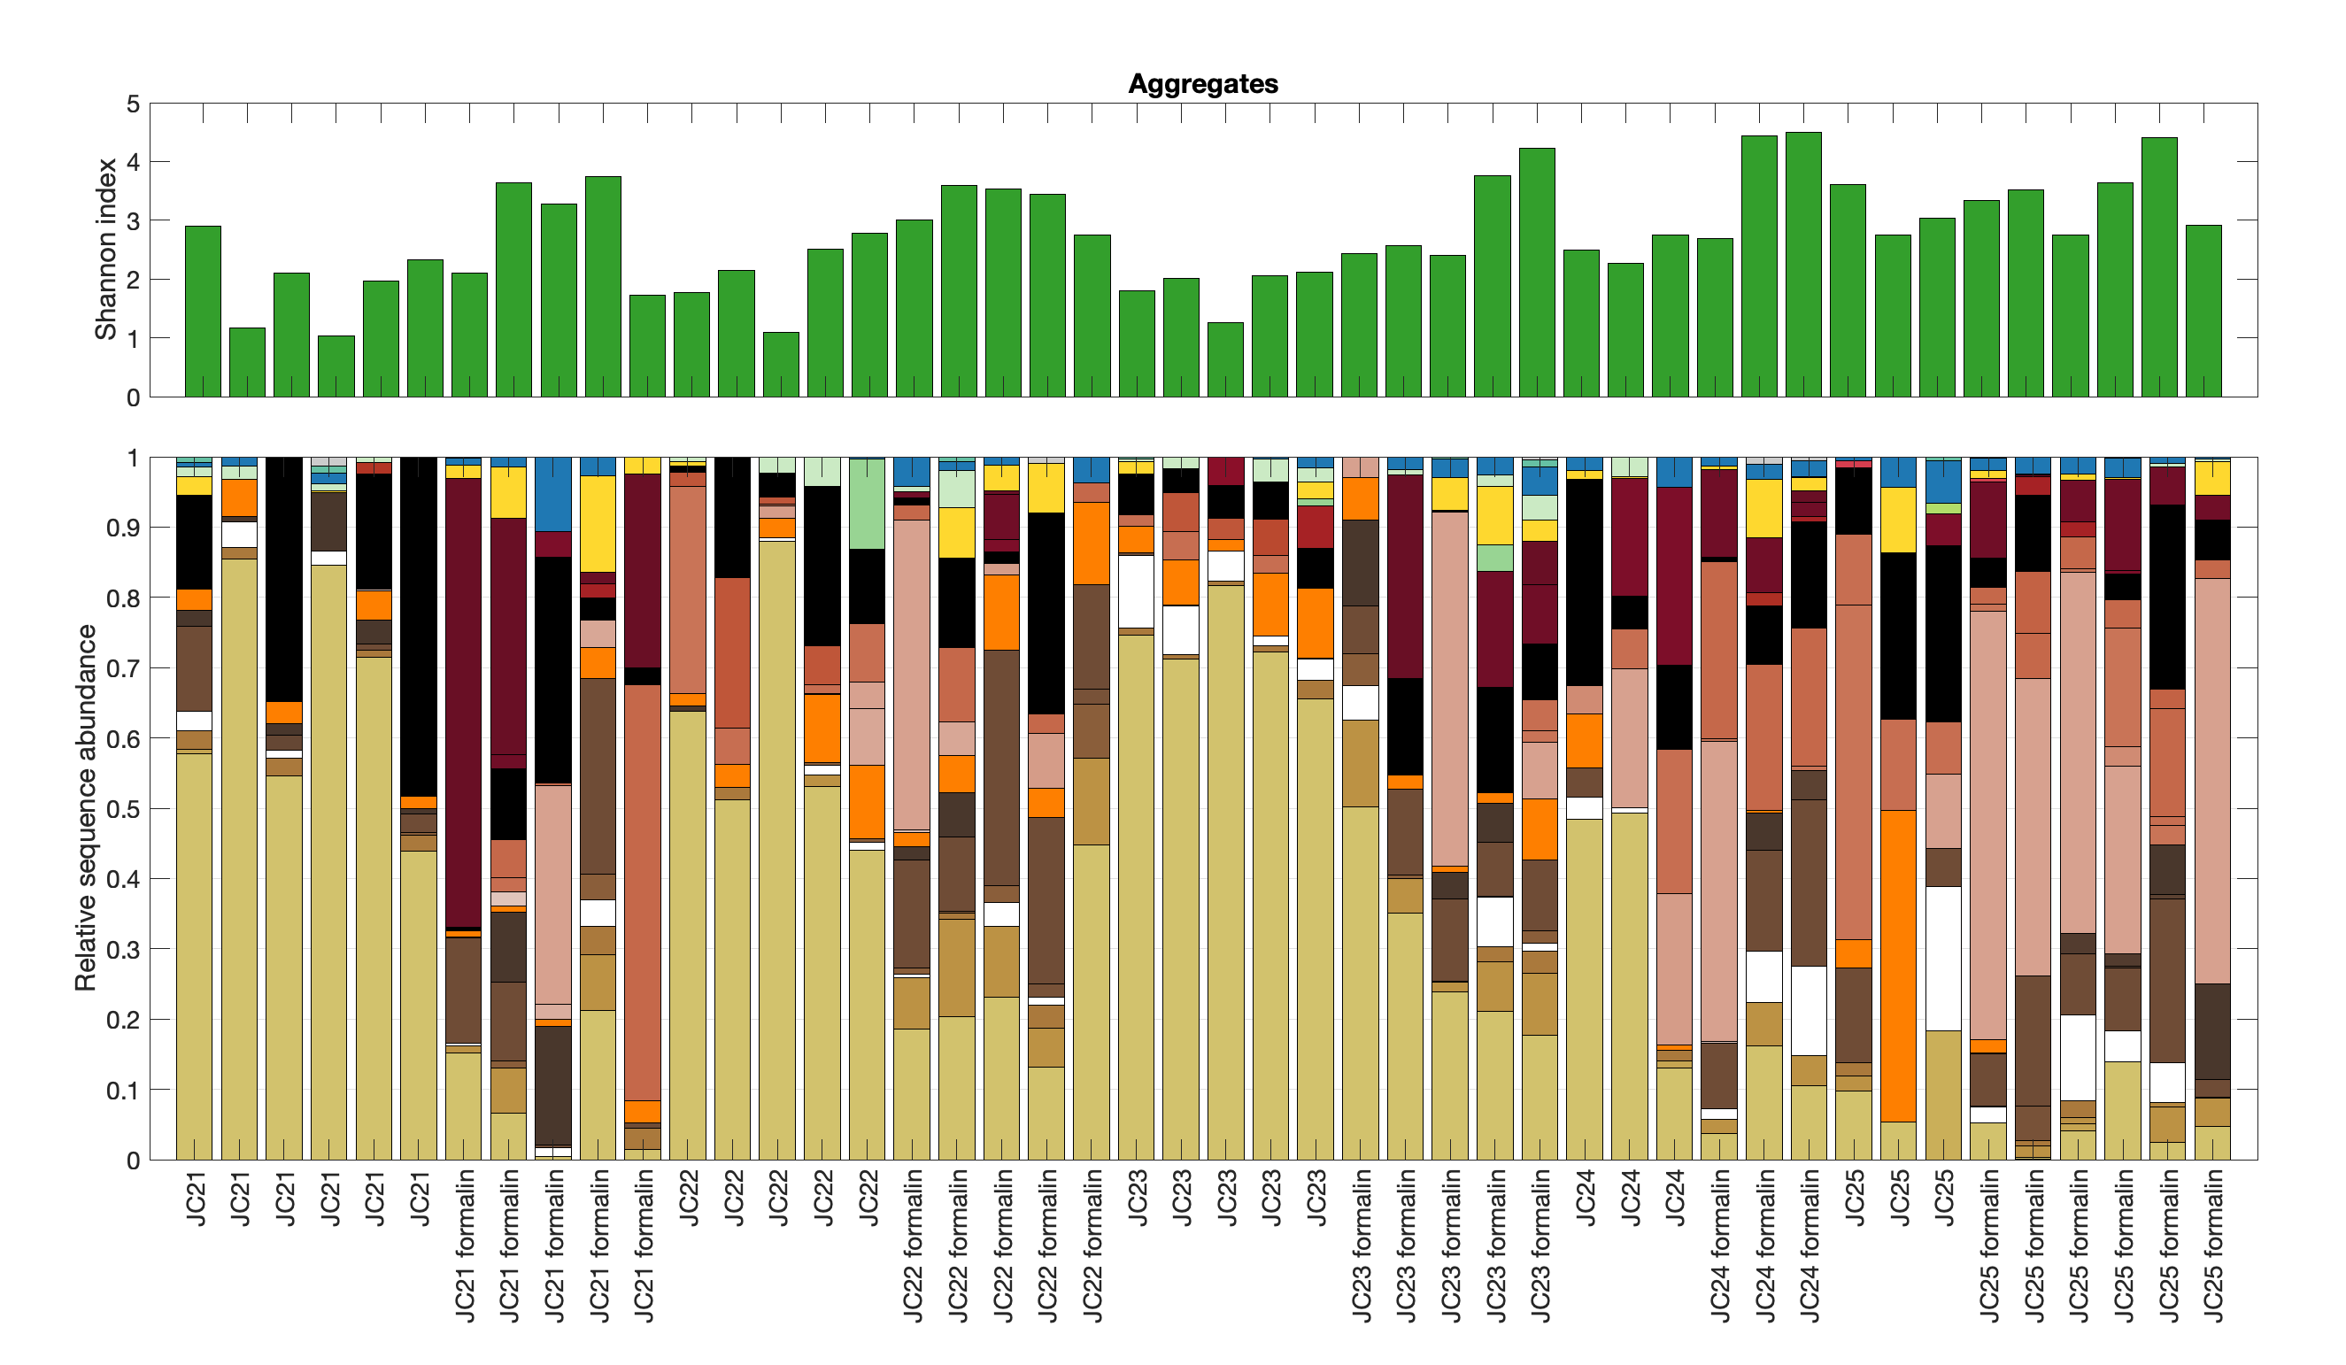
Formalin vs. unpoisoned geltrap particles
Particles isolated from gels with and without 0.3% formalin overlying
Trap tubes side by side on same platform, same 5 depths
No t=0 data in this experiment: unfixed particles degraded for up to 3 days prior to isolation
75 m
125 m
b
175 m
330 m
500 m

Slide 11
Can fixation prevent loss of the community diversity in particles after they arrive in the trap?
Particles isolated from gels with and without 0.3% formalin overlying
Trap tubes side by side on same platform, same 5 depths
No t=0 data in this experiment: unfixed particles degraded for up to 3 days prior to isolation
Preserved particles appear to be more diverse, especially in the shallower trap depths
Preserved particles appear to have relatively more dinoflagellate reads and less diatom reads

Slide 12
Amacher et al. 2013 –
bulk: 0.7% formalin and unpoisoned, phenol:chloroform extraction,
less efficient extraction from formalin
mostly no difference in richness between poisoned/unpoisoned, sometimes poisoned > richness
Cruz et al 2021 –
Gel particles: 2% formalin
had to rinsed particles first and then pooled 8, used Qiagen kit with extra lysis step
Implied that they had difficulty amplifying due to formalin
Gutierrez-Rodriguez et al. 2019
Bulk: 0.4% formalin vs unpoisoned brine
Macherey-Nagel extraction kit
Live traps had greater protist OTU richness than fixed traps in 3 out of 4 samples
VERY different protist community composition in formalin vs. unpoisoned traps
Fontanez et al. 2015
Bulk: RNAlater vs. unpoisoned brine
Different bacterial communities in RNAlater vs. unpoisoned traps
Qiagen kit extraction
Valencia et al.
Bulk: RNAlater vs. unpoisoned
Macherey-Nagel extraction kit
Assessed relative abundances, not diversity or community comp differences

