Slide 1
902305- Event Detection using the Sedimentation Event Sensor
What’s the fundamental problem, question, or issue you are addressing?
We need in situ instrumentation that can detect large, unpredictable carbon flux events, and trigger other nearby instruments to wake up.
Why is it important/why should anyone care?
-These advancements work toward more strategic use of power-hungry autonomous instrumentation.
What are we doing about it/what’s MBARI’s unique contribution?
-Event response and adaptive sampling algorithms are areas that have been of interest at MBARI for a long time.

Slide 2
902305- Event Detection using the Sedimentation Event Sensor
What are your project plans for next year (2023)?
-Mathematically define these carbon flux events
- Develop an algorithm and code for SES to identify their early indicators using onboard real-time image analysis.
- Modify a conventional sediment trap for eventual triggering
Deploy the SES autonomously near MARS (spring, fall 2023), and check on it with the Wave Glider

Slide 3
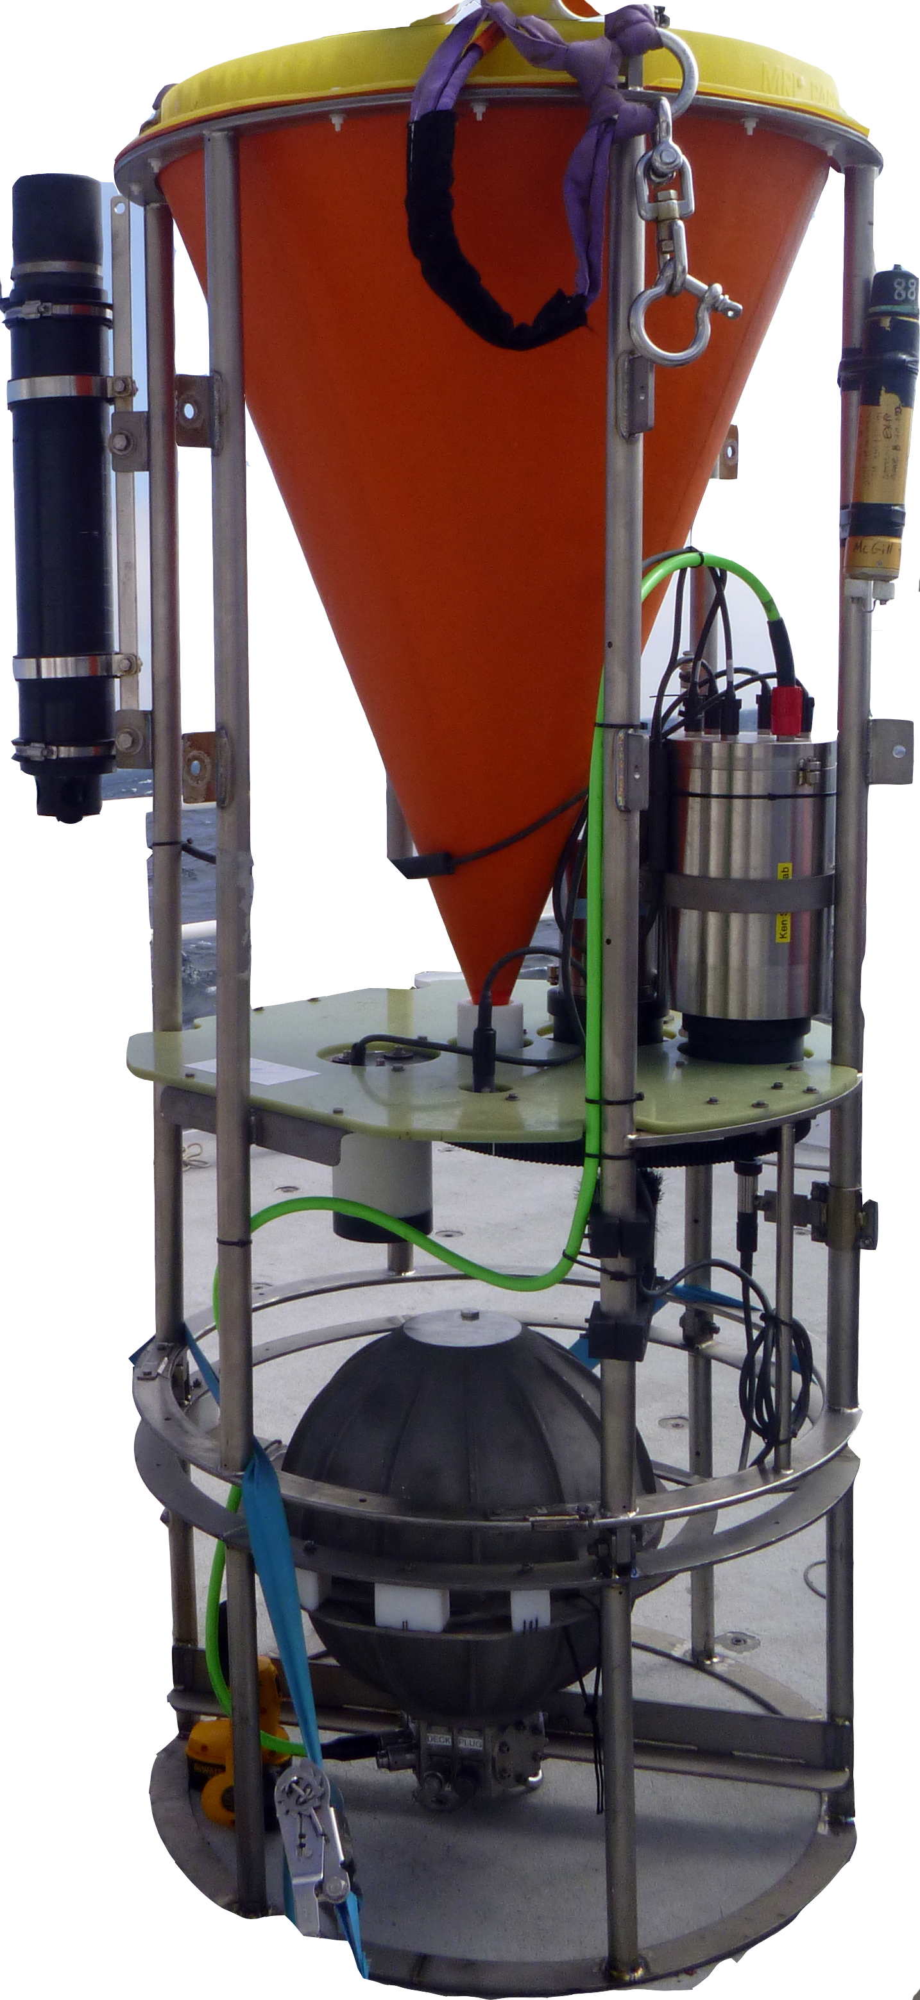
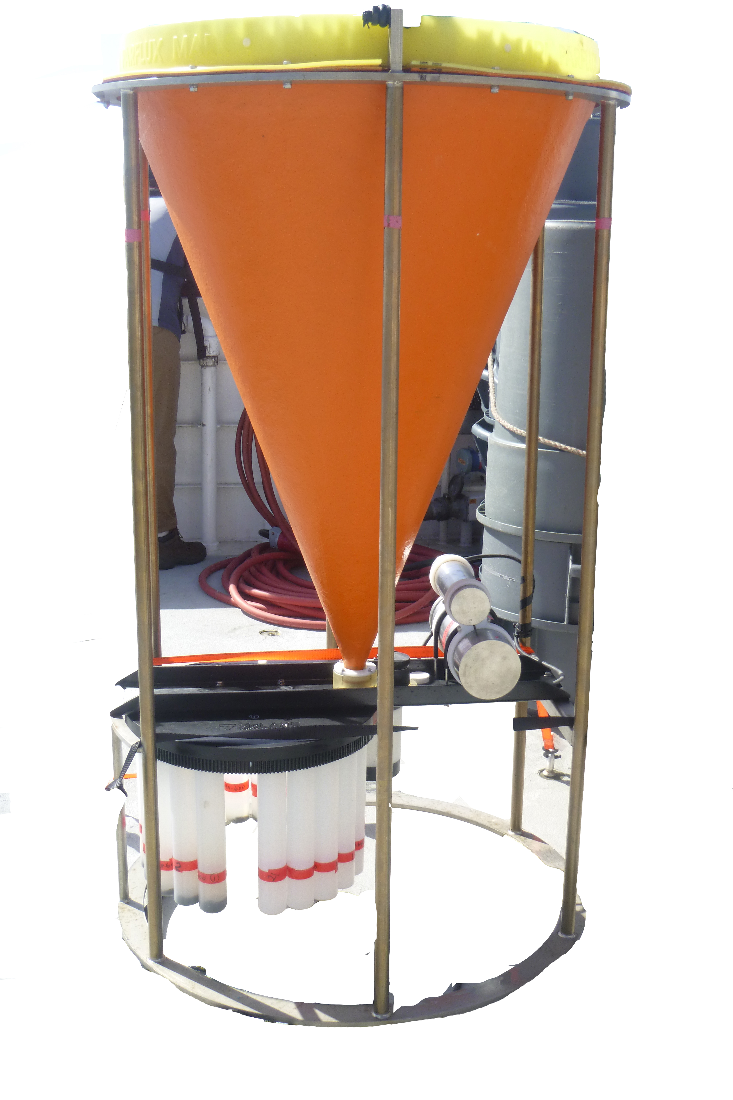
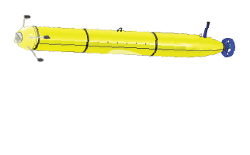
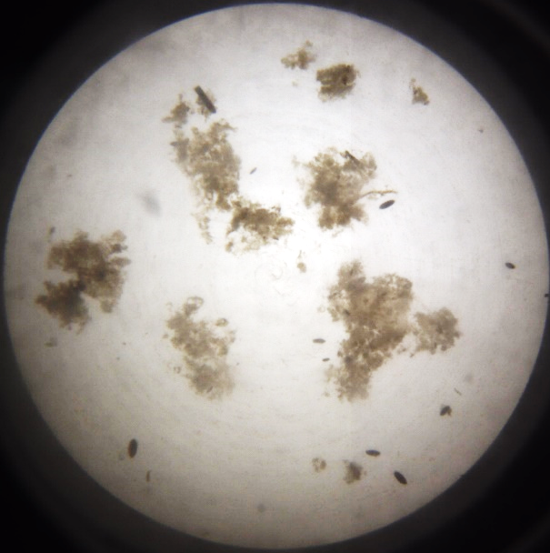
902305- Event Detection using the Sedimentation Event Sensor
Sediment trap
(this project)
*
LRAUV
(future
possibility)
Notes:
SES (left) is a low-power instrument that takes pictures of sinking marine snow (two round pictures). We propose to add an algorithm to the SES software so that it can detect in real time when more material is sinking in big “pulse” event (red spikes in time-series plot), and turn on another instrument. Our first step is to work toward triggering a conventional (sample-collecting) sediment trap. In the longer-term, this could be used to trigger an AUV.

