Slide 1
902305: Event Detection with the Sedimentation Event Sensor
What’s the fundamental problem, question, or issue you are addressing?
We need in situ instrumentation that can detect large, unpredictable carbon flux events, and trigger other nearby instruments to wake up.
Why is it important/why should anyone care?
-These advancements work toward more strategic use of power-hungry autonomous instrumentation.
What are we doing about it/what’s MBARI’s unique contribution?
-Event response and adaptive sampling algorithms are areas that have been of interest at MBARI for a long time.

Slide 2
902305: Event Detection with the Sedimentation Event Sensor
What are your project plans for next year (2024)?
Develop and test in-situ real-time image analysis, event-detection algorithms, and remote instrument triggering protocols.
- Modify an existing McLane sediment trap and upgrade SES electronics for remote triggering.
- Co-deploy SES (plugged into MARS) with autonomous modified conventional trap to test algorithm in real-world conditions.

Slide 3
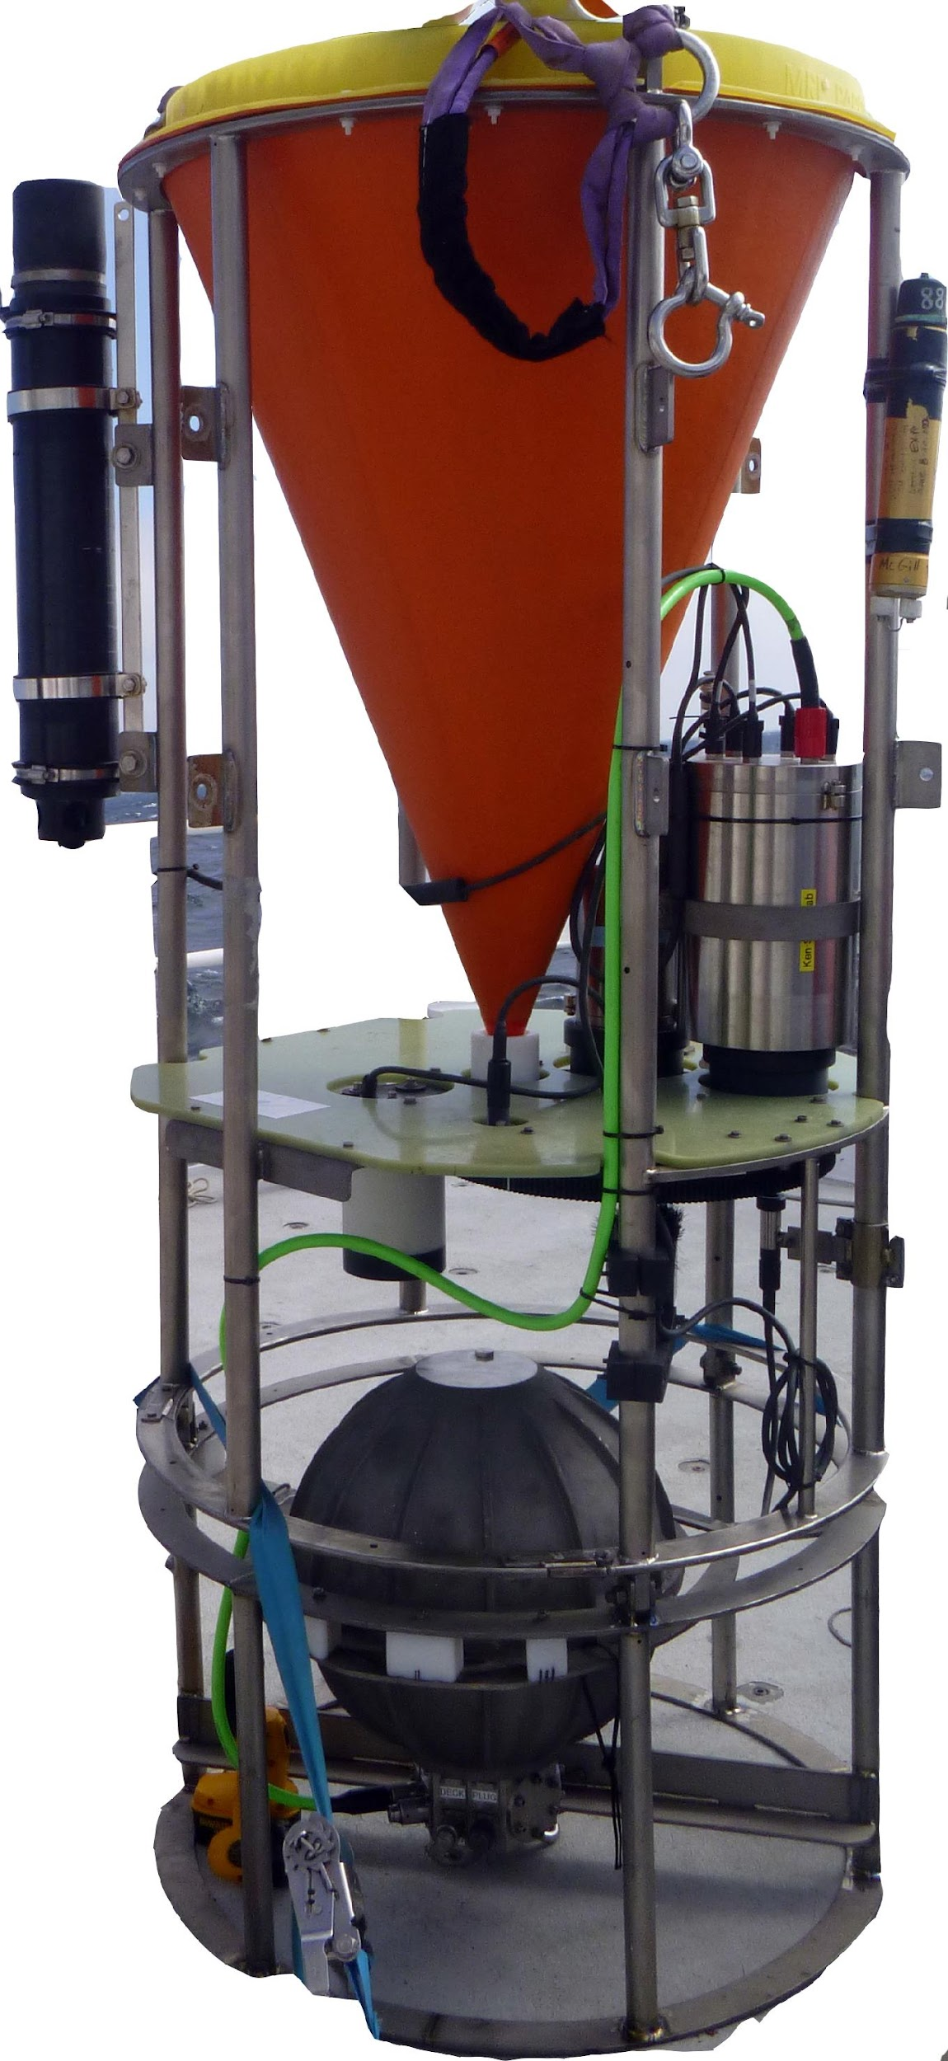
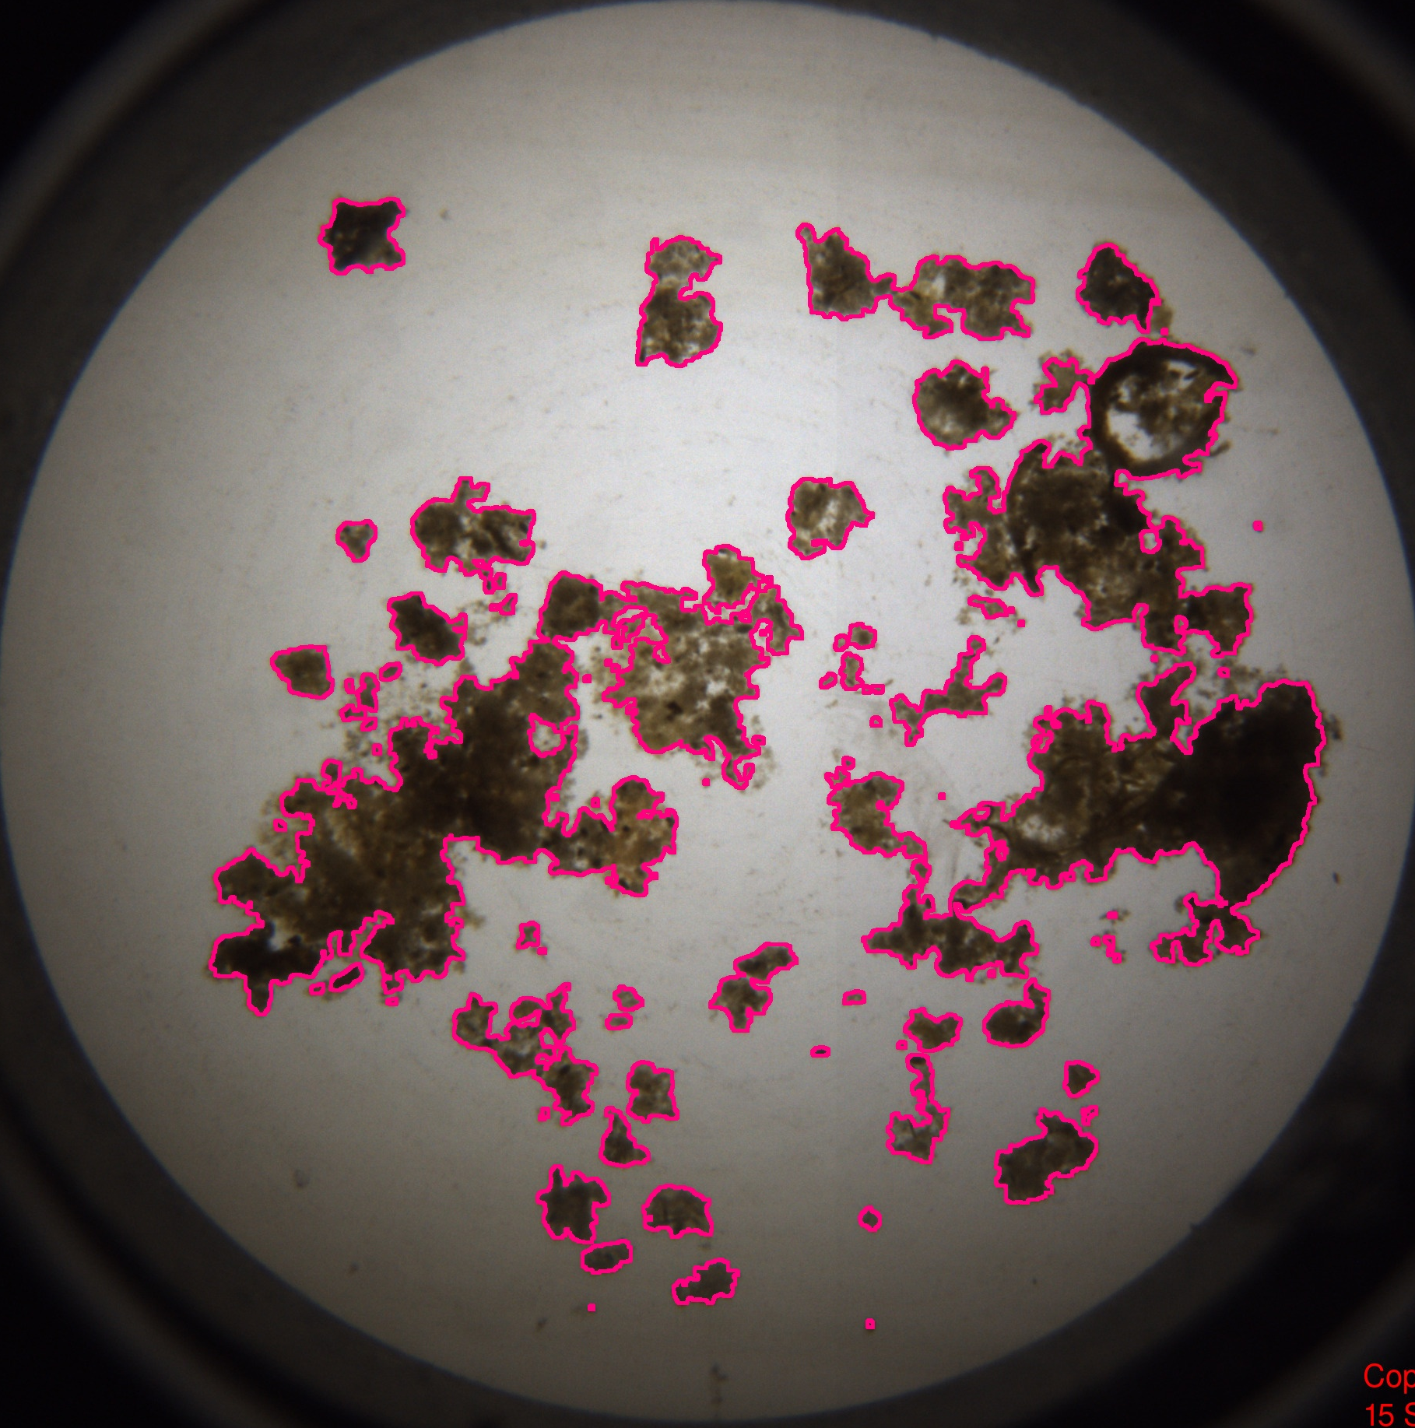
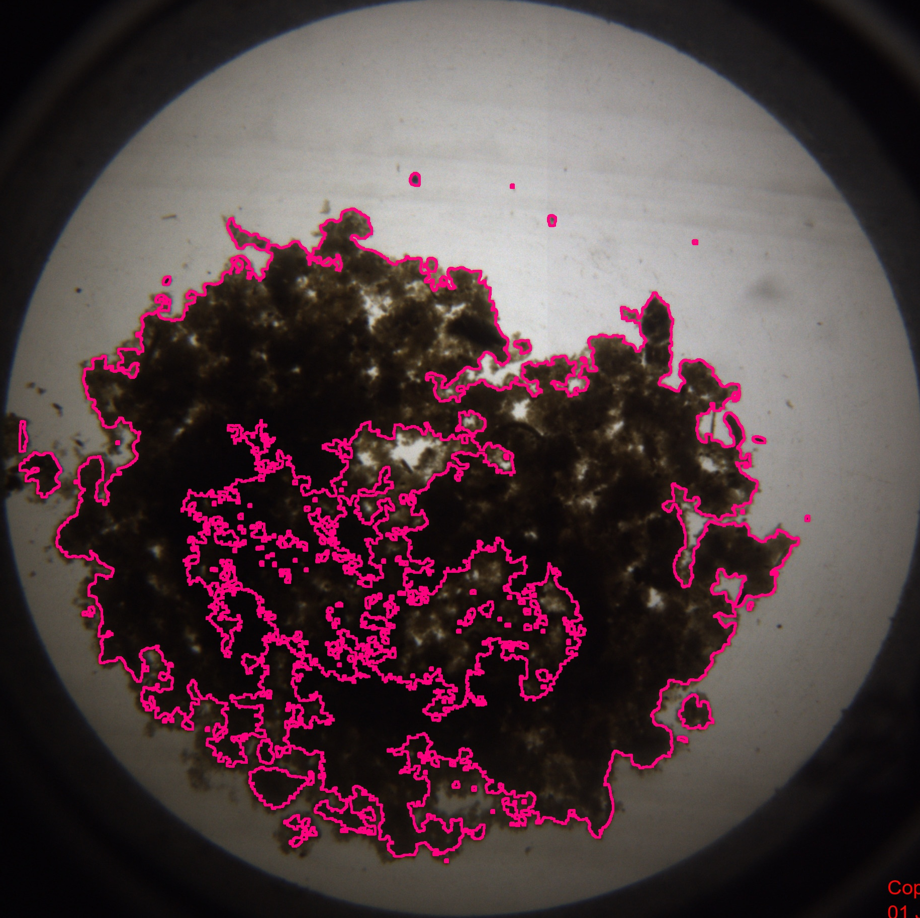
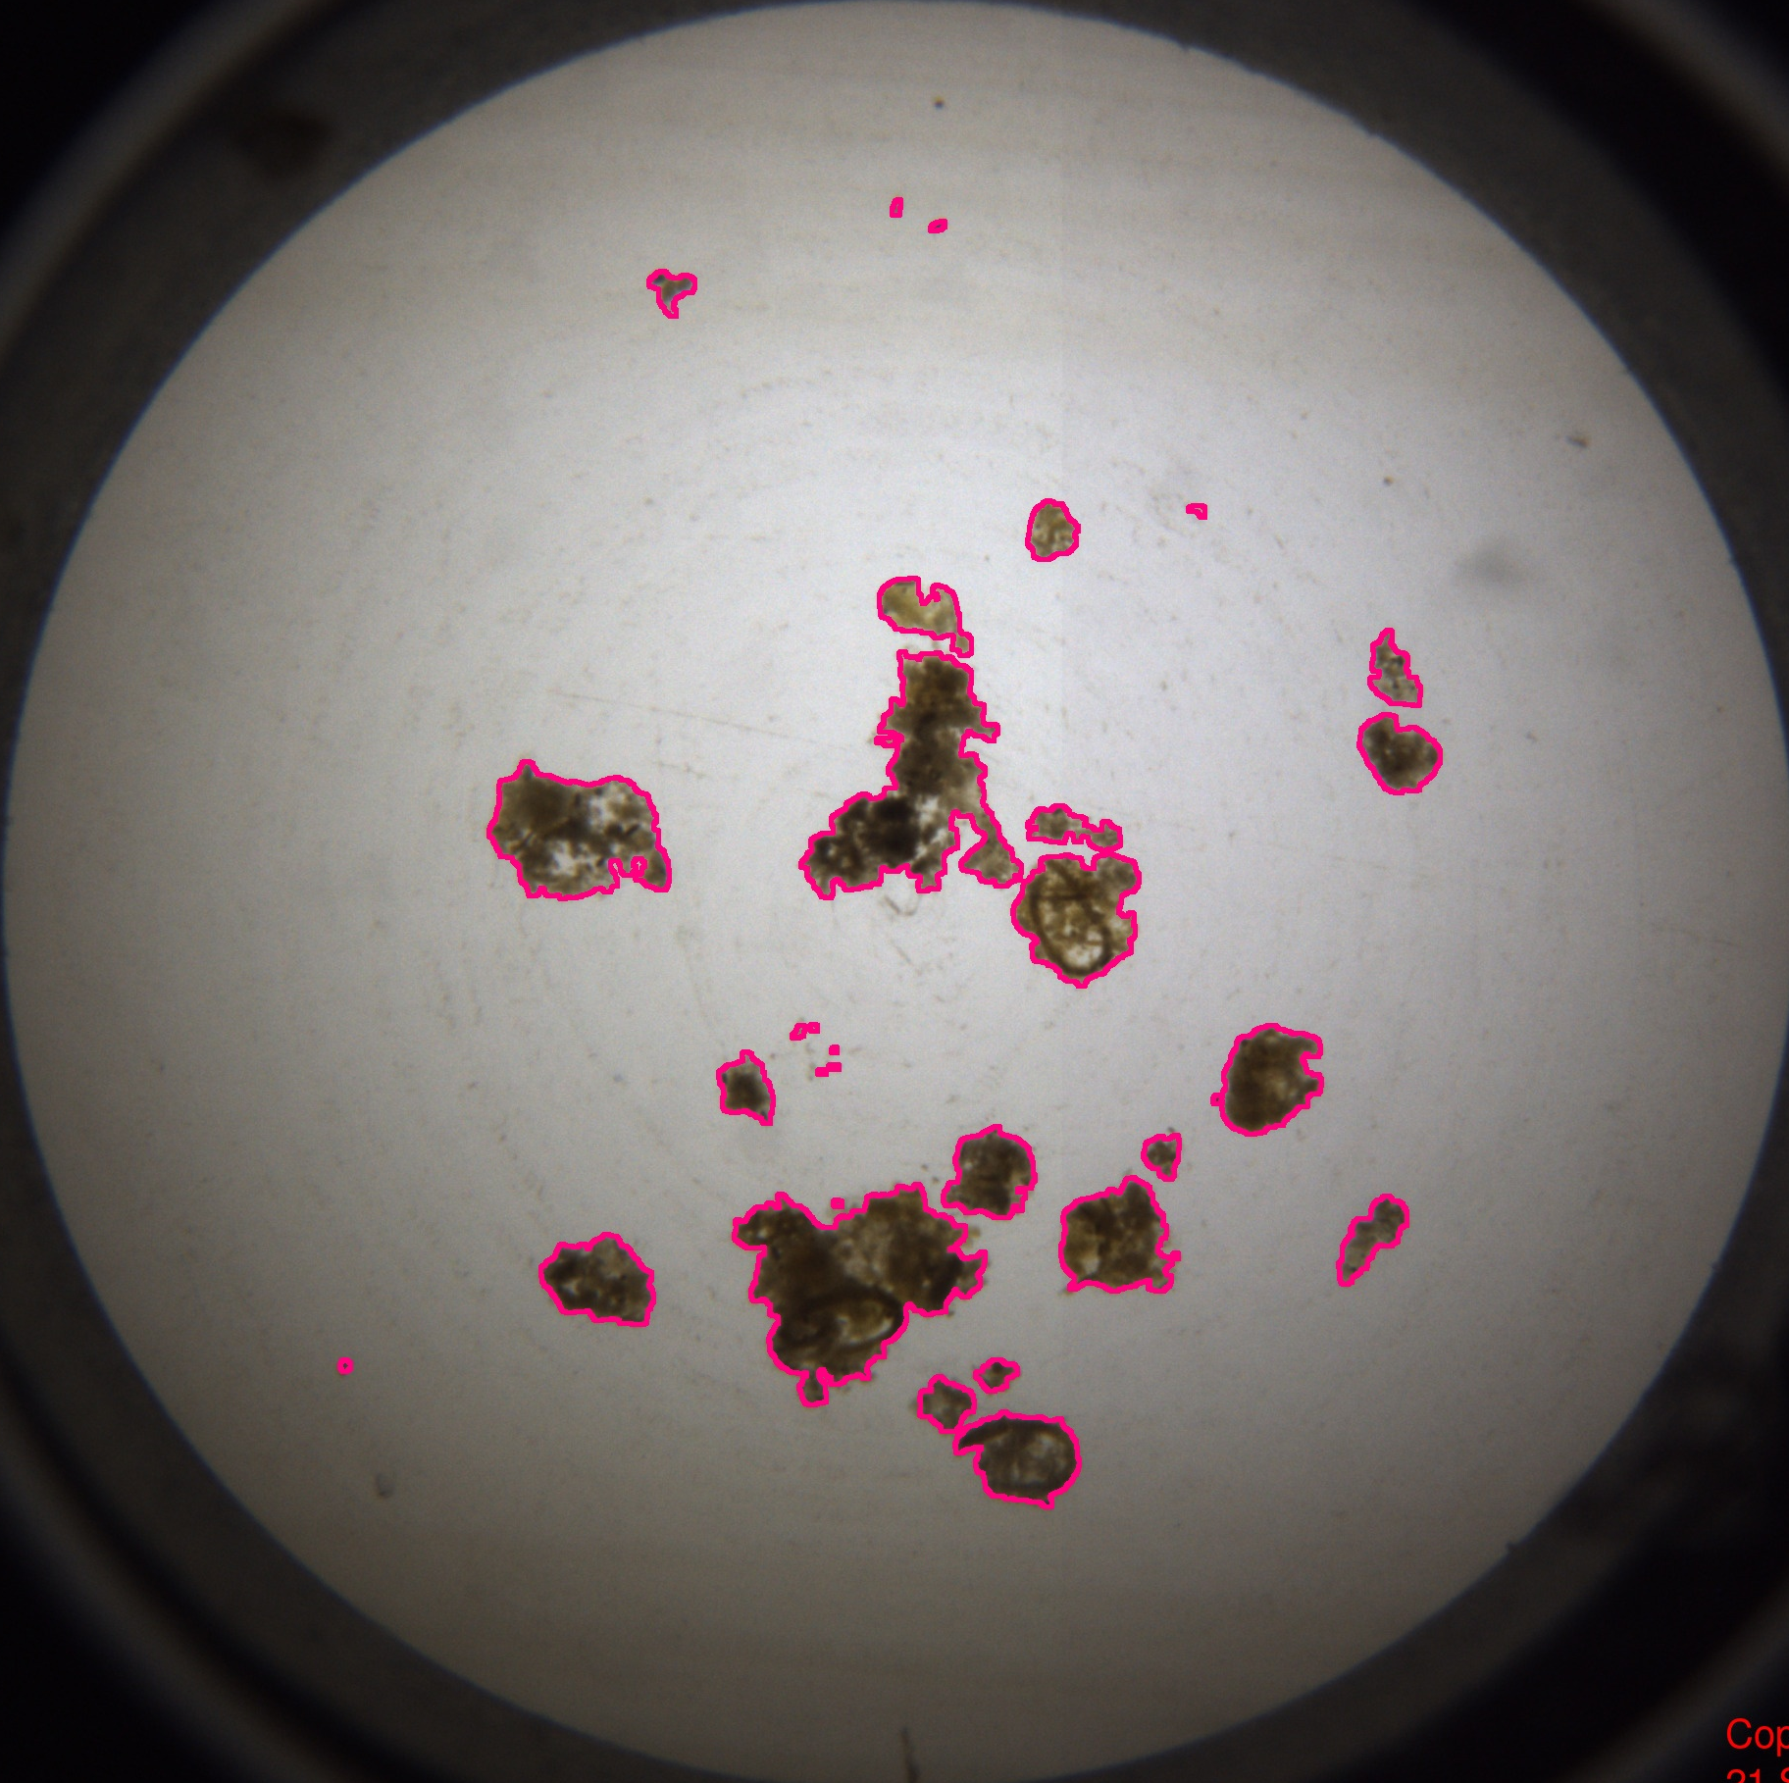
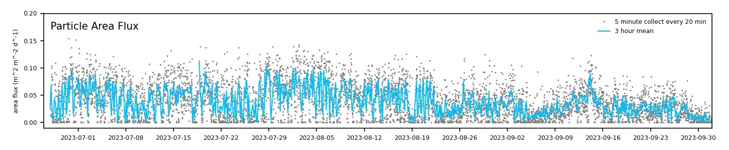
902305: Event Detection using the Sedimentation Event Sensor
Notes:
SES (left) is a low-power instrument that takes pictures of sinking marine snow (two round pictures). We propose to add an algorithm to the SES software so that it can detect in real time when more material is sinking in big “pulse” event (red spikes in time-series plot), and turn on another instrument. Our first step is to work toward triggering a conventional (sample-collecting) sediment trap. In the longer-term, this could be used to trigger an AUV.

