Slide 1
902305: Event Detection with the Sedimentation Event Sensor
What’s the fundamental problem, question, or issue you are addressing?
We need in situ instrumentation that can detect large, unpredictable carbon flux events, and trigger other nearby instruments to wake up.
Why is it important/why should anyone care?
-These advancements work toward more strategic use of power-hungry autonomous instrumentation.
What are we doing about it/what’s MBARI’s unique contribution?
- In 2024 we successfully tested new adaptive sampling algorithms at sea!
-MBARI has been interested in these developments for a long time.

Slide 2
902305: Event Detection with the Sedimentation Event Sensor
What are your project plans for next year (2025)?
Test and evaluate the performance of event-detection algorithm under winter (low flux) conditions
- Calibrate SES carbon estimates to McLane trap measures
Compare particle types and modeled carbon flux as detected by the SES to zooplankton communities detected by the echosounder, and bottom-water conditions (pH, oxygen concentration);
Write short paper about algorithm development and system performance (aim for IEEE).

Slide 3
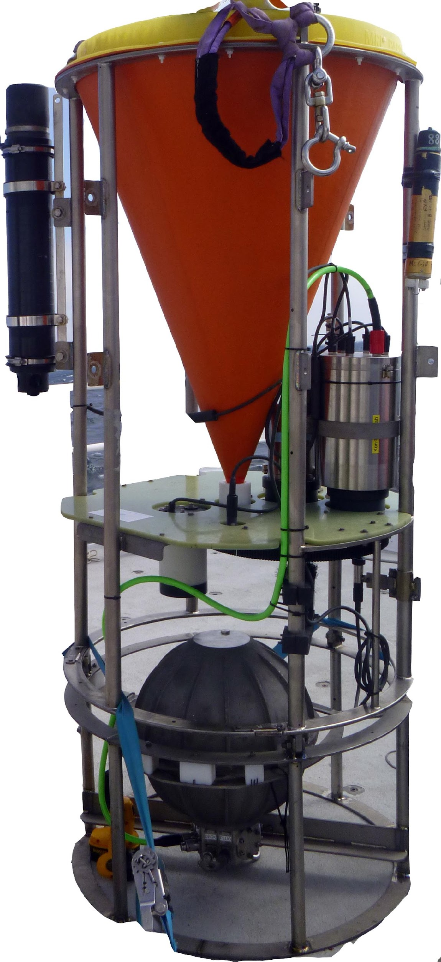
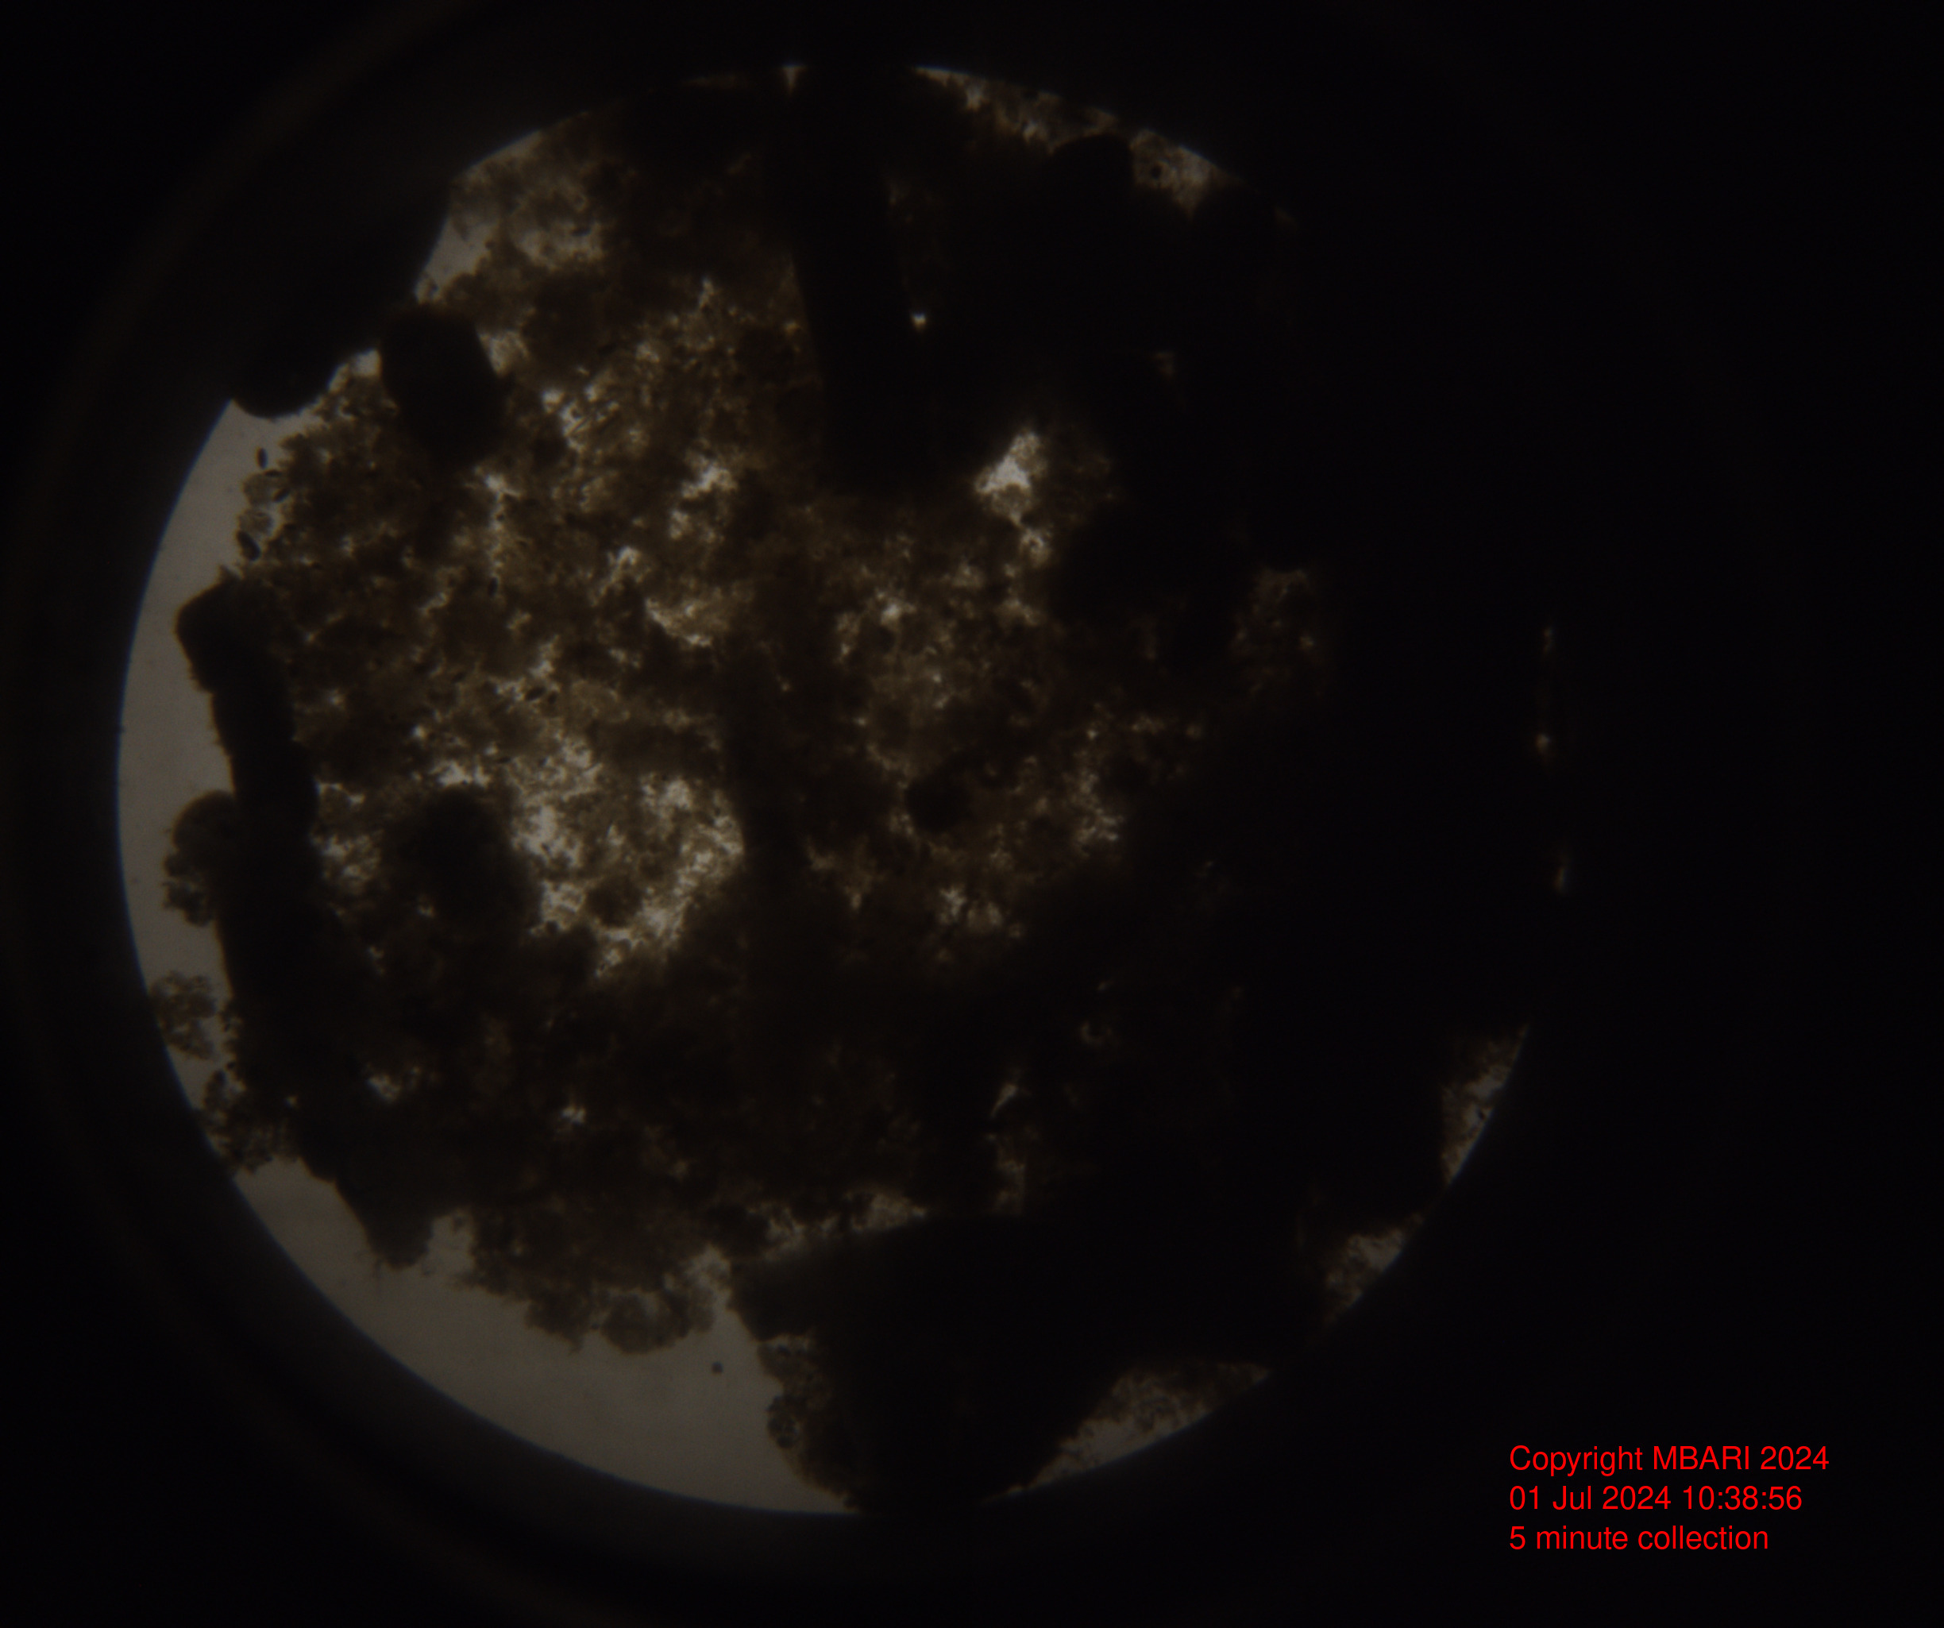
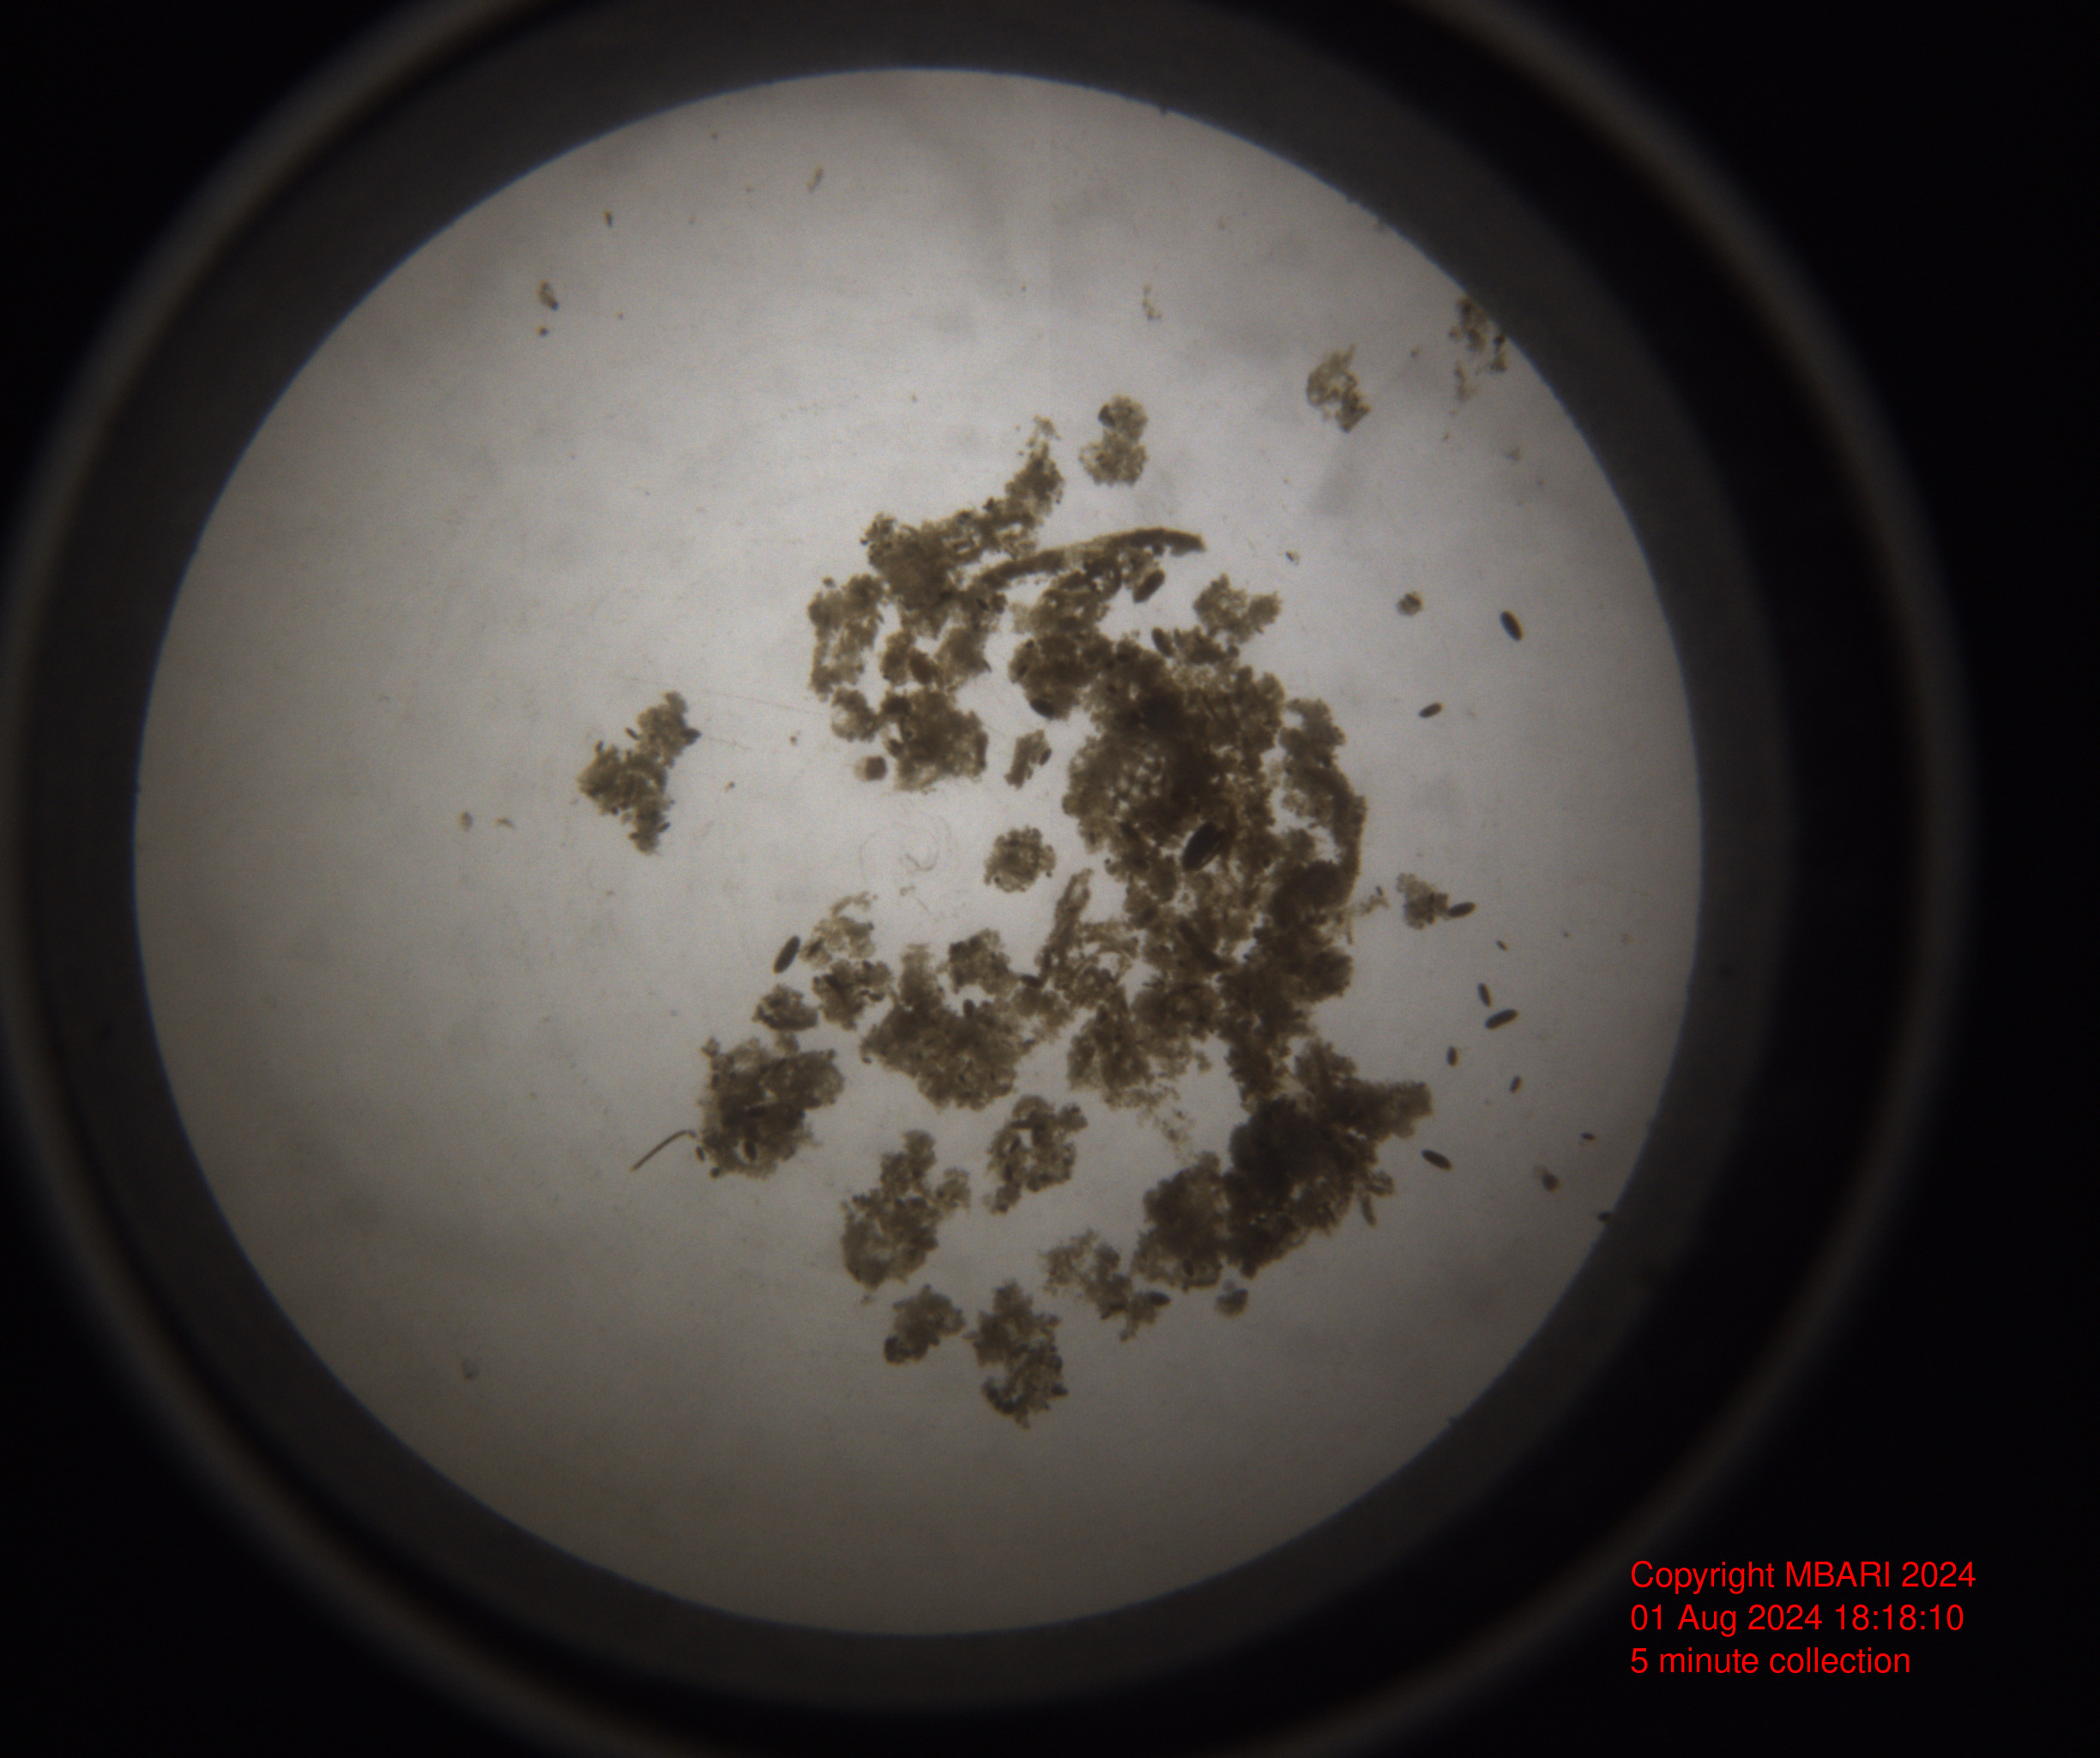
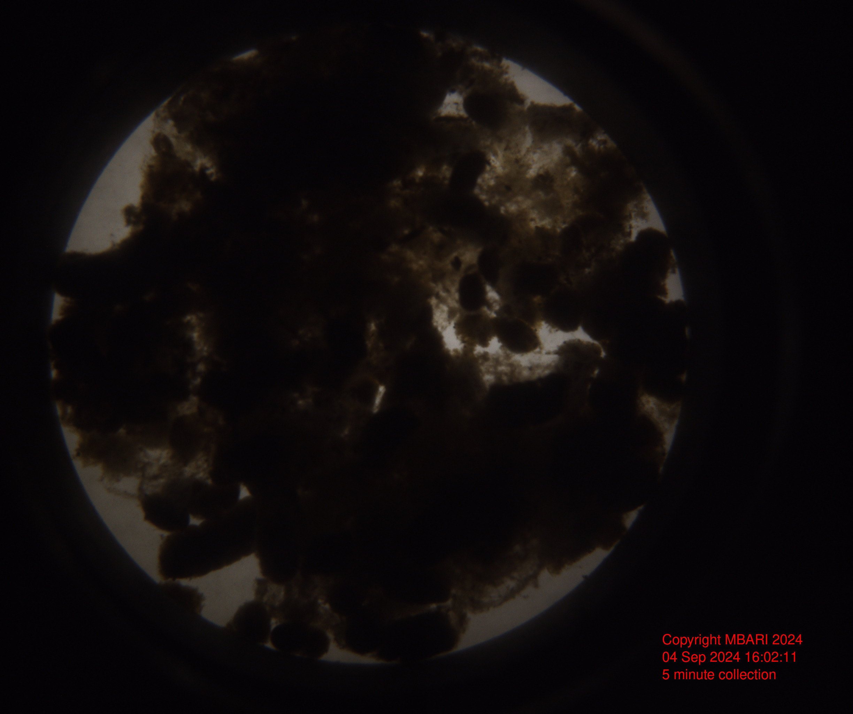
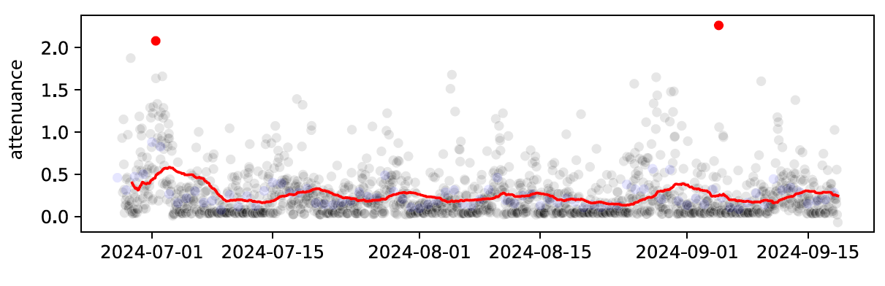
902305: Event Detection with the Sedimentation Event Sensor
Notes:
The dots and SES images in red show the trigger points using onboard image analysis. The image in the middle shows a more typical lower-flux image. The red line shows the 150 hour rolling average. The first trigger fires just before an several-day-long increase in flux. The second point fired correctly according to the criterial we outlined, but clearly we need to do some refining here, since it the event it alerted us to was very fleeting.

