Slide 1


Slide 2
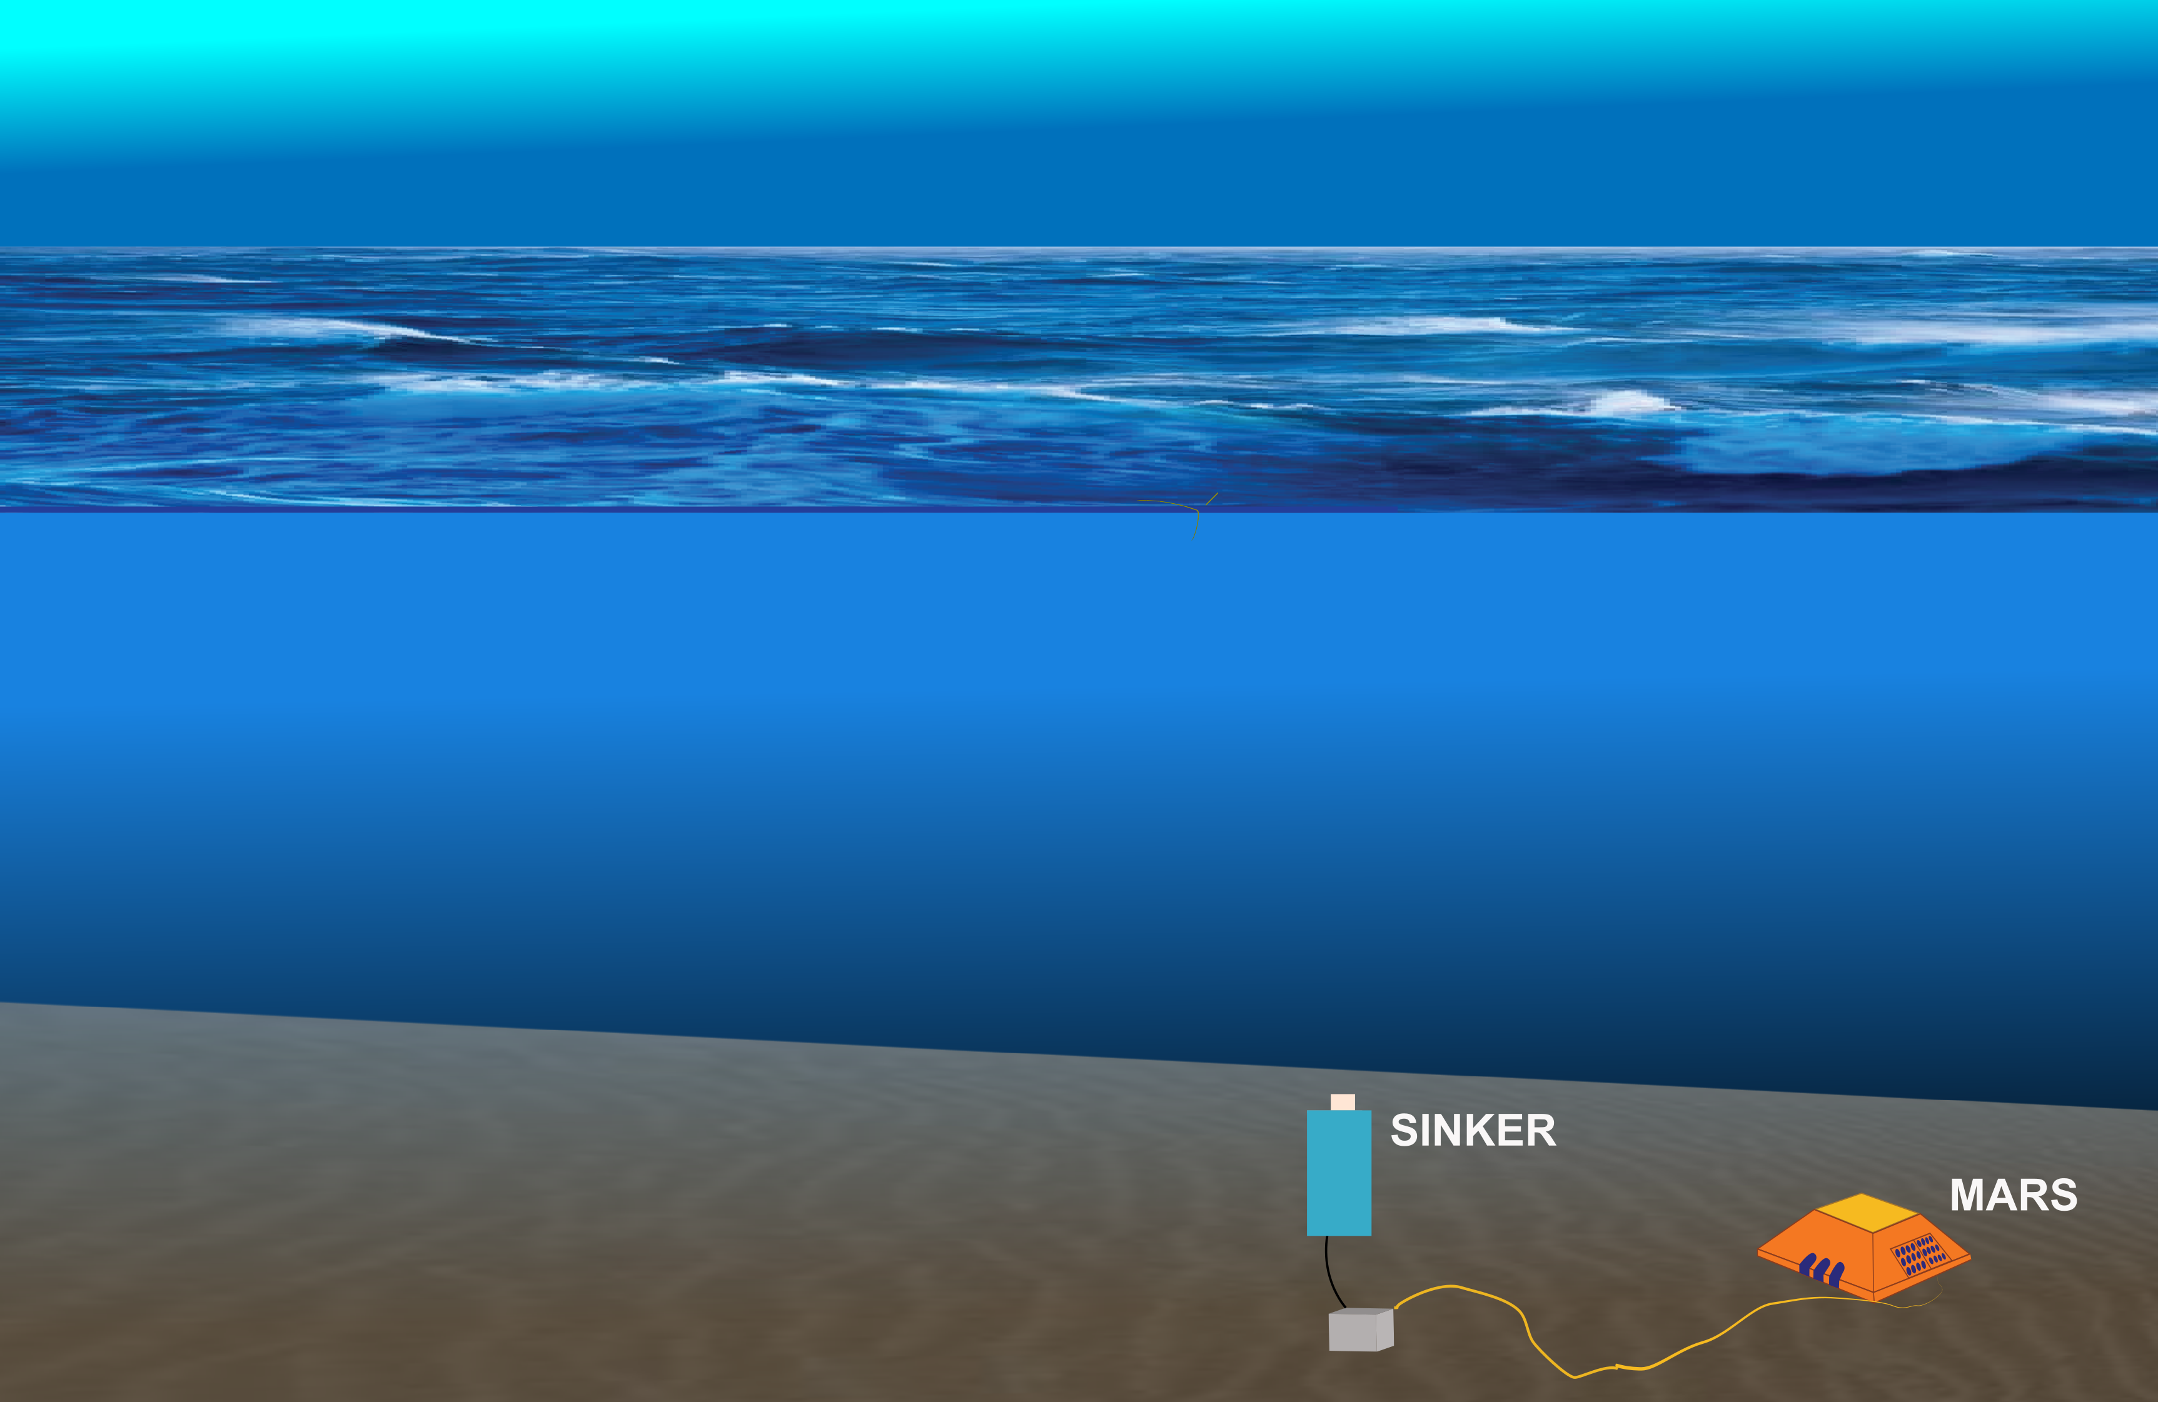
SINKER: a moored instrument for measuring sinking particles
Mission:
Remotely observe the
ecological mechanism of
carbon export, sustained over
hours and across seasons
Team:
Colleen Durkin
Paul Roberts
François Cazanave
Enoch Nicholson
Alana Sherman
Paul McGill
George Stern
Rich Henthorn
Francisco Chavez

Slide 3
Outline
Motivation
Requirements and System Overview
Optical Design
Electrical Design
Mechanical Design
Software Design
Risk and Mitigation
Safety

Slide 4
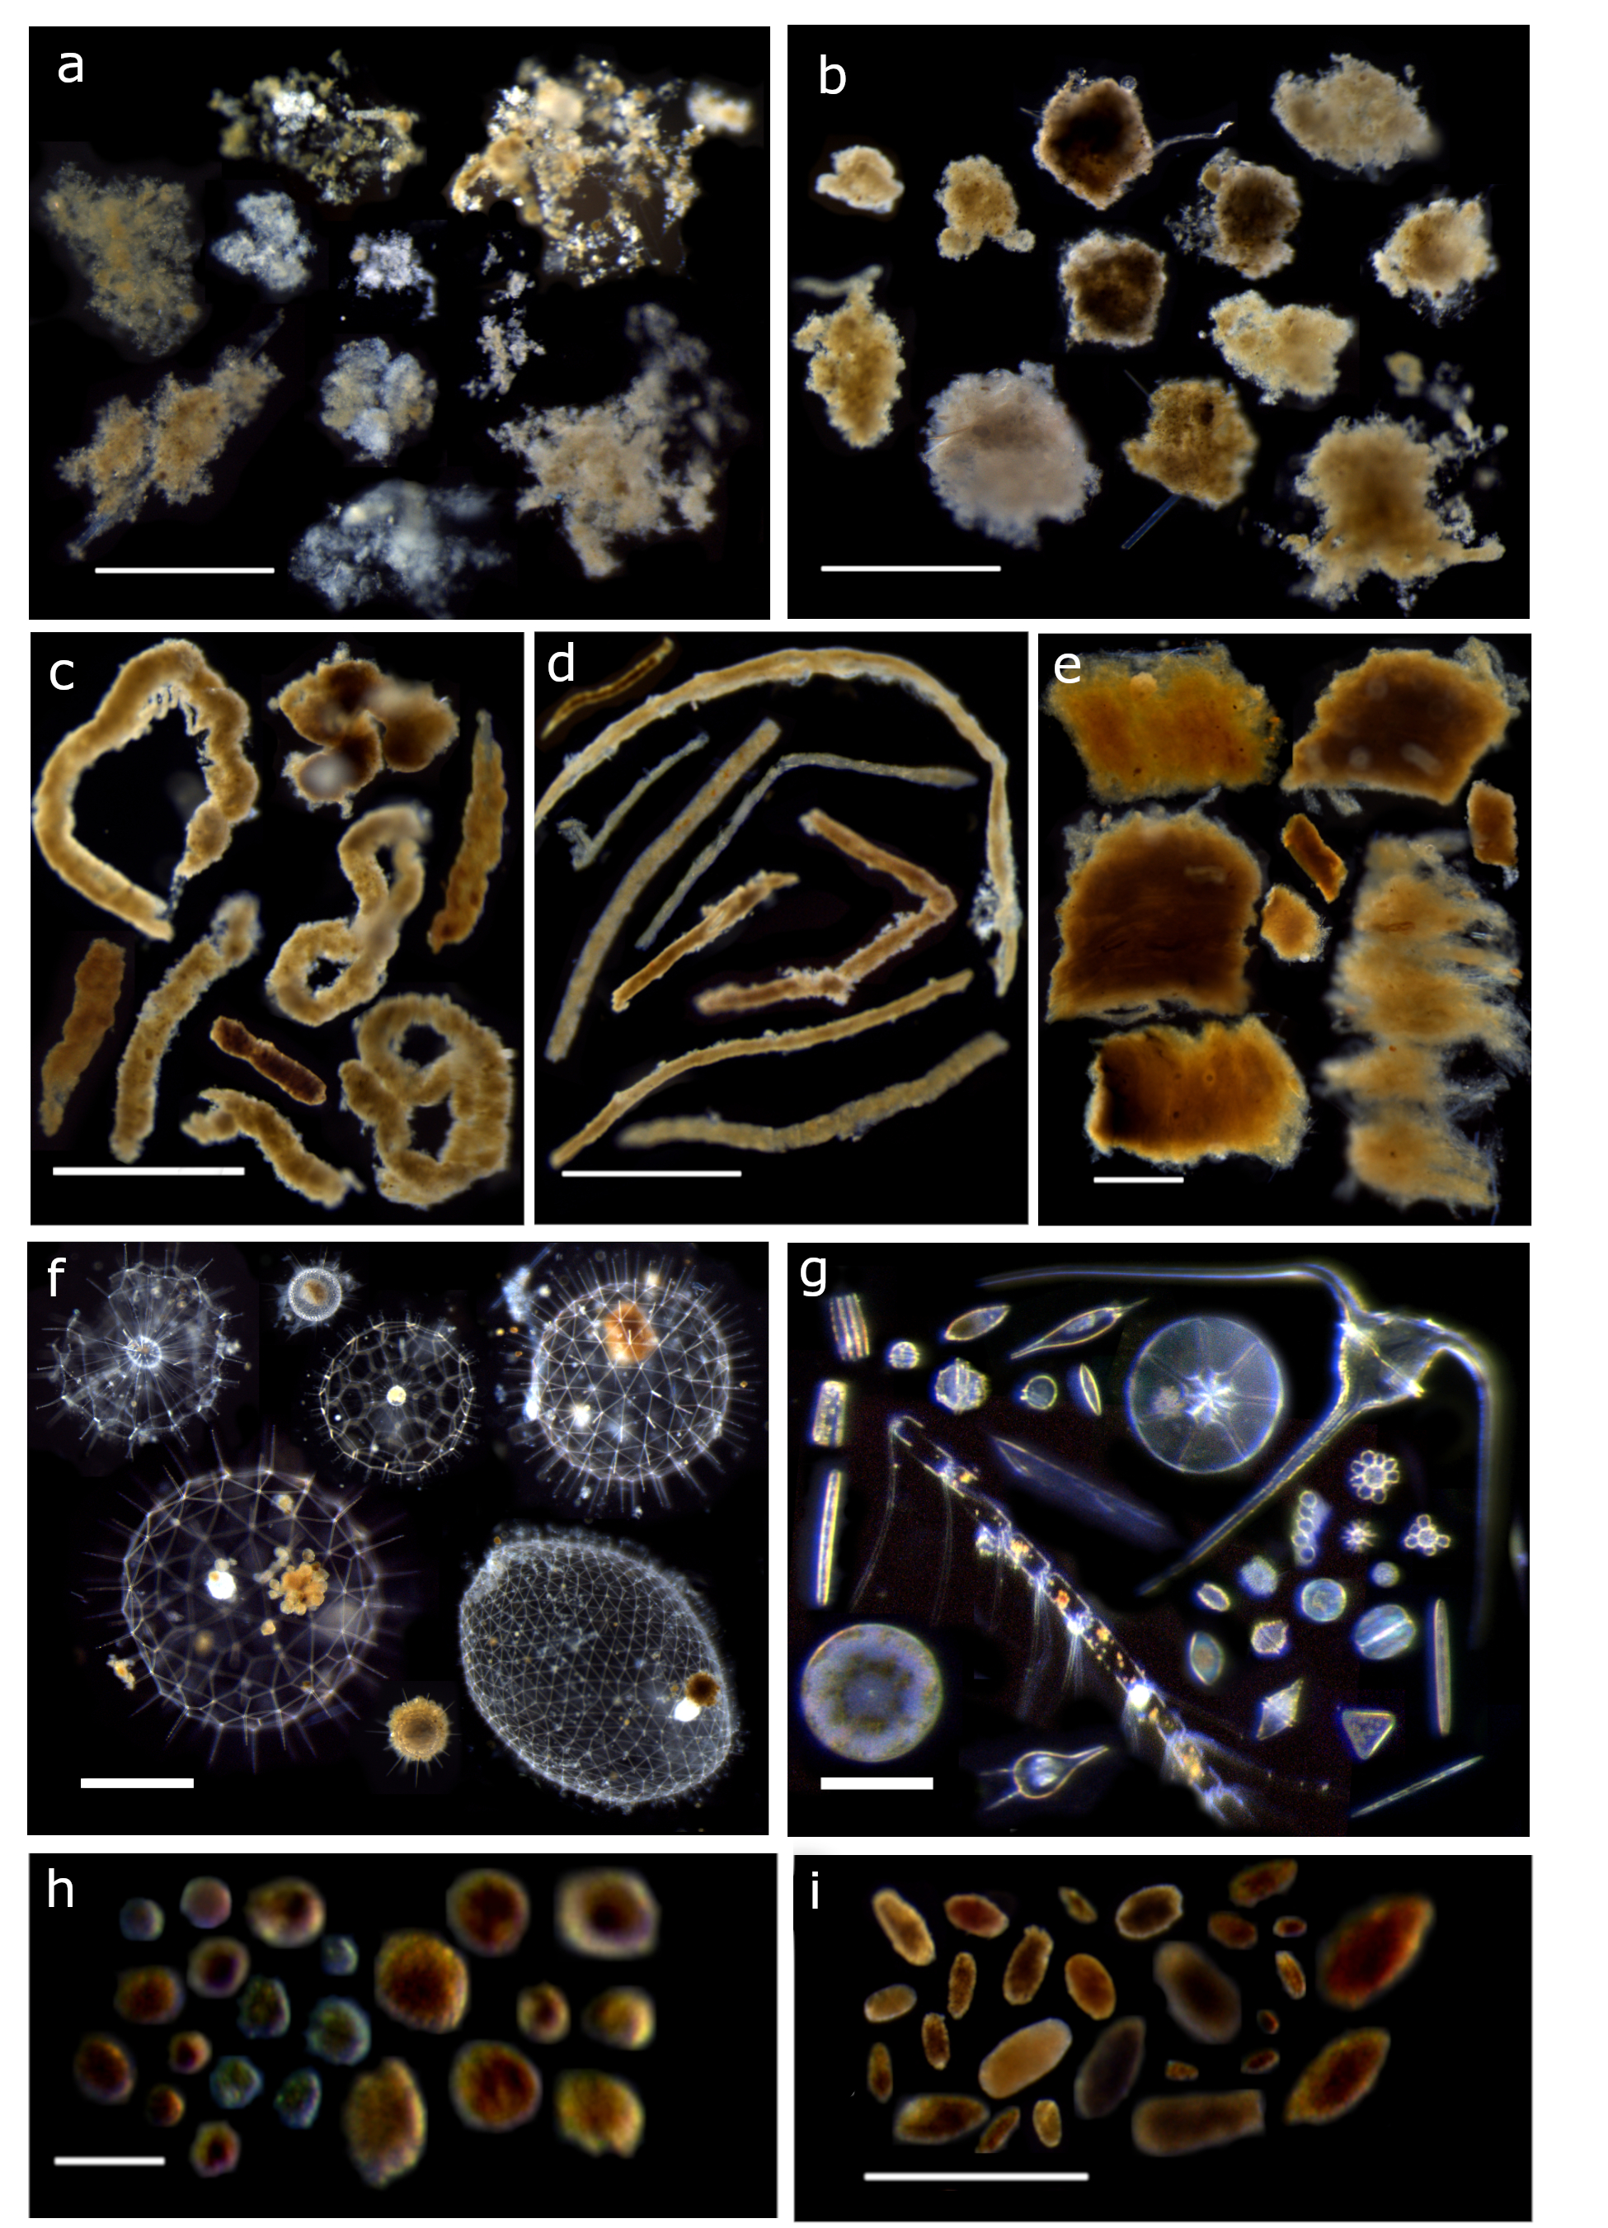
phytoplankton
aggregates
dense detritus
Why do we need to collect
ecologically relevant
observations of carbon export?
Particle type explains
why carbon was exported
and how much.
large-loose pellets
long pellets
salp pellets
rhizaria
5000 µm
50 µm
mini pellets
short pellets
Scale bars:
White = 1 mm
Blue = 100 µm

Slide 5
Key Requirements (User and Design)
2.1.1 The instrument shall visually resolve different types of particles that originate from different ecological sources
    2.2.1 The instrument shall resolve the identity and size of particles in a size range of 50 µm–2000 µm.
    2.2.2 The instrument shall resolve particle sizes with an accuracy of 10%
2.1.3 The instrument shall detect fluxes of particles generated by both microzooplankton and mesozooplankton in addition to detrital aggregates.
2.2.6 The sediment camera shall provide color imagery with reflectance and transmission illumination modes.
2.1.4 The instrument shall measure the sinking speed of particles
2.2.4 The instrument shall be capable of measuring sinking speeds between 1 and 1000 m/d for the larger field of view cameras, 250 m/d for the smaller field of view =
2.1.5 The instrument shall be capable of monitoring flux variations that occur on diel cycles (hours) and across seasons (months to years).
2.1.7. The data from the instrument shall be accessible without recovery.
2.2.10. The instrument shall be plugged into the MARS cabled observatory.
2.2.13. The instrument shall be deployed and operating for at least 1 year with the ultimate goal of annual servicing

Slide 6
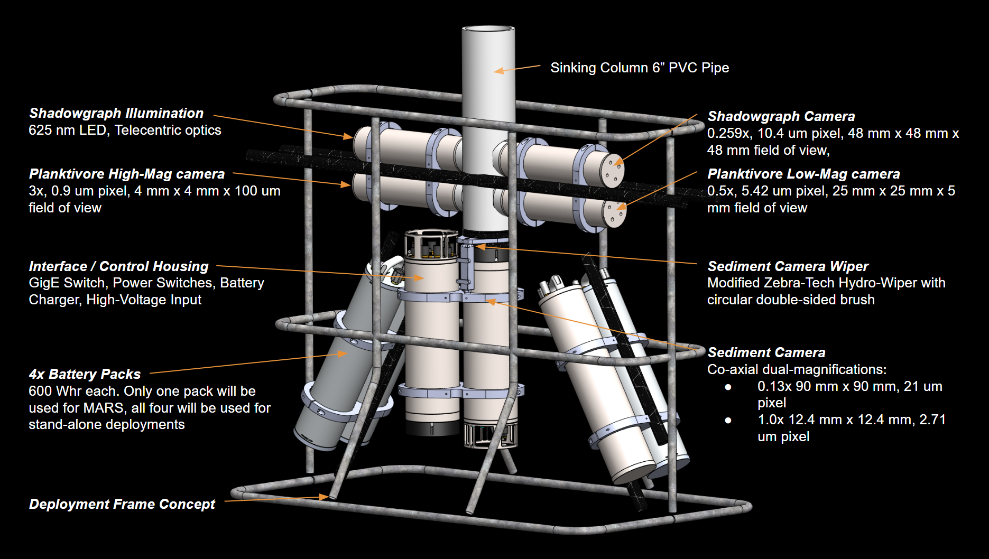

Slide 7
Optical Design
Split the detection, velocimetry, and flux into separate imaging systems
  Shadowgraph (size and statistics of sinking rates)
  Darkfield (size and color)
  Sediment (Accumulation with size and color)

Slide 8
Measuring flux and sinking speed of particles
spanning 3 orders of magnitude requires multiple cameras
 | Sinking Speeds (m d⁻¹) |  |  | Fluxes (# m⁻² d⁻¹)
Size range: | 30–300 µm | 200–1000 µm | 800–5000 µm | 30–500 µm | 300–5000 µm
Shadowgraph
Planktivore low mag
Planktivore high mag
Sediment camera low mag
Sediment camera high mag

Slide 9
Estimation Methods
Particle Identification
  Based on existing work at MBARI (Chiton, Planktivore, SES) using traditional computer vision and machine learning.
Particle Sinking speed
  Based on particle tracking velocimetry (PTV). Record a sequence of frames and measure displacement of particles over time to estimate velocity.
Particle Flux
  Image accumulation of particles on an optical surface over time, detect area of accumulation using traditional computer vision

Slide 10
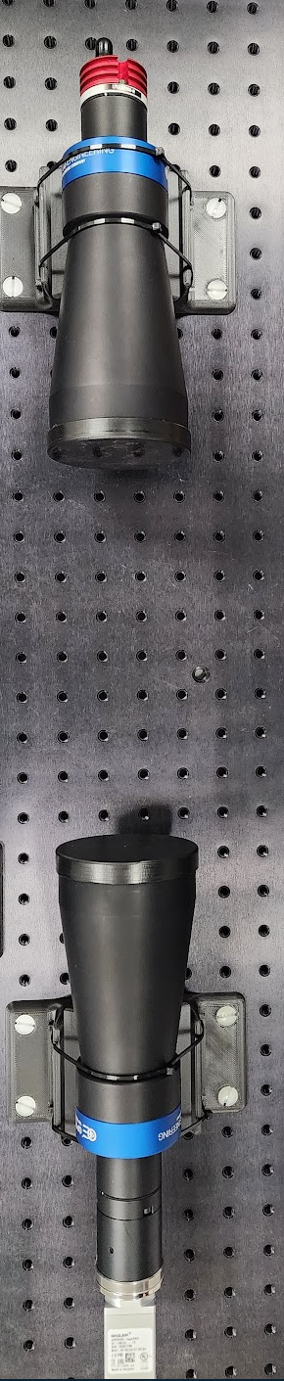
Shadowgraph
Telecentric illumination
Telecentric Imaging
Duplicate existing systems (ISIIS DPI)
COTS illumination and imaging hardware

Slide 11
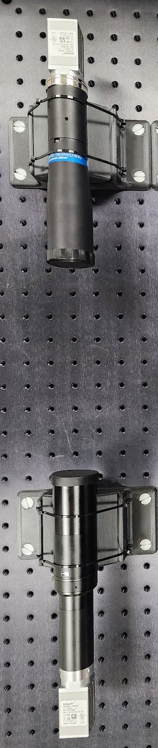
Darkfield
LowMag Imaging
HighMag illumination
HighMag Imaging
LowMag Illumination
Duplicate existing systems Planktivore Project
Dual magnifications

Slide 12
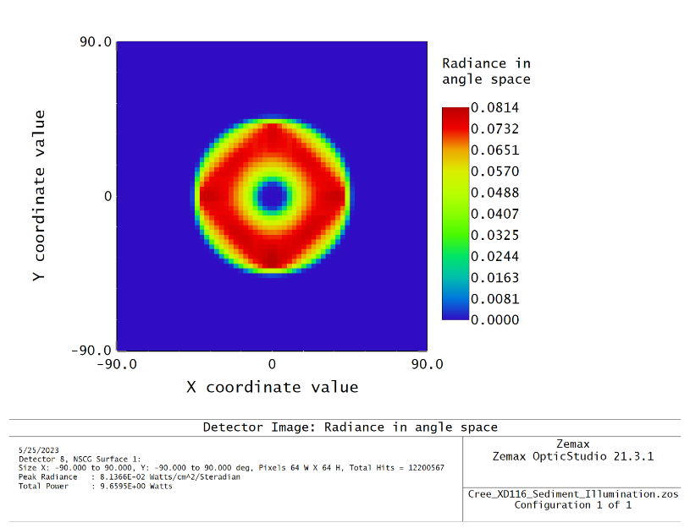
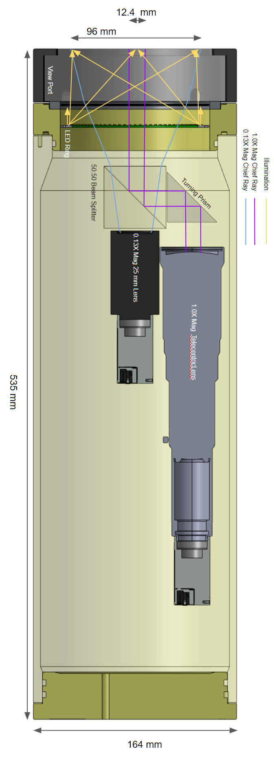
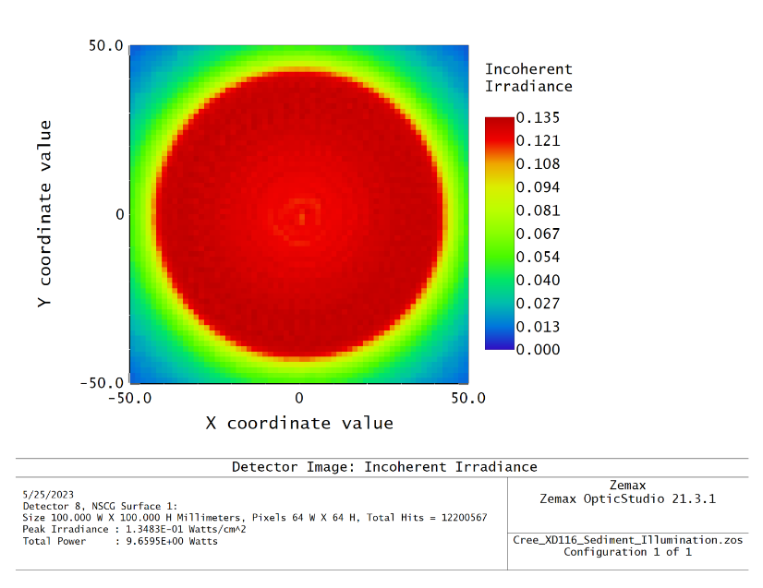
Sediment
New design
Dual magnifications
Wiper cleans imaging surface to start new integration
Flux estimation from automated closed contour detection

Slide 13
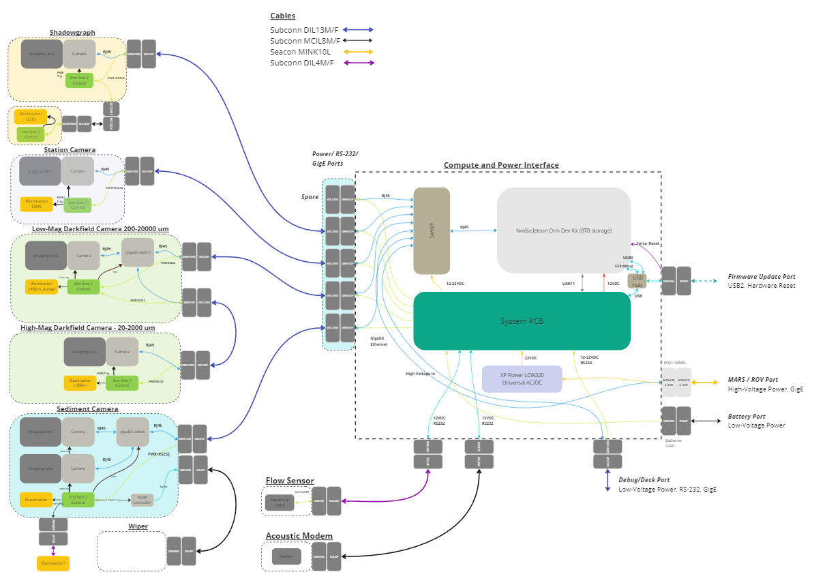
Electrical
Design
Interface node with external cameras, lights and sensors
Standard Ports for cameras: GigE, Power, RS-232
External battery and charging
Low-power system control board
External acoustic and water velocity sensors

Slide 14
Mechanical Design
Materials
  Titanium, BK7 glass, Acetal, PVC
Viewports
  Based on rover camera port design (glass on hardened steel support)
Frame
  Galvanized steel, welded with locations for stabs and mounts for elevator
Wiper
  Modified Zebra-Tech Hydro-Wiper for longevity and depth rating
  Circular brush acts as seal when not in use

Slide 15
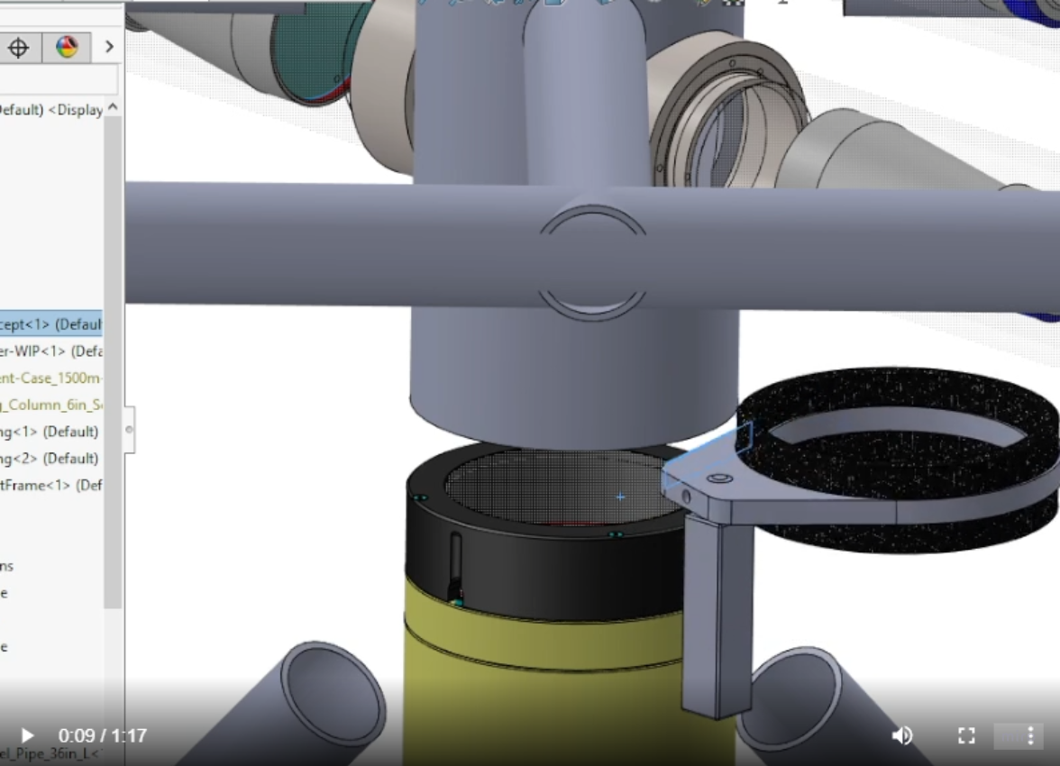
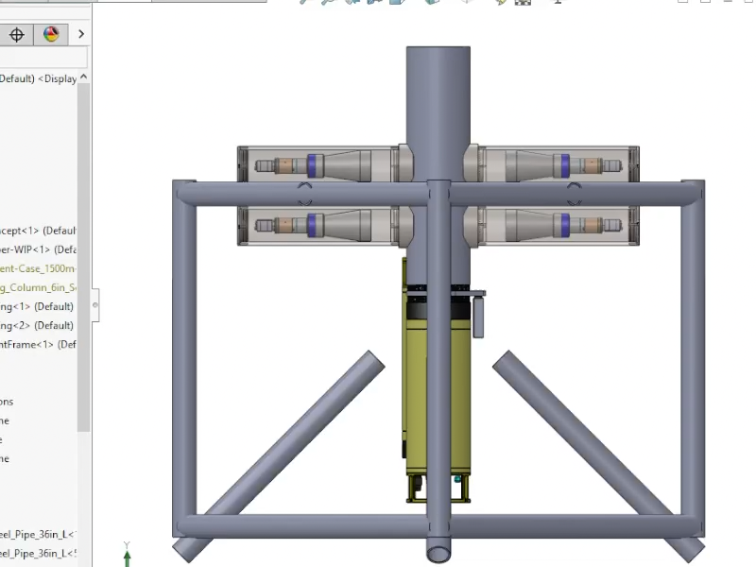
Wiper Design
Wiper
  Modified Zebra-Tech Hydro-Wiper for longevity and depth rating
  Circular brush acts as seal when not in use

Slide 16
Software Design
Camera acquisition software
  Standard GigE-Vision compliant driver with application code derived from Chiton.
  Store raw frames and processed ROIs for each frame capture.
  Frames triggered by hardware
System control firmware
  SAMD21 drivers based on Chiton system controller
Camera/Light control board
  SAMD21 drivers based on Chiton system controller

Slide 17
Software Design: System Control
Recorded Images
Recorded Images
Sediment Accumulation Timeout
Baseline
Sediment
Measurement
Event Trigger
Idle
Imaging
Event
Cleaning Event
Imaging
Event
No Sediment Timeout
Low Power Mode ~ 0.1W
Full Power Mode
~ 50W

Slide 18
Imaging Event (Battery Power)
Time / sensor Event
Events are preprogrammed before deployment (eg. every 20 minutes)
SINKER waits in low-power state between events
Time
Power Up System
Acquire Sediment Images
Clean port if scheduled / needed
Store Images Locally
Power Down System
Acquire Shadowgraph
Acquire Shadowgraph
Acquire Shadowgraph
Acquire Shadowgraph
Acquire Darkfield
Acquire Darkfield
Acquire Darkfield
Acquire Darkfield
Imaging Sequence: Multiple images acquired on side-looking cameras with logarithmic frame interval

Slide 19
Imaging Event (MARS)
Time / sensor Event
Events are programmed from shore and can be updated as desired
Time
Check System
Acquire Sediment Images
Clean port if scheduled / needed
Transfer images to shore
Acquire Shadowgraph
Acquire Shadowgraph
Acquire Shadowgraph
Acquire Shadowgraph
Acquire Darkfield
Acquire Darkfield
Acquire Darkfield
Acquire Darkfield
Imaging Sequence: Multiple images acquired on side-looking cameras with logarithmic frame interval

Slide 20
Risks and Mitigation
Wiper Mechanics/Optics
  Test tank for wiper design iteration
  Planning year 2 iteration of design based on field data
Long deployment duration
  Materials selected to limit corrosion risk
  Controller with enabled watchdog to prevent stuck instrument on MARS
  All housings can monitor for leaks, and ground faults. Subsystems can be individually shutoff

Slide 21
Safety
Using COTS universal AC/DC converter with external fuse for 375VDC to 22VDC conversion.
All subsystems are isolated from high voltage and use voltages less than 36VDC.
System controller monitors for ground faults on each external subsystem.

