Slide 1
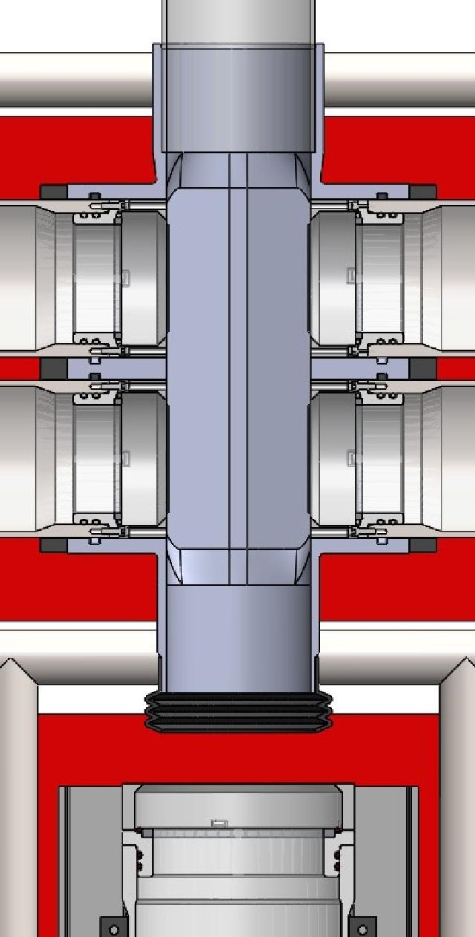
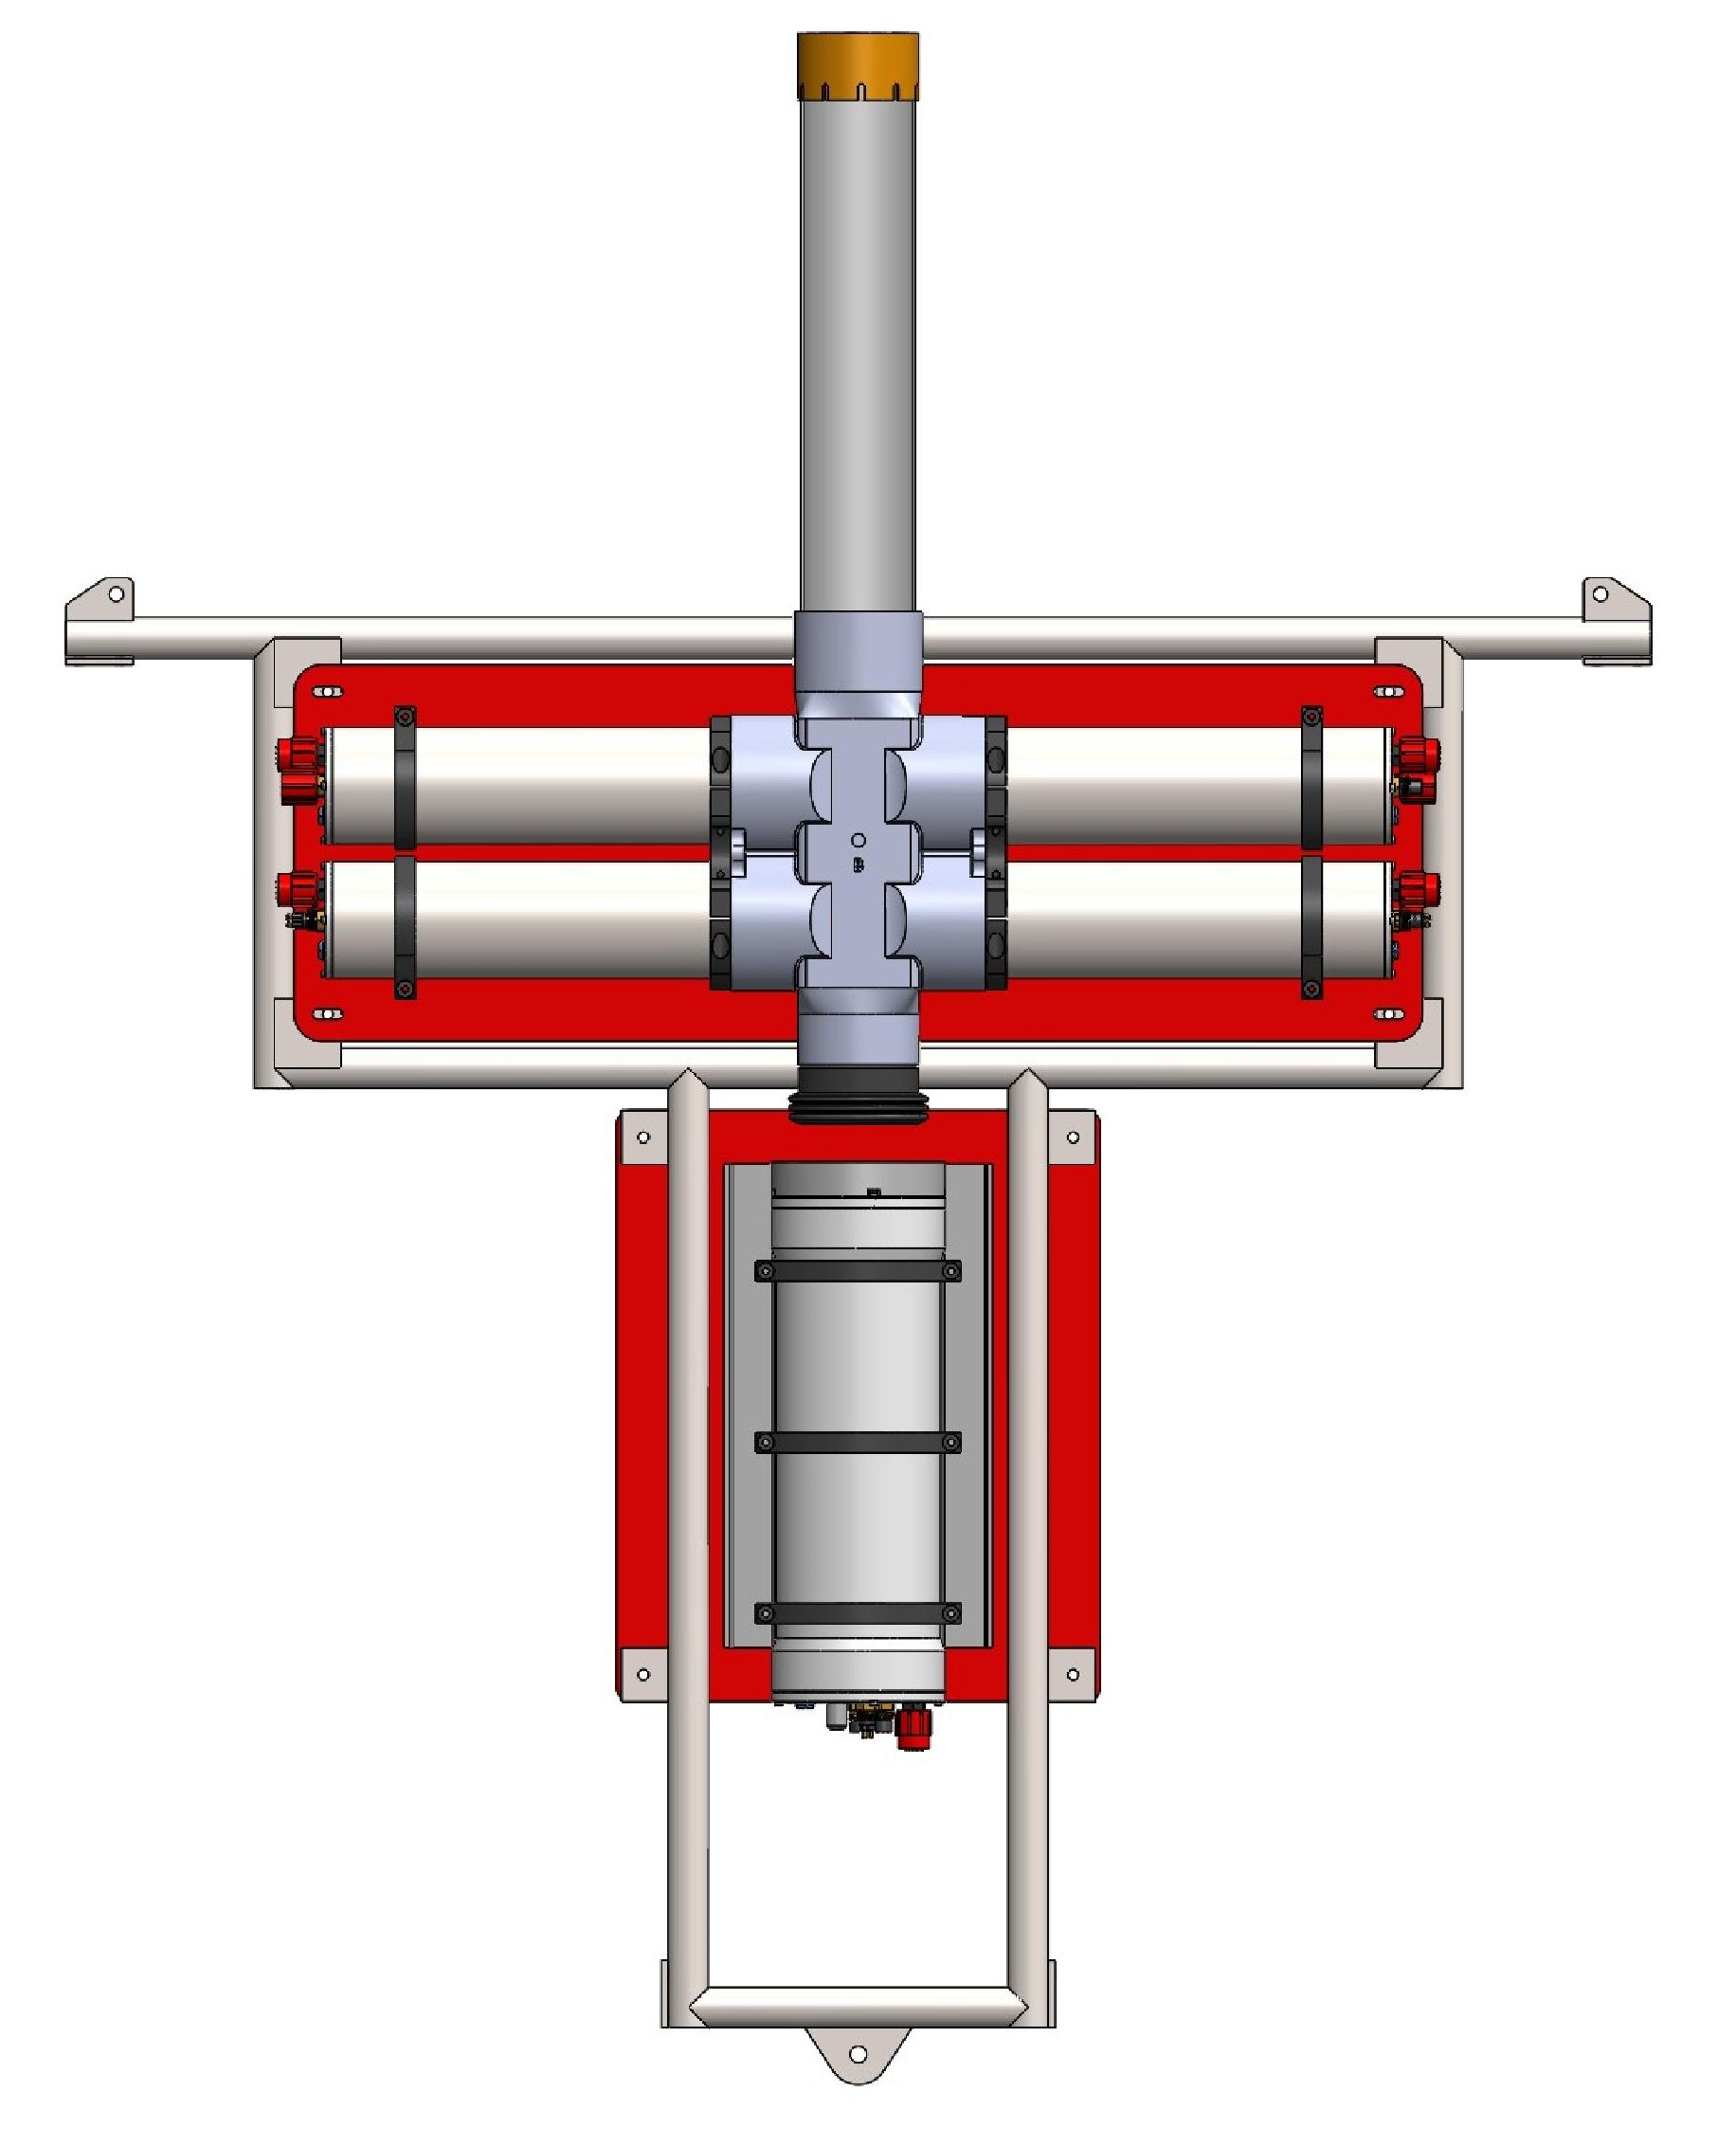
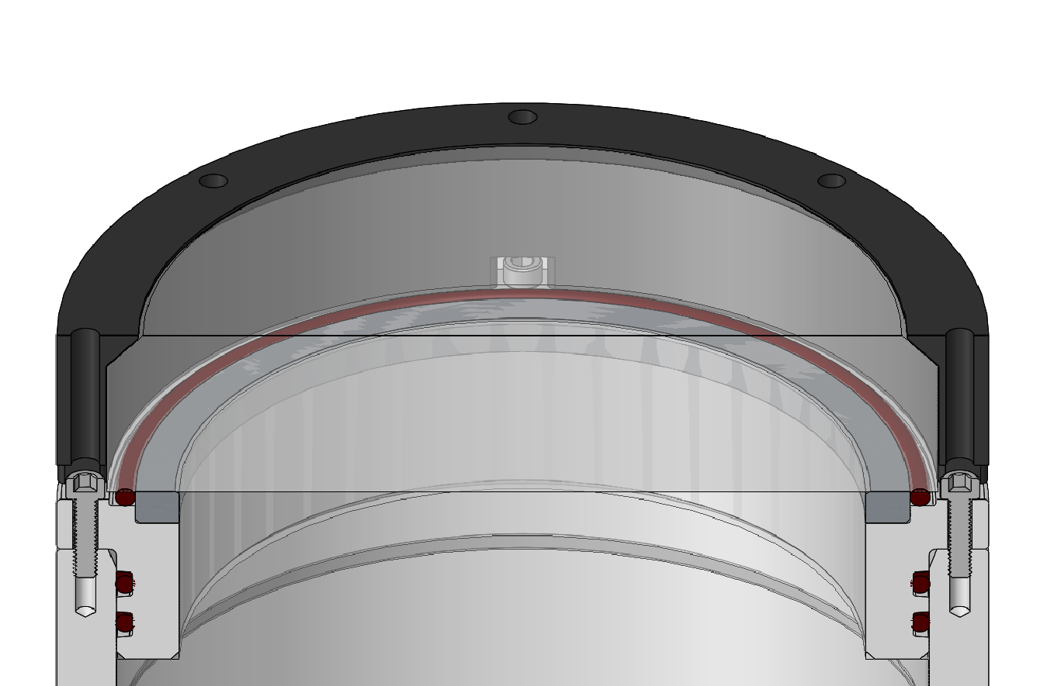
Particles Enter
Particles Settle
Particles Imaged While Sinking
Shadowgraph Imaged Volume
Particles Collected & Imaged
Darkfield Imaged Volumes: High Magnification & Low Magnification
Beveled Flush Viewport

Slide 2
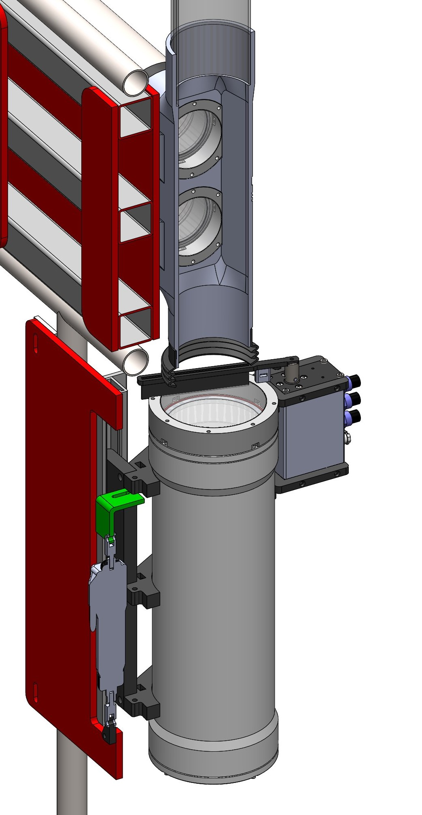
Bellows Seal
MBARI Rotary Actuator
Ultramotion U1 Linear Actuator
Cleaning Brush

Slide 3
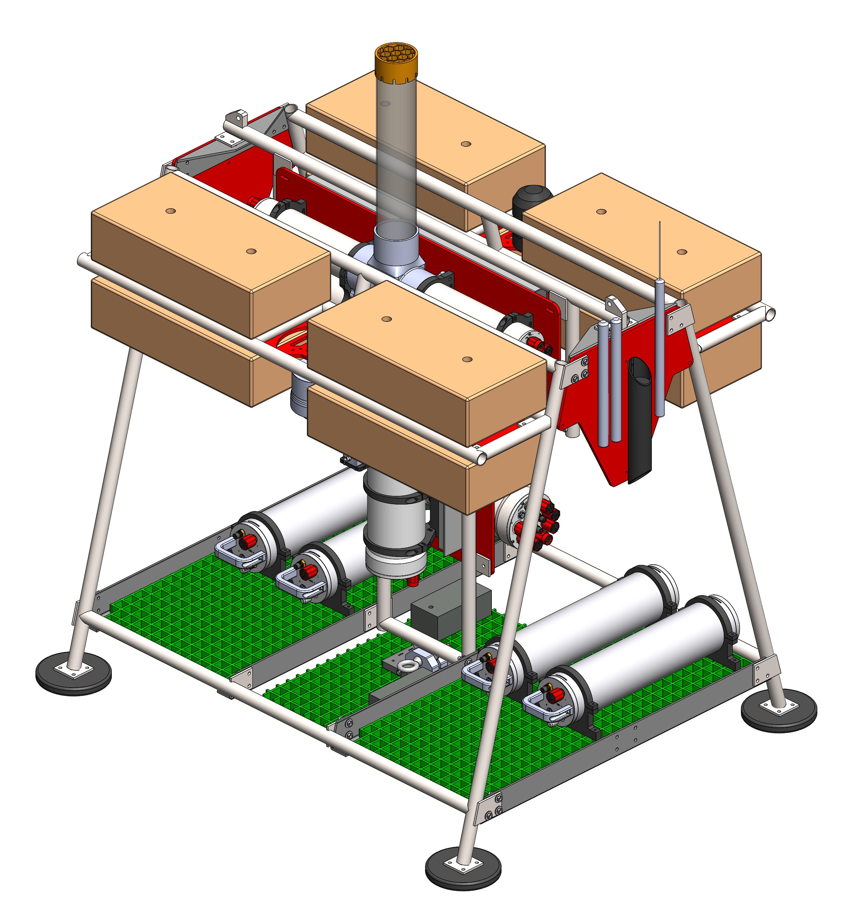
Imaging Assembly
ADCP
Fixed Flotation
Station Camera
70 cm
Battery System
Drop Weight
140 cm
150 cm
120 cm

