Slide 1
Directions
Answer the questions on the following slides with this guidance:
limit text to bullets that are easy to read (i.e., use large font)
be concise
assume you're audience is the "informed general public”
Additional details can be added in the notes section, if needed.

Slide 2
902306 – SINKing Ecology Robot (SINKER)
What’s the fundamental problem, question, or issue you are addressing?
SINKER will measure variability of carbon flux to the seafloor and the ecological source of this variation over seasonal time scales.
Why is it important/why should anyone care?
The amount of carbon exported to the deep ocean is poorly quantified and modeled, and there is growing consensus that ecological mechanisms of particle export must be accounted for to improve estimates.
What are we doing about it/what’s MBARI’s unique contribution?
SINKER leverages MBARI’s unique access to the deep sea and MARS along with our expertise in underwater imaging to enable unprecedented observations of sinking particles.
What are your project plans for next year (2024)?
In 2024 we plan to deploy SINKER twice in a stand-alone configuration and install permanently on MARS by the end of the year.

Slide 3
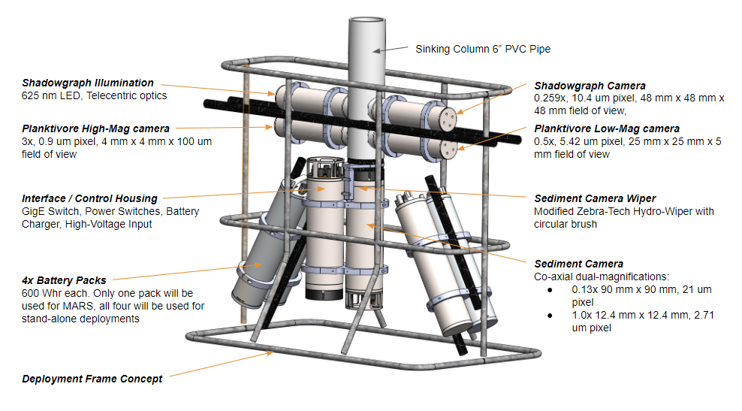
Preliminary design of the system showing the two free-space imaging systems (Shadowgraph (ISIIS DPI), and Planktivore) imaging sinking particles through the side of the 6” pipe. At the bottom of the pipe a sediment camera images particle that collect on the viewport at two complimentary magnifications that are collocated on the same optical axis. A mechanical wiper attached to a circular brush periodically wipes the upward facing port clean to initiate a new sample and seals off the bottom of the sinking column when not in use. Up to four battery packs are mounted in the deployment frame to enable stand-alone operations when MARS is not available.

Slide 4
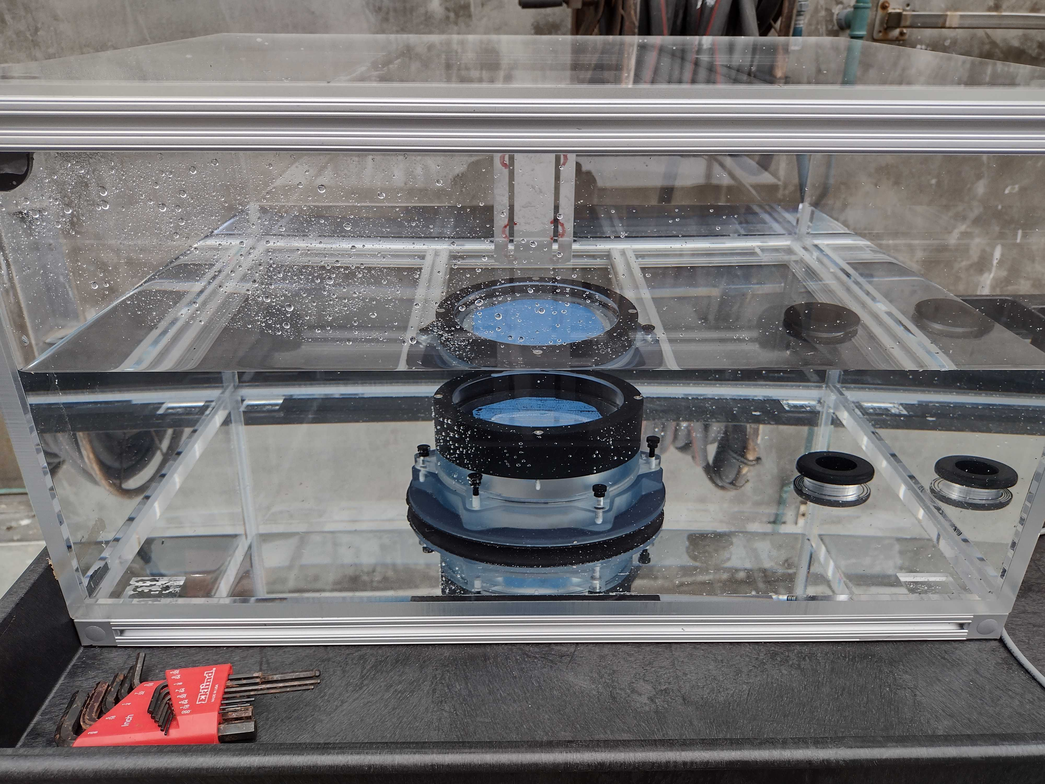
Photo of the test tank used to validate the mechanical wiper design and test optics for the sediment camera

