Slide 1
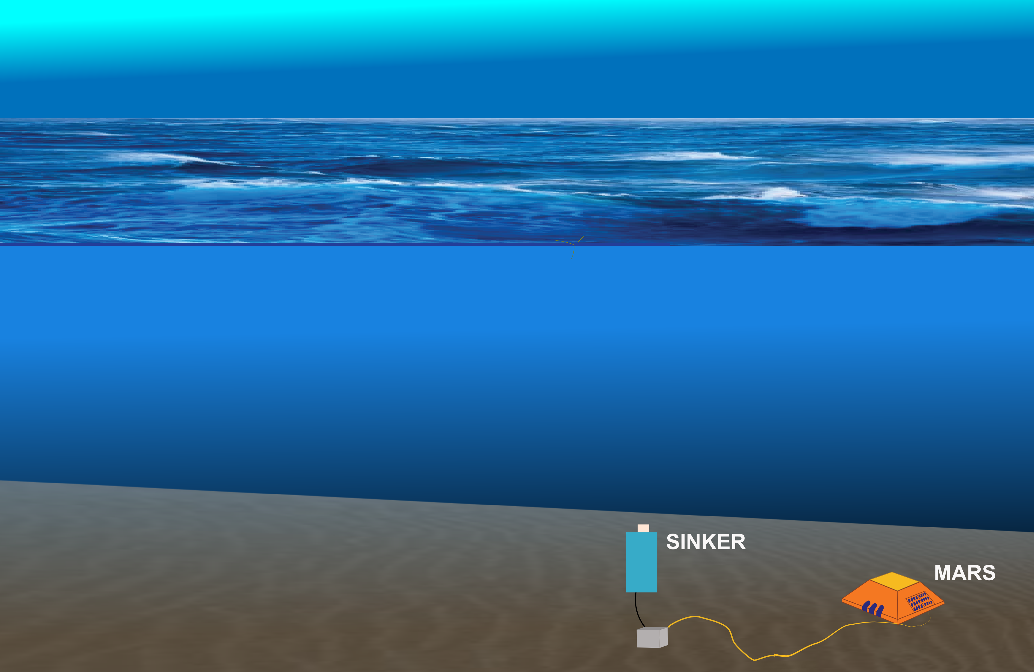
SINKER: a moored instrument for measuring sinking particles
Mission:
Remotely observe the
ecological mechanism of
carbon export, sustained over
hours and across seasons
Team:
Colleen Durkin
Paul Roberts
François Cazanave
Alana Sherman
Paul McGill
Francisco Chavez

Slide 2
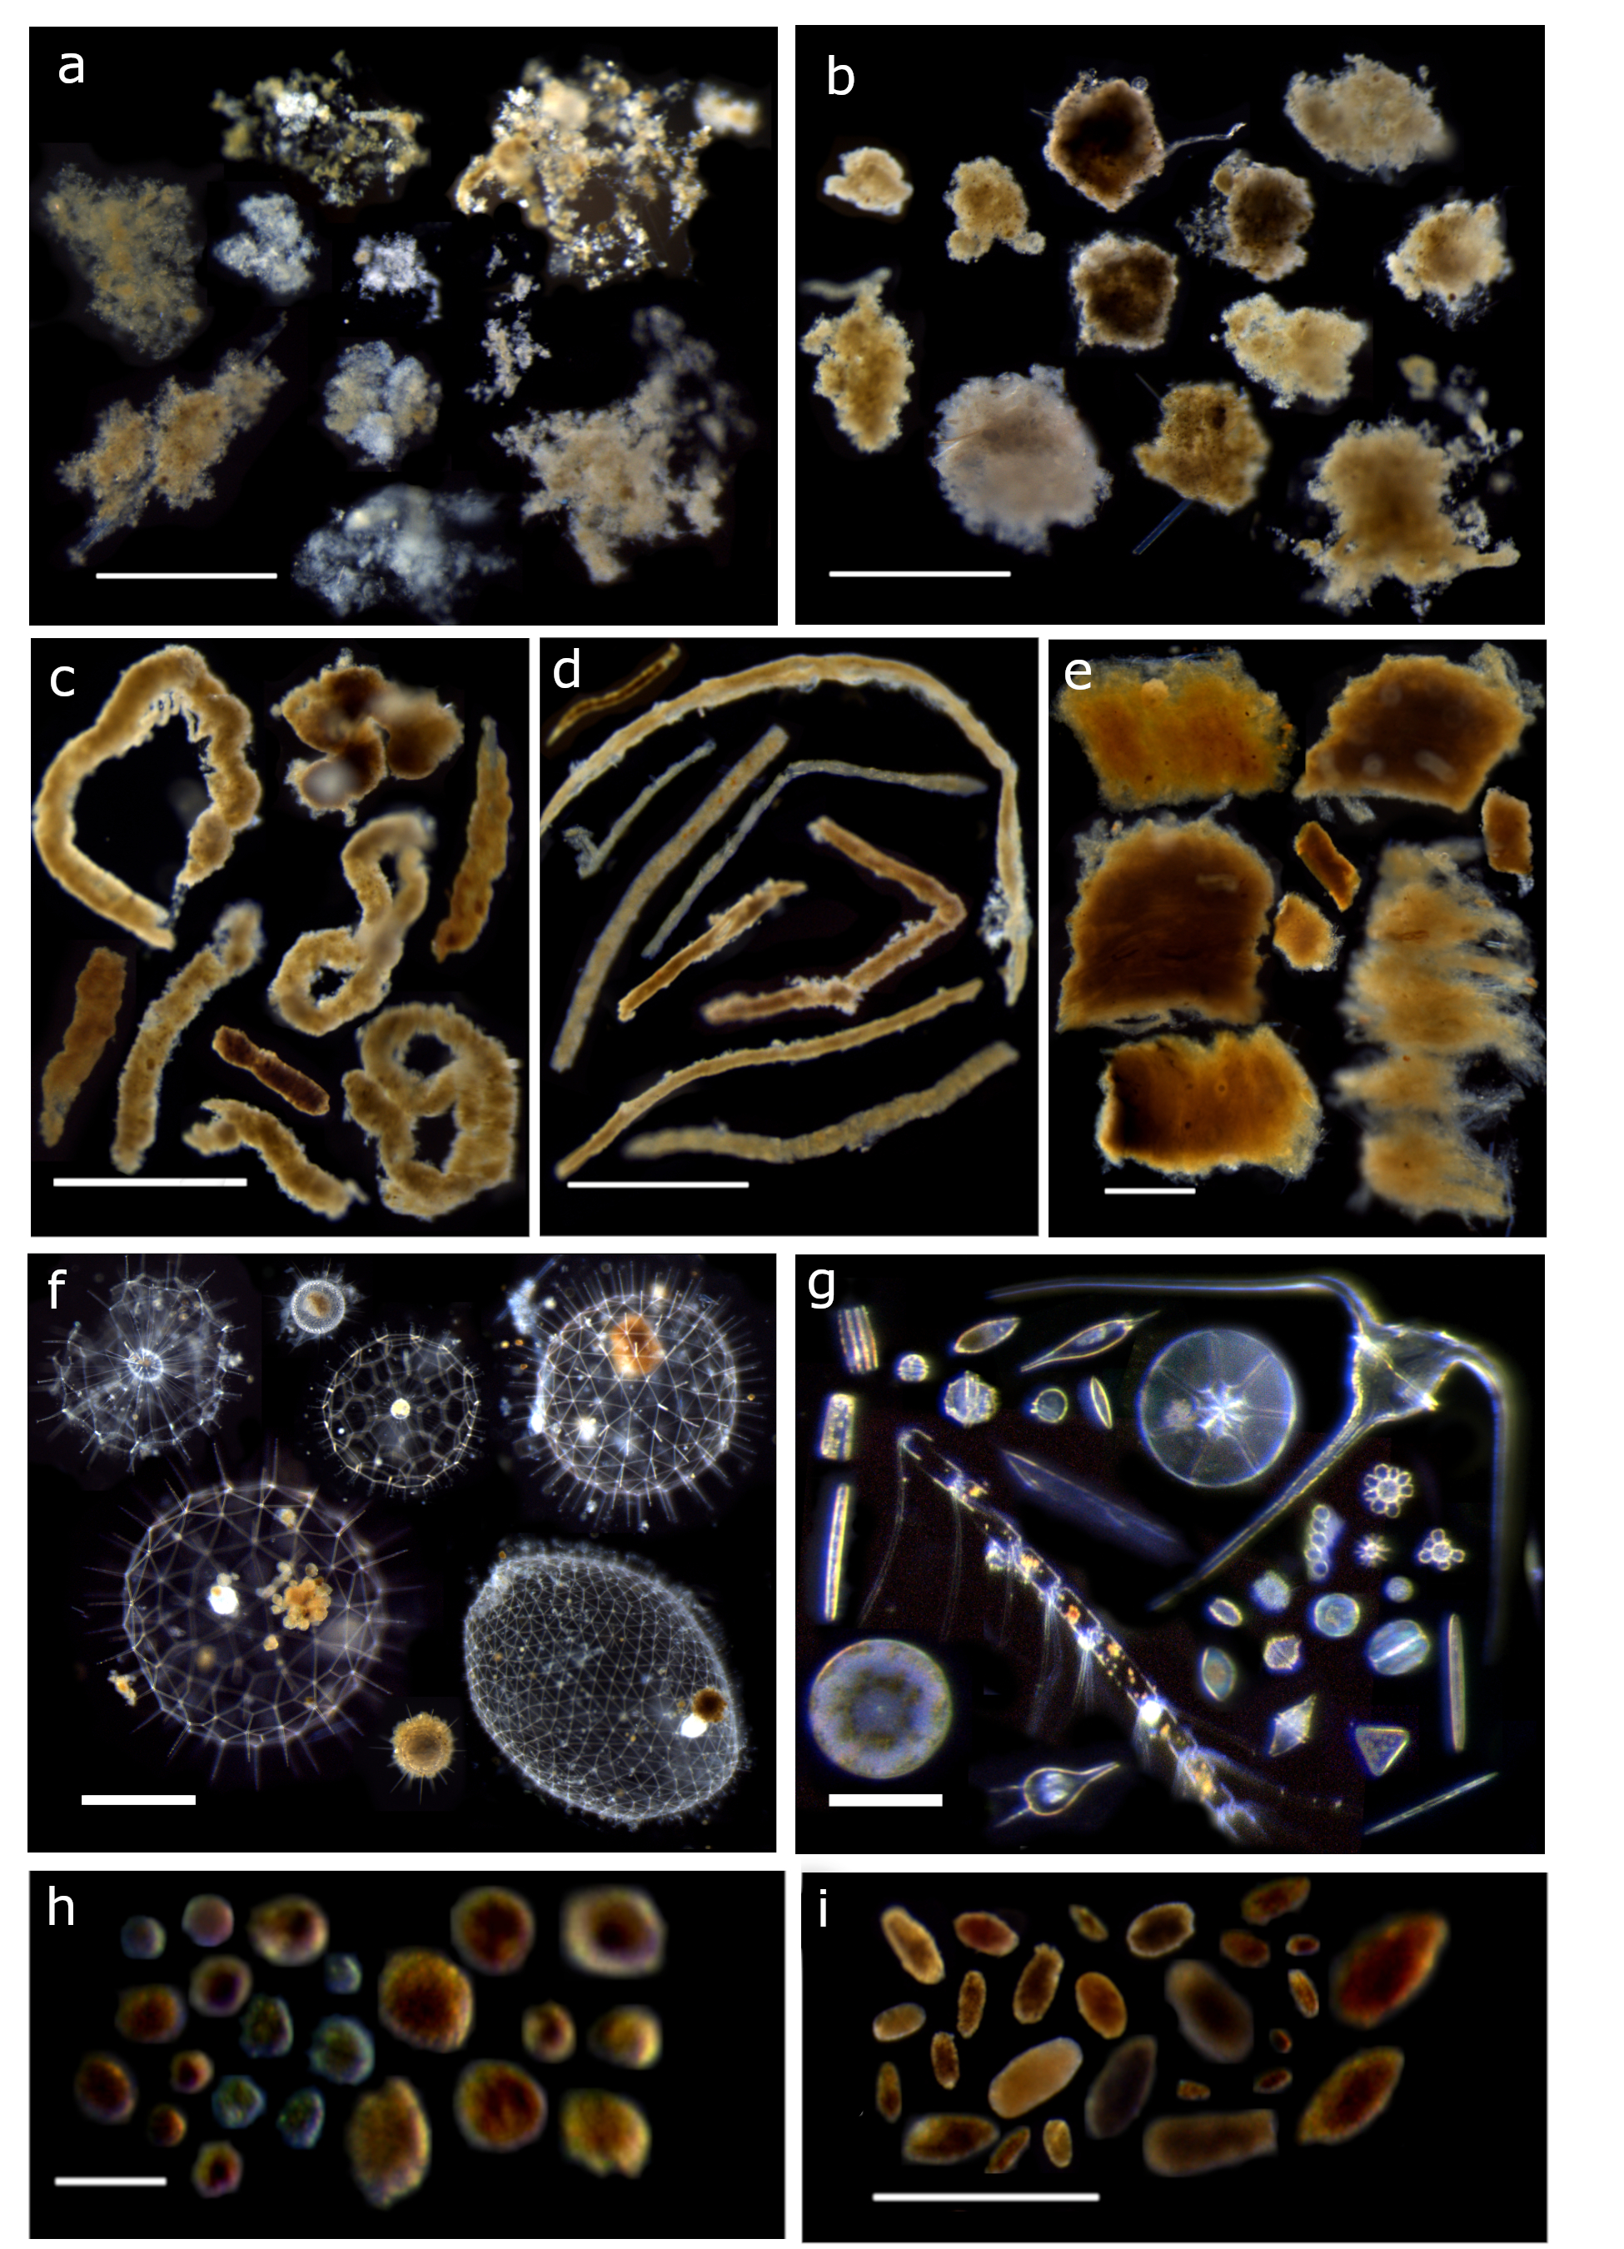
phytoplankton
aggregates
dense detritus
Why do we need to collect
ecologically relevant
observations of carbon export?
Particle type explains
why carbon was exported
and how much.
large-loose pellets
long pellets
salp pellets
rhizaria
5000 µm
50 µm
mini pellets
short pellets
Scale bars:
White = 1 mm
Blue = 100 µm

Slide 3
Current Challenges
Persistence : currently one-off snapshots
Automation : imaging and analysis require extensive human resources
Scalability: currently too resource intensive (personell time, ships, $$$)
Available in situ particle imaging tools are not designed to address these challenges
(e.g. UVP, ISIIS, EyeRIS, Planktivore, VPR, IFCB)
      Don’t measuring sinking particles (i.e. fluxes)
      Don’t measure sinking speeds
      Don’t span the relevant size range
      Don’t have a persistent presence

Slide 4
We want to build an instrument that will:
  Identify sinking particles across a large size range
  Measure their sinking speeds
  Measure their fluxes
  Sustain observations over ecologically relevant time periods
  Make measurements scalable through automated approaches

Slide 5
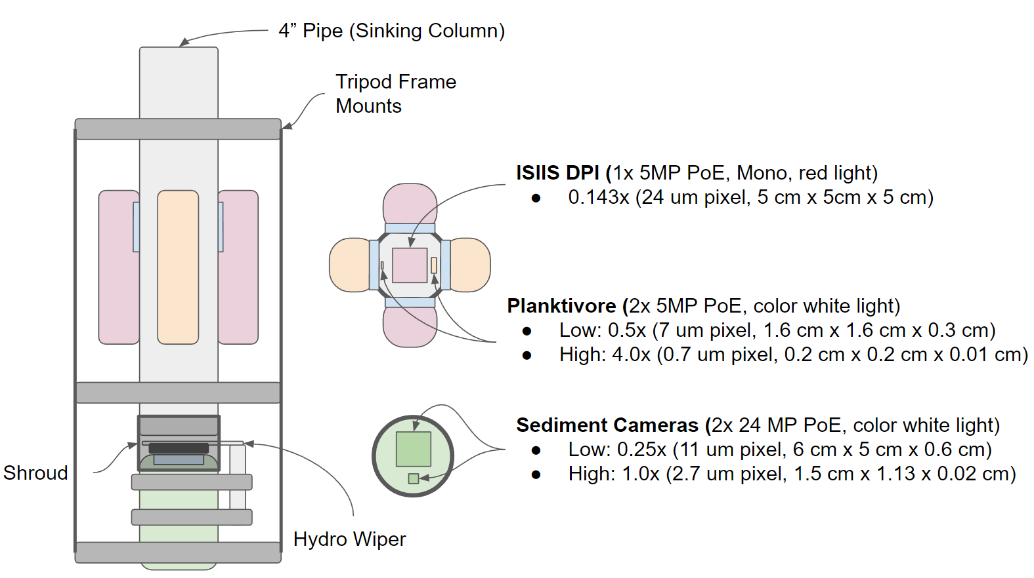
Proposed Concept
SINKER: the SINKing Ecology Robot

Slide 6
Measuring flux and sinking speed of particles
spanning 3 orders of magnitude requires multiple cameras
 | Sinking Speeds (m d⁻¹) |  |  | Fluxes (# m⁻² d⁻¹)
Size range: | 30–300 µm | 200–1000 µm | 800–5000 µm | 30–500 µm | 300–5000 µm
ISIIS DPI
Planktivore low mag
Planktivore high mag
Sediment camera low mag
Sediment camera high mag

Slide 7
Year 1 Timeline and Resources
SINKER: the SINKing Ecology Robot
EyeRIS
Planktivore
BioInspir Lab Multicam
Timelapse Cameras
Year 1 | Year 2 | Year 3
Development | Refinement / MARS integration | Science Operations
 | Jan-Mar | Apr-Jun | Jul-Sep | Oct-Dec
 | Complete Design / Design Review | Tank Test with Imaging Systems | Tank Test with Complete System | Field Test on Battery Power (no MARS)
Colleen Durkin | Requirements |  | Tank Data Analysis | Field deployments and data analysis
Paul Roberts (300 hrs) | System design, camera interfaces, software | System integration | Image processing and visualization
François Cazanave (300 hrs) | Pressure housings, internal mech, support frame | Test tank support |  | Rigging and deployment support
Alana Sherman (150 hrs) | Battery power and low-power control
Paul McGill (150 hrs) | MARS compatibility / interface
M-Tech / E-Tech |  | System Integration
Machine Shop |  | Housing Fabrication

Slide 8
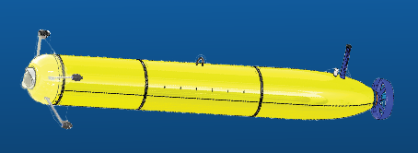

Slide 9
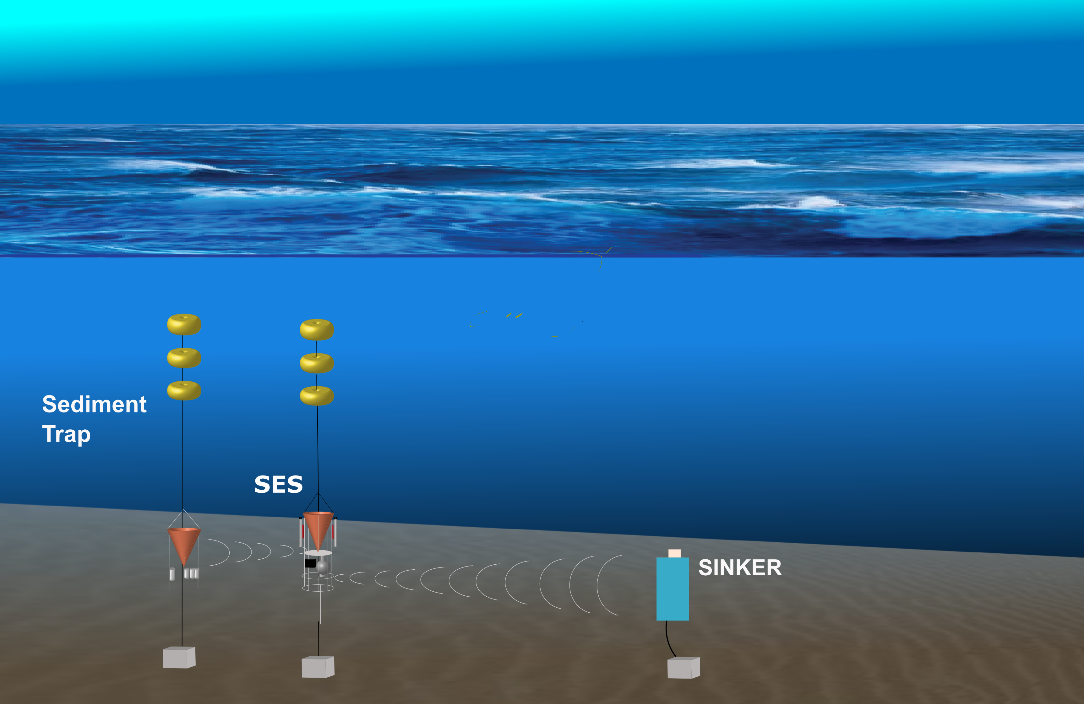

Slide 10


Slide 11
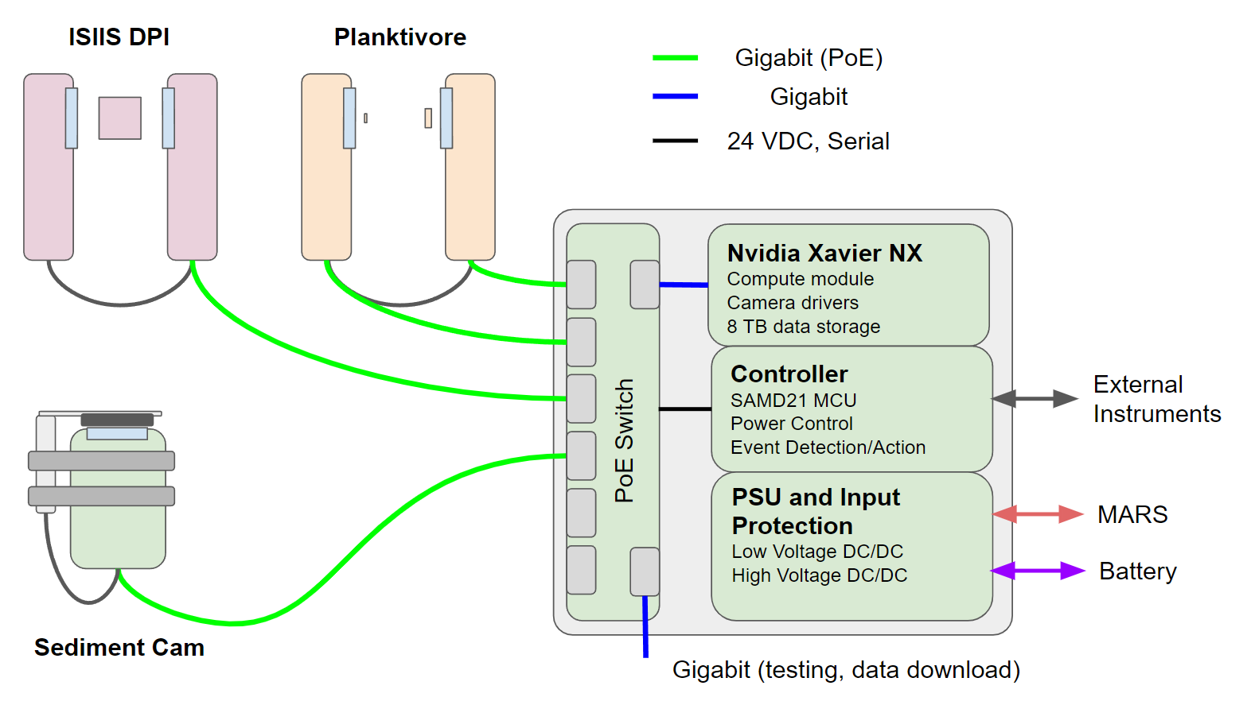
Proposed Concept
SINKER: the SINKing Ecology Robot

Slide 12
SINKER imaging system will identify a wide size range
Cameras for sinking speed
ISIIS-DPI
Planktivore Low Mag
Planktivore High Mag
microscopy of sediment trap gel layers
Past work as reference
10 µm
100 µm
1000 µm
10,000 µm

Slide 13
SINKER imaging system will identify a wide size range
Upward-facing camera
Upward-facing camera
microscopy of sediment trap gel layers
Past work as reference
10 µm
100 µm
1000 µm
10,000 µm

Slide 14
SINKER imaging system will resolve flux and sinking speed of a large size range
Upward-facing camera
Upward-facing camera
ISIIS-DPI
Planktivore Low Mag
Planktivore High Mag
microscopy of sediment trap gel layers
Past work as reference
10 µm
100 µm
1000 µm
10,000 µm

