Slide 1
Directions
Answer the questions on the following slides with this guidance:
limit text to bullets that are easy to read (i.e., use large font)
be concise
assume you're audience is the "informed general public”
Please do not add formatting or background to slides.
Additional details can be added in the notes section, if needed.

Slide 2
902311 Wire Walker Power
What’s the fundamental problem, question, or issue you are addressing?
    - We propose to extract wave energy to increase data collection (frequency and/or duration) on Wire Walker profiling vehicles
Why is it important/why should anyone care?
  - The existing Wire Walker platform is limited by energy needs of integrated science sensors. By harvesting wave energy the platform will collect more data and reduce required maintenance and battery costs
What are we doing about it/what’s MBARI’s unique contribution?
    -MBARI will design a complete harvesting system and may transfer the technology to Del Mar Oceanographic Inc where it will be offered for sale to end users
What are your project plans for next year (2023)?
  - Investigate several ideas for converting potential energy at depth. These include (but are not limited to) turbines/pinwheels (continuation of previous project) and piston/leadscrew arrangements (unexplored but worth consideration).
  - prototype will be manufactured and deployed on the Wire Walker.

Slide 3
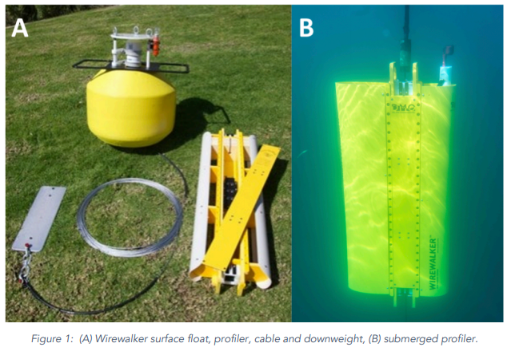
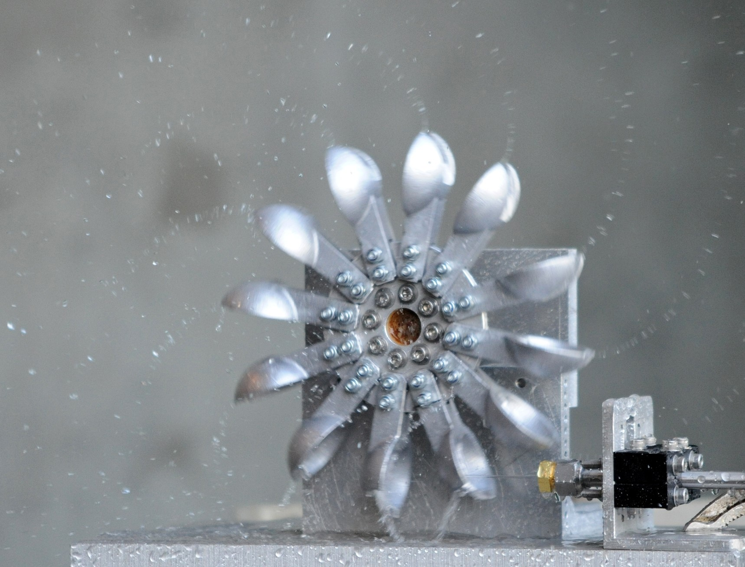
902311 Wire Walker Power
Water stream drives turbine.

