Slide 1
Directions
Answer the questions on the following slides with this guidance:
limit text to bullets that are easy to read (i.e., use large font)
be concise
assume you're audience is the "informed general public”
Additional details can be added in the notes section, if needed.

Slide 2
902311 Wire Walker Power
What’s the fundamental problem, question, or issue you are addressing?
    - We propose to extract wave energy to increase data collection (frequency and/or duration) on Wire Walker profiling vehicles
Why is it important/why should anyone care?
  - The existing Wire Walker platform is limited by energy needs of integrated science sensors. By harvesting wave energy the platform will collect more data and reduce required maintenance and battery costs
What are we doing about it/what’s MBARI’s unique contribution?
    -MBARI will design a complete harvesting system and may transfer the technology to Del Mar Oceanographic Inc where it will be offered for sale to end users
What are your project plans for next year (2024)?
  - prototype will be manufactured and deployed on the Wire Walker.
  - licensing agreement will be pursued

Slide 3
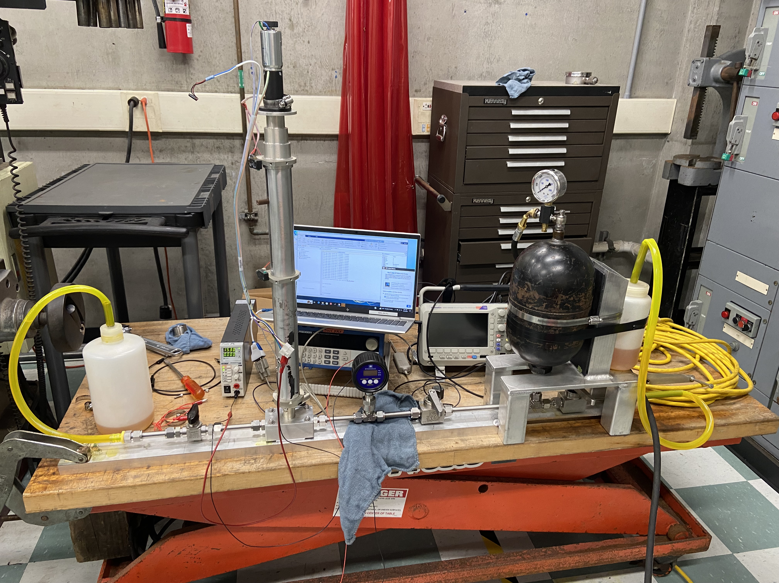
902311 Wire Walker Power
DC Regen Motor
Piston Assembly
Piston + DC Motor bench testing
- Results being obtained for single stroke piston driven by
external pressure on linear ball screw
- Piston drives DC motor where energy is harvested
- Bench testing will lead to optimization of system
- Small, favorable aspect ratio for integration on Wire Walker
- Simple system with very few seals and moving parts

