Slide 1
Directions
Answer the questions on the following slides with this guidance:
limit text to bullets that are easy to read (i.e., use large font)
be concise
assume you're audience is the "informed general public”
Additional details can be added in the notes section, if needed.

Slide 2
902311 Wire Walker Power
What’s the fundamental problem, question, or issue you are addressing?
  The WireWalker is a commercially available profiling platform that uses wave-energy to motivate the device vertically through the water column. Although very capable, it’s instrumentation is limited by the amount of energy that can be stored in batteries.
  Energy availability is a fundamental limitation of most oceanographic measurements, and this project is one of several at MBARI addressing this limitation.

Slide 3
902311 Wire Walker Power
Why is it important/why should anyone care?
  By expanding the energy available on this platform, the extent and duration of autonomous time-series measurements can be expanded, helping to reduce the reliance on ships for monitoring the ocean.
  Similarly, the frequency of maintenance trips to the platform will be reduced if additional energy is available, allowing less expensive fielding of instrumentation, and opportunities for more remote deployments.
  When the energy availability of any platform is increased, the ability to communicate and transfer data to/from shore is also increased, allowing more control of, and faster data collection from, the instrument.

Slide 4
902311 Wire Walker Power
What are we doing about it/what’s MBARI’s unique contribution?
  MBARI is working to evaluate the feasibility of developing a unique energy harvesting system for this platform.
  Expertise with the WireWalker platform, and the existence of technology at MBARI developed for other projects provides an opportunity to perform a unique development.

Slide 5
902311 Wire Walker Power
What are your project plans for next year (2024)?
  There are competing technical solutions to this problem under investigation, and work in 2024 is intended to perform prototyping and testing to evaluate the best option.
  When the optimum technology is determined, prototyping and deployment on the WireWalker in Monterey Bay will be performed.

Slide 6
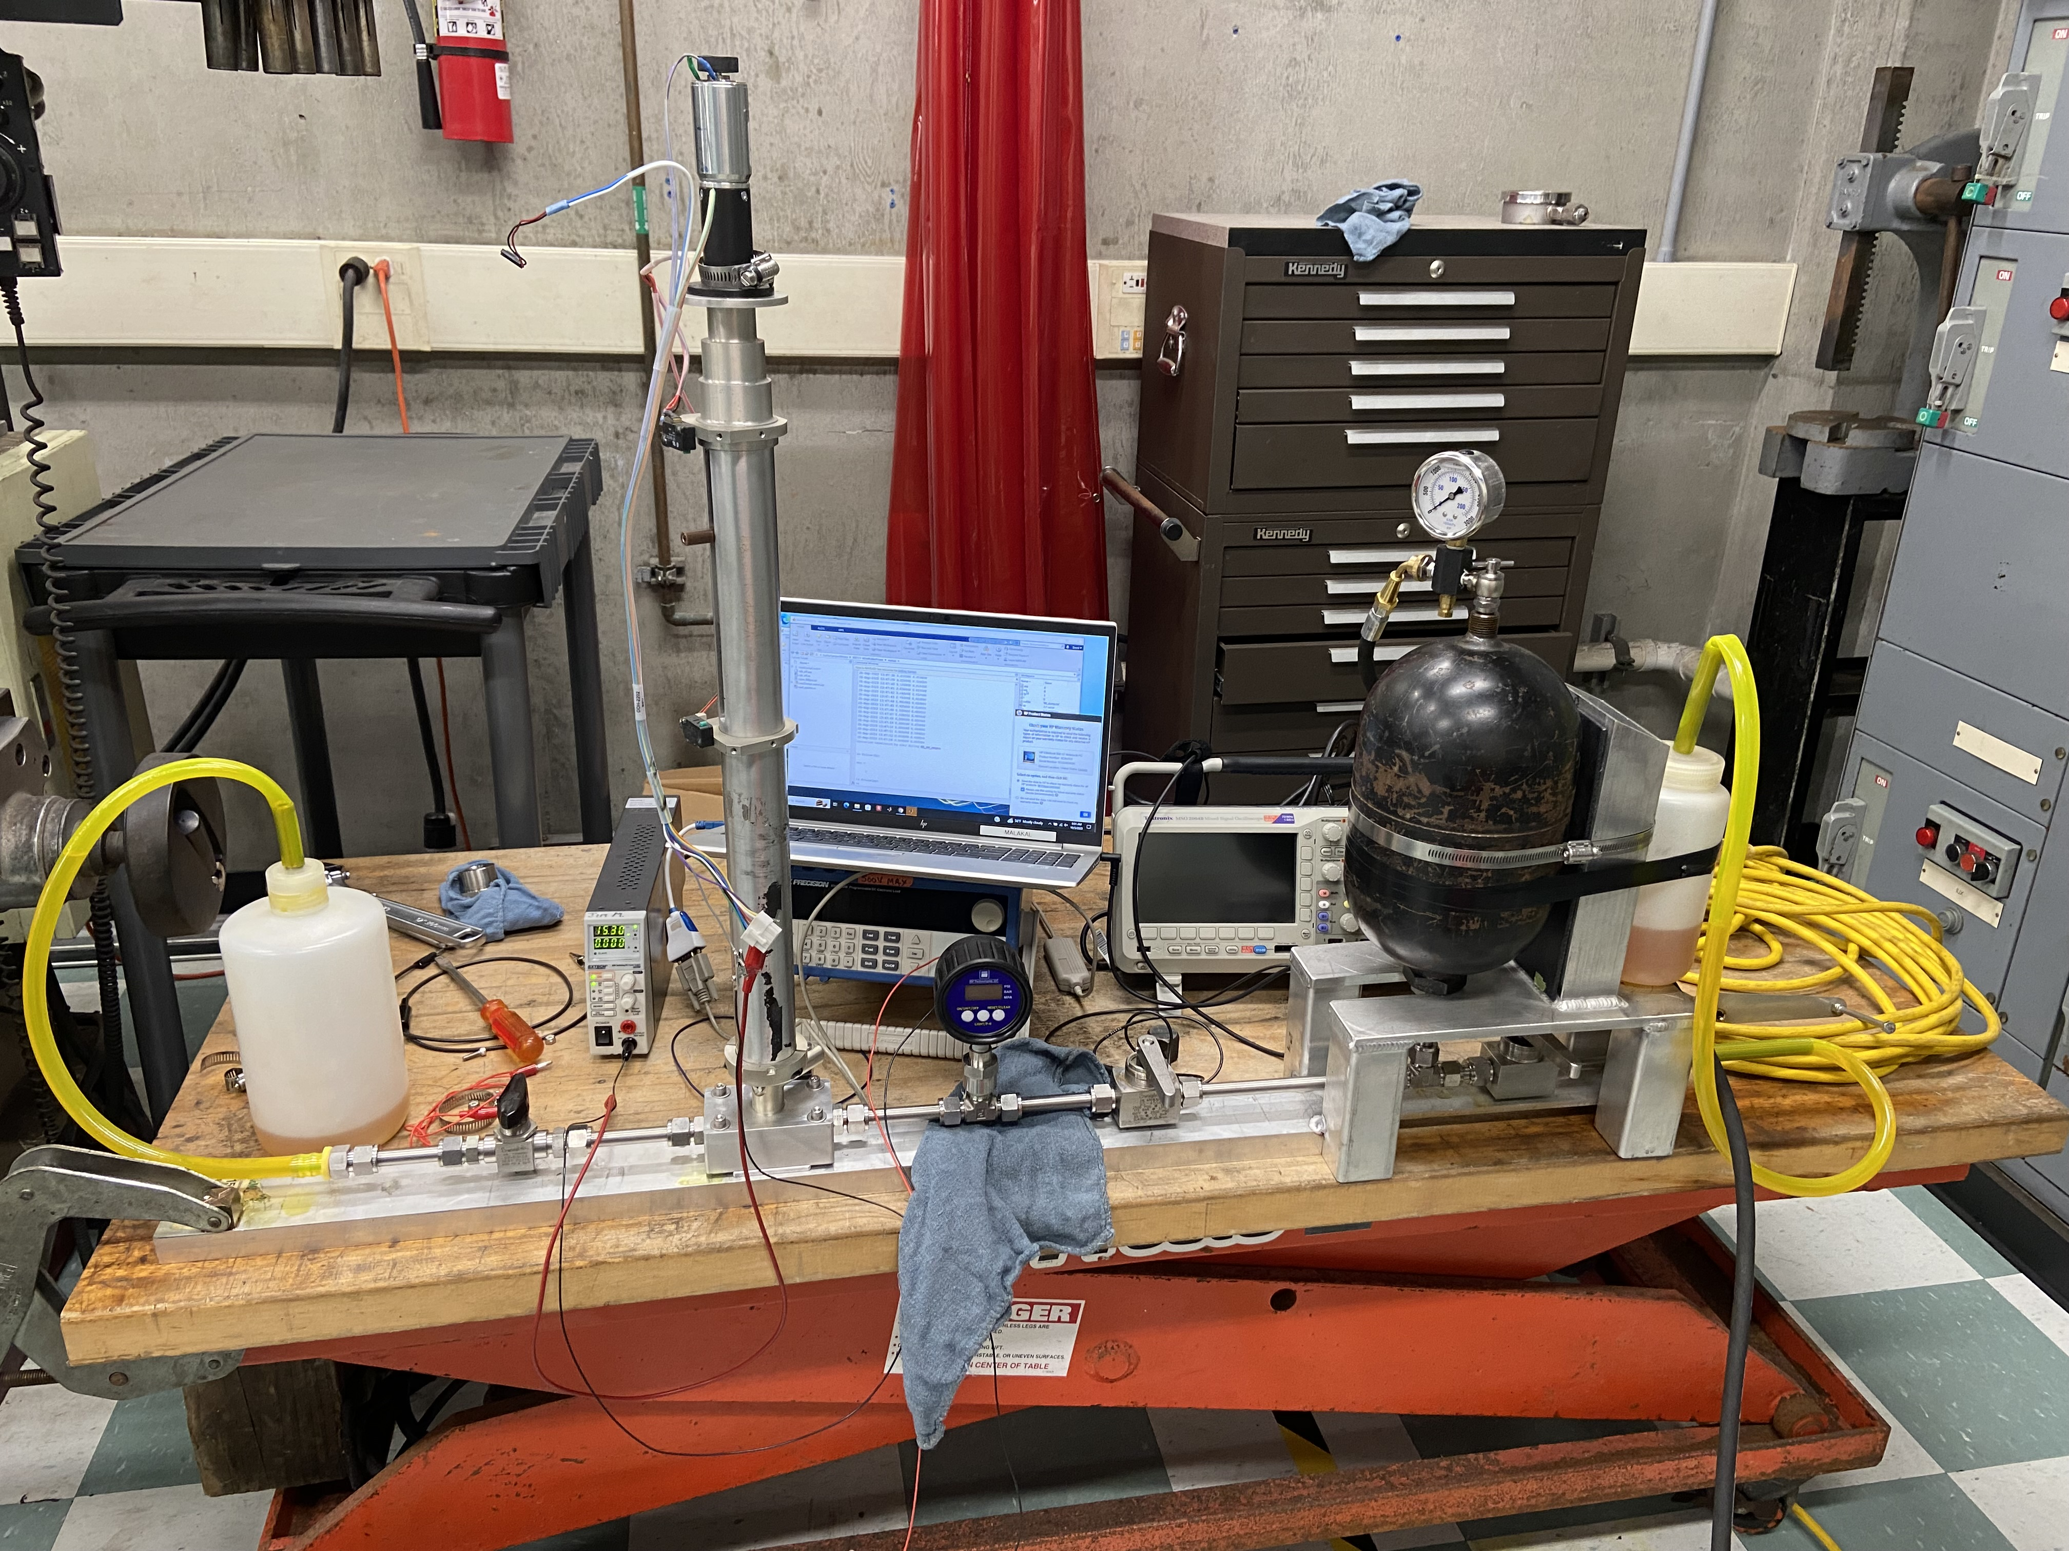
902311 Wire Walker Power
DC Regen Motor
Piston + DC Motor bench testing
- Results being obtained for single stroke piston driven by
external pressure on linear ball screw
- Piston drives DC motor where energy is harvested
- Bench testing will lead to optimization of system
- Small, favorable aspect ratio for integration on Wire Walker
- Simple system with very few seals and moving parts
Piston Assembly

