Slide 1
Wirewalker Power Generation
Jones, Marin, Jenson, Chavez, Hamilton
Revisiting on-board power generation from 2009
Energy capture for persistent presence
What’s changed?
Maturation of the Wirewalker platform
Wirewalker is currently in use at MBARI
Increase in relevant power-electronics expertise at MBARI
Potential for technology transfer pathway to
  Del Mar Oceanographic
The return of Roman Marin
Positively Buoyant
(6-8 lbs)
Ratchet
Mechanism

Slide 2
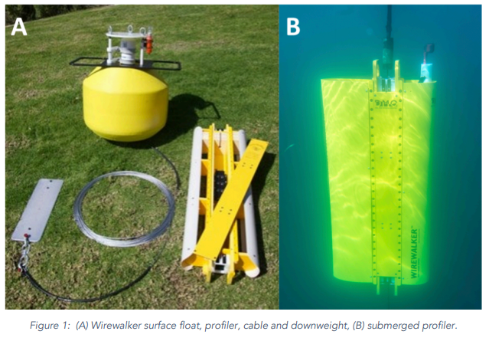
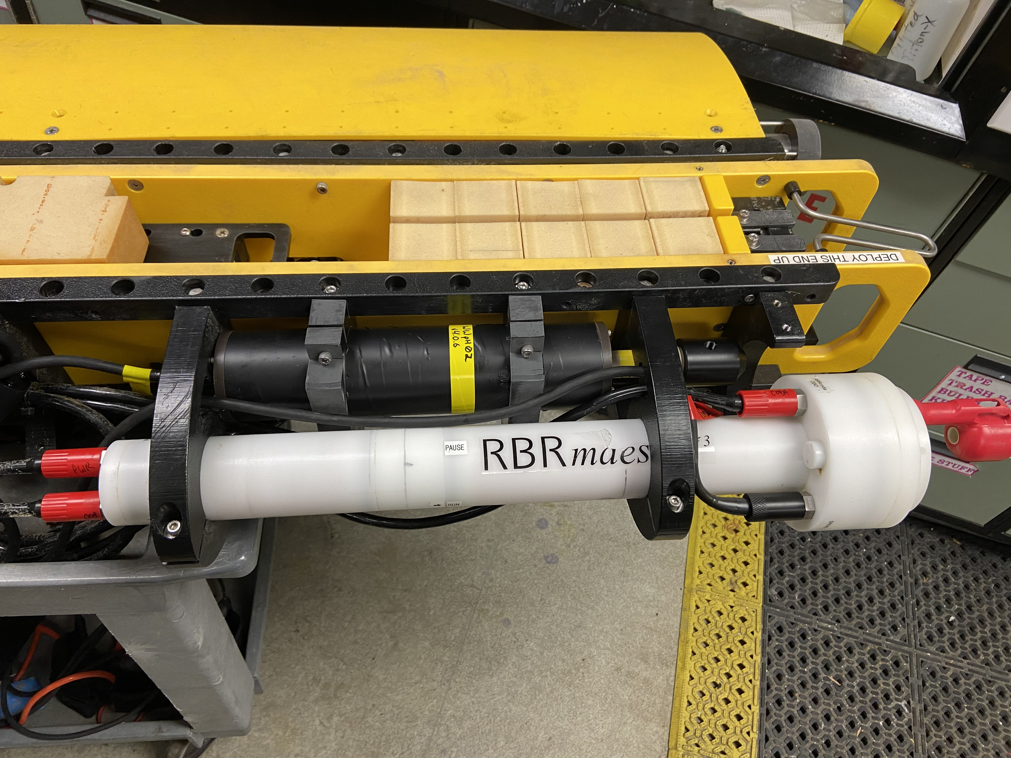
Wire-Walker Description
Positively Buoyant
(6-8 lbs)
(A) Wirewalker surface float, profiler, cable and downweight
(B) Submerged profiler
Inductive modem comms to buoy
Ratchet
Mechanism
- Wirewalker itself purely mechanical and wave powered = theoretically infinite deployment time
- Plans for further outfitting (pH pump, etc) = more energy needed
- Plenty of room for more instrumentation, battery limited

Slide 3
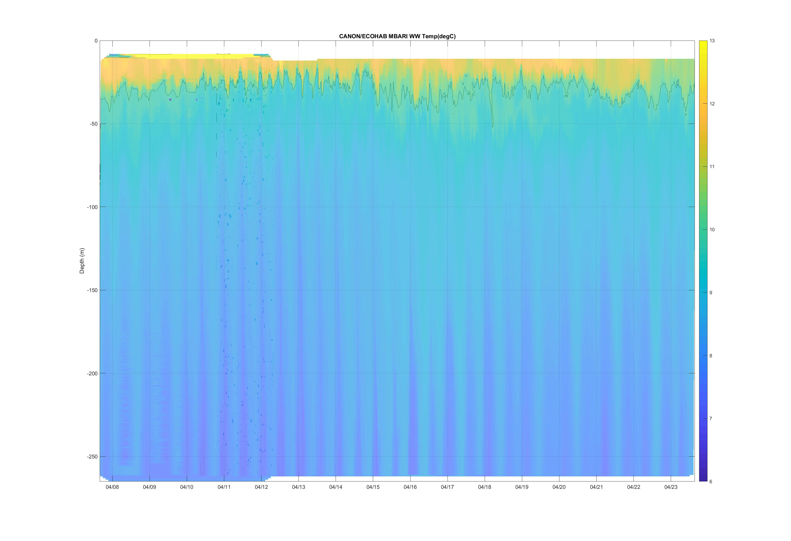
Operations and Data
Hi temporal resolution CTD + 02 + Flurometer data returned in real time
Currently configured duration is ~ 50 days
Obvious: Longer deployment = less money and overhead with better temporal coverage
Benefit of fewer recoveries:
- Less risk to WW system damage
- Inaccessible places
- Drifting

Slide 4
Energy Capture
Each additional lb of buoyancy submerged = 450 Joules/cast Potential Energy (WW currently uses 100 J/cast)
  Five times more power available is possible
  In theory MBARI WW could run forever (as currently configured)
  Previous testing indicates 2-3 lbs of addition buoyancy was OK
  Considerably more power available for instrumentation with this device integrated.

Slide 5
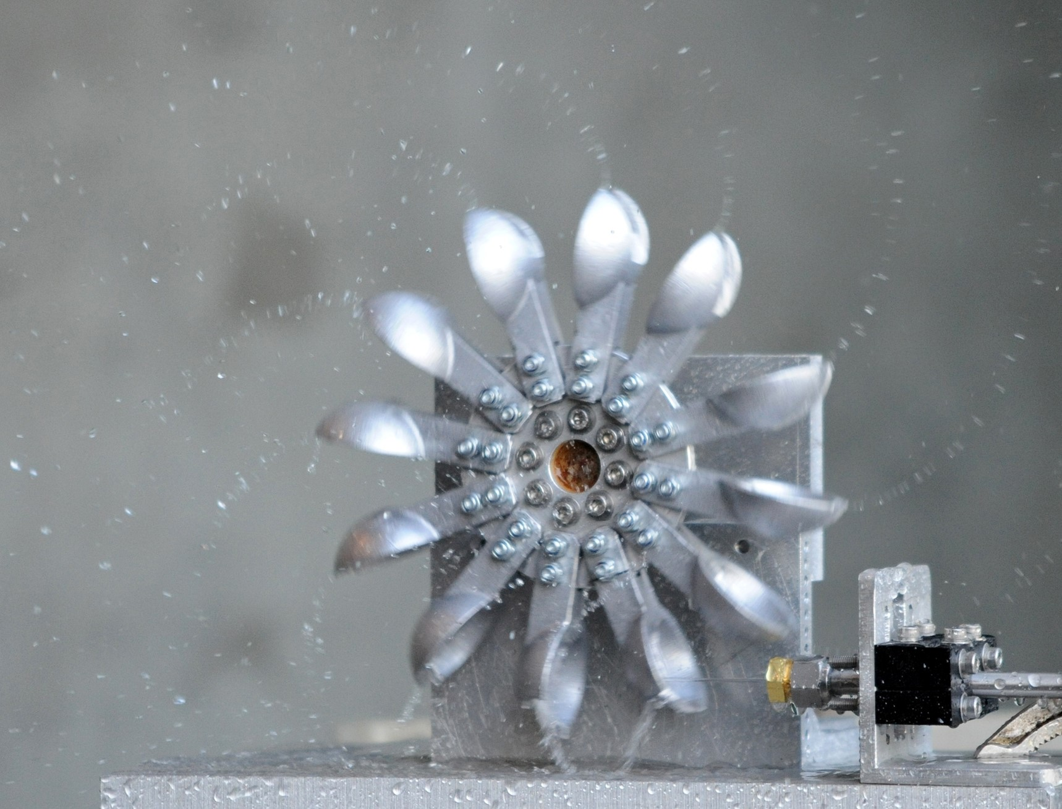
Engineering Developments
Step 1:
How much additional buoyancy/drag can the ratchet mechanism tolerate?
  Sea-state dependent
  Easy to test
Step 2:
Determine how best to extract this energy unclear (most efficient, reliable, etc.)
  Piston Arrangement
  Hydraulic Turbine
  Drag device on mooring wire (SIO/DelMarOceanographic approach)
  Other solutions.
Water stream drives turbine.
+V,I
Piston/Leadscrew arrangement

Slide 6
Project Description
Team: Jones, Marin, Jensen, Chavez, Hamilton
Scope: Expect to request 2 months for each member and several Paragon days
Cost: <$50k per year, will be refined in proposal
2-3 year timeline:
Y1 – Investigate ideas on bench then integrate prototype on WW
Y2/3 – Further refinements targeting efficiency and reliability

Slide 7
Technology Transfer Plans
Del Mar Oceanographic has expressed interest.
Del Mar Oceanographic has indicated they’d prefer to discuss this on the front end.
The vision for this project is an MBARI development, used here for our purposes, and also disseminated by Del Mar Oceanographic if successful.

Slide 8
Niobicon Opportunity
Niobicon Docking Rod
An alternative approach would be to use the Niobicon dock at the top of the mooring
Promising, more complicated surface buoy,
Relies on solar power
License required from Northrop, so some investigation still needed.
Room for both solutions…
Positively Buoyant
(6-8 lbs)
Niobicon Brushes
Ratchet
Mechanism

