Slide 1
Piston design req’s
100m depth = 150psi
1L volume
Minimum 100 Joules captured / 65m cast
Regen time ~60s (WW takes 3-5 min to ascend 65m)

Slide 2
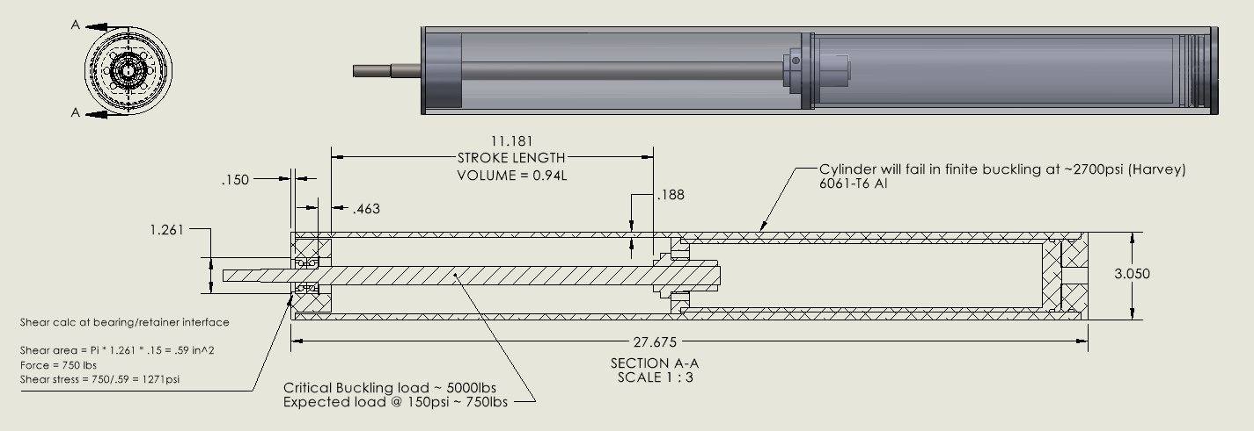
Mechanical Overview
See BallScrewCalcs.mlx for columnar buckling instability calc

Slide 3
Regen calcs and motor selection
See Motor_selection.mlx for detailed calculations
Summary:
From ball screw documentation an expected Torque is produced from 750psi. Knowing stroke length,
Ball screw lead, and timing Maxon engineers suggested a DCX22L, EB48V motor + GPX22UP, 35:1 gearbox
From the motor specs and assuming 100% efficiency of the system (motor + ball screw + cylinder drag +
gearbox) I calculate we will generate ~500J / cast. This indicates the overall efficiency of the system has to
Be > 20%

