Slide 1
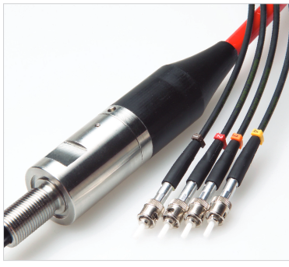
Fiber Optic Connection to Housing
Pressure compensated
Oil-filled J-box
Ambient pressure
Up to 3000 psi
1 atm Ti Sphere
Sensor
Macartney Optolink Penetrator

