Slide 1
Directions
Answer the questions on the following slides with this guidance:
limit text to bullets that are easy to read (i.e., use large font)
be concise
assume you're audience is the "informed general public”
Additional details can be added in the notes section, if needed.

Slide 2
902401 Geo-Sense
What’s the fundamental question you are addressing?
What information can Distributed Acoustic Sensing (DAS) technology provide on the initiation and behavior of sedimentary flows in Monterey Canyon?
How do we take the rapidly DAS developing technology and deploy it as an autonomous instrument?
Why is it important/why should anyone care?
DAS has recently been shown to be a powerful technology for detecting seafloor hazards (e.g., earthquakes and ocean currents). DAS has transformative potential in geomorphology, because it can characterize fine-scale processes.
What are we doing about it/what’s MBARI’s unique contribution?
MBARI engineers and our external collaborators are developing an autonomous seafloor DAS, due to be deployed in 2025.
What are your project plans for next year (2024)?
-Add bullets

Slide 3
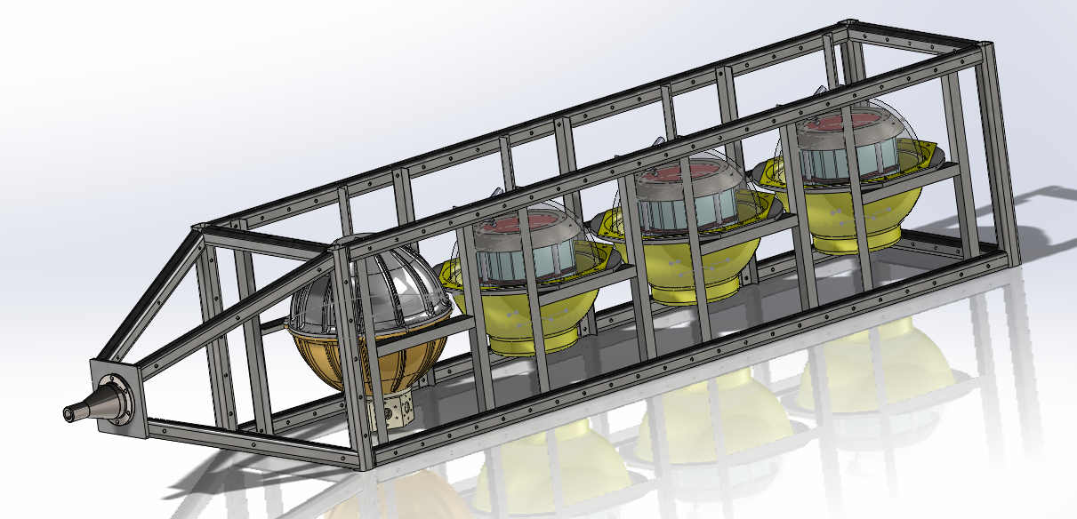
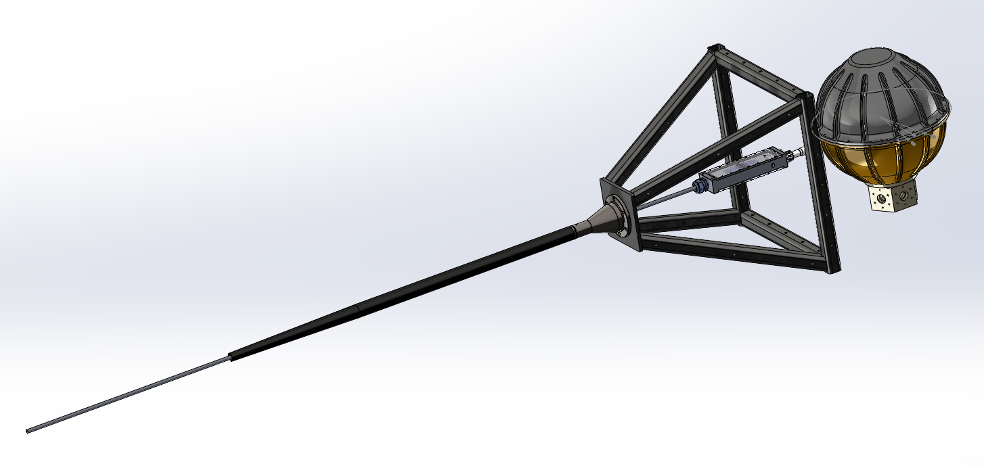
Insert name of project here (e.g. – 901023 Continental Margins)
Geo-Sense instrument comprises a Ti instrument housing and 3 glass spheres containing batteries, all held in a welded frame.
An armored cable containing fiber optics is used for sensing and deployment of the system.

