Slide 1
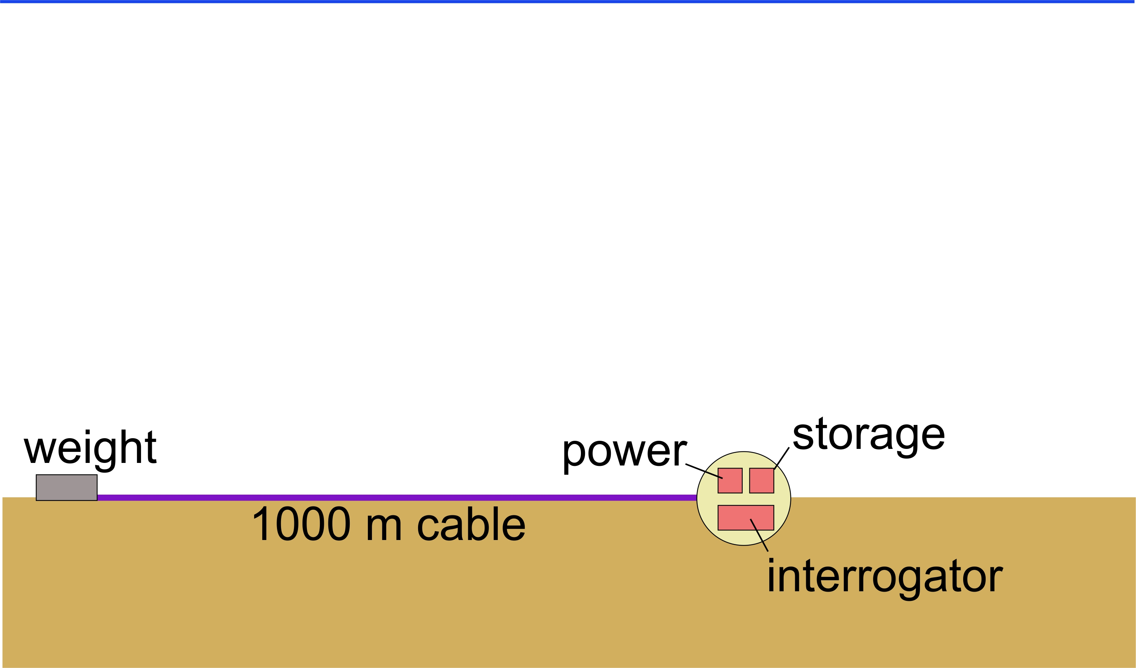
Geo-Sense Concept

Slide 2
System Block Diagram –
Cable Termination
Strain
Relief
FO Core
DAS
1 km armored FO cable
Cable
Termination
Black
Hole
Term.
Oil-compensated
Junction box –
Fiber breakout

Slide 3
System Block Diagram – Instrument/Battery Package
Deepsea
Connect
“Toaster”
DAS
10 kWHr
Li Primary Batteries
10 kWHr
Li Primary Batteries
10 kWHr
Li Primary Batteries
FO
Penetrator
Ti sphere housing, glass spheres, battery pack design, and Deepsea Connect are reused technologies.

