Slide 2
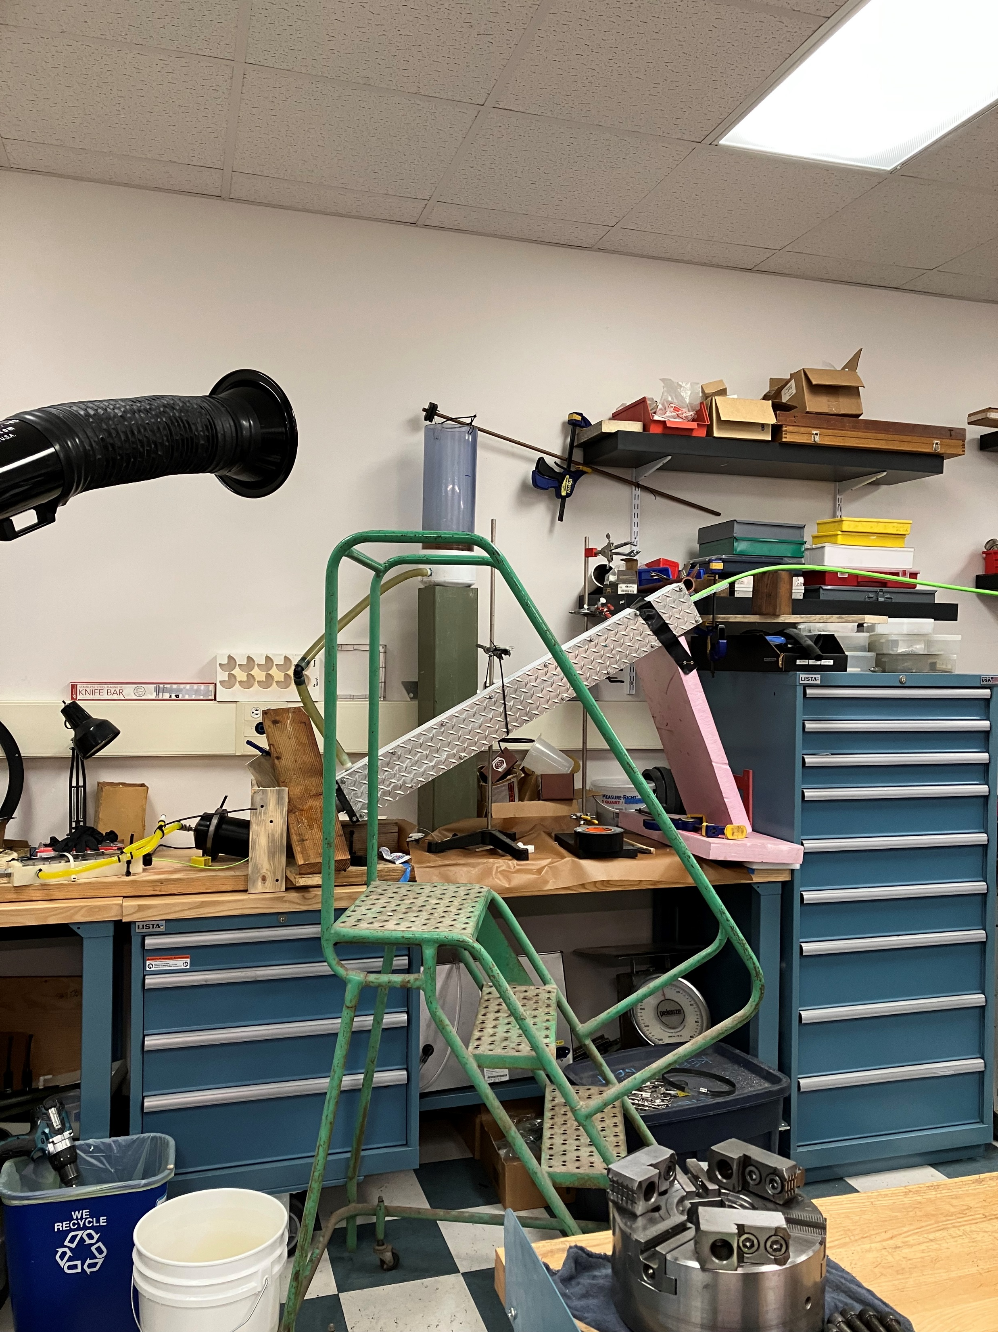
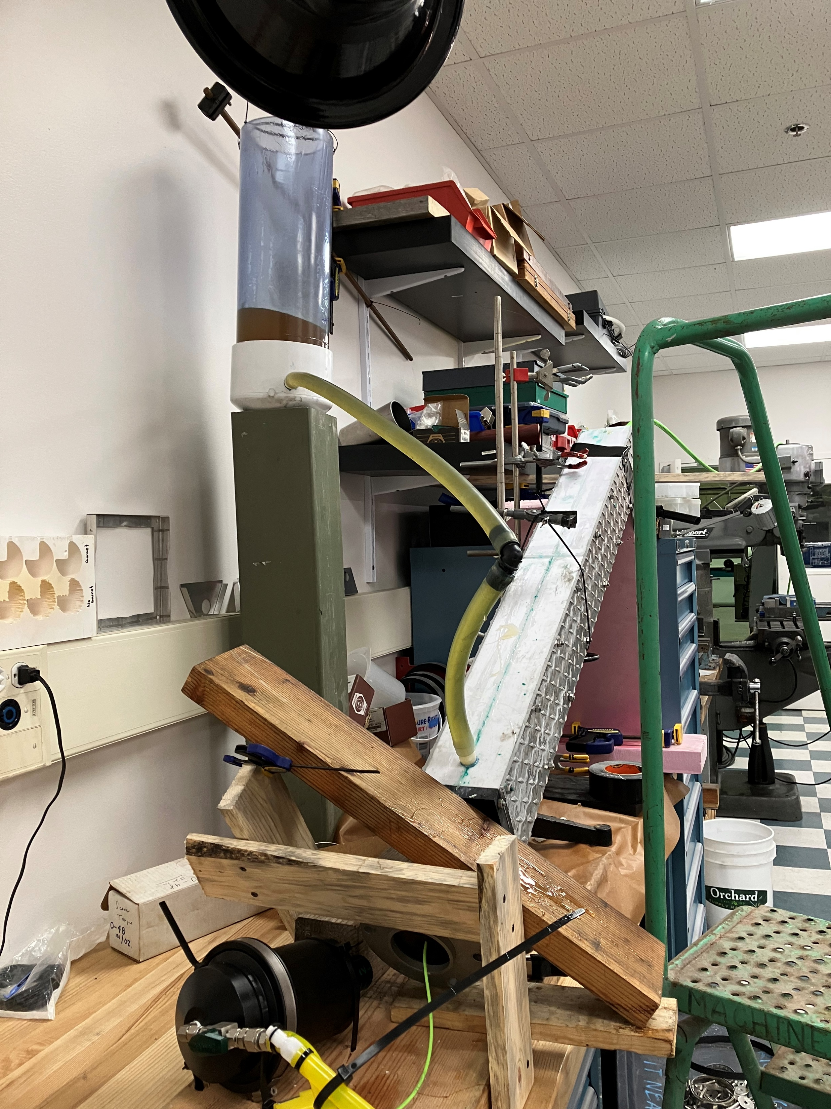
Strain Relief Part 2

Slide 3
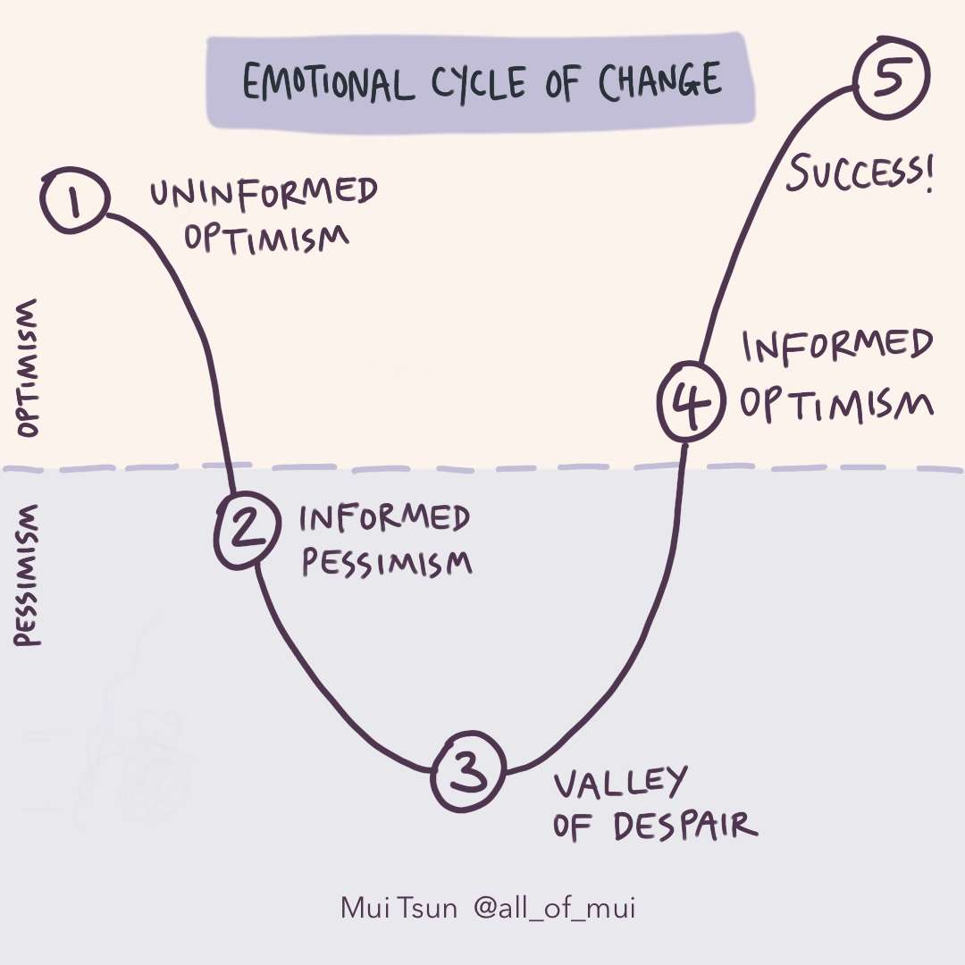
Morale…

Slide 4
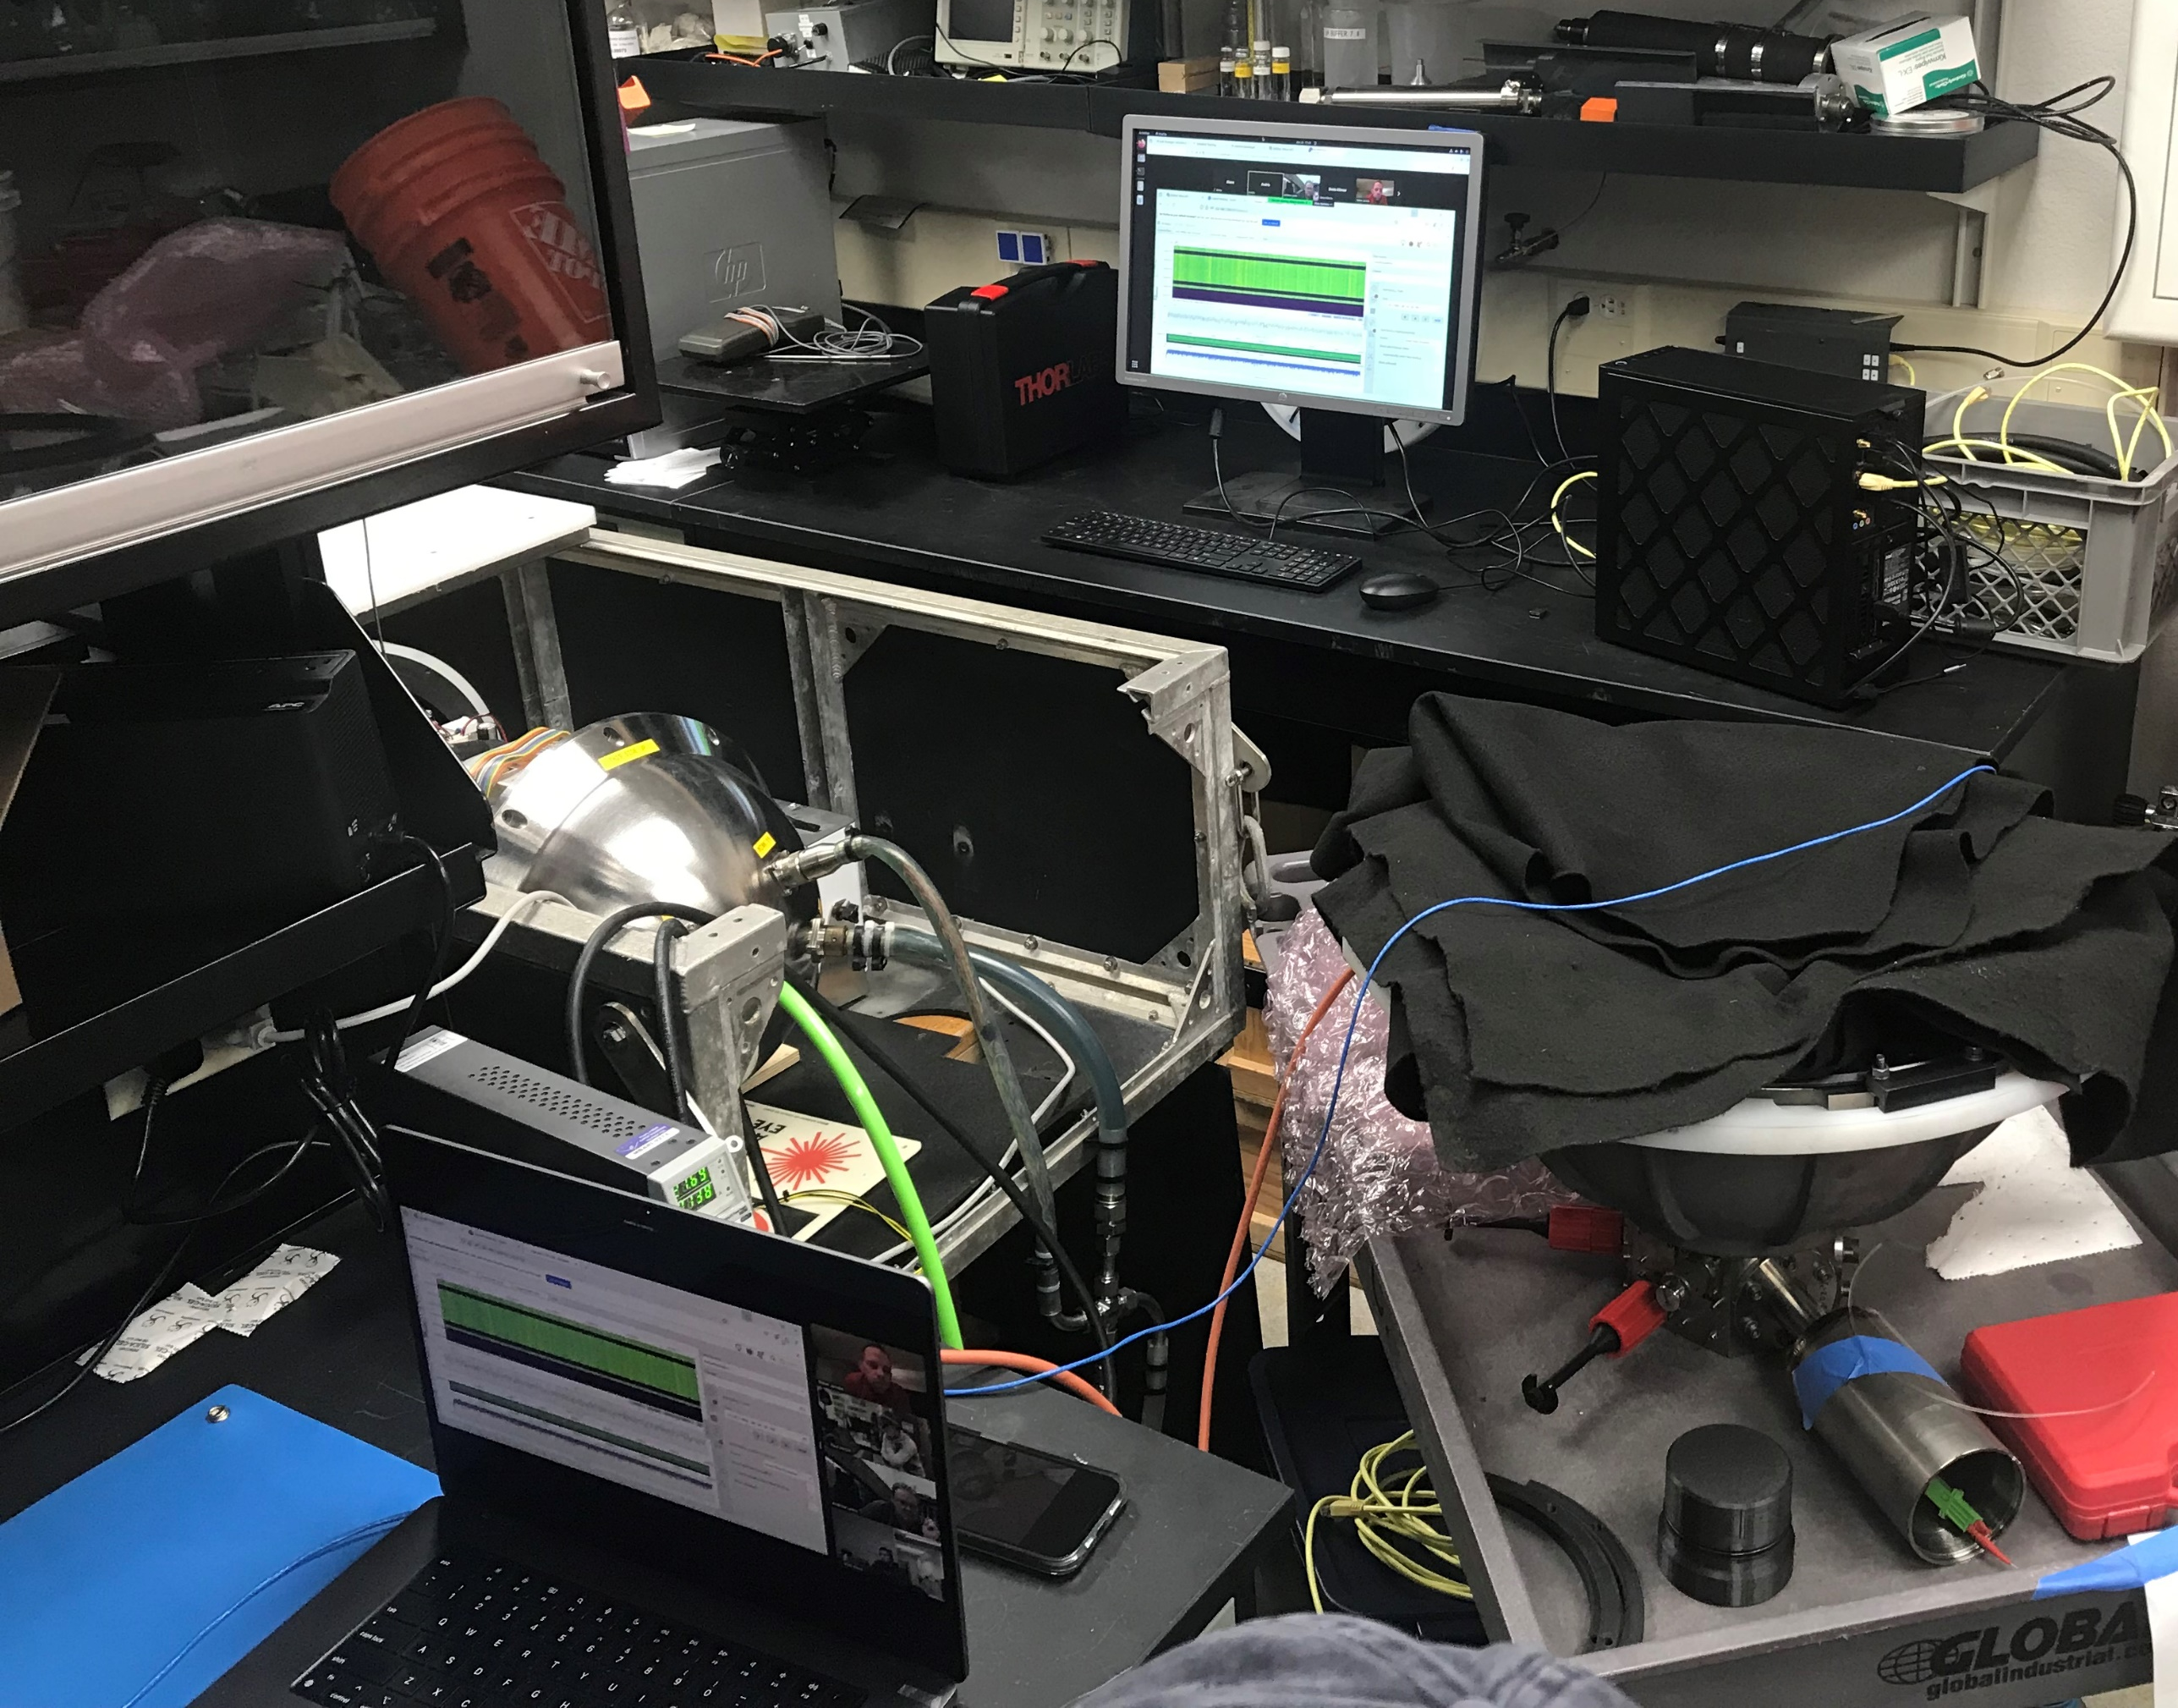
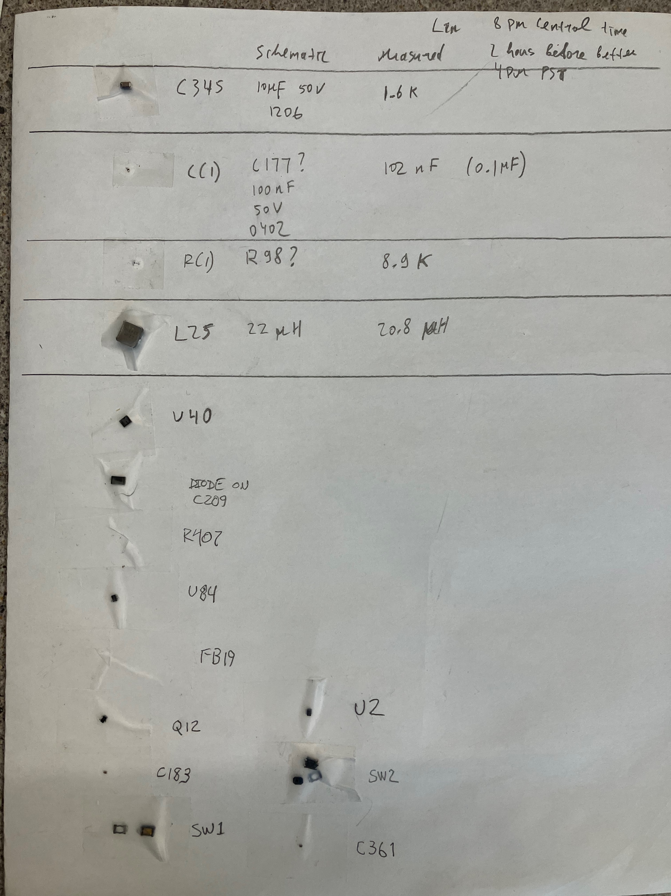
Early Sunday…Collateral Damage
Notes:
Replace Nano jetson- linux machine, custom serial adapter
Configure
Set up network collab agreement ( Joe in for reviews)
Left Sunday program and test instrument remotely
10 hour zoom on Sunday 8 am – 6 pm PST

Slide 5
Tuesday, Jan 28
Deployment Day

Slide 6
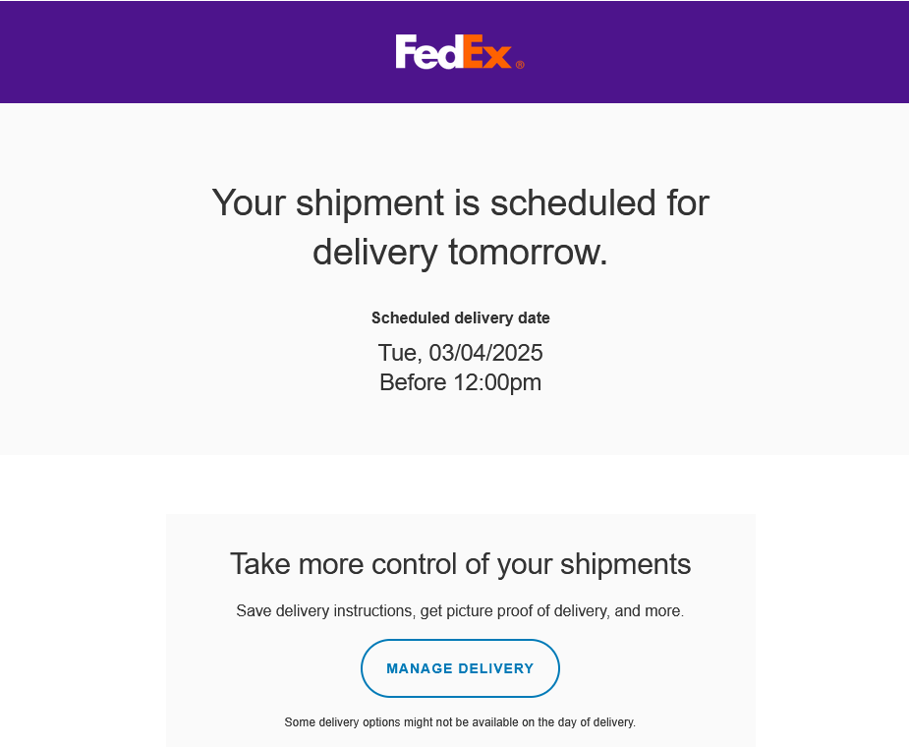
And we got the new DAS

Slide 7
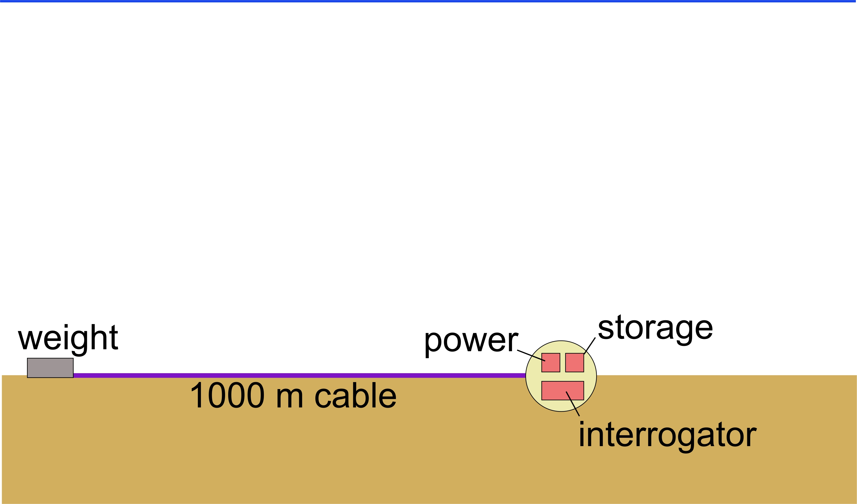
Initial Geo-Sense Concept
Monterey

Slide 8
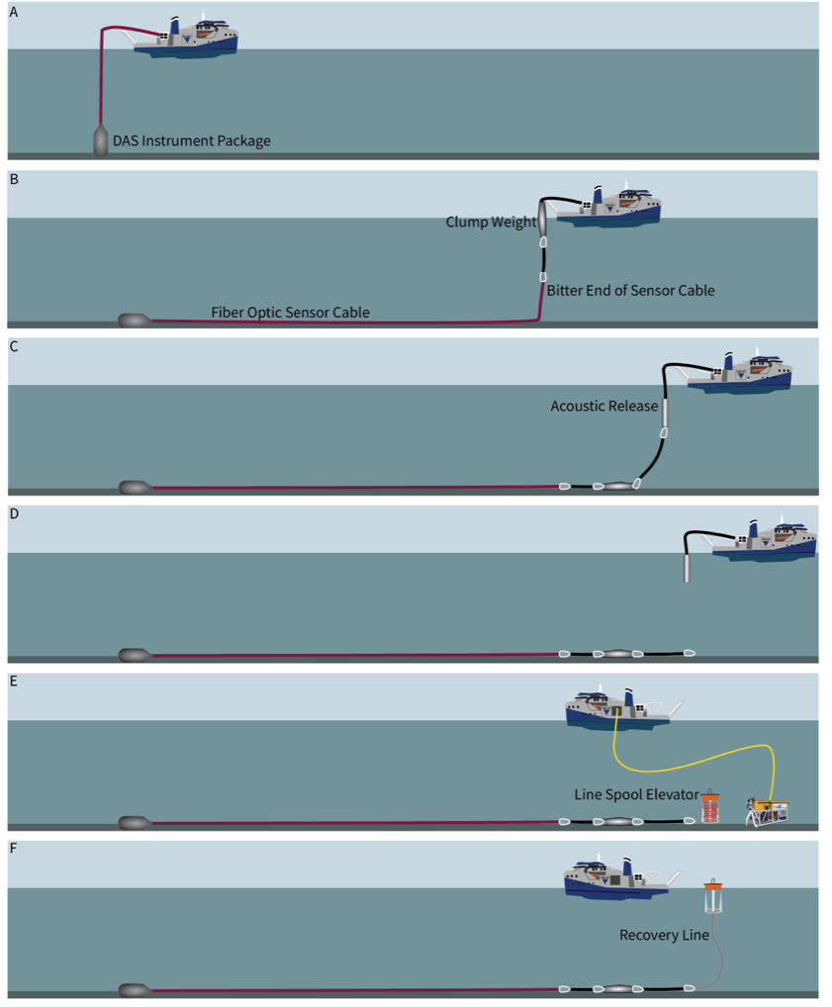
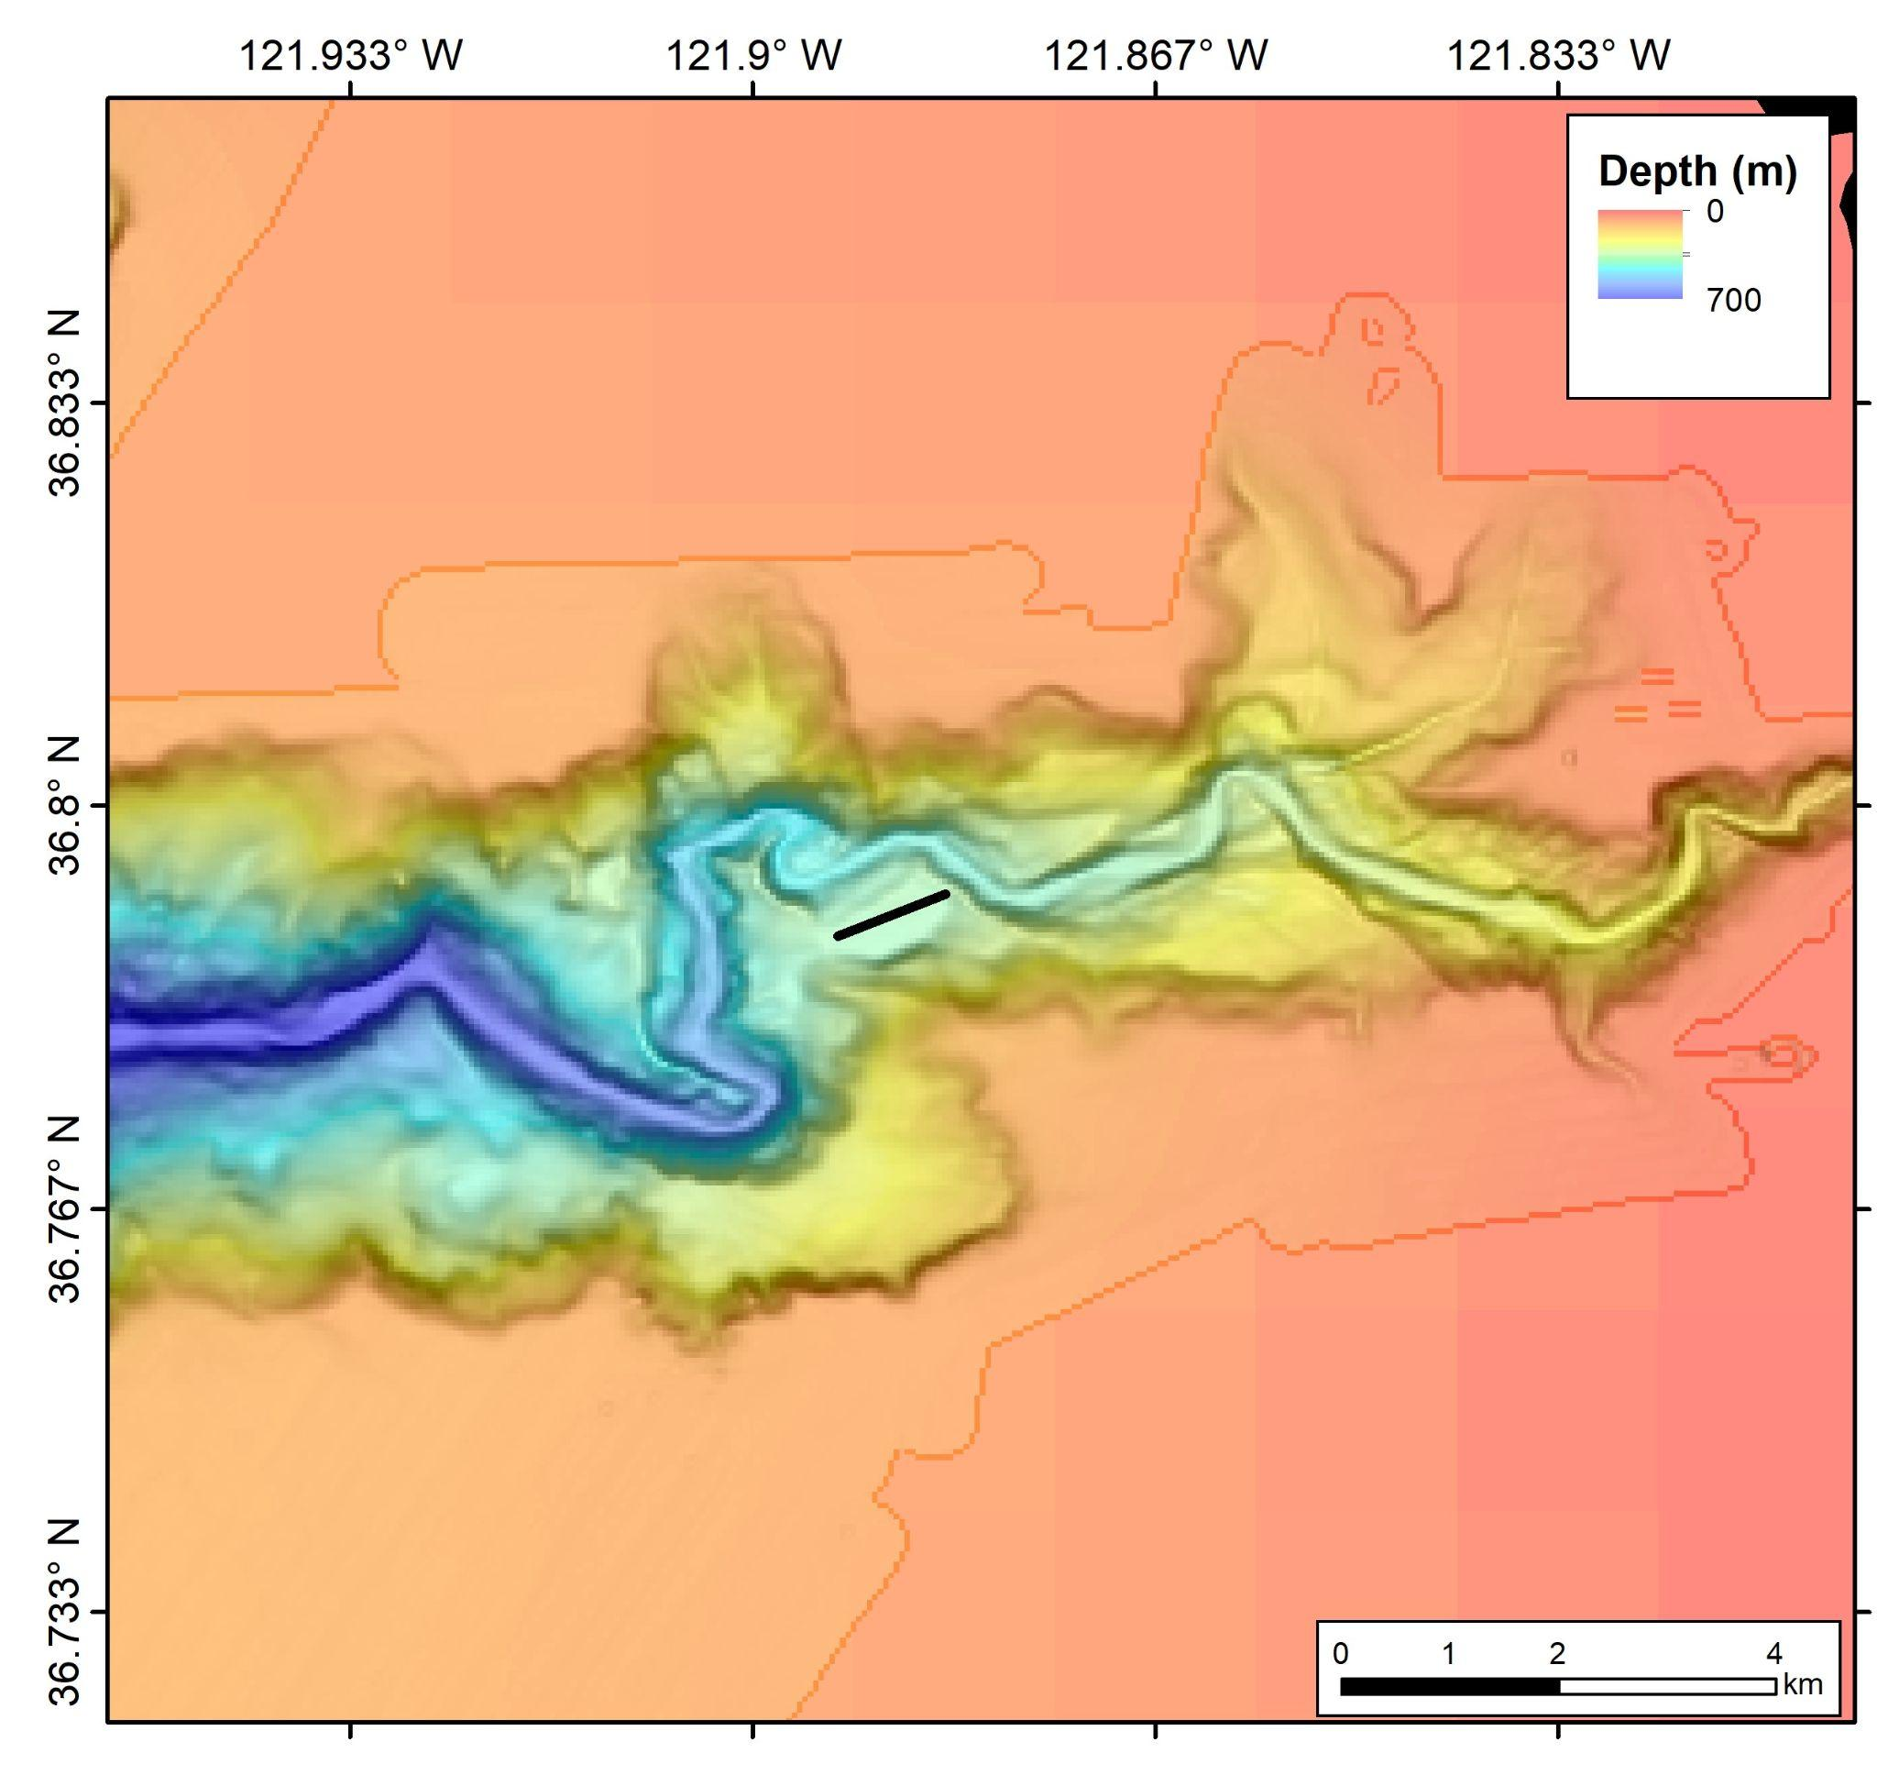
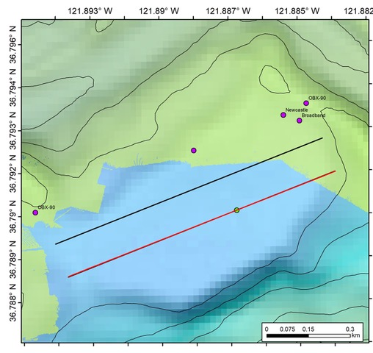
Deployment Method

Slide 9
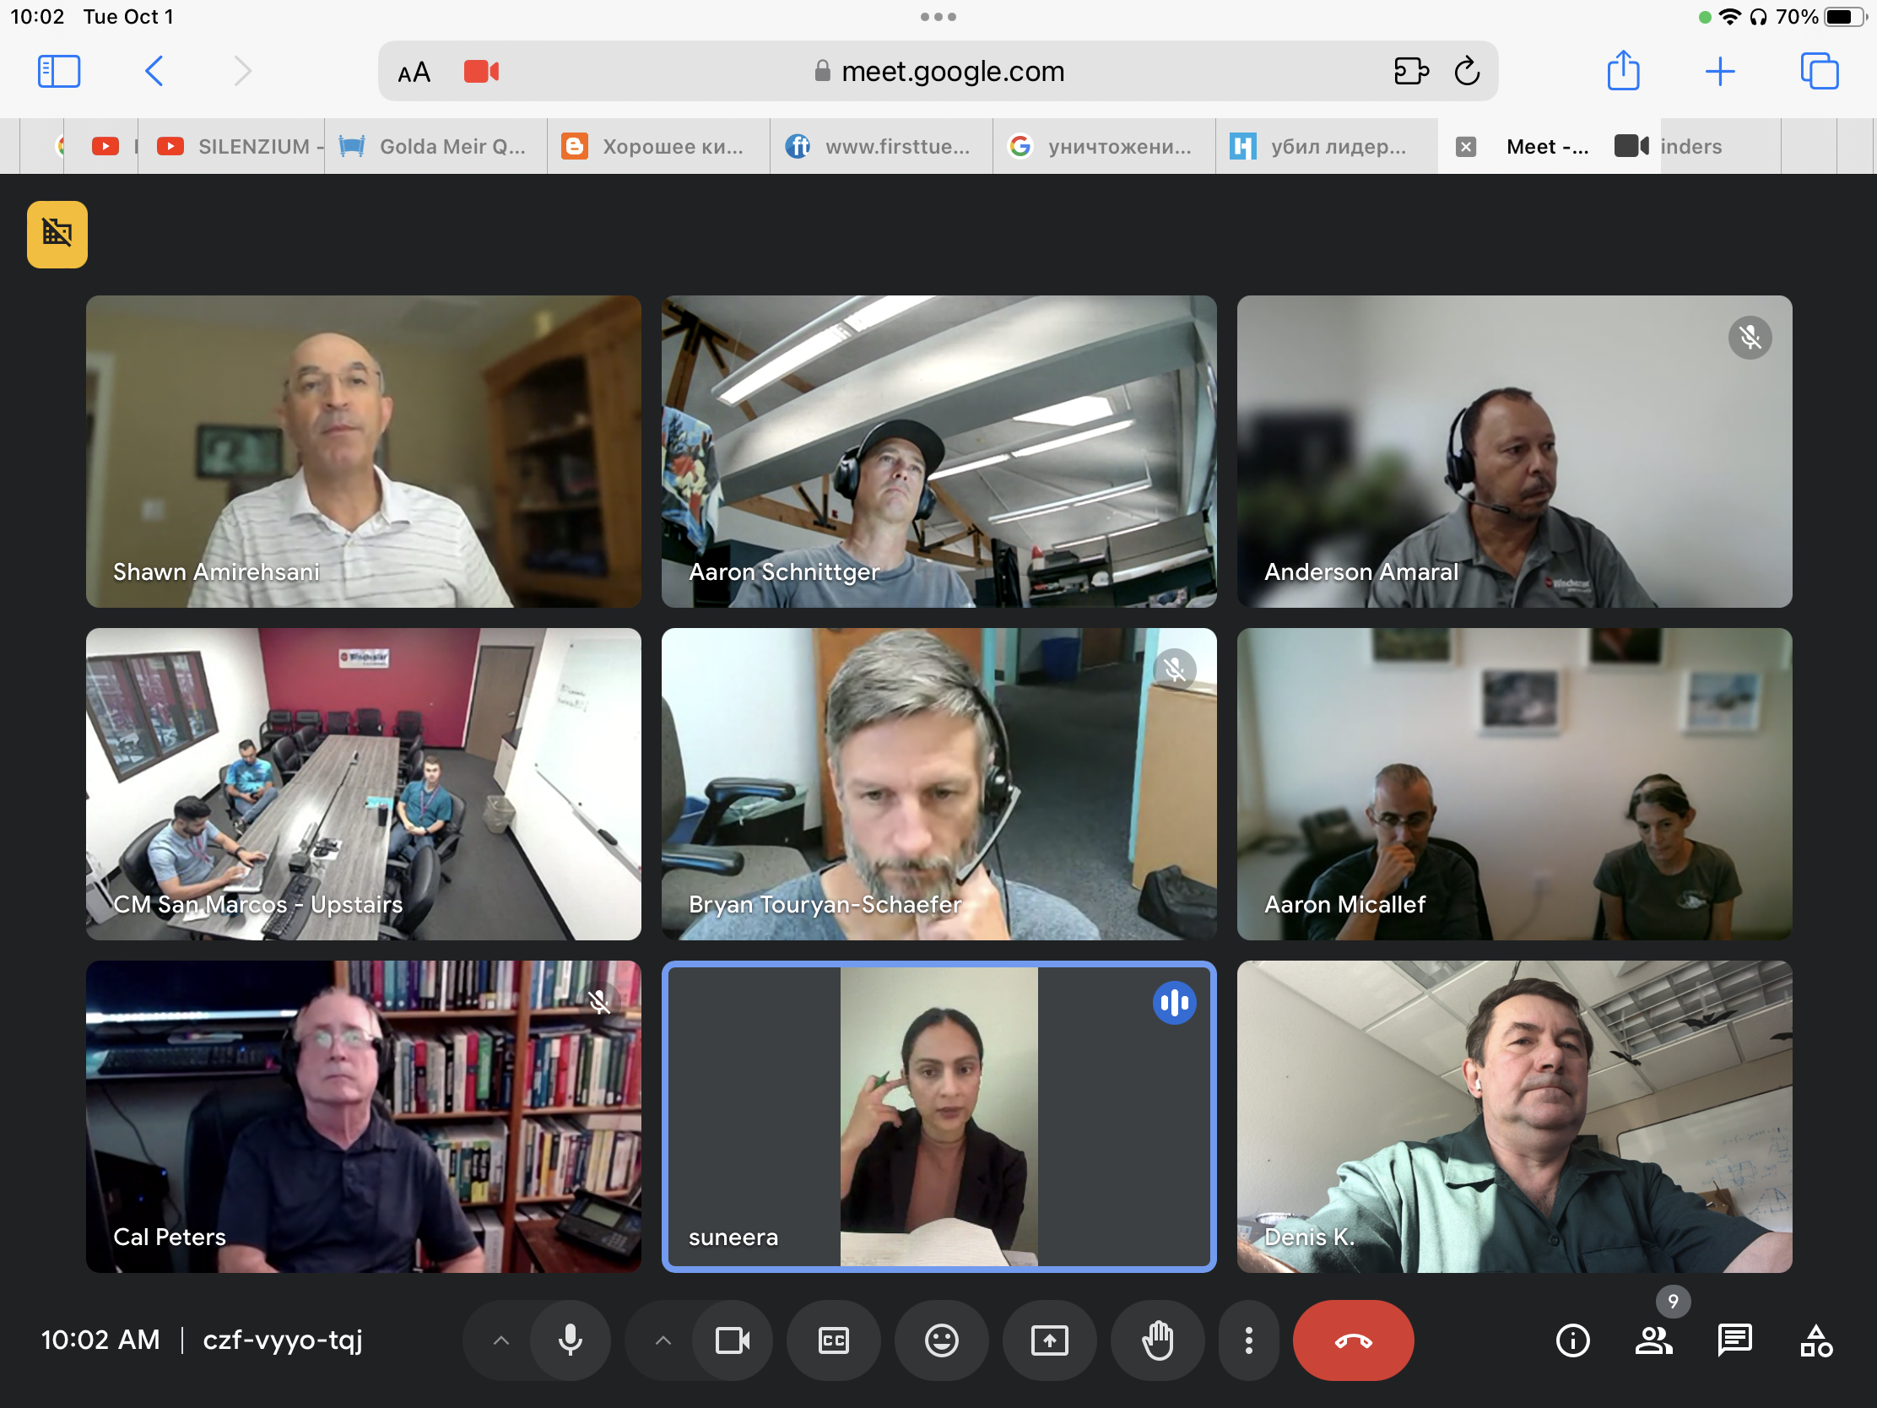
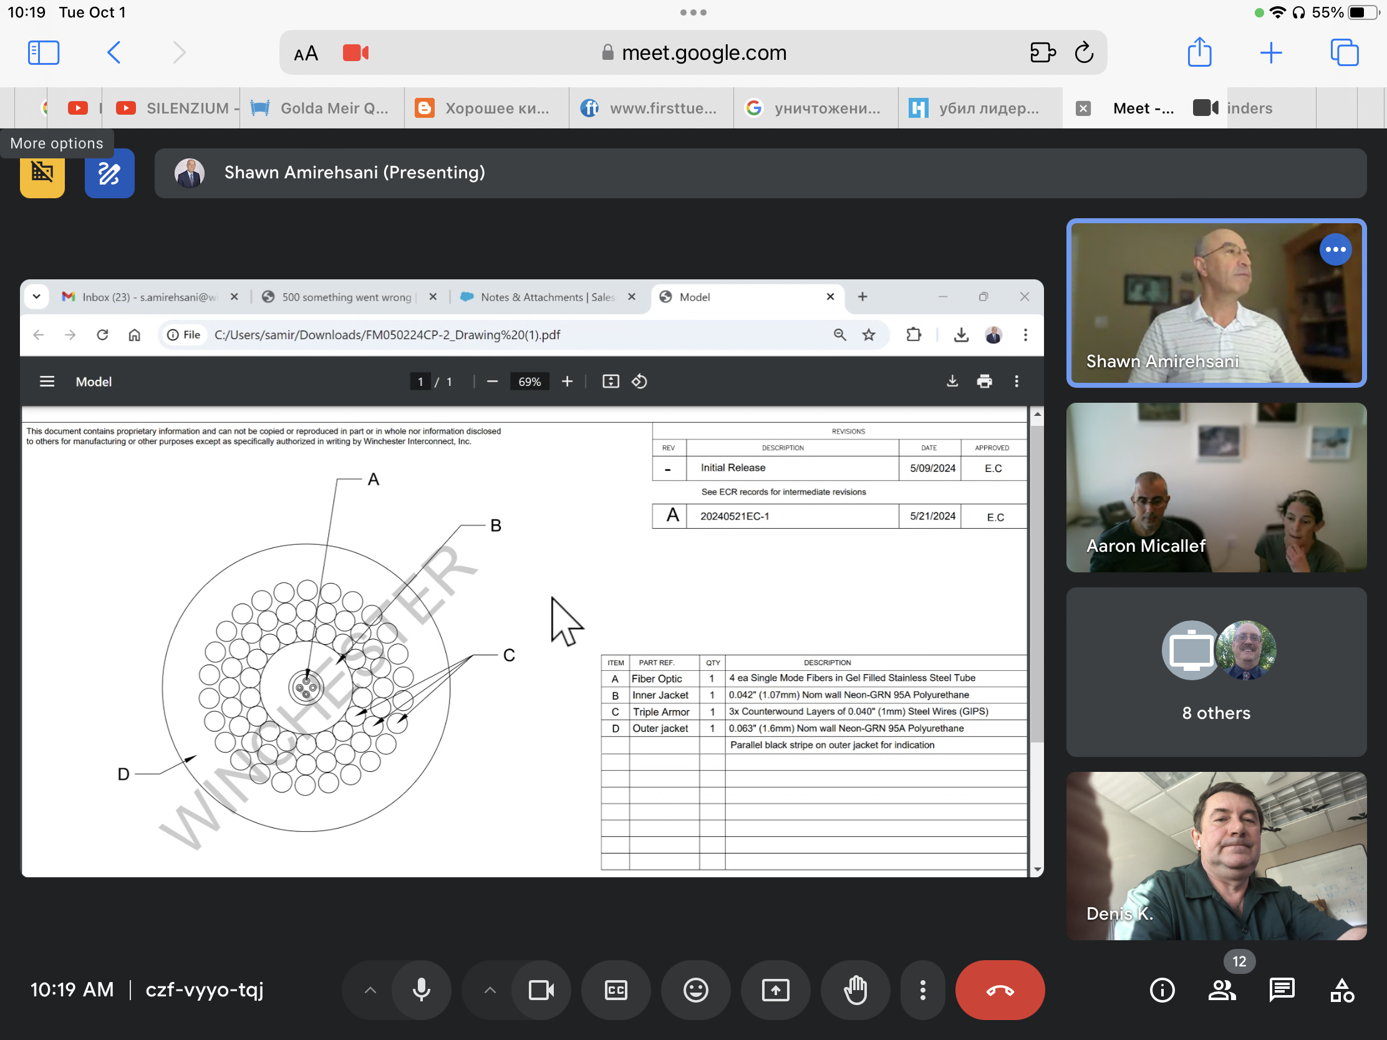
There is a problem with the cable

Slide 10
There is a problem with the cable

Slide 11
Problems
limited availability of submarine cables and access to dark fibers and interrogators
submarine cables tend to be located away from seafloor processes of interest

Slide 12

Key Elements: DAS, Cable, Deployment Scheme
Electronics
Housing
Rover Battery
Sphere
9 kWhr
Rover Battery
Sphere
9 kWhr
DAS
Fiber Optic Cable

Slide 13
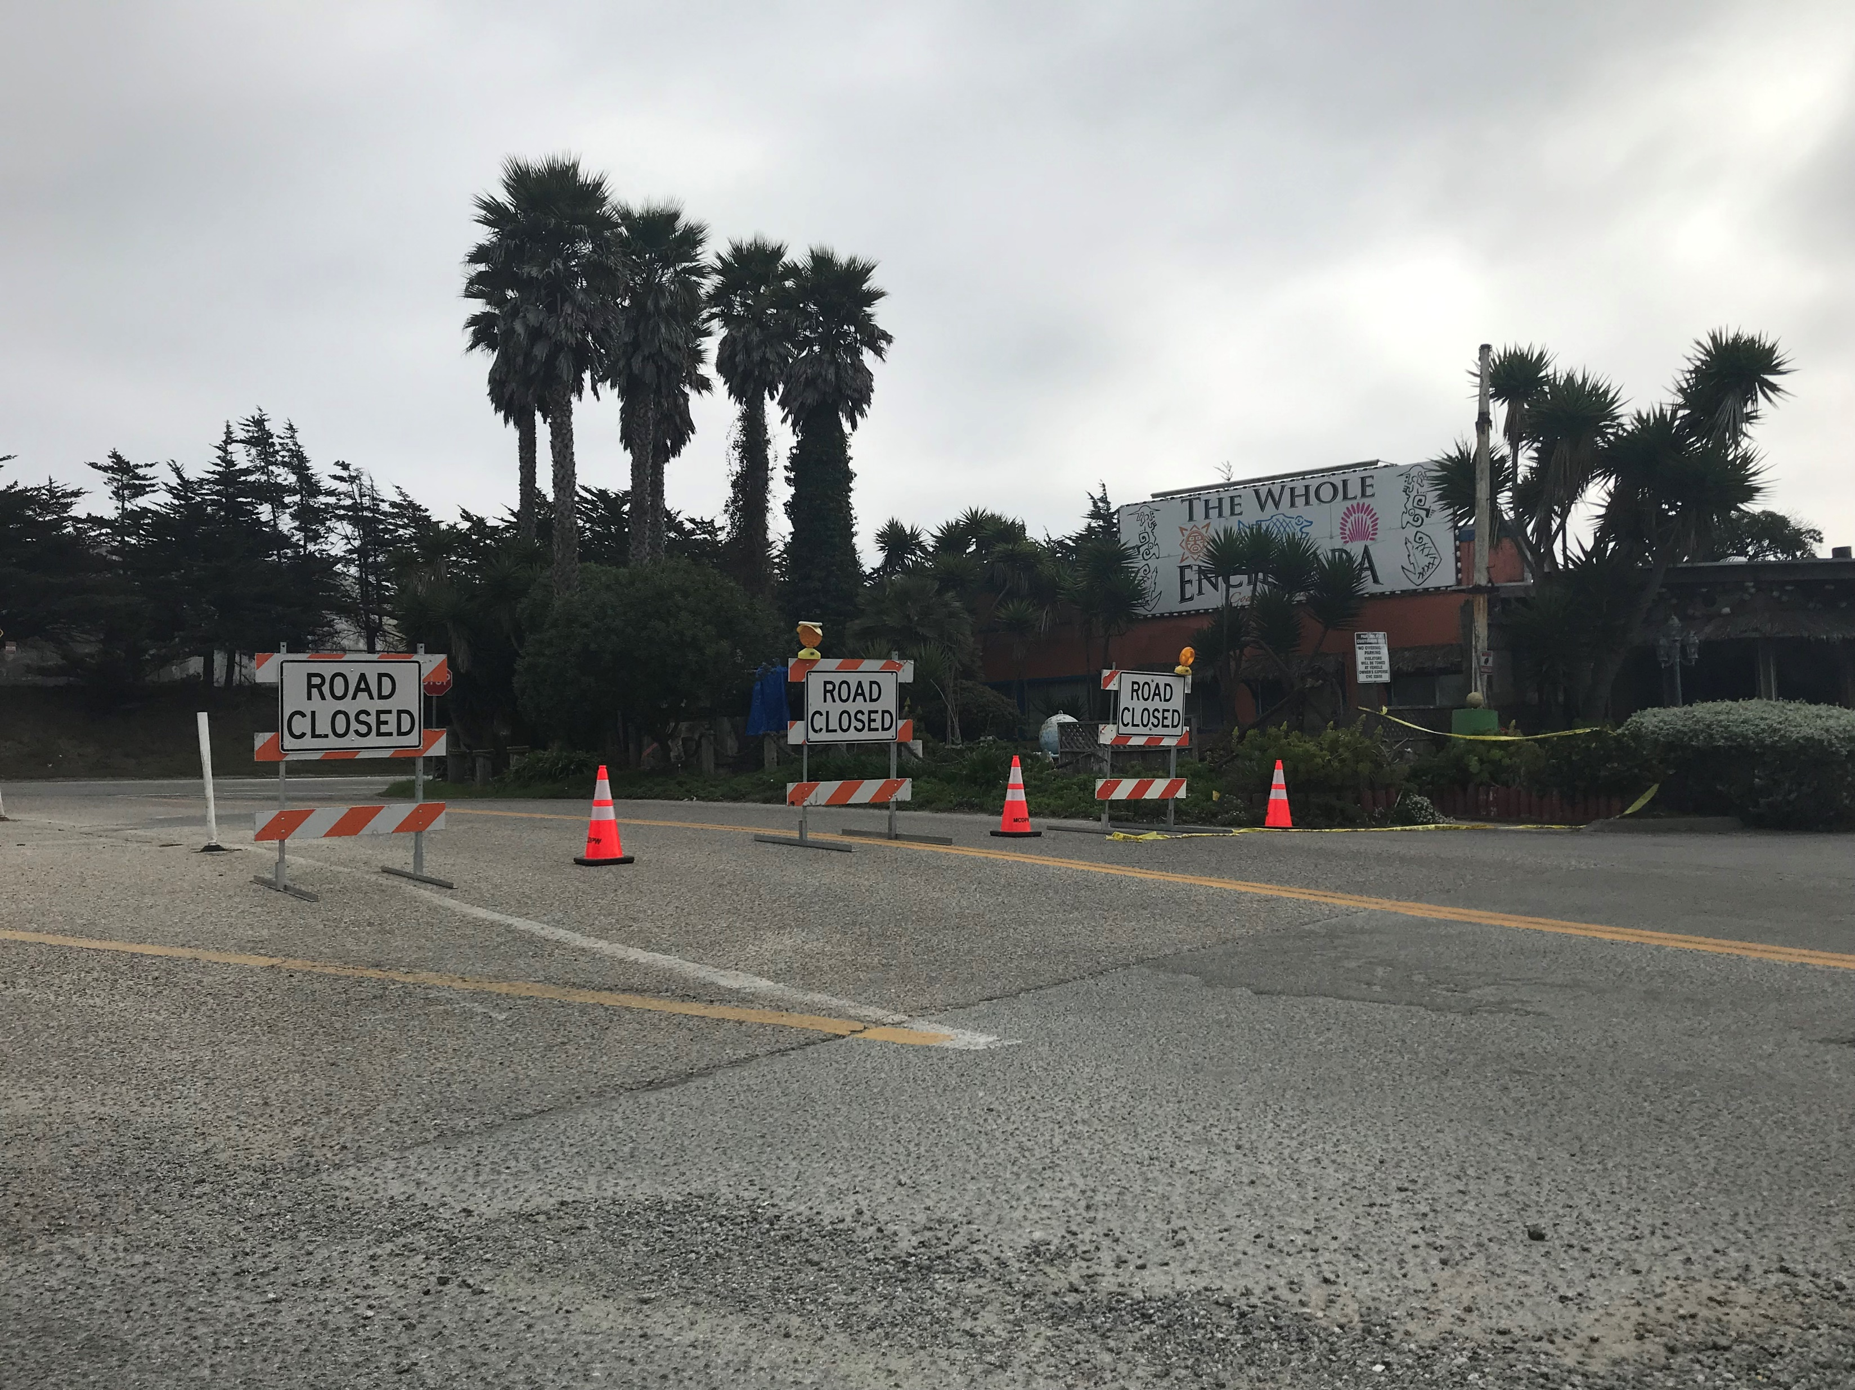
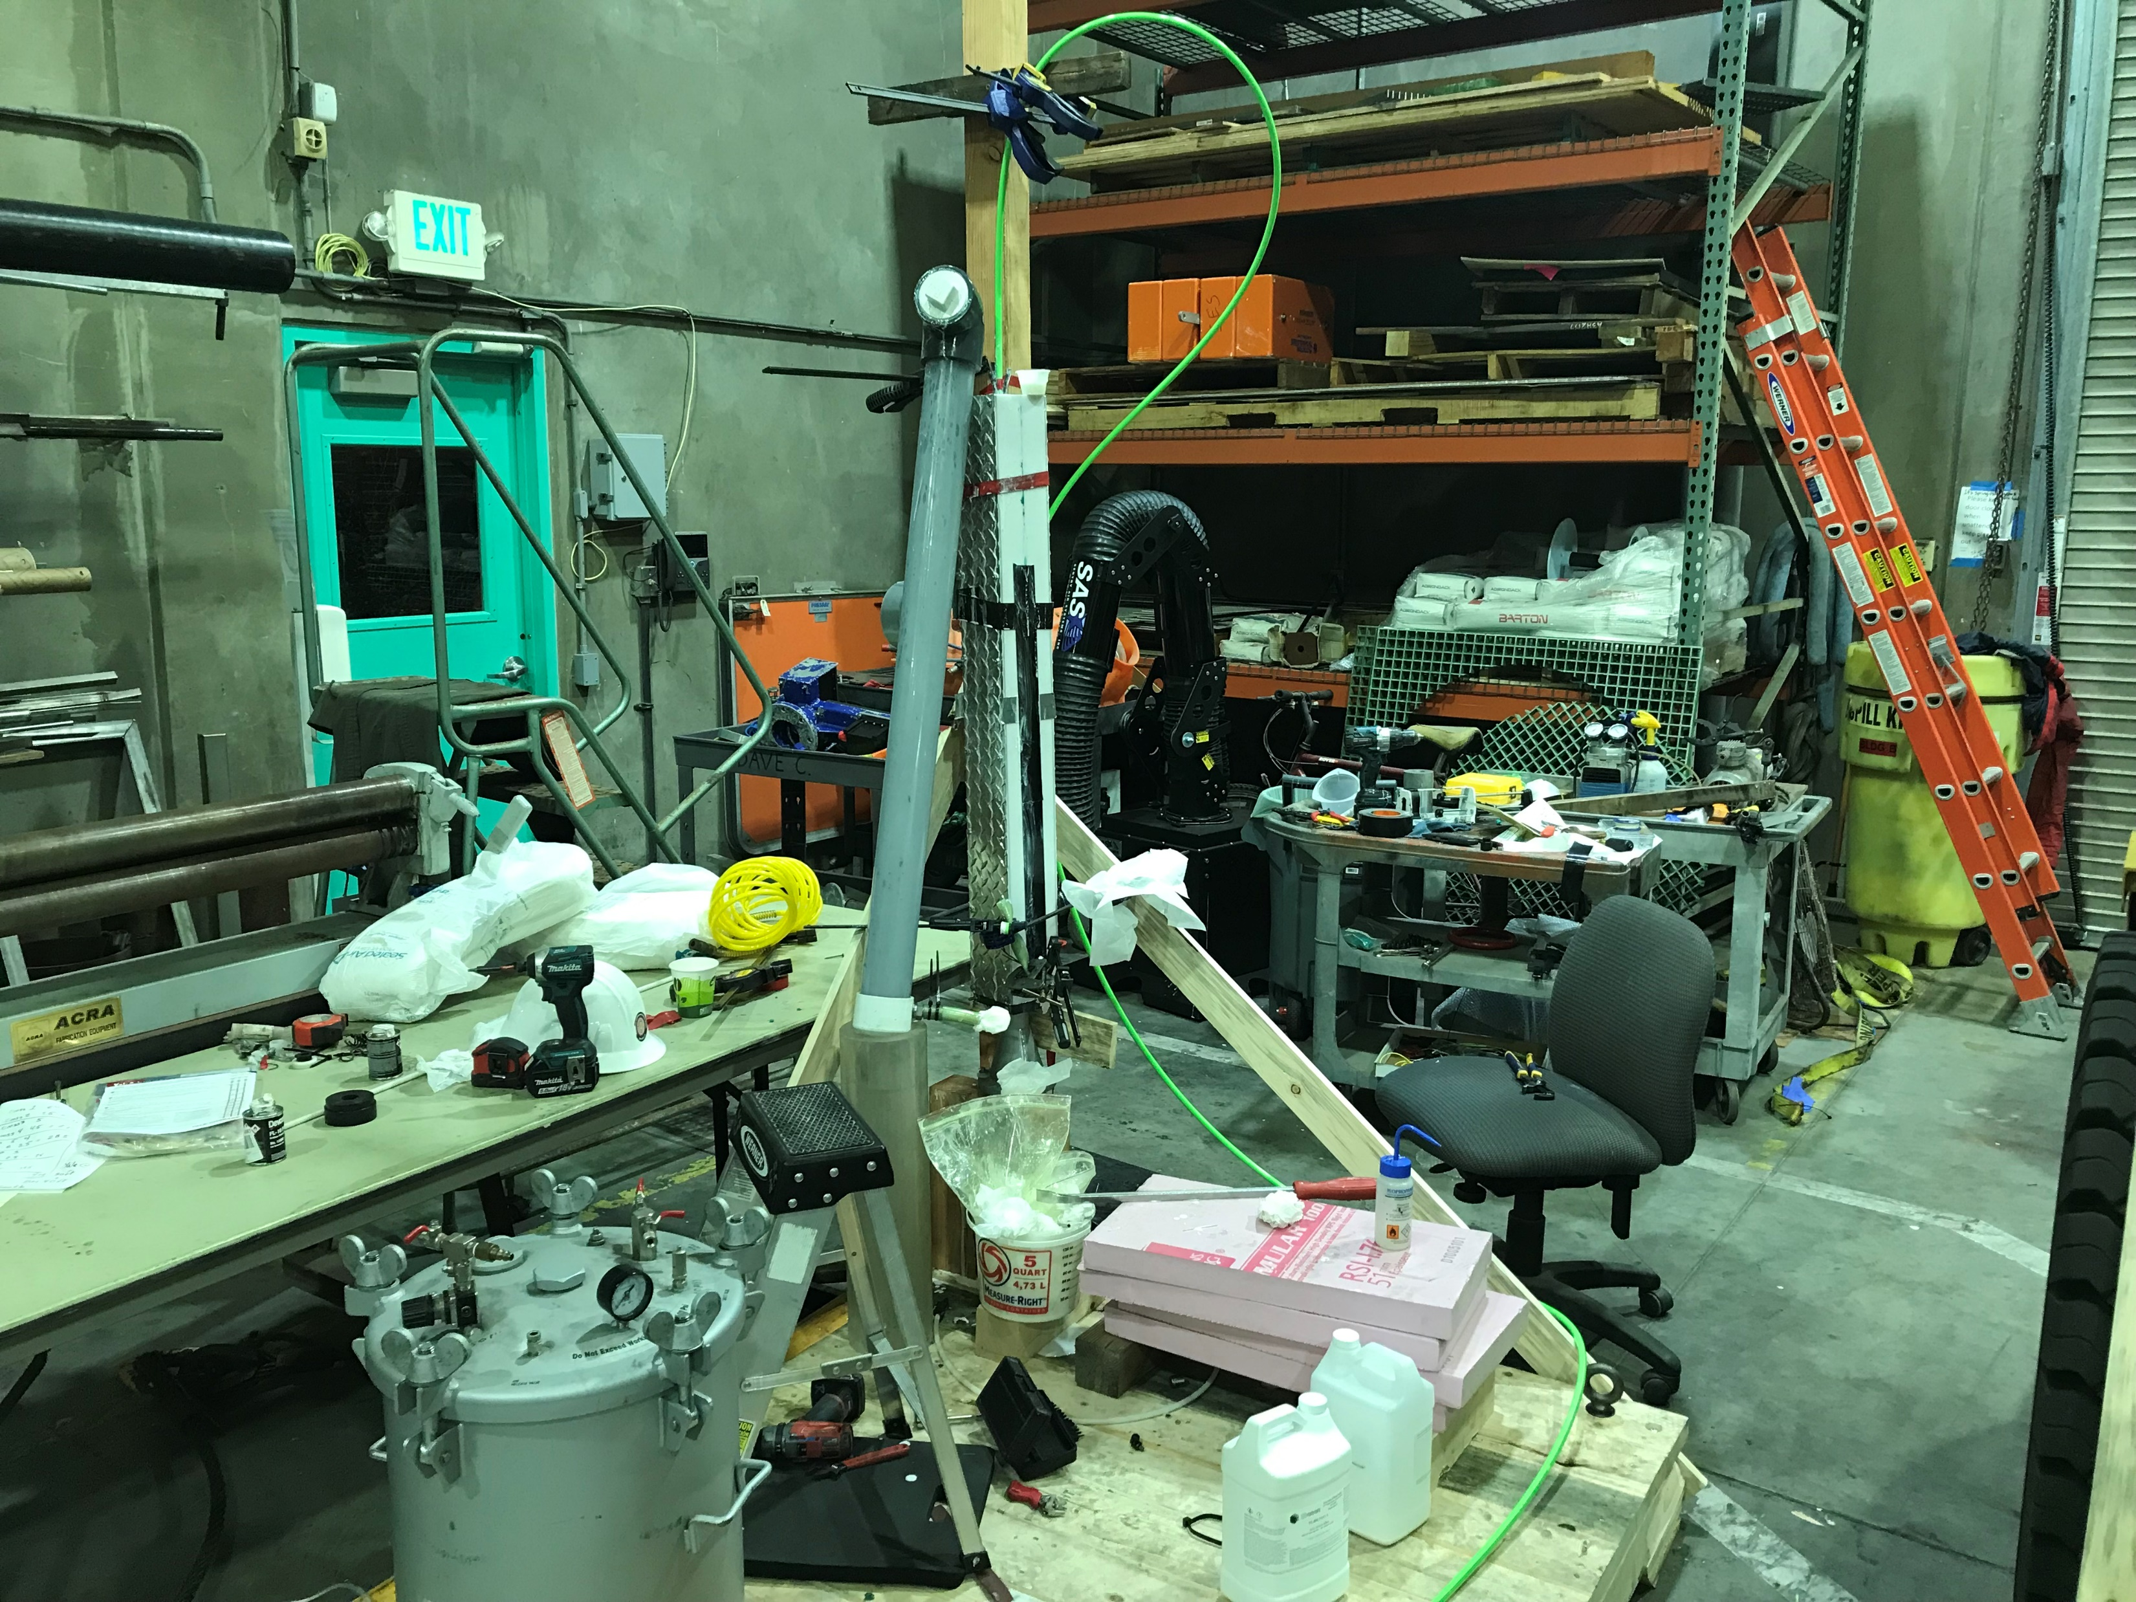
Sunday, Jan 19, begin potting strain relief

Slide 14
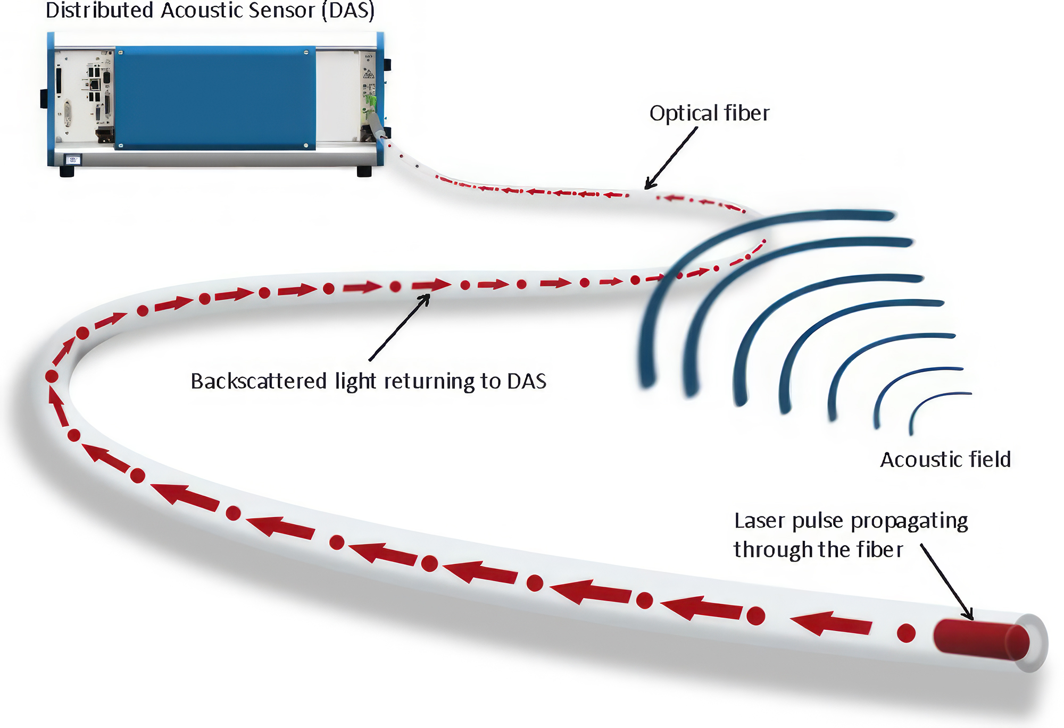
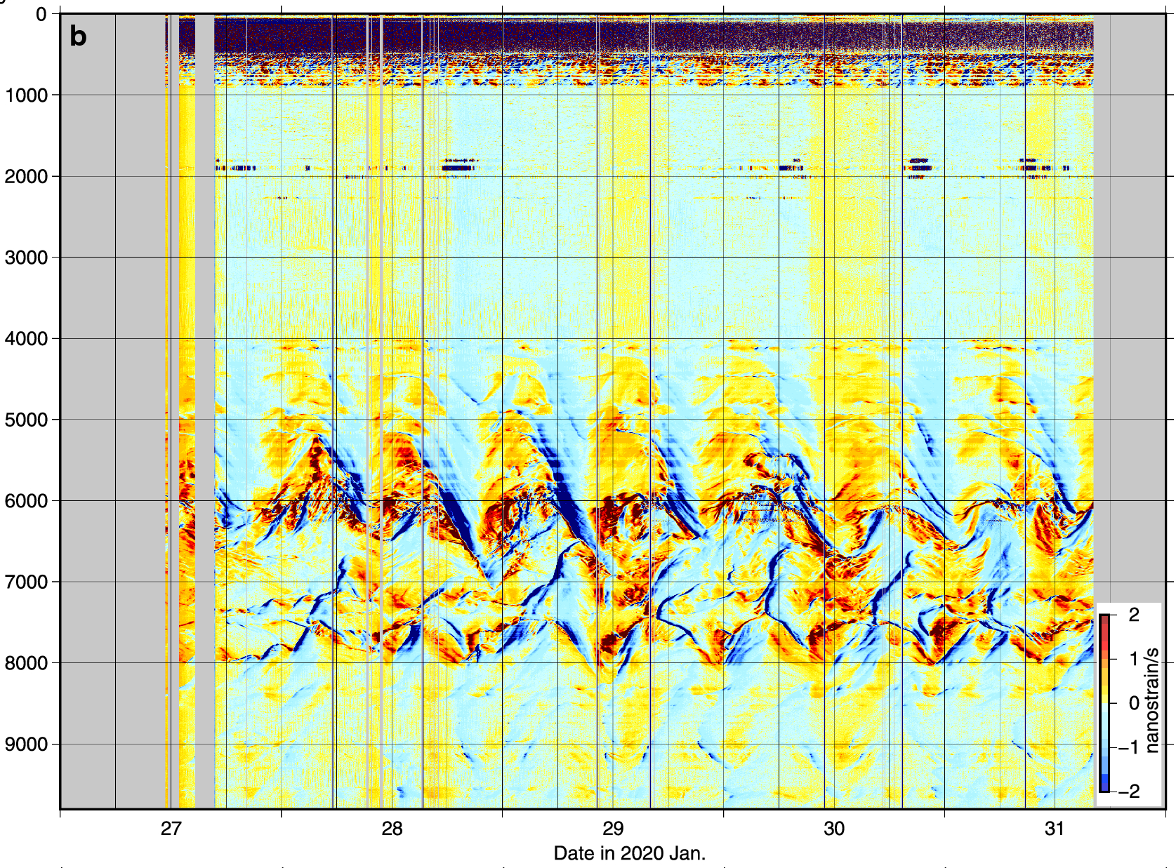
Enabling Technology: Distributed Acoustic Sensing (DAS)
Variation of strain (temperature) along cable
Channels
Dates (Jan 2020)
Ide et al. (2021)
Notes:
limited availability of submarine cables and access to dark fibers and interrogators
submarine cables tend to be located away from seafloor processes of interest

Slide 15
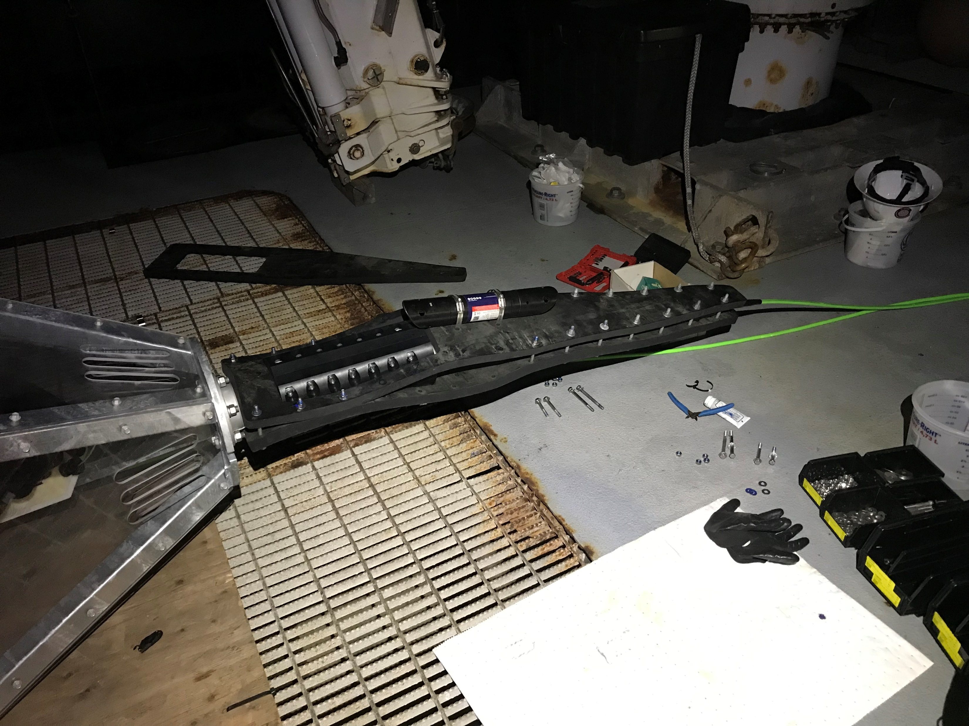
Mob Night – until 11 p.m. Jan 23

Slide 16
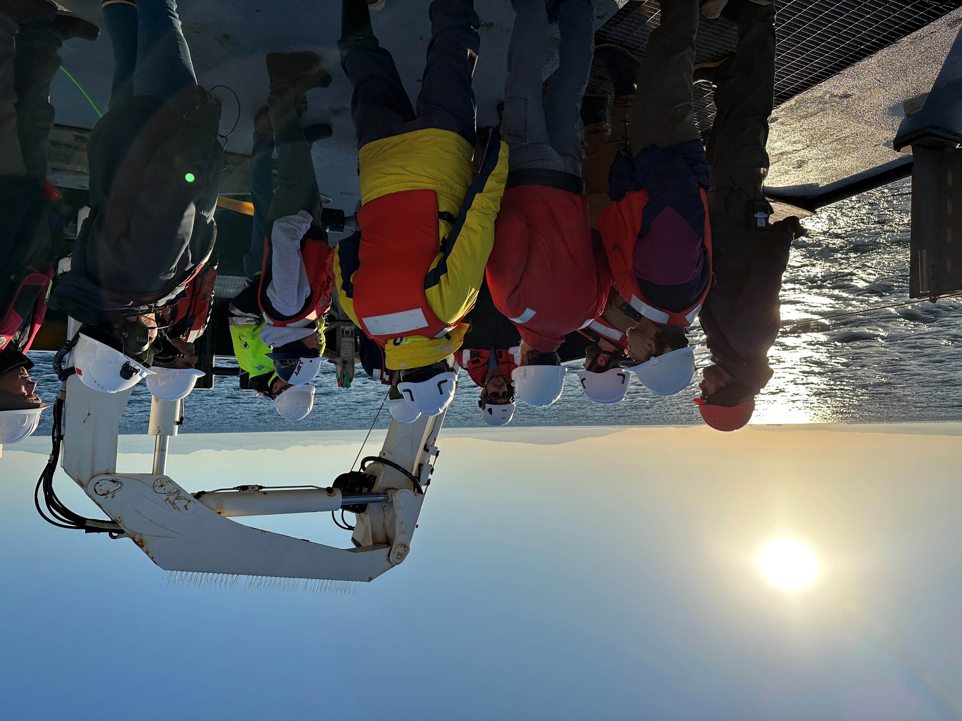
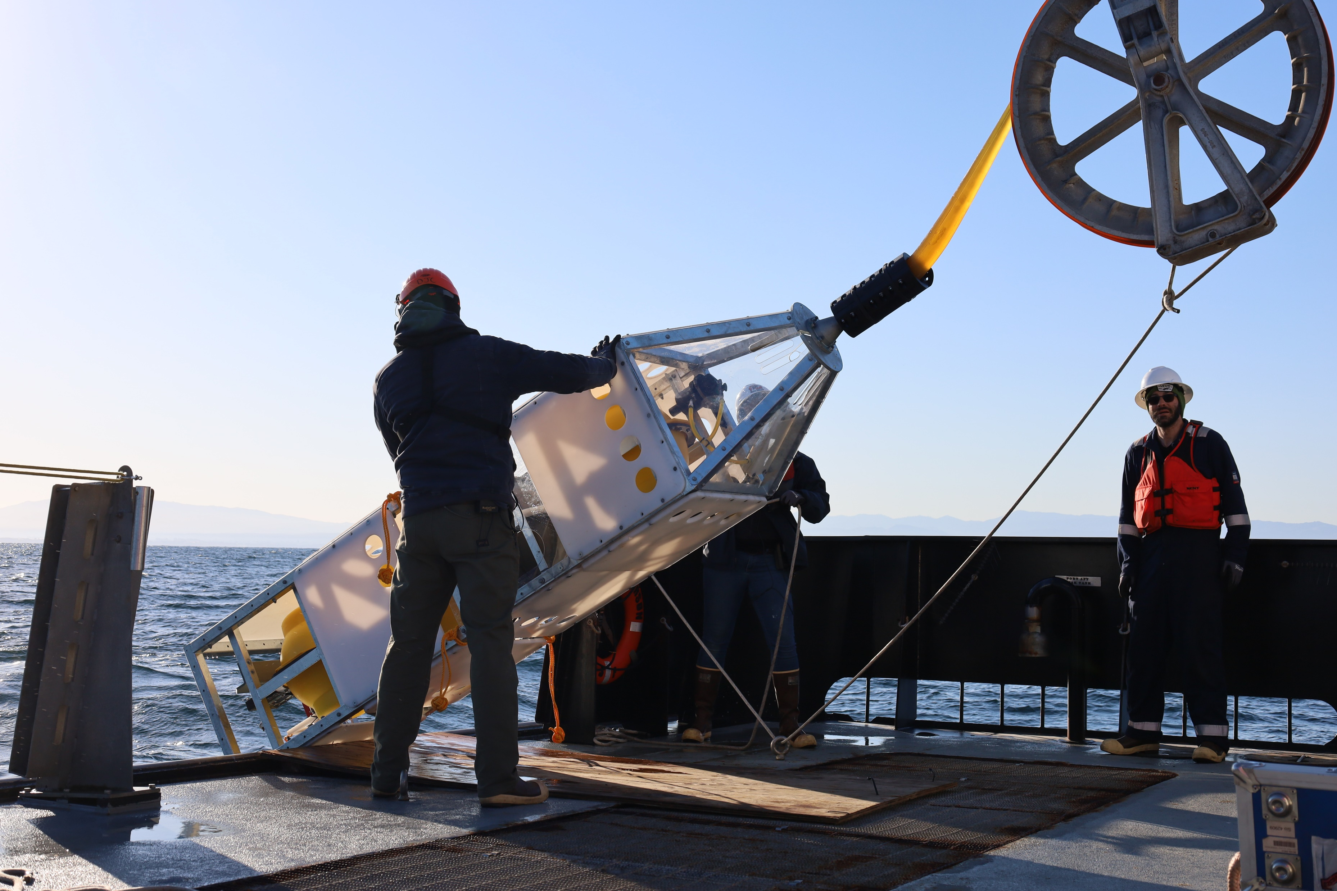

Slide 17
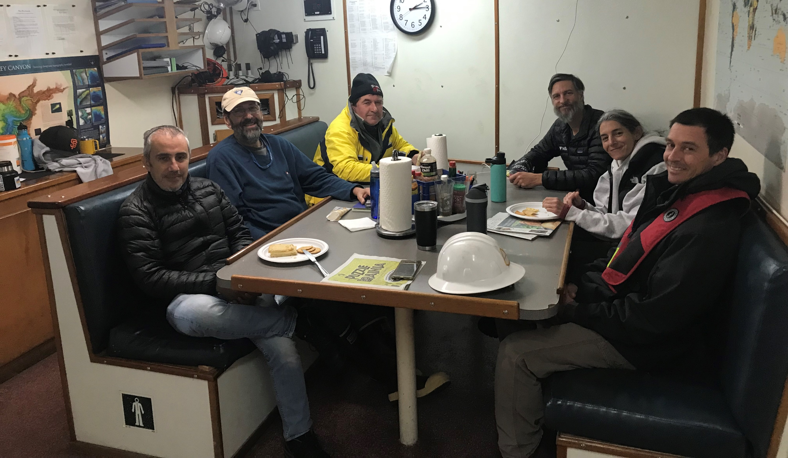
Ice cream Time

Slide 18
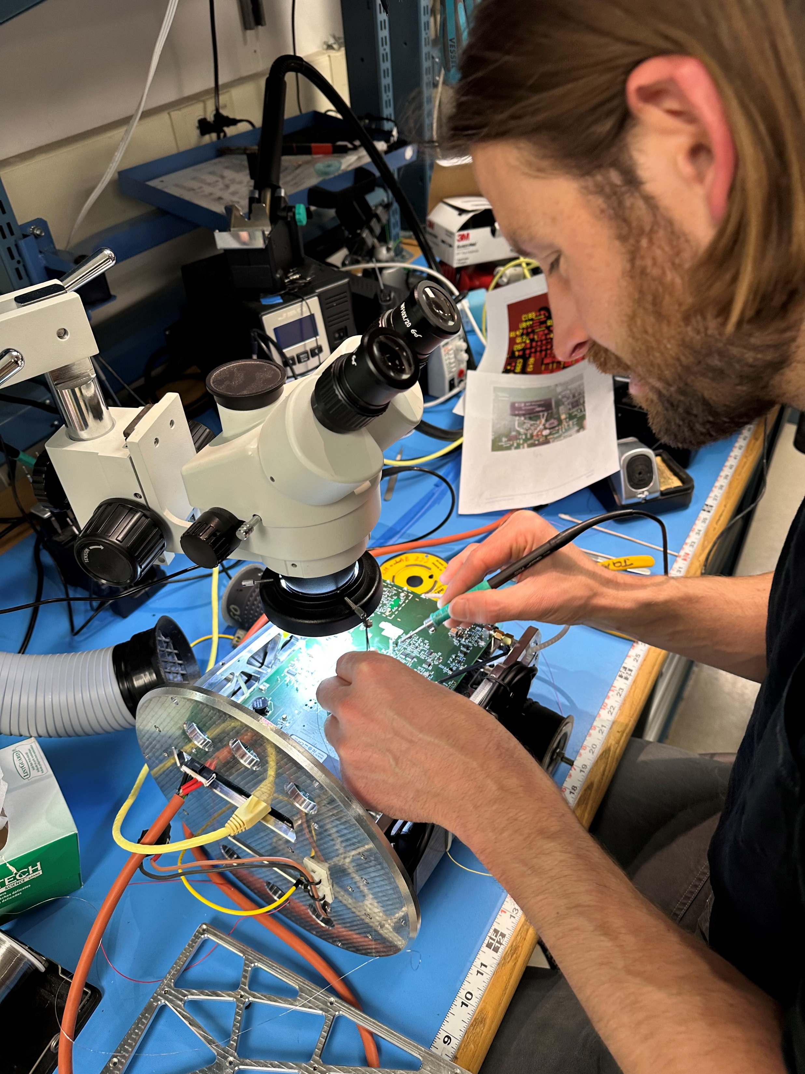
Saturday mid-morning
Calling in the pros!

Slide 19
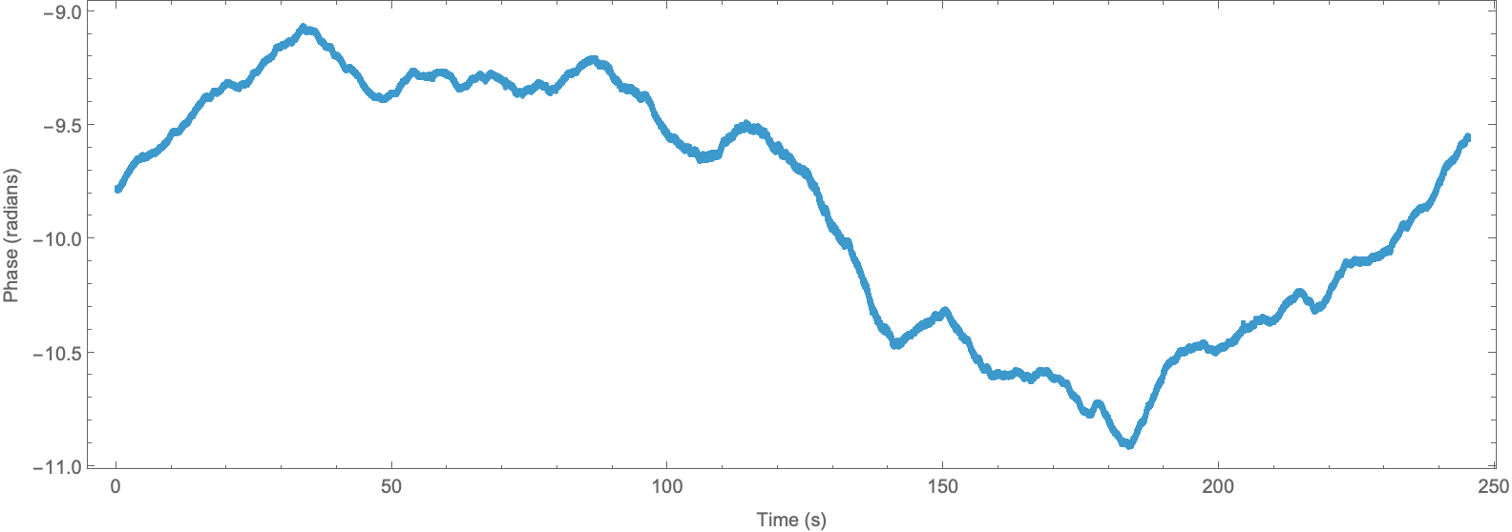
Data are dominated by big waves
Notes:
The most dominant signal we see is from the ocean surface waves

Slide 20
We removed the bad part but …
Notes:
Sintela sent us a rework schedule with things to remove and where to attach wires, but each time we powered up the board, it was still shorted (-5V and +12V shorted to ground). We kept taking off more parts until the whole section was empty. Then we realized the problem was somewhere else on the board. We used a thermal camera to find the problem. Video. We then started to use Denis’ dental drill to excavate into the board until we could clear the short. This board would normally be trash, but that was not an option

Slide 21
Tuesday, Jan 28
Deployment Day (Again!)

Slide 22
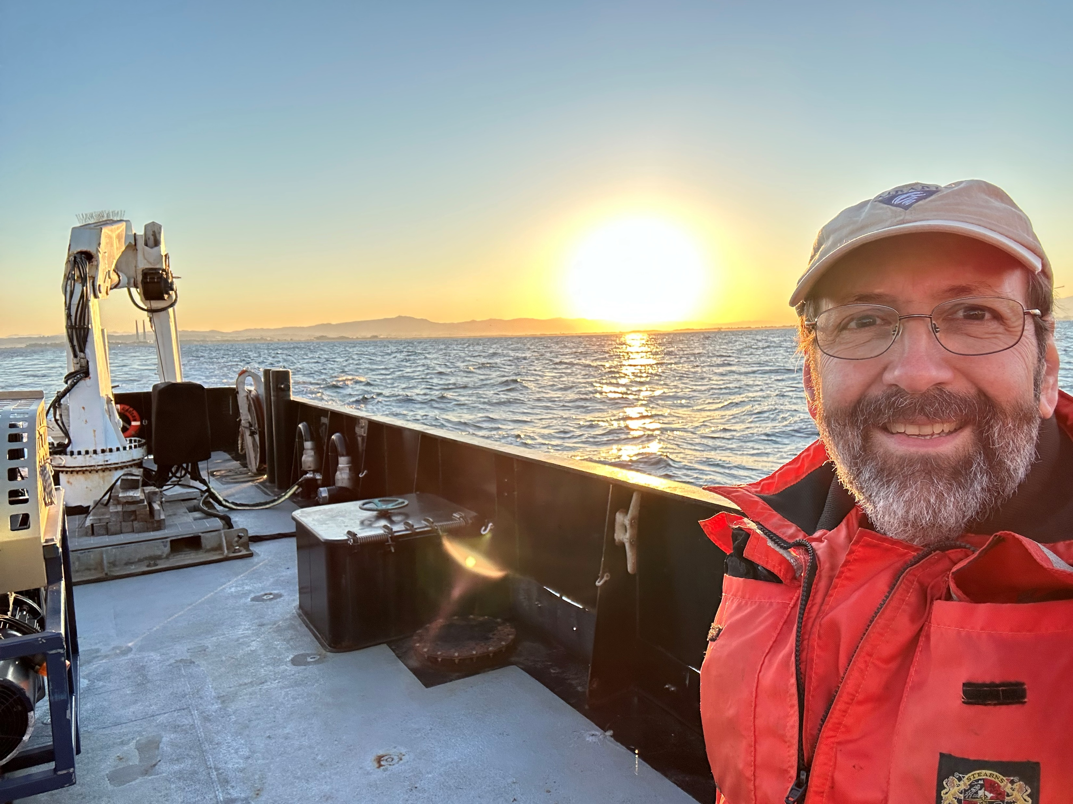
Thanks!!

Slide 23
Geo-Sense Timeline by Summer 2024
From our proposal:
  Components procured June 2024
    Cable due 9/25/24
    DAS expected by 11/1/24
  Prototype assembled Sept 2024 Dec 2024
  2 days on the R/V David Packard after September 2024 to test the deployment/recovery strategy.
  4 days on the R/V David Packard in February–March 2025 to deploy and recover the prototype and cable. Begin begging for ship days on the R/V Rachel Carson

Slide 24
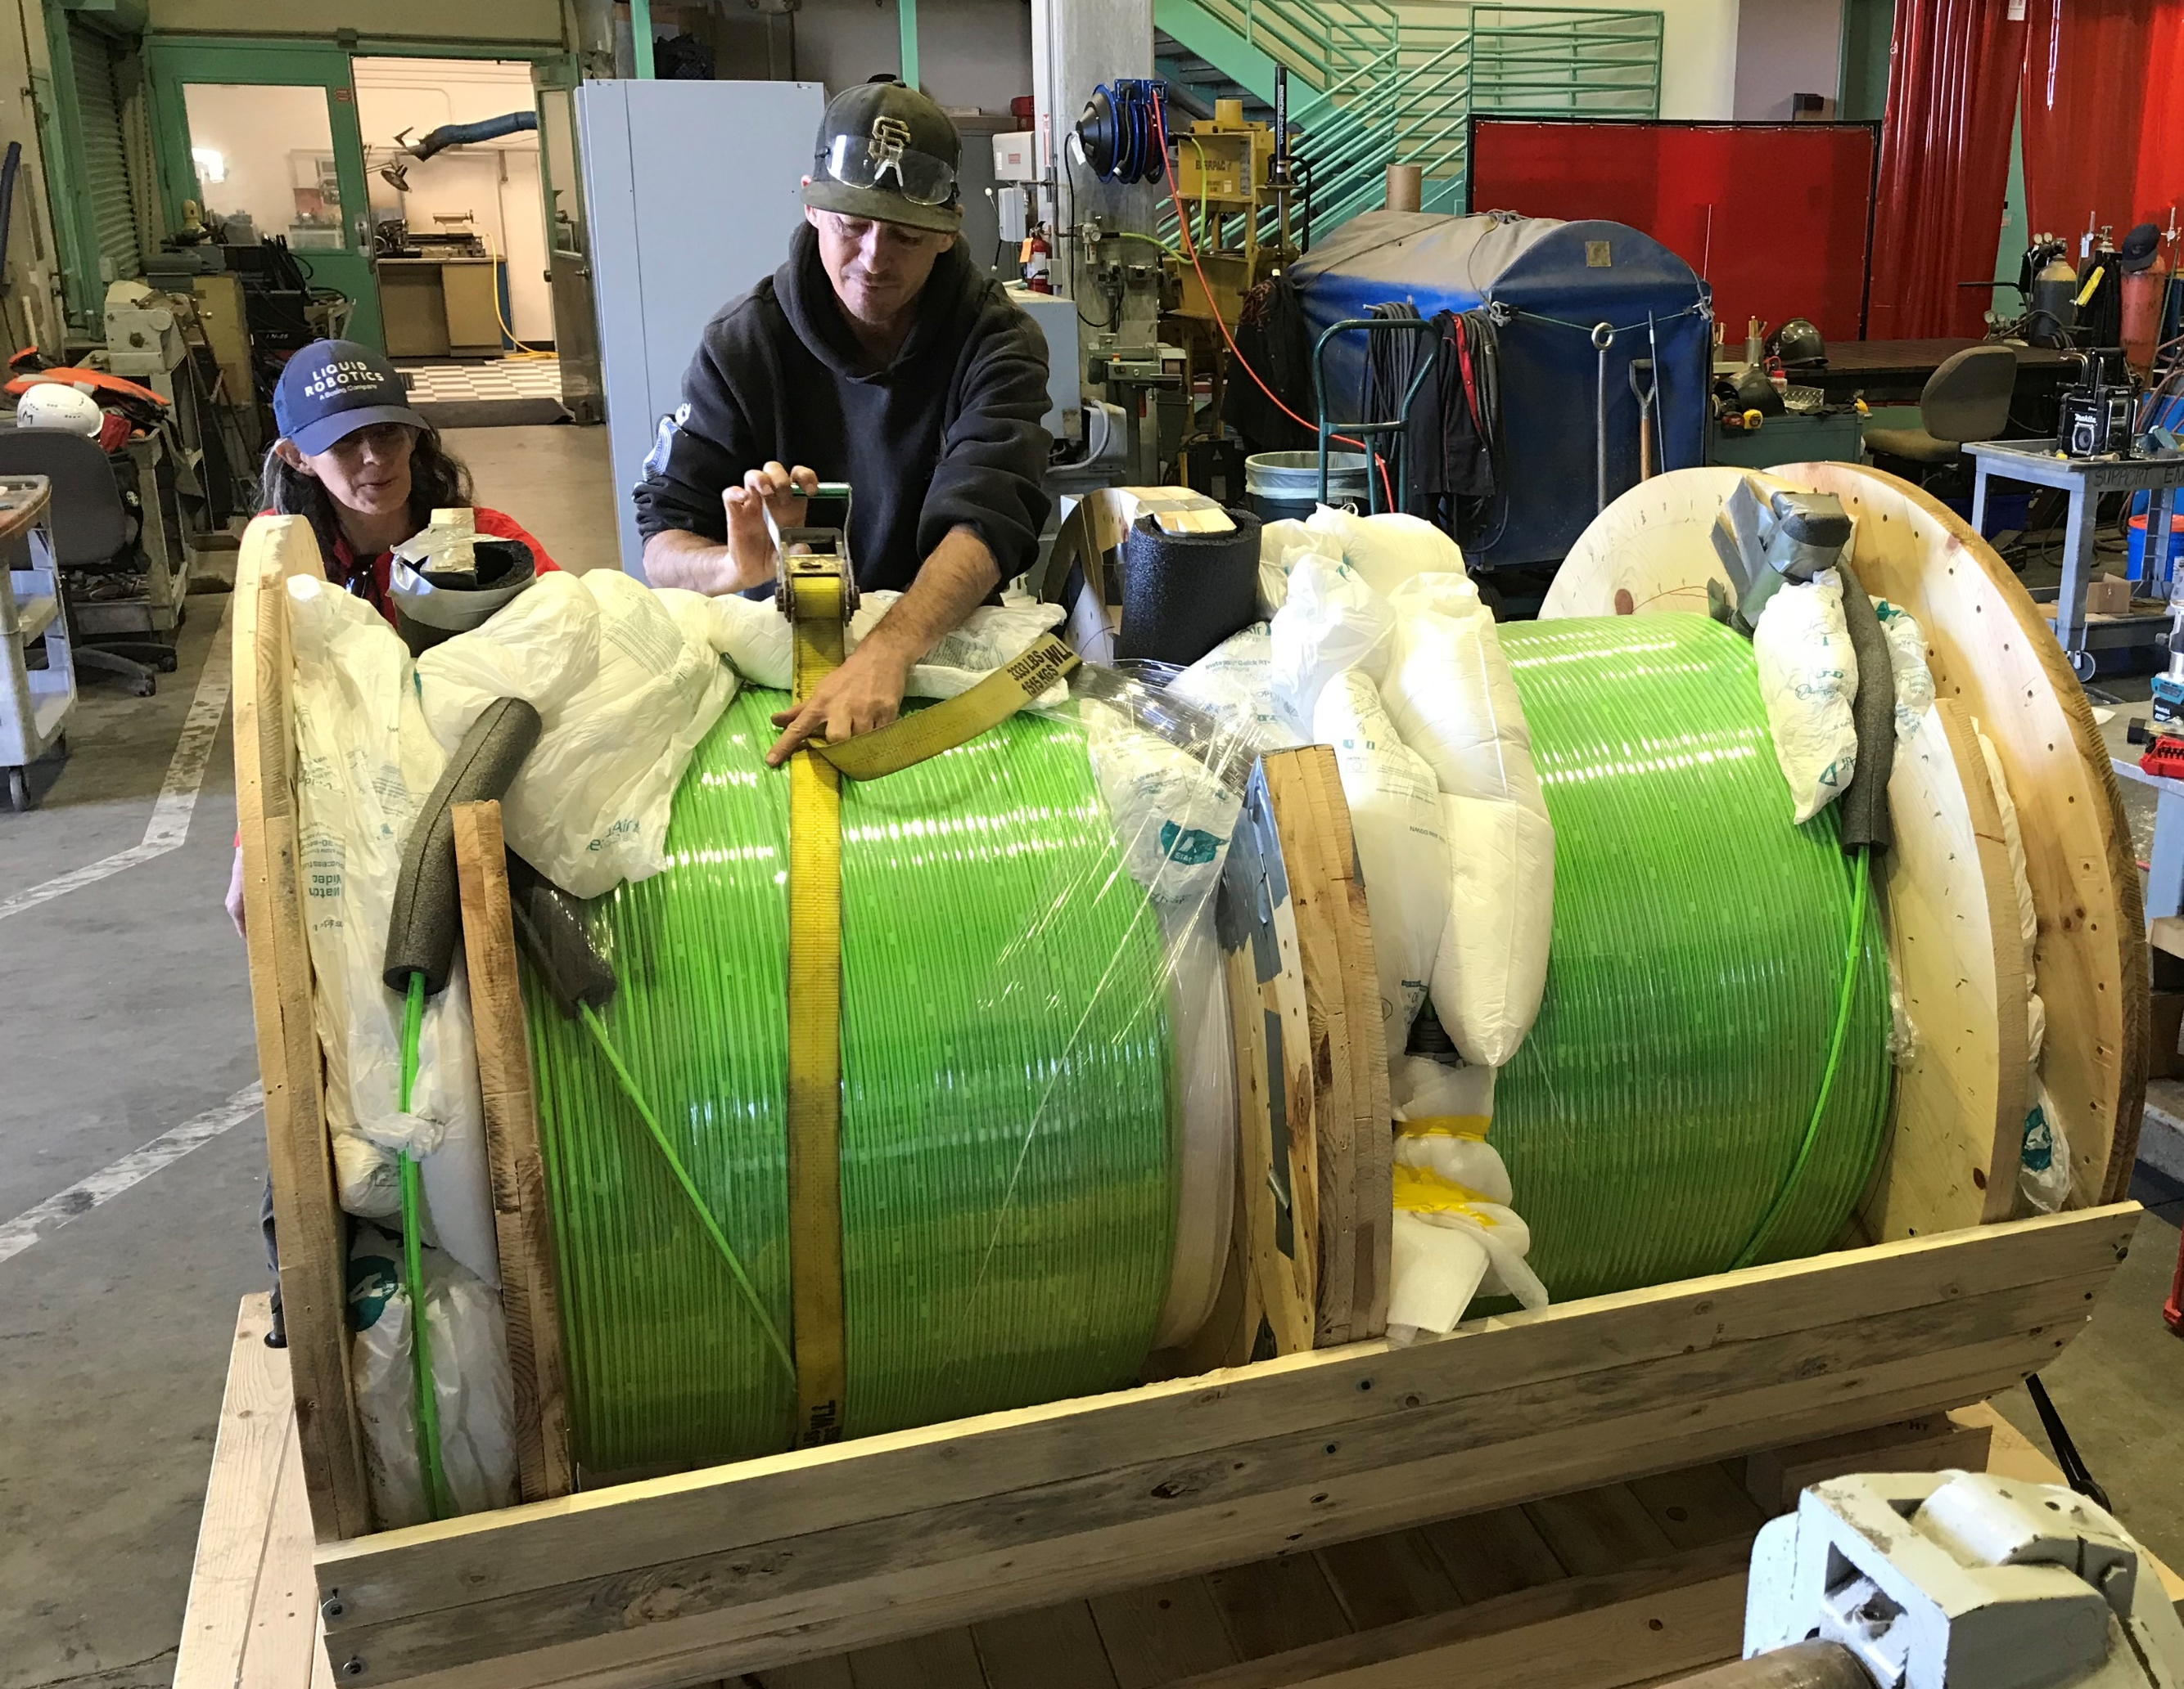
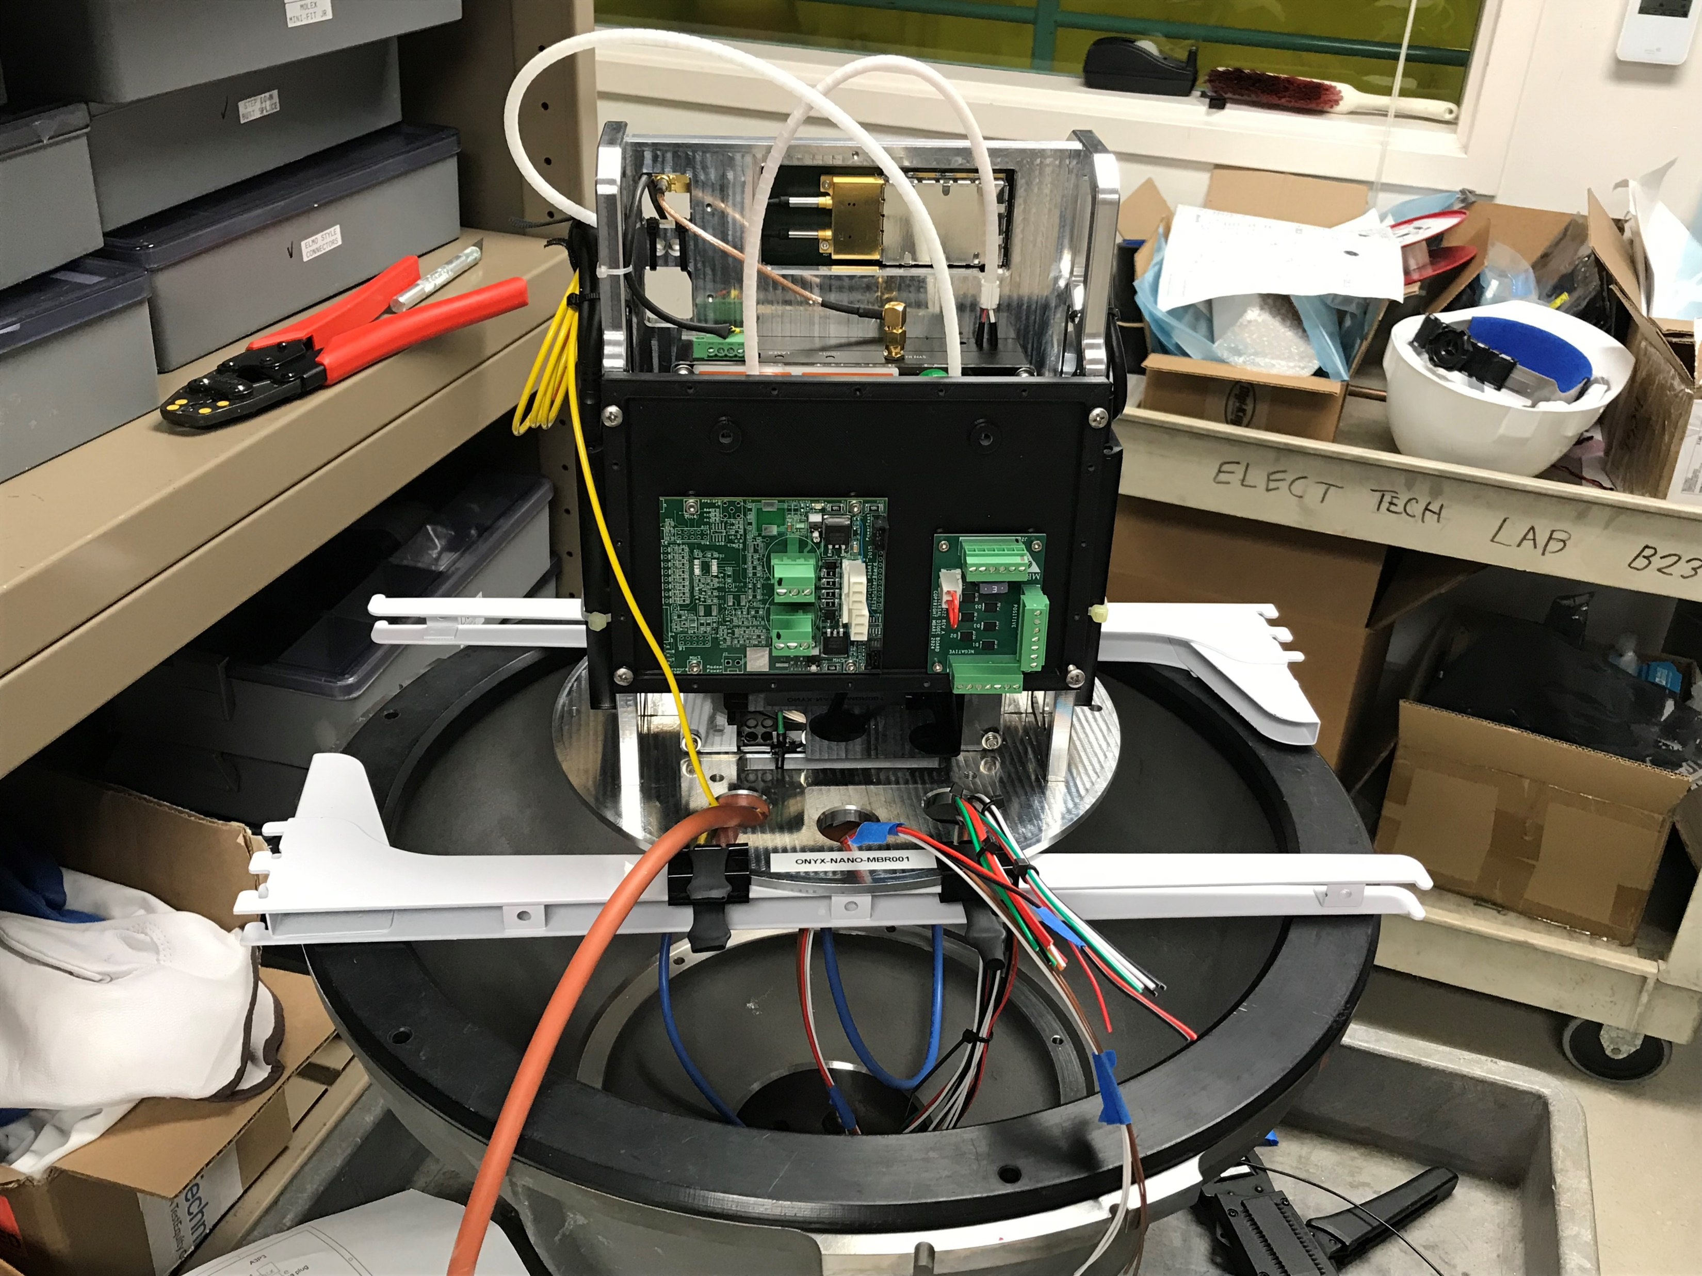
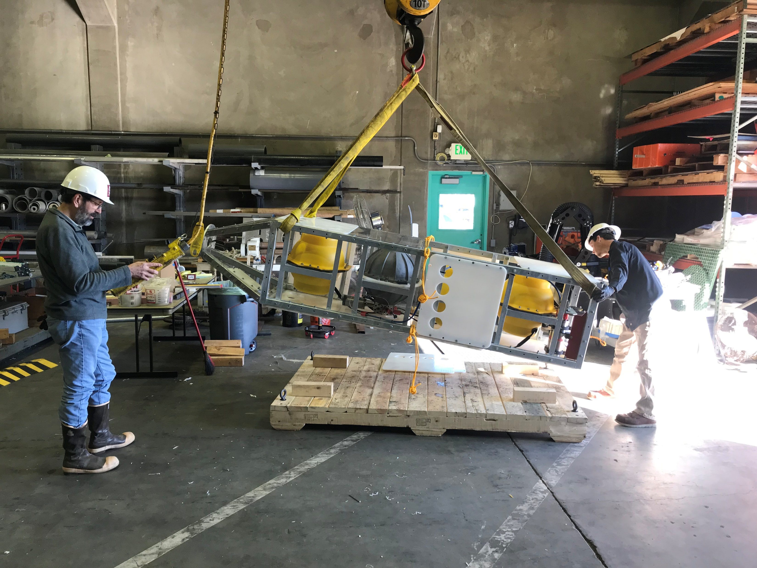
Geo-Sense Timeline by Dec 31, 2024
From our proposal:
  Components procured June 2024
    Cable due 9/25/24
    Terminated cable arrived Dec 17, 2024
    DAS expected by 11/1/24
    DAS arrived Dec 27, 2024…with a better one on the way
  Prototype assembled Sept 2024 Dec 2024
  mid-Jan 2025
  2 days on the R/V David Packard after September 2024 to test the deployment/recovery strategy.
  4 days on the R/V David Packard in February–March 2025 to deploy and recover the prototype and cable. R/V Carson days Jan 24, 27, 28

Slide 25
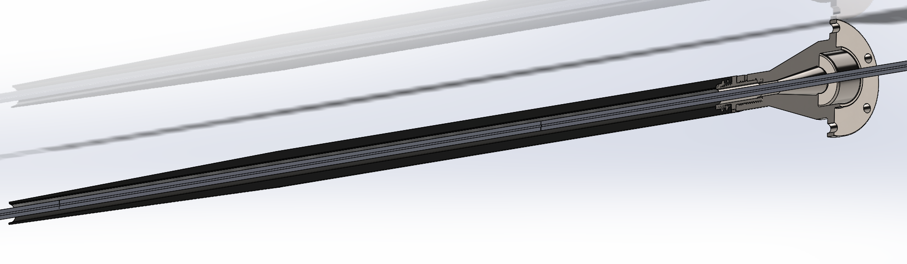
Strain Relief – Jan 16
8 days until deployment
Notes:
24- 36 hours for initial cure

Slide 26
DAS
Strain
Relief
FO Core
DAS
1 km armored FO cable
Cable
Termination
Black
Hole
Term.
Oil-compensated
Junction box –
Fiber breakout

Slide 27
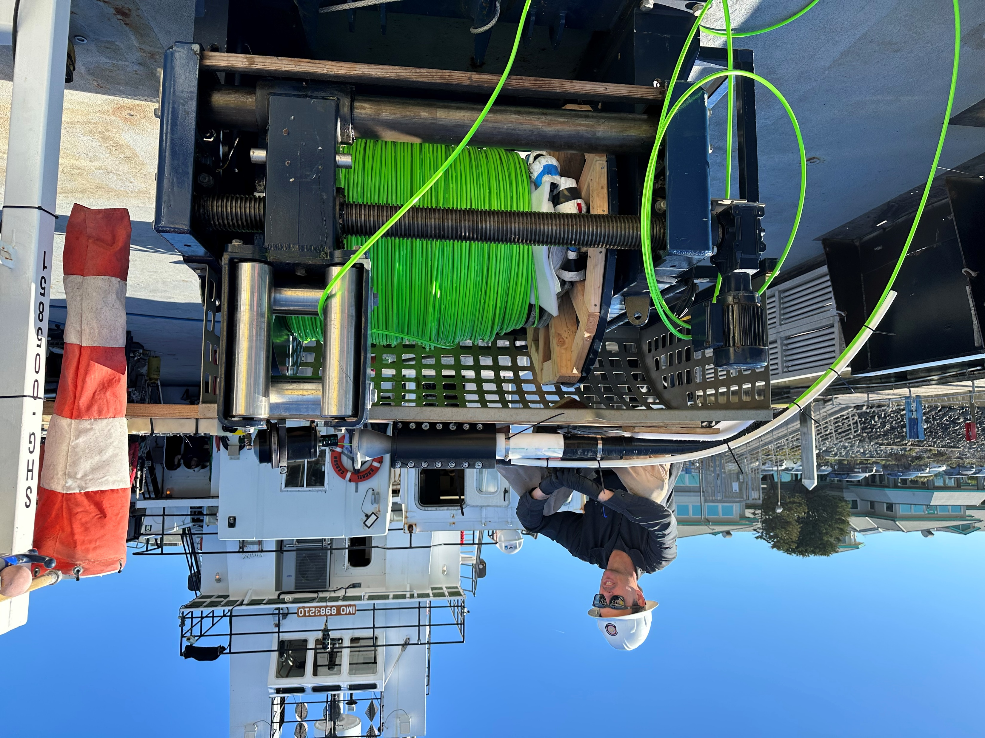
Mob day – Jan 23 – 1 day until deployment
Strain relief is a little sticky… but the instrument is working
We are ready to go!
Notes:
Noro virus
Denis and Aaron stay late

Slide 28
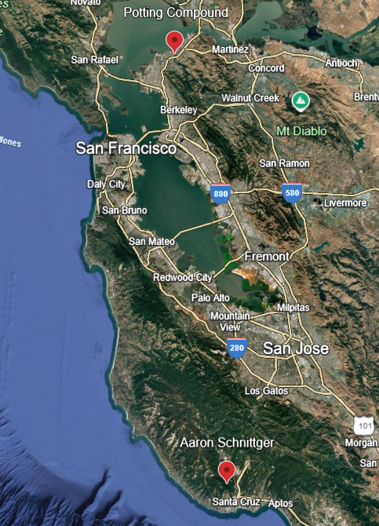
Also that morning…
Strain Relief Part 2:
Revenge of the Potting Compound

Slide 29
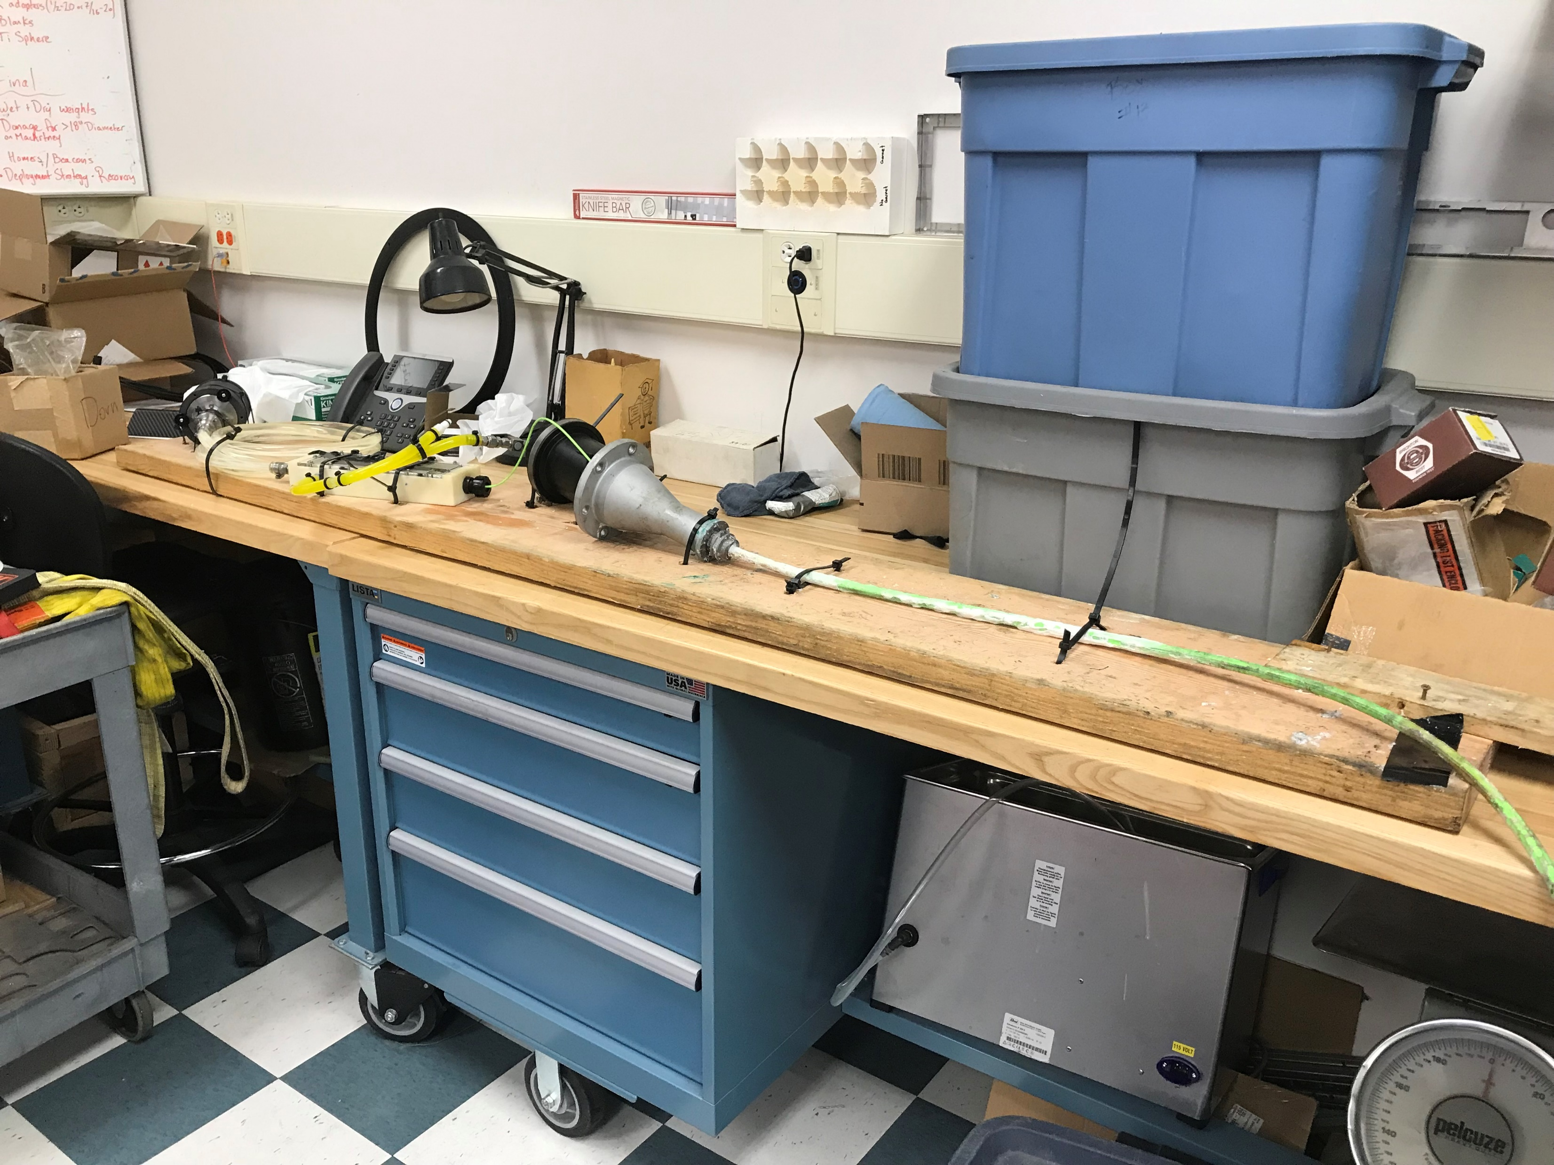
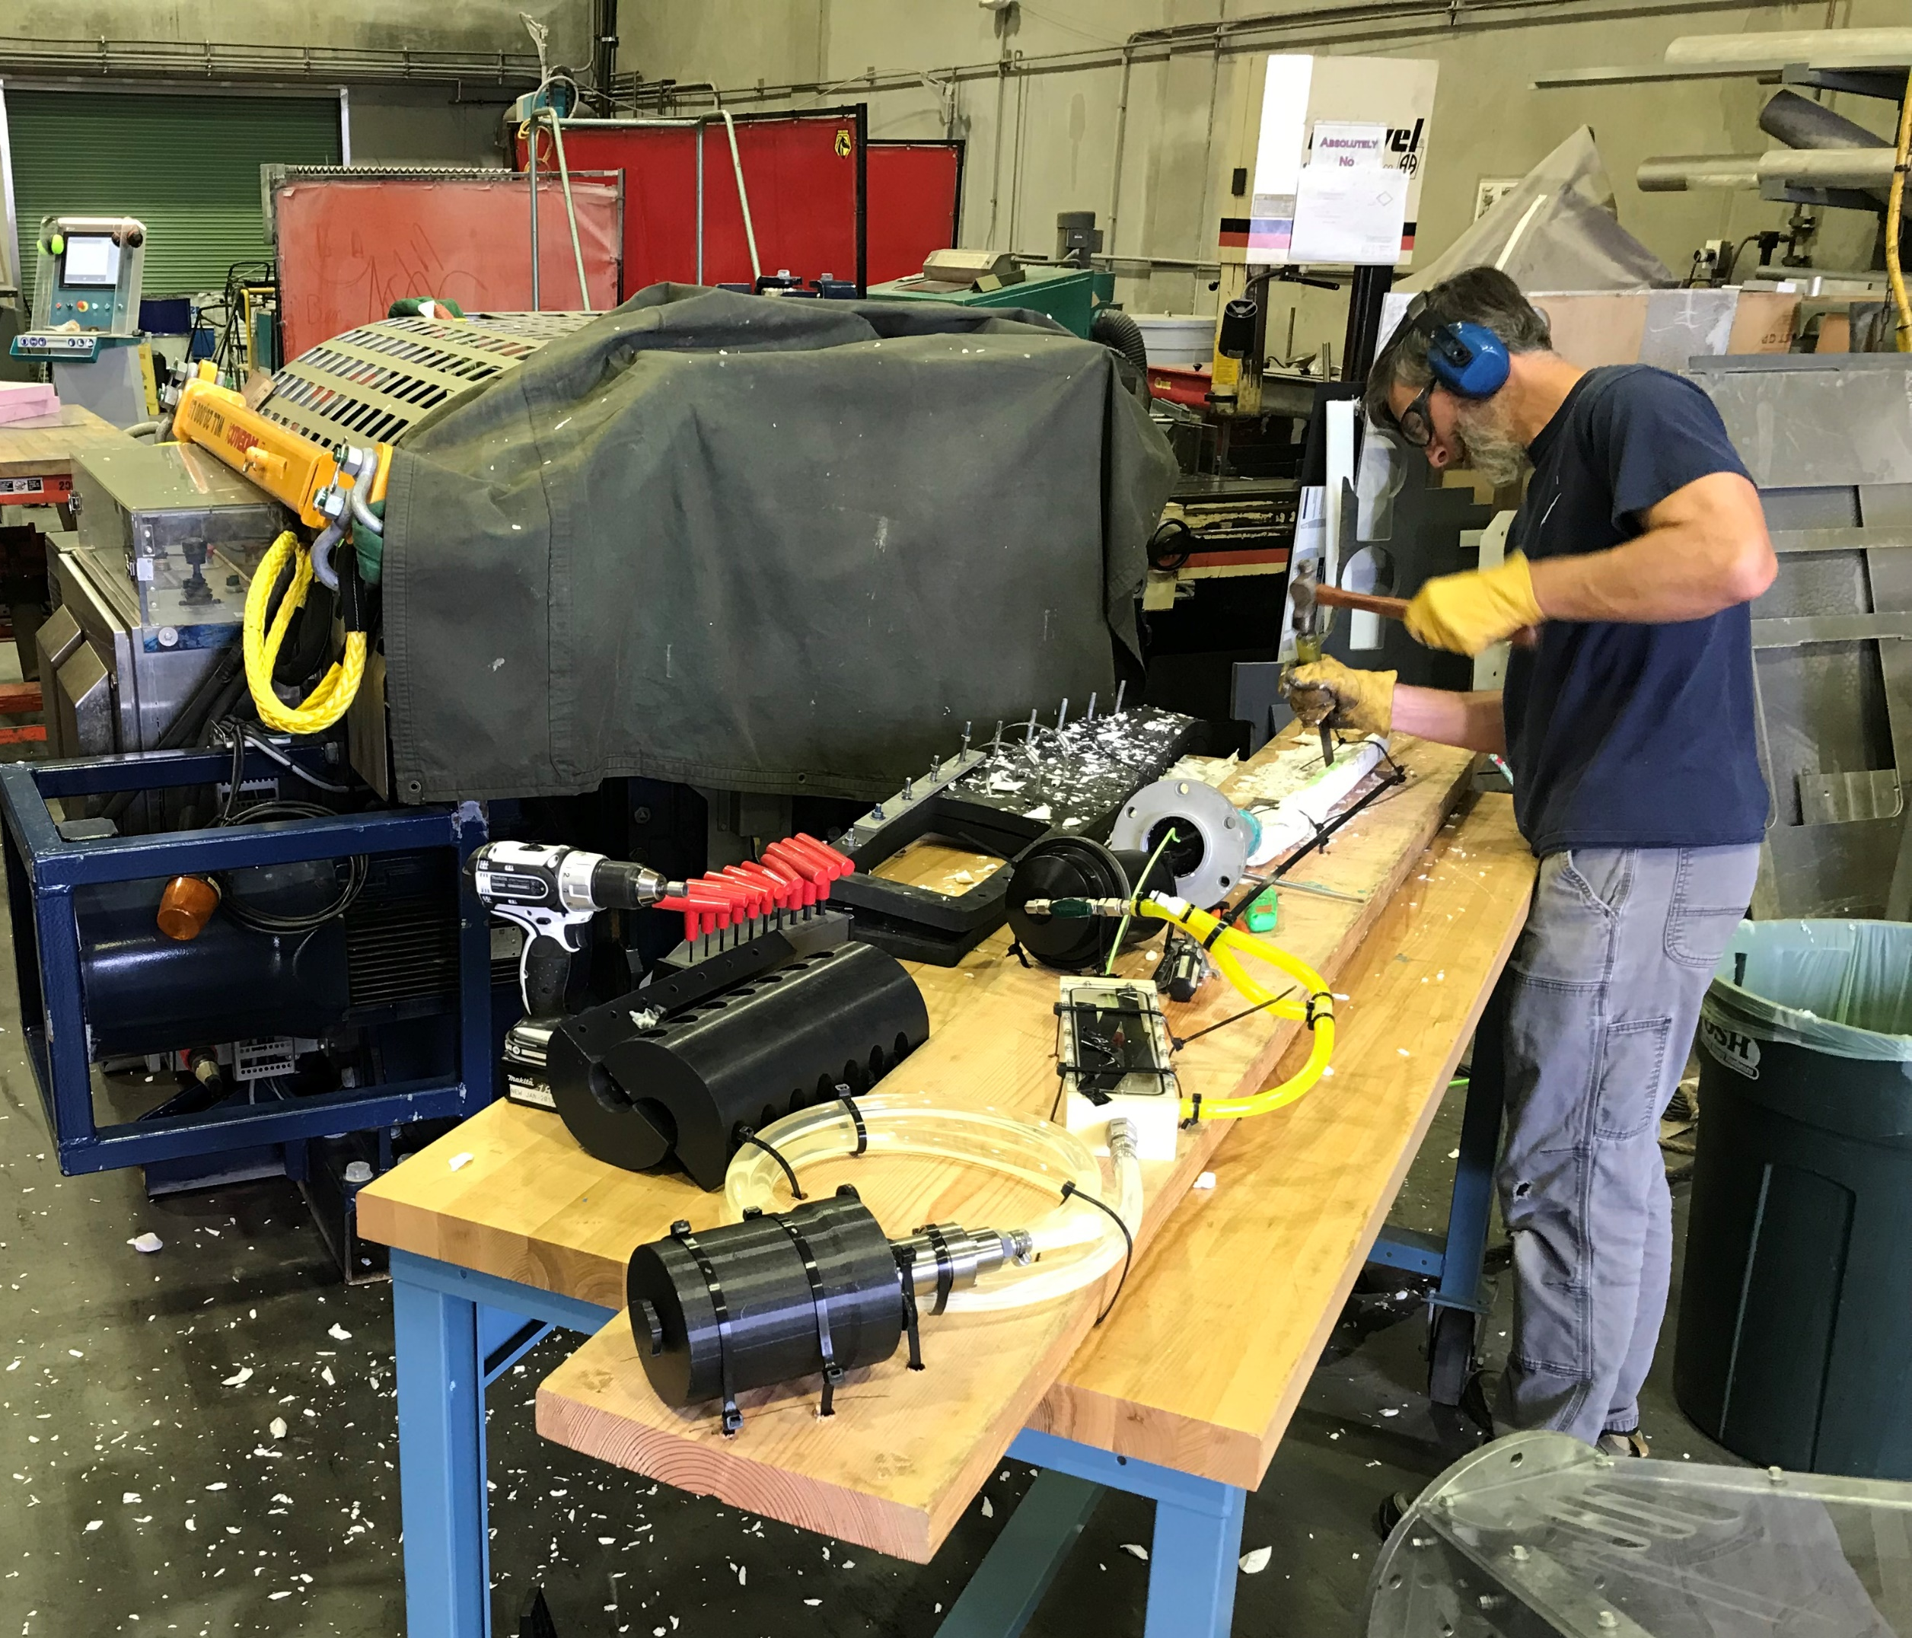
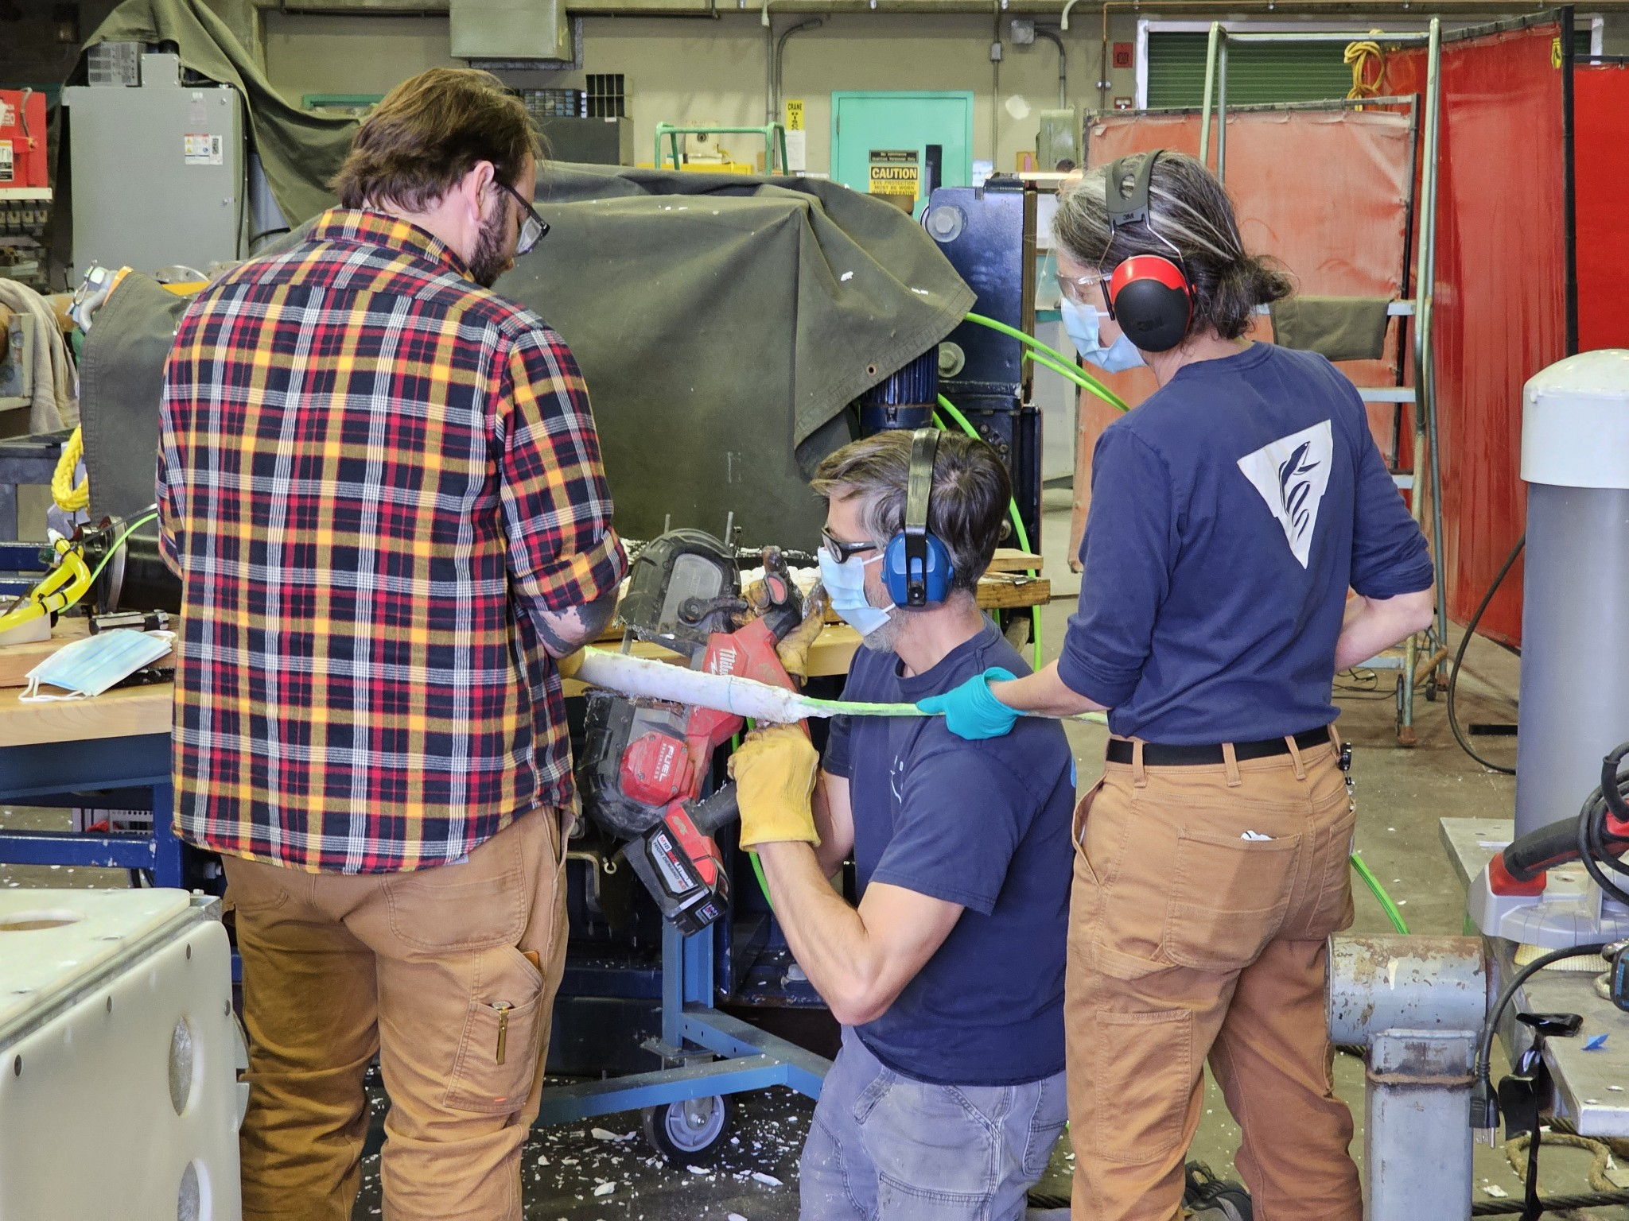
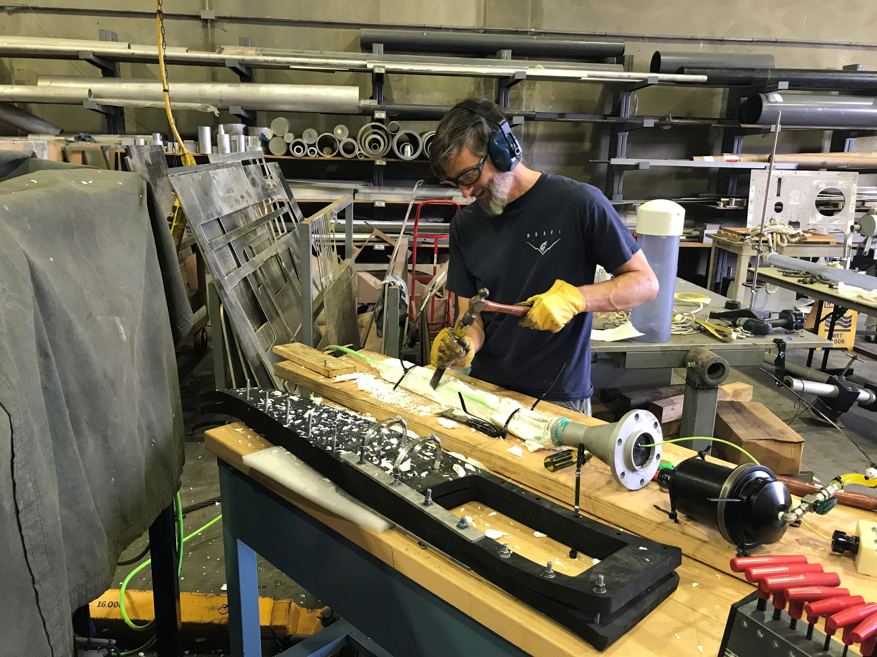
Chipping away at the problem

Slide 30
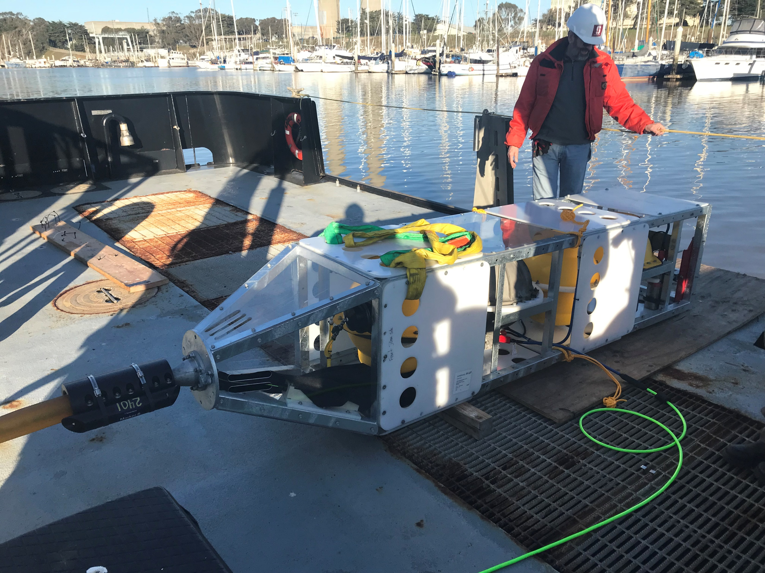
Monday, Jan 27
Mob Day
Notes:
Phase lock loop chip, clock drift 5%

Slide 31
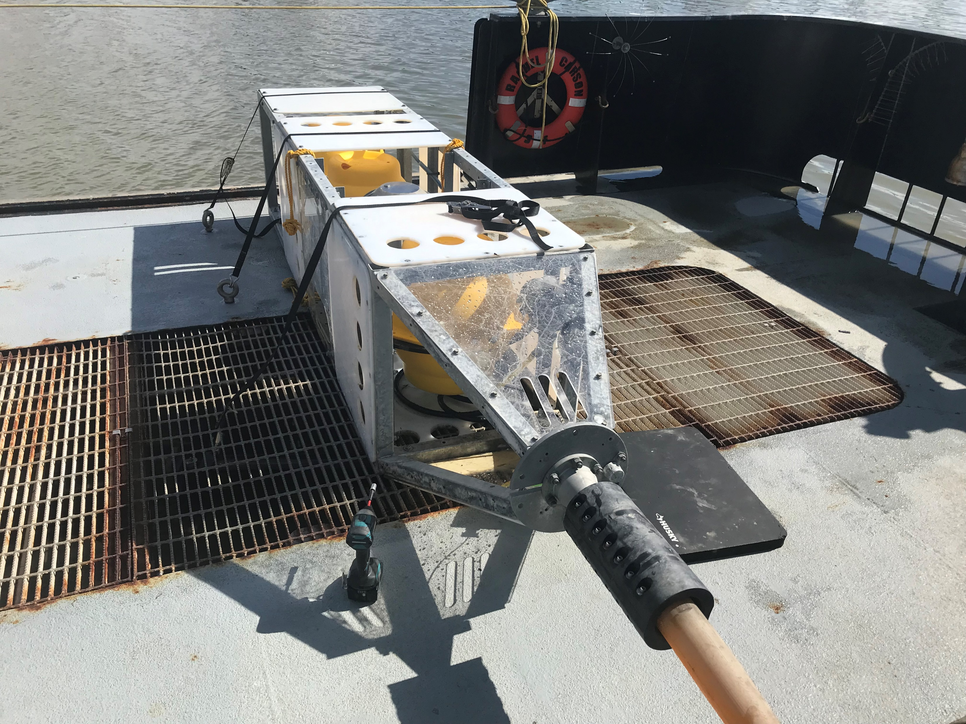
Recovery – Feb 28

Slide 32
Deployment Method

Slide 33
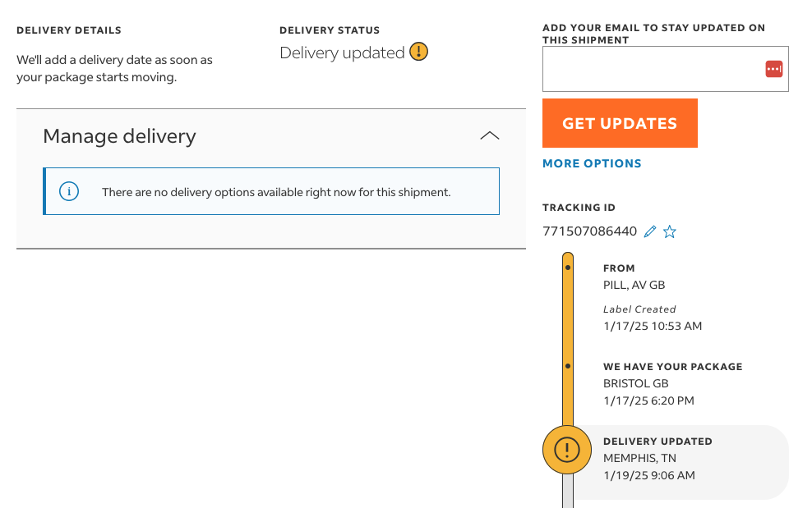
Where is that other DAS…

Slide 34
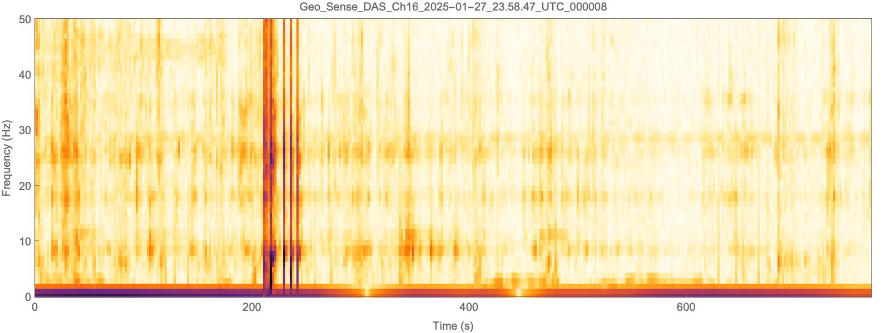

Spectrograms and sounds: On deck
Notes:
This is sped up ten times so we can hear them. Impact drill most likely

Slide 35
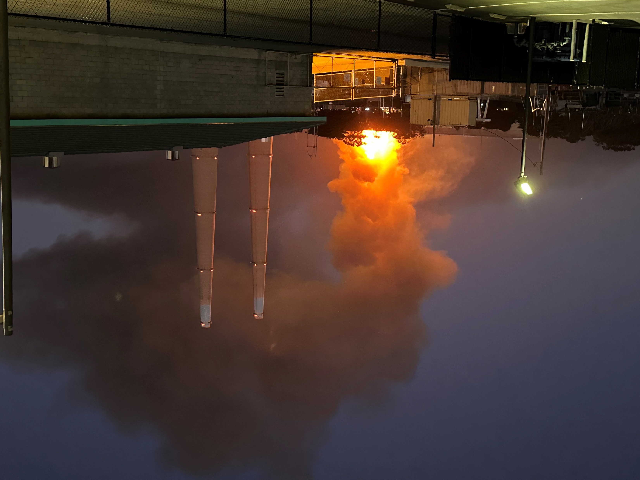
Jan 16 – 8 days until deployment
Slight Delay….

