Slide 1
Deployment Methods R/V Gaia Blu
September 15, 2025

Slide 2
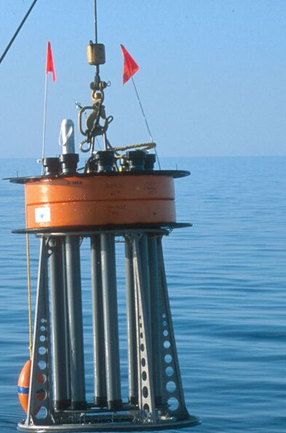
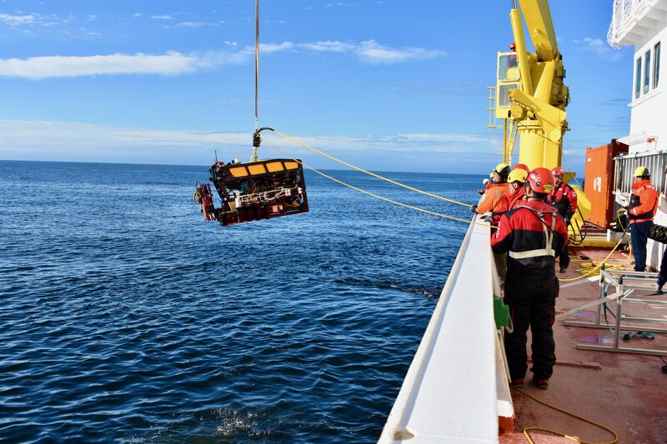

Elevator Method
Requires:
Elevator
  Build our own that can be reassembled on site
Cable spool with Linden cable
Recovery mechanism, either:
  Acoustic release requires:
    Sonardyne RT-6 300 release (borrow DMO, otherwise cost >$10k. Bryan thinks DMO can lend)
    MiniROV mini Ranger 2 topside (borrow from MiniTeam or ASO)
  Pop up buoy
    Edgetech pop up (buy $14k)
    borrowed deck box (KBB)
ROV to unspool cable -MiniROV
Ability to detach spool from ROV – modify toolsled?
What else?

Slide 3
Elevator Method
Requires:
Pros
  Ability to lay cable carefully, avoiding hazards
  Cable laying and surveying could happen simultaneously
  Perhaps use DSC to talk to instrument from mini
  Straightforward recovery with elevator
  ROV could assist with recovery is issues arise
  Other ROV work on cruise?
Cons
  Requires more time to set up ROV system on foreign vessel- definitely would increase number of mob days
  increases the cost of shipping containers
  Large payload/ballast change for Mini
Costs
  Ship 2 containers. ChatGPT says still possible for $26k
  Cost of building elevator from existing parts
  Extra labor and mob day for Mini

Slide 4
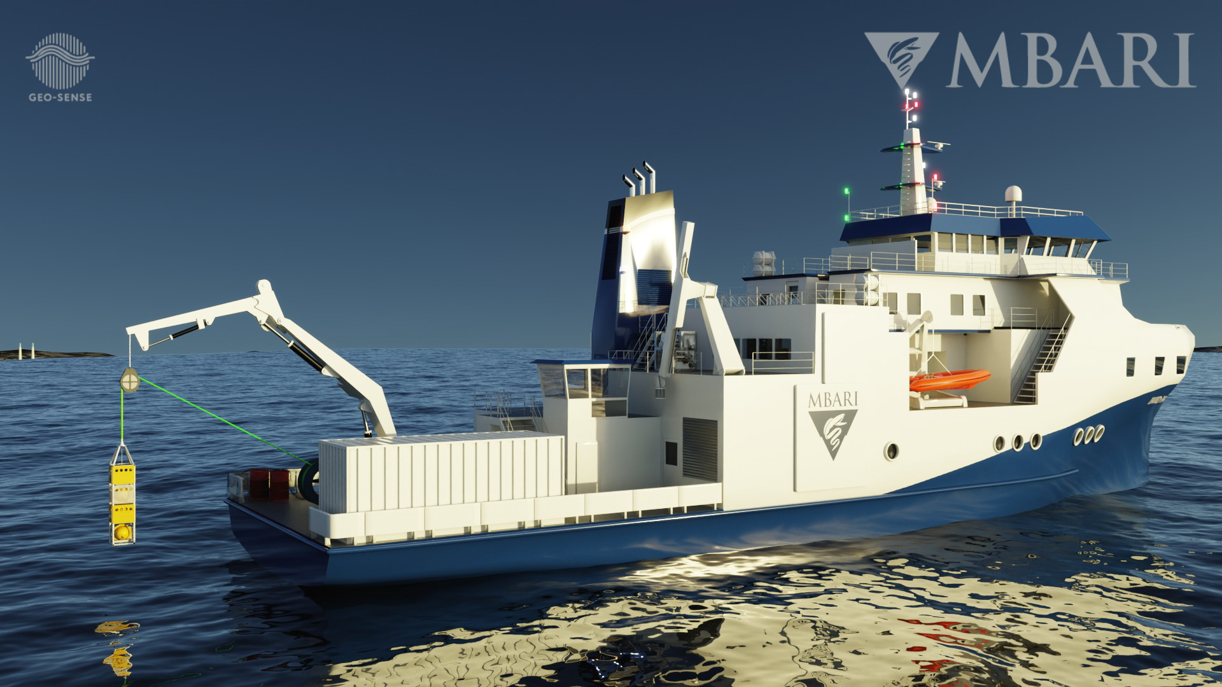
Winch method
Requires
Winch
  Macartney if available
  Use R/V Gaia Blu is possible hydraulic winch
Original instrument with Winchester cable
Payout counter and sheave
Crane to deploy instrument
  Not a problem for R/V Gaia Blu
Recovery method
  Pop-up buoy
    Edgetech
      pop up (buy $14k)
      borrowed deck box (KBB)
    Fiomarine
      Timer based spool release $5k
Inspection class ROV to survey cable (borrow from Alessandra? Mola?)

Slide 5
Winch method
Pros
Only one deployed asset – no ROV to set up
We’ve tried it and we know it works
Cons
Less control over placement
Will require a new expensive system to recover – more recovery risk
More complex if we can’t take Macartney winch
Costs:
Shipping 1 container
Pop-up buoy ~ $14k unless one is at MBARI

