Slide 1
Geo-Sense

Slide 2
1. How do we take the rapidly developing DAS technology and deploy it as an autonomous instrument?
2. What information can DAS technology provide on the initiation and behavior of sedimentary flows in Monterey Canyon?

Slide 3
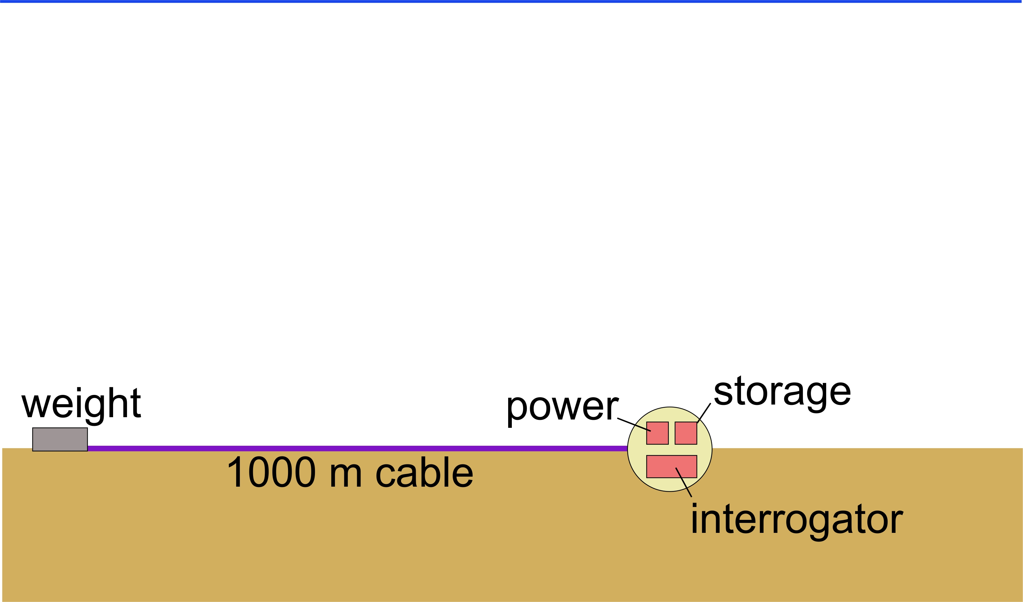
1. How do we take the rapidly developing DAS technology and deploy it as an autonomous instrument?
sea-level
Monterey

Slide 4

System Diagram
Electronics
Housing
Rover Battery
Sphere
9 kWhr
Rover Battery
Sphere
9 kWhr
DAS
Fiber Optic Cable

Slide 5
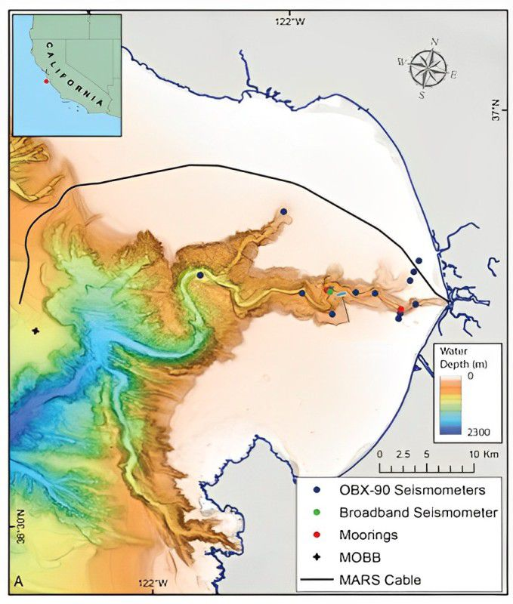
2. What information can DAS technology provide on the initiation and behavior of sedimentary flows in Monterey Canyon?
MARS cable
Moored instruments
Geo-Sense
Water
depth (m)
Seismometers
0
2300

Slide 6
Budget
  DAS interrogator - $55,000
  Battery package (20 kWhrs of Li primary batteries) - $20,000
  Underwater cable - $20,000
  FO connectors - $10,000
  Beacons (if required) - $5,000
  Frame materials and mechanical components - $3,000
  Travel (to Sintela HQ) - $1,645
Monterey

Slide 7
Team
Personnel
Science
Charlie Paull, Roberto Gwiazda, Eve Lundsten, John Ryan
Engineering
Alana Sherman (400 hrs) – project manager
Aaron Schnittger (240 hrs)
Denis Klimov (280 hrs)
Paul McGill (280 hrs)
Rich Henthorn (120 hrs)
Yanwu Zhang (20 hrs)
DMO
Knute Brekke (80 hrs)
DMO-Marine Operations Support (160 hrs)
Monterey

Slide 8
Ship requirements
  R/V Packard – 2 days for testing in October 2024 (?)
Monterey

Slide 9
Work plan 2024
Task | Month (2024)
 | Jan | Feb | Mar | Apr | May | Jun | Jul | Aug | Sep | Oct | Nov | Dec
Question 1
Identify latest suitable instruments
Develop a conceptual design of a portable DAS system
Carry out SWOT analysis
Conduct a design review
Question 2
Critical design review and detailed design
Selection of appropriate deployment and recovery protocol
Identify components already available at MBARI
Procurement of interrogator, cable and batteries
Assembly of prototype
Testing of prototype in the lab and field
Others
Permitting issues
Monterey

Slide 10
Work plan 2025
  Deployment/recovery of DAS prototype in January – February 2025 in Monterey Canyon
Monterey

Slide 11
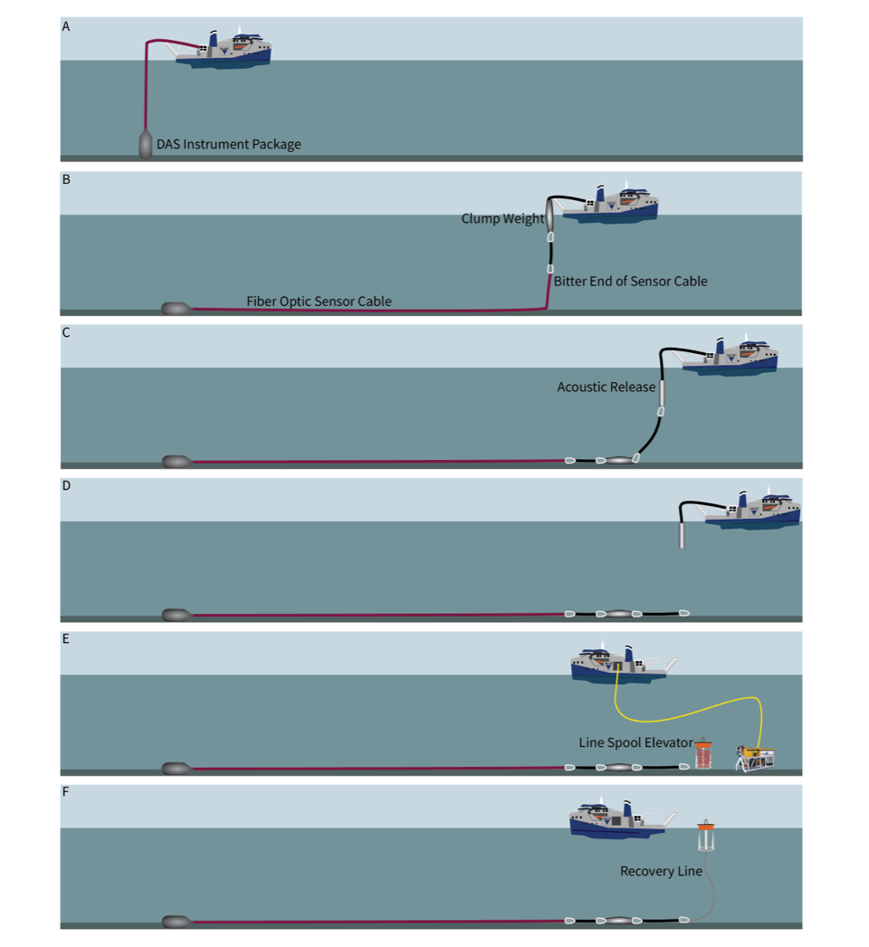
Deployment/recovery strategy
Monterey

