Slide 1
GeoSense
DAS Cable
Design Review
Mechanical Engineering Team Review

Slide 2
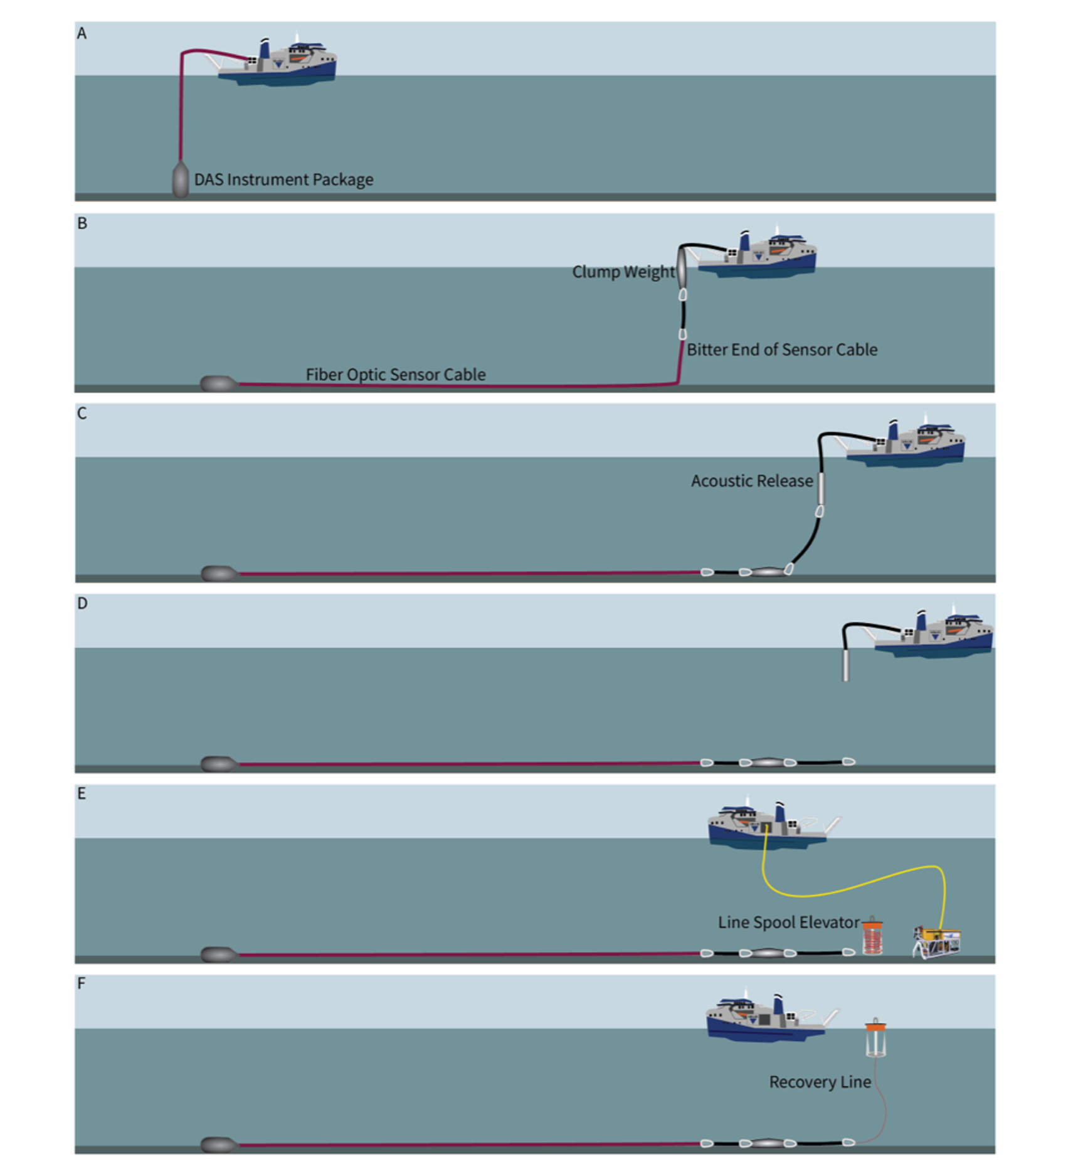
The Paull Plan
Factors influencing cable Survivability
Weight of Electronics Package
Sea-state Conditions
Peak Loads (Heave Loads)
Currents in the water column
Current Vectors in the water column
R/V D. Packard's Dynamic Positioning

Slide 3
Cable Requirements During Deployment
Deployed from R/V David Packard using the MacArtney Winch
Electronics package connected to 1kM of armored fiber optic cable
Cable may be used to lower and recover electronics package
Location- A bench along Monterey Canyon ~390 meters depth
Payout electronics package and 1kM cable in a straight-ish line
Lower (Electronics package/bitter end) to seafloor and spool out cable

Slide 4
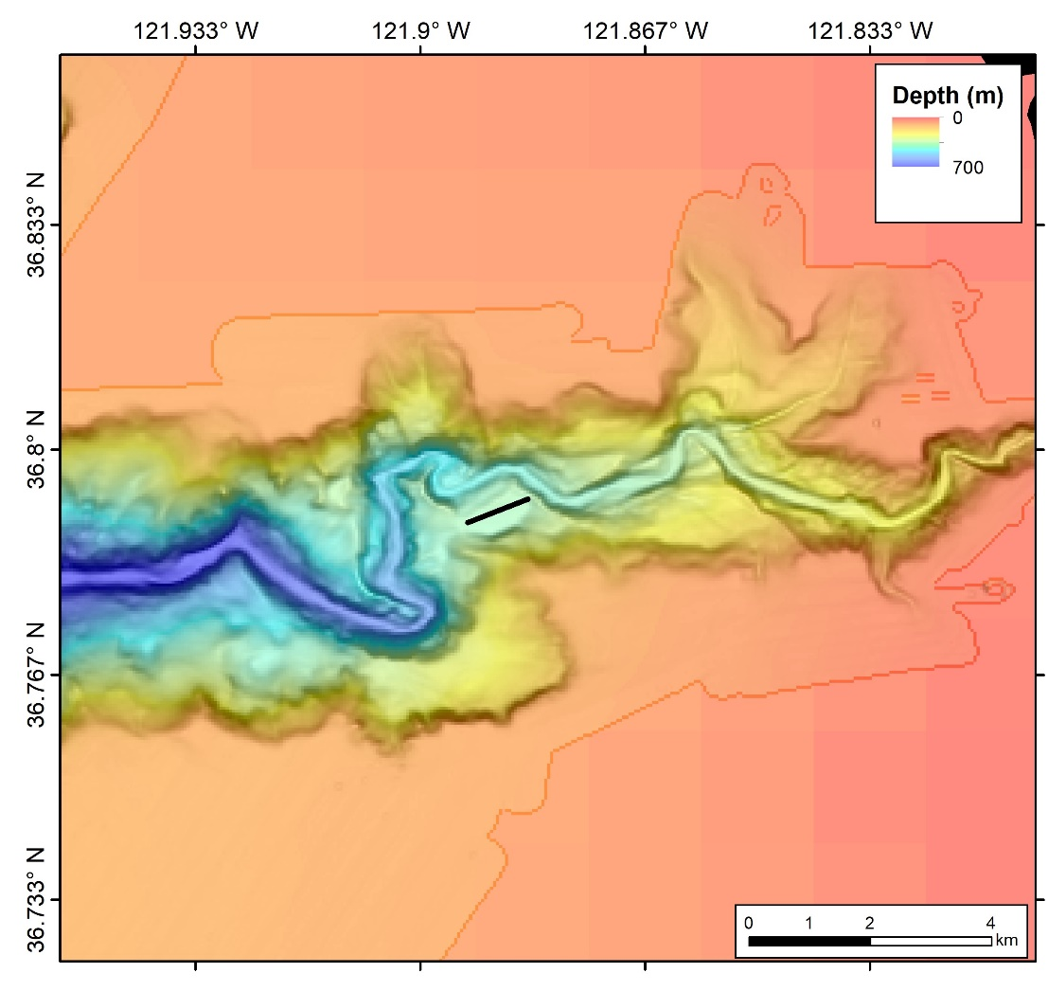
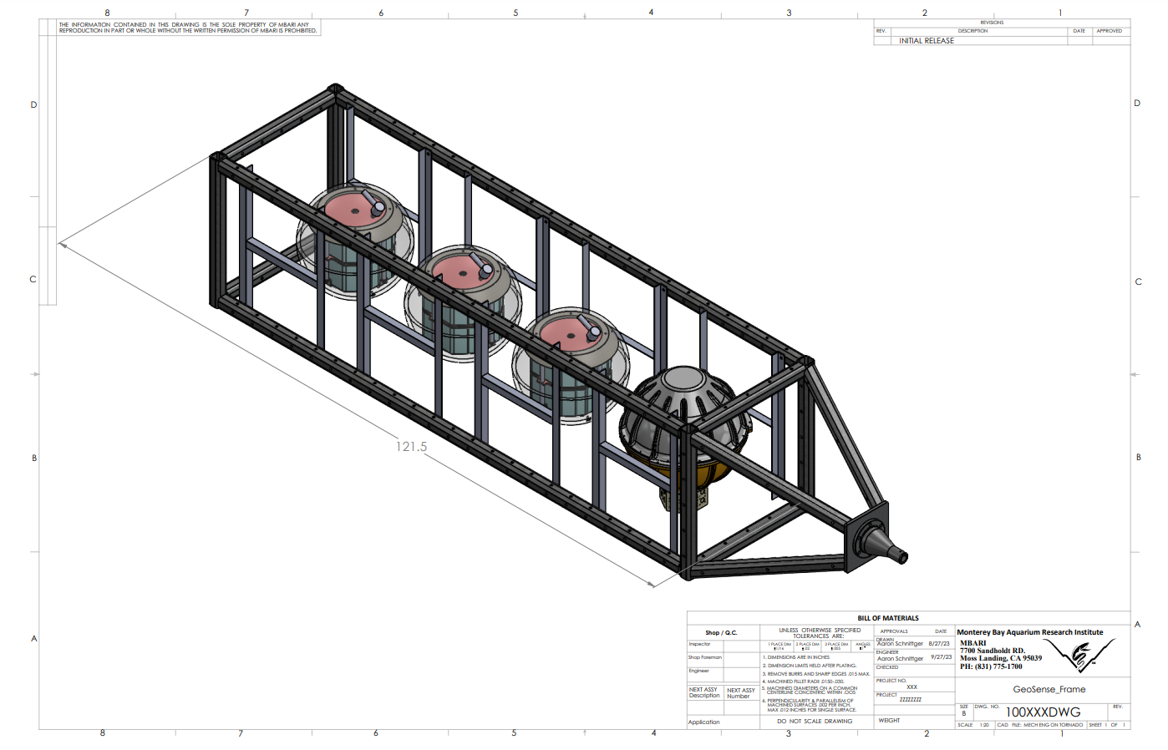
Location of the Cable Lay
Electronics Package (Current Configuration)
Desired wet weight of 300 lbs.(~140 Kg)

Slide 5
Mechanical Requirements Submitted to Vendors
Armored Cable
Double wrap torque balanced galvanized steel wire
Minimum breaking strength ≥ 50kN
Outer Sheath (Polyethylene or Polyurethane)
Separate layer to make breaking out the fibers easier
Bend Radius
The winch that MBARI currently uses and has the capacity for 1km of cable is a MacArtney winch(Model No.*******) with a drum radius of 0.3 meters
Weight in Sea water
Cable weight ≥ .320 kg/m (negatively buoyant)
Other Desired Characteristics
Fiber breaking cable load ≥ 20kN
OD of Cable ≥ 15mm
Excess fiber in tube 0.1 - 0.3%
SWD minimum 2000M
Length 1000M

Slide 6
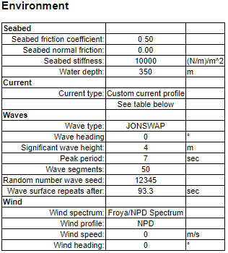

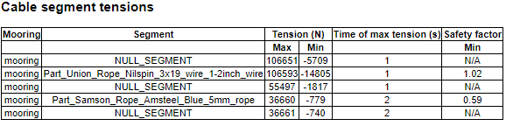
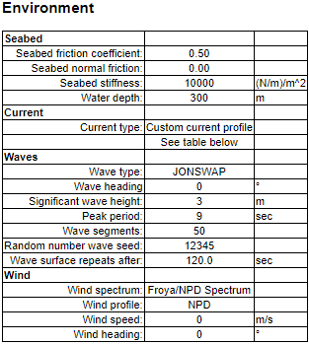

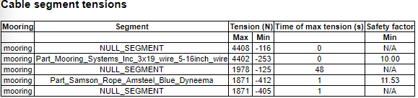
DSA Oceans
Proteus Mooring Simulation Software
Results
Used the Proteus cable directory to simulate a comparable cable with similar (weight per meter)
Simulated E-Package …

Slide 7


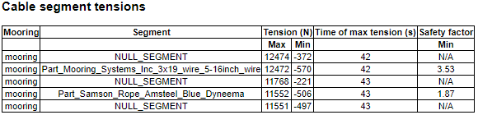
DSA Oceans
Proteus Mooring Simulation Software
Results(continued)
Cable Data
Electronics Package Data

Slide 8
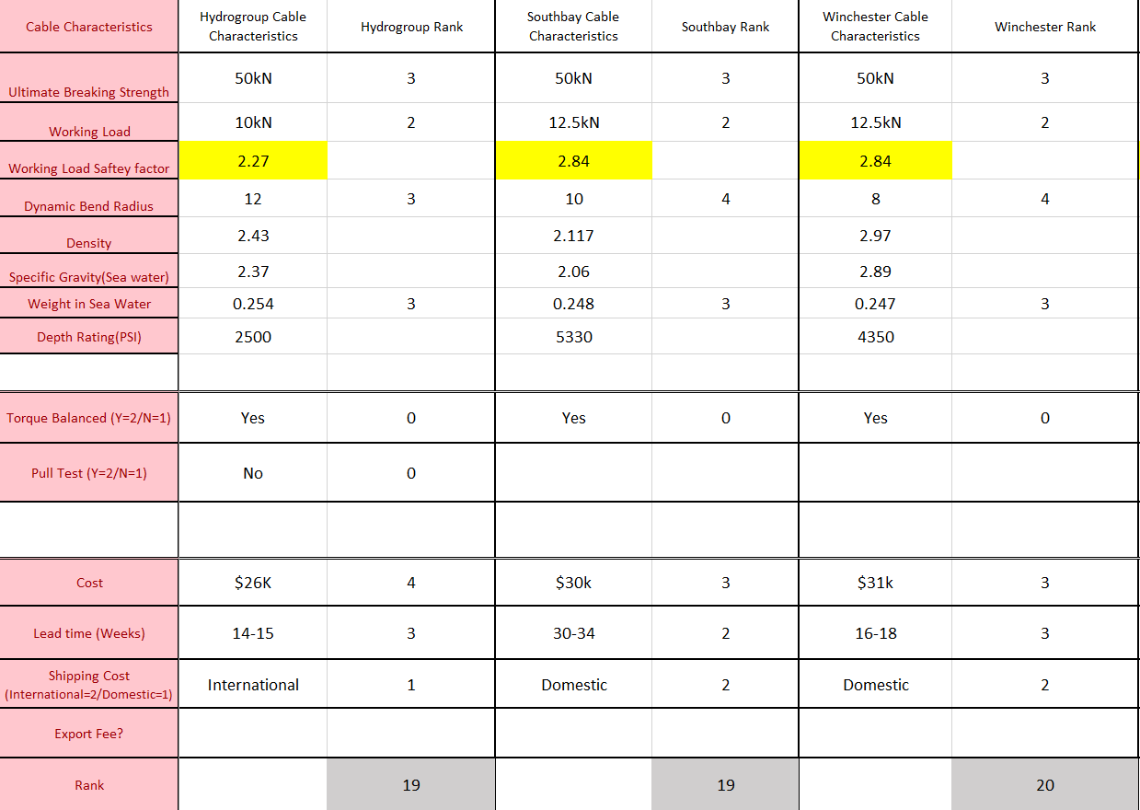

Slide 9
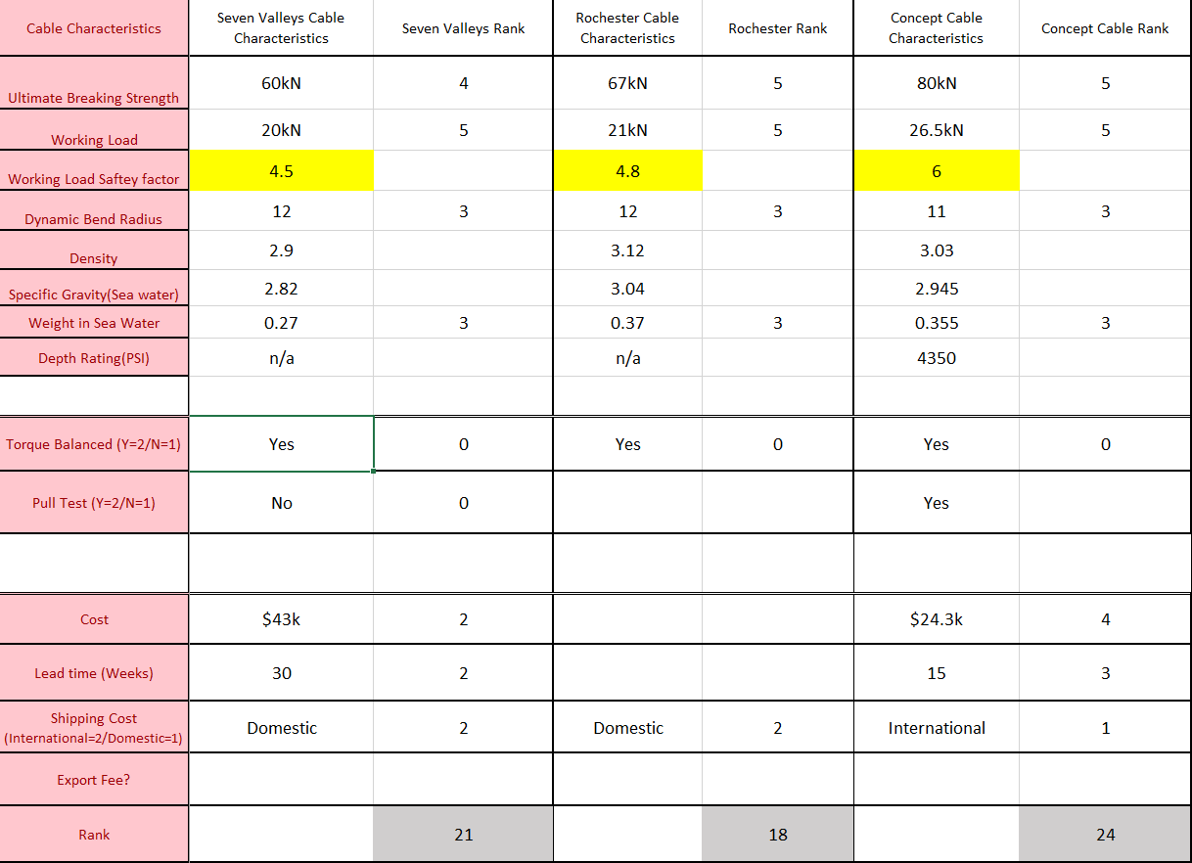

Slide 10
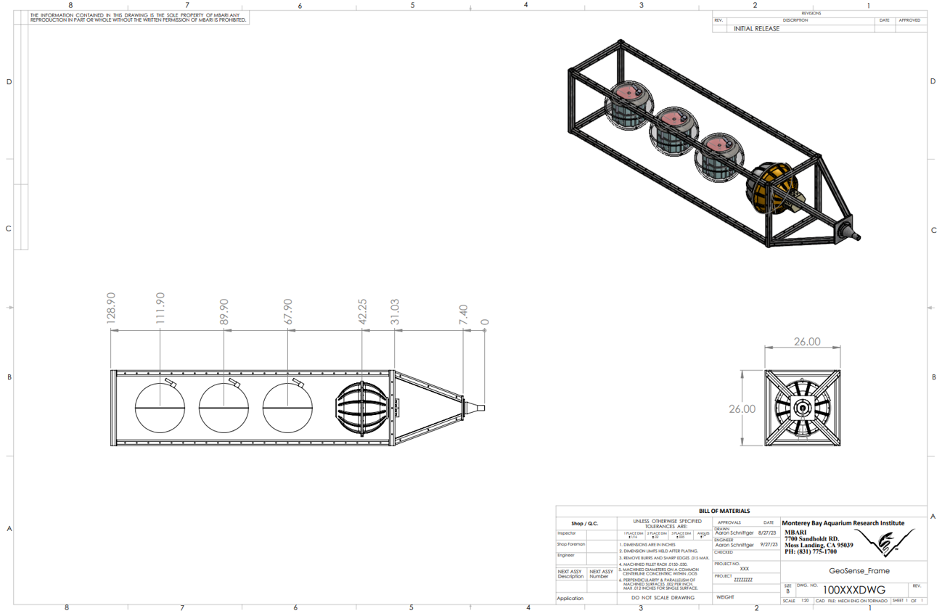
Electronics Frame
Dimensions

Slide 11
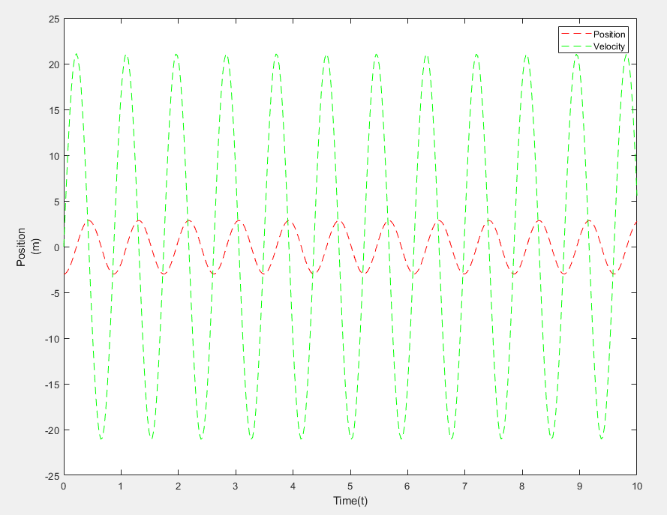
MatLAB Analysis
Still a work in progress:

Slide 12
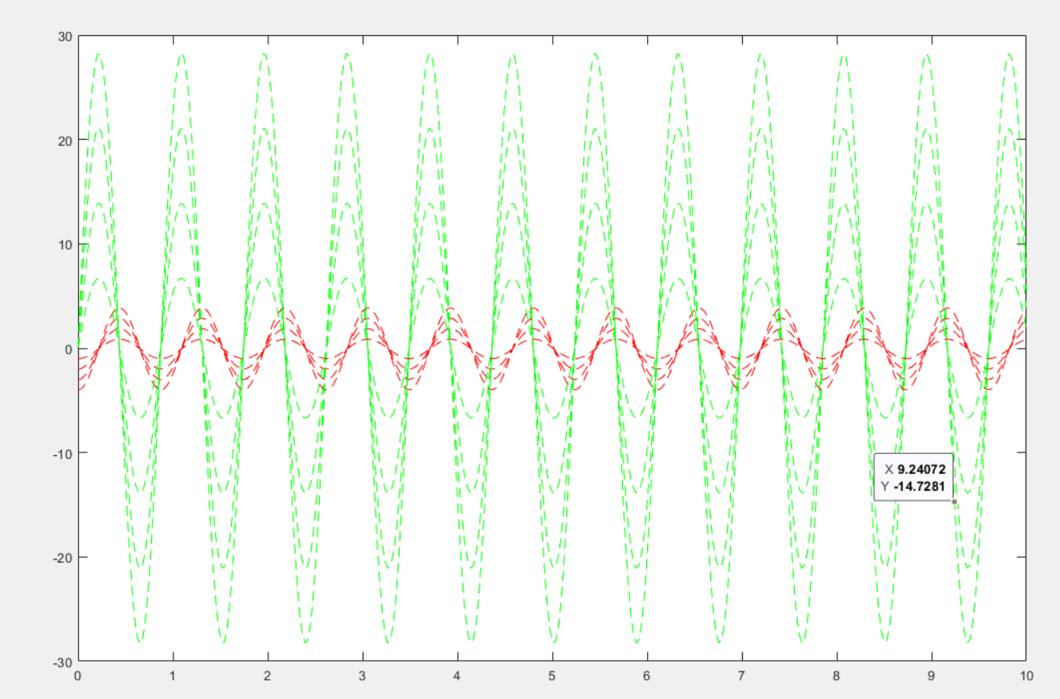
Responses Of Different Sea-States
1M
2M
3M
4M

