Slide 1
GeoSense
DAS Cable
Design Review
Mechanical Engineering Team Review

Slide 2
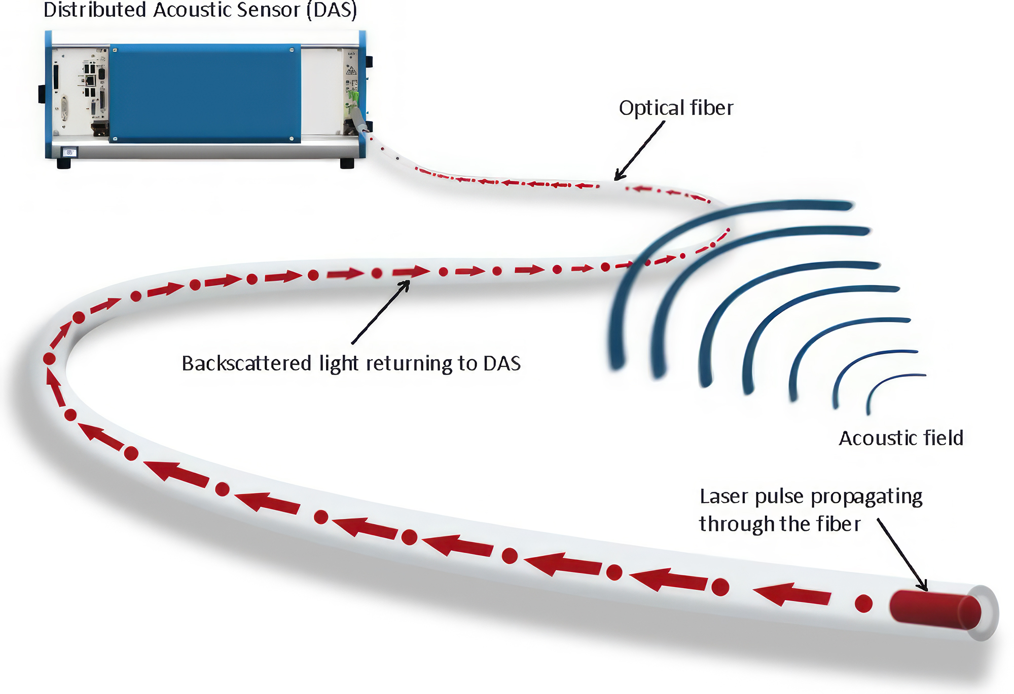
GeoSense Project Concept
Use Distributed Acoustic Sensing (DAS) to study marine sediment flows.

Slide 3
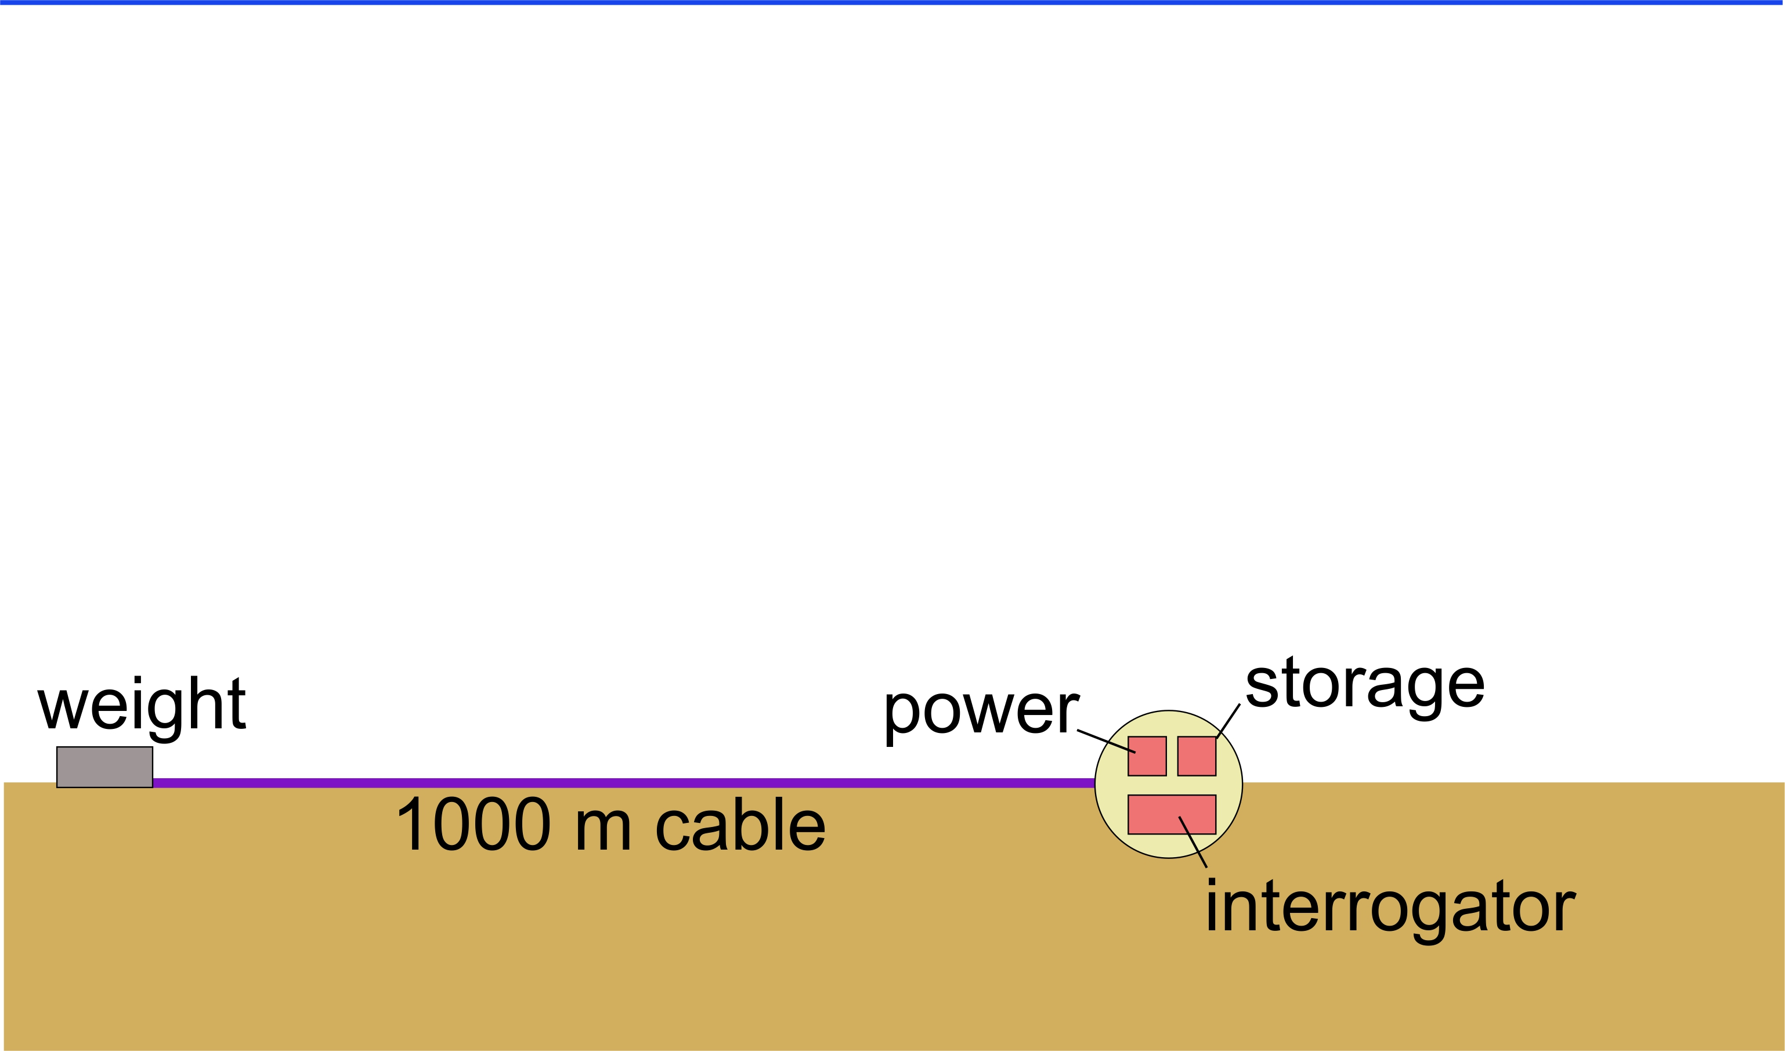
GeoSense Project Concept
sea-level

Slide 4
Review Goal
We have specified requirements for a cable (coming up in next slides)
We have solicited designs from 8 different manufacturers
Our goal today is to review the submitted designs /cable constructions toward the ultimate goal of selecting and purchasing our cable
We have our preference but would like your experienced opinions to confirm our selections
Due to the deployment strategy the cable is a critical part of the system design

Slide 5
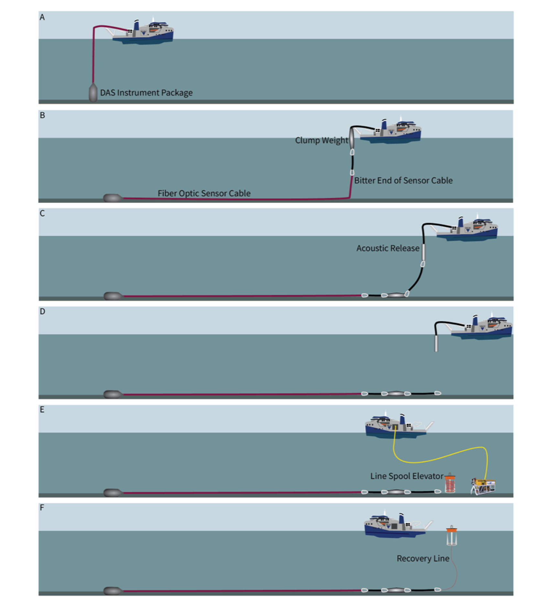
Deployment and Recovery Concept :
The Paull Plan
Factors influencing cable survivability:
Weight of Electronics Package
Sea-state Conditions
Peak Loads (Heave Loads)
Currents in the water column
Current Vectors in the water column
R/V D. Packard's Dynamic Positioning

Slide 6
Cable Requirements During Deployment
Deployable from R/V David Packard using the existing MacArtney winch
Electronics package will be connected to 1km of armored fiber optic cable
Cable must be used to lower and recover electronics package
Location- A bench along Monterey Canyon ~390 meters depth
Payout the1km cable in a straight-ish line

Slide 7
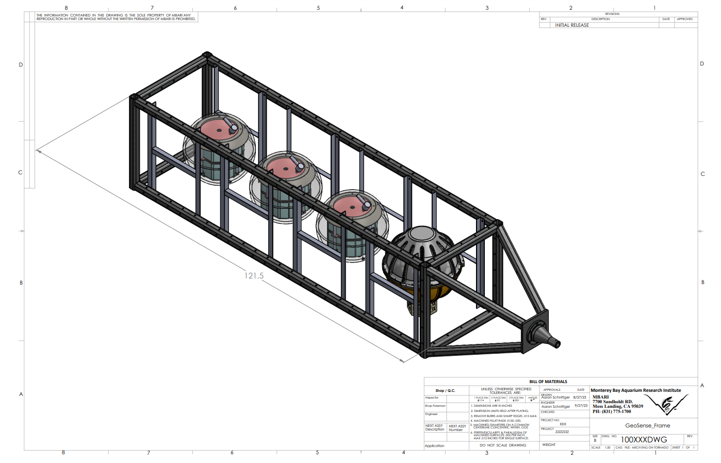
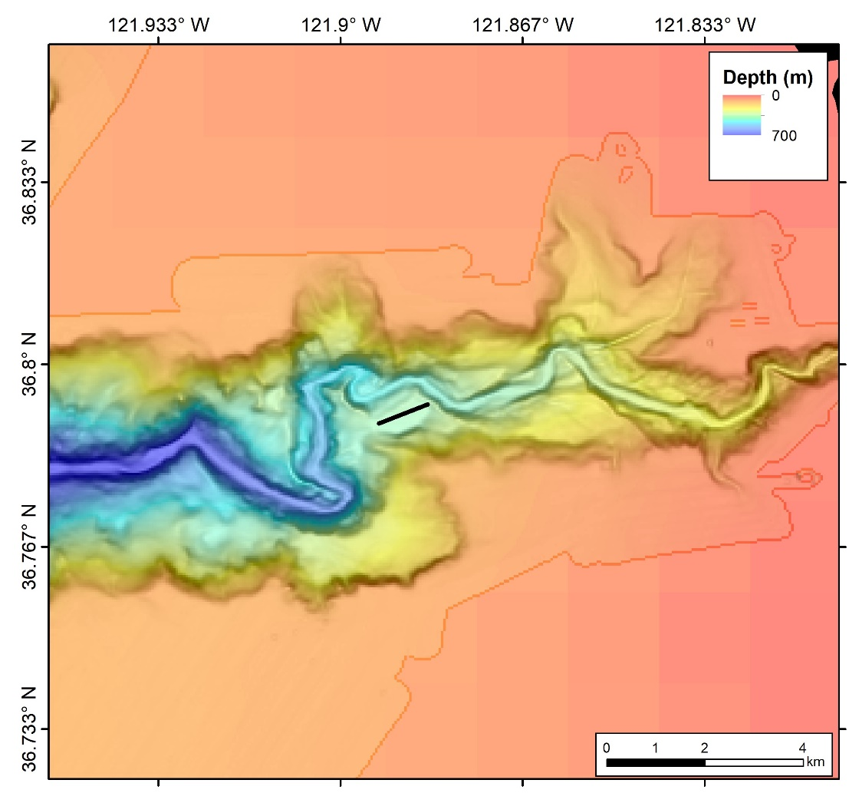
Geo-Sense Preliminary Design
Deployment Location:
Upper Canyon ~300 m
Instrument Package (Current Configuration)
Desired wet weight of 300 lbs.(~140 Kg)

Slide 8
Cable design – Simulation Results
Used DSA Oceans Proteus mooring simulation software used to estimate the load specifications for the DAS cable. A comparable cable (weight per meter) was used to simulate the strain in different sea states.
Cable Data
Electronics Package Data

Slide 9
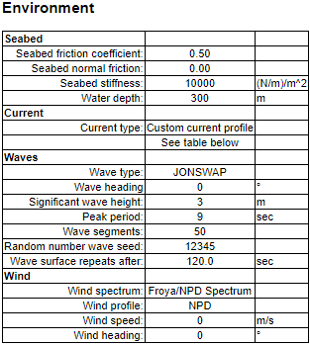

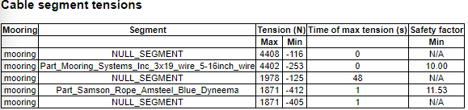
Simulations Results –
3m Wave Height/9 sec period

Slide 10


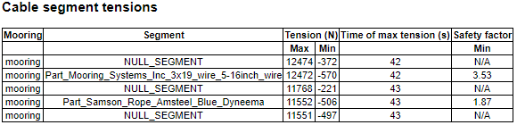
Simulation Results –
2 m Wave Height/ 2 sec period

Slide 11
Mechanical Requirements Submitted to Vendors
Armored Cable
Double wrap torque balanced galvanized steel wire
Minimum breaking strength ≥ 50kN
Outer Sheath (Polyethylene or Polyurethane)
Separate layer to make breaking out the fibers easier
Bend Radius
The winch that MBARI currently uses and has the capacity for 1km of cable is a MacArtney winch(Model No.*******) with a drum radius of 0.3 meters
Weight in Sea water
Cable weight ≥ .320 kg/m (negatively buoyant)
Other Desired Characteristics
Fiber breaking cable load ≥ 20kN
OD of Cable ≥ 15mm
Excess fiber in tube 0.1 - 0.3%
SWD minimum 2000m
Length 1000m

Slide 12
Cable Options
We requested cable designs and quotes from over 8 companies including:
  Southbay, Winchester (Falmat), Rochester, Seven Valleys (Cortland), Hydrogroup, Concept Cables, Nova Cavi, Birns
  A couple quotes had prices or lead times that are not feasible for us- in one case we still don’t have a quote

Slide 13
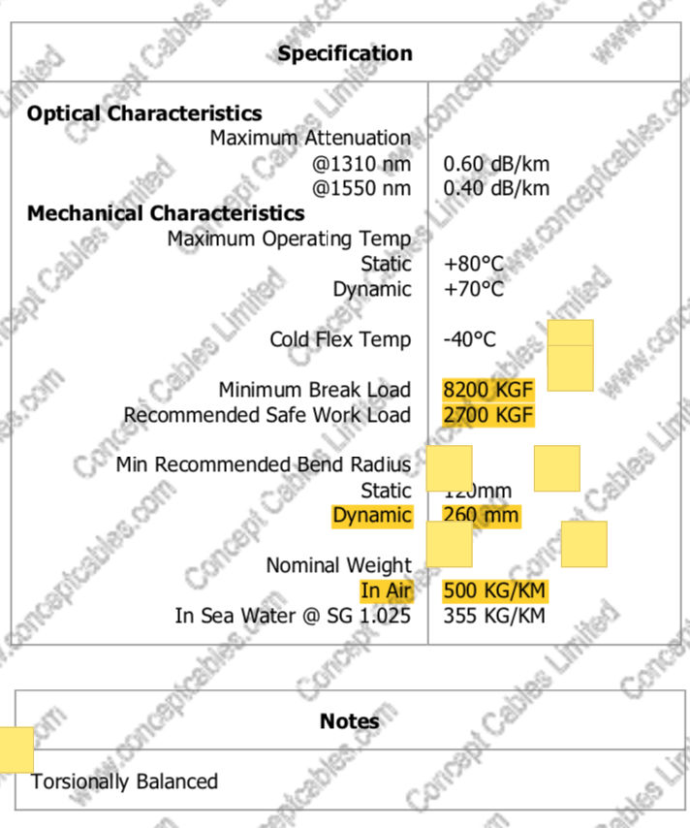
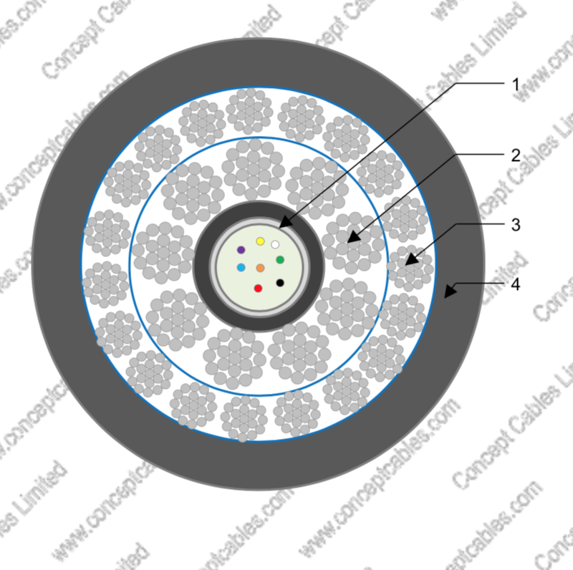
Concept Cables

Slide 14
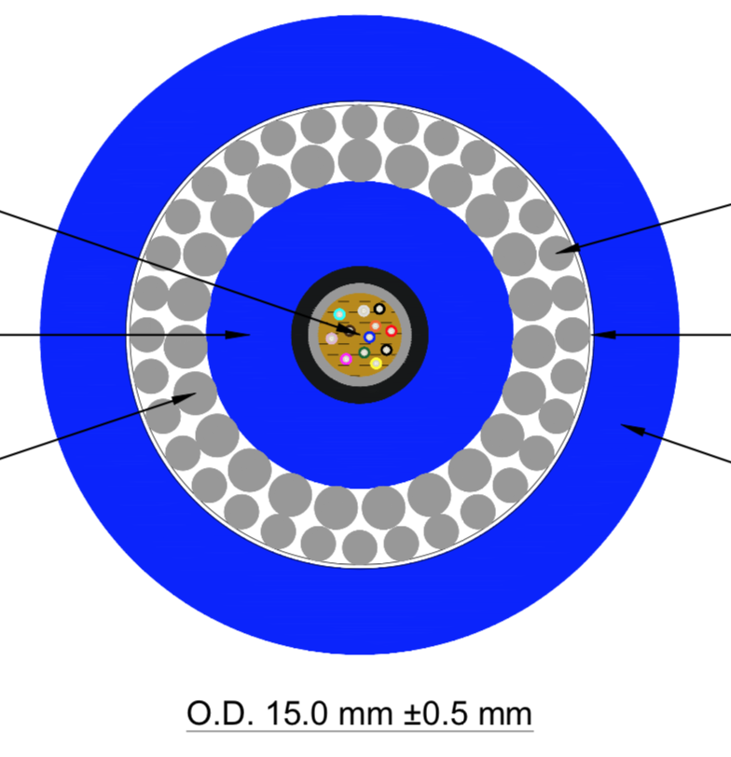
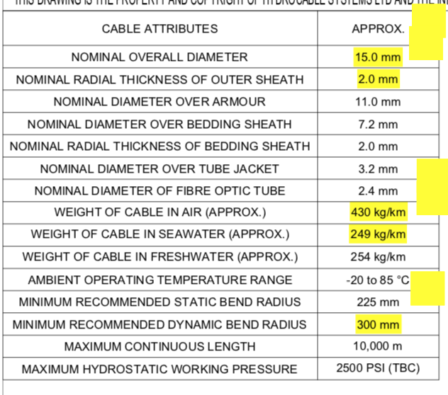
Hydrogroup

Slide 15
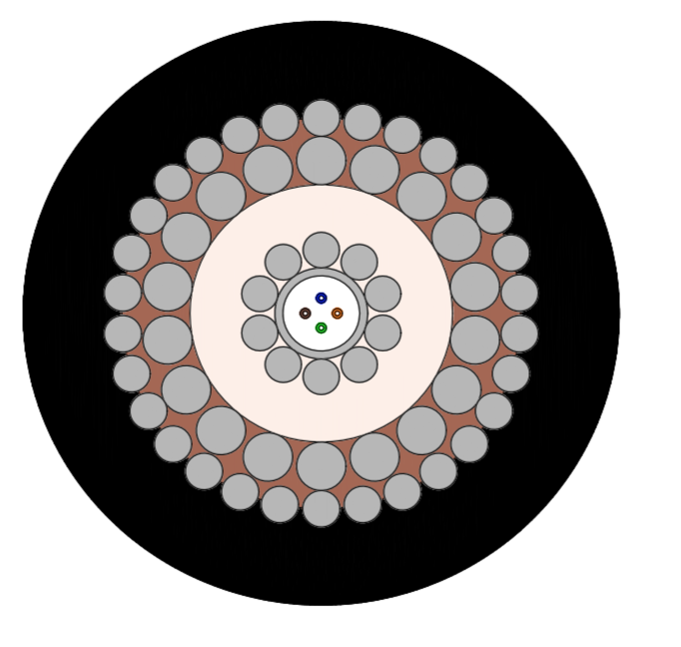
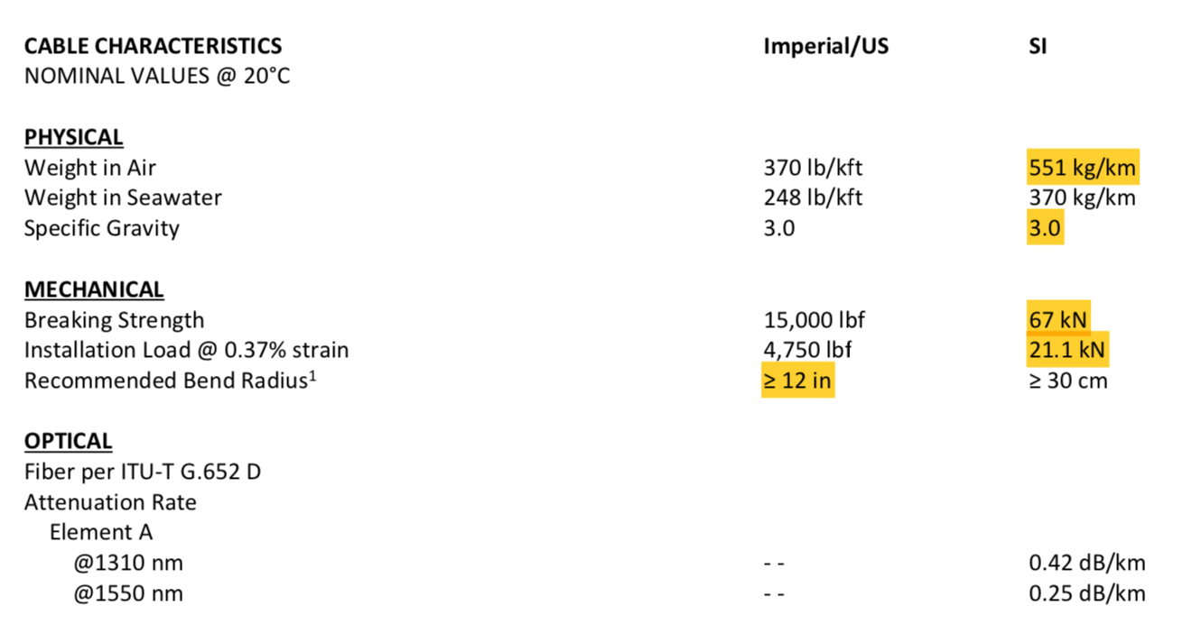
Rochester

Slide 16
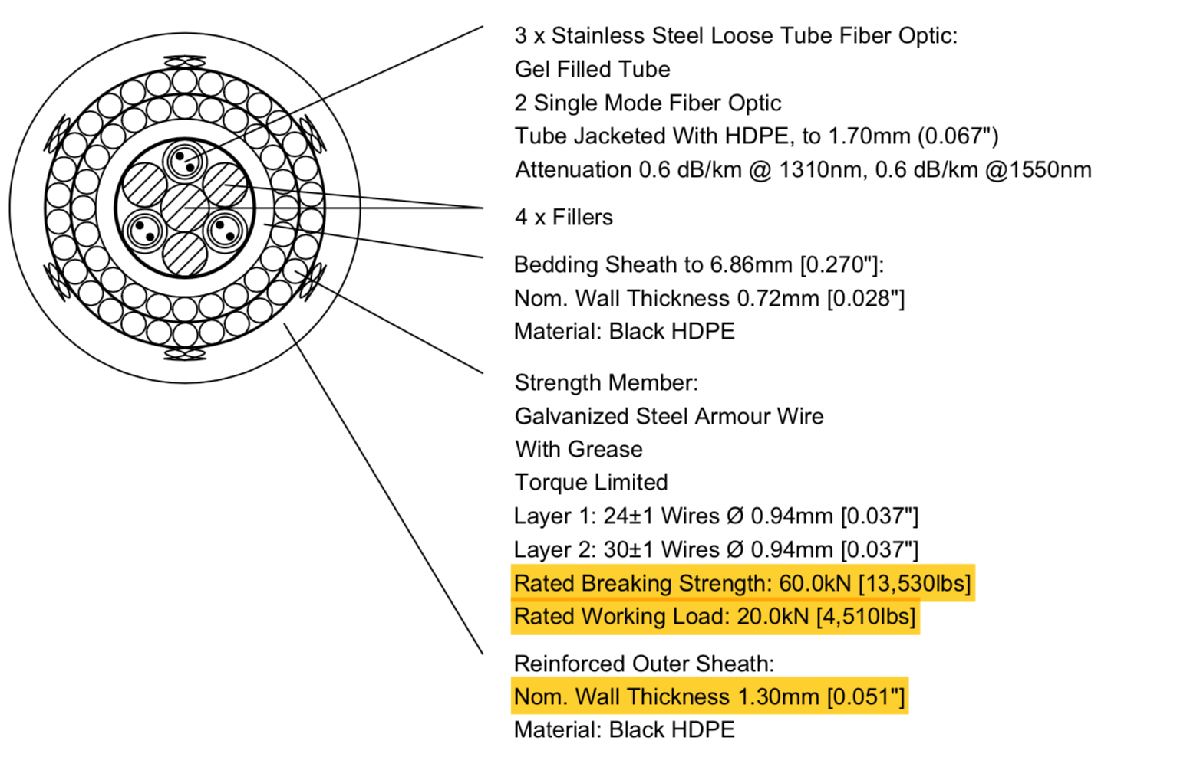
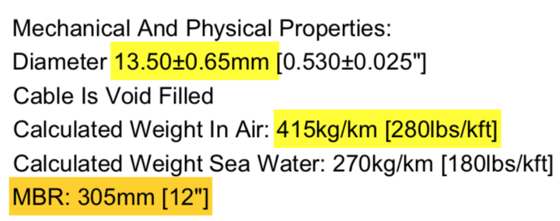
Seven Valleys

Slide 17
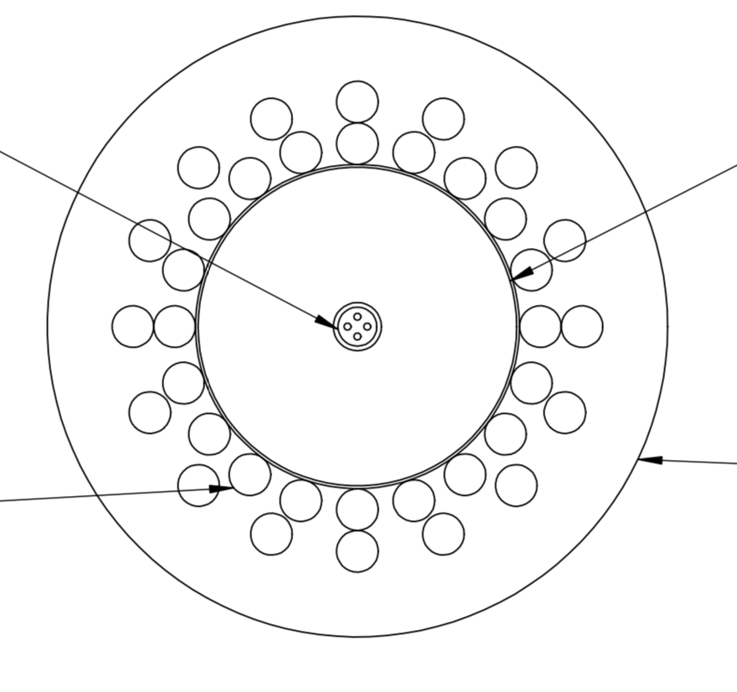
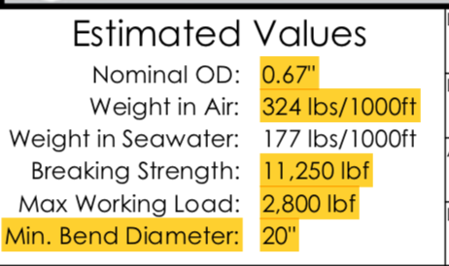
South Bay

Slide 18
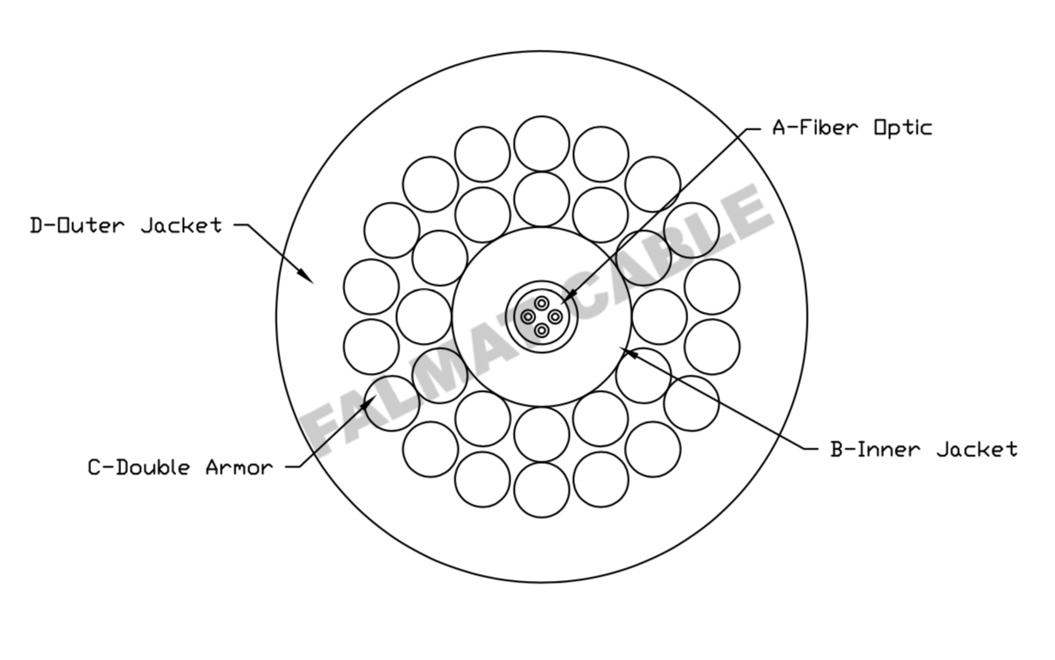
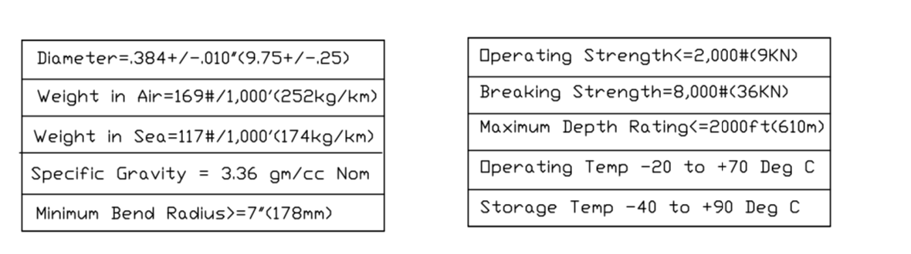
Winchester - Falmat

Slide 19
Cable Characteristics | Hydrogroup Cable Characteristics | Hydrogroup Rank | Southbay Cable Characteristics | Southbay Rank | Winchester Cable Characteristics | Winchester Rank
Ultimate Breaking Strength | 50kN | 3 | 50kN | 3 | 50kN | 3
Working Load | 10kN | 2 | 12.5kN | 2 | 12.5kN | 2
Working Load Safety factor | 2.27 |  | 2.84 |  | 2.84
Dynamic Bend Radius | 12 | 3 | 10 | 4 | 8 | 4
Density | 2.43 |  | 2.117 |  | 2.97
Specific Gravity(Sea water) | 2.37 |  | 2.06 |  | 2.89
Weight in Sea Water | 0.254 |  |  |  | 0.247
Depth Rating(PSI) | 2500 |  | 5330 |  | 4350
Torque Balanced (Y=2/N=1) | Yes | 0 | Yes | 0 | Yes | 0
Pull Test (Y=2/N=1) | No | 0
Cost | $26K | 4 | $30k | 3 | $31k | 3
Lead time (Weeks) | 14-15 |  | 30-34 |  | 16-18
Shipping Cost (International=2/Domestic=1) | International | 1 | Domestic | 2 | Domestic | 2
Rank |  | 13 |  | 14 |  | 14

Slide 20
Cable Characteristics | Seven Valleys Cable Characteristics | Seven Valleys Rank | Rochester Cable Characteristics | Rochester Rank | Concept Cable Characteristics | Concept Cable Rank
Ultimate Breaking Strength | 60kN | 4 | 67kN | 5 | 80kN | 5
Working Load | 20kN | 5 | 21kN | 5 | 26.5kN | 5
Working Load Saftey factor | 4.5 |  | 4.8 |  | 6
Dynamic Bend Radius | 12 | 3 | 12 | 3 | 11 | 3
Density | 2.9 |  | 3.12 |  | 3.03
Specific Gravity(Sea water) | 2.82 |  | 3.04 |  | 2.945
Weight in Sea Water | 0.27 |  | 0.37 |  | 0.377
Depth Rating(PSI) | n/a |  | n/a |  | 4350
Torque Balanced (Y=2/N=1) | Yes | 0 | Yes | 0 | Yes | 0
Pull Test (Y=2/N=1) | No | 0
Cost | $43k | 2 |  |  | $24.3k | 4
Lead time (Weeks) | 14-15
Shipping Cost (International=2/Domestic=1) | Domestic | 2 | Domestic | 2 | International | 1
Rank |  | 16 |  | 15 |  | 18

Slide 21
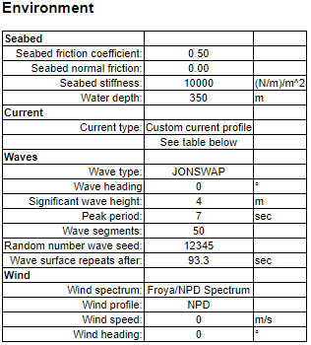

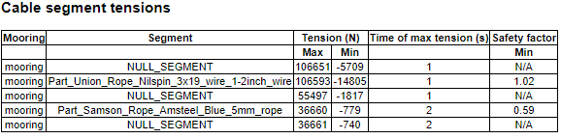
DSA Oceans
Proteus Mooring Simulation Software
Results
Used the Proteus cable directory to simulate a comparable cable with similar (weight per meter)
Simulated E-Package …

Slide 22
DSA Oceans
Proteus Mooring Simulation Software
Results(continued)

Slide 23
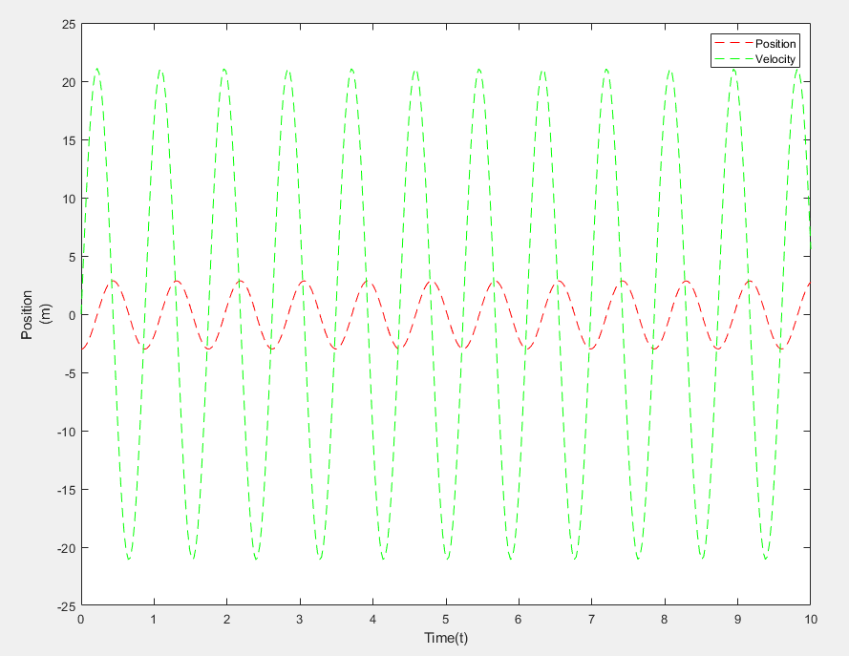
MatLAB Analysis
Still a work in progress:

Slide 24
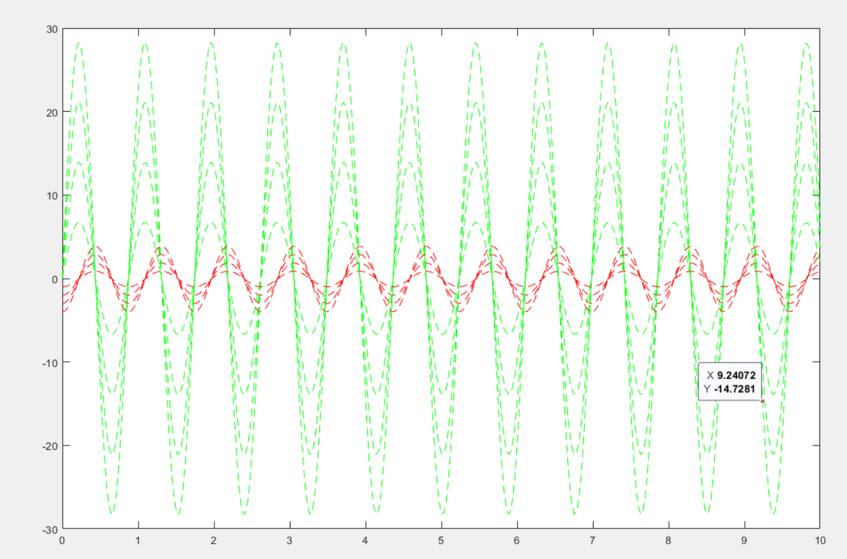
Responses Of Different Sea-States
1M
2M
3M
4M

Slide 25
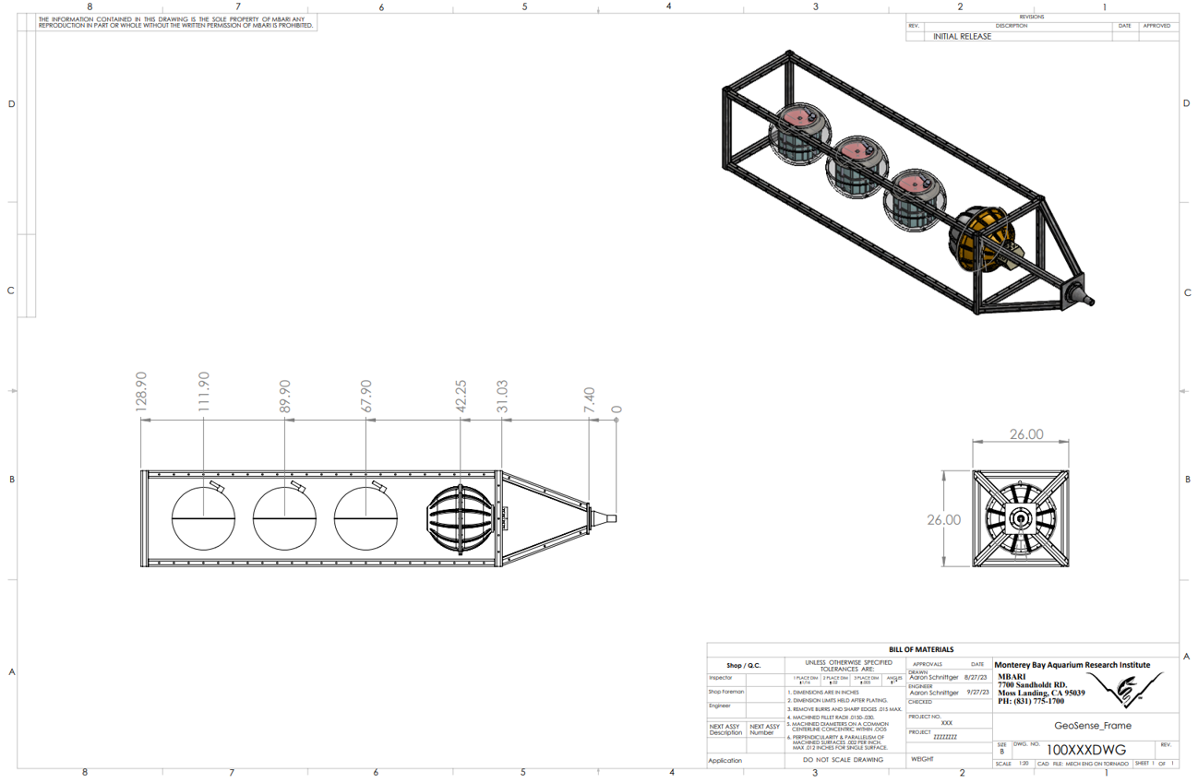
Electronics Frame
Dimensions

Slide 26
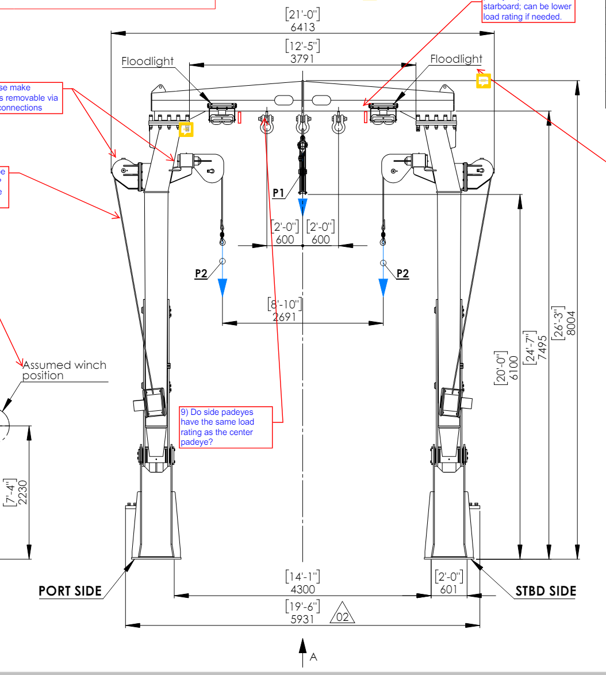
Using the “diggers” to pick up the frame and place in the water
A-frame will lower frame to bottom using center sheave
SWL of center sheave is 6 tonne
Sheave Clearance ~20 ft

Slide 27
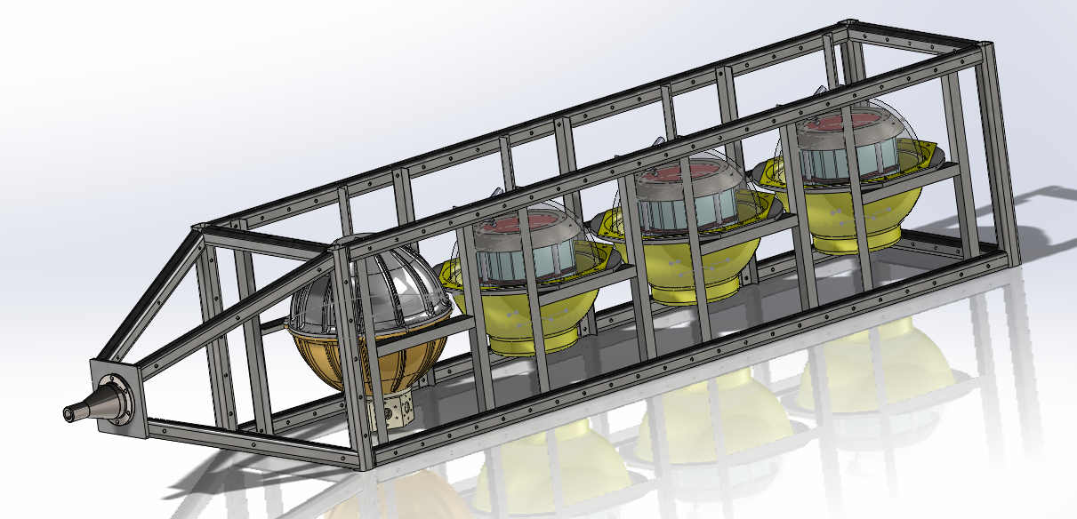
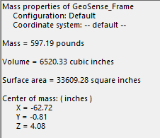

Slide 28
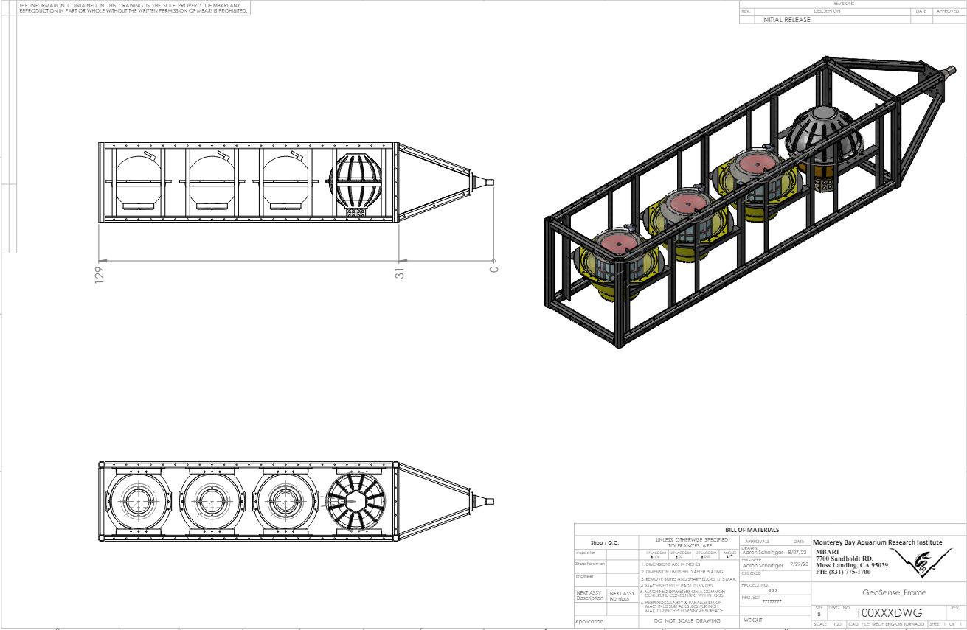

Slide 29
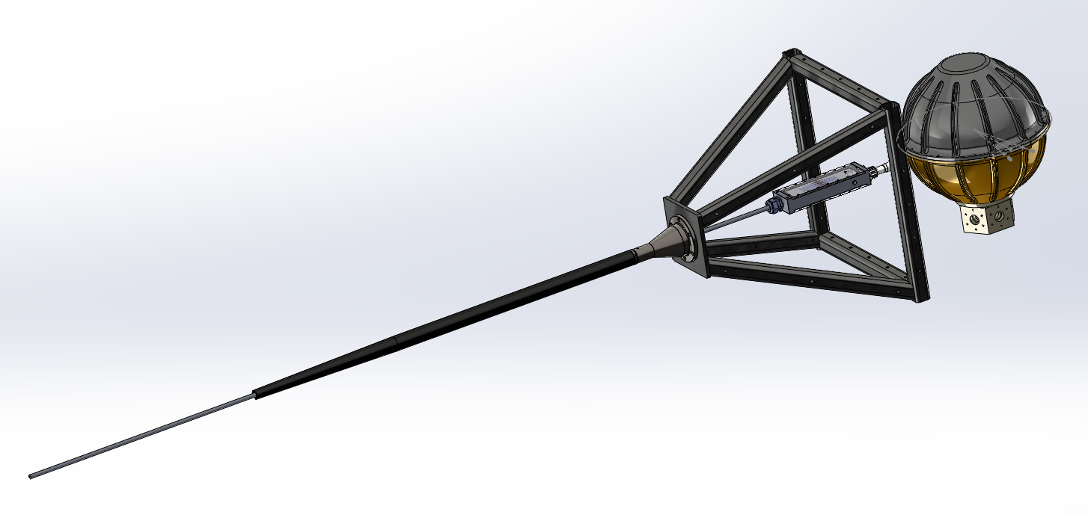

Slide 30
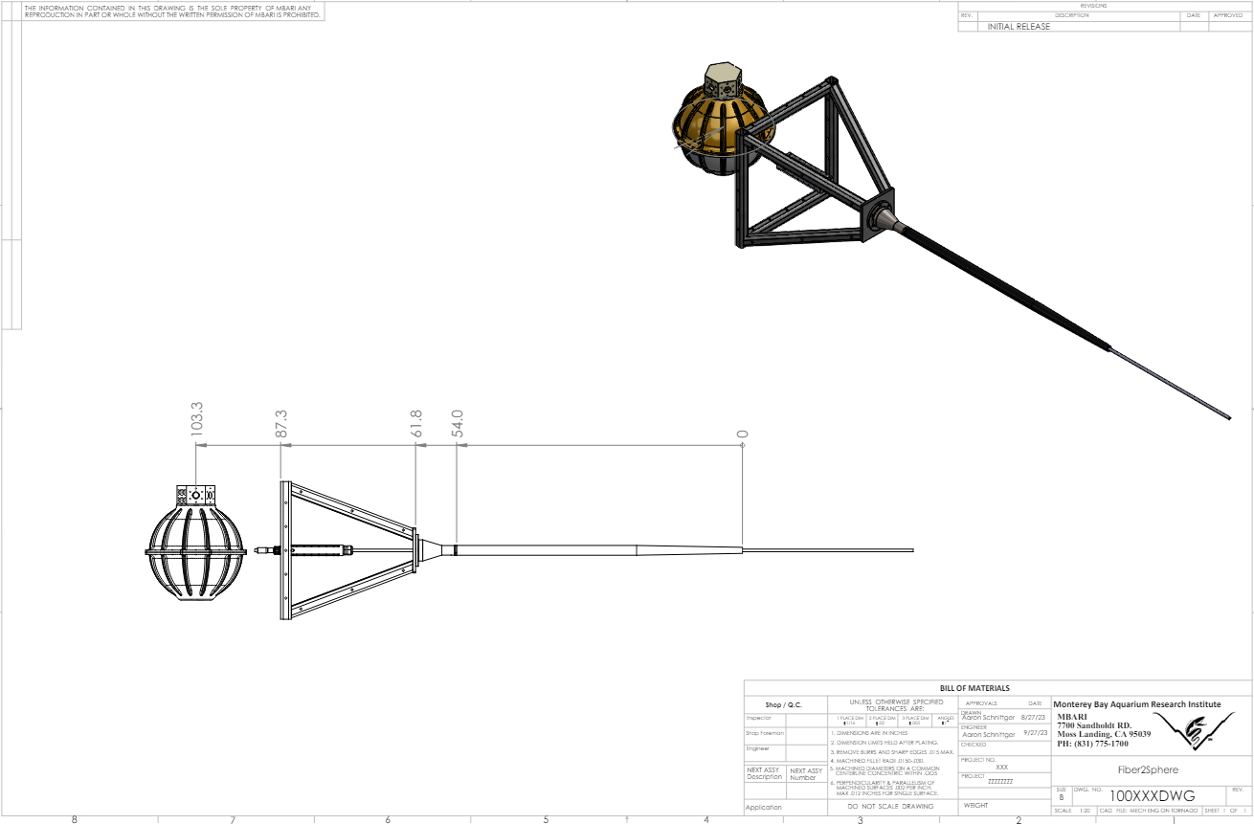

Slide 31
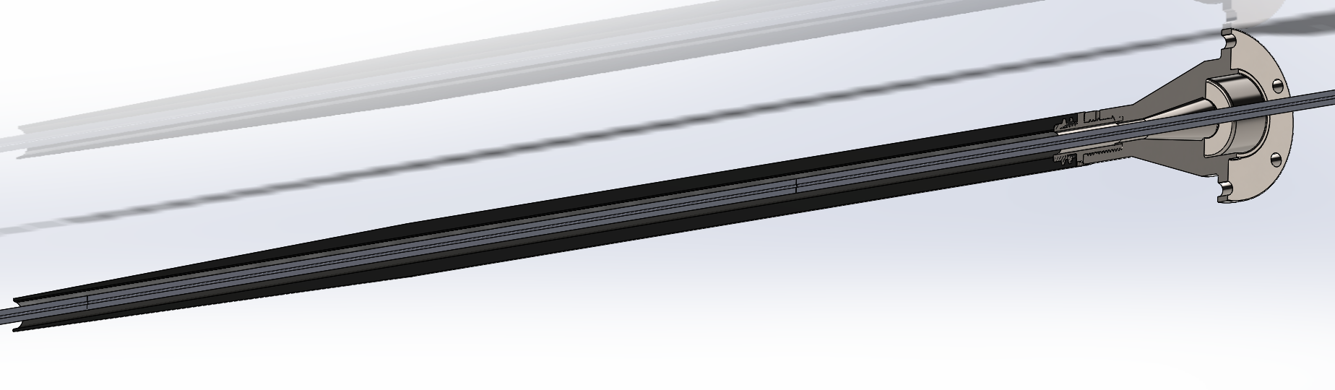

Slide 32
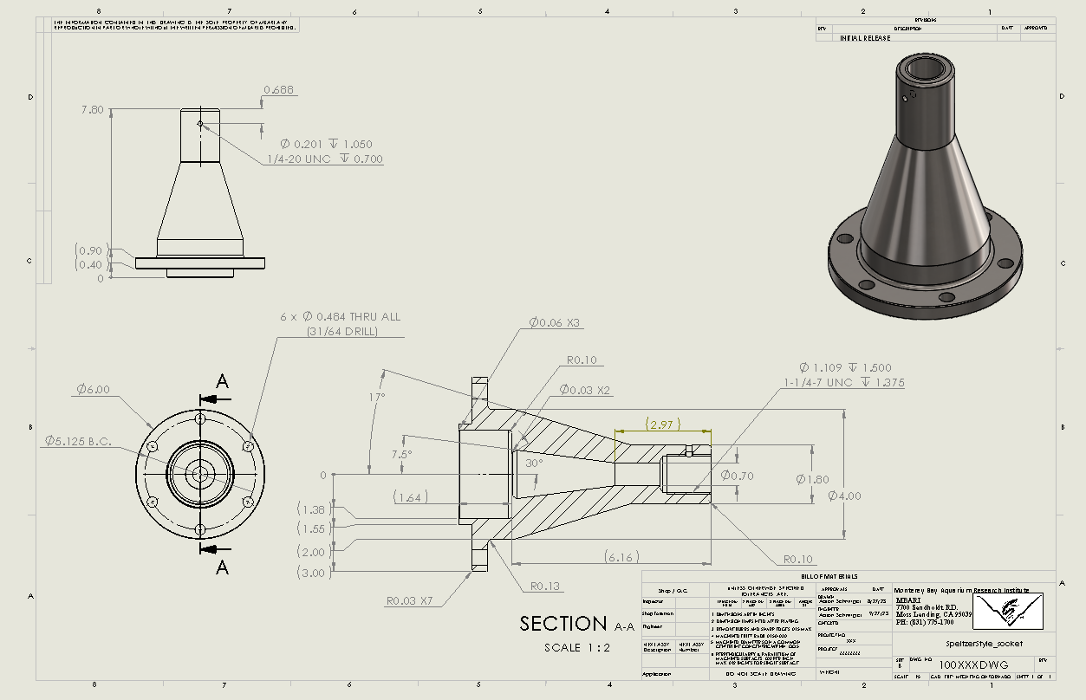

Slide 33
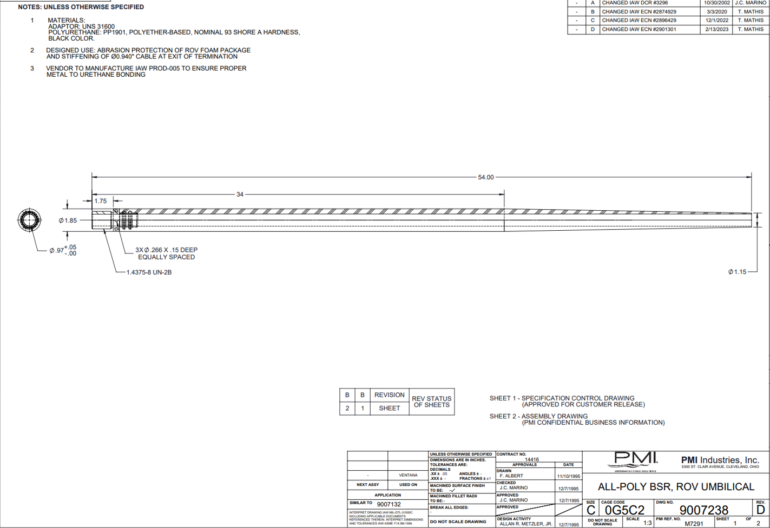

Slide 34
