Slide 1
Cable design – Simulation Results
Used DSA Oceans Proteus mooring simulation software used to estimate the load specifications for the DAS cable. A comparable cable (weight per meter) was used to simulate the strain in different sea states.
Cable Data
Electronics Package Data

Slide 2
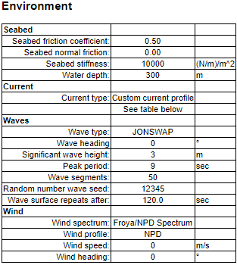

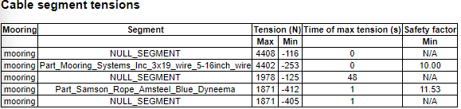
Simulations Results –
3m Wave Height/9 sec period

Slide 3
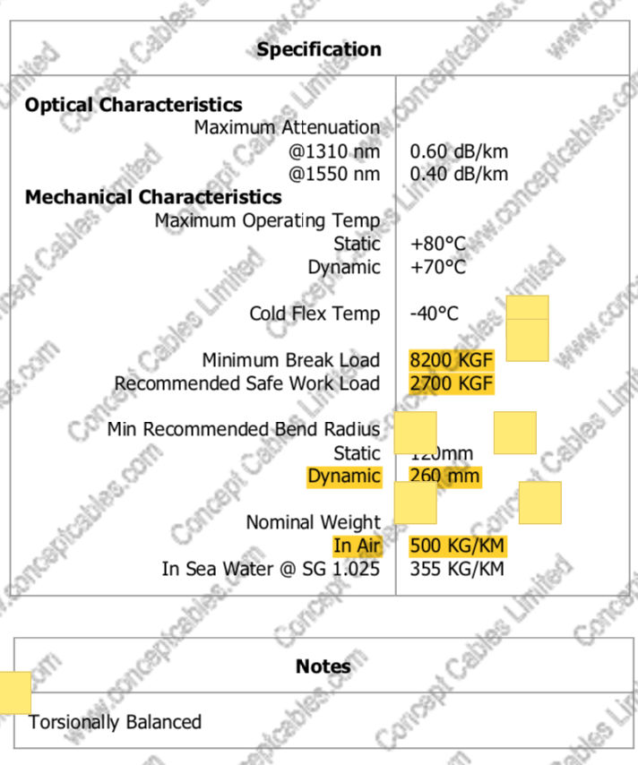
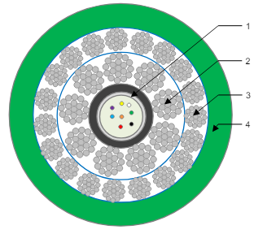
Concept Cables

Slide 4
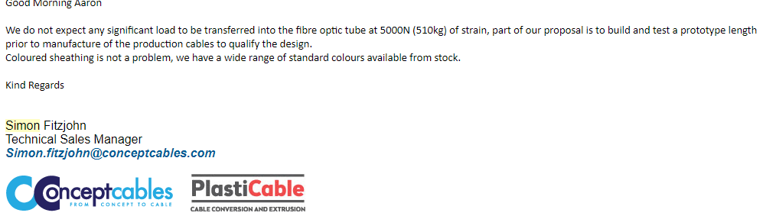
Concept Cables-
Response to an inquiry regarding the strain on the K-tube during peak dynamic loading:

Slide 5
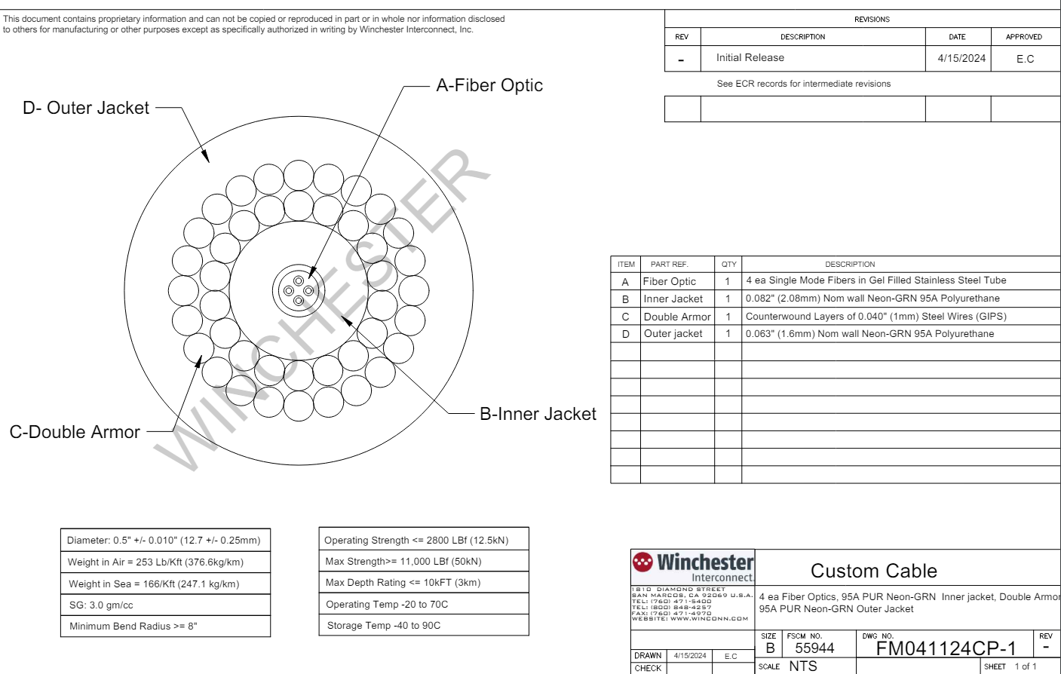
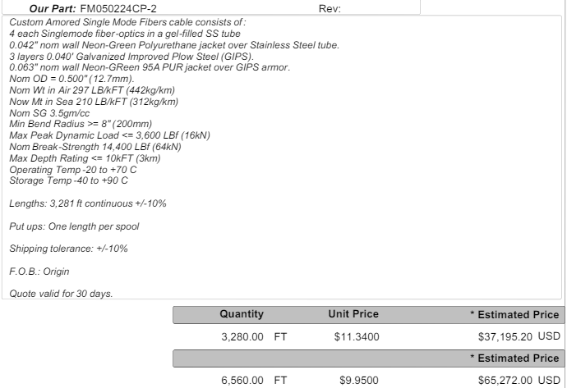

Slide 6

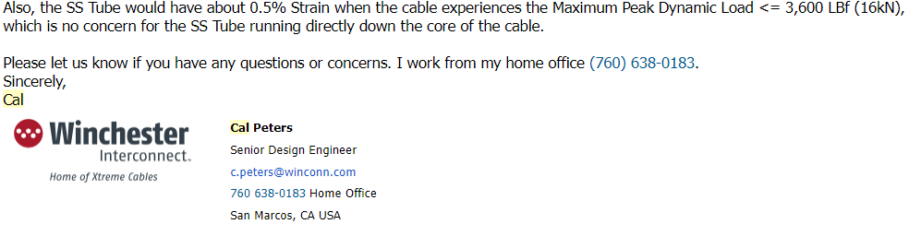
Response to an inquiry regarding the strain on the K-tube during peak dynamic loading:

Slide 7
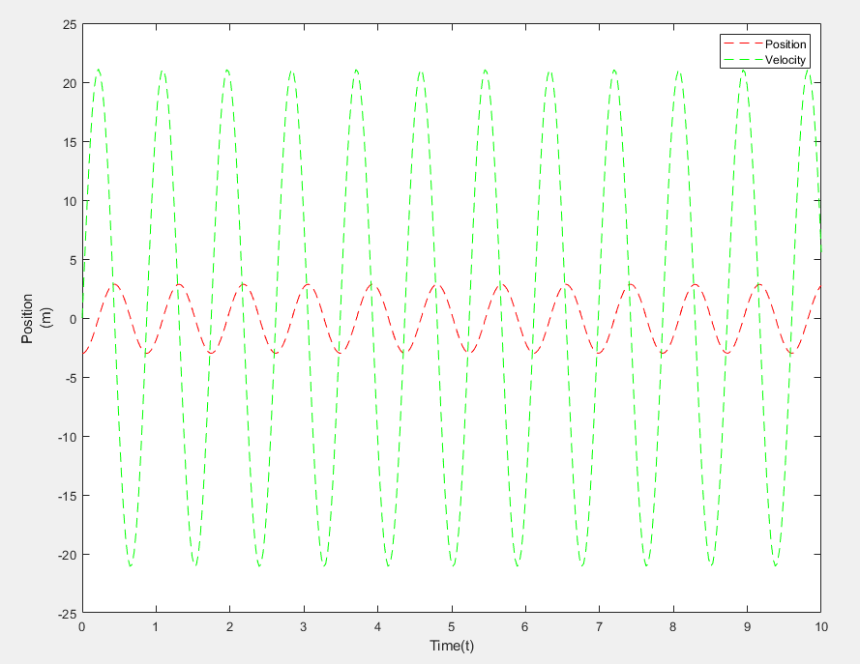
MatLAB Analysis
Still a work in progress:

Slide 8
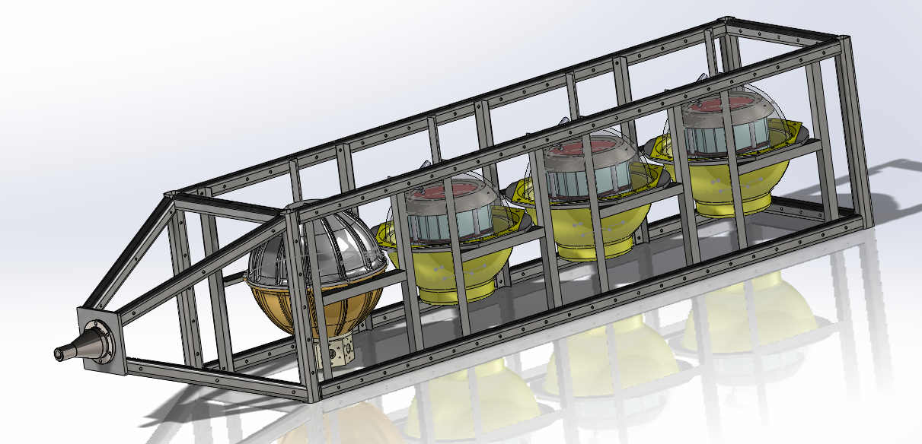
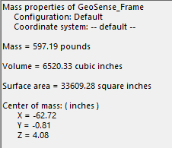

Slide 9
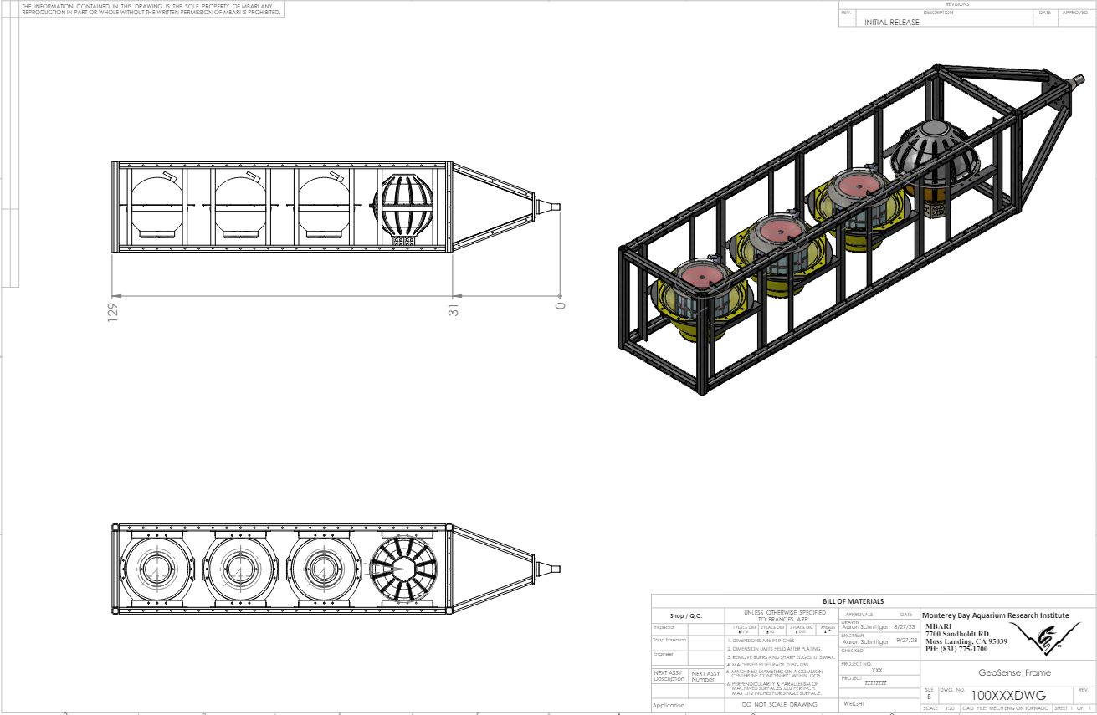

Slide 10
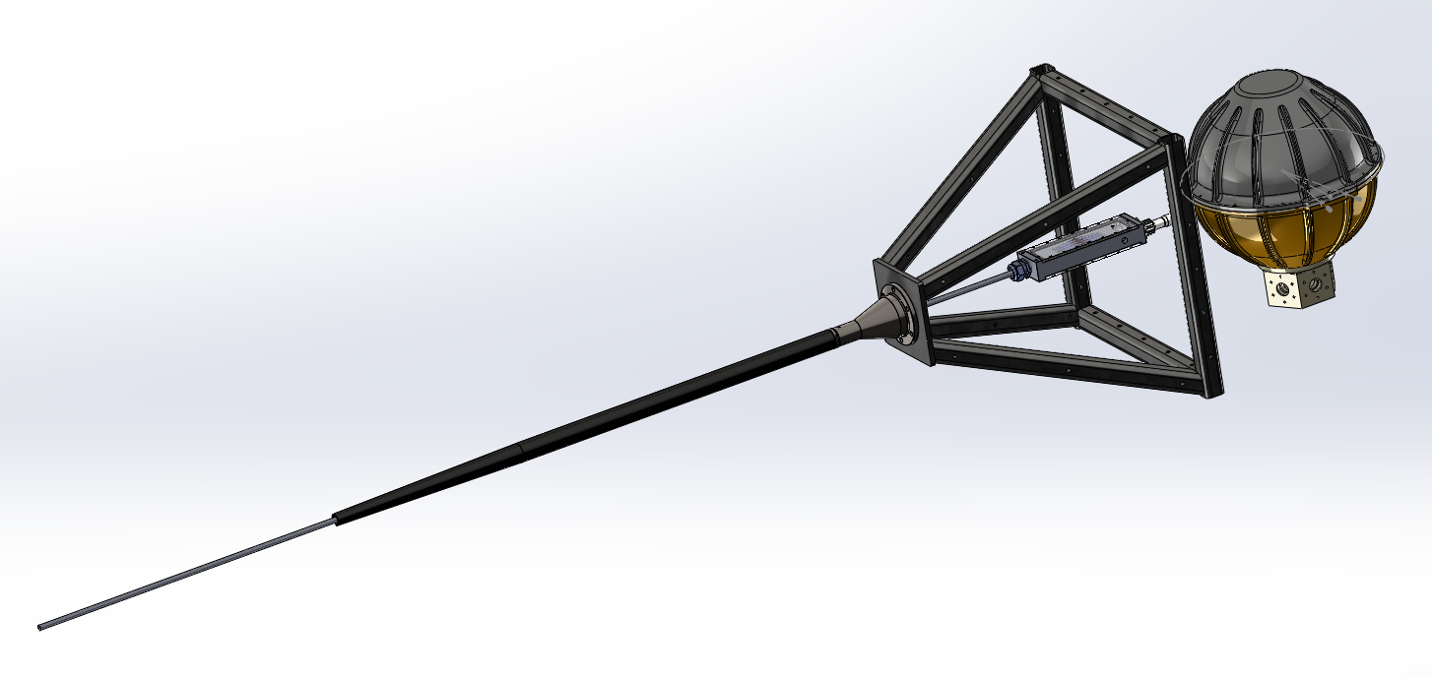

Slide 11
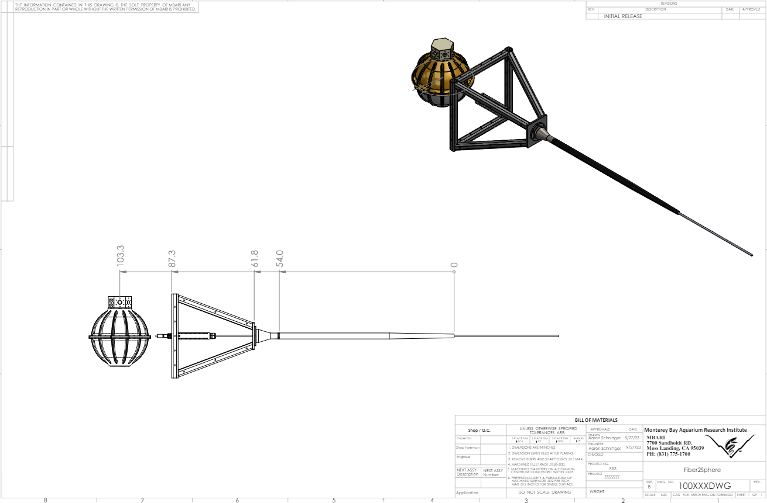

Slide 12
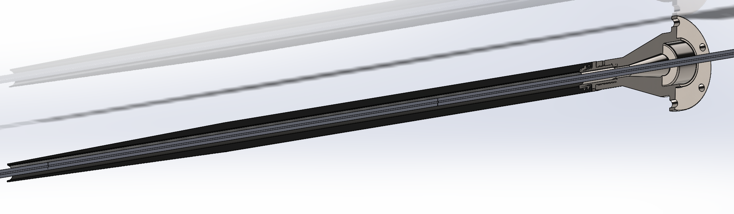

Slide 13
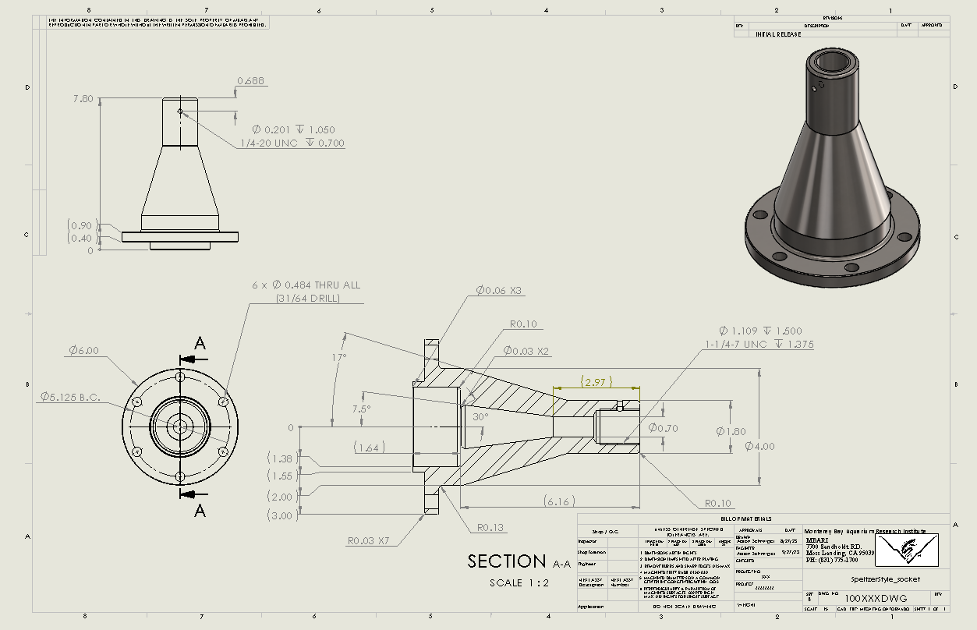

Slide 14
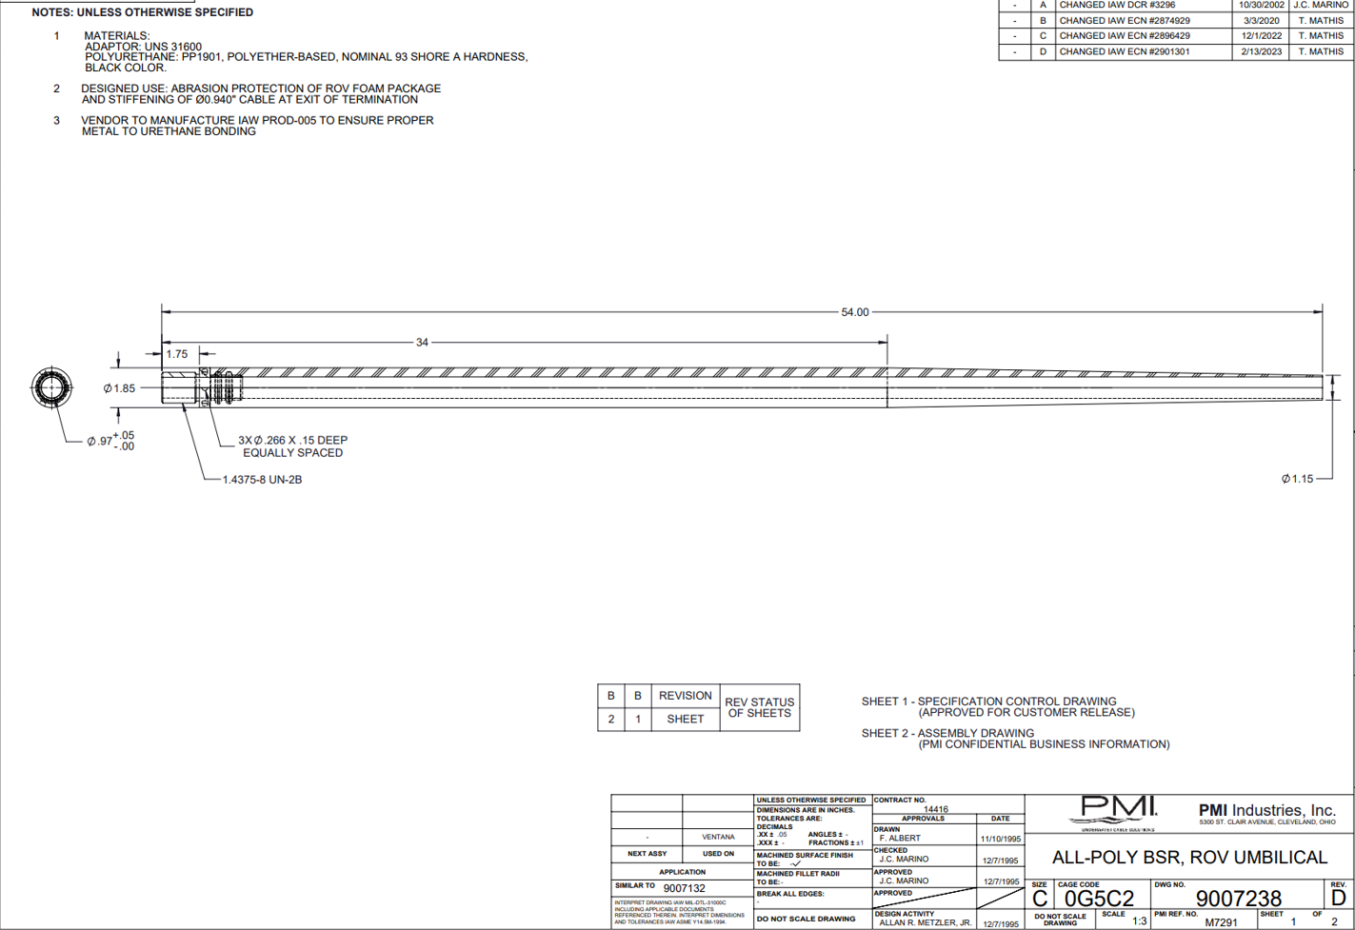

Slide 15
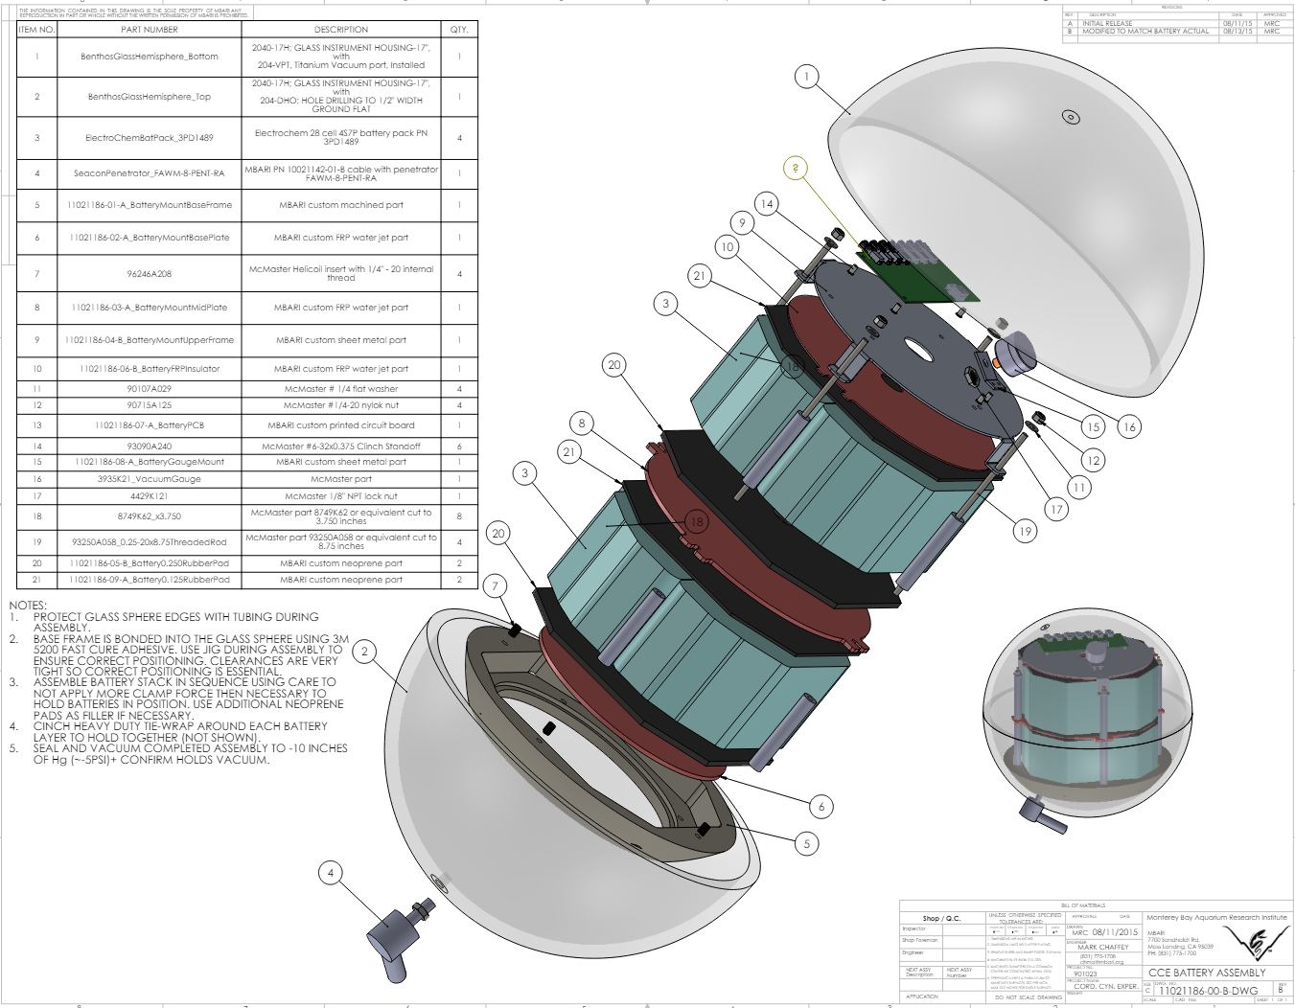

Slide 16
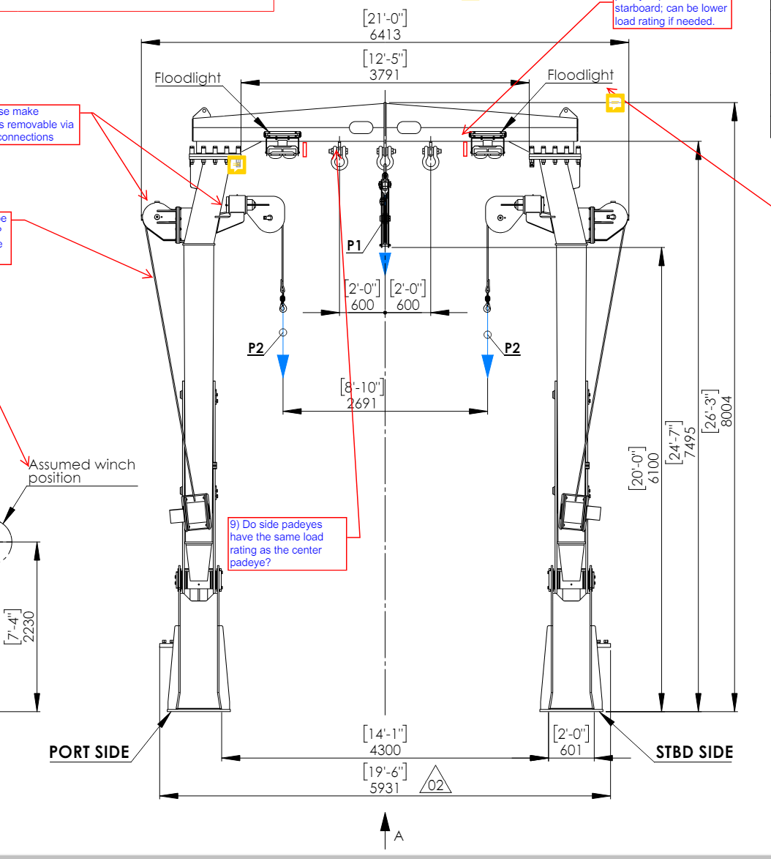
Using the “diggers” to pick up the frame and place in the water
A-frame will lower frame to bottom using center sheave
SWL of center sheave is 6 tonne
Sheave Clearance ~20 ft

