Slide 1
GeoSense Deployment Review

Slide 2
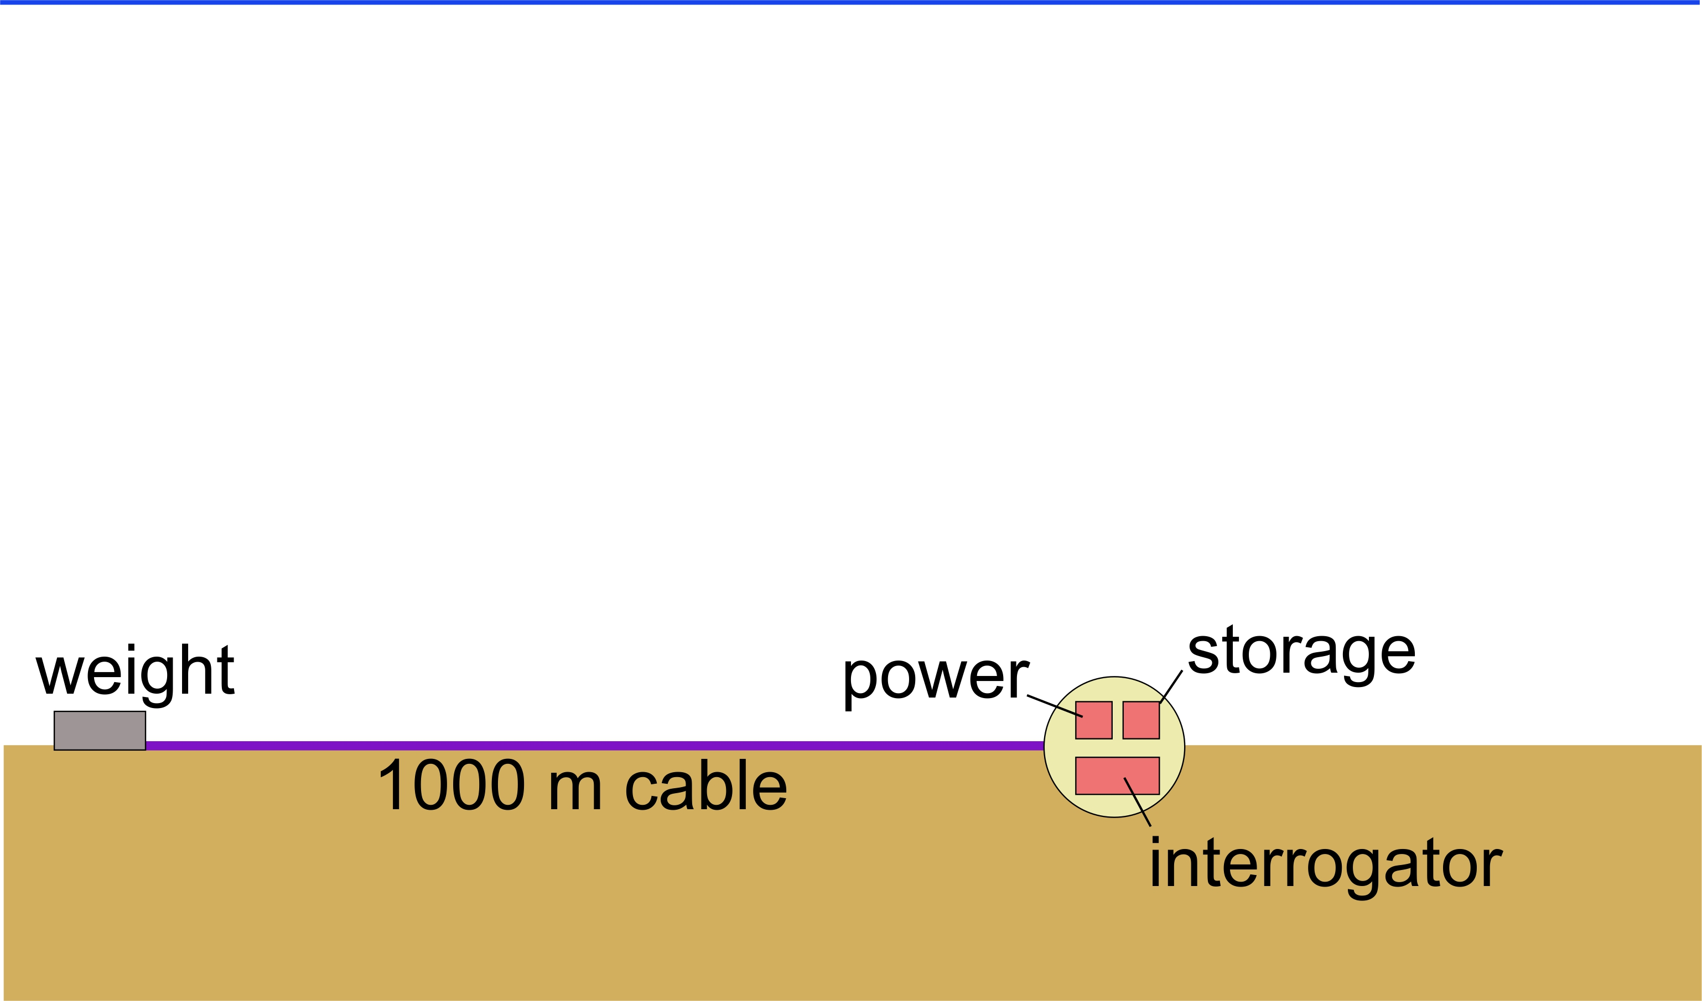
Geo-Sense Concept

Slide 3
System Block Diagram –
Cable Termination
Strain
Relief
FO Core
DAS
1 km armored FO cable
Cable
Termination
Black
Hole
Term.
Oil-compensated
Junction box –
Fiber breakout

Slide 4
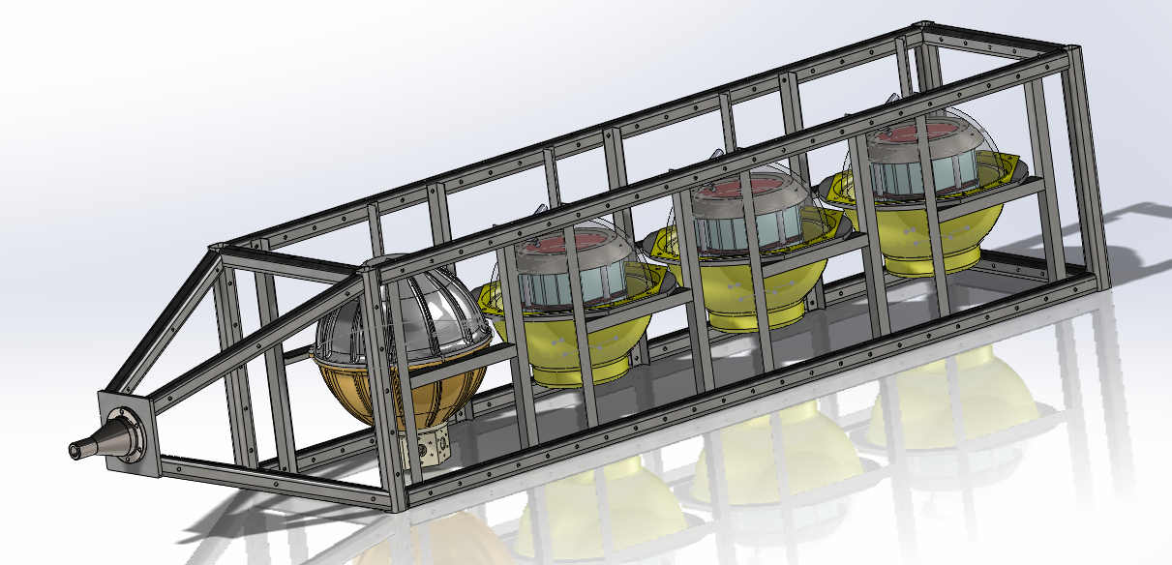
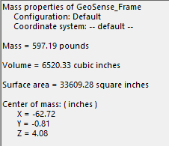

Slide 5
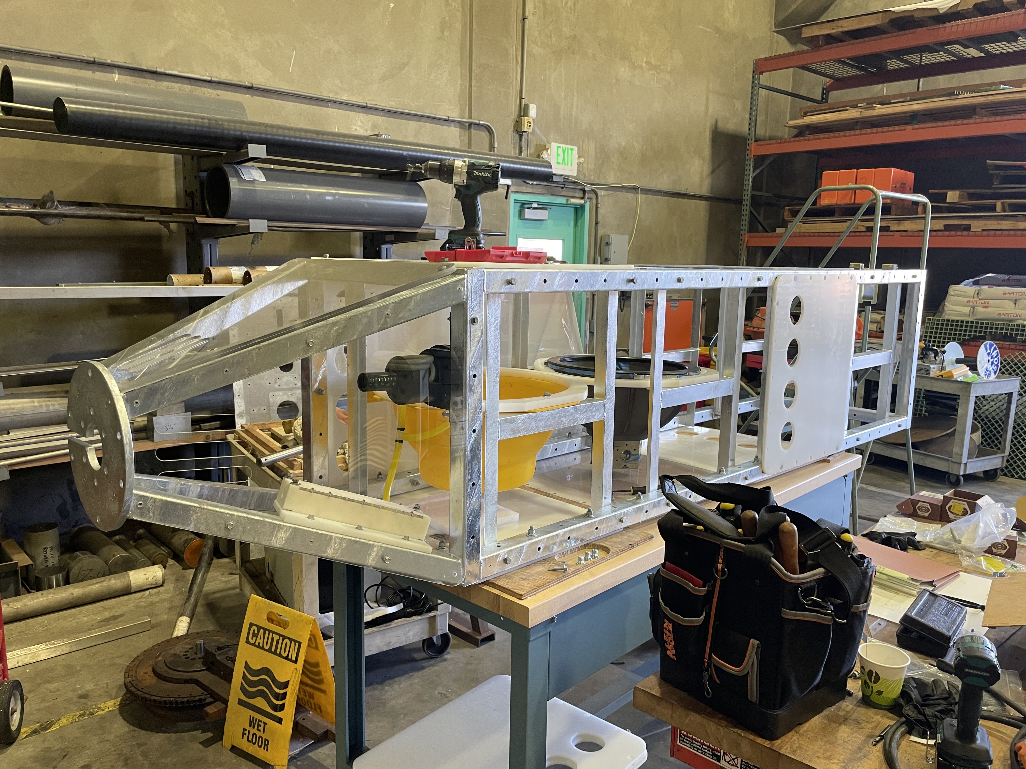

Slide 6
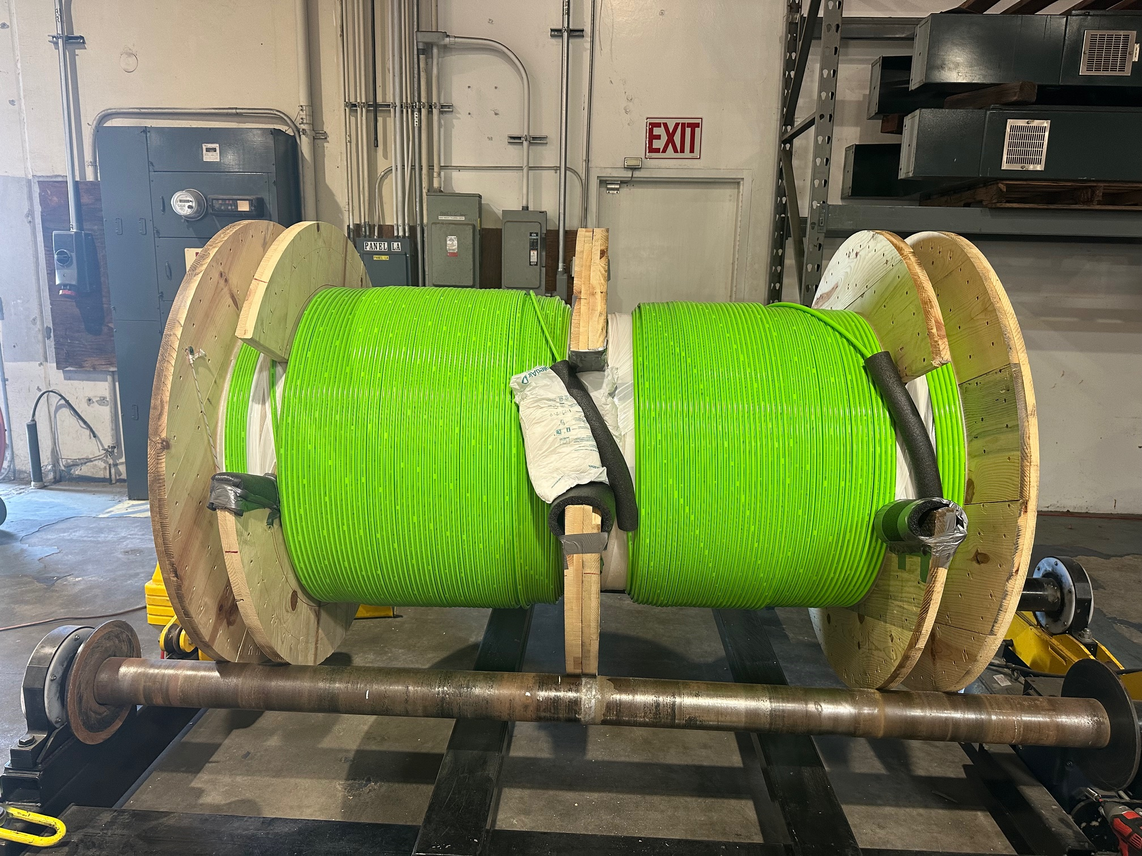

Slide 7
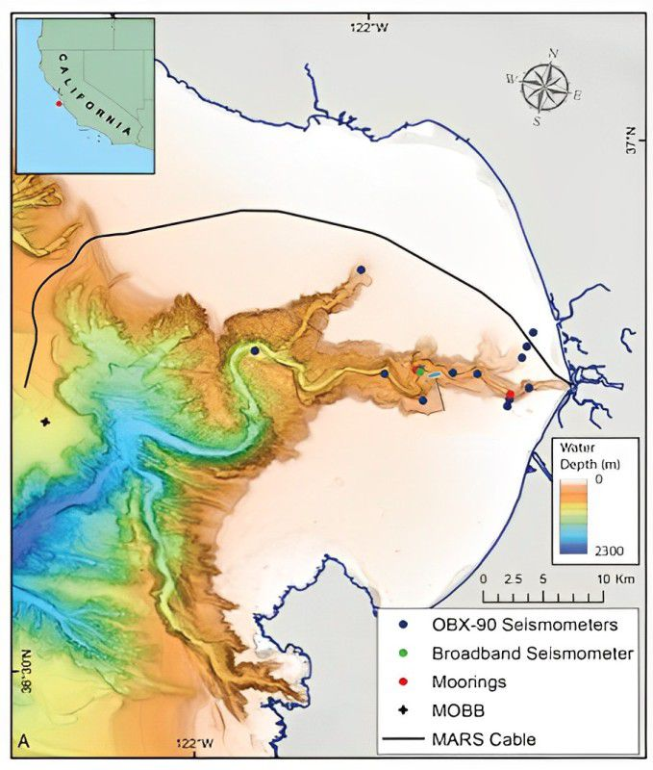
Motivation for Development Schedule
MARS cable
Seismometers
The ongoing seismic experiment (Winter 2024-25) provides a rare opportunity to ground truth DAS results with many instruments making simultaneous measurements.
Geo-Sense

Slide 8
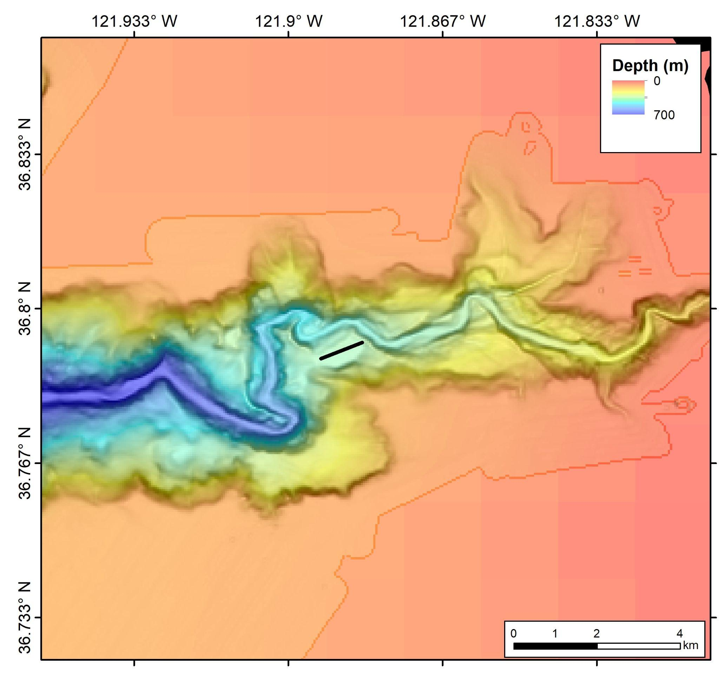
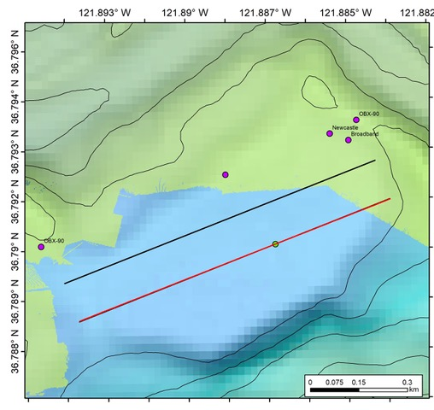
Deployment Location

Slide 9
Deployment Goals
Lay 1 km of sensing cable in staightish line
Cable makes a good mechanical connection with the seafloor- no piles no floating sections
Cable stays on the shelf – not hanging over the edge
Cable not damaged in the process – monitor tension if possible
Would like to communicate with Instrument via Deepsea Connect
Would like to survey cable with ROV

Slide 10
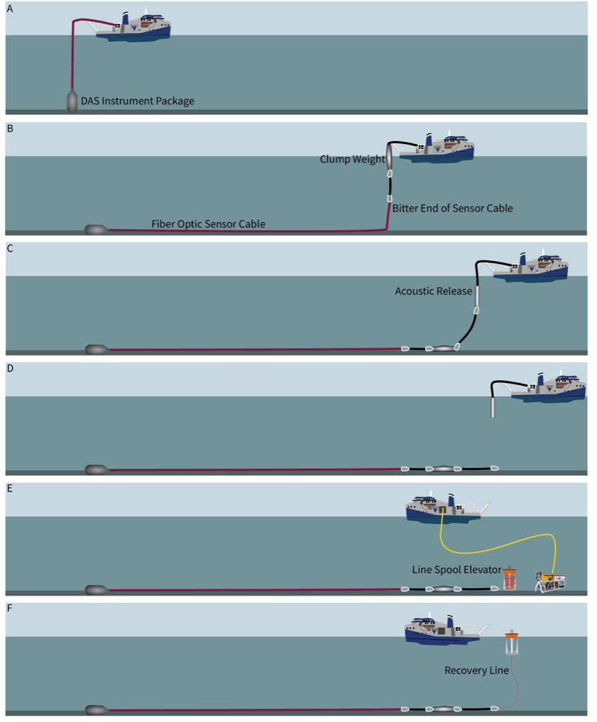
Deployment & Recovery

Slide 11
Deployment: Assembly Configuration

Slide 12
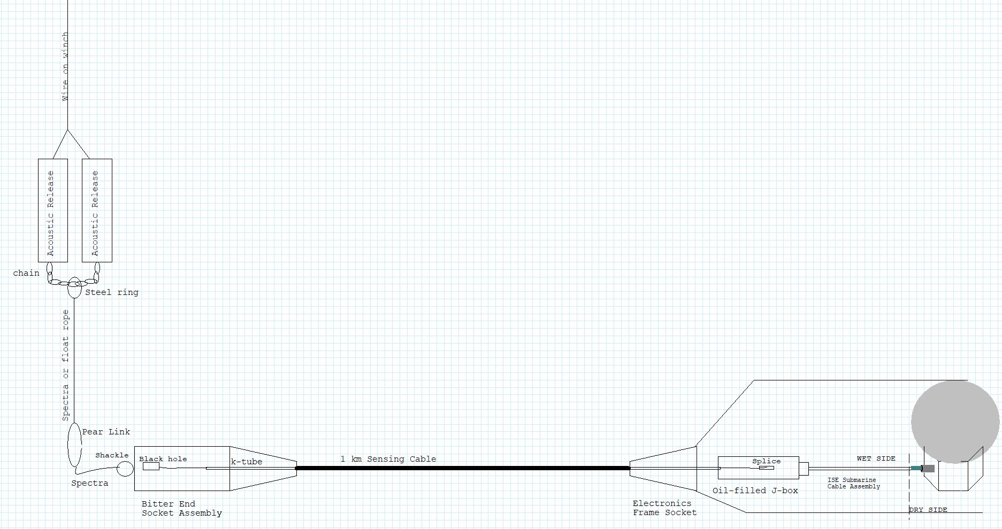
How long should spectra be?
How long should wire be?
What type of acoustic releases?
Any details on the chain?
Hook shackle directly to pear link?
Tie-off points?
Where should we place beacons?
NOT TO SCALE

Slide 13
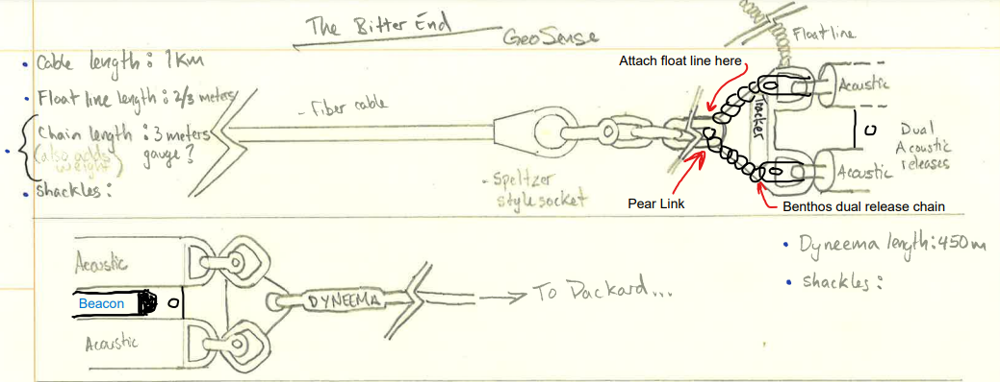

Slide 14
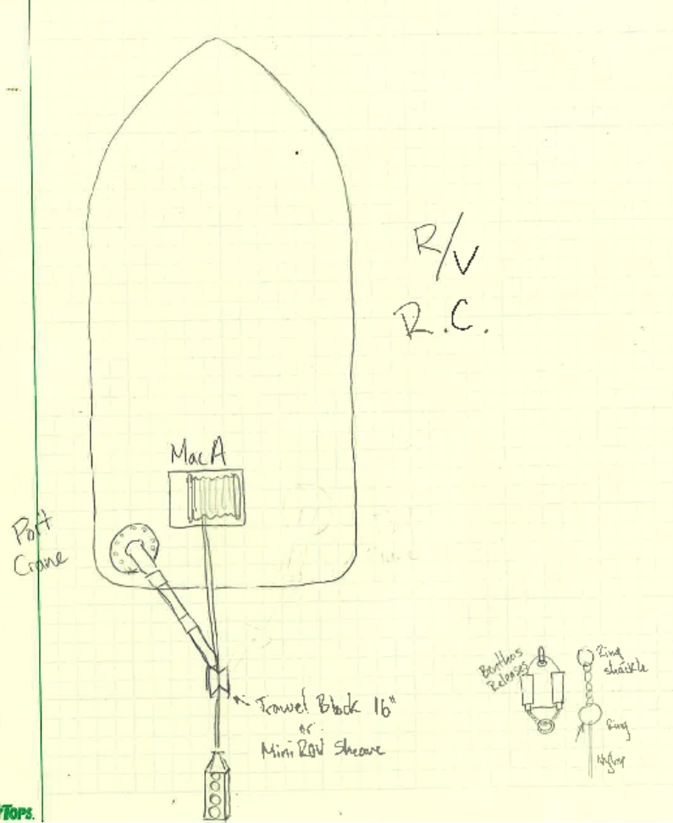
Deployment: Shipboard Configuration and Equipment
Macartney Winch – bitter end laid into recess in winch
Sheave (MiniROV – with minor mods) or trawl block – minimum 16”
Deck Layout
Package will need to be slinged to get over the rail
Mob considerations – can Ventana be on at the same time as all GeoSense system (what about deploying the Mapper)
What is best way to attach acoustic release package

Slide 15
Recovery process
ROV dive
  Pop recovery line
  then, with line spool elevator connect recover line to pear link
  D-rings on the frame for hooking into
Recovery through same sheave in reverse
Float rope off electronics package for picking with crane?

Slide 16
ROV Operations
Connecting to DeepSea Connect
  Placement of toast
  Placement of magnetic switch

Slide 17
Other questions…

Slide 20
Assumptions and Proteus Simulation Results
● Expected Strain on the Cable
○ 4.4 kN (989 lbf) From the Proteus mooring software
● Breaking Strength of the Winchester cable(estimate)
○ 64 kN (14,400 lbf)
● Operating Strength of the cable(estimate)
○ 16 kN (3600 lbf.
● Heave load is based on the wet weight of the DAS instrument package weight at
150 kg (~300 lbs) in a sea-state of 3 meters at 9 seconds
Note:
Using the estimated cable tension of 4.4 kN under a 3-meter, 9-second sea state, the
armored fiber optic cable must achieve an operating strength (fiber breaking strength) of
16 kN (a 3.6:1 safety factor for the fibers). To meet this requirement, I determined that
the cable needed a minimum ultimate breaking strength of 50 kN. I used this 50 kN
value as the benchmark for the design of the two spelter socket assemblies.

