Slide 1
Sea Floor Processes
GeoSense
Mechanical Design Requirements

Slide 2
Mechanical Requirements
Deployed from R/V David Packard and/or Carson…?
Electronics package connected to 1kM of armored fiber optic cable
Cable may be used to lower and recover electronics package
Location- A bench along Monterey Canyon ~390 meters depth
Payout electronics package and 1kM cable in a straight-ish line
Lower (Electronics package/bitter end) to seafloor and spool out cable
Dual releases to deploy and recover…? end at end of the deployment (20 days)

Slide 3
Packard/Carson Deployment
Using Winch, Block, and A-frame to deploy Geo-sense equipment
The winch and block cannot exceed the minimum bend radius of the optical fiber(s) under load
    Winch drum and block radius cannot subceed minimum bend radius of the optical fiber under loaded condition
    If a sufficient winch is not available then investigate a linear cable engine
Use ships DP system to layout cable as straight as possible with minimal dragging
Monitor cable tension-not to exceed fiber or critical cable breaking strength
Attached mooring line or spectra(500m) will be fixed to end components and laid out with dual acoustic releases float and drop weight to ensure fiber optic cable continues in a straight-ish line
  Releases will be used to drop weight and float to the surface for recovery
  Float pack will need a beacon, strobe, etc.

Slide 4
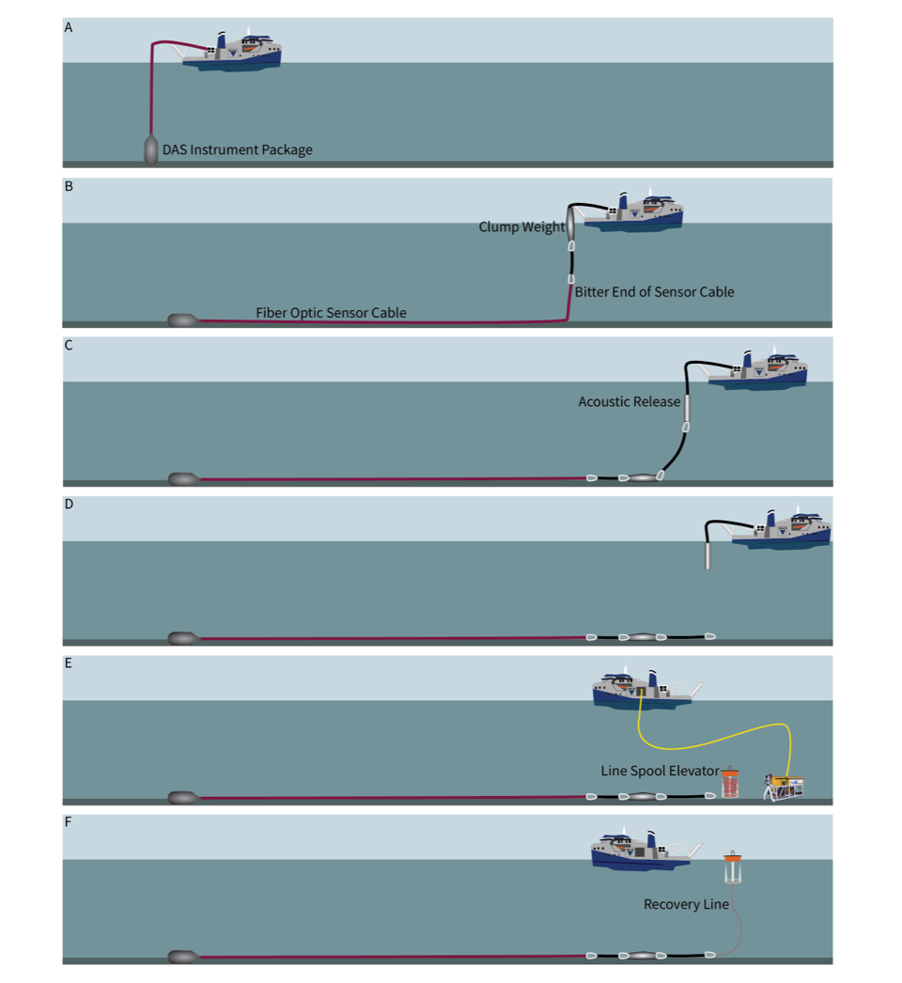
Deployment Plan…?
Tentatively Paull plan(Adjacent image)
Weight(150kg), spectra(~300mtrs), DAS electronics frame, 1km cable, “bitter end” Assembly,Spectra or floatline(~300mtr), and release mechanism-all payed out via ship
Other Suggestions

Slide 5
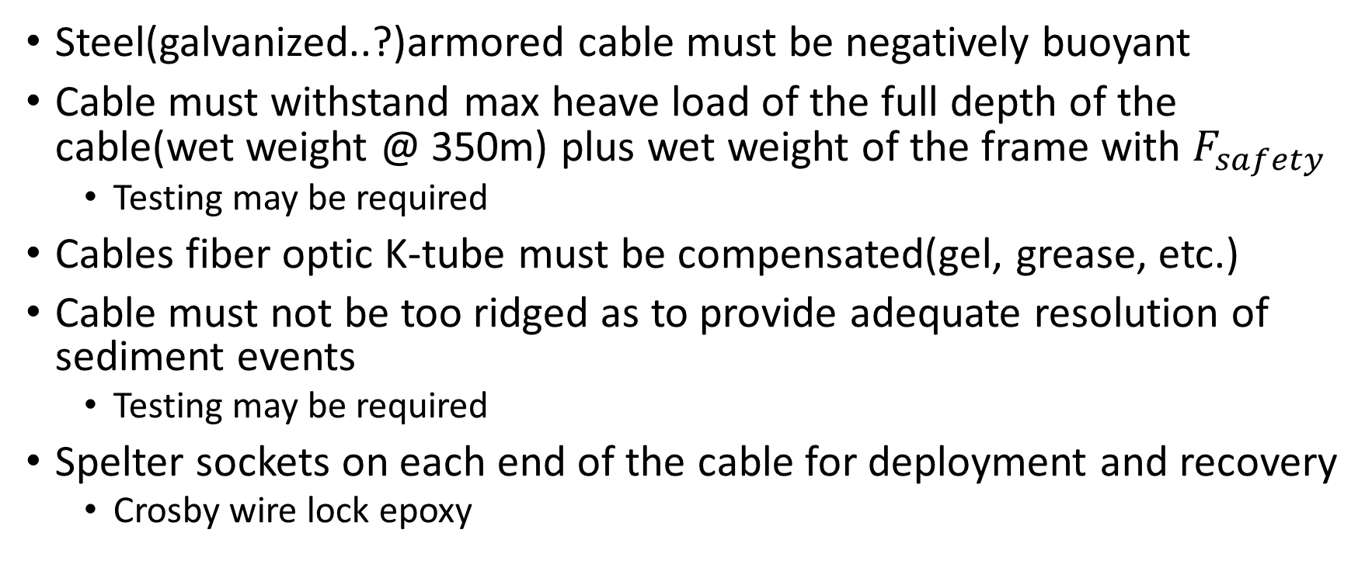
Armored Fiber Optic Cable
Steel(galvanized..?)armored cable must be negatively buoyant
Cable must withstand max heave load of the full depth of the cable(wet weight @ 350m) plus wet weight of the frame with $F_{safety}$
  Testing may be required
Cables fiber optic K-tube must be compensated(gel, grease, etc.)
Cable must not be too ridged as to provide adequate resolution of sediment events
  Testing may be required
Spelter sockets on each end of the cable for deployment and recovery
  Crosby wire lock epoxy

Slide 6
GeoSense Cable Requirements Rev2
Armored Cable
Double wrap torque balanced galvanized steel wire with bitumen+wrapping
Minimum breaking strength ≥ 50kN
Outer Sheath (Polyethylene or Polyurethane or …?)
Separate layer(tape..?) to make breaking out the fibers easier
Bend Radius
The winch that MBARI currently uses and has the capacity for 1km of cable is a MacArtney winch(Model No.*******) with a drum radius of 0.3 meters
Weight in Sea water
Cable weight ≥ 0.375 kgm(negatively buoyant)
Fiber Optics
Fibers shall to be encased in a stainless steel k-tube Sheathed in (Polyethylene or Polyurethane)
Optical and mechanical specifications for the optical fiber: 2-4 fibers (Single Mode)
Optical specifications for fiber and optical connections in Onyx Datasheet (see below). The type of the fiber is specified (SMF-28e) as well minimum performance rating (e); operating wavelength (1550 nm) and maximum acceptable losses (18 dB per fiber) and attenuation (0.2 dB.km-1 at 1550 nm)
The optical fiber needs to be in the tight buffer configuration, (presumably 245μm buffer) to ensure good mechanical coupling of the optical fiber(s) to the fiber bundle assembly
Minimum of four (4) SMF-28e fibers (or better, SMF-28e+, or SMF-28 Ultra), per fiber bundle assembly
Fibers will run down the core of the cable(not stranded)
Fibers are to be compensated with gel for hydrostatic resistance(SWD=1000m)
The cable will be deployed for ~40 days
Other Specifications
Fiber breaking cable load 20kN
OD of Cable ≥ 15mm
Excess fiber in tube 0.1 - 0.3%
Outer jacket marked at one meter increments as follows <Cable ID ><Product Order No> <Optical fiber type and quantity> <Vendor>
<year>, <meter>
Application: Sea floor fiber optic strain cable
Deployment/Recovery will be a dynamic condition
Length 1000M

Slide 7
Electronics Package
Use a steel/aluminum frame to mount titanium or glass spheres
  BINS battery sphere design…?
  3 battery spheres and 1 electronics sphere
Frame shall protect 1BAR housings from minimal(or not) dragging
Frame will be able to accept a Spelter style socket mount to fix cable to frame
  Socket will have an equivalent breaking strength to the cable
Electronics frames wet weight will not exceed 500lbs.(227 kg)
Large strain relief

Slide 8
Packard /Carson Recovery
Releases will be attached to drop weight and floats will bring the “Bitter end” to the surface for recovery
  Benthos Release(s) drop weight and float pack
  Line-spooling Elevator
  WHOI steel tube(Probably not)
  ROV mounted recovery line(…?)

Slide 9
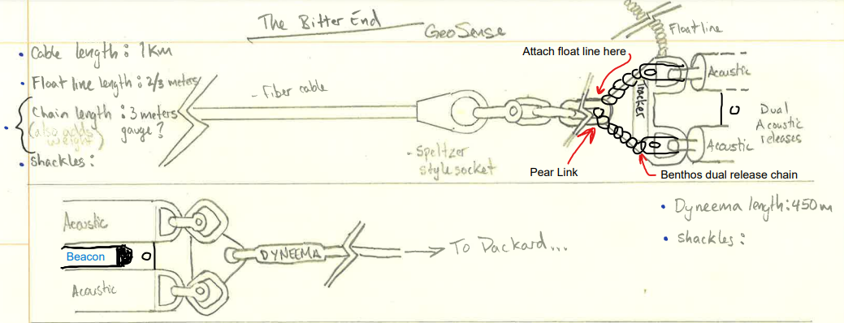
Packard /Carson Recovery

Slide 10
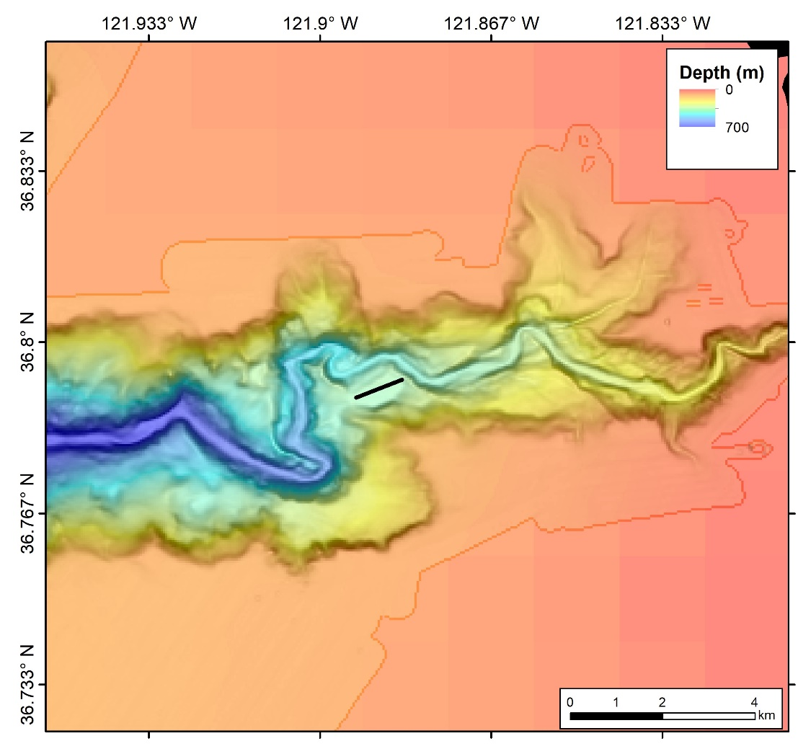
Proposed Location of Deployment

Slide 11
Alternative Cable Options
SouthBay
Dataline
Rochester
Cortland

Slide 12
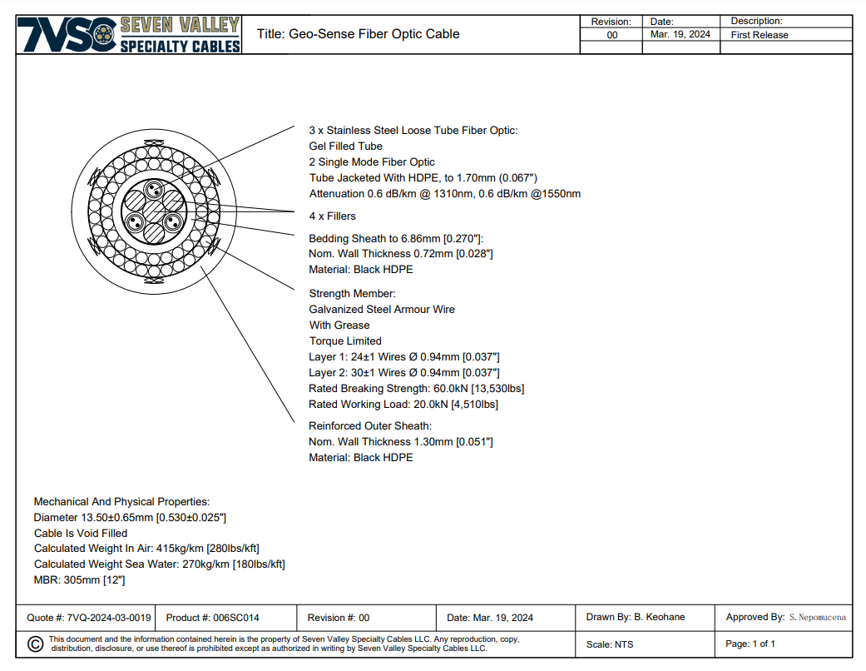
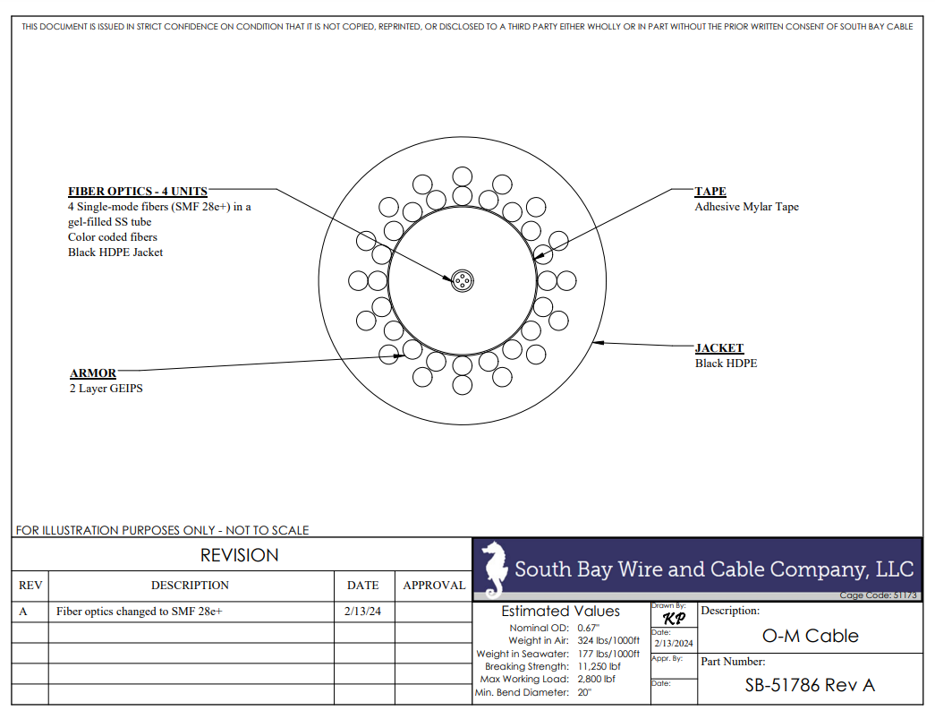
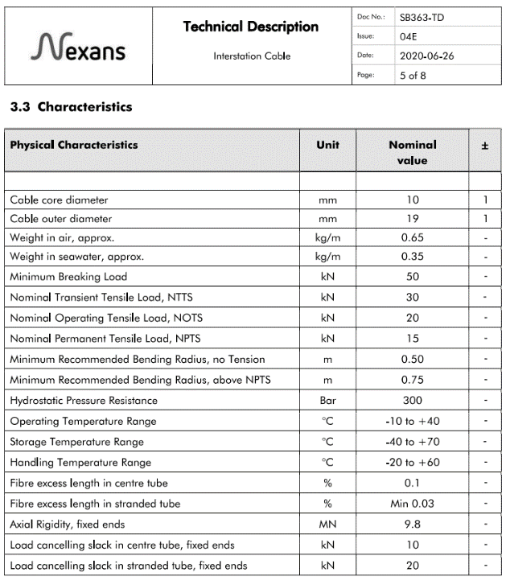
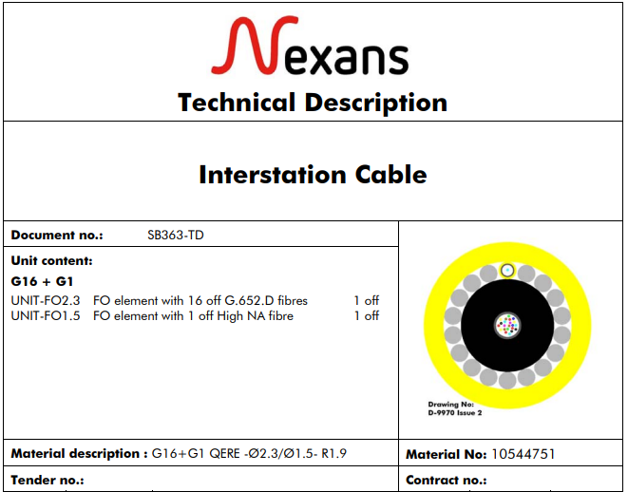
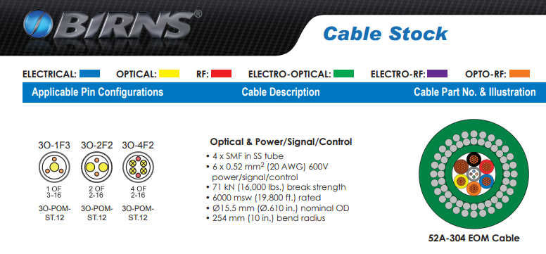

Slide 13
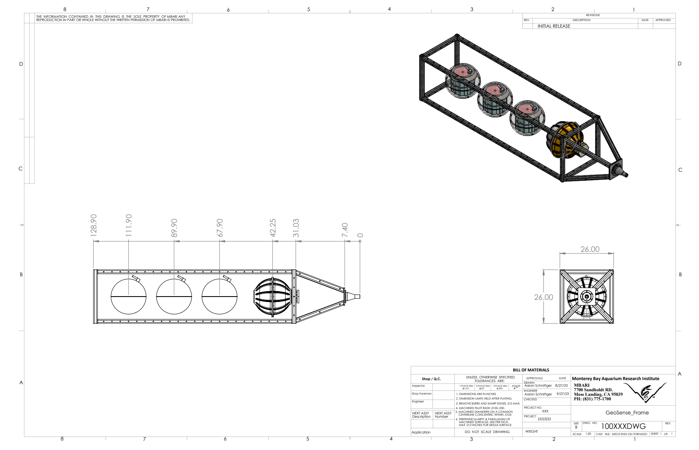

Slide 14
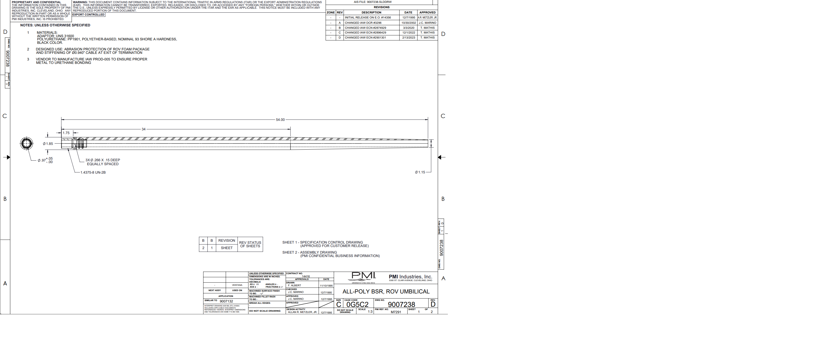
PMI strain relief $800 per unit

Slide 15
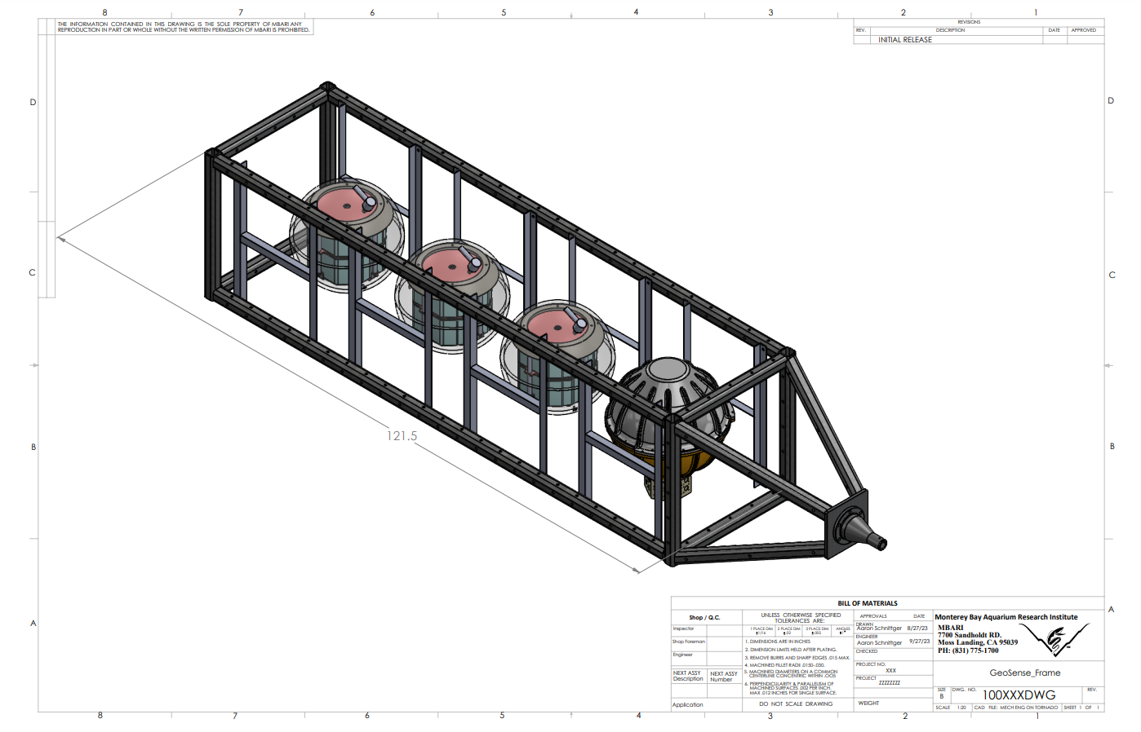

Slide 16
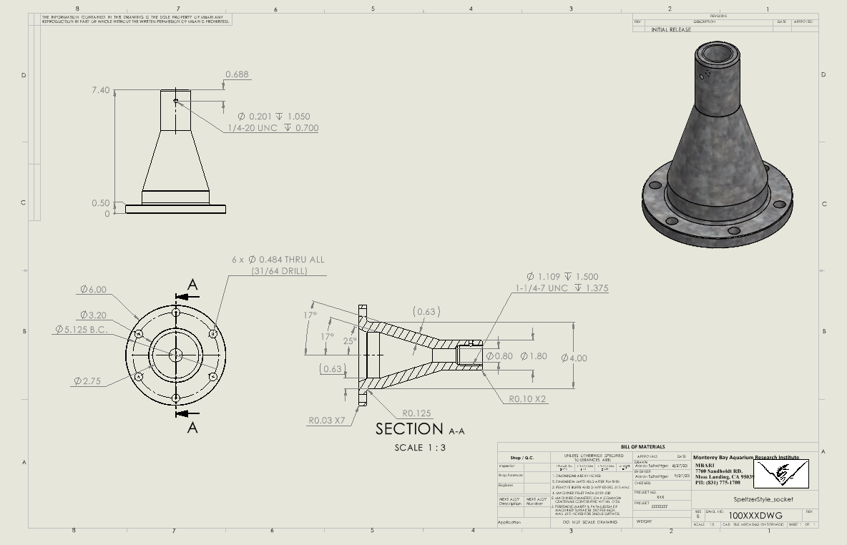

Slide 17
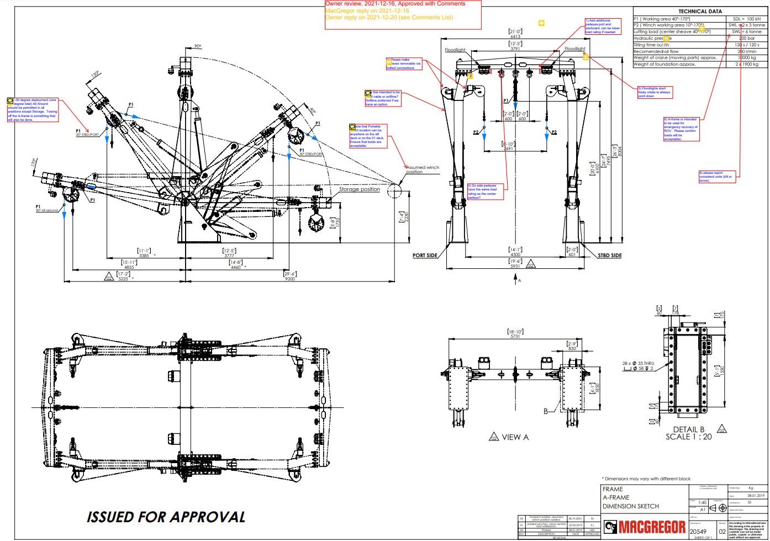

Slide 18
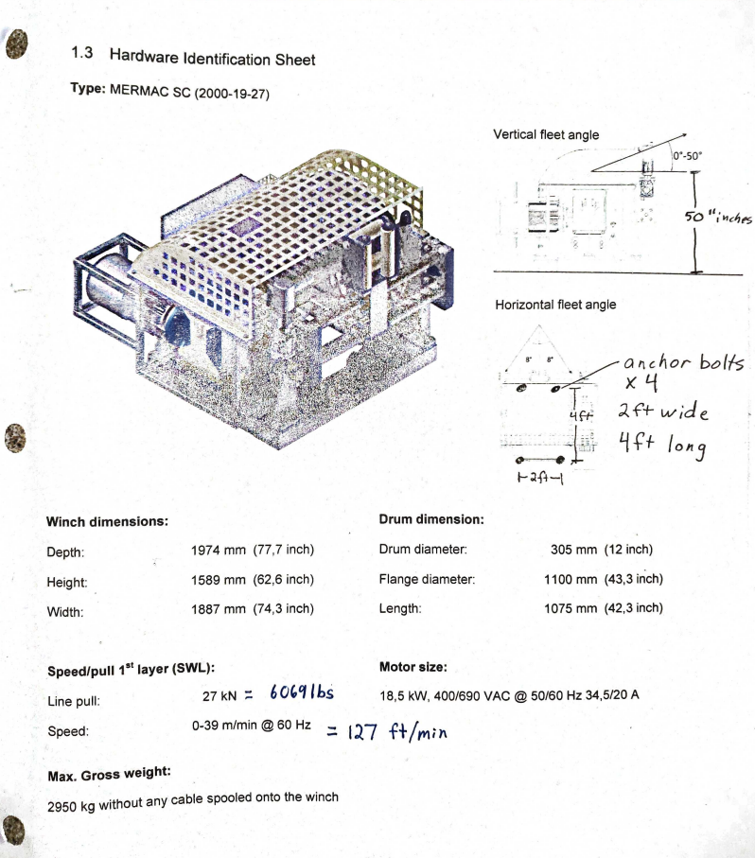
MacArtney Winch

Slide 19
