Slide 1
A paradigm shift towards finer scale field measurements in seafloor geomorphology
Aaron Micallef
Seafloor processes lab

Slide 2
1. State-of-the-art

Slide 3
Field measurements
Modelling
Desk analyses
Laboratory analyses

Slide 4
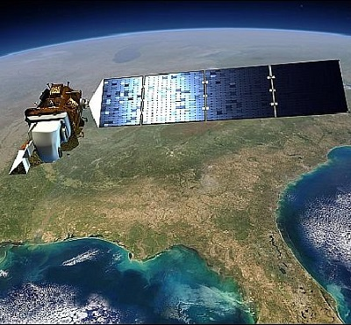
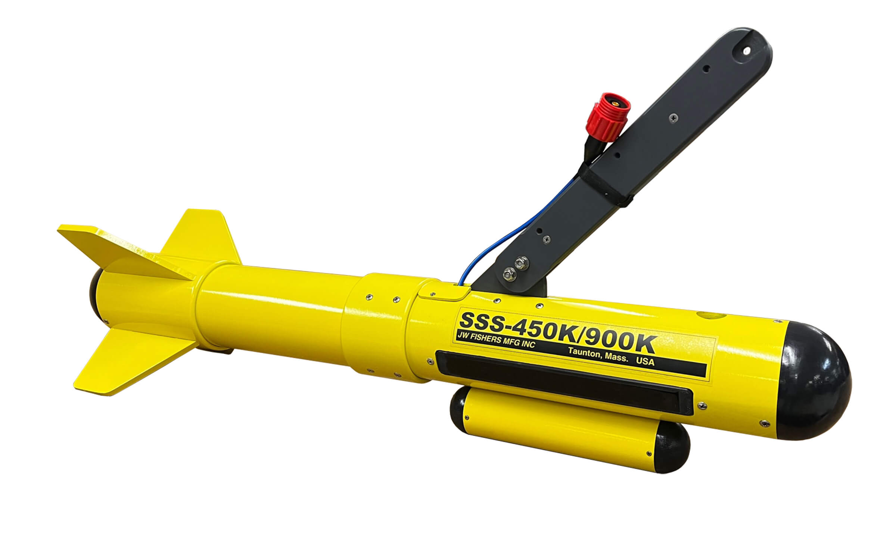
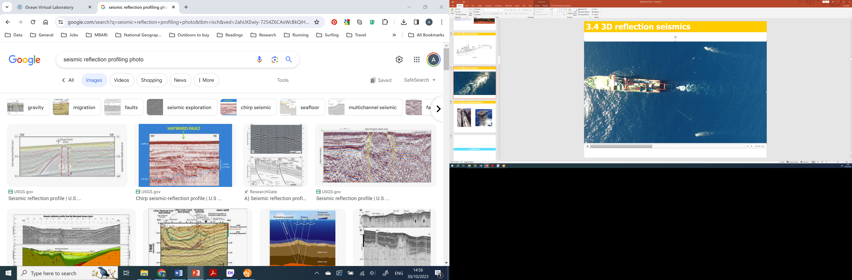
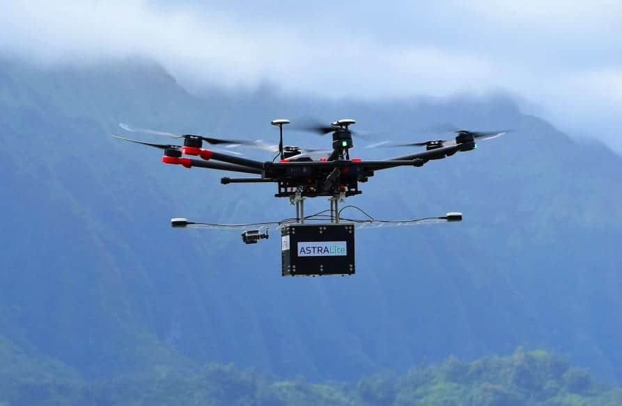
1.
Remote sensing
Sonars
Satellite sensors
Reflection seismics
LiDAR

Slide 5
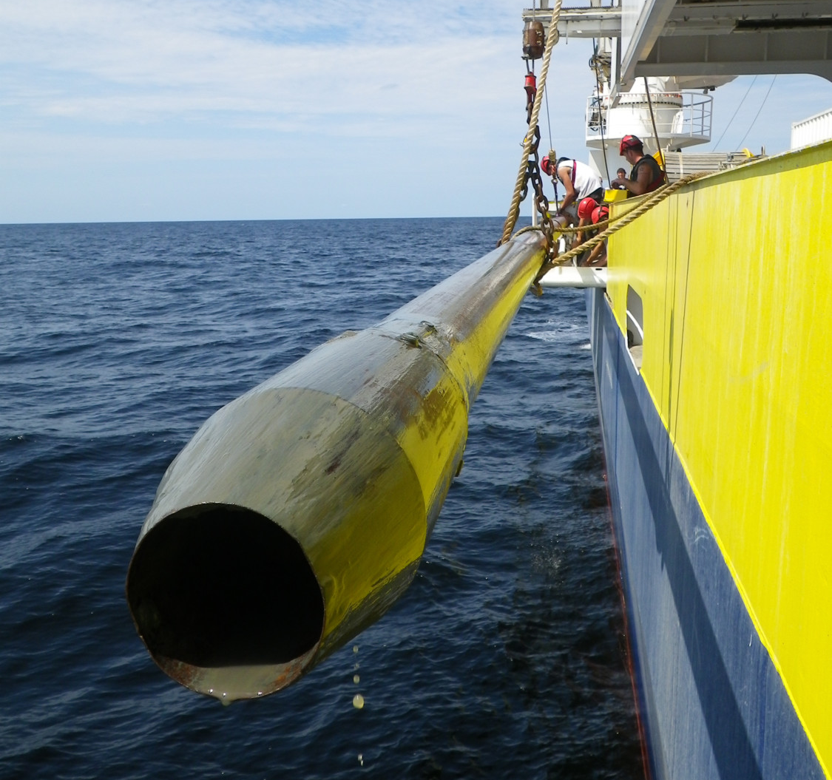
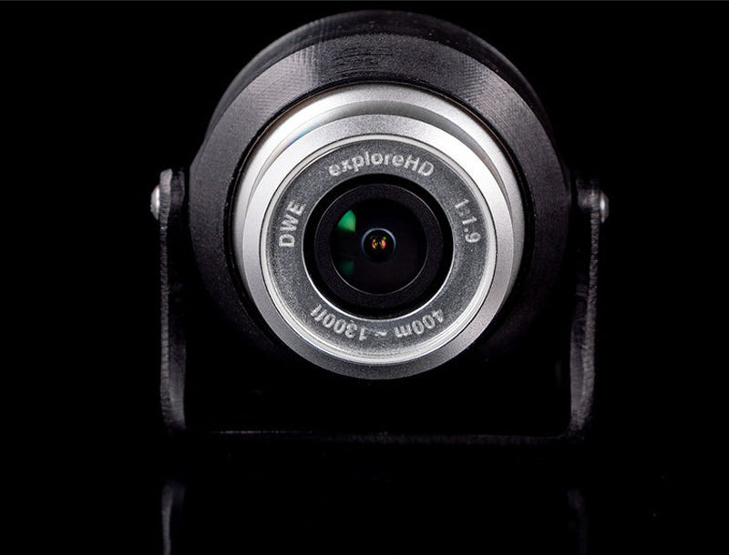
2.
Sampling
Cameras
Corers

Slide 6
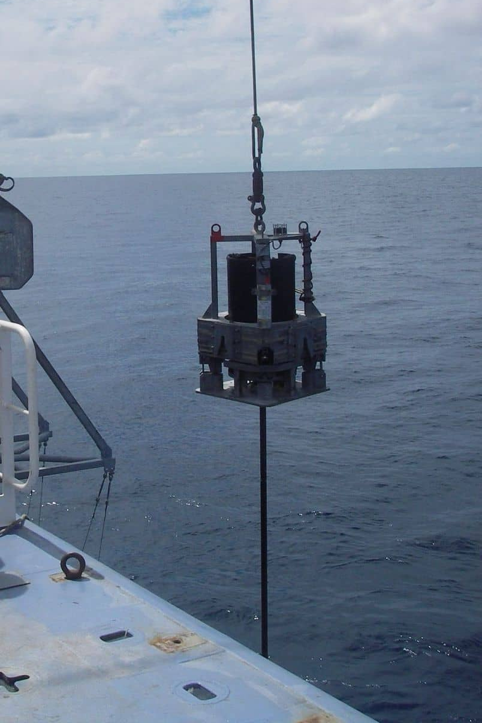
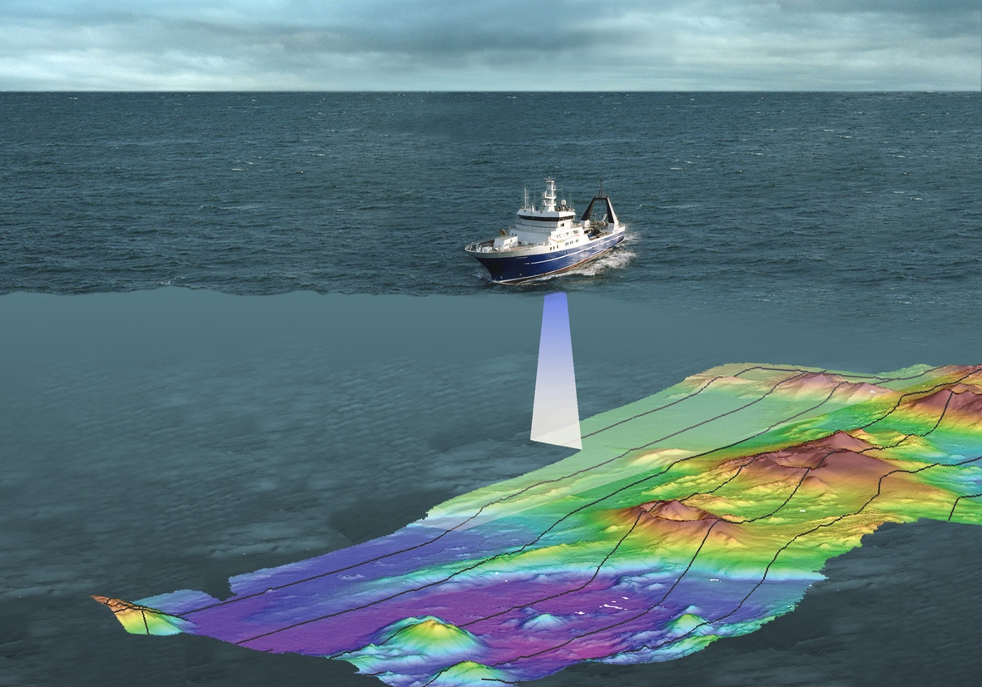
3.
Monitoring
Repeat mapping
Piezometer

Slide 7
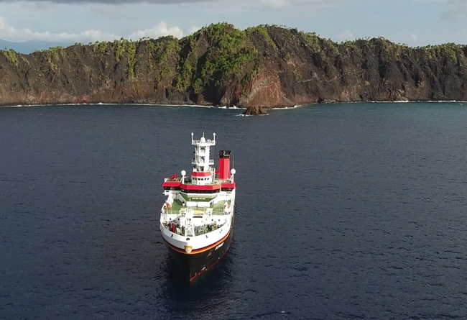
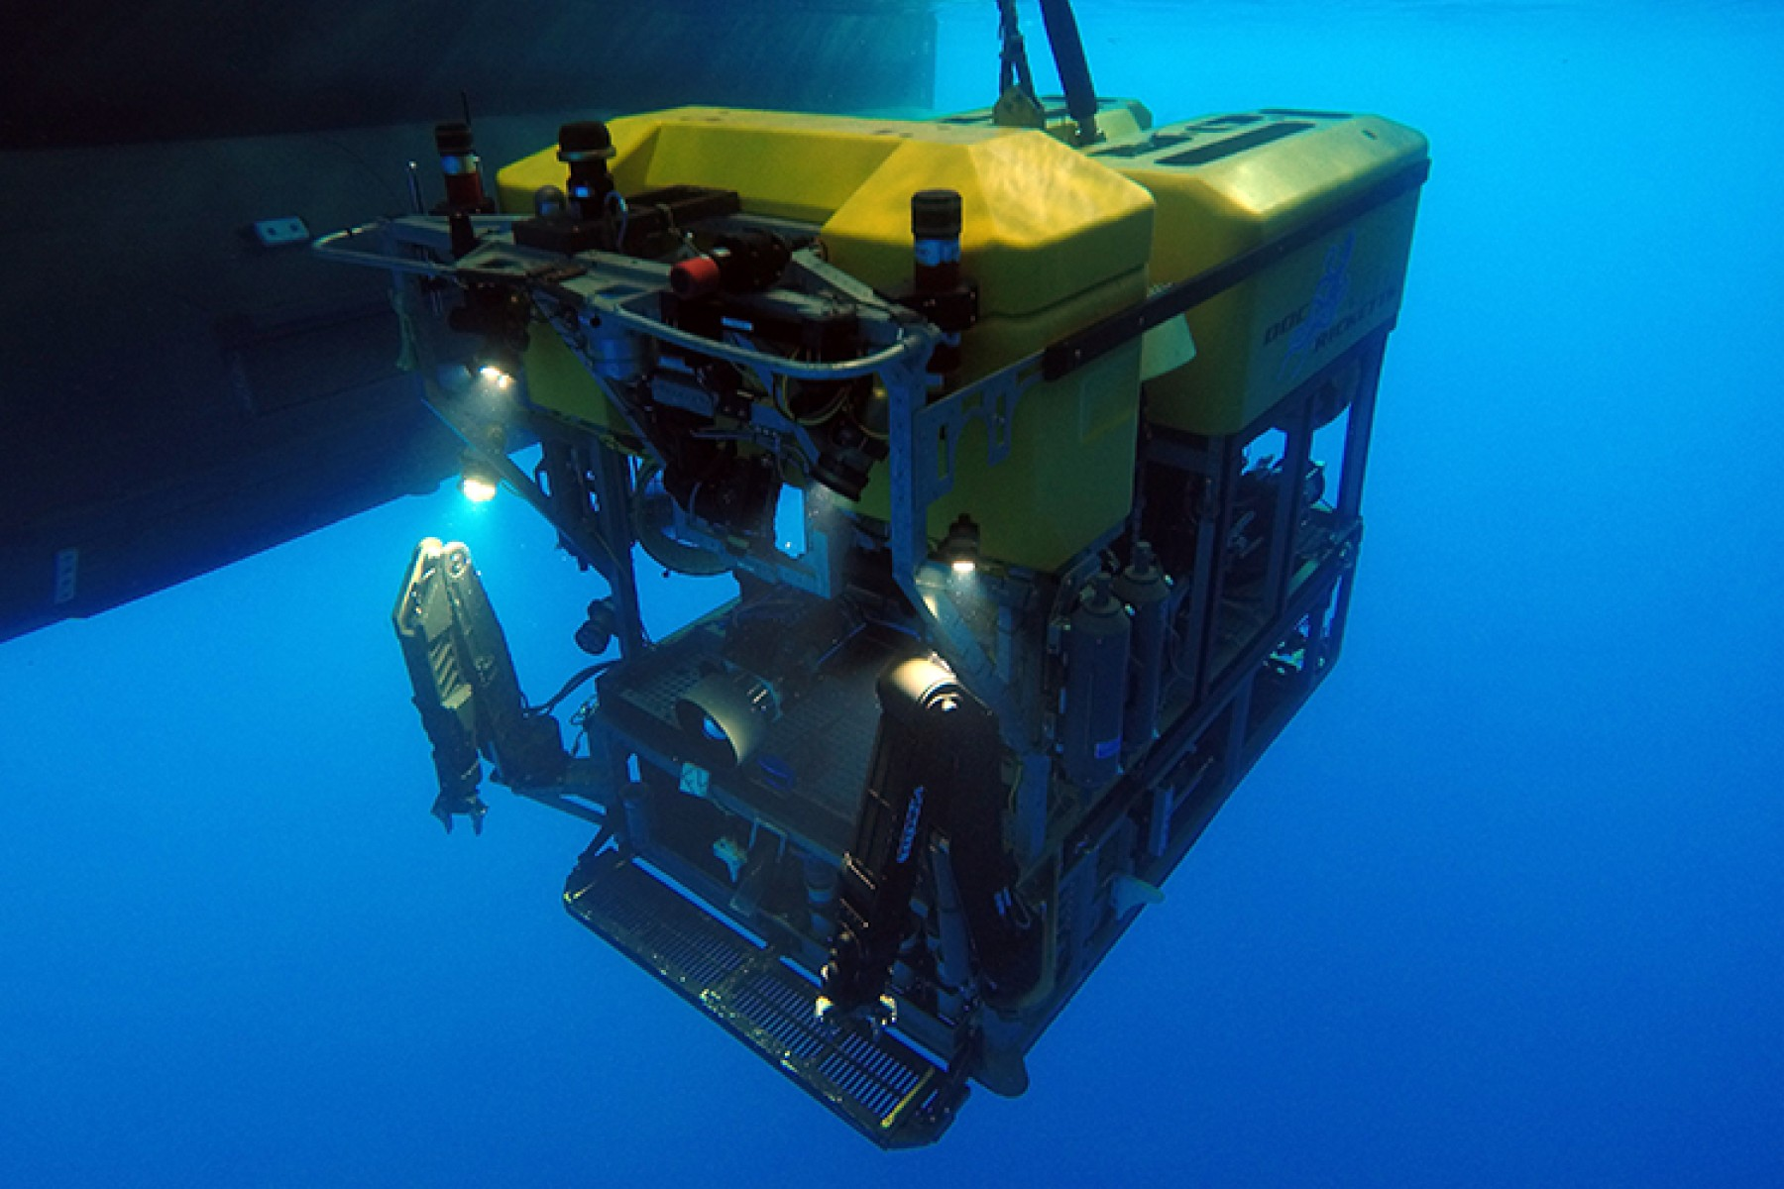
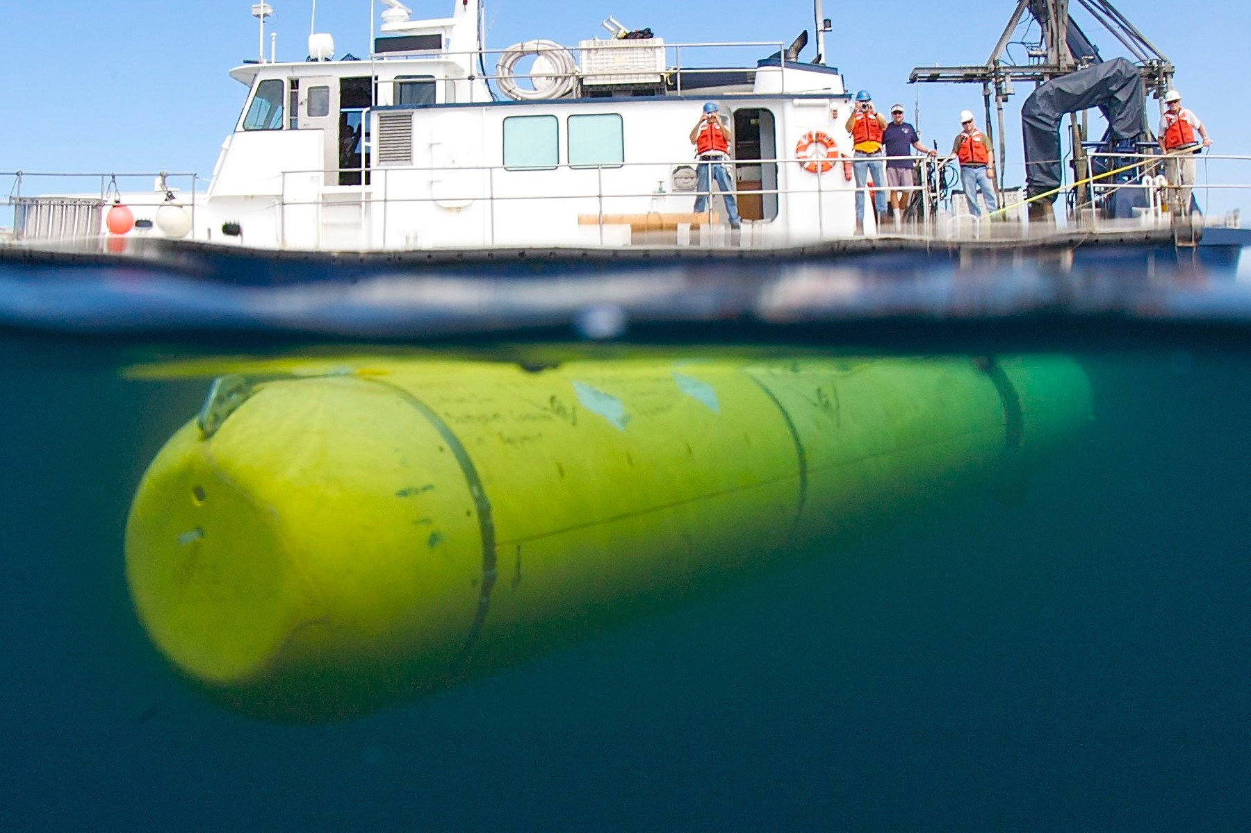
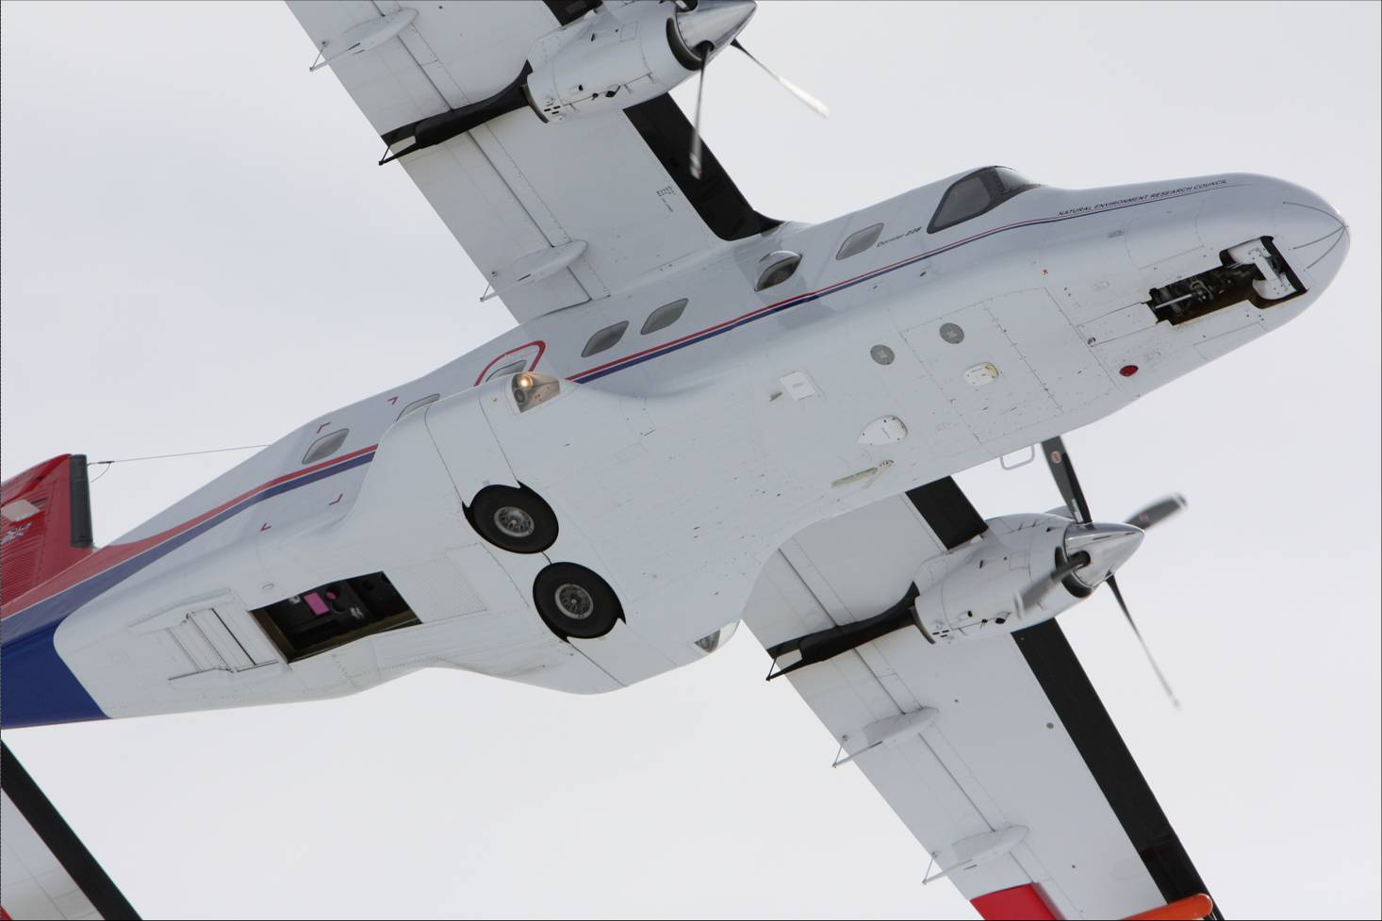
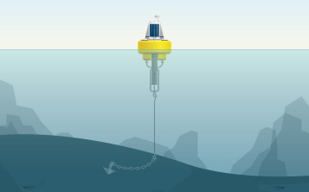
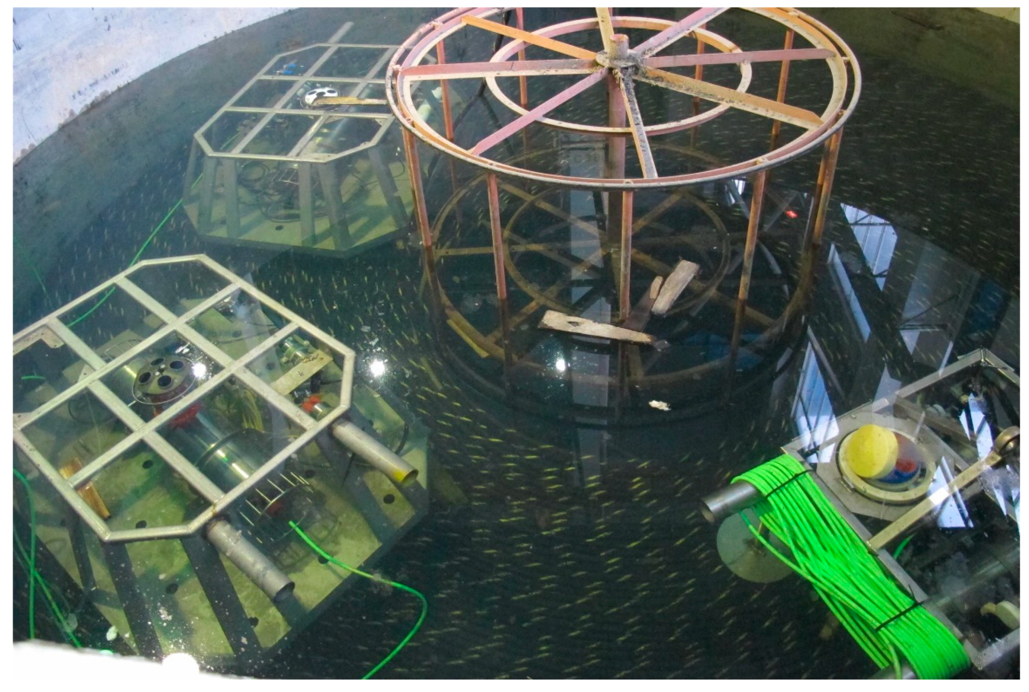
Platforms
Vessels
ROVs
AUVs
Aircraft
Moorings
Seafloor observatories

Slide 8
2. Knowledge gaps

Slide 9
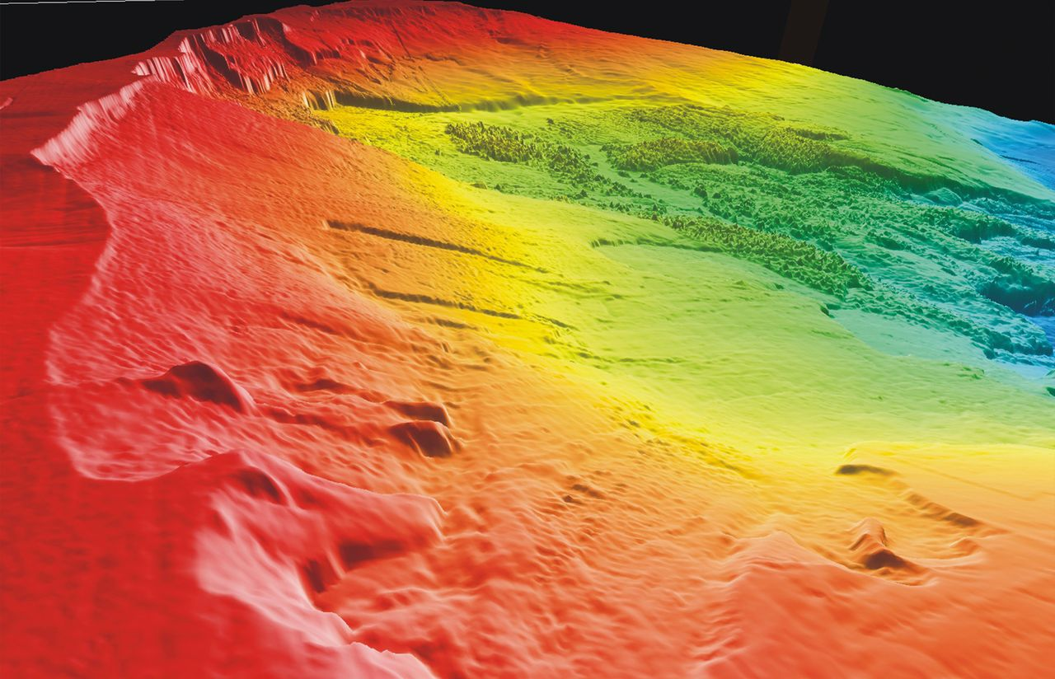
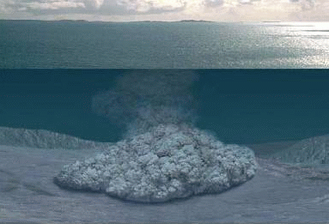
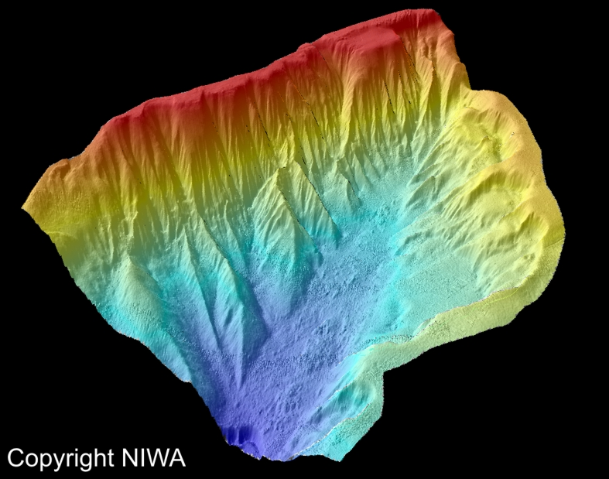
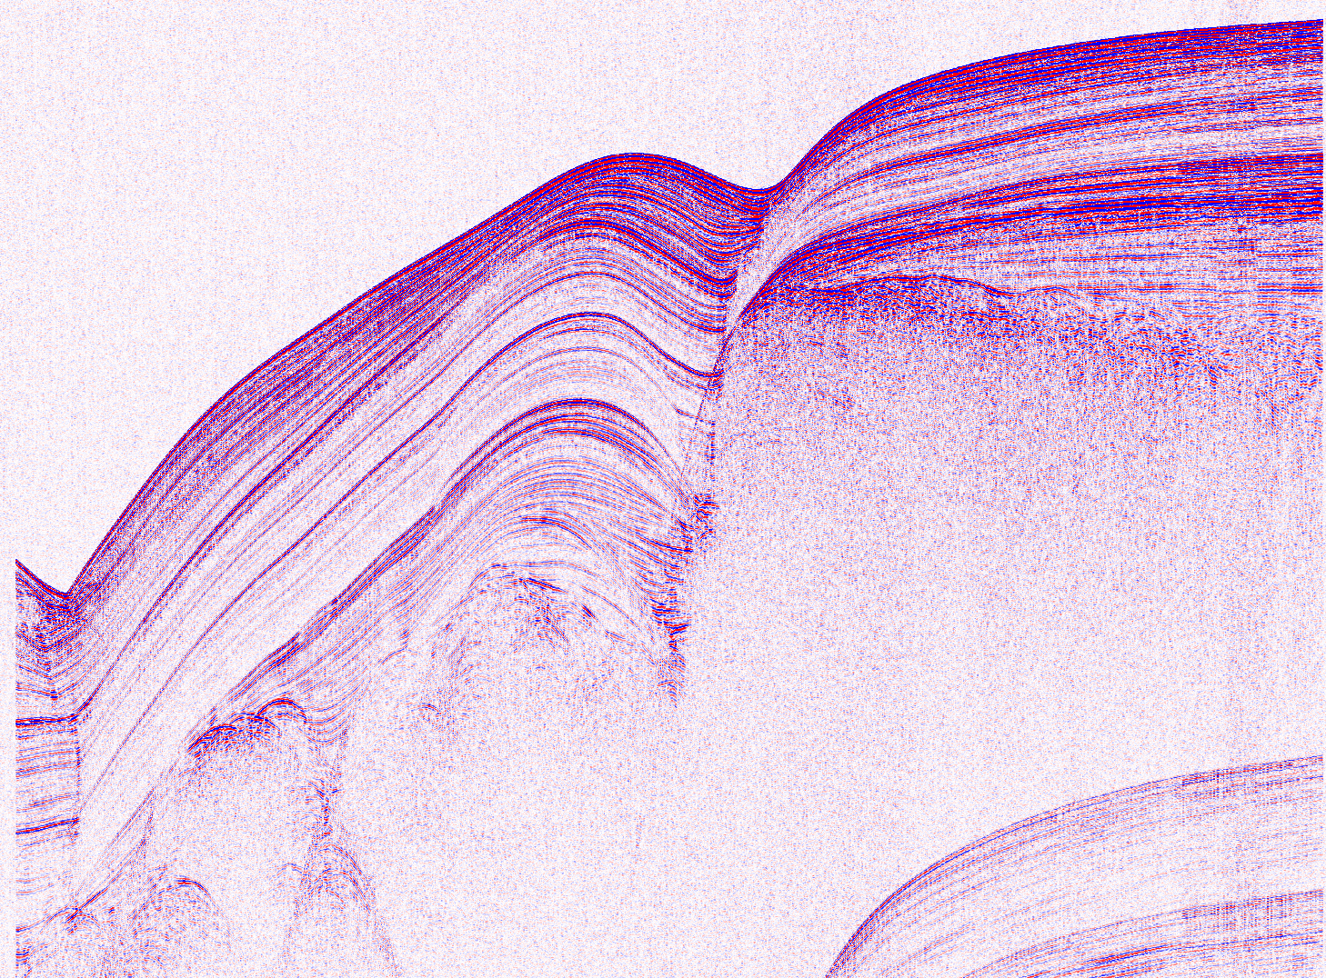
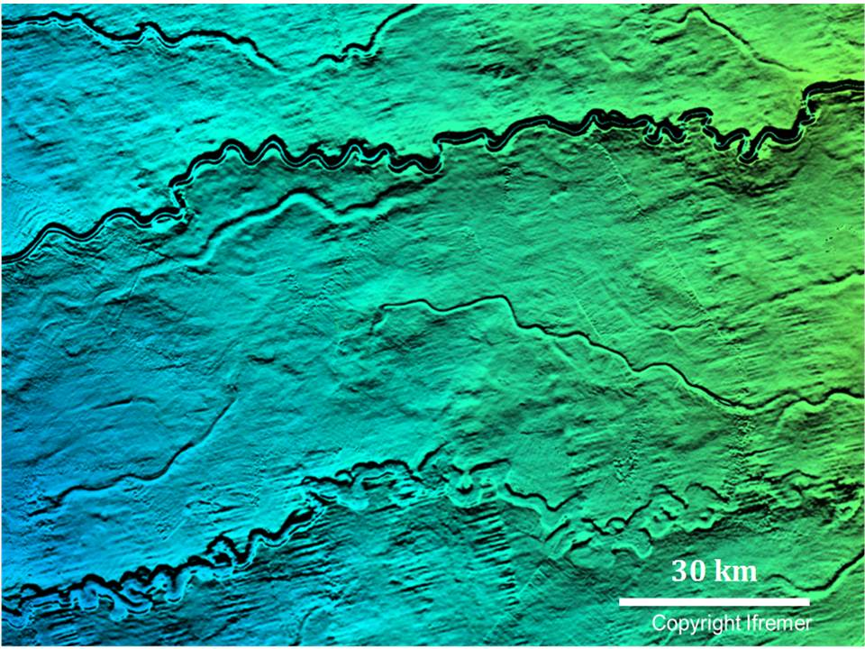
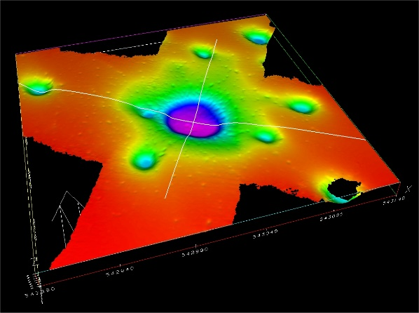

Slide 10
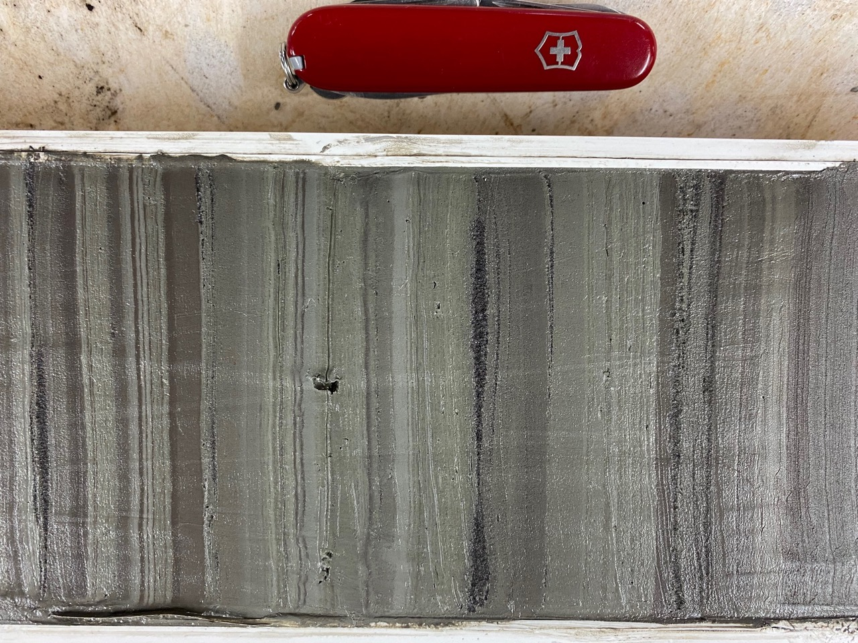
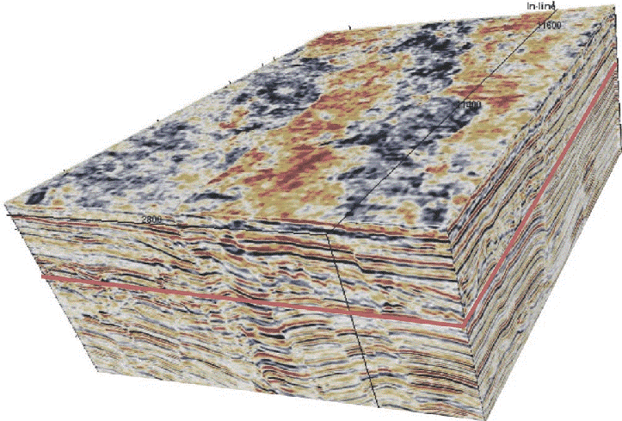
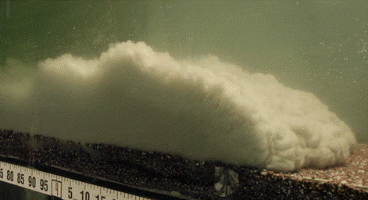
Issues:
Uncertainties
Field scale validation
Mechanistic explanation

Slide 11
Main knowledge gap:
  active seafloor processes
  at fine spatial and temporal scales, and
  their feedbacks with seafloor form,
  for a large portion of the seafloor

Slide 12
1. What are the characteristics of the seafloor process?
2. How does the process interact with seafloor?
3. What are the key drivers and controlling factors of the
process and landform evolution?
Questions that cannot be addressed with conventional techniques.

Slide 13
3. Proposed approach

Slide 14
Repeat/continuous acquisition of in situ
seafloor, sub-seafloor &
water column data
Automated processing,
detection & classification
Advanced numerical methods

Slide 15
Paradigm shift
Paull et al. (2018)
Elevation (m)
Urlaub et al. (2018)
Time (days)
Azpiroz-Zabala et al. (2017)

Slide 16
Vision
Global leader in the characterization of a wide range of seafloor processes at fine spatial/temporal scales

Slide 17
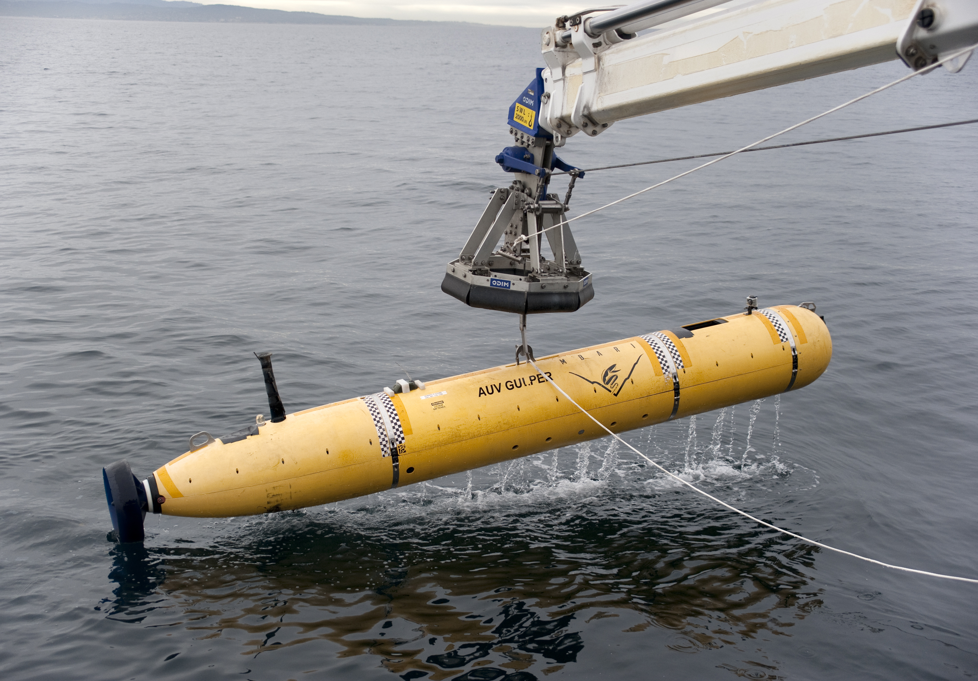
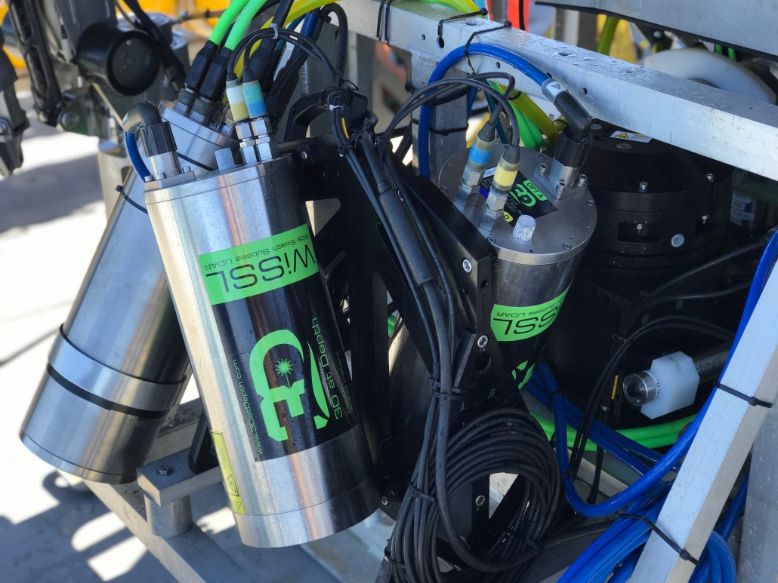
Mapping seafloor change

Slide 18
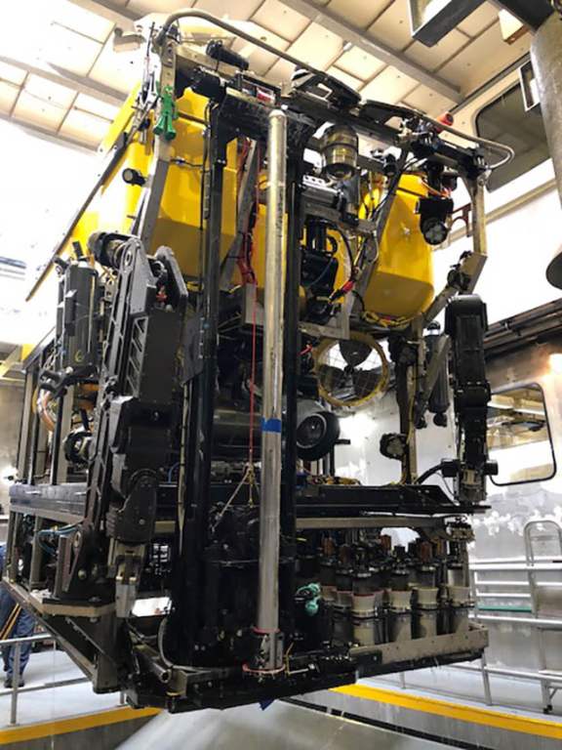
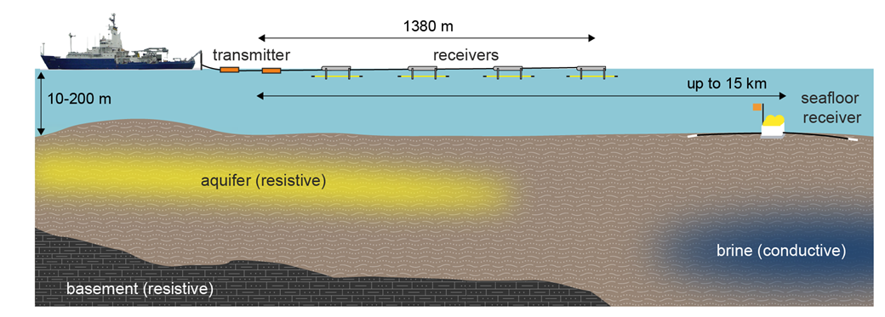
Physical property measurement

Slide 19
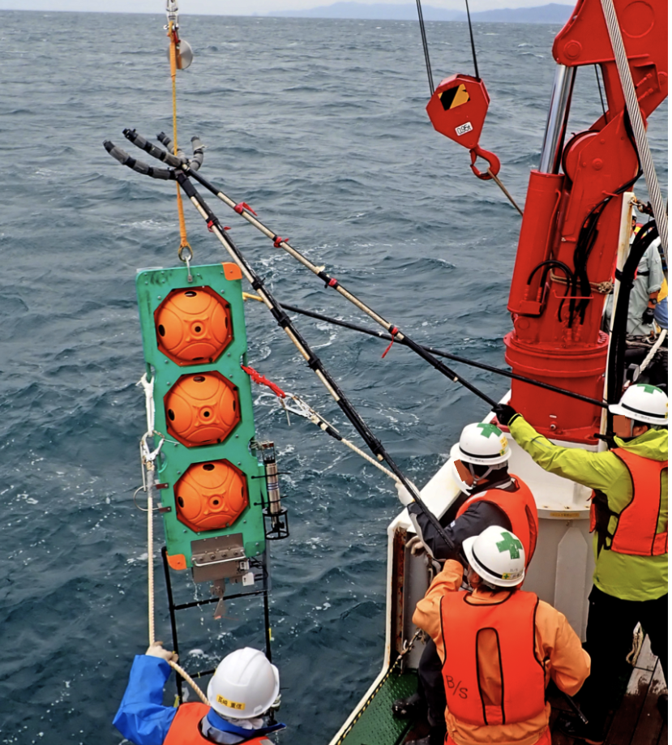
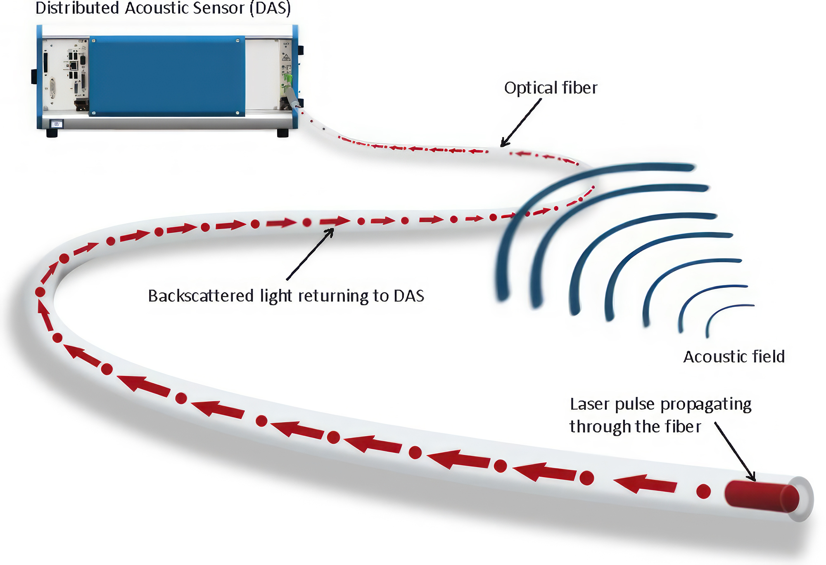
Process rate measurement

Slide 20
Bridging scales

Slide 21
4. Geo-Sense

Slide 22
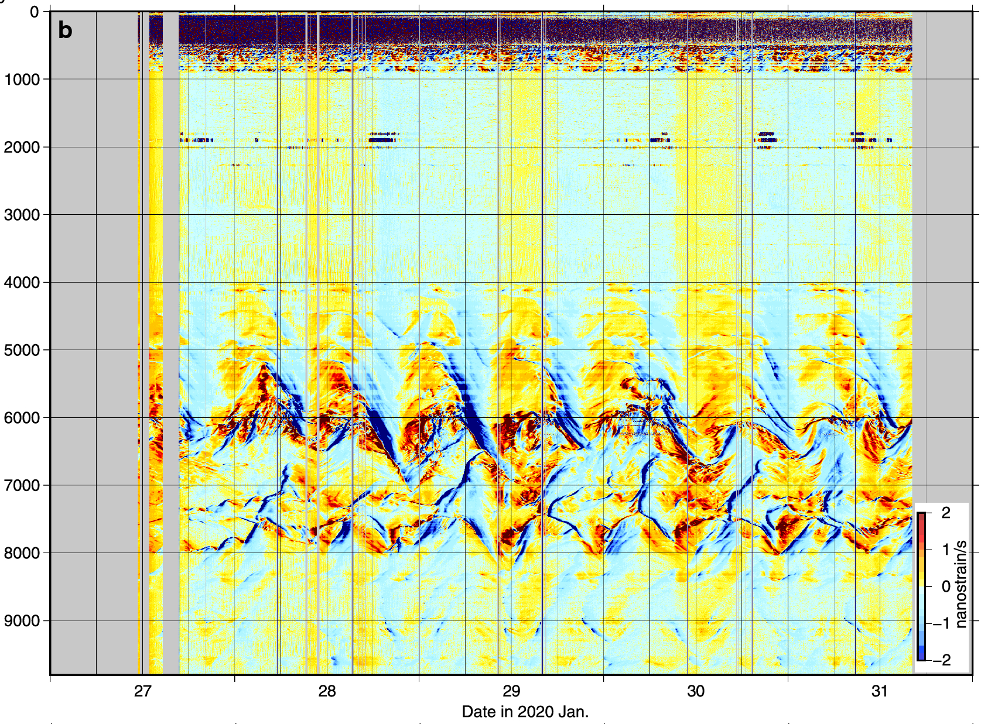
Variation of strain (temperature) along cable
Channels
Dates (Jan 2020)
Ide et al. (2021)

Slide 23
Problems
limited availability of submarine cables and access to dark fibers and interrogators
submarine cables tend to be located away from seafloor processes of interest

Slide 24
1. How do we take the rapidly developing DAS technology and deploy it as an autonomous instrument?
2. What information can DAS technology provide on the initiation and behavior of sedimentary flows in Monterey Canyon?

Slide 26
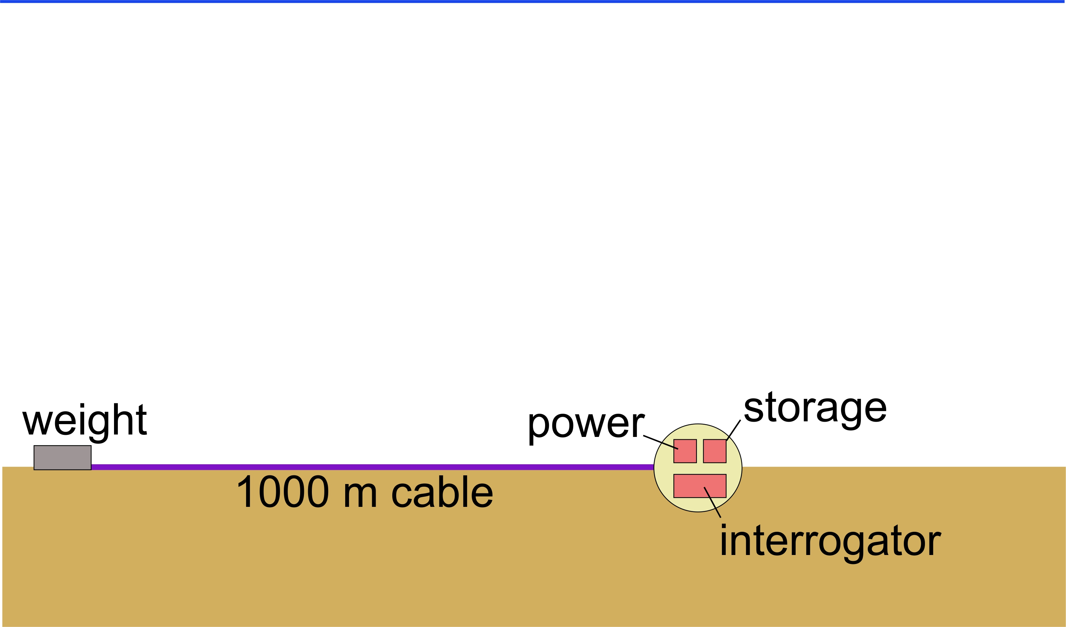
1. How do we take the rapidly developing DAS technology and deploy it as an autonomous instrument?
sea-level
Monterey

Slide 27
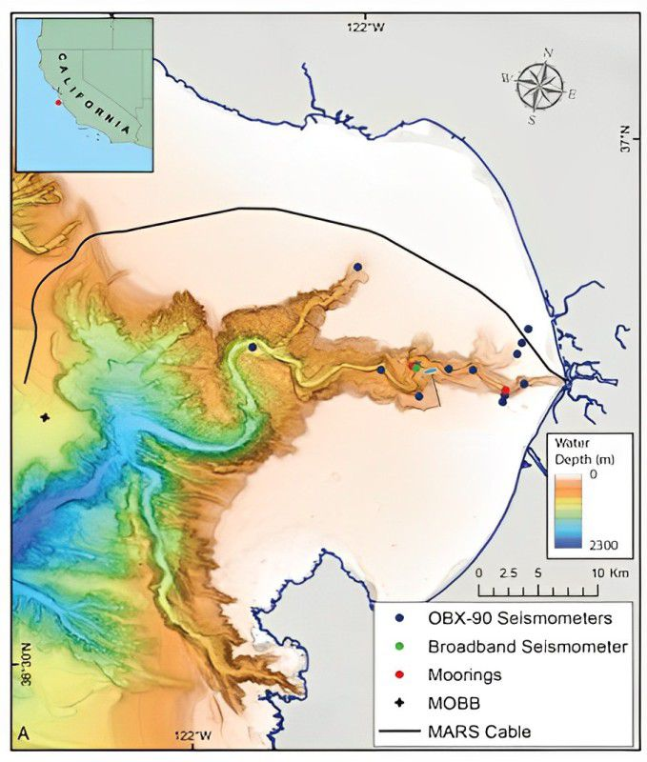
2. What information can DAS technology provide on the initiation and behavior of sedimentary flows in Monterey Canyon?
MARS cable
Moored instruments
Geo-Sense
Water
depth (m)
Seismometers
0
2300

Slide 28
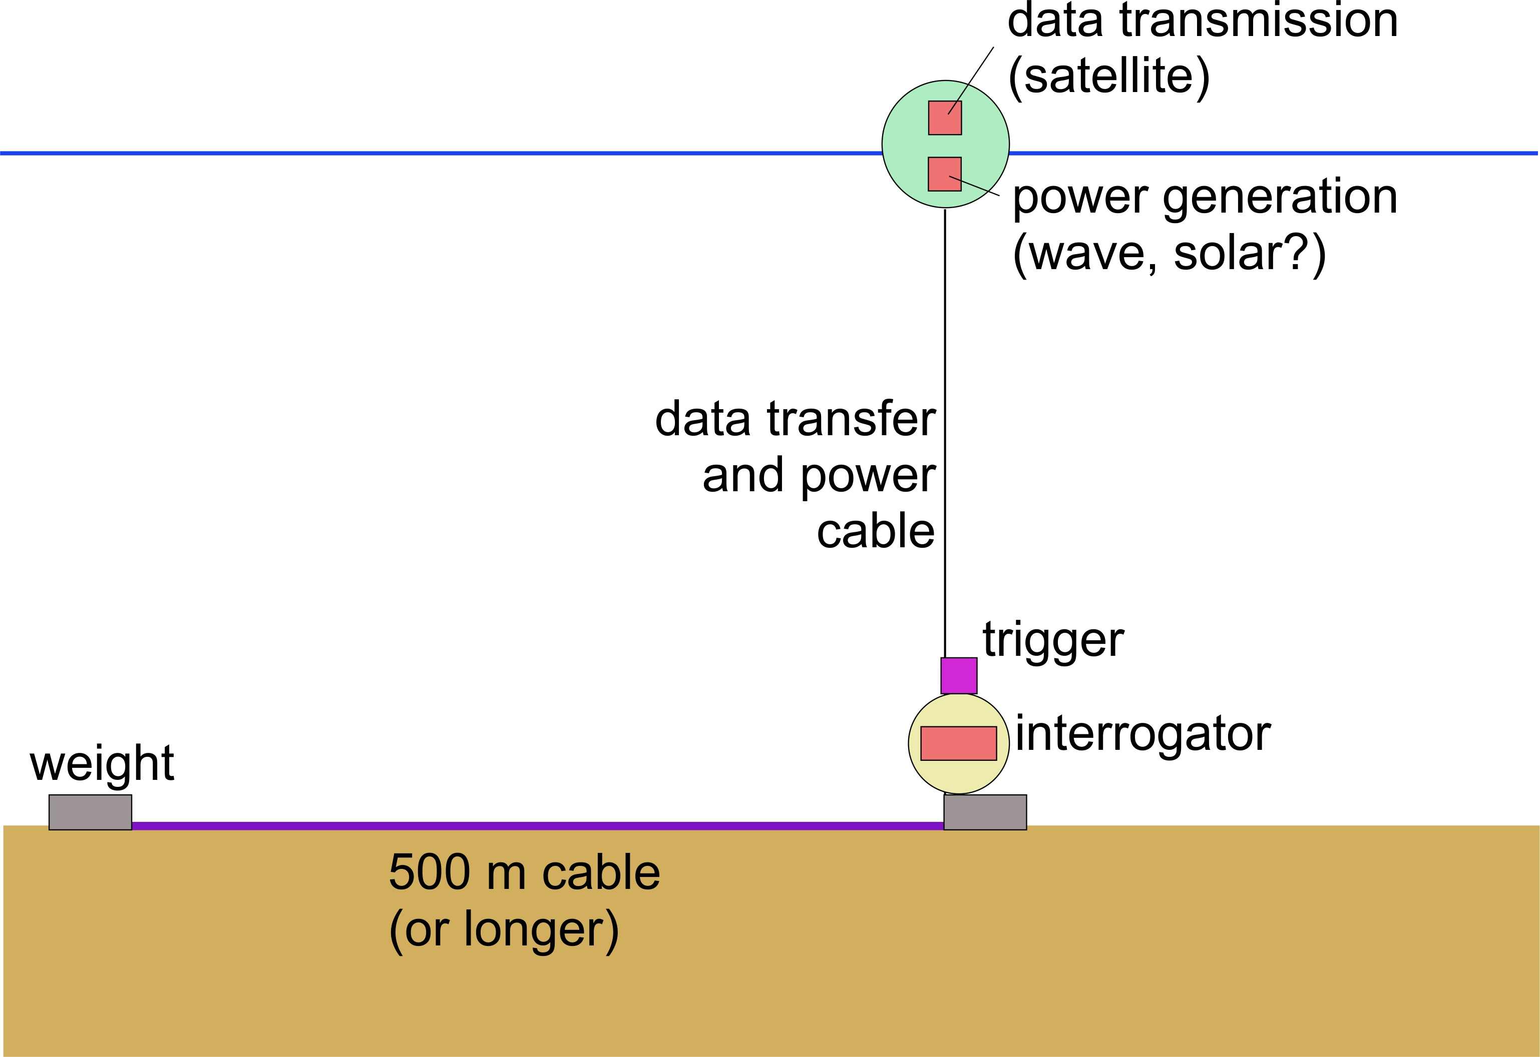
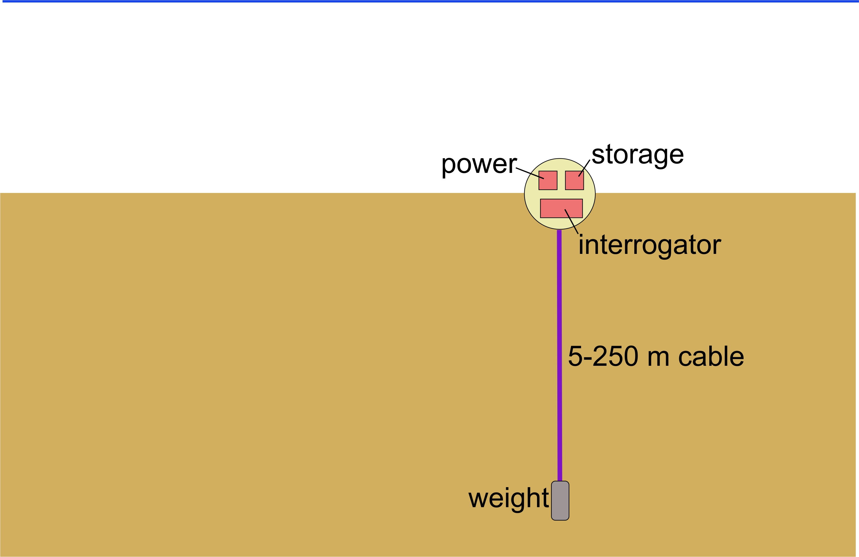
Monterey

Slide 29
5. Impact and alignment with MBARI vision

Slide 30

Impact
1. Seafloor processes are at nexus of multiple disciplines:
  Biogeochemical cycles
  Resource management
  Hazard assessment
2. Seafloor/sub-seafloor can be used as archive of environmental processes
3. Fundamental input to predictive models

Slide 31
Strategic priorities
1. Map the deep seafloor at high resolution
2. Study the impact of climate change and other ocean threats
3. Build scalable technologies to improve ocean health assessments
4. Advance ocean-based artificial intelligence
5. Explore and observe life in a dynamic ocean
6. Make ocean science and engineering accessible to all

Slide 32
Thank you!

