Slide 1
Geo-Sense System Design Review

Slide 2
Review Contents
Motivation
Enabling technology: Distributed Acoustic Sensing (DAS)
Geo-Sense Concept
DAS Onyx Nano specs
Deployment

Slide 3
Motivation
Can we capture high resolution measurements of seafloor processes in areas were there is no connection to shore power or communications?

Slide 4
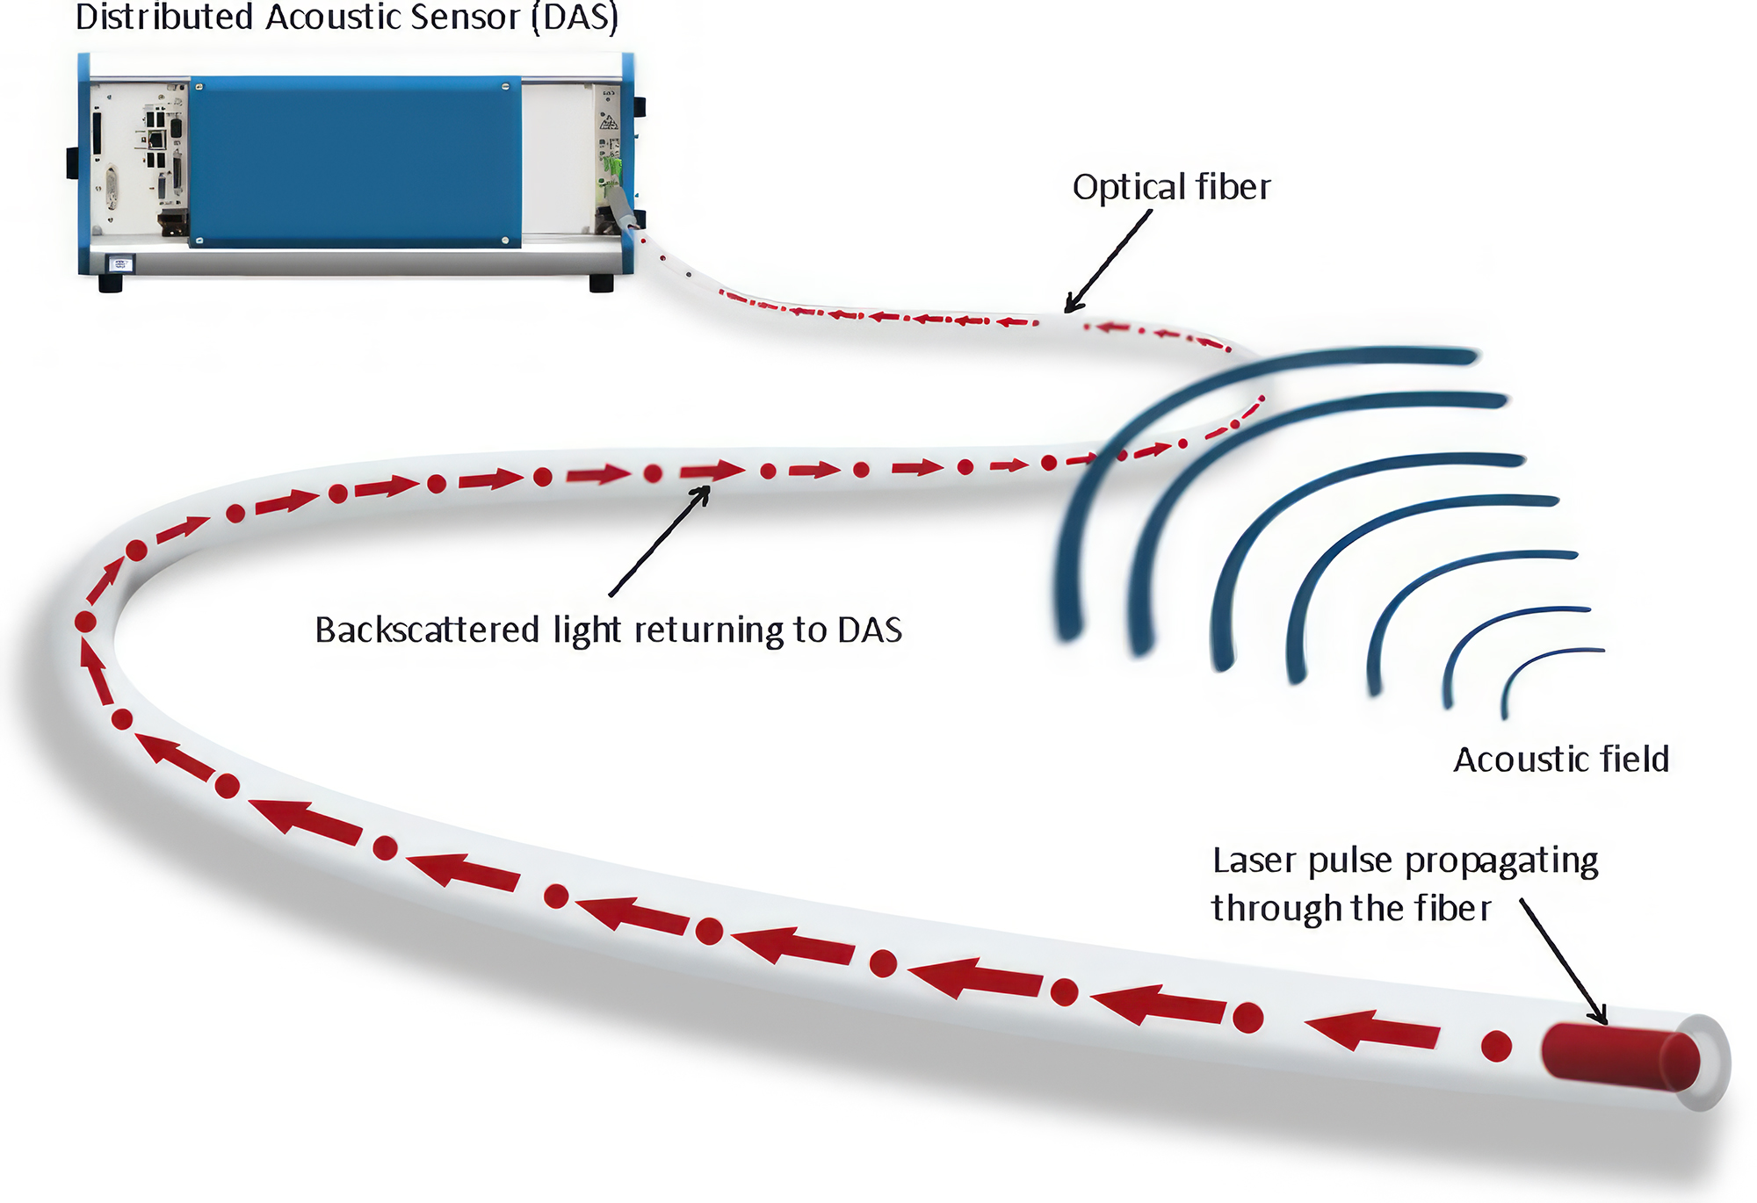
DAS technology: Optical Method of Measuring Acoustic Signals

Slide 5
DAS
Advantages:
  incredibly sensitive measurements over a large area
  Can measure acoustic strain and temperature
Challenges
  Currently used only on cables running to shore
  Very large and power hungry instruments

Slide 6
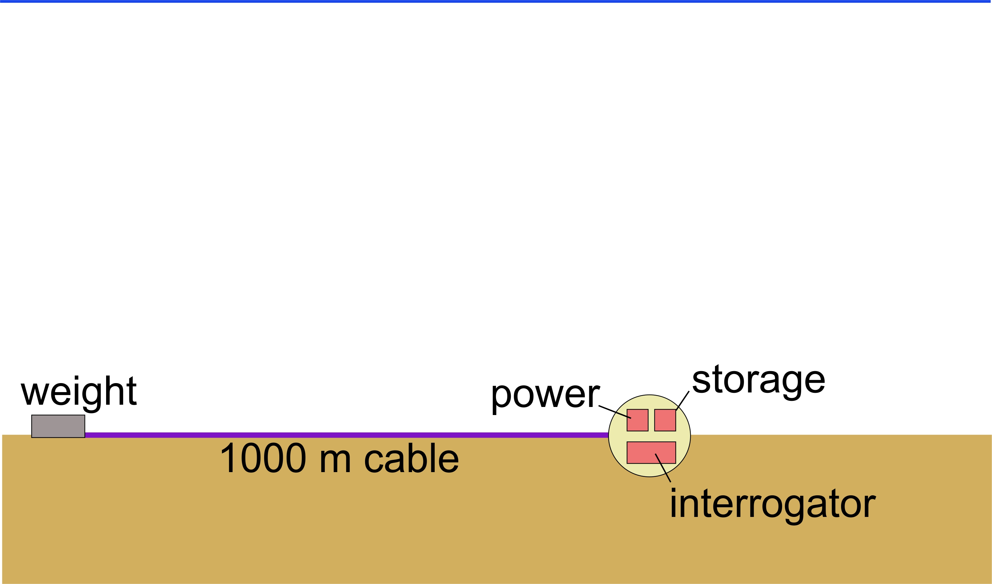
Geo-Sense Concept

Slide 7
Enabling Tech: New DAS Instrument
We are working with Sintela Ltd to develop a custom version of their product in development the Onyx Nano
Key features:
  Smaller size: 30 cm x 20 cm x 7.5 cm vs. 3U in 19” rack
  Lower power <40W vs. 100 W continuous
  Can set trigger to record only samples above a certain threshold
  Works up to 5 km, which is 5x more than we need

