Slide 1
Subsea Cable Selection
Software simulations informed requirements
Request for quote sent to 8 manufacturers
Cable specific design review held
Decision down to two cables (Concept Cables and Winchester)
SS Tube would have about 0.5% Strain when the cable experiences the Maximum Peak Dynamic Load <= 3,600 LBf (16kN)-Winchester

Slide 2
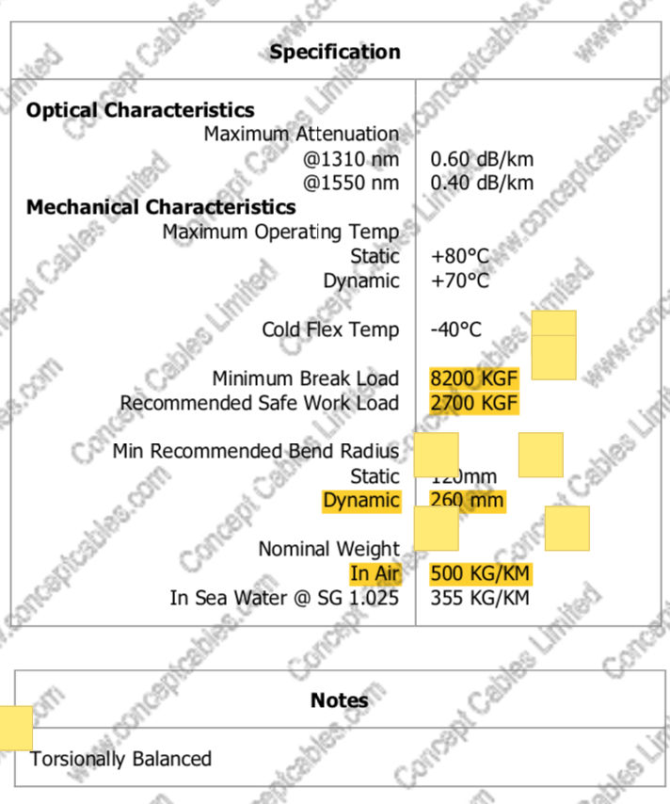
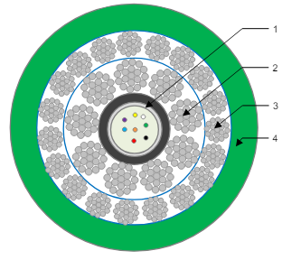
Concept Cables

Slide 3
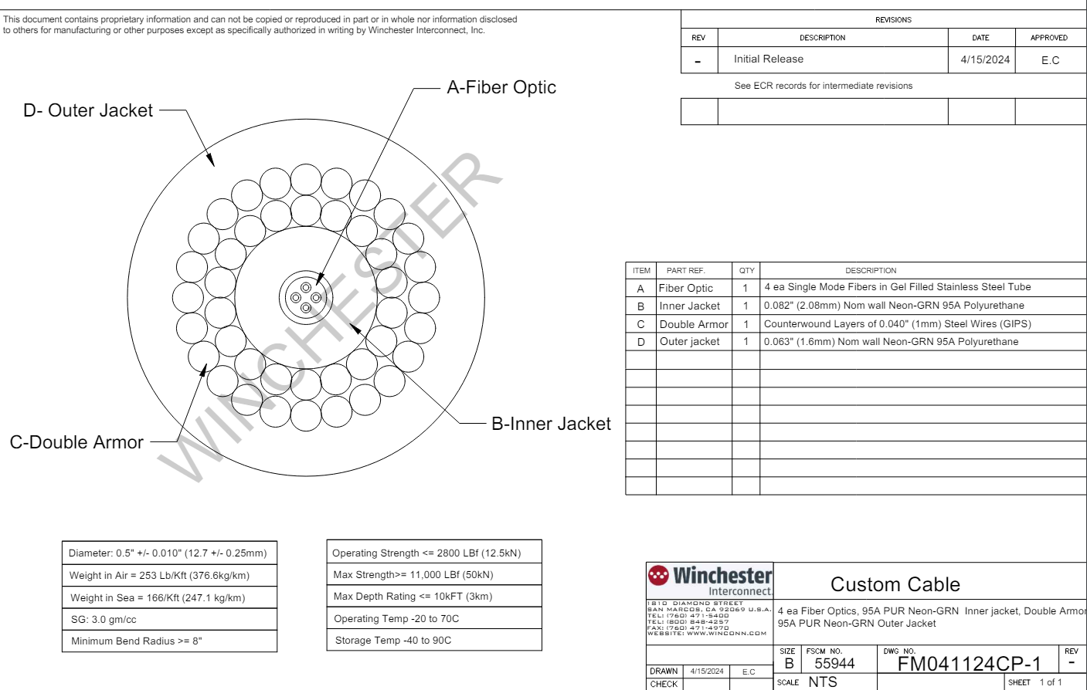

Slide 4
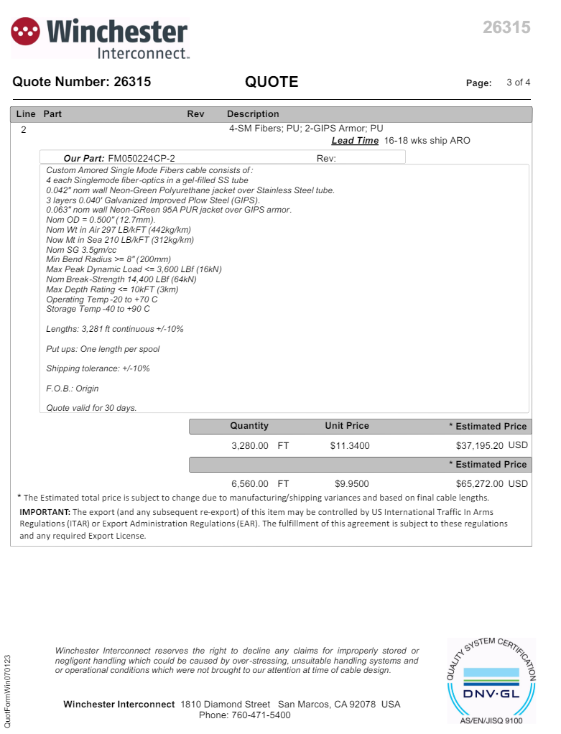

Slide 5
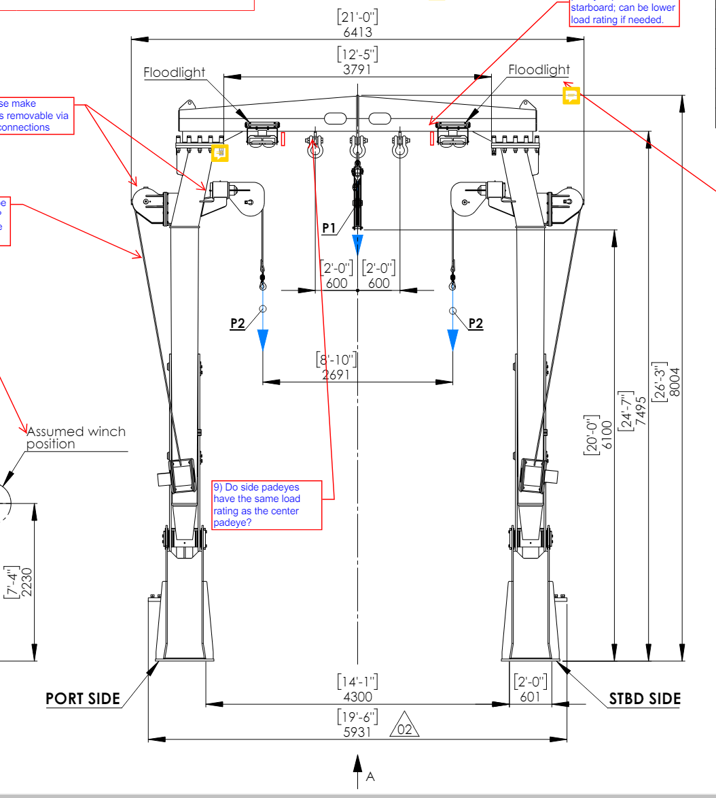
Using the “diggers” to pick up the frame and place in the water
A-frame will lower frame to bottom using center sheave
SWL of center sheave is 6 tonne
Sheave Clearance ~20 ft

Slide 6
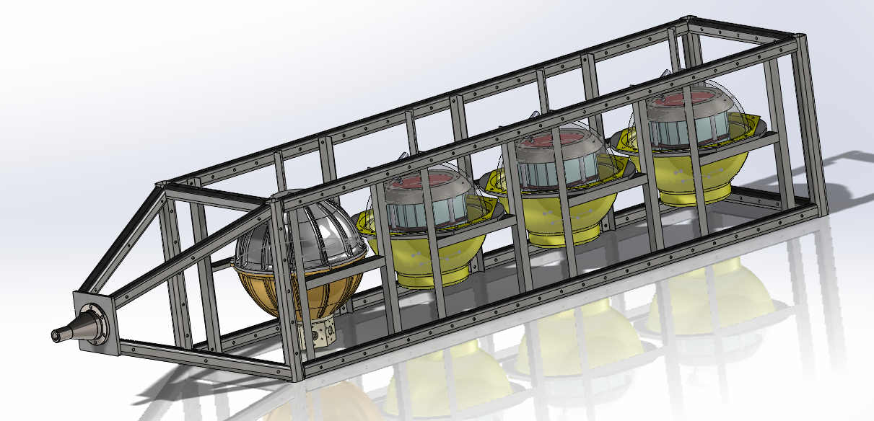
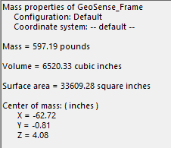

Slide 7
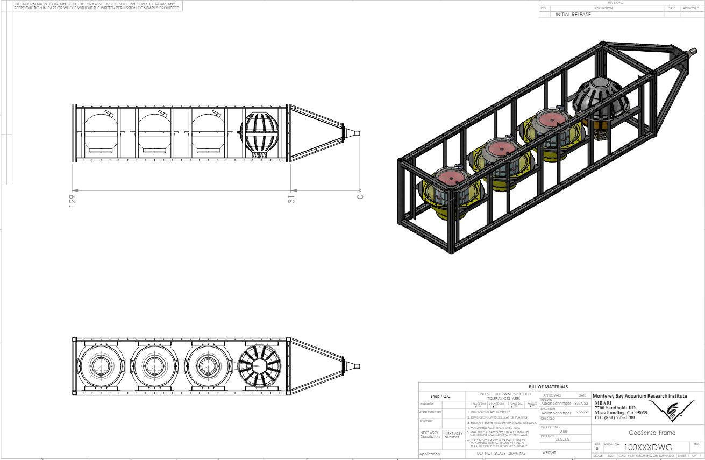

Slide 8
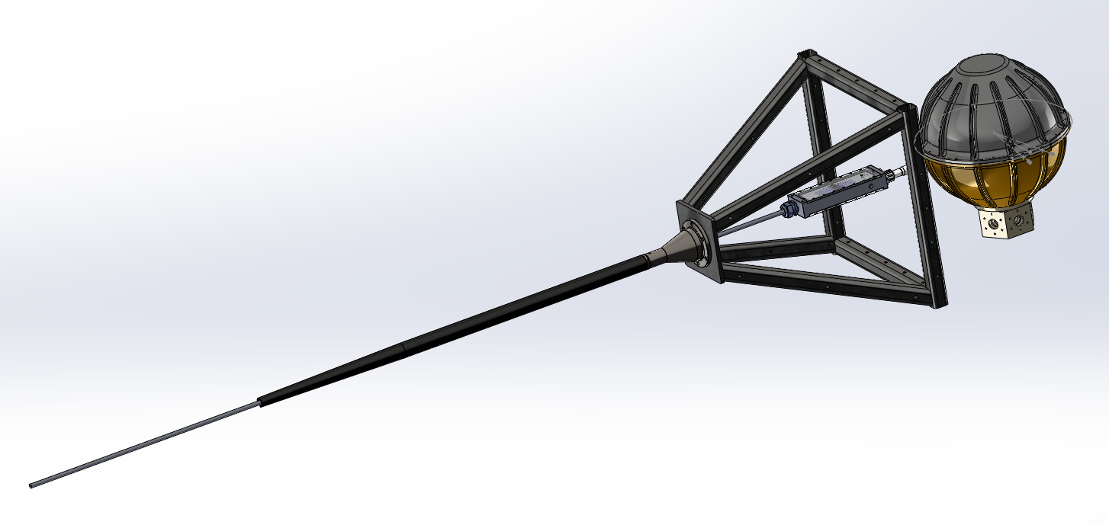

Slide 9
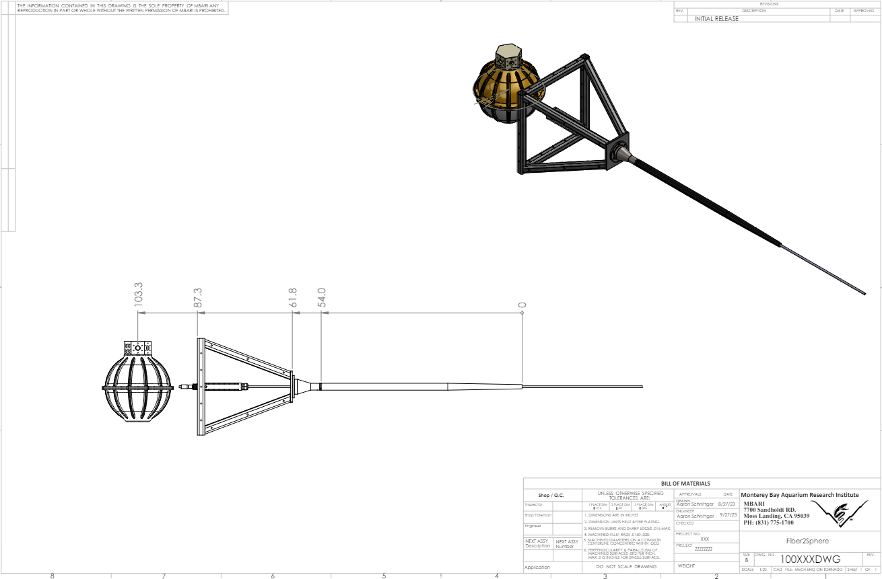

Slide 10
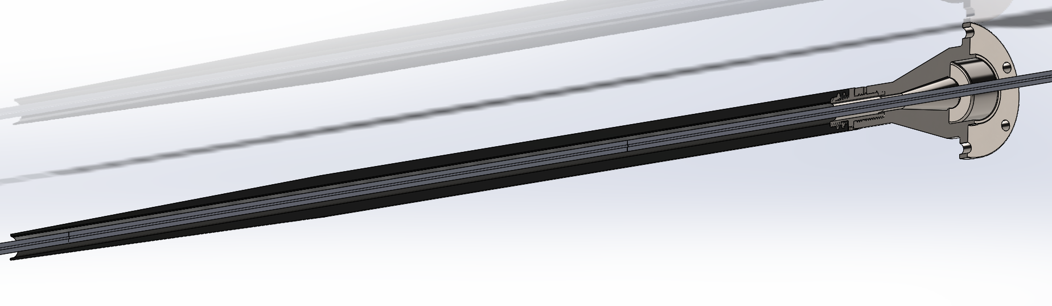

Slide 11
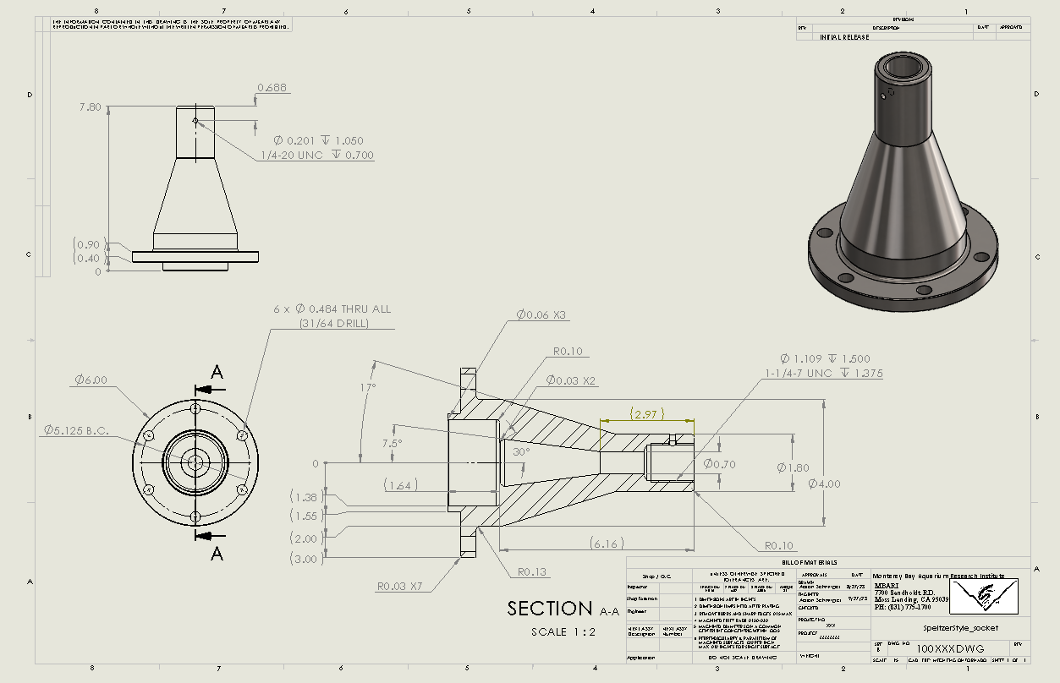

Slide 12
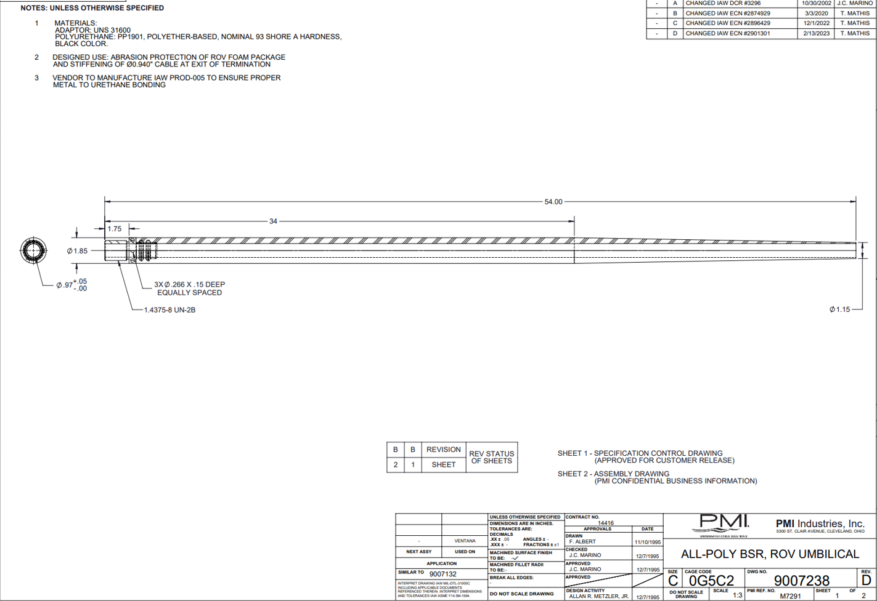

Slide 13
