Slide 1
Geo-Sense Preliminary Design Review
May 9, 2024

Slide 2
Review Outline
Science Motivation
Geo-Sense Concept
Operational Concept: Deployment and Recovery
System Requirements
Electrical System
Mechanical System
Schedule
Test and integration plan
High-risk elements

Slide 3
Science Motivation
Can we capture high-resolution measurements of seafloor processes in areas with no connection to shore power or communications?

Slide 4
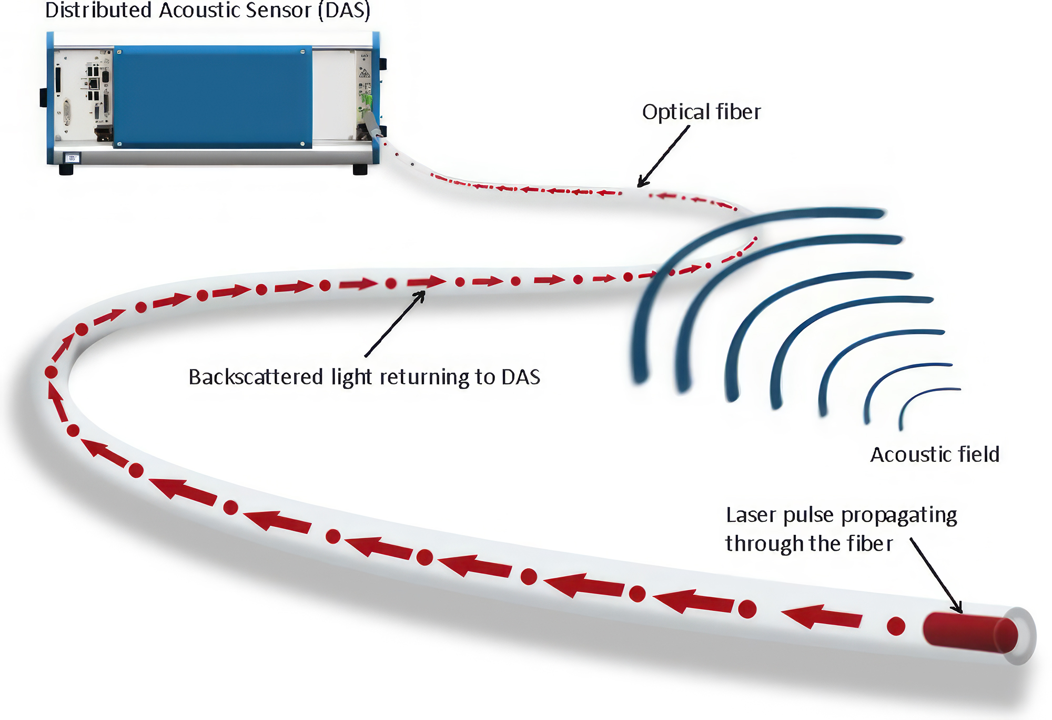
DAS (Distributed Acoustic Sensing):
Optical Method of Measuring Acoustic Signals

Slide 5
DAS
Advantages:
  Incredibly sensitive measurements over a large area
  Can measure acoustic strain and temperature
Challenges
  Currently used only on cables running to shore
  Large volume and high-power instruments

Slide 6
Enabling Tech: New compact DAS Instrument
We are working with Sintela Ltd to develop a custom version of their product in development the Onyx Nano
Key features:
  Smaller size: 30 cm x 20 cm x 7.5 cm vs. 3U in 19” rack
  Lower power <40W vs. 100 W continuous
  Can set trigger to record only samples above a certain threshold
  Works up to 10 km, which is far more than we need

Slide 7
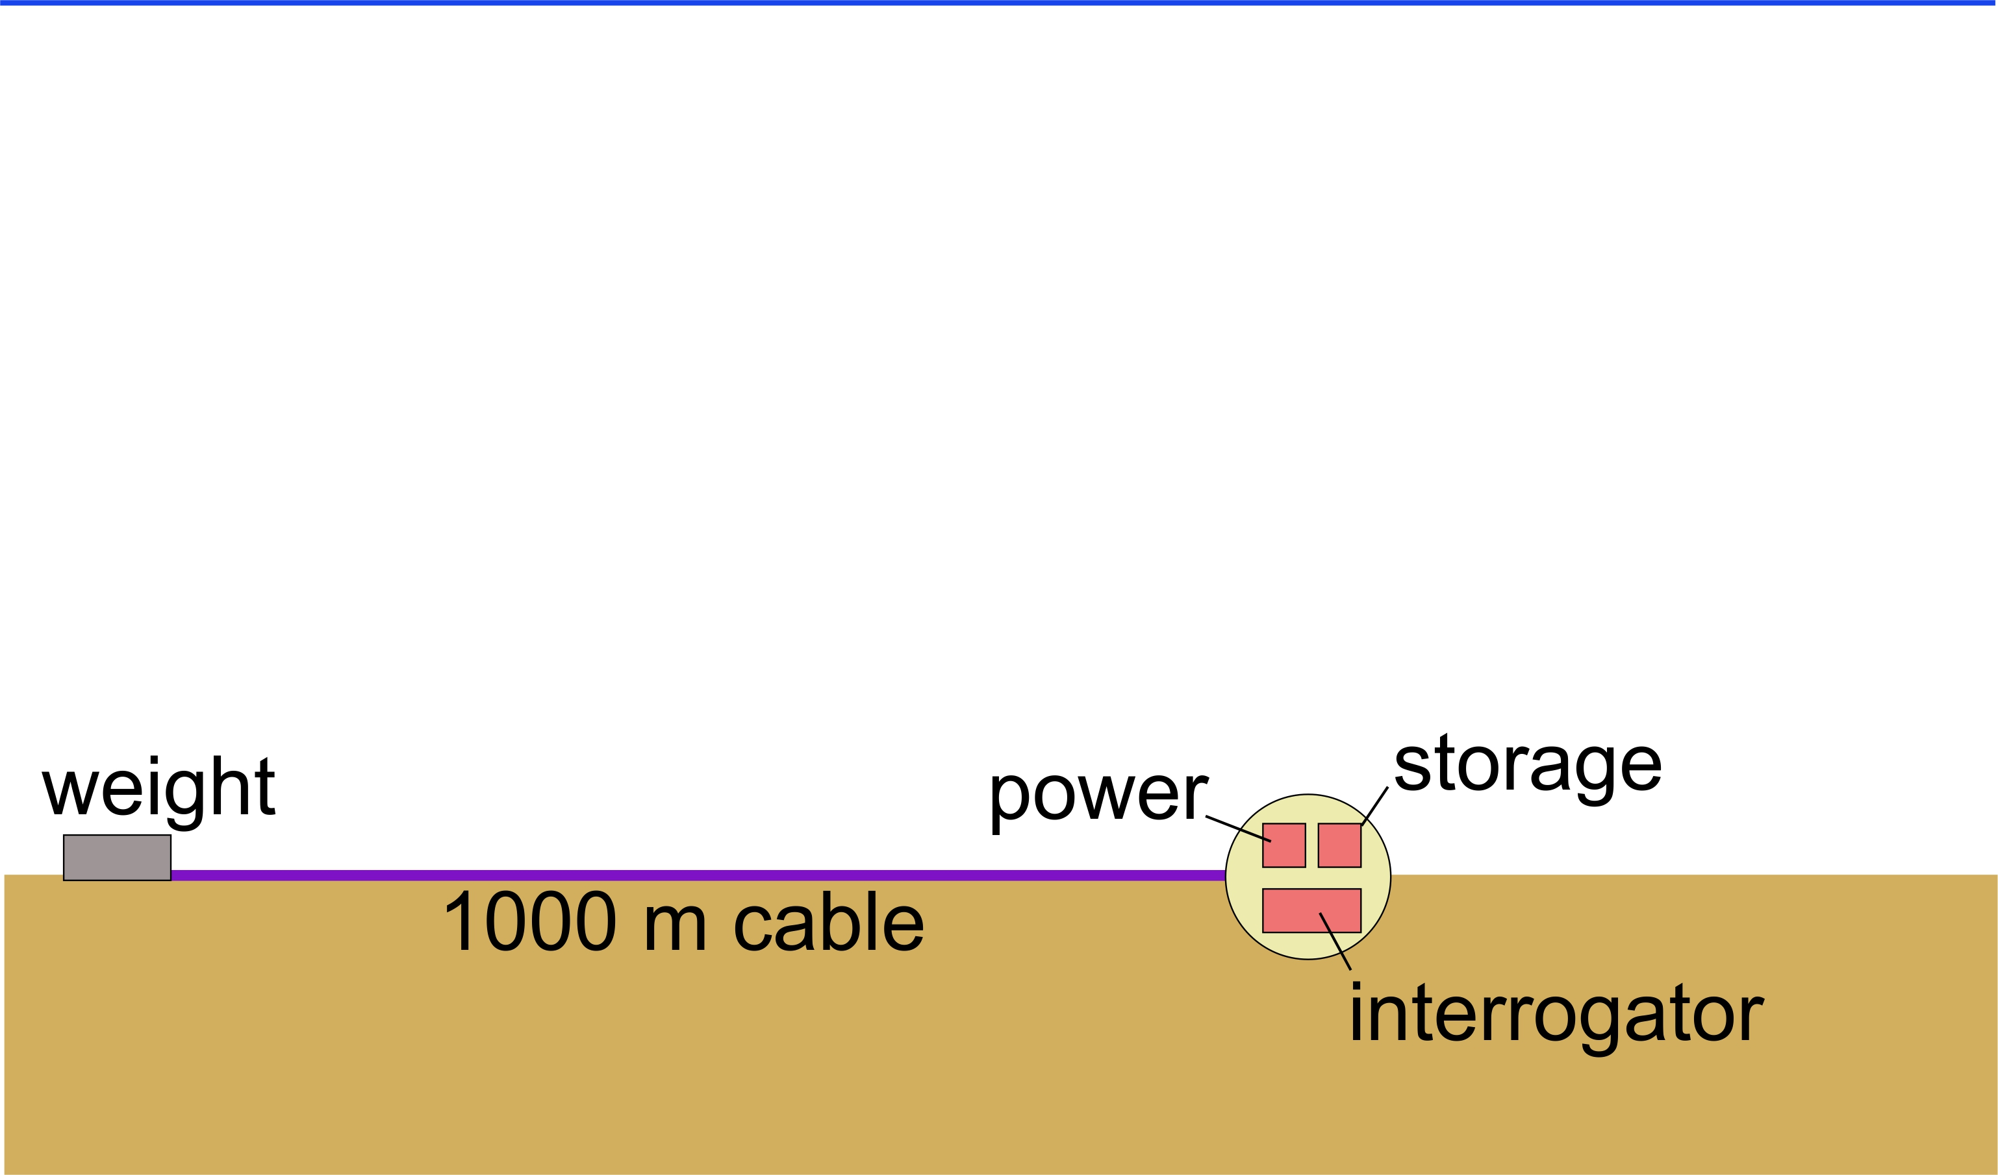
Geo-Sense Concept

Slide 8
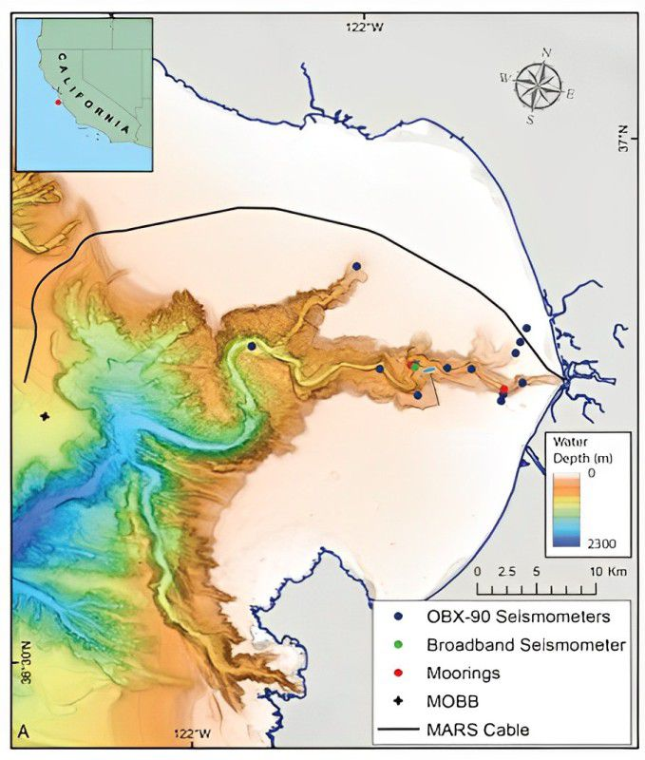
Motivation for Development Schedule
MARS cable
Seismometers
The ongoing seismic experiment (Winter 2024-25) provides a rare opportunity to ground truth DAS results with many instruments making simultaneous measurements.
Geo-Sense

Slide 9
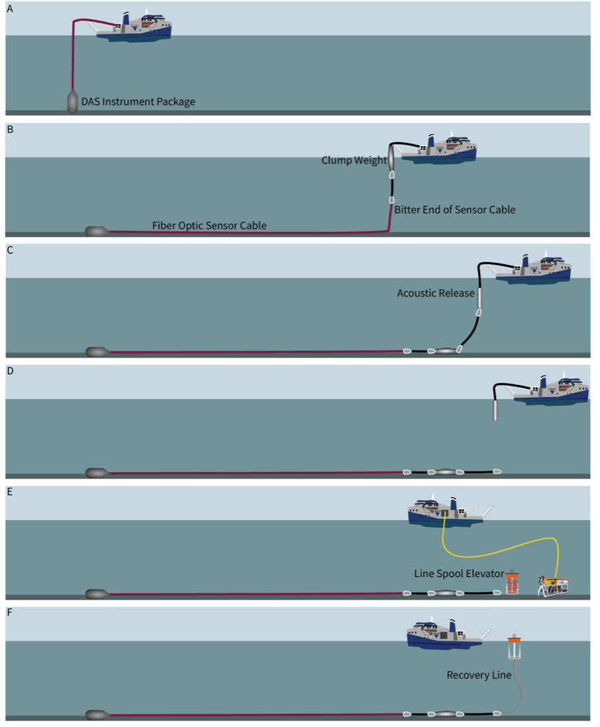
Deployment & Recovery

Slide 10
Select Requirements – System Level
The system shall resolve seismic waves with a frequency range of 0 - 20 Hz.
The system shall resolve seismic waves with a spatial resolution of 5 meters.
The system shall be able to operate autonomously (without operator intervention) for 1 to 2 months. This includes locally recording data.
The system shall be deployable from MBARI vessel R/V David Packard
  Size limit based on A-frame: 18 ft
  Desired package weight based on previous experience: 300 lbs (water weight)
  Cable bend radius limited by winch and sheave: 12” bend radius
The system shall be deployable to depths of 1000 meters (for the initial design)
The cable shall be well coupled to the seafloor (lay flat/similar density to sediment/visible for inspection) – these are combined requirements for measurement and permitting.

Slide 11
System Requirements – Electrical/Mechanical
Batteries and instrument shall fit into the volume of existing spherical housings (17” diameter)
The DAS system must be mounted robustly enough to withstand deployment and recovery.
The DAS system shall be capable of operating at likely temperatures on the seafloor 4 - 8 deg C (in 5-15% humidity non-condensing environment).
The DAS system shall be capable of operating in any orientation to Earth’s gravity field.
The system shall operate from the existing battery design for 17” pressure housings. Desired voltage range = 24V - 32V.
The system shall be capable of shutting down gracefully in case the energy from batteries is depleted before recovery.
The system shall include a means to disconnect the fiber optic cable from the electronics pressure housing on deck. (Desired)

Slide 12
Requirements - Software
The user shall be able to communicate with the instrument and set it in “deployment mode” on deck
The user shall be able to connect with the system while deployed via Ethernet and retrieve instrument status (Required) and data (Desired).
The instrument shall record data to non-volatile memory. (Required).
Data shall be stored on redundant drives (Desired) – risk vs. cost tradeoff

Slide 13
System Block Diagram –
Cable Termination
Strain
Relief
FO Core
DAS
1 km armored FO cable
Cable
Termination
Black
Hole
Term.
Oil-compensated
Junction box –
Fiber breakout

Slide 14
System Block Diagram – Instrument/Battery Package
Deepsea
Connect
“Toaster”
DAS
10 kWHr
Li Primary Batteries
10 kWHr
Li Primary Batteries
10 kWHr
Li Primary Batteries
FO
Penetrator
Ti sphere housing, glass spheres, battery pack design, and Deepsea Connect are reused technologies.

Slide 15
Electrical Design
DAS Onyx Nano Specification
System Power and Communications
System Interconnects
Fiber Optic Connection

Slide 16
DAS Details – Onyx Nano
Modification to commercial product in development
Preliminary design specifications:
  Fiber Range: 10 km
  Spatial Resolution: 2 m (possibly 1 m)
  Noise floor: Approx. -63 dB rad.Hz–½
  Acq. Sample Rates: 10, 20, 50 kHz
  Weight: c. 5 kg
  Dimensions: c. 300 x 200 x 75 mm
  Operating Temp: -10 °C to 50 °C
  Power: 20 V – 60 V DC, 40 W
  External I/O: 1 x 1 Gb Copper LAN
  Software ONYX standard SW

Slide 17
Power Budget
DAS should run directly from 28 V main battery, so no DC-DC loss
Sintela estimates “less than 40 W” for DAS
Using waste heat from FPGA to warm laser, which must be kept at 25 degC
We will have 30 kWh of Li primary batteries
Batteries would last 31 days at 40 W, 42 days at 30 W
DAS will operate down to ~20 V, by which time the batteries are completely depleted

Slide 18
Data Budget
At 200 Hz sampling with 2 m channel pitch, system will record 17.3 GB per day
In 42 days, this would be 727 GB, easily stored on a 1 TB SSD
Sintela is investigating the cost and power of adding a redundant SSD
System power only increases by ~1.5 W while recording, so not worth it to use triggered sampling to save on storage and possibly miss events

Slide 19
Communications
Underwater comms during deployment provided by field-proven Deepsea Connect
Deck cable will provide power to DAS and DSC, and DSC will provide WiFi connectivity to DAS
Data offload can be done through DSC port on DAS sphere with hardwired GbE
Fallback for data offload is to open DAS sphere

Slide 20
Electrical Interconnects

Slide 21
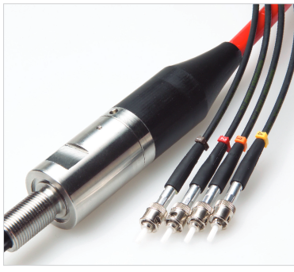
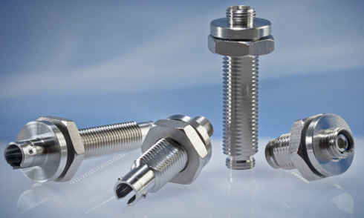
Fiber Optic Connection to Housing
Macartney Optolink Penetrator
DAS
Splice
Lancer
Manufacturer | Part Number | fiber passes | Insertion loss (dB) | Return Loss/ Back Reflection (dB) | depth rating (closed face) | Cost | Lead Time
Green Tweed/Lancer | 500-BST-ST-S1-B02 | 1 | <1 | ? | 5000 psi | $478.45 | 10 weeks if out of stock
Macartney | optolink penatrator, Ti | 4 | 0.2 |  | 6000 m | $3,815 | 6 weeks

Slide 22
Mechanical Design
Instrument in Ti Sphere
Frame
  ROV interaction
cable
  Strain relief
Speltzer and bitter end

Slide 23
Instrument Mounted in Ti Sphere
MBARI Geo-Sense Design Review 05-09-2024.pdf

Slide 24
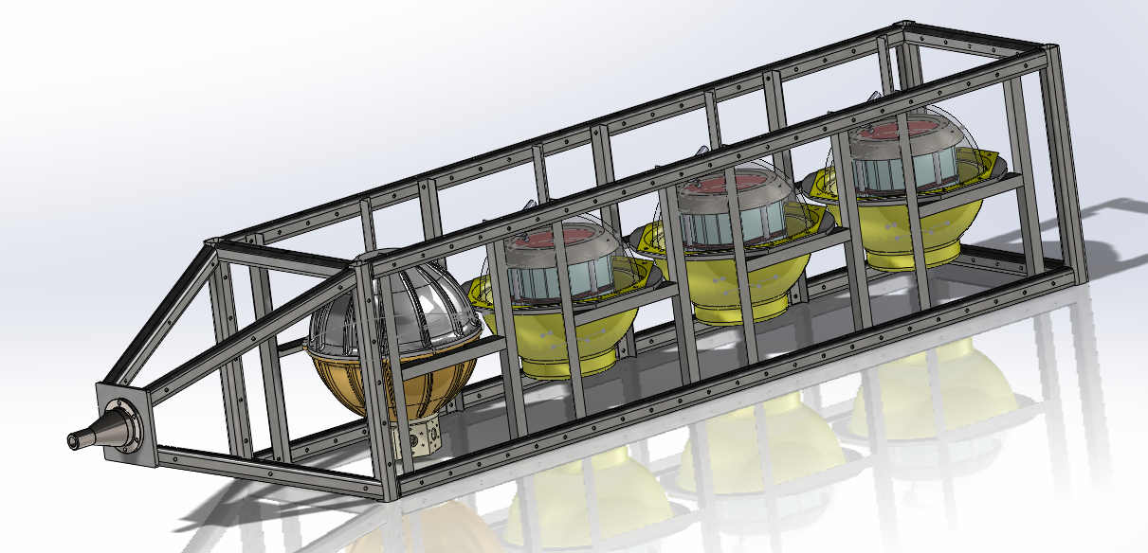
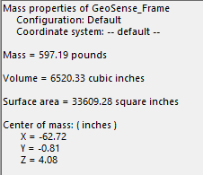

Slide 25
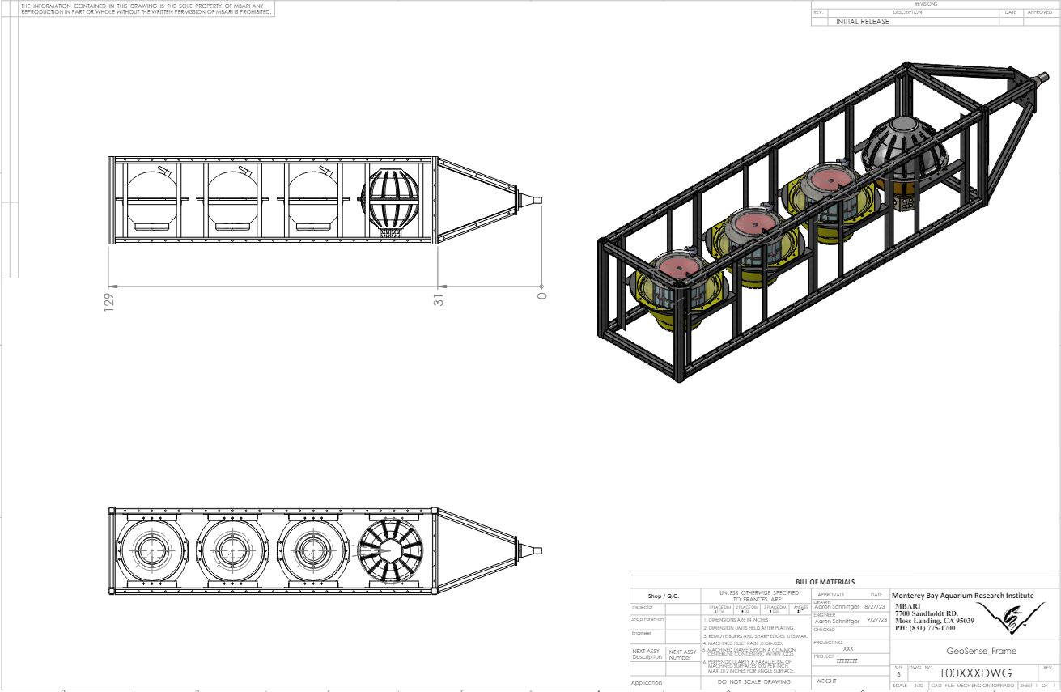

Slide 26
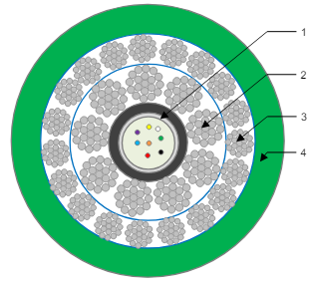
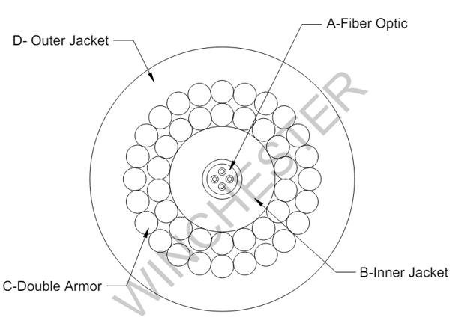
Subsea Cable Selection
Software simulations informed requirements
Request for quote sent to 8 manufacturers
Cable specific design review held
Decision down to two cables (Concept Cables and Winchester)

Slide 27
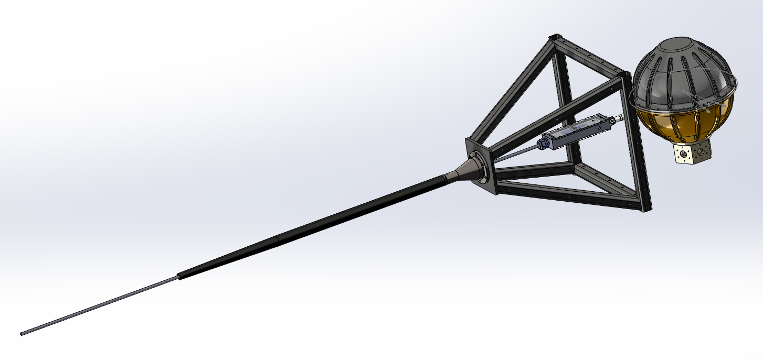

Slide 28
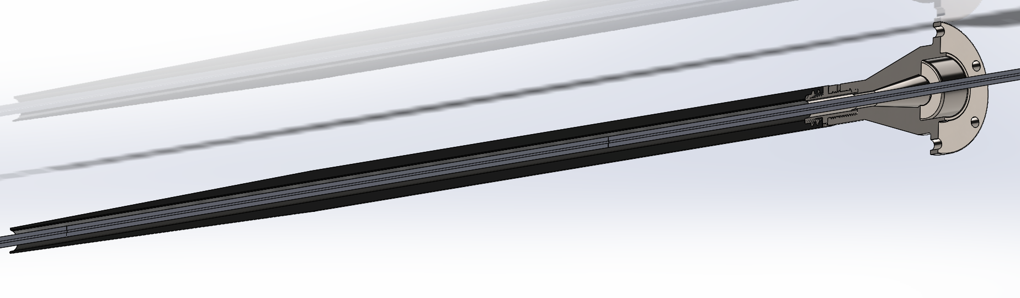

Slide 29
Status of project
DAS system being designed by Sintela, expected delivery early Fall 2024
All housings are identified and in the lab
Rubber molded cables and connectors are purchased
Batteries have arrived
Components for Deepsea Connect are being purchased
To do in next couple weeks:
  Cable selection down to two choices (Concept Cables and Winchester) lead times for both are < 4 months, final decision to be made
  FO connecter needs to be ordered
Termination details to be worked out
Housing designed or found for Deepsea Connect

Slide 30
Proposed Schedule
Task | Month (2024)
 | Jan | Feb | Mar | Apr | May | Jun | Jul | Aug | Sep | Oct | Nov | Dec
Identify latest suitable instruments
Develop a conceptual design of a portable DAS system
Carry out SWOT analysis
Conduct a design review
Critical design review and detailed design
Selection of appropriate deployment and recovery protocol
Identify components already available at MBARI
Procurement of interrogator, cable and batteries
Assembly of prototype
Testing of prototype in the lab and field
Permitting issues

Slide 31

Status of Schedule
Task | Month (2024)
 | Jan | Feb | Mar | Apr | May | Jun | Jul | Aug | Sep | Oct | Nov | Dec
Identify latest suitable instruments
Develop a conceptual design of a portable DAS system
Carry out SWOT analysis
Conduct a design review
Critical design review and detailed design
Selection of appropriate deployment and recovery protocol
Identify components already available at MBARI
Procurement of interrogator, cable and batteries
Assembly of prototype
Testing of prototype in the lab and field
Permitting issues |  |  | OK?

Slide 32
Testing and Integration Plan
DAS instrument can be tested on the bench with a 1 km spool of fiber
Software can be tested independently of hardware using docking image (platform is a jetson orin)
Bench testing of Deepsea Connect
Analysis of MARS DAS data by summer intern will inform expectations for data and sampling plans
Cable unspooling?
Test deployment?

Slide 33
Remaining High-Risk Elements
Unforeseen delays with DAS instrument, FO cable, Termination
Cable connection to the seafloor – will it lie flat
New deployment scheme for MBARI
Ship availability

Slide 34
Safety Considerations
Careful planning of deck operations due to heavy load
Any laser safety issues: Denis

Slide 35
Discussion

Slide 36
Electrical Design – FO connector options
Fiber penetrator from MacArtney:
  Advantages: low loss, can fit with APC connectors on end
  Disadvantage: can’t disconnect the system from 1 km of cable
Lancer connectors:
  Advantage: can disconnect system easily; these are available and have been regularly used in other systems
  Disadvantage: not the most robust design
Birns
  Advantages: can disconnect, best optical properties of connectors
  Disadvantages: $10k, longer lead time, not most customer friendly experience

Slide 37
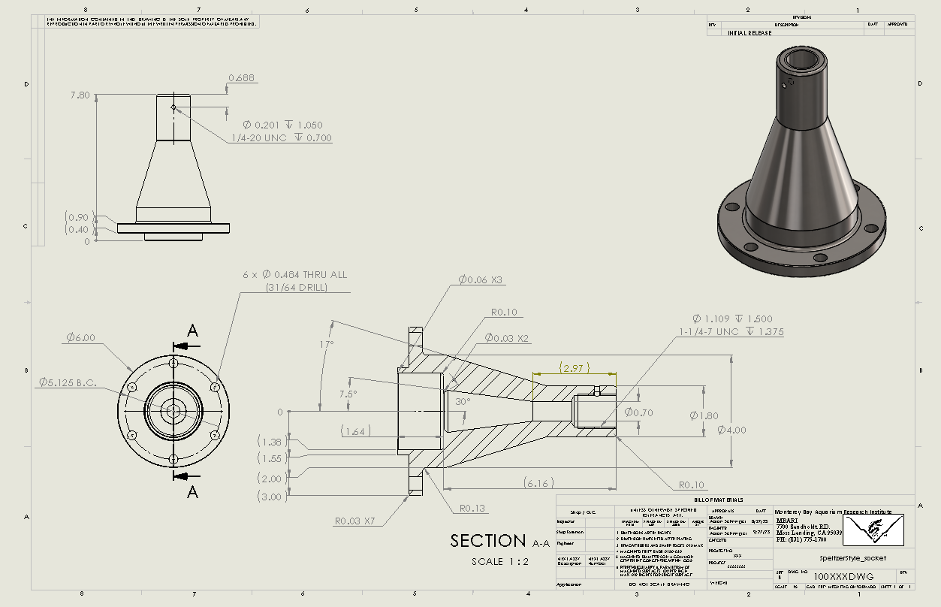

Slide 38
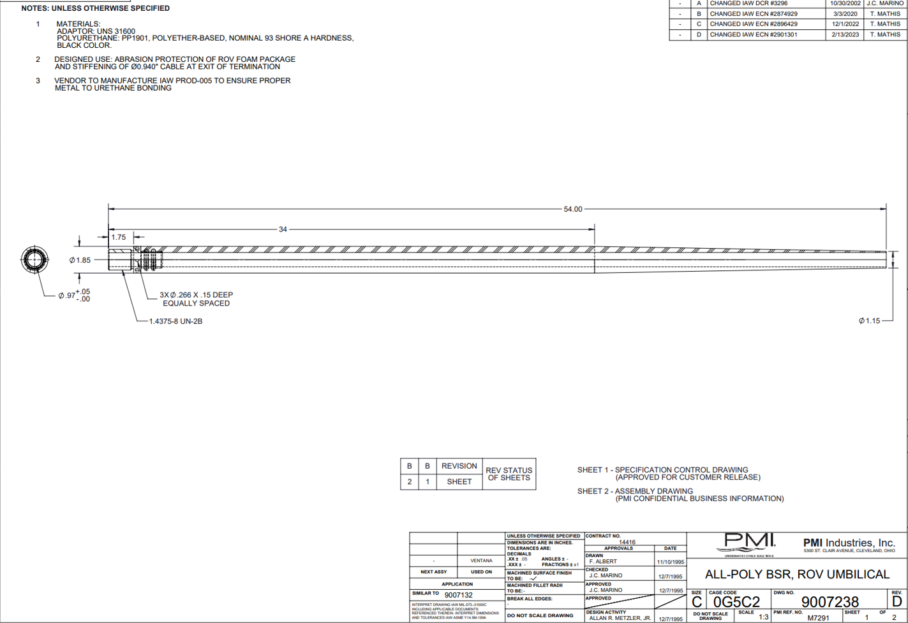

Slide 39
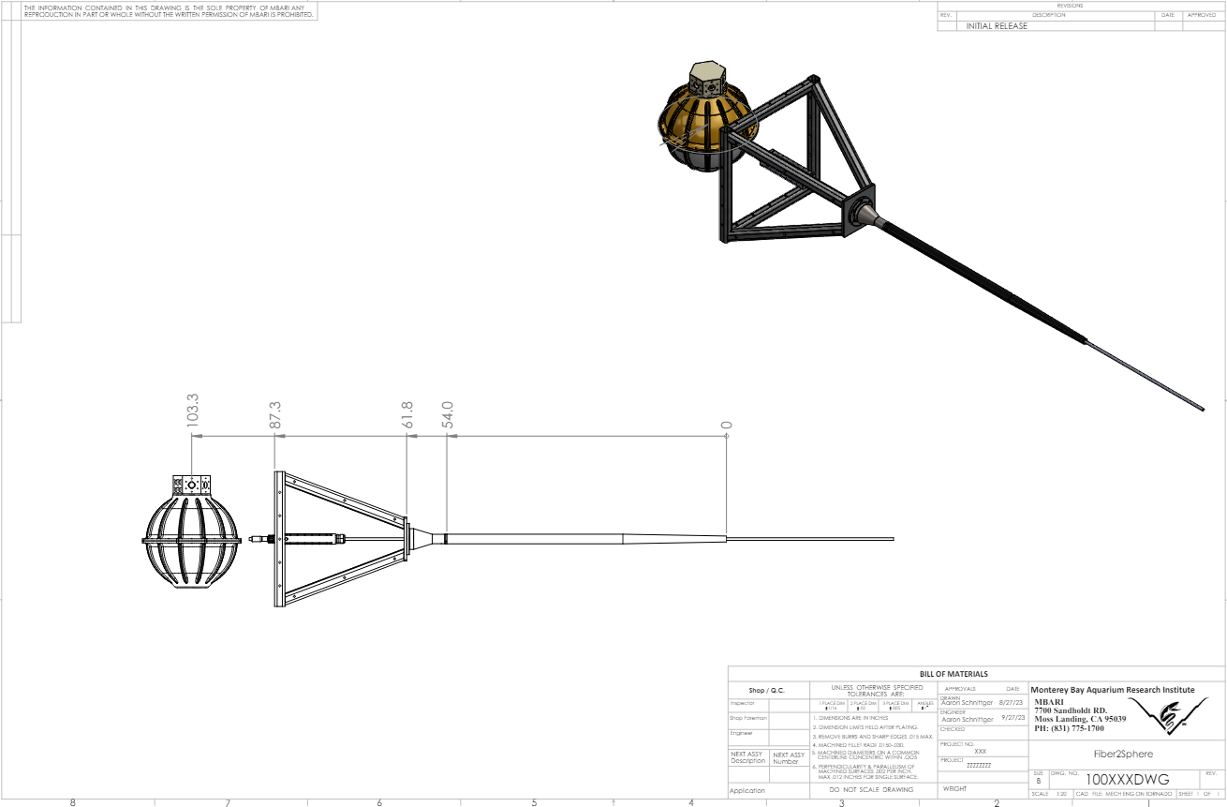

Slide 40
