Slide 1
902402 Controlled Source Electromagnetics (CSEM)
What’s the fundamental problem, question, or issue you are addressing?
There is an inadequate understanding of how subsea fluid flow and discharge shape the seafloor, due to limited field and process-based observations.
Current methodologies are inadequate for capturing fine-scale, spatial, and temporal changes in fluid flow.

Slide 2
902402 Controlled Source Electromagnetics (CSEM)
Why is it important/why should anyone care?
Fluids play a crucial role in geomorphic processes, shaping specialized ecosystems, influencing climate change, and informing hazard assessments.
Fluid dynamics associated to climate change are associated with rapid seafloor change.

Slide 3
902402 Controlled Source Electromagnetics (CSEM)
What are we doing about it/what’s MBARI’s unique contribution?
At MBARI we are laying the foundations for controlled-source electromagnetic (CSEM) surveying at fine spatial and temporal scales across various water depths.
This involves testing newly developed CSEM technologies in harsh environments for a wide range of applications, with plans to deploy them from autonomous platforms and integrate them with cutting-edge technologies such as fiber optic sensing.

Slide 4
902402 Controlled Source Electromagnetics (CSEM)
What are your project plans for next year (2025)?
To map submarine permafrost in the Canadian Beaufort Sea using the SWAN CSEM system.
Process and analyze data from both the Monterey Bay survey (December 2024) and the Canadian Beaufort Sea survey (August 2025), and spatially correlate observations of fluid flow and seepage with evidence of seafloor morphological change.

Slide 5
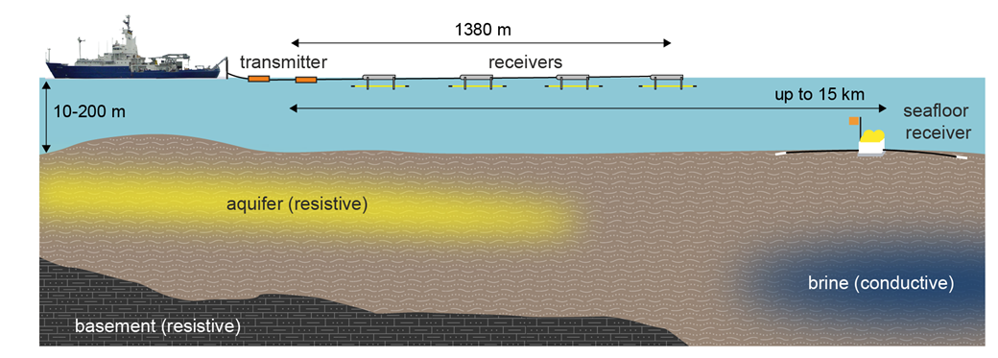
902402 Controlled Source Electromagnetics (CSEM)
Figure 1. A surface towed CSEM system able to differentiate between brine and freshwater aquifers.

Slide 6
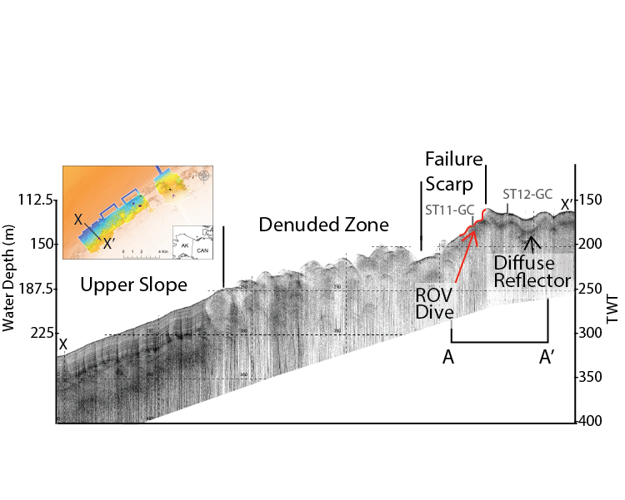
902402 Controlled Source Electromagnetics (CSEM)
Figure 2. Sub bottom profile of submarine permafrost in the Arctic.

